Slide 1
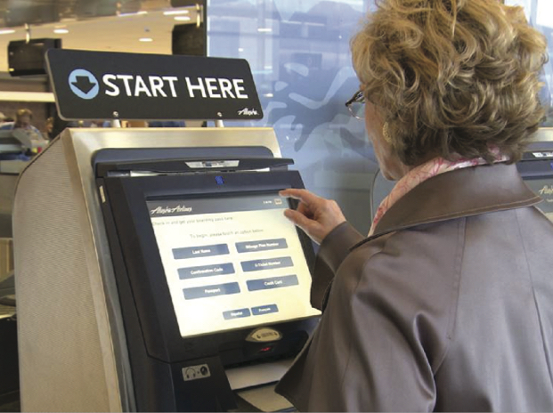
Decision-Making Tools
A
MODULE
PowerPoint presentation to accompany
Heizer, Render, Munson
Operations Management, Twelfth Edition
Principles of Operations Management, Tenth Edition
PowerPoint slides by Jeff Heyl

Slide 2
The Decision Process in Operations
Clearly define the problem and the factors that influence it
Develop specific and measurable objectives
Develop a model
Evaluate each alternative solution
Select the best alternative
Implement the decision and set a timetable for completion
Notes:
This slide provides some reasons that capacity is an issue. The following slides guide a discussion of capacity.

Slide 3
Fundamentals of
Decision Making
Terms:
  Alternative – a course of action or strategy that may be chosen by the decision maker
  State of nature – an occurrence or a situation over which the decision maker has little or no control
Notes:
This slide can be used to frame a discussion of capacity.
Points to be made might include:
- capacity definition and measurement is necessary if we are to develop a production schedule
- while a process may have “maximum” capacity, many factors prevent us from achieving that capacity on a continuous basis.
Students should be asked to suggest factors which might prevent one from achieving maximum capacity.

Slide 4
Fundamentals of
Decision Making
Symbols used in a decision tree:
  □ – Decision node from which one of several alternatives may be selected
  ○ – A state-of-nature node out of which one state of nature will occur
Notes:
This slide can be used to frame a discussion of capacity.
Points to be made might include:
- capacity definition and measurement is necessary if we are to develop a production schedule
- while a process may have “maximum” capacity, many factors prevent us from achieving that capacity on a continuous basis.
Students should be asked to suggest factors which might prevent one from achieving maximum capacity.

Slide 5
Decision Tree Example
A decision node
A state of nature node
Favorable market
1
Construct large plant
Unfavorable market
Favorable market
Construct small plant
2
Unfavorable market
Do nothing
Figure A.1

Slide 6
Decision Table Example
Decision Table: A tabular means of analyzing decision alternatives and state of nature
TABLE A.1 | Decision Table with Conditional Values for Getz Products
 |  | STATES OF NATURE
ALTERNATIVES |  | FAVORABLE MARKET | UNFAVORABLE MARKET
Construct large plant |  | $200,000 | –$180,000
Construct small plant |  | $100,000 | –$ 20,000
Do nothing |  | $ 0 | $ 0

Slide 7
Decision-Making Environments
Decision making under uncertainty
  Complete uncertainty as to which state of nature may occur
Decision making under risk
  Several states of nature may occur
  Each has a probability of occurring
Decision making under certainty
  State of nature is known

Slide 8
Uncertainty
Maximax
  Find the alternative that maximizes the maximum outcome for every alternative
  Pick the outcome with the maximum number
  Highest possible gain
  This is viewed as an optimistic decision criteria

Slide 9
Uncertainty
Maximin
  Find the alternative that maximizes the minimum outcome for every alternative
  Pick the outcome with the minimum number
  Least possible loss
  This is viewed as a pessimistic decision criteria

Slide 10
Uncertainty
Equally likely
  Find the alternative with the highest average outcome
  Pick the outcome with the maximum number
  Assumes each state of nature is equally likely to occur

Slide 11
Uncertainty Example
TABLE A.2 | Decision Table for Decision Making Under Uncertainty
 |  | STATES OF NATURE
ALTERNATIVES |  | FAVORABLE MARKET | UNFAVORABLE MARKET | MAXIMUM IN ROW | MINIMUM IN ROW | ROW AVERAGE
Construct large plant |  | $200,000 | –$180,000 | $200,000 | –$180,000 | $10,000
Construct small plant |  | $100,000 | –$ 20,000 | $100,000 | –$ 20,000 | $40,000
Do nothing |  | $ 0 | $ 0 | $ 0 | $ 0 | $ 0
Maximax
Maximin
Equally likely
Maximax choice is to construct a large plant
Maximin choice is to do nothing
Equally likely choice is to construct a small plant

Slide 12
Decision Making Under Risk
Each possible state of nature has an assumed probability
States of nature are mutually exclusive
Probabilities must sum to 1
Determine the expected monetary value (EMV) for each alternative

Slide 13
Expected Monetary Value
EMV (Alternative i) | = | (Payoff of 1st state of nature) x (Probability of 1st state of nature)
 | + | (Payoff of 2nd state of nature) x (Probability of 2nd state of nature)
 | + … + |  | (Payoff of last state of nature) x (Probability of last state of nature)
Notes:
It might be useful at this point to discuss typical equipment utilization rates for different process strategies if you have not done so before.

Slide 14
EMV Example
TABLE A.3 | Decision Table for Getz Products
 |  | STATES OF NATURE
ALTERNATIVES |  | FAVORABLE MARKET | UNFAVORABLE MARKET
Construct large plant (A₁) |  | $200,000 | –$180,000
Construct small plant (A₂) |  | $100,000 | –$ 20,000
Do nothing (A₃) |  | $ 0 | $ 0
Probabilities |  | 0.6 | 0.4
EMV(A₁) = (.6)($200,000) + (.4)(–$180,000) = $48,000
EMV(A₂) = (.6)($100,000) + (.4)(–$20,000) = $52,000
EMV(A₃) = (.6)($0) + (.4)($0) = $0
Best Option
Notes:
It might be useful at this point to discuss typical equipment utilization rates for different process strategies if you have not done so before.

Slide 15
Decision Making Under Certainty
Is the cost of perfect information worth it?
Determine the expected value of perfect information (EVPI)
Notes:
It might be useful at this point to discuss typical equipment utilization rates for different process strategies if you have not done so before.

Slide 16
Expected Value of
Perfect Information
EVPI is the difference between the payoff under certainty and the payoff under risk
Expected value with perfect information
EVPI = –
Maximum EMV
Expected value with perfect information (EVwPI) | = | (Best outcome or consequence for 1st state of nature) x (Probability of 1st state of nature)
 | + | Best outcome for 2nd state of nature) x (Probability of 2nd state of nature)
 | + | … + Best outcome for last state of nature) x (Probability of last state of nature)

Slide 17
EVPI Example
The best outcome for the state of nature "favorable market" is "build a large facility" with a payoff of $200,000. The best outcome for "unfavorable" is "do nothing" with a payoff of $0.
Expected value with perfect information
= ($200,000)(.6) + ($0)(.4) = $120,000

Slide 18
EVPI Example
The maximum EMV is $52,000, which is the expected outcome without perfect information. Thus:
EVPI = EVwPI –
Maximum EMV
= $120,000 – $52,000 = $68,000
The most the company should pay for perfect information is $68,000

Slide 19
Decision Trees
Information in decision tables can be displayed as decision trees
A decision tree is a graphic display of the decision process that indicates decision alternatives, states of nature and their respective probabilities, and payoffs for each combination of decision alternative and state of nature
Appropriate for showing sequential decisions

Slide 20
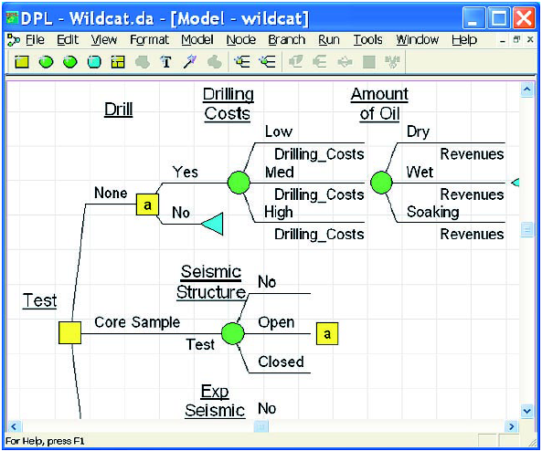
Decision Trees

Slide 21
Decision Trees
Define the problem
Structure or draw the decision tree
Assign probabilities to the states of nature
Estimate payoffs for each possible combination of decision alternatives and states of nature
Solve the problem by working backward through the tree computing the EMV for each state-of-nature node

Slide 22
Decision Tree Example
Figure A.2
EMV for node 1
= $48,000
= (.6)($200,000) + (.4)(–$180,000)
Payoffs
Favorable market (.6)
$200,000
1
Unfavorable market (.4)
Construct large plant
–$180,000
Favorable market (.6)
$100,000
Construct small plant
2
Unfavorable market (.4)
–$20,000
Do nothing
EMV for node 2
= $52,000
= (.6)($100,000) + (.4)(–$20,000)
$0

Slide 23
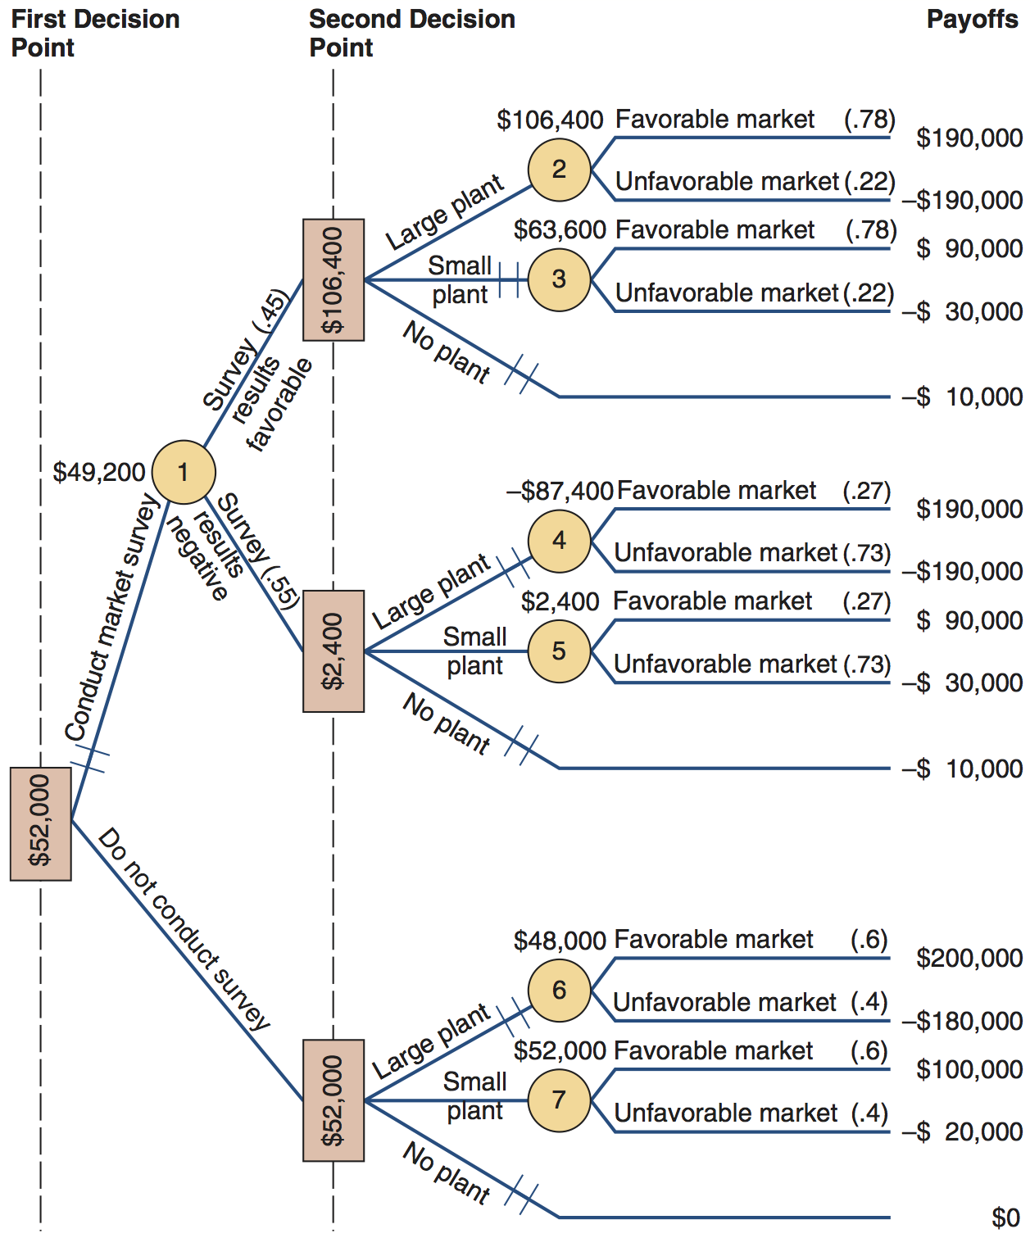
Complex Decision Tree Example
Figure A.3

Slide 24
Complex Example
Given favorable survey results
EMV(2) = (.78)($190,000) + (.22)(–$190,000) = $106,400
EMV(3) = (.78)($90,000) + (.22)(–$30,000) = $63,600
The EMV for no plant = –$10,000 so, if the survey results are favorable, build the large plant

Slide 25
Complex Example
Given negative survey results
EMV(4) = (.27)($190,000) + (.73)(–$190,000) = –$87,400
EMV(5) = (.27)($90,000) + (.73)(–$30,000) = $2,400
The EMV for no plant = –$10,000 so, if the survey results are negative, build the small plant

Slide 26
Complex Example
Compute the expected value of the market survey
EMV(1) = (.45)($106,400) + (.55)($2,400) = $49,200
If the market survey is not conducted
EMV(6) = (.6)($200,000) + (.4)(–$180,000) = $48,000
EMV(7) = (.6)($100,000) + (.4)(–$20,000) = $52,000
The EMV for no plant = $0 so, given no survey, build the small plant

Slide 27
Complex Example
The expected monetary value of not conducting the survey is $52,000 and the EMV for conducting the study is $49,200
The best choice is to not seek marketing information and build the small plant

Slide 28
The Poker Design Process
The money already in the pot
If T. J. folds,
EMV = (.80)($99,000)
= $79,200
If T. J. calls,
The chance T.J. will call
EMV = .20[(.45)($853,000) – Phillips’s bet of $422,000]
= .20[$383,850 – $422,000]
= .20[–$38,150] = –$7,630
Overall EMV = $79,200 – $7,630 = $71,750

Slide 29
The Poker Design Process
The money already in the pot
The overall EMV of $71,570 indicates that if this decision were to be made many times, the average payoff would be large. Even though Phillips’s decision in this instance did not work out, his analysis and procedure was the correct one.
If T. J. folds,
EMV = (.80)($99,000)
= $79,200
If T. J. calls,
The chance T.J. will call
EMV = .20[(.45)($853,000) – Phillips’s bet of $422,000]
= .20[$383,850 – $422,000]
= .20[–$38,150] = –$7,630
Overall EMV = $79,200 – $7,630 = $71,750

