Slide 1
Structure Type
Problem Solving & Program Design in C
Eighth Edition
Jeri R. Hanly & Elliot B. Koffman

Slide 2
User-Defined Structure Types
record
a collection of information about one data object
structure type
a data type for a record composed of multiple components
hierarchical structure
a structure containing components that are structures

Slide 3
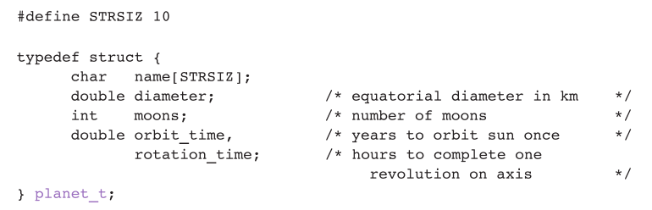
User-Defined Structure Types
Name: Jupiter
Diameter: 142,800 km
Moons: 16
Orbit time: 11.9 years
Rotation time: 9.925 hours

Slide 4
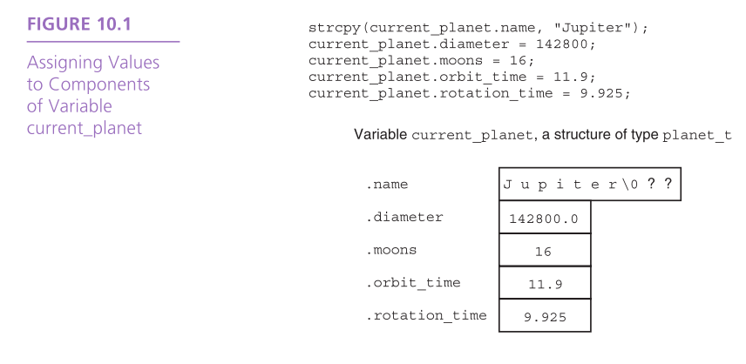
Individual Components of a Structured Data Object
direct component selection operator
a period placed between a structure type variable and a component name to create a reference to the component

Slide 5
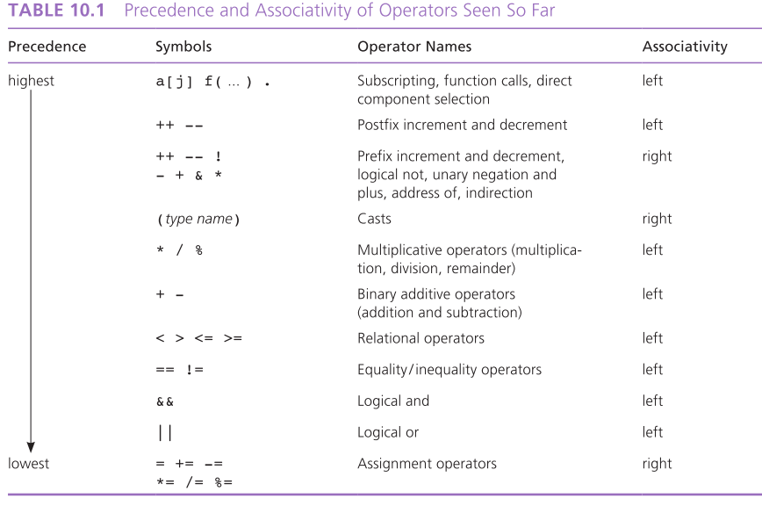

Slide 6
Structure Data Type as Input and Output Parameters
When a structured variable is passed as an input argument to a function, all of its component values are copied into the components of the function’s corresponding formal parameter.
previous_planet = current_planet;
When such a variable is used as an output argument, the address-of operator must be applied in the same way that we would pass output arguments of the standard types char, int, and double.

Slide 7
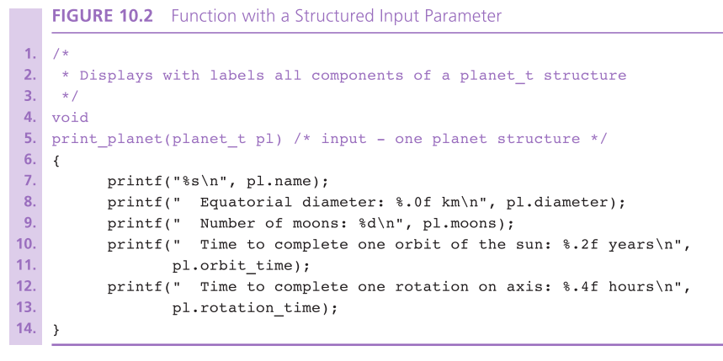

Slide 8
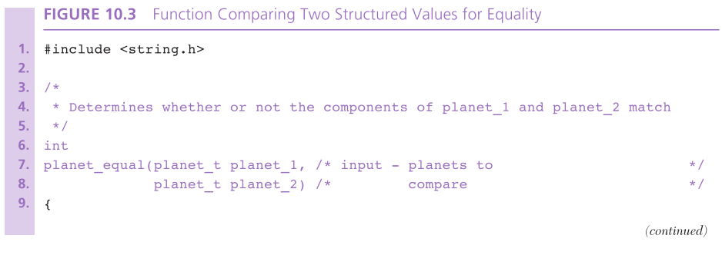
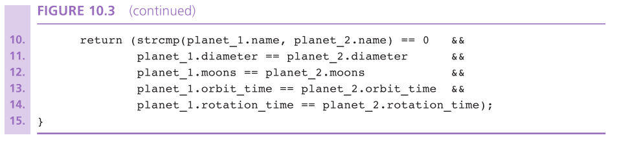

Slide 9
Structure Data Type as Input and Output Parameters
indirect component selection operator
the character sequence -> placed between a pointer variable and a component name creates a reference that follows the pointer to a structure and selects the component

Slide 10
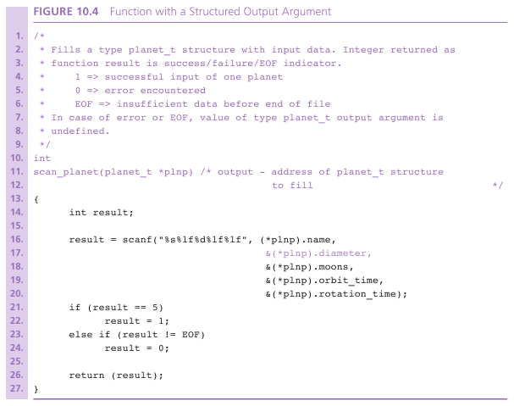

Slide 11
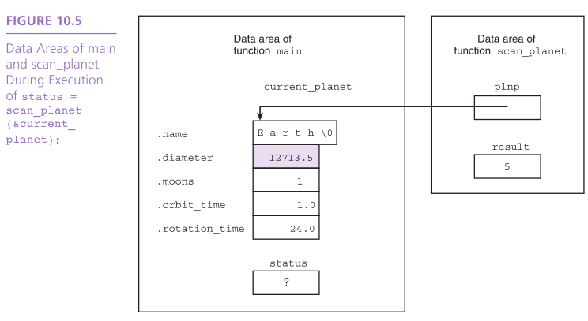

Slide 12
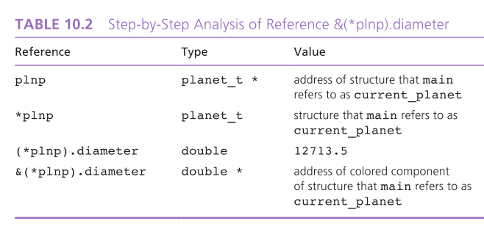

Slide 13
Functions Whose Result Values are Structured
A function that computes a structured result can be modeled on a function computing a simple result.
A local variable of the structure type can be allocated, fill with the desired data, and returned as the function result.

Slide 14
Functions Whose Result Values are Structured
The function does not return the address of the structure as it would with an array result.
Rather, it returns the values of all components.

Slide 15
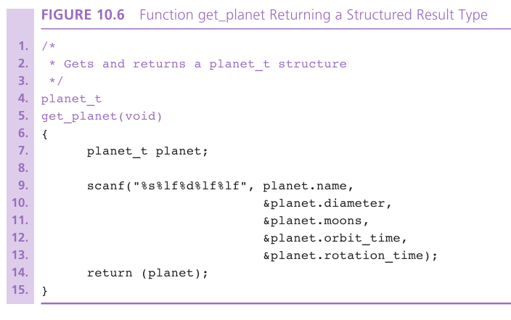

Slide 16
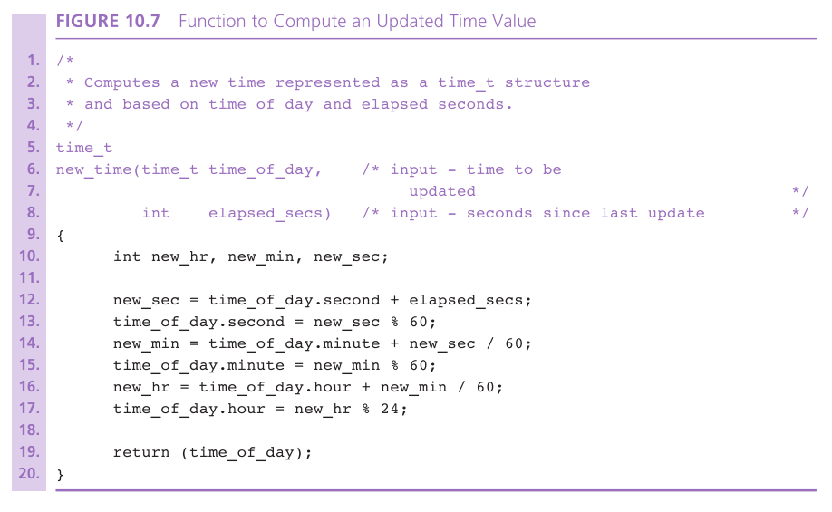

Slide 18
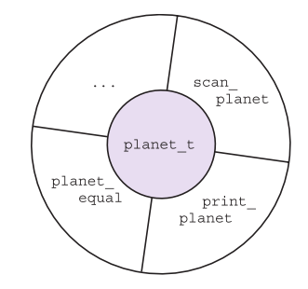
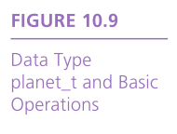
Problem Solving with Structure Types
abstract data type (ADT
a data type combined with a set of basic operations

Slide 19
Parallel Arrays and Arrays of Structures
A natural organization of parallel arrays with data that contain items of different types is to group the data into a structure whose type we define.

Slide 20

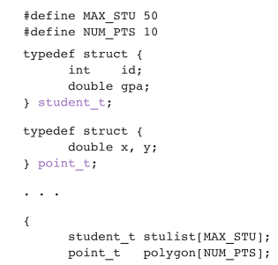

Slide 21
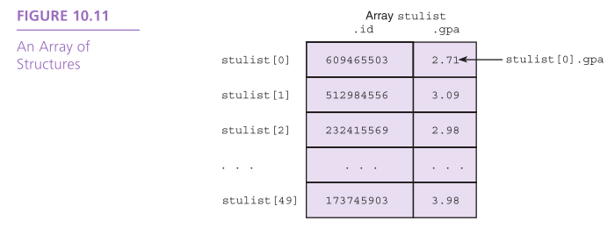

Slide 22
Wrap Up
C permits the user to define a type composed of multiple named components.
User-defined structure types can be used in most situations where build-in types are value.
Structured values can be function arguments and function results and can be copied using the assignment operator.

Slide 23
Wrap Up
Structure types are legitimate in declarations of variables, of structure components, and of arrays.
Structure types play an important role in data abstraction. You create an abstract data type (ADT) by implementing all of the types necessary operations.

Slide 24
Pointers and Dynamic Data Structures
Problem Solving & Program Design in C
Eighth Edition
Jeri R. Hanly & Elliot B. Koffman

Slide 25
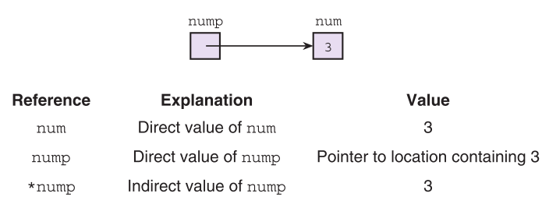
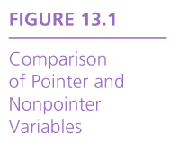

Slide 26
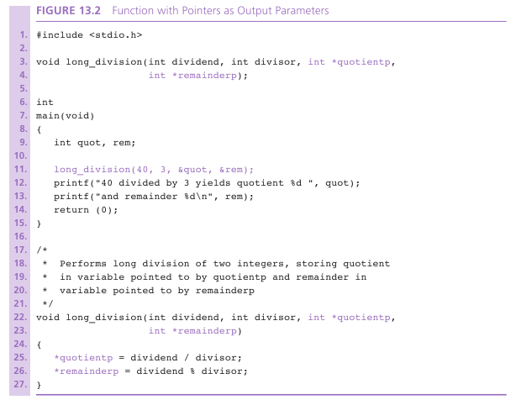

Slide 27
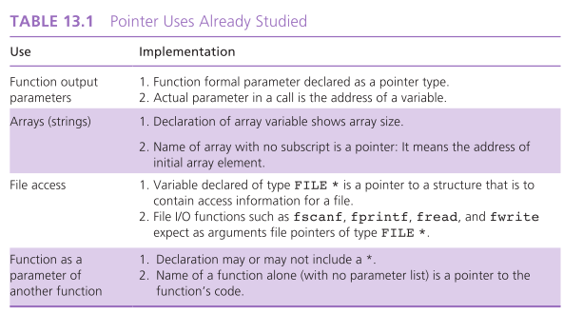

Slide 28
Dynamic Memory Allocation
heap
region of memory in which function malloc dynamically allocates blocks of storage
stack
region of memory in which function data areas are allocated and reclaimed

Slide 29
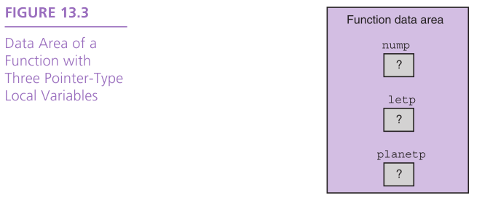

Slide 30
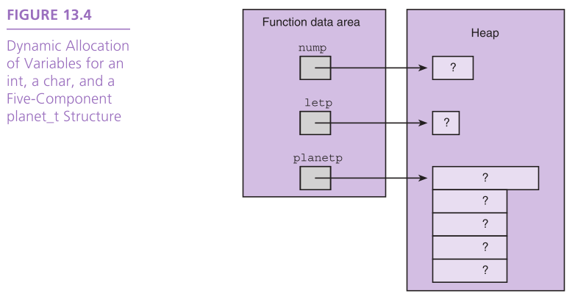

Slide 31
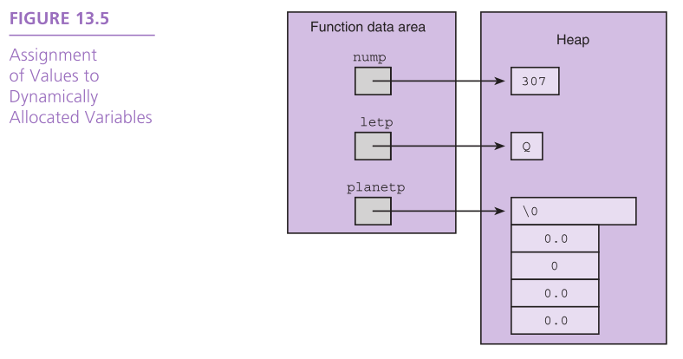

Slide 32
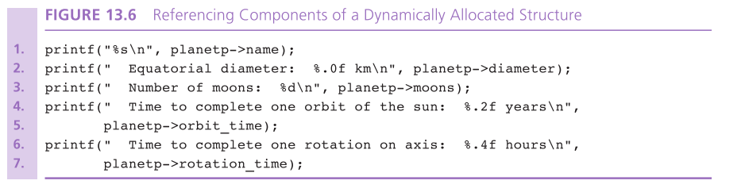

Slide 33
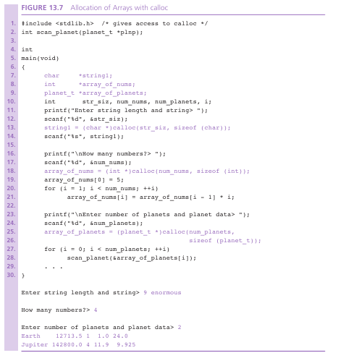

Slide 34
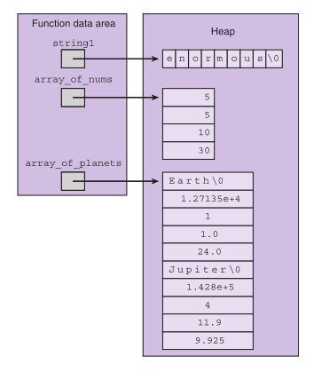
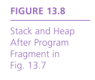

Slide 35
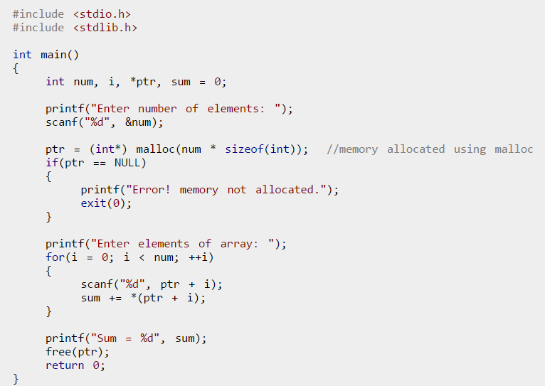
malloc() example

Slide 36
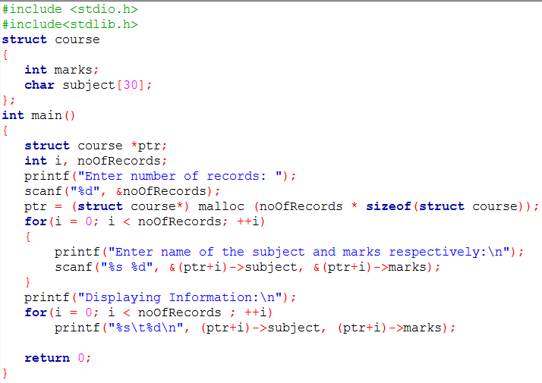
Example: Demonstrate the Dynamic Memory Allocation for Structure

Slide 37
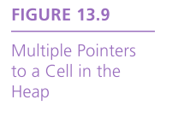
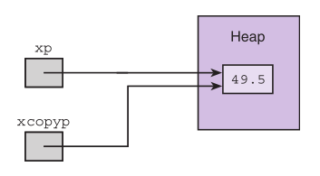
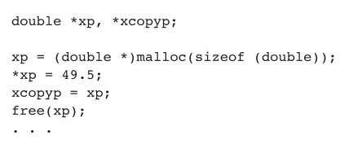

Slide 38
Wrap Up
Function malloc from the stdlib library can be used to allocate single elements, or nodes, or a dynamic data structure.
Function calloc from stdlib dynamically allocates an array.
Function free from stdlib returns memory cells to the storage heap.

