Slide 1


E-commerce 2021: Business. Technology. Society.
Sixteenth Edition
Chapter 1
The Revolution Is Just Beginning
Copyright © 2022, 2019, 2018 Pearson Education, Inc. All Rights Reserved
Notes:
If this PowerPoint presentation contains mathematical equations, you may need to check that your computer has the following installed:
1) MathType Plugin
2) Math Player (free versions available)
3) NVDA Reader (free versions available)

Slide 2
Learning Objectives
1.1 Understand why it is important to study e-commerce.
1.2 Define e-commerce, understand how e-commerce differs from e-business, identify the primary technological building blocks underlying e-commerce, and recognize major current themes in e-commerce.
1.3 Identify and describe the unique features of e-commerce technology and discuss their business significance.
1.4 Describe the major types of e-commerce.
1.5 Understand the evolution of e-commerce from its early years to today.
1.6 Describe the major themes underlying the study of e-commerce.
1.7 Identify the major academic disciplines contributing to e-commerce.

Slide 3
Uber: The New Face of E-commerce?
Class Discussion
  Have you used Uber or any other on-demand service companies?
  What is the appeal of these companies for users and providers?
  Are there any negative consequences to the increased use of on-demand services like Uber and Airbnb?
  How has the Covid-19 pandemic impacted Uber and other on-demand services?

Slide 4
The First Thirty Seconds
First two decades of e-commerce
  Just the beginning
  Rapid growth and change
Technologies evolve at exponential rates
  Disruptive business change
  New opportunities
Why study e-commerce
  Understand opportunities and risks
  Analyze e-commerce ideas, models, issues

Slide 6
Introduction to E-commerce
Use of Internet to transact business
  Includes Web, mobile browsers and apps
More formally:
  Digitally enabled commercial transactions between and among organizations and individuals
  Google has identified over 130 trillion individual web pages, 2019

Slide 7
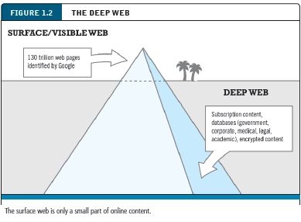
Introduction to E-commerce

Slide 8
Introduction to E-commerce
Internet: worldwide network of computer networks built on common standards
World Wide Web (the Web): An information system running on Internet infrastructure that provides access to billions of web pages.
HyperText Markup Language (HTML): a language to create the web pages. HTML pages can contain text, graphics, animations, and other objects.
Mobile platform: provides the ability to access the Internet from a
variety of mobile devices such as smartphones, tablets, and other ultra lightweight laptop computers

Slide 9
The Difference Between E-commerce and E-business
E-business:
  Digital enabling of transactions and processes within a firm, involving information systems under firm’s control
  Does not include commercial transactions involving an exchange of value across organizational boundaries

Slide 10
Insight on Technology: Will Apps Make the Web Irrelevant?
Class Discussion
  What are the advantages and disadvantages of apps, compared with websites, for mobile users?
  What are the benefits of apps for content owners and creators?
  What are progressive web apps (P W A s) and how do they differ from native apps?
  Will apps eventually make the Web irrelevant? Why or why not?

Slide 11
Major Trends in E-commerce
Business trends include:
  Covid-19 pandemic fuels surge in retail e-commerce, m-commerce, and certain on-demand services
Technology trends include:
  Mobile platform and cloud computing
  Big data and Internet of Things
Societal trends include:
  Increased concern about impact of social networks
  Concerns about increasing market dominance of big technology firms

Slide 12
Unique Features of E-commerce
Ubiquity: Available just about everywhere, at all times
  Marketplace: physical space you visit in order to transact
  Marketspace: marketplace extended beyond traditional boundaries and removed from a temporal and geographic location
2. Global reach: the total number of users or customers an e-commerce business can obtain
  The potential market size for e-commerce merchants is roughly equal to the size of the world’s online population (over 3.8 billion in 2019)
Notes:
Additional concepts and terminology include: Information asymmetry, menu costs, marketplaces and marketspaces, transaction costs, cognitive energy, market entry costs, search costs, price discovery, network externalities.

Slide 13
Unique Features of E-commerce
3. Universal standards: standards that are shared by all nations around the world
  lower market entry costs: the cost merchants must pay just to bring their goods to market.
  Reduce search cost: the effort required by consumer to find suitable products.
  Price discovery: becomes simpler, faster, and more accurate for both business and individuals.
  Network externalities: With e-commerce technologies, it is possible to easily find many of the suppliers, prices, and delivery terms of a specific product anywhere in the world environment.

Slide 14
Unique Features of E-commerce Technology
4. Information Richness: the complexity and content of a message.
  E-commerce technologies have the potential for offering considerably more information richness than traditional media.
5. Interactivity: technology that allows for two-way communication between merchant and consumer

Slide 15
Unique Features of E-commerce
6. Information Density: the total amount and quality of information available to all market participants.
  reduce information collection, storage, processing, and communication costs.
  information becomes more plentiful, less expensive, and of higher quality.
  reduction in information asymmetry
  Increase Price transparency: refers to the ease with which consumers can find out the variety of prices in a market.
  Increase cost transparency: refers to the ability of consumers to discover the actual costs merchants pay for products.

Slide 16
Unique Features of E-commerce Technology
6. Information Density:
  entire marketplace potentially becomes more price competitive (Negative for merchant).
  Online merchants can discover much more about consumers (Positive for merchant).
  Price discrimination—selling the same goods, or nearly the same goods, to different targeted groups at different prices
7. Personalization/customization:
  Personalization: the targeting of marketing messages to specific individuals by adjusting the message to a person’s name, interests, and past purchases.
  Customization: changing the delivered product or service based on a user’s preferences or prior behavior

Slide 17
Unique Features of E-commerce Technology
8. Social technology: allowing users to create and share content with a worldwide community.
  E-commerce technologies provide a unique, many-to-many model of mass communication.

Slide 18
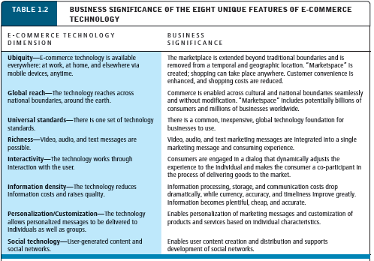
Unique Features of E-commerce Technology
Notes:
Additional concepts and terminology include price transparency, cost transparency, and price discrimination.

Slide 19
Types of E-commerce
1. Business-to-Consumer (B2C): online businesses selling to individual consumers.
  Includes purchases of retail goods, travel, financial, real estate, and other types of services, and online content.
  B2C business models: online retailers, service providers, transaction brokers, content providers, community providers/social networks, market creators, and portals.

Slide 20
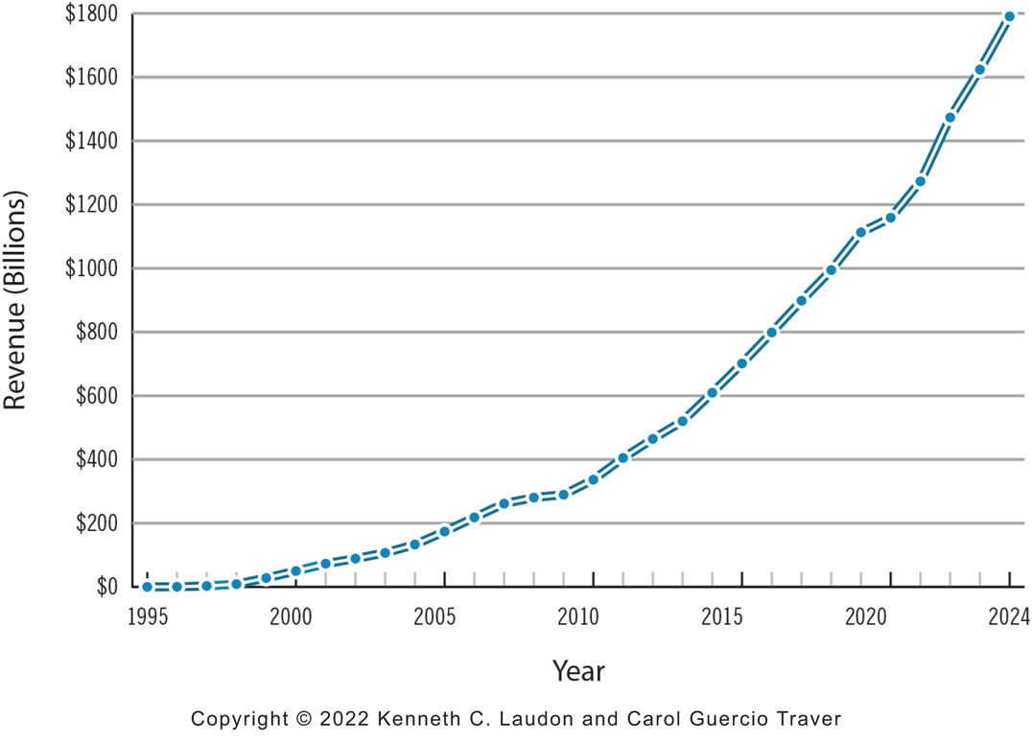
Figure 1.5 The Growth of B2C E-commerce in the United States
Notes:
Figure 1.5, Page 22.
In the early years, B2C e-commerce was doubling or tripling each year. Although B2C e-commerce growth in the United States slowed in 2008–2009 due to the economic recession, it resumed growing at about 13% in 2010 and since then, has continued to grow at double-digit rates. In 2020, revenues from B2C e-commerce are expected to reach $1.16 trillion. While the Covid-19 pandemic is anticipated to result in a dramatic decrease in the amount of digital travel revenues in 2020, both retail e-commerce revenues and certain online services, as well as online content revenues, are expected to be stable or increase, offsetting the decline.
SOURCES: Based on data from eMarketer, Inc., 2020f, 2020g; U.S. Census Bureau, 2019a; authors’ estimates.
Alt Text
Long description: A graph shows the growth of B 2 C e commerce revenue in the United States in billions of dollars from 19 95 to 20 24, as follows: The graph shows B 2 C e commerce revenue rising steadily from around 50 billion dollars in 2000 to a projected 1800 billion dollars in 20 24. All values are estimated.

Slide 21
Types of E-commerce
2. Business-to-Business (B2B): online businesses selling to other businesses.
  There are two primary business models used within the B2B arena:
      Net marketplaces, which include e-distributors, e-procurement companies, exchanges, and industry consortia,
      private industrial networks.

Slide 22
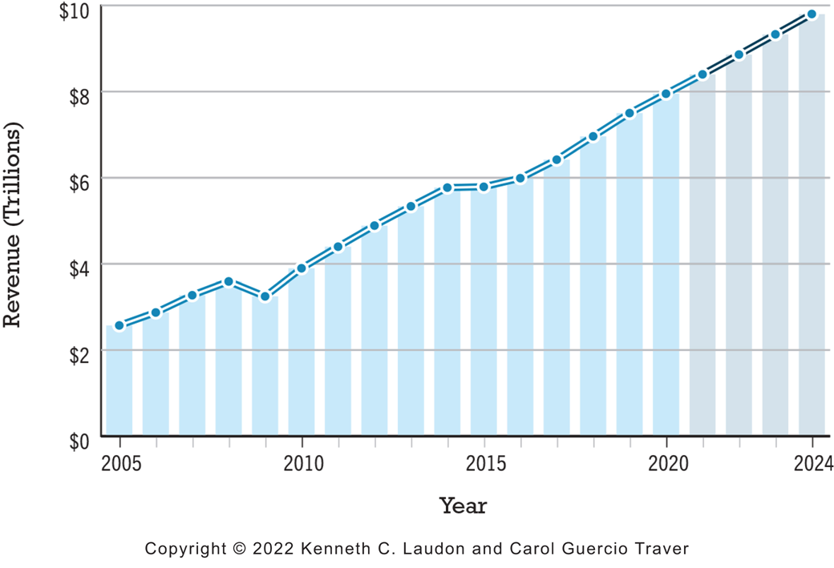
Figure 1.7 The Growth of B2B E-commerce in the United States
Notes:
Figure 1.7, Page 24.
B2B e-commerce in the United States is over six times the size of B2C e-commerce. In 2024, B2B e-commerce is projected to be reach around $9.8 trillion. (Note: Estimates for 2020 through 2024 may be impacted by the Covid-19 pandemic.)
SOURCES: Based on data from eMarketer, Inc., 2020i; U.S. Census Bureau, 2019b; authors’ estimates.
Alt Text
Long description: A graph shows the growth of B 2 B e commerce revenue in the United States in trillions of dollars from 2005 to 20 24, as follows: The graph shows B 2 B e-commerce revenue rising steadily from about 2.5 trillion dollars in 2005 to a projected 9.8 trillion dollars in 20 24. All values are estimated.

Slide 23
Types of E-commerce
3. Consumer-to-Consumer (C2C): consumers selling to other Consumers.
        with the help of an online market maker (also called a platform provider).
        ebay, Amazon, Facebook
        On-demand service companies such as Uber and Airbnb can also be considered as C2C platform providers.

Slide 24
Types of E-commerce
4. Mobile e-commerce (M-commerce): use of mobile devices to enable online transactions
Factors that are driving the growth of m-commerce include:
  increasing amount of time consumers are spending using mobile devices,
  larger smartphone screen sizes,
  greater use of responsive design enabling websites to be better optimized for mobile use and mobile checkout and payment, and enhanced mobile search
  Conversational commerce: involves the use of chat bots on mobile messaging apps such as Facebook Messenger, WhatsApp, Snapchat, and Slack as a vehicle for companies to engage with consumers.

Slide 25
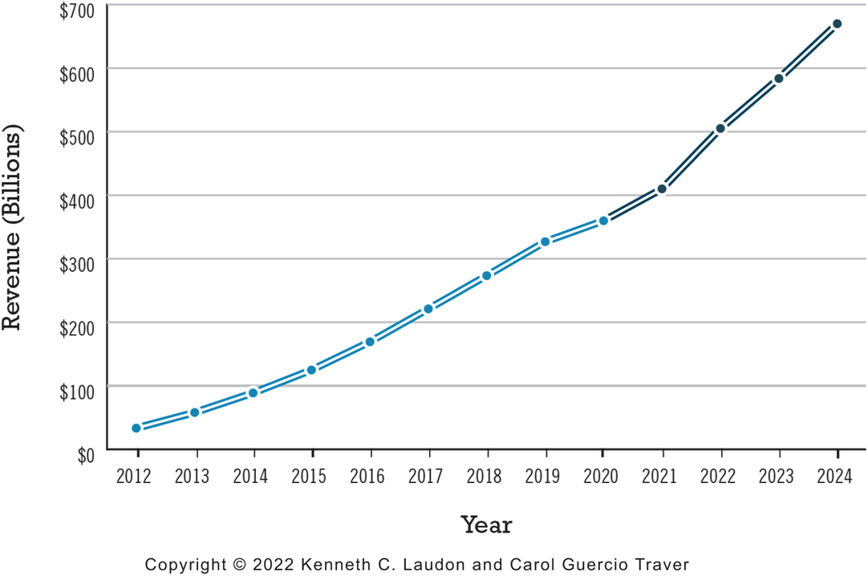
Figure 1.8 The Growth of M-commerce in the United States
Notes:
Figure 1.8, page 25.
M-commerce has increased astronomically, from just $32.8 billion in 2012 to an estimated $360 billion in 2020.
SOURCE: Based on data from eMarketer, Inc., 2020g, 2020h.
Alt Text
Long description: A graph shows the growth of m commerce revenue in billions of dollars from 20 12 to 20 24, as follows: The graph show m commerce revenue rising steadily from about 25 billion dollars in 20 12 to a projected 675 billion dollars in 20 24. All values are estimated.

Slide 26
Types of E-commerce
5. Social e-commerce is e-commerce that is enabled by social networks and online social relationships.
The growth of social e-commerce is being driven by a number of factors, including:
the increasing popularity of social sign-on (signing onto websites using your Facebook or other social network ID),
network notification (the sharing of approval or disapproval of products, services, and content).
online collaborative shopping tools, social search (recommendations from online trusted friends
the increasing prevalence of integrated social commerce tools such as Buy buttons, Shopping tabs, marketplace groups, and virtual shops on Facebook, Instagram, Pinterest, YouTube, and other social networks.

Slide 27
Types of E-commerce
6. local e-commerce: e-commerce that is focused on engaging the consumer based on his or her current geographic location

Slide 28
E-commerce: A Brief History (1 of 4)
Precursors
  Baxter Healthcare modem-based system (1970s)
  Order entry systems (1980s)
  Electronic Data Interchange (E D I) standards (1980s)
  French Minitel (1981)

Slide 29
E-commerce: A Brief History (2 of 4)
1995–2000: Invention
  Sale of simple retail goods
  Limited bandwidth and media
  Euphoric visions of
    Friction-free commerce
    First-mover advantages
  Dot-com crash of 2000
Notes:
Additional concepts: disintermediation, monopoly profits, switching costs, network effects, disruption of traditional channels.

Slide 30
E-commerce: A Brief History (3 of 4)
2001–2006: Consolidation
  Emphasis on business-driven approach
  Traditional large firms expand presence
  Start-up financing shrinks
  More complex products and services sold
  Growth of search engine advertising
  Business web presences expand

Slide 31
E-commerce: A Brief History (4 of 4)
2007–Present: Reinvention
  Rapid growth of:
    Web 2.0, including online social networks
    Mobile platform
    Local commerce
    On-demand service economy
  Entertainment content develops as source of revenues
  Transformation of marketing

Slide 32
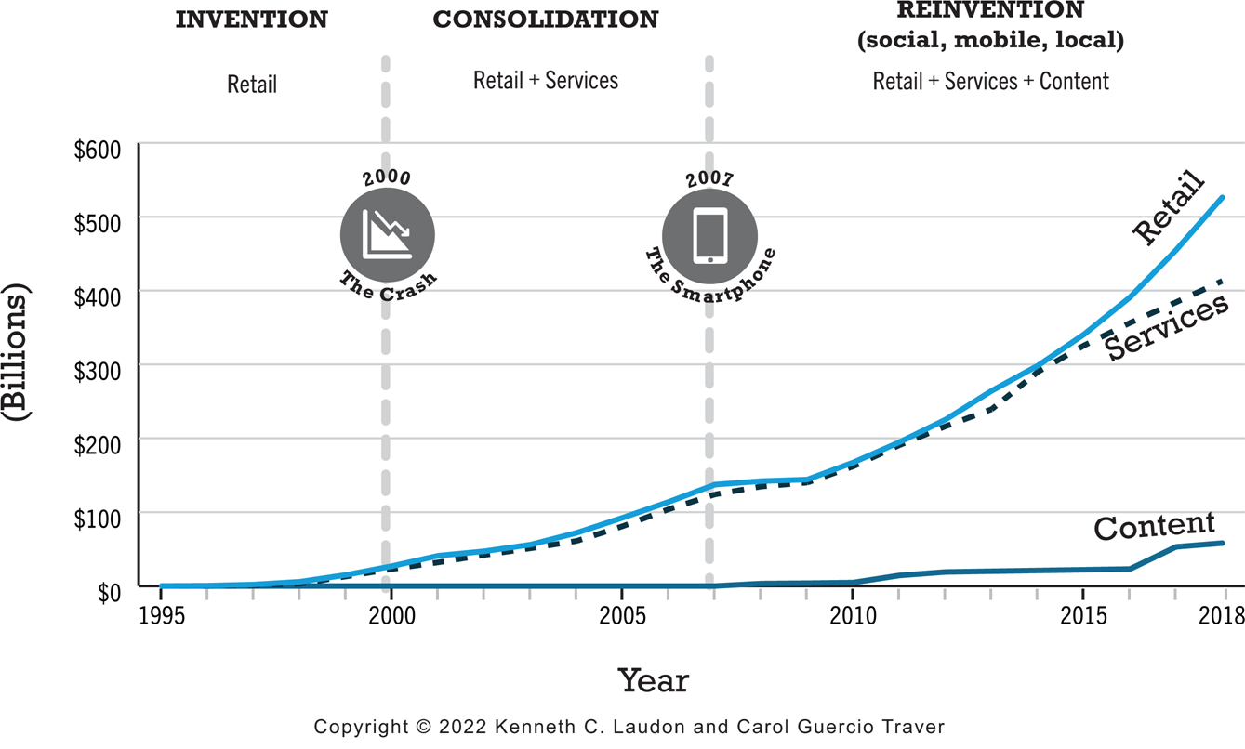
Figure 1.10 Periods in the Development of E-commerce
Notes:
Figure 1.10, page 28.
Alt Text
Long description: A graph illustrates phases of the development of e commerce in terms of billions of dollars of revenue for retail, services, and content, from 19 95 to 20 18, as follows: The three phases are Invention, Consolidation and Reinvention. During the period of Invention, from 19 95 to 2000, the curve for content revenue remains at 0, and retail and service revenue rise slightly from 0 in 19 98 to 25 billion dollars in 2000. The economic crash occurred in the U S in 2000. During the period of Consolidation from 2001 to 2007, the curve for retail and services revenues increases from 25 billion dollars in 2001 to 140 billion in 2007. The smartphone was invented in 2007. During the period of Reinvention, during which social, mobile, and local e commerce emerged, from 2008 to 20 18, the curve for retail revenue rises to 530 billion dollars in 20 18. Services revenue rises to 400 billion dollars in 20 18. Content revenue grows to 50 billion dollars by 20 18. All values are estimated.

Slide 33
Insight on Business: Y Combinator’s Startup Boot Camp
Class Discussion
  Why do you think investors today are still interested in investing in startups?
  What are the benefits of investing in a company that is a graduate of a Y Combinator boot camp?
  Is an incubator the best solution for startups to find funding? Why or why not?

Slide 34
Assessing E-commerce (1 of 2)
Stunning technological success
Early years a mixed business success
  Few early dot-coms have survived
  Online sales growing rapidly
Many early visions not fulfilled
  Price dispersion
  Information asymmetry
  New intermediaries

Slide 35
Assessing E-commerce (2 of 2)
Other surprises
  Fast-follower advantages
  Start-up costs
  Impact of mobile platform
  Emergence of on-demand e-commerce

Slide 36
Understanding E-commerce: Organizing Themes
Technology:
  Development and mastery of digital computing and communications technology
Business:
  New technologies present businesses with new ways of organizing production and transacting business
Society:
  Intellectual property, individual privacy, public welfare policy

Slide 37
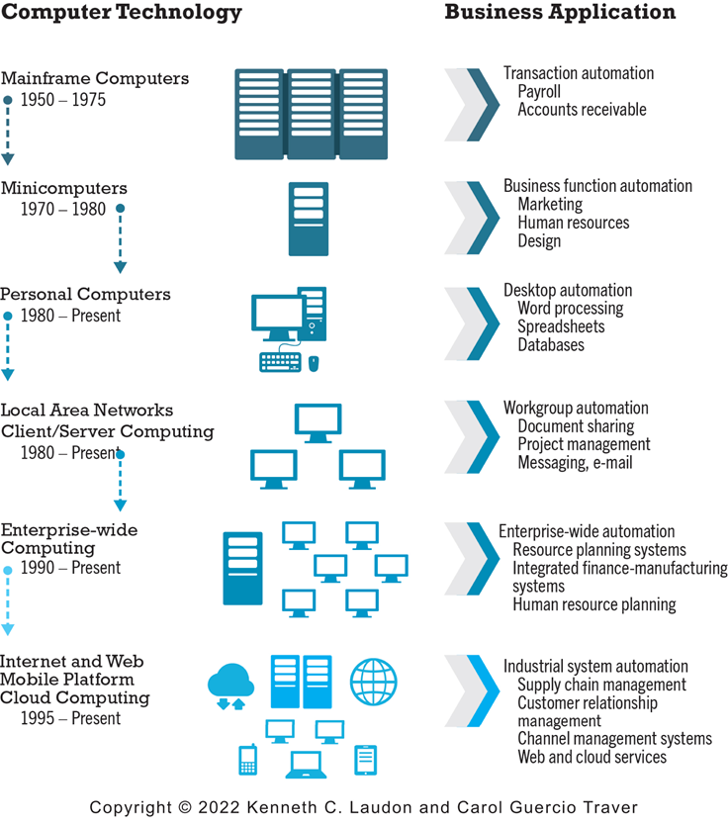
Figure 1.11 The Internet and the Evolution of Corporate Computing
Notes:
Figure 1.11, page 38.
The Internet and Web, and the emergence of a mobile platform held together by the Internet cloud, are the latest in a chain of evolving technologies and related business applications, each of which builds on its predecessors.
Alt Text
Long description: An illustration describes the evolution of corporate computing in the form of a timeline of advancements in computer technology and the corresponding business applications, as follows: Mainframe computer, 19 50 to 19 75. Applications, transaction automation, payroll, accounts payable. Minicomputers, 19 70 to 19 80. Applications, business function automation, marketing, human resources, and design. Personal computers, 19 80 to present. Applications: desktop automation, word processing, spread sheets, databases. Local area networks, client server computing, 19 80 to present. Applications, workgroup automation, document sharing, project management, messaging, email. Enterprise wide computing, 19 90 to present. Applications, enterprise wide automation, resource planning systems, integrated finance manufacturing systems, human resource planning. Internet and web mobile platform, cloud computing, 19 95 to present. Applications, industrial system automation, supply chain management, customer relationship management, channel management systems, web and cloud services.

Slide 38
Insight on Society: Facebook and the Age of Privacy
Class discussion:
  Why are social networks interested in collecting user information?
  What types of privacy invasion are described in the case? Which is the most privacy-invading, and why?
  Was the F T C’s $5 billion fine and its placement of new restrictions on Facebook’s business operations sufficient in light of Facebook’s history with respect to privacy violations?
  How do you protect your privacy online?

Slide 39
Academic Disciplines Concerned with Technology
Technical
  Computer science, management science, information systems
Behavioral
  Information systems research, economics, marketing, management, finance/accounting, sociology

Slide 40
Careers in E-commerce
Position: Category specialist in E-commerce Retail Program
Qualification/Skills
Preparing for the Interview
Possible Interview Questions

Slide 41

Copyright
This work is protected by United States copyright laws and is provided solely for the use of instructors in teaching their courses and assessing student learning. Dissemination or sale of any part of this work (including on the World Wide Web) will destroy the integrity of the work and is not permitted. The work and materials from it should never be made available to students except by instructors using the accompanying text in their classes. All recipients of this work are expected to abide by these restrictions and to honor the intended pedagogical purposes and the needs of other instructors who rely on these materials.

