Slide 1
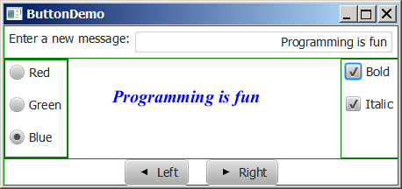
TextField Example
TextFieldDemo
Run
Notes:
package JavaFX;
import javafx.geometry.Insets;
import javafx.geometry.Pos;
import javafx.scene.control.Label;
import javafx.scene.control.TextField;
import javafx.scene.layout.BorderPane;
public class TextFieldDemo extends RadioButtonDemo {
@Override // Override the getPane() method in the super class
protected BorderPane getPane() {
BorderPane pane = super.getPane();
BorderPane paneForTextField = new BorderPane();
paneForTextField.setPadding(new Insets(5, 5, 5, 5));
paneForTextField.setStyle("-fx-border-color: green");
paneForTextField.setLeft(new Label("Enter a new message: "));
TextField tf = new TextField();
tf.setAlignment(Pos.BOTTOM_RIGHT);
paneForTextField.setCenter(tf);
pane.setTop(paneForTextField);
tf.setOnAction(e -> text.setText(tf.getText()));
return pane;
}
/**
* The main method is only needed for the IDE with limited
* JavaFX support. Not needed for running from the command line.
*/
public static void main(String[] args) {
launch(args);
}
}

Slide 2
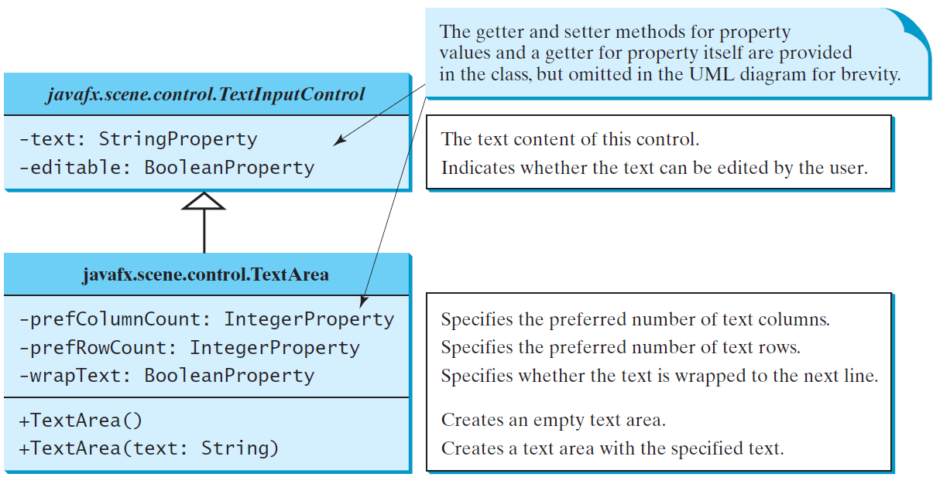
TextArea
A TextArea enables the user to enter multiple lines of text.

Slide 3
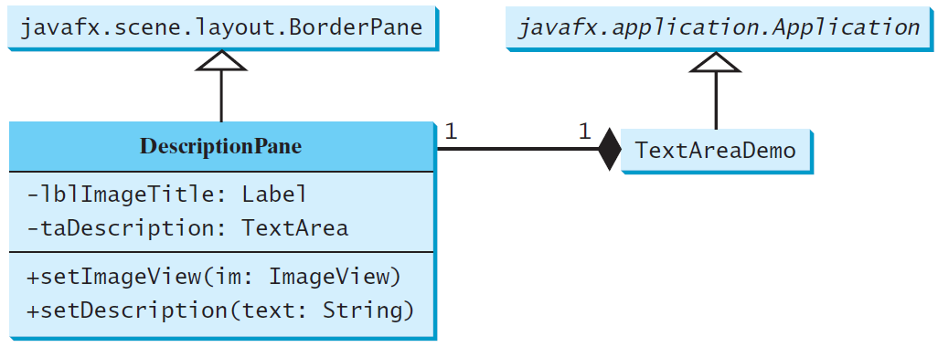
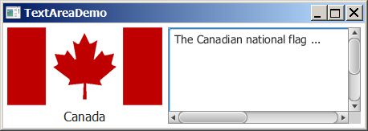
TextArea Example
DescriptionPane
TextAreaDemo
Run

Slide 4
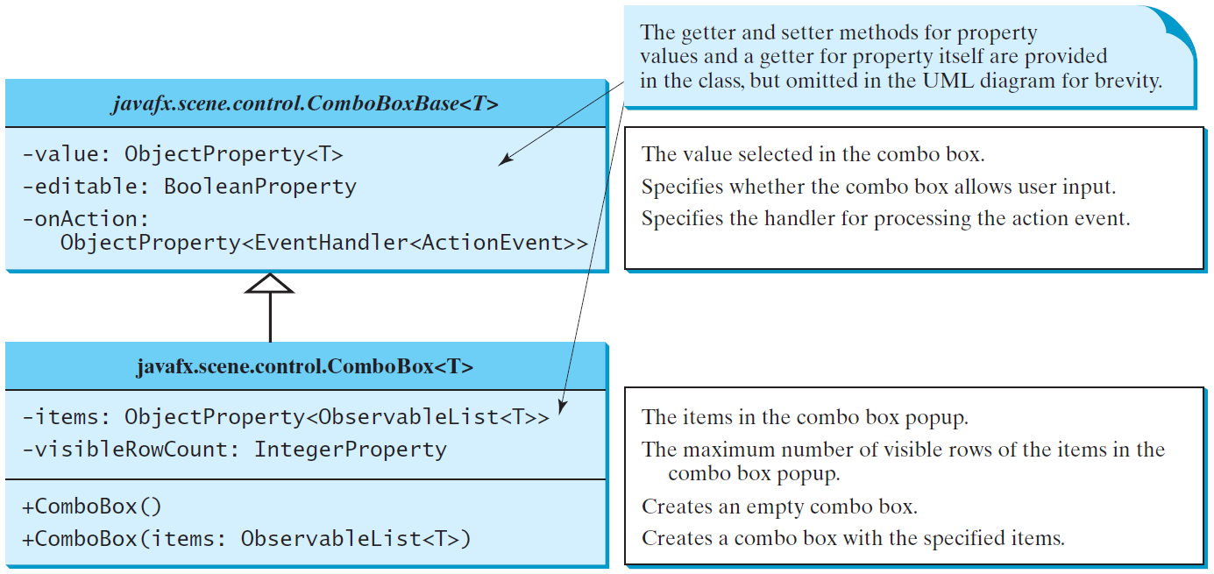
ComboBox
A combo box, also known as a choice list or drop-down list, contains a list of items from which the user can choose.

Slide 5
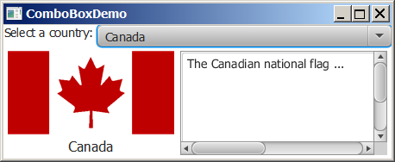
ComboBox Example
This example lets users view an image and a description of a country's flag by selecting the country from a combo box.
ComboBoxDemo
Run
Notes:
import javafx.application.Application;
import javafx.stage.Stage;
import javafx.collections.FXCollections;
import javafx.collections.ObservableList;
import javafx.scene.Scene;
import javafx.scene.control.ComboBox;
import javafx.scene.control.Label;
import javafx.scene.image.ImageView;
import javafx.scene.layout.BorderPane;
public class ComboBoxDemo extends Application {
// Declare an array of Strings for flag titles
private String[] flagTitles = {"Canada", "China", "Denmark",
"France", "Germany", "India", "Norway", "United Kingdom",
"United States of America"};
// Declare an ImageView array for the national flags of 9 countries
private ImageView[] flagImage = {new ImageView("image/ca.gif"),
new ImageView("image/china.gif"),
new ImageView("image/denmark.gif"),
new ImageView("image/fr.gif"),
new ImageView("image/germany.gif"),
new ImageView("image/india.gif"),
new ImageView("image/norway.gif"),
new ImageView("image/uk.gif"), new ImageView("image/us.gif")};
// Declare an array of strings for flag descriptions
private String[] flagDescription = new String[9];
// Declare and create a description pane
private DescriptionPane descriptionPane = new DescriptionPane();
// Create a combo box for selecting countries
private ComboBox<String> cbo = new ComboBox<>(); // flagTitles
@Override // Override the start method in the Application class
public void start(Stage primaryStage) {
// Set text description
flagDescription[0] = "The Canadian national flag ...";
flagDescription[1] = "Description for China ... ";
flagDescription[2] = "Description for Denmark ... ";
flagDescription[3] = "Description for France ... ";
flagDescription[4] = "Description for Germany ... ";
flagDescription[5] = "Description for India ... ";
flagDescription[6] = "Description for Norway ... ";
flagDescription[7] = "Description for UK ... ";
flagDescription[8] = "Description for US ... ";
// Set the first country (Canada) for display
setDisplay(0);
// Add combo box and description pane to the border pane
BorderPane pane = new BorderPane();
BorderPane paneForComboBox = new BorderPane();
paneForComboBox.setLeft(new Label("Select a country: "));
paneForComboBox.setCenter(cbo);
pane.setTop(paneForComboBox);
cbo.setPrefWidth(400);
cbo.setValue("Canada");
ObservableList<String> items =
FXCollections.observableArrayList(flagTitles);
cbo.getItems().addAll(items); // Add items to combo box
pane.setCenter(descriptionPane);
// Display the selected country
cbo.setOnAction(e -> setDisplay(items.indexOf(cbo.getValue())));
// Create a scene and place it in the stage
Scene scene = new Scene(pane, 450, 170);
primaryStage.setTitle("ComboBoxDemo"); // Set the stage title
primaryStage.setScene(scene); // Place the scene in the stage
primaryStage.show(); // Display the stage
}
/** Set display information on the description pane */
public void setDisplay(int index) {
descriptionPane.setTitle(flagTitles[index]);
descriptionPane.setImageView(flagImage[index]);
descriptionPane.setDescription(flagDescription[index]);
}
/**
* The main method is only needed for the IDE with limited
* JavaFX support. Not needed for running from the command line.
*/
public static void main(String[] args) {
launch(args);
}
}

Slide 6
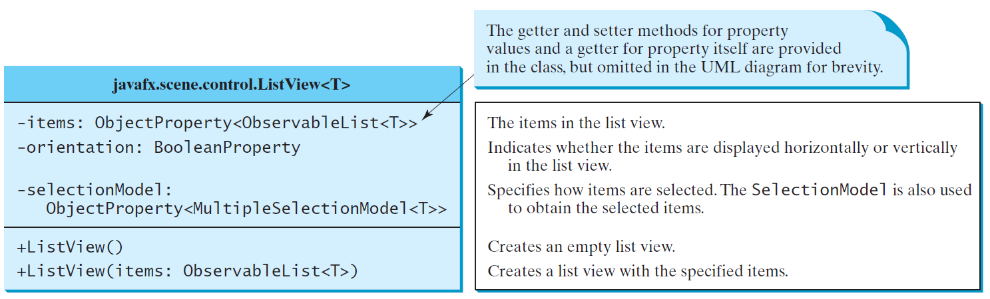
ListView
A list view is a component that performs basically the same function as a combo box, but it enables the user to choose a single value or multiple values.

Slide 7
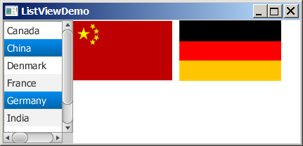
Example: Using ListView
This example gives a program that lets users select countries in a list and display the flags of the selected countries in the labels.
ListViewDemo
Run
Notes:
import javafx.application.Application;
import javafx.stage.Stage;
import javafx.collections.FXCollections;
import javafx.scene.Scene;
import javafx.scene.control.ListView;
import javafx.scene.control.ScrollPane;
import javafx.scene.control.SelectionMode;
import javafx.scene.image.ImageView;
import javafx.scene.layout.BorderPane;
import javafx.scene.layout.FlowPane;
public class ListViewDemo extends Application {
// Declare an array of Strings for flag titles
private String[] flagTitles = {"Canada", "China", "Denmark",
"France", "Germany", "India", "Norway", "United Kingdom",
"United States of America"};
// Declare an ImageView array for the national flags of 9 countries
private ImageView[] ImageViews = {
new ImageView("image/ca.gif"),
new ImageView("image/china.gif"),
new ImageView("image/denmark.gif"),
new ImageView("image/fr.gif"),
new ImageView("image/germany.gif"),
new ImageView("image/india.gif"),
new ImageView("image/norway.gif"),
new ImageView("image/uk.gif"),
new ImageView("image/us.gif")
};
@Override // Override the start method in the Application class
public void start(Stage primaryStage) {
ListView<String> lv = new ListView<>
(FXCollections.observableArrayList(flagTitles));
lv.setPrefSize(140, 400);
lv.getSelectionModel().setSelectionMode(SelectionMode.MULTIPLE);
// Create a pane to hold image views
FlowPane imagePane = new FlowPane(10, 10);
BorderPane pane = new BorderPane();
pane.setLeft(new ScrollPane(lv));
pane.setCenter(imagePane);
lv.getSelectionModel().selectedItemProperty().addListener(
ov -> {
imagePane.getChildren().clear();
for (Integer i: lv.getSelectionModel().getSelectedIndices()) {
imagePane.getChildren().add(ImageViews[i]);
}
});
// Create a scene and place it in the stage
Scene scene = new Scene(pane, 450, 170);
primaryStage.setTitle("ListViewDemo"); // Set the stage title
primaryStage.setScene(scene); // Place the scene in the stage
primaryStage.show(); // Display the stage
}
/**
* The main method is only needed for the IDE with limited
* JavaFX support. Not needed for running from the command line.
*/
public static void main(String[] args) {
launch(args);
}
}

Slide 8
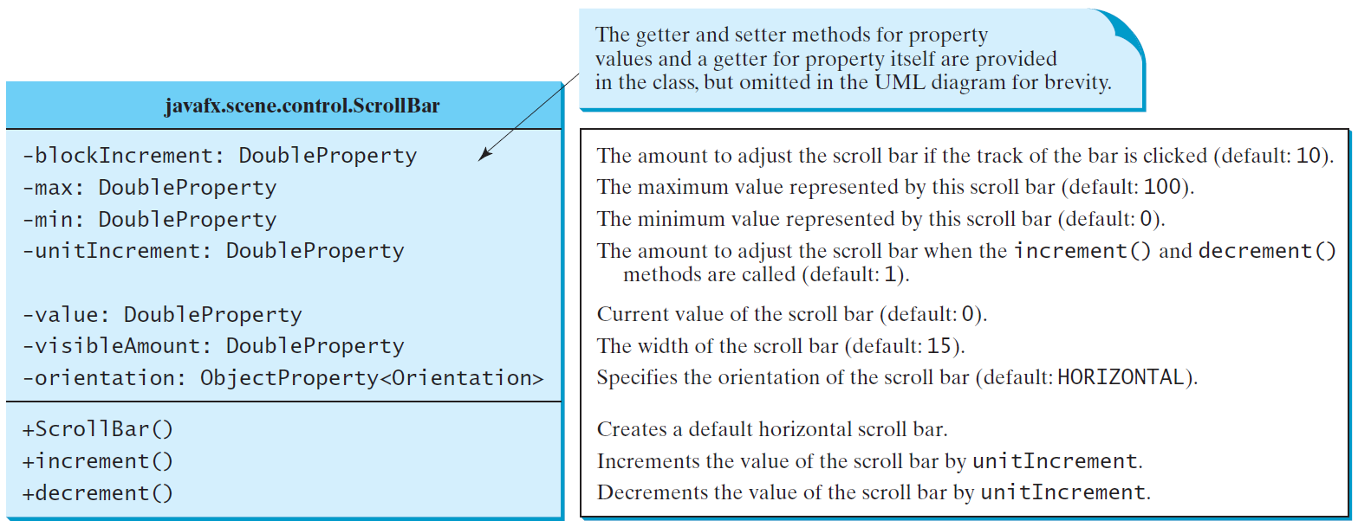
ScrollBar
A scroll bar is a control that enables the user to select from a range of values. The scrollbar appears in two styles: horizontal and vertical.

Slide 9
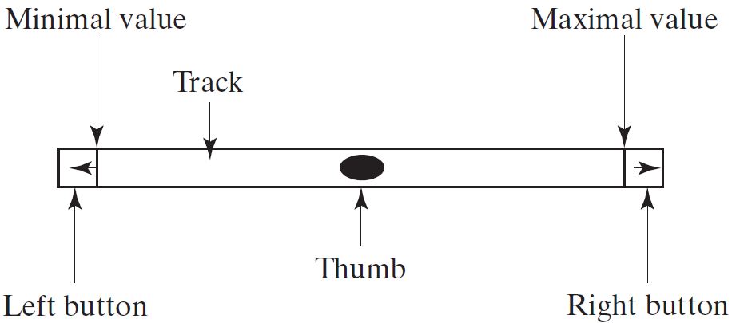
Scroll Bar Properties

Slide 10
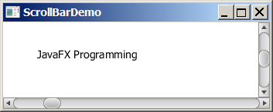
Example: Using Scrollbars
This example uses horizontal and vertical scrollbars to control a message displayed on a panel. The horizontal scrollbar is used to move the message to the left or the right, and the vertical scrollbar to move it up and down.
ScrollBarDemo
Run
Notes:
import javafx.application.Application;
import javafx.stage.Stage;
import javafx.geometry.Orientation;
import javafx.scene.Scene;
import javafx.scene.control.ScrollBar;
import javafx.scene.layout.BorderPane;
import javafx.scene.layout.Pane;
import javafx.scene.text.Text;
public class ScrollBarDemo extends Application {
@Override // Override the start method in the Application class
public void start(Stage primaryStage) {
Text text = new Text(20, 20, "JavaFX Programming");
ScrollBar sbHorizontal = new ScrollBar();
ScrollBar sbVertical = new ScrollBar();
sbVertical.setOrientation(Orientation.VERTICAL);
// Create a text in a pane
Pane paneForText = new Pane();
paneForText.getChildren().add(text);
// Create a border pane to hold text and scroll bars
BorderPane pane = new BorderPane();
pane.setCenter(paneForText);
pane.setBottom(sbHorizontal);
pane.setRight(sbVertical);
// Listener for horizontal scroll bar value change
sbHorizontal.valueProperty().addListener(ov ->
text.setX(sbHorizontal.getValue() * paneForText.getWidth() /
sbHorizontal.getMax()));
// Listener for vertical scroll bar value change
sbVertical.valueProperty().addListener(ov ->
text.setY(sbVertical.getValue() * paneForText.getHeight() /
sbVertical.getMax()));
// Create a scene and place it in the stage
Scene scene = new Scene(pane, 450, 170);
primaryStage.setTitle("ScrollBarDemo"); // Set the stage title
primaryStage.setScene(scene); // Place the scene in the stage
primaryStage.show(); // Display the stage
}
/**
* The main method is only needed for the IDE with limited
* JavaFX support. Not needed for running from the command line.
*/
public static void main(String[] args) {
launch(args);
}
}

Slide 11
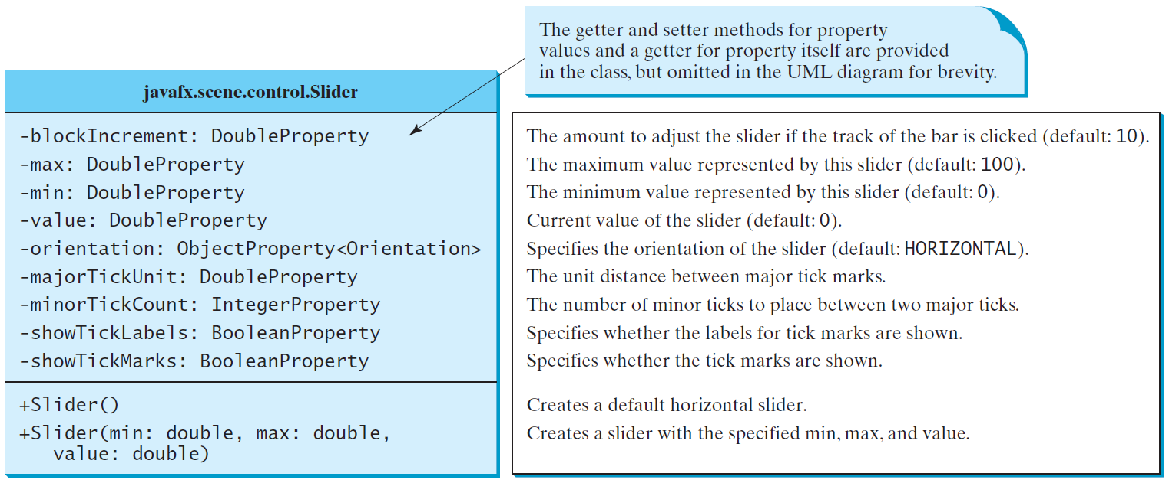
Slider
Slider is similar to ScrollBar, but Slider has more properties and can appear in many forms.

Slide 12
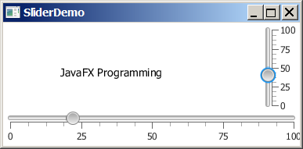
Example: Using Sliders
Rewrite the preceding program using the sliders to control a message displayed on a panel instead of using scroll bars.

Slide 13
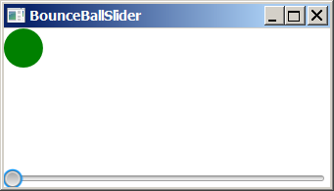
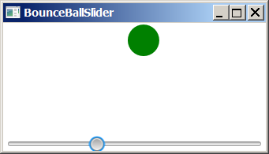
Case Study: Bounce Ball
Listing 15.17 gives a program that displays a bouncing ball. You can add a slider to control the speed of the ball movement.
SliderDemo
Run
Notes:
import javafx.application.Application;
import javafx.stage.Stage;
import javafx.geometry.Orientation;
import javafx.scene.Scene;
import javafx.scene.control.Slider;
import javafx.scene.layout.BorderPane;
import javafx.scene.layout.Pane;
import javafx.scene.text.Text;
public class SliderDemo extends Application {
@Override // Override the start method in the Application class
public void start(Stage primaryStage) {
Text text = new Text(20, 20, "JavaFX Programming");
Slider slHorizontal = new Slider();
slHorizontal.setShowTickLabels(true);
slHorizontal.setShowTickMarks(true);
Slider slVertical = new Slider();
slVertical.setOrientation(Orientation.VERTICAL);
slVertical.setShowTickLabels(true);
slVertical.setShowTickMarks(true);
slVertical.setValue(100);
// Create a text in a pane
Pane paneForText = new Pane();
paneForText.getChildren().add(text);
// Create a border pane to hold text and scroll bars
BorderPane pane = new BorderPane();
pane.setCenter(paneForText);
pane.setBottom(slHorizontal);
pane.setRight(slVertical);
slHorizontal.valueProperty().addListener(ov ->
text.setX(slHorizontal.getValue() * paneForText.getWidth() /
slHorizontal.getMax()));
slVertical.valueProperty().addListener(ov ->
text.setY((slVertical.getMax() - slVertical.getValue())
* paneForText.getHeight() / slVertical.getMax()));
// Create a scene and place it in the stage
Scene scene = new Scene(pane, 450, 170);
primaryStage.setTitle("SliderDemo"); // Set the stage title
primaryStage.setScene(scene); // Place the scene in the stage
primaryStage.show(); // Display the stage
}
/**
* The main method is only needed for the IDE with limited
* JavaFX support. Not needed for running from the command line.
*/
public static void main(String[] args) {
launch(args);
}
}

