Slide 1
Using MongoDB Atlas to Create and Insert Data
A Step-by-Step Guide

Slide 2
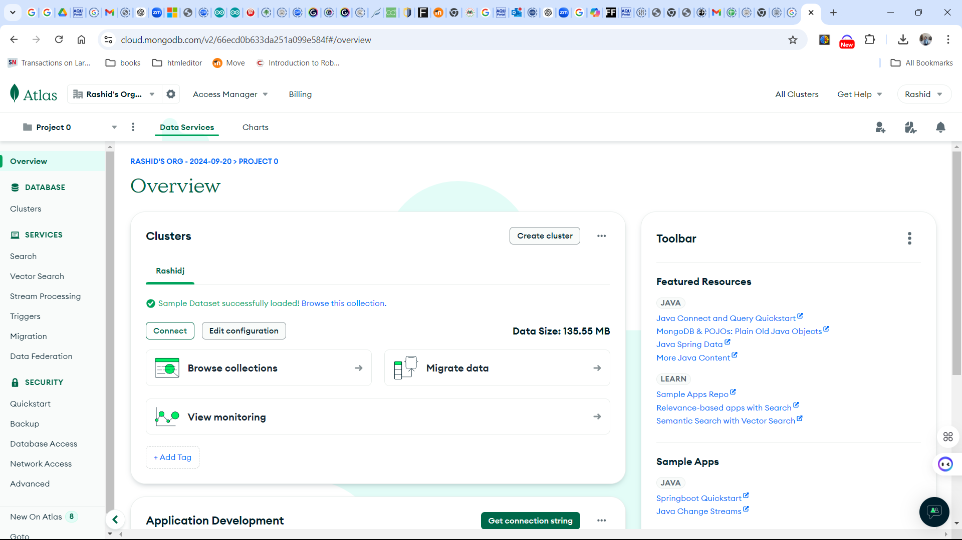
Step 1: Login to MongoDB Atlas
1. Visit https://www.mongodb.com/cloud/atlas
2.Sign in or create a new account.

Slide 3
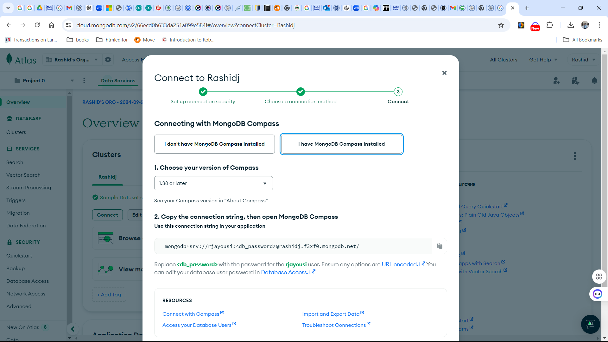
Step 2: Access Your Cluster
1. From the Atlas dashboard, click on your desired cluster.
2. In the 'Databases' tab, click 'Browse Collections'.

Slide 4
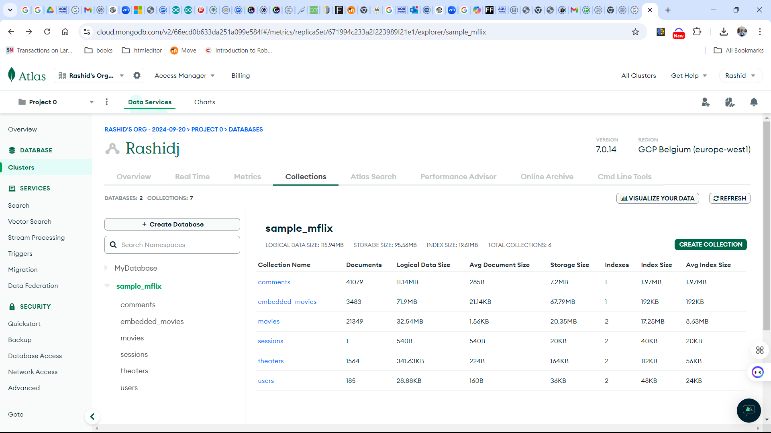
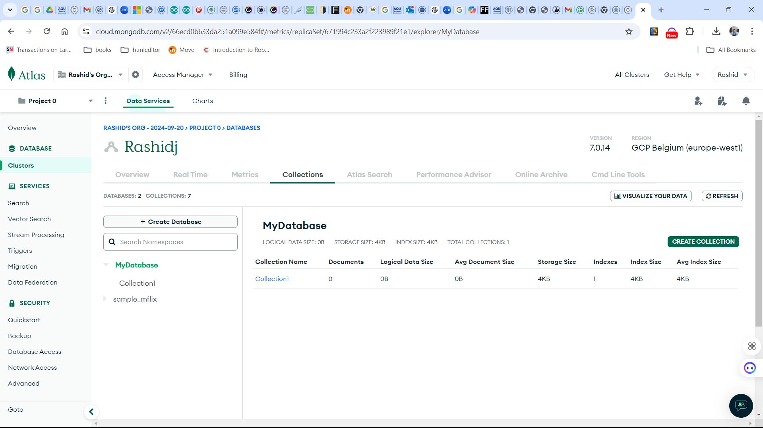
Step 3: Create a Database
1. Click 'Add My Own Data' on the collections page.
2. Enter a Database Name (e.g., mydb) and Collection Name (e.g., users).
3. Click 'Create'.

Slide 5
Step 4: Insert Data into the Collection
1. Inside your new collection, click 'Insert Document'.
2. Add JSON data, such as:
{
"name": "Alice",
"age": 25,
"email": "alice@example.com"
}
3. Click 'Insert' to save the document.

Slide 6
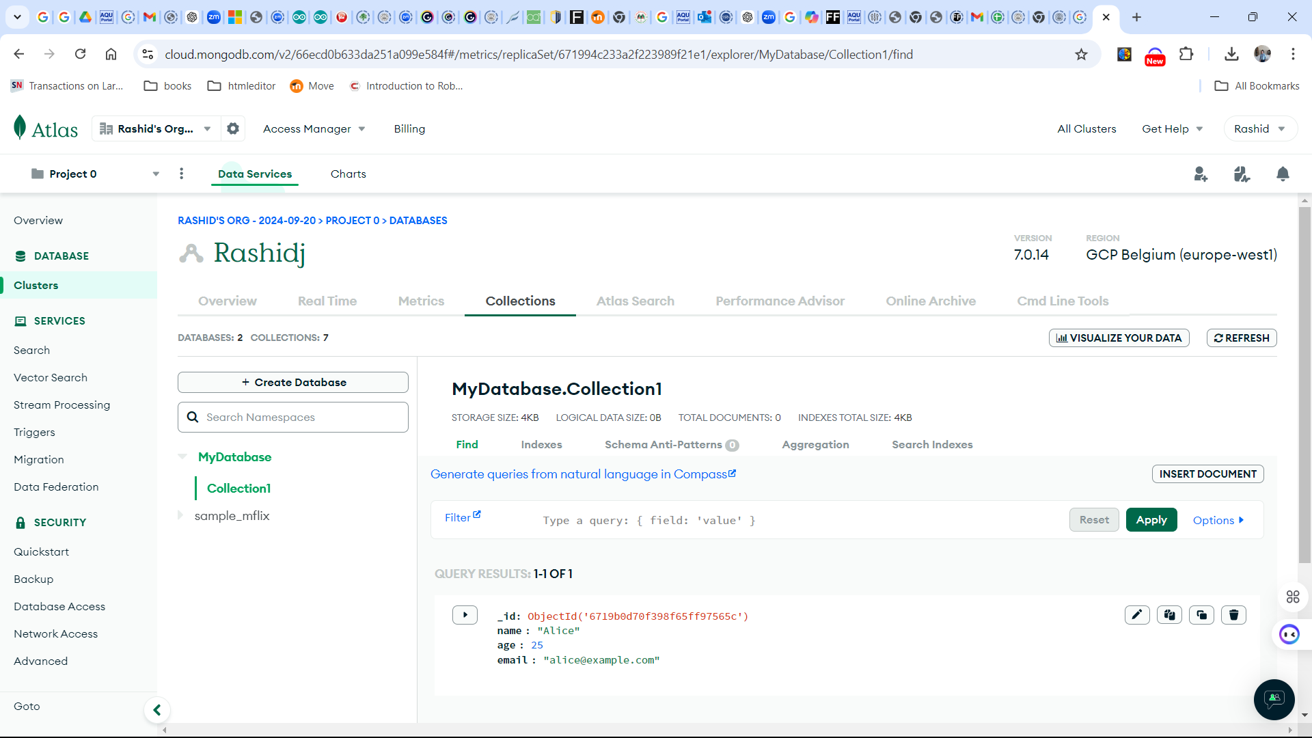

Slide 7
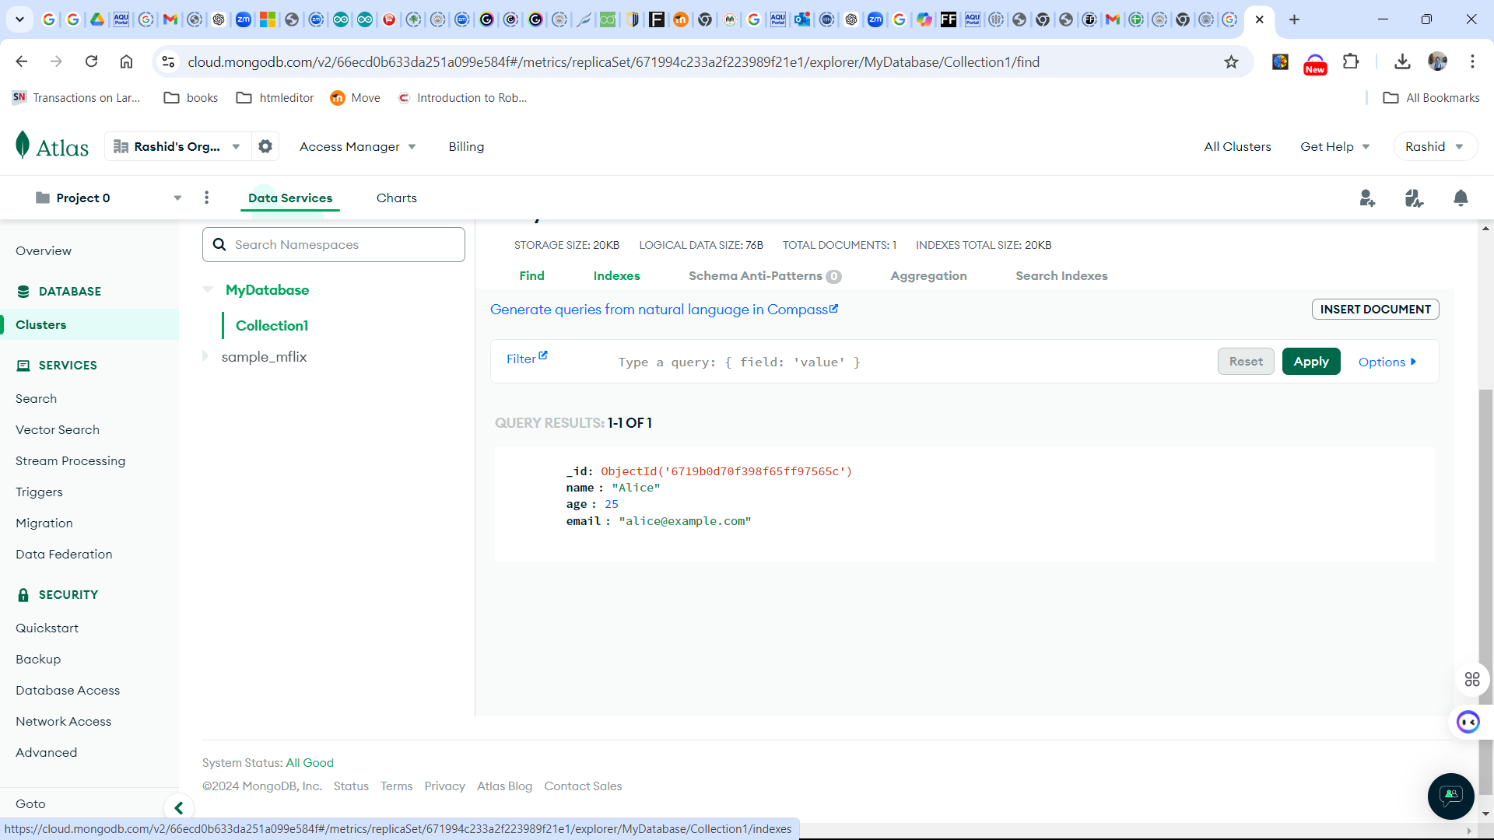
Step 5: View Your Data
The inserted documents will appear in the collection view.

Slide 8
Example: Querying All Documents in a Collection
Open MongoDB Atlas: Go to your MongoDB Atlas dashboard.
Select Your Cluster: Click on the cluster you want to query.
Navigate to Collections: Click on the "Collections" tab.
Select a Collection: Click on the collection you want to query.
Run a Query: Click on the "Find Documents" button and leave the query field empty to retrieve all documents.

Slide 9
Query: Find al withtype “movie”
Open MongoDB Atlas: Go to your MongoDB Atlas dashboard.
Select Your Cluster: Click on the cluster where the sample_mflix database is located.
Navigate to Collections: Click on the "Collections" tab.
Select the movies Collection: Click on the movies collection.
Run a Query: Click on the "Find Documents" button and enter the following query:
{ "type": "movie" }

Slide 10
Run a query to find movies with Runtime Greater than 10 Minutes
{ "runtime": { "$gt": 10 } }

Slide 11
Using Aggregation Pipeline
Step 1: $unwind
{ "$unwind": "$genres" }
Purpose: This stage splits the array of genres into individual documents.
If a movie has multiple genres, this will create a separate document for each genre.

