Slide 1
The Cell

Slide 2
Introduction
A disease has been defined as an interruption, cessation or disorder of a body system or organ structure that is characterized usually by a recognized etiologic agent or agents, an identifiable group of signs and symptoms, or consistent anatomic alterations.

Slide 3
Etiology
The cause of disease or known as etiologic factors.
Among the recognized etiologic agents are biologic agents (e.g., bacteria, viruses), physical forces (e.g., trauma, burns, radiation), chemical agents (e.g., poisons, alcohol), and nutritional excesses or deficits.

Slide 4
Pathogenesis
Pathogenesis is the sequence of cellular and tissue events that take place from the time of initial contact with an etiologic agent until the ultimate expression of a disease.

Slide 5
Morphology
It refers to the fundamental structure or form of cells or tissues.

Slide 6
Clinical Manifestations
Diseases can manifest in a number of ways. Sometimes the condition produces manifestations, such as fever, that make it evident that the person is sick.
In other cases, the condition is silent at the onset and is detected during examination for other purposes or after the disease is far advanced.

Slide 7
Diagnosis
Is the designation as to the nature or cause of a health problem (bacterial pneumonia).

Slide 8
Clinical Course
It describes the evolution of a disease. A disease can have an acute, subacute, or chronic course.

Slide 9
Acute
An acute disorder is one that is relatively severe, but self-limiting.

Slide 10
Chronic
Chronic disease implies a continuous, long-term process.
A chronic disease can run a continuous course or can present with exacerbations (aggravation of symptoms and severity of the disease) and remissions (a period during which there is a decrease in severity and symptoms).

Slide 11
Subacute
Subacute disease is intermediate or between acute and chronic; it is not as sever as an acute disease and not as prolonged as a chronic disease.

Slide 12
Epidemiology
Is the study of disease occurrence in human populations.

Slide 13
Risk Factors
Are the conditions suspected of contributing to the development of a disease.

Slide 14
Natural History
It refers to the progression and projected outcome of the disease without medical intervention.

Slide 15
Levels of Prevention
Primary: is directed at keeping disease from occurring by removing all risk factors (e.g., immunizations).
Secondary: detects disease early when it is still asymptomatic and treatment measures can affect a cure or stop it from progressing.
Tertiary: is directed at clinical interventions that prevent further deterioration or reduce the complications of a disease once it has been diagnosed.

Slide 16
Cell
Is the smallest functional unit.
Cells with similar embryonic origin or function are often organized into larger functional units called tissues.
These tissues in turn combine to form the various body structures and organs.

Slide 17
Cell
Although the cells of different tissues and organs vary in structure and function, certain characteristics are common to all cells.
Cells are remarkably similar in their ability to exchange materials with their immediate environment, obtain energy from organic nutrients, synthesize complex molecules and replicate themselves.

Slide 18
Functional Components of the Cell
All eukaryotic cells (cells with a true nucleus) have in common structures that perform unique functions.
The major components of the eukaryotic cell: the plasma membrane, the nucleus, and the cytoplasm.

Slide 19
Functional Components of the Cell
The living part of the cell is called protoplasm. Protoplasm is composed of water, proteins, lipids, carbohydrates and electrolytes.

Slide 20
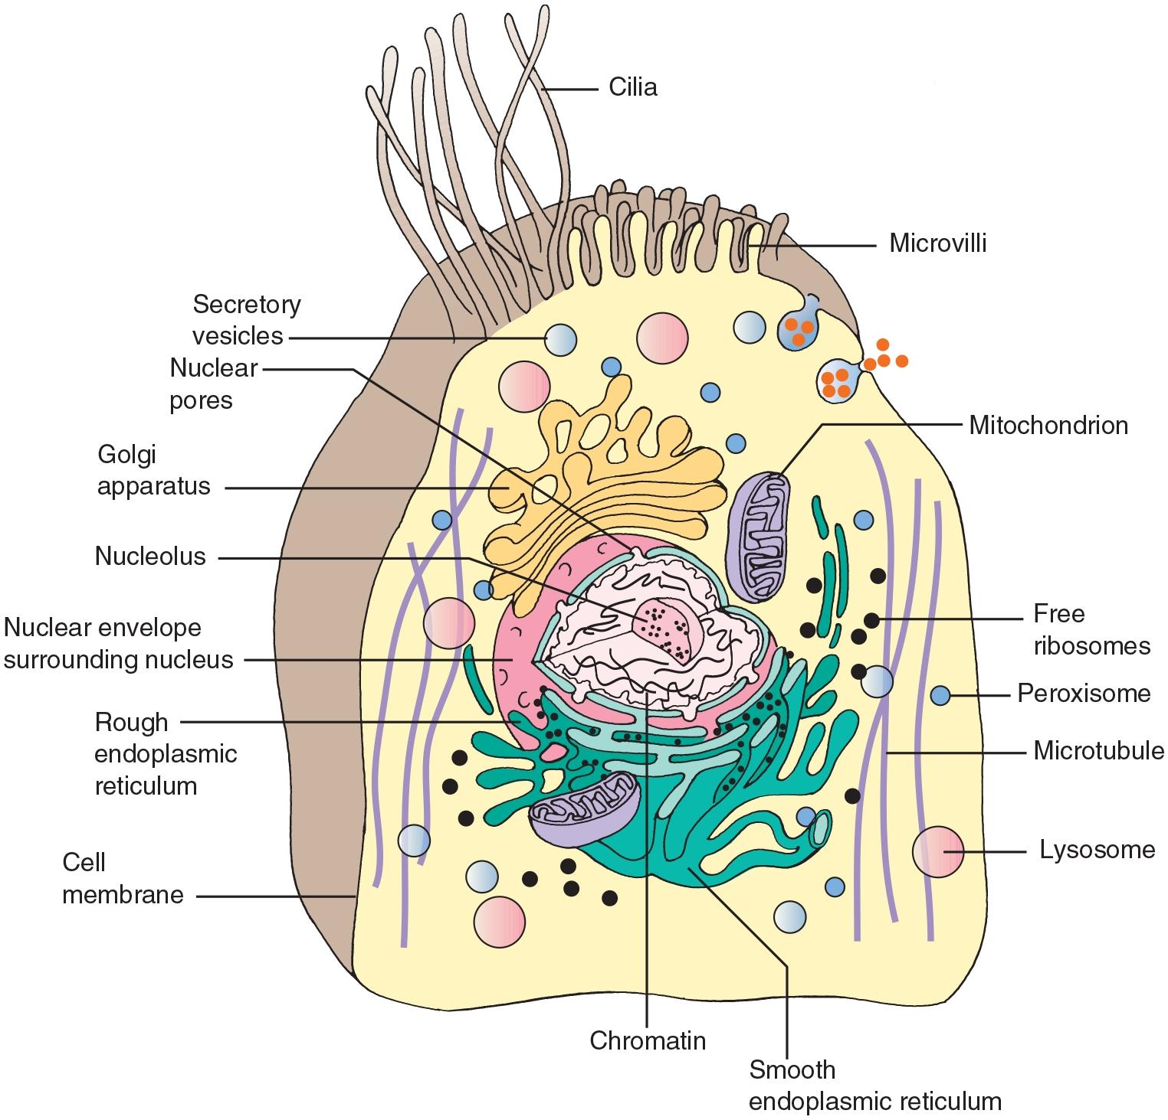
Cell Structure

Slide 21
The Plasma (Cell) Membrane
It acts as a semipermeable structure that separates the intracellular and extracellular environments.
It controls the transport of materials from the extracellular fluids to the interior of the cell.
Provides receptors for hormones and other biologically active substances.
Participates in the generation and conduction of electrical currents that occur in nerve and muscle cells.
Aids in the regulation of cell growth and proliferation.

Slide 22
The Plasma (Cell) Membrane (Cont’d)
A main structural component of the membrane is its lipid bilayer. It is a bimolecular layer that contains primarily of phospholipids, with glycolipids and cholesterol.
This lipid bilayer provides the basic fluid structure of the membrane and serves as a relatively impermeable barrier to all but lipid-soluble substances.

Slide 23
The Plasma (Cell) Membrane (Cont’d)
Approximately, 75% of the lipids are phospholipids, each with a hydrophilic (water-soluble) head and a hydrophobic (water-insoluble) tail.
The hydrophilic heads retain water and help cells stick to each other. At normal body temperature, the viscosity of the lipid component of the membrane is equivalent to that of olive oil. The presence of cholesterol stiffens the membrane.

Slide 24
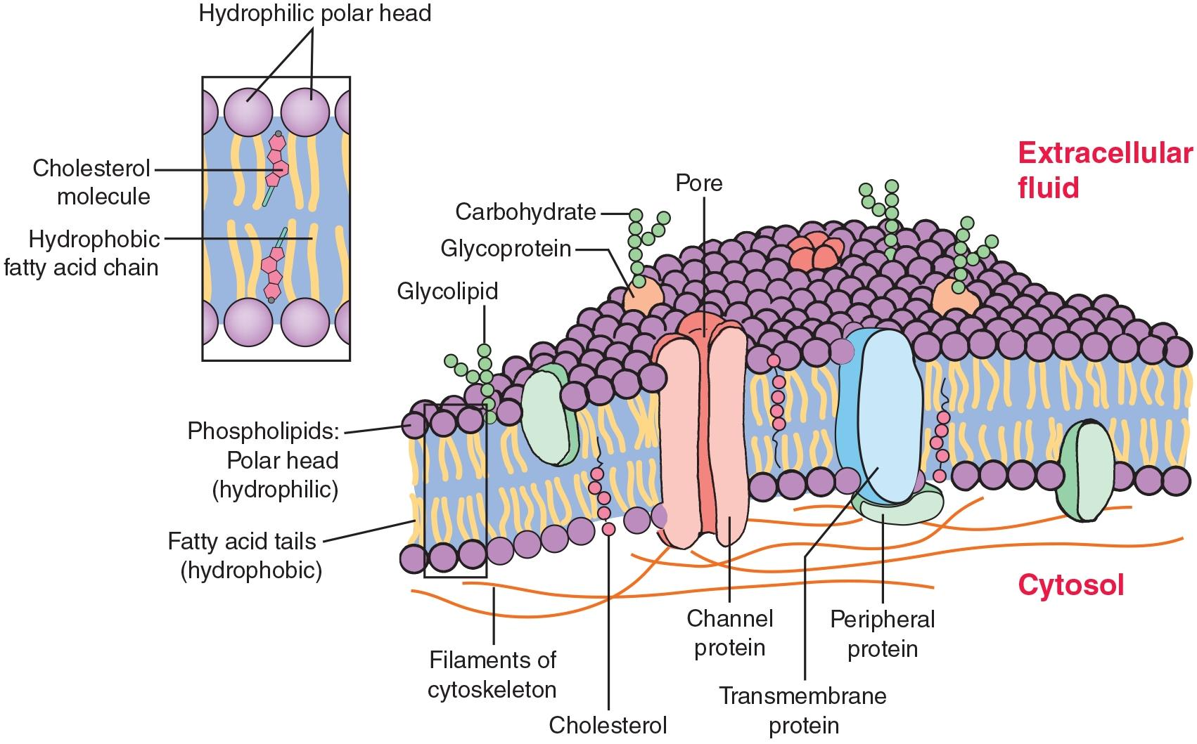
The Plasma Membrane

Slide 25
The Functional Organization of the cell
The nucleus is the control center for the cell. It also contains most of the hereditary material.
The organelles, which are analogous to the organs of the body, are contained in the cytoplasm.
The organelles include the mitochondria, which supply the energy needs of the cell; the ribosomes, which synthesize proteins and other materials needed for cell function; and the lysosomes and proteosomes, which function as the cell’s digestive system.

Slide 26
The Functional Organization of the cell
The cell membrane encloses the cell and provides for intracellular communication, transport of materials into and out of the cell, and maintenance of the electrical activities that power cell function.

Slide 27
The Nucleus
It contains deoxyribonucleic acid (DNA), which provides the information necessary for the synthesis of the various proteins that the cell must produce to stay alive and to transmit information from one generation to another.

Slide 28
Organelles
The cytoplasm contains the cell’s organelles .
Ribosomes serve as sites for protein synthesis in the cell.
The endoplasmic reticulum (ER) functions as a tubular communication system through which substances can be transported from one part of the cell to another.
The Golgi apparatus modifies materials synthesized in the ER and packages them into secretory granules for transport within the cell or export from the cell.

Slide 29
Organelles
Lysosomes, which can be viewed as the digestive system of the cell, contain hydrolytic enzymes that digest worn-out cell parts and foreign materials.
The mitochondria serve as power plants for the cell because they transform food energy into ATP, which is used to power cell activities. They contain their own extra chromosomal DNA, which is used in the synthesis of certain proteins required for mitochondrial function.

Slide 30
Organelles
In addition to its organelles, the cytoplasm also contains a network of microtubules, actin microfilaments, and intermediate filaments called the cytoskeleton.
Actin microfilaments are dynamic, thin, threadlike cytoplasmic structures that are important in cell movement and organelle positioning.

Slide 31
Organelles
Metabolism is the process whereby the carbohydrates, fats, and proteins from the foods we eat are broken down and subsequently converted into the energy needed for cell function.
Energy is stored in the high-energy phosphate bonds of adenosine triphosphate (ATP), which serves as the energy currency for the cell.

Slide 32
Question?
ATP is produced without oxygen.

Slide 33
Answer
True
Rationale: ATP can be produced in the cytosol without oxygen during glycolysis.

Slide 34
Energy Conversion
Two sites of energy conversion are present in cells: the anaerobic glycolytic pathway in the cytoplasm and the aerobic pathways in the mitochondria.
The most efficient of these pathways is the aerobic citric acid cycle and electron transport chain in the mitochondria. This pathway, which requires oxygen, produces carbon dioxide and water as end products and results in the release of large amounts of energy that is used to convert adenosine diphosphate (ADP) to ATP.
The glycolytic pathway in the cytoplasm involves the breakdown of glucose to form ATP. This pathway can function without oxygen by producing lactic acid.

Slide 35
Movement of Substances
Substances that enter or leave the cell must cross the cell membrane.
Diffusion is a process by which substances such as ions move from areas of greater concentration to areas of lesser concentration until reaching a uniform distribution. Facilitated diffusion is a passive process, in which molecules that cannot normally pass through the cell’s membranes do so with the assistance of a carrier molecule.
Active transport requires the cell to expend energy in moving ions against a concentration gradient. The Na+/K+-ATPase membrane pump is the best-known type of active transport.

Slide 36
Vesicular Transport
Vesicular transport is a mechanism in which a cell encloses extracellular material in a membrane-bound vesicle.
There are two types of vesicular transport: endocytosis, in which materials are brought into the cell by invagination of the cell membrane to form a vesicle, and exocytosis, in which materials are exported from the cell by fusion of a vesicle with the cell membrane.

Slide 37
Electrical Potentials
Electrical potentials, which are measured in volts, describe the ability of separated electrical charges of opposite polarity (+ and −) to do work. In regard to cells, the oppositely charged particles are ions, and the barrier that separates them is the cell membrane.
There are two main factors that alter membrane potentials and excitability: the difference in concentration of ions on the inside and outside of the membrane and the permeability of the membrane to these ions.

Slide 38
Question?
Your patient has been given an intravenous solution of water. What will happen to this patient’s red blood cells?
  They will burst/lyse.
  They will shrink.
  They will not be affected by the water solution.

Slide 39
Answer
A. They will burst/lyse.
Rationale: Osmosis causes movement from “more watery” to “less watery.” Because water is “more watery” than the RBCs (it is water, after all), water moves into the cell, causing it to expand and burst/lyse.

Slide 40
Tissues
Body cells are organized into four basic tissue types: epithelial, connective, muscle, and nervous.
The epithelium covers and lines the body surfaces and forms the functional components of glandular structures.
Epithelial tissue is classified in to three types according to the shape of the cells and the number of layers that are present: simple, stratified, and pseudostratified.

Slide 41
Connective
Connective tissue supports and connects body structures; it forms the bones and cartilage, the joint structures, the dermis of the skin, the sheaths of blood vessels and nerves, adipose tissue, lymphatic tissues, and blood.
Fibroblasts are the most abundant connective tissue cells. They are responsible for the synthesis of collagen, elastic, and reticular fibers and the gel-like ground substance that fills the intercellular spaces.

Slide 42
Muscle
Muscle tissue is a specialized tissue designed for contractility. Three types of muscle tissue exist: skeletal, cardiac, and smooth. Actin and myosin filaments interact to produce muscle shortening, a process activated by the presence of calcium.
In skeletal muscle, calcium is released from the sarcoplasmic reticulum in response to an action potential.
Smooth muscle is often called involuntary muscle because it contracts spontaneously or through the activity of the autonomic nervous system. It differs from skeletal muscle in that its sarcoplasmic reticulum is less defined and it depends on the entry of extracellular calcium ions for muscle contraction.

Slide 43
Nervous
Nervous tissue is designed for communication purposes and includes the neurons, the supporting neural structures, and the ependymal cells that line the ventricles of the brain and the spinal canal.

