Slide 1
Fundamentals of Pharmaceutical Calculations
Chap.1

Slide 2
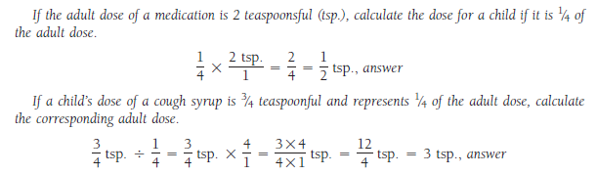
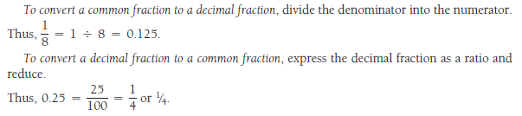

Slide 3
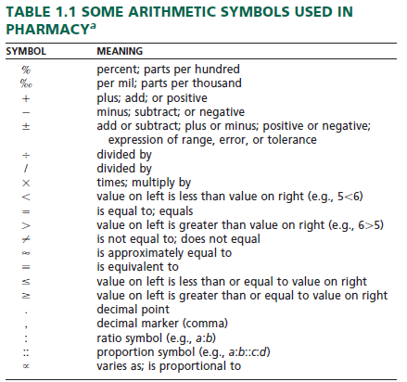

Slide 4

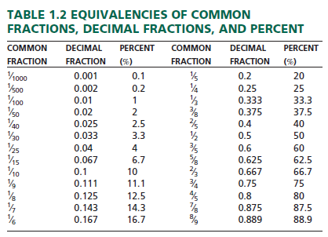

Slide 5



Slide 6
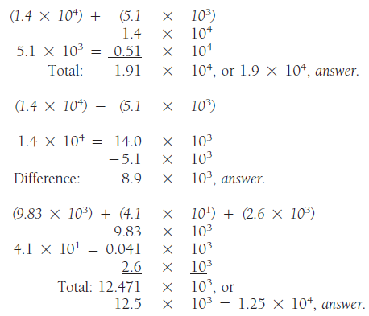

Slide 7




Slide 8

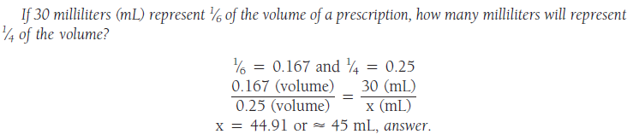
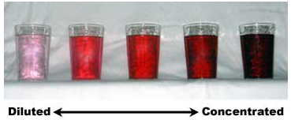
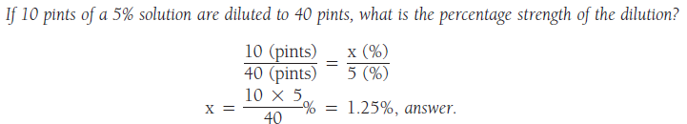

Slide 9
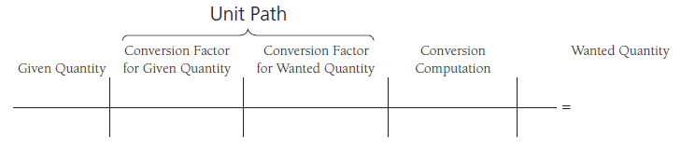
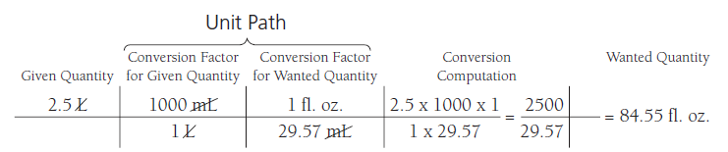


Slide 10


Slide 11




Slide 12
A- Using a ruler calibrated: 11.3 cm but not 11.32 cm.
B- 2.43 may be rounded to 2.4, but 2.46 should be rounded to 2.5.
C- 162.4gr +0.489gr + 0.1875gr + 120.78gr, the sum is 283.8565 gr, but the rounded sum is 283.9 gr.
D- 1.6437gr X 0.26 = 0.427362gr, rounded to 0.43gr.
E- 2.54mg X 96 = 243.84 mg, rounded to 244 mg.

