Slide 1
Econometrics
Ch4.
Multiple Regression: Estimation and Hypothesis Testing

Slide 2
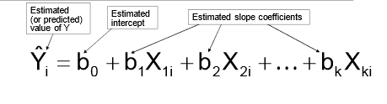
Multiple Regression Equation
The coefficients of the multiple regression model are estimated using sample data.
Multiple regression equation with k independent variables:

Slide 3
Assumptions of multiple linear regression
The same as those made for simple linear regression plus
the assumption of no exact collinearity among the explanatory variables.
high collinearity among the explanatory variables is called multicollinearity

Slide 4
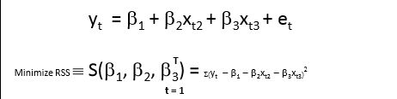
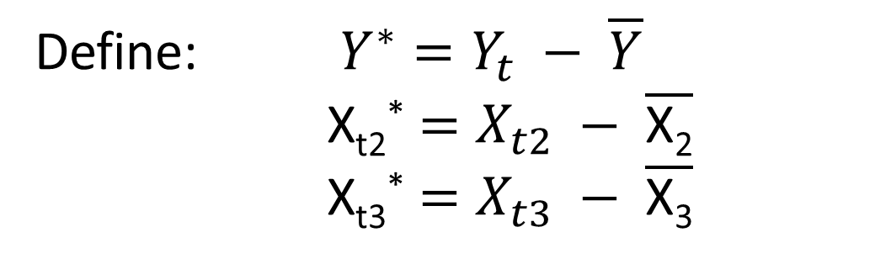
Least Squares Estimation
Define: $Y^{∗}=Y_{t} − \overline{Y}$
X_{t2}* $=X_{t2} − \overline{\text{X}\text{2}}$
X_{t3}* $=X_{t3} − \overline{\text{X}\text{3}}$

Slide 5
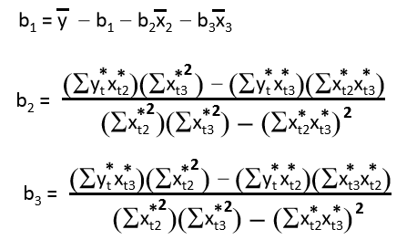
Least Squares Estimators

Slide 6
Example:
2 Independent Variables
A distributor of frozen desert pies wants to evaluate factors thought to influence demand
Dependent variable: Pie sales (units per week)
Independent variables: Price (in $)
  Advertising ($100’s)
Data are collected for 15 weeks

Slide 7
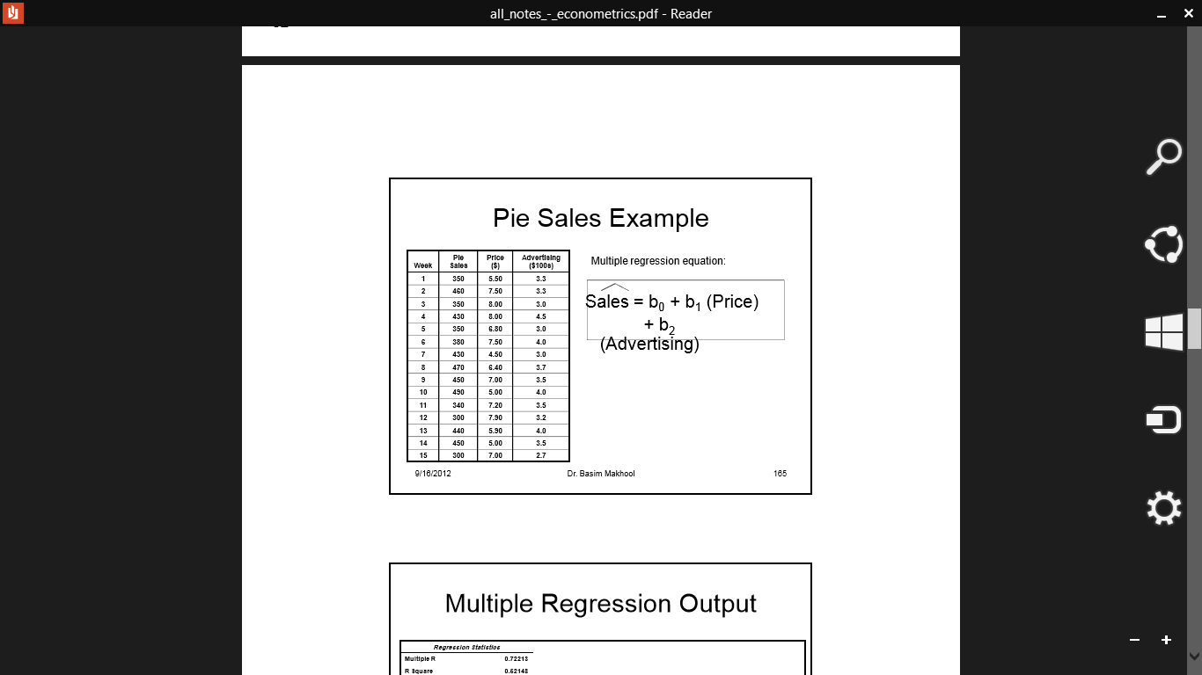
Pie Sales Example

Slide 8
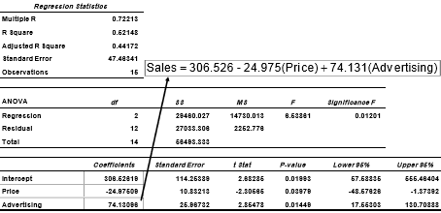
Multiple Regression Output

Slide 9
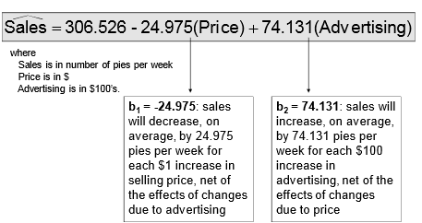
The Multiple Regression Equation

Slide 10
Interpreting the coefficients
Each slope is a partial slope indicating change in Y given 1 unit change in the respective explanatory variable keeping the other explanatory variables constant.
One cannot make decision on the relative importance of the different explanatory variables based on the partial slopes
In order to compare between variables, it has to be used in standardized form in the model
Coefficients then indicate change in Y for 1 standard deviation change in X variable
Relative effects of X variables can now be compared. Eg Is radio or tv advertising more effecting in promoting sales?

Slide 11
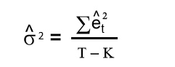
Error Variance Estimation
Unbiased estimator of the error variance:
Where :
T: sample size.
K: Number of independent variables.

Slide 12
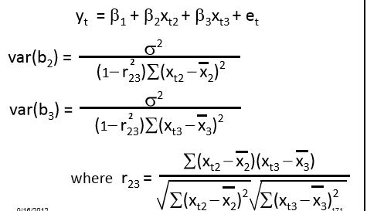
Variances

Slide 13
Variance Decomposition
The variance of an estimator is smaller when:
1. The error variance, σ², is smaller.
2. The sample size, T, is larger.
3. The variable’s values are more spread out.
4. The correlation between independent variables is close to zero.

Slide 14
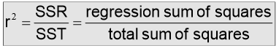
Coefficient of Multiple Determination
Reports the proportion of total variation in Y explained by all X variables taken together.

Slide 15
R-sq and Adjusted R-sq
Rsq is a non-decreasing function of the number of variables in the model
Rsq therefore cannot be compared of 2 models unless both have same no. of variables and also the dependent variable appears in both models in the same form
To enable comparison of Rsq of different models with different no.s of variables we use Adjusted R-sq
What is the net effect of adding a new variable?
  We lose a degree of freedom when a new X variable is added
  Did the new X variable add enough explanatory power to offset the loss of one degree of freedom?

Slide 16
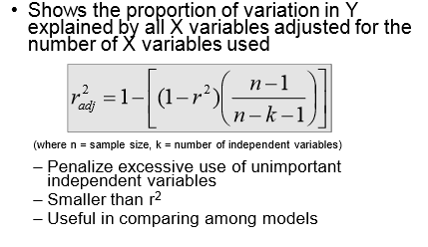
Adjusted R²

Slide 17
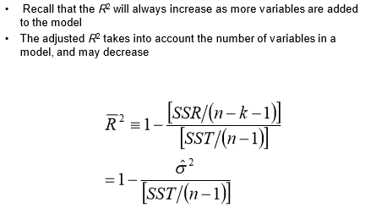
Adjusted R²

Slide 18
Adjusted R²
It’s easy to see that the adjusted R² is just (1 – R²)(n – 1) / (n – k – 1), but most packages will give you both R² and adj-R²
You can compare the fit of 2 models (with the same y) by comparing the adj-R²
You cannot use the adj-R² to compare models with different y’s (e.g. y vs. ln(y))

Slide 19
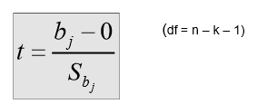
Are Individual Variables Significant?
Use t tests of individual variable slopes.
Shows if there is a linear relationship between the variable X_{j} and Y
Hypotheses:
  H₀: β_{j} = 0 (no linear relationship)
  H₁: β_{j} ≠ 0 (linear relationship does exist between X_{j} and Y)
  Test Statistic:

Slide 20
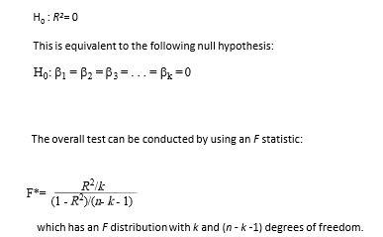
Test the overall significance of the model

