Slide 1
Mobile Apps
Introduction
Birzeit University, CS Dept, Mobile Software Development- Dr. Samer Zein

Slide 2
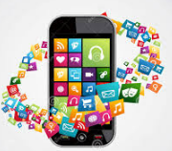
Overview
Mobile applications running on smartphone devices have become an indispensible part in people’s daily activities and modern life
For many people, smartphones have become an extension of themselves
Birzeit University, CS Dept., Mobile Software Development Course

Slide 3
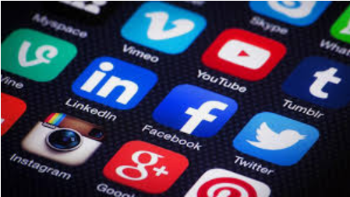
Overview..cont.
Studies have shown that people become anxious if they misplace their device, lose connectivity, or run low on battery
Great advancements in HW:
Faster CPUs
Larger Memories
More Accurate Sensors
Birzeit University, CS Dept., Mobile Software Development Course

Slide 4
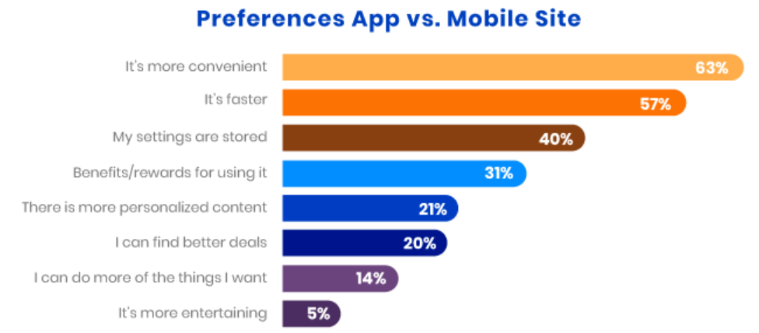
M-Sites vs Native Apps
Refs: buildfire.com
Birzeit University, CS Dept., Mobile Software Development Course

Slide 5
Overview
5.22 billion unique mobile users worldwide
218 billion apps downloaded in 2020
Estimates predict 258 billion downloads in 2022
Mobile applications, also known as apps, are software products developed to run on mobile devices, such as smartphones and tablets.
Smartphones technology as well as mobile apps are growing at steady pace, with no signs of slowing down in near future.
Source: TechCrunch
Birzeit University, CS Dept., Mobile Software Development Course

Slide 6
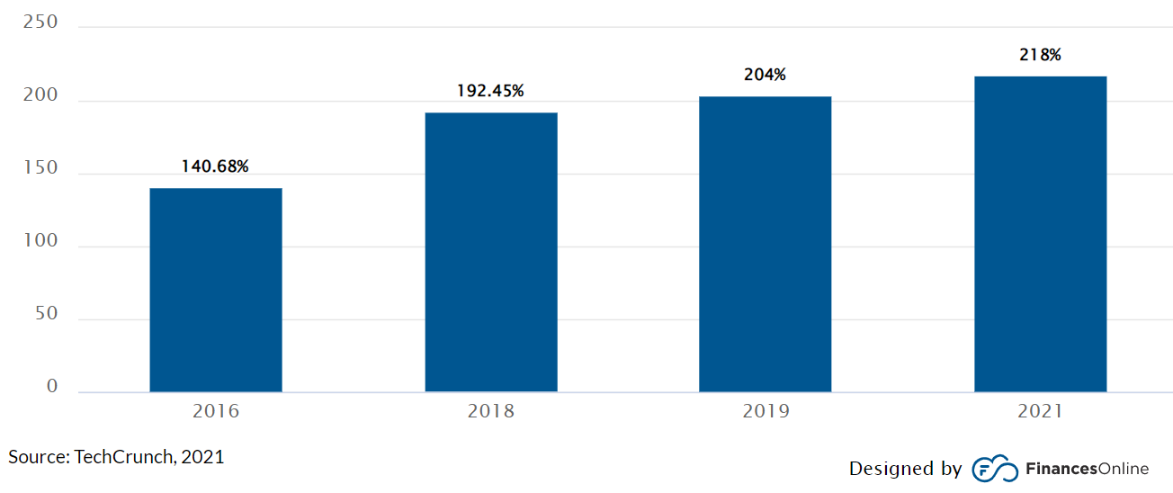
Global Mobile App Downloads 2016 - 2021
As of 2022:
Google Play has 3.5 million apps
Apple store has
2.2 millions apps
Source: Statista
Birzeit University, CS Dept., Mobile Software Development Course

Slide 7
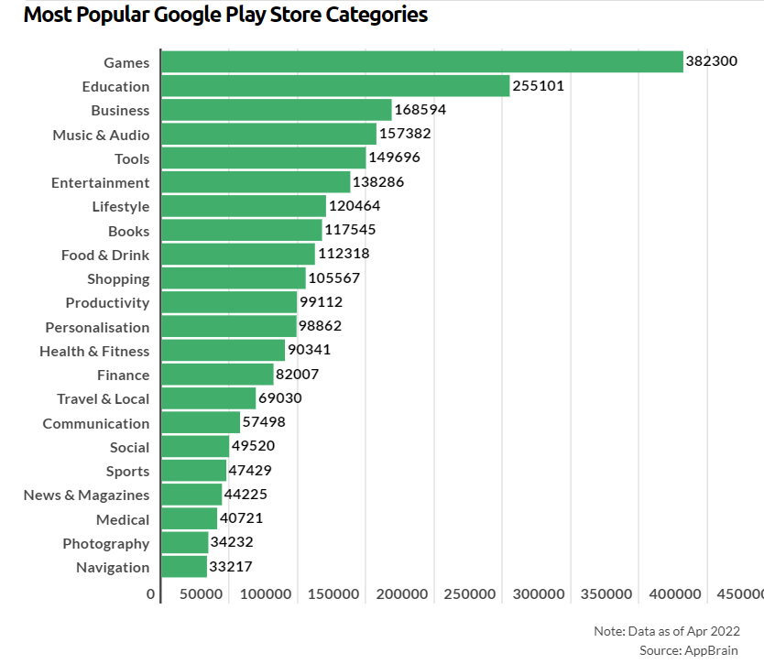
Popular apps
Birzeit University, CS Dept., Mobile Software Development Course

Slide 8
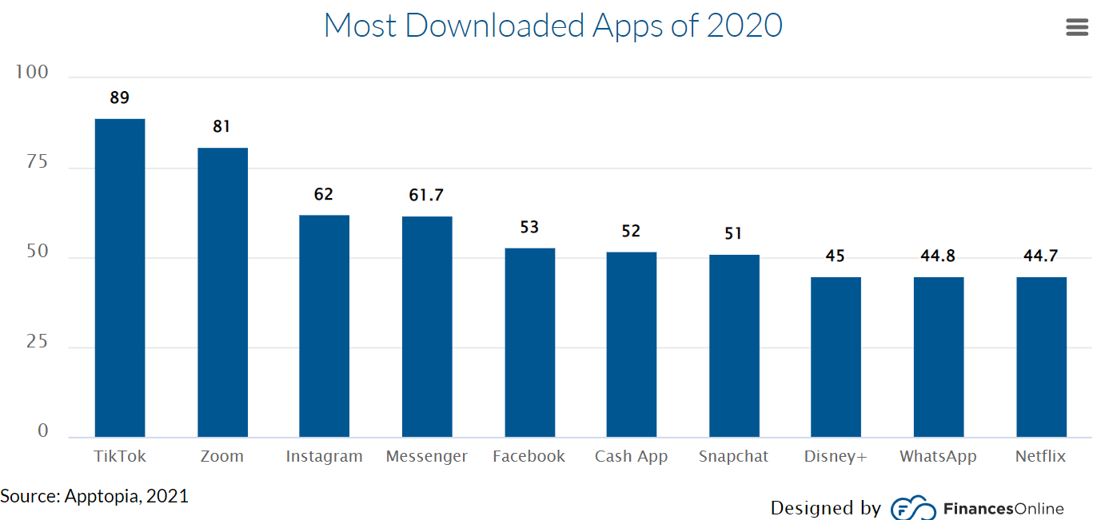
Paid vs Free Apps
Not surprisingly, the vast majority of global downloads are free. As a matter of fact, 98% of app revenue worldwide comes from free apps (Buildfire, 2021). Only a few are willing to pay for downloads.
Birzeit University, CS Dept., Mobile Software Development Course

Slide 9
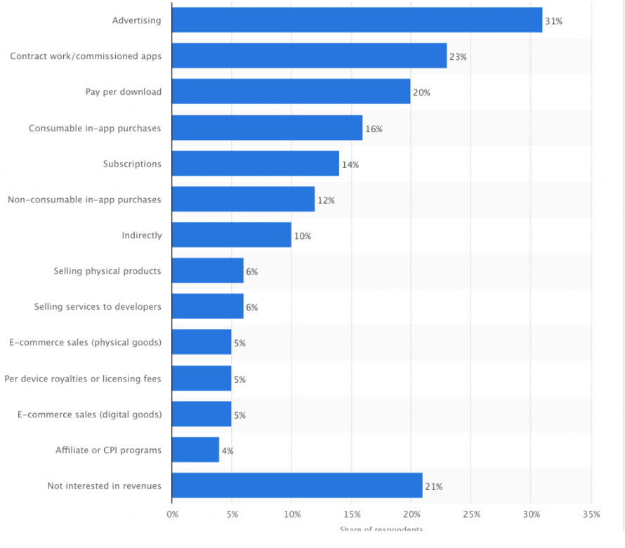
How do mobile apps make money?
Birzeit University, CS Dept., Mobile Software Development Course

Slide 10
Different than traditional web and desktop development?
A mobile application is more sophisticated and more complex than web applications because:
resource management,
data entry, sensors,
data storage,
and life cycle.
Furthermore, each operating system has its own set of development guidelines and a proprietary deployment model.
Birzeit University, CS Dept., Mobile Software Development Course

Slide 11


Mobile Sensors
Accelerometer: This sensor measures the acceleration of the device in three dimensions, which can be used to detect movement, orientation, and shaking. For example, the accelerometer is used to detect when the device is being tilted, which can be used to control the volume of music or to switch between apps.
Gyroscope: This sensor measures the rotation of the device in three dimensions, which can be used to detect changes in orientation, such as when the device is being turned or tilted. The gyroscope is often used in conjunction with the accelerometer to provide more accurate information about the device's motion.
Birzeit University, CS Dept., Mobile Software Development Course

Slide 12


Mobile Sensors..2
Magnetometer: This sensor measures the strength and direction of the magnetic field around the device. This can be used to determine the device's orientation, such as when it is being held in landscape or portrait mode. The magnetometer is also used in conjunction with the accelerometer and gyroscope to provide more accurate information about the device's motion.
Ambient light sensor: This sensor measures the amount of light in the environment around the device. This can be used to automatically adjust the brightness of the screen, so that it is easy to see in different lighting conditions.
Birzeit University, CS Dept., Mobile Software Development Course

Slide 13

Mobile Sensors..3
Proximity sensor: This sensor detects when the device is close to another object, such as when the user is holding the device up to their face to make a call. This can be used to turn off the screen to save battery power.
Barometer: This sensor measures the atmospheric pressure. This can be used to determine the altitude of the device, which can be useful for navigation apps.
GPS sensor: This sensor determines the location of the device using satellite signals. This can be used for navigation, location-based services, and augmented reality apps.
Birzeit University, CS Dept., Mobile Software Development Course

Slide 14
Mobile Sensors..4
Heart rate sensor: This sensor measures the heart rate of the user. This can be used to track fitness and health data.
Fingerprint sensor: This sensor scans the fingerprint of the user to authenticate their identity. This can be used to unlock the device, make payments, and access secure apps.
Birzeit University, CS Dept., Mobile Software Development Course

