Slide 1
Chapter 3, The Relational Model

Slide 2
Introduction to Relational Model
Codd proposed the relational data model in 1970.
  Prior to that, database systems were based on older data models (the hierarchical model and the network model); the relational model revolutionized the database ﬁeld and largely supplanted these earlier models
  Main idea was to organize data as groups of relations
  Each relation describes a group of objects with similar attributes
Student ID | Name | Major
1161234 | Ahmad | ENCS
1161455 | Noor | COMP
Course ID | CODE | Name
56478 | COMP333 | Database management Systems
56479 | COMP232 | Data Structures

Slide 3
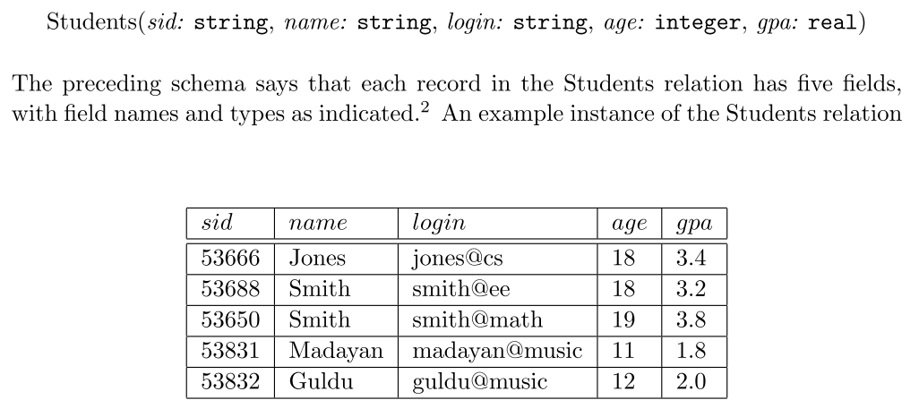
Relational data model example

Slide 4
Keys
A super key of an entity set is a set of one or more attributes whose values uniquely determine each entity.
A candidate key of an entity set is a minimal super key
  ID is candidate key of instructor
  course_id is candidate key of course
Although several candidate keys may exist, one of the candidate keys is selected to be the primary key.

Slide 5
Simplicity
The relational model is very simple and elegant; a database is a collection of one or more relations, where each relation is a table with rows and columns.
A DBMS permits the use of SQL to query, and manipulate data and relations in a database.

Slide 6
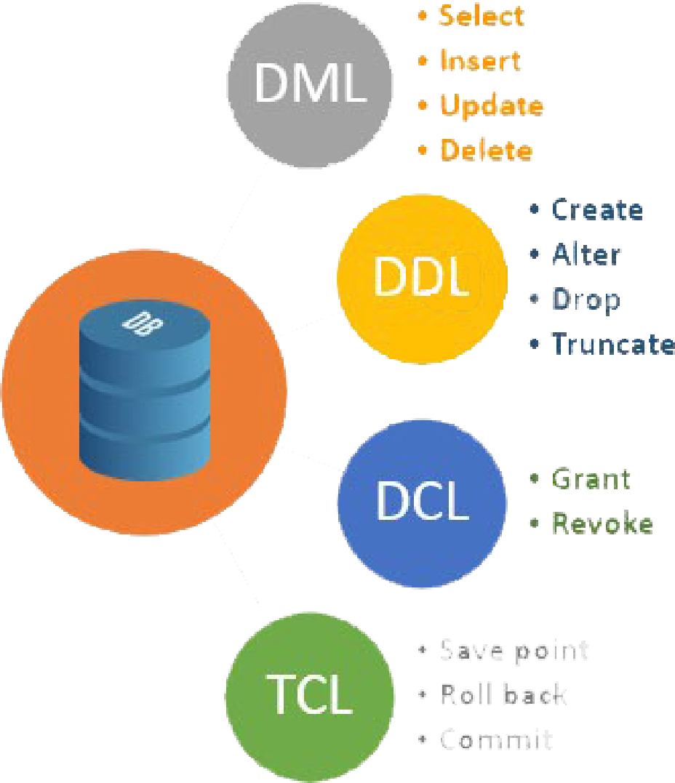
SQL
DBMS Supports Structured Query Language.
  Based on Relational Algebra
Composed of
  DDL
  DML

Slide 7
Main Constructs
The main construct in relational model is Relation
A Relation consist of:
  Schema
  Instance
There should be no redundant data (rows) inside a database
Degree: number of fields (attributes)
Cardinality: number of records (tuples)

Slide 8
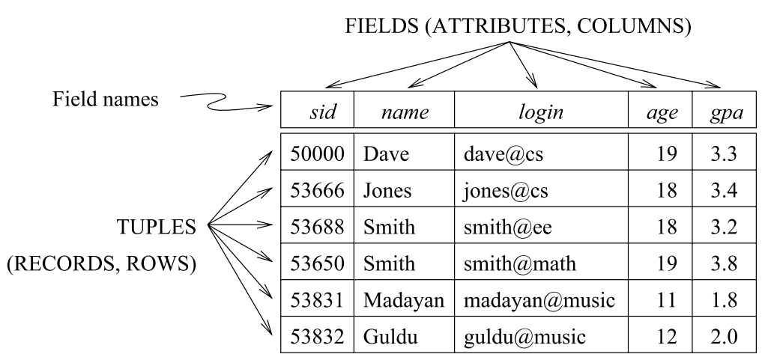
Example:

Slide 9
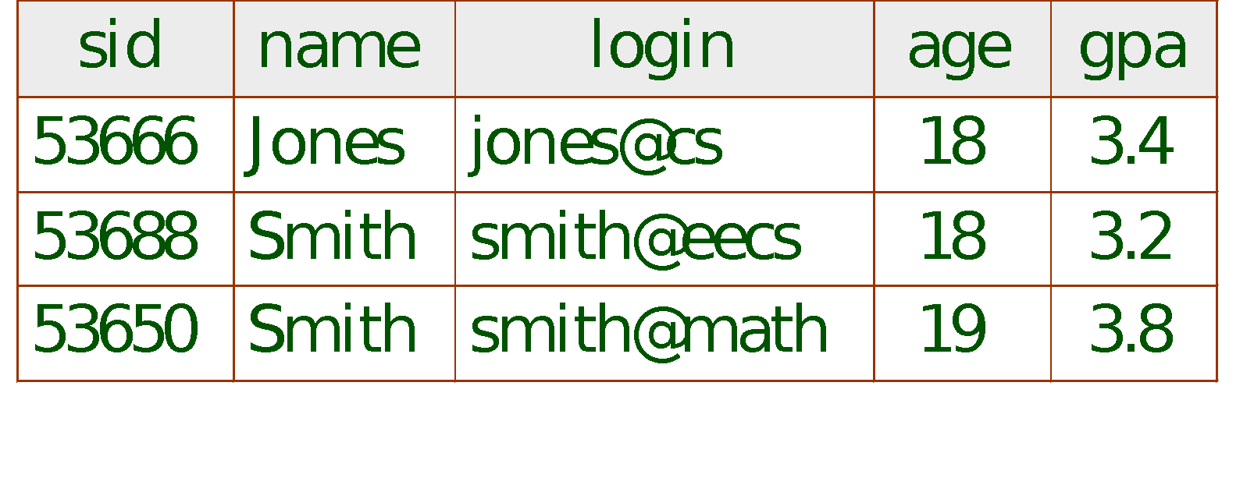
Example Instance of Students Relation
Cardinality = 3, degree = 5, all rows distinct
Do all columns in a relation instance have to
be distinct?
Notes:
4

Slide 10
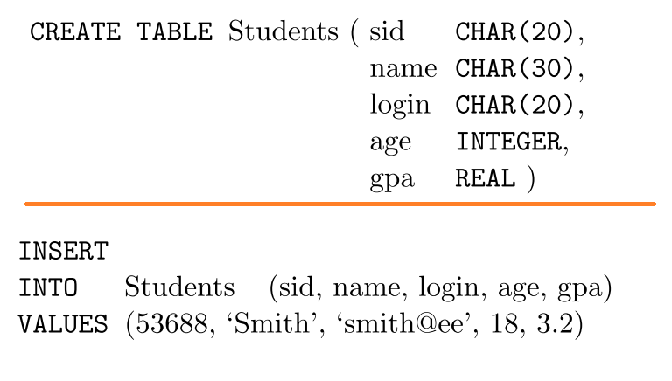
Example SQL

Slide 11
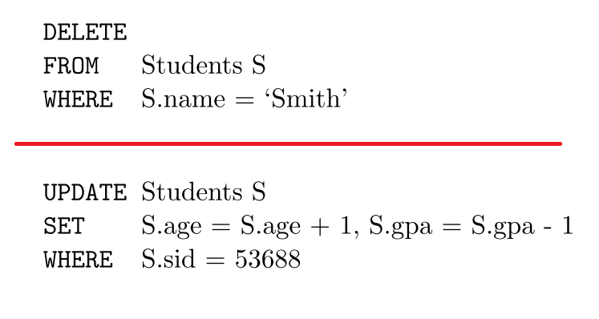
Example SQL..2

Slide 12

mySQL
We will be using mySql server
  Download from
  https://dev.mysql.com/downloads/mysql/
Must install a client to connect to server
  Best: mySql WorkBench

Slide 13
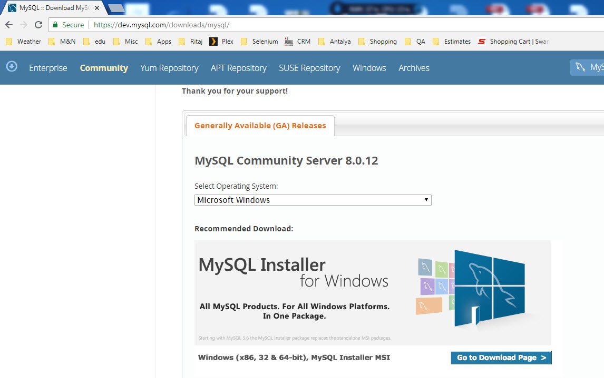

Slide 14
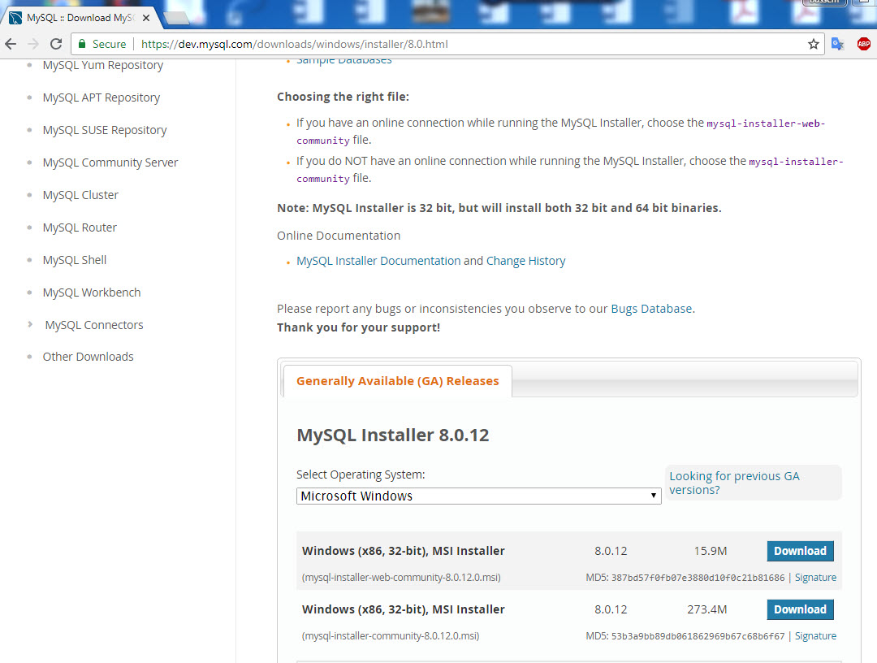

Slide 15
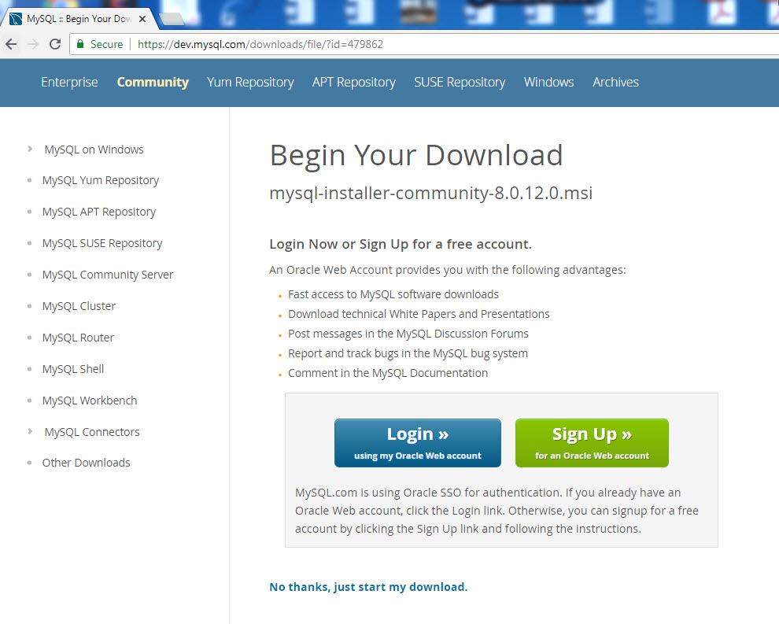

Slide 16


Slide 17
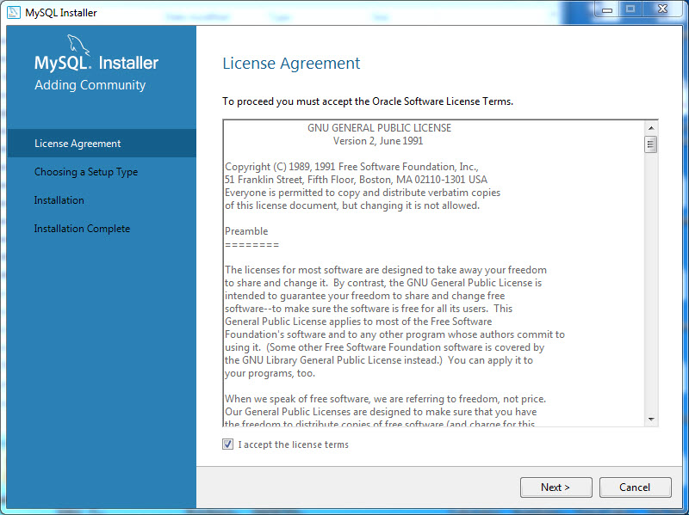

Slide 18
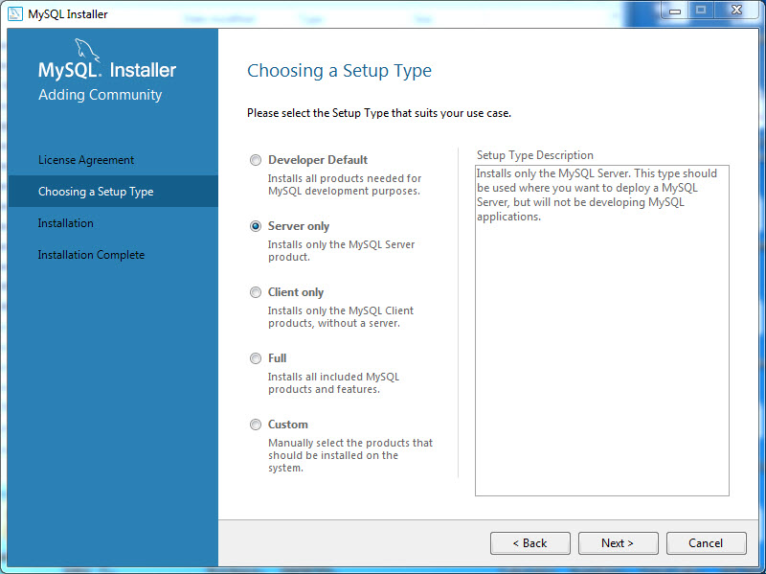

Slide 19
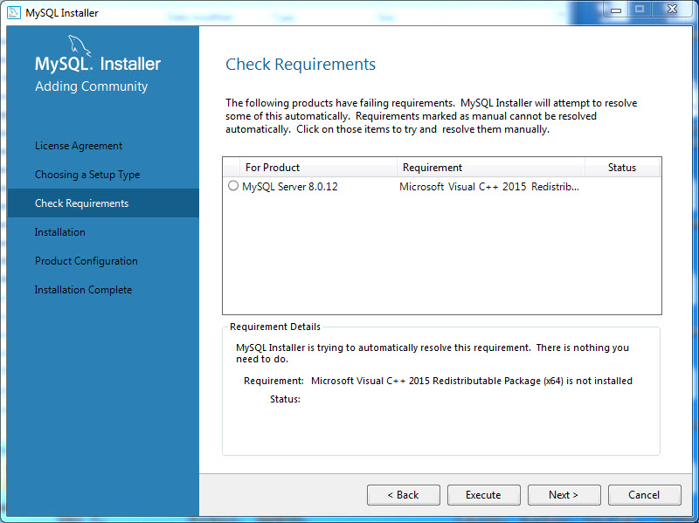

Slide 20


Slide 21
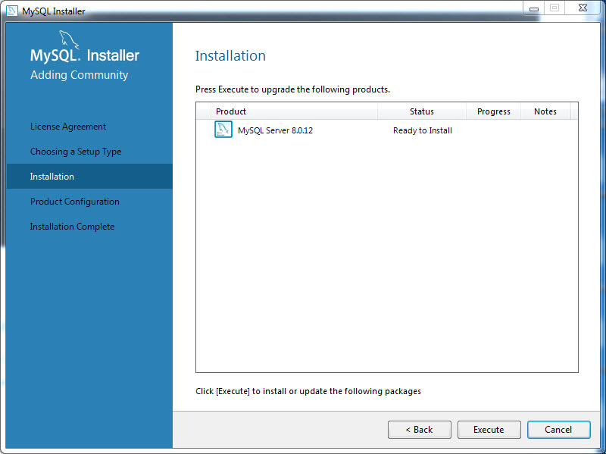

Slide 22
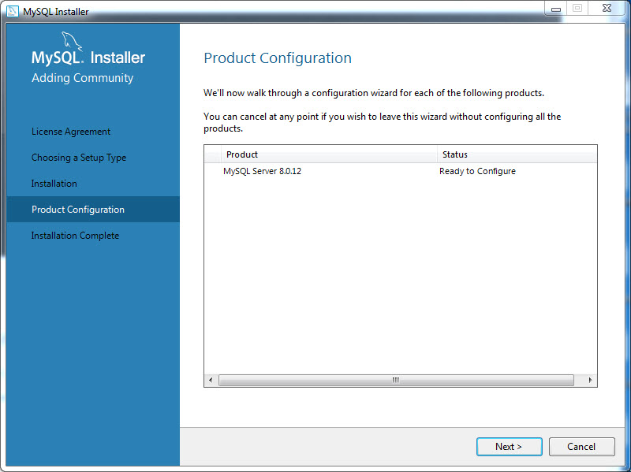

Slide 23
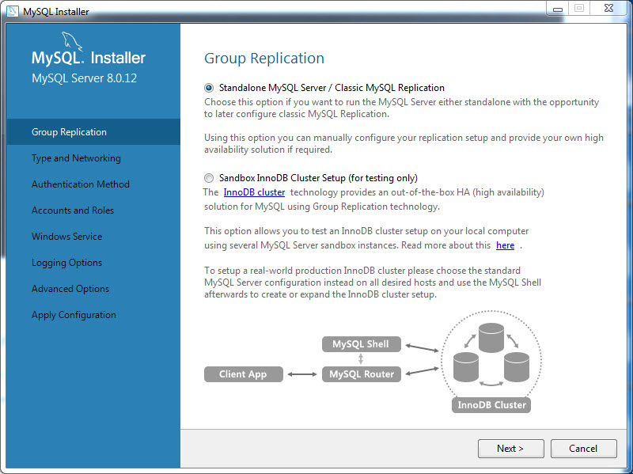

Slide 24
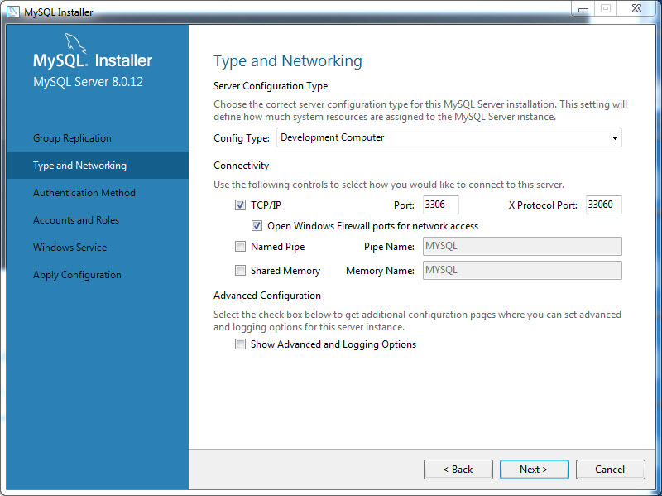

Slide 25
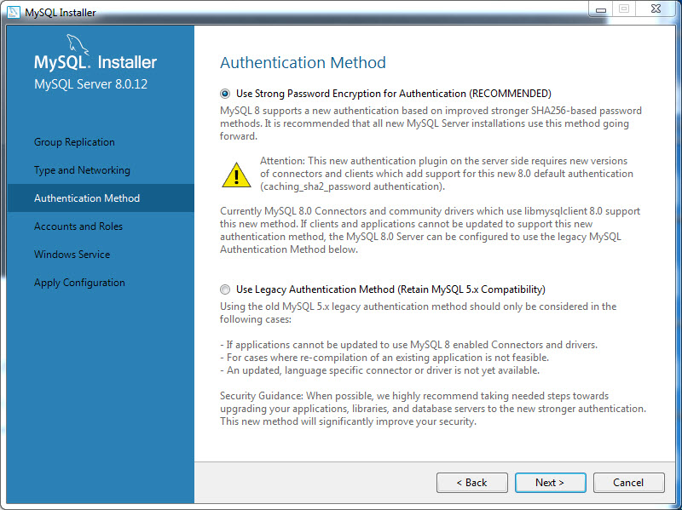

Slide 26
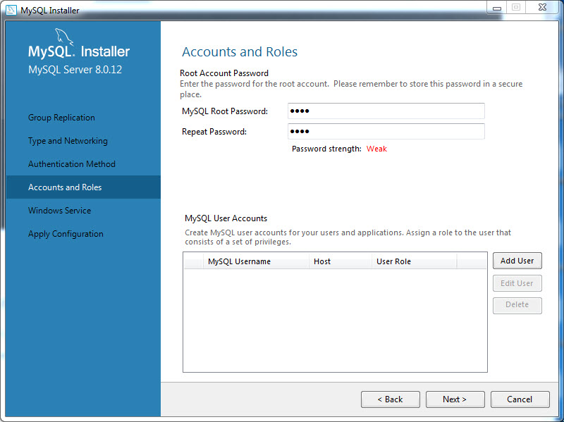

Slide 27
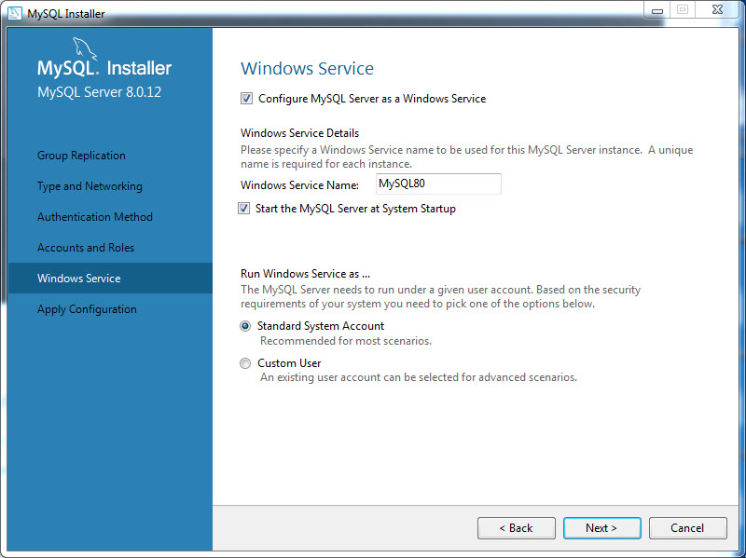

Slide 28
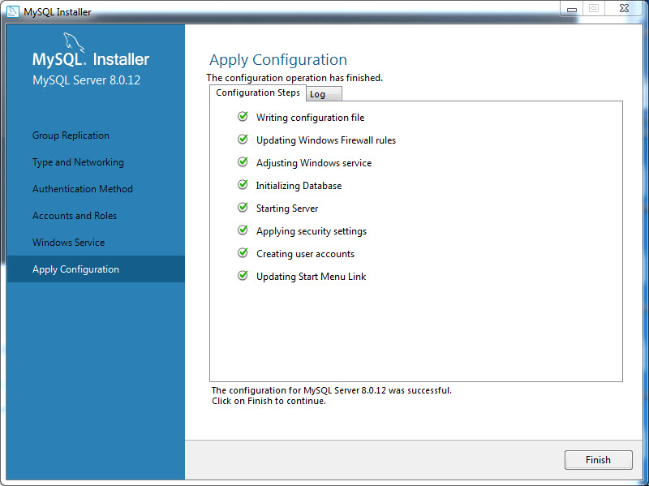

Slide 29
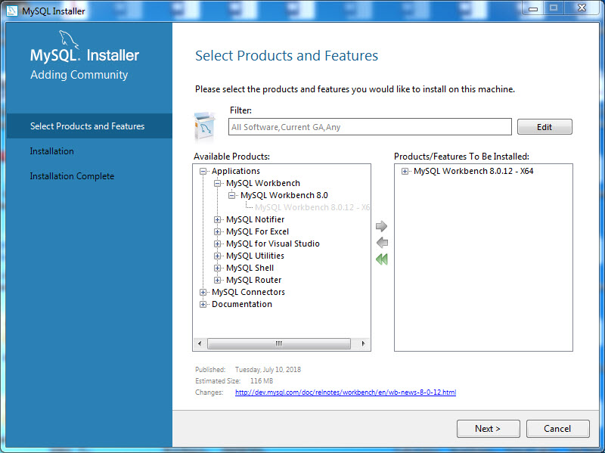

Slide 30
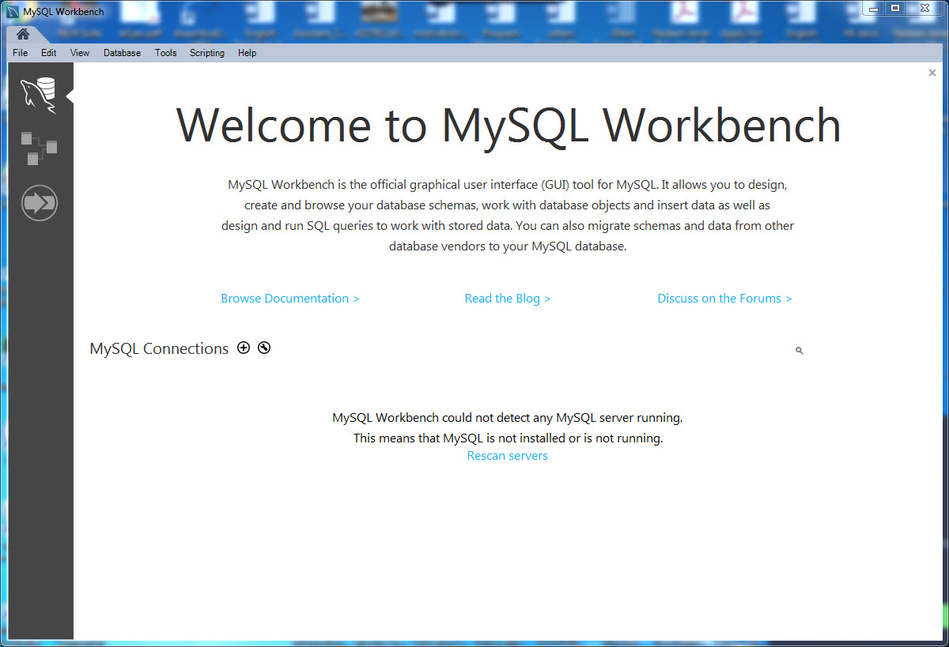

Slide 31
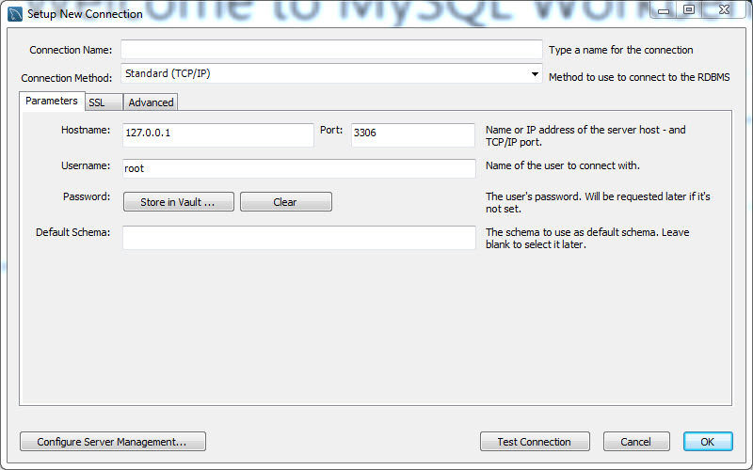

Slide 32
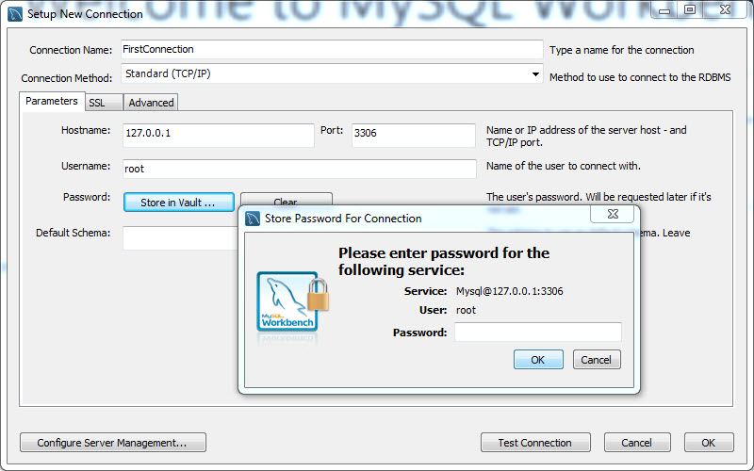

Slide 33
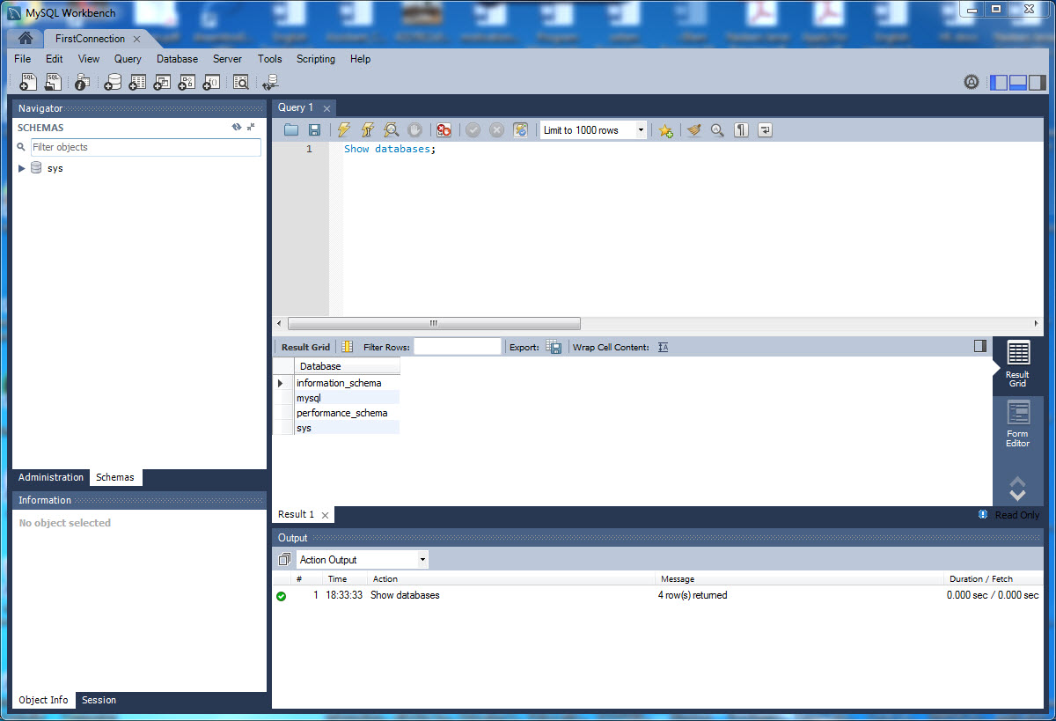

Slide 34
MySQL Basics – Data Definition
SHOW DATABASES;
CREATE DATABASE university;
SHOW DATABASES;
USE university;
DROP DATABASE university;

Slide 35
MySQL Basics
CREATE TABLE student (
sid INT,
sname VARCHAR(32),
bdate DATE,
gpa REAL,
PRIMARY KEY (sid));
SHOW TABLES;
SHOW CREATE TABLE student;
ALTER TABLE STUDENT ADD major VARCHAR(16);
ALTER TABLE STUDENT ADD phone VARCHAR(16) AFTER bdate;
DROP TABLE student;

Slide 36
MySQL Basics – Data Manipulation
Query:
SELECT *
FROM student;
INSERT INTO STUDENT VALUES (1051122, 'Ahmad', '1980-01-20', 99);
SELECT * FROM student;
INSERT INTO STUDENT (sid, sname) VALUES (1061122, 'Sireen’);
DELETE FROM student WHERE sid>=1060000 AND sid<=1069999;
Query:
SELECT sid, sname
FROM student
WHERE sname = ‘Ahmad’;

Slide 37
MySQL Basics – Auto increment
ALTER TABLE student MODIFY sid int auto_increment;
SELECT * FROM student;
INSERT INTO student (sname) VALUES ('Iyad');
ALTER TABLE student auto_increment=1070000;
INSERT INTO student (sname) VALUES ('Gabi');
ALTER TABLE student MODIFY gpa REAL DEFAULT 60;
SELECT * FROM student;
ALTER TABLE student MODIFY bdate DATE DEFAULT '1900-01-01';
INSERT INTO student (sname) VALUES ('Gabi');

Slide 38
MySQL Basics – Data Control
CREATE USER 'user1'@'localhost' IDENTIFIED BY ‘password';
GRANT ALL PRIVILEGES ON university.* TO 'user1'@'localhost' WITH GRANT OPTION;
CREATE USER 'user1'@'%' IDENTIFIED BY ‘password';
GRANT ALL PRIVILEGES ON university.* TO 'user1'@'%' WITH GRANT OPTION;
CREATE USER 'user2'@'localhost' IDENTIFIED BY ‘password2';
GRANT SELECT ON university.* TO 'user2'@'localhost' WITH GRANT OPTION;
CREATE USER 'user2'@'%' IDENTIFIED BY ‘password2';
GRANT SELECT ON university.* TO 'user2'@'%' WITH GRANT OPTION;

Slide 39
Integrity Constraints Over Relations
A database is only as good as the information stored in it, and a DBMS must therefore help prevent the entry of incorrect information.
An integrity constraint (IC) is a condition that is speciﬁed on a database schema, and restricts the data that can be stored in an instance of the database.
We already have seen the Domain Constraints

Slide 40
Key Constraints
A key constraint is a statement that a certain minimal subset of the ﬁelds of a relation is a unique identiﬁer for a tuple.
Two Important Note:
  Two distinct tuples in a legal instance cannot have identical values in all the ﬁelds of a key.
  No subset of the set of ﬁelds in a key is a unique identiﬁer for a tuple.
Primary Key, Candidate Key, and Super key

Slide 41
Keys (continued)
Composite key
  Composed of more than one attribute
Key attribute
  Any attribute that is part of a key
Superkey
  Any key that uniquely identifies each row
Candidate key
  A superkey without redundancies

Slide 42
Keys (continued)
Nulls:
  No data entry
  Not permitted in primary key
  Should be avoided in other attributes
  Can represent
    An unknown attribute value
    A known, but missing, attribute value
    A “not applicable” condition
  Can create problems when functions such as COUNT, AVERAGE, and SUM are used
  Can create logical problems when relational tables are linked

Slide 43
SQL for Data Definition: CREATE with CONSTRAINT
Creating database tables with PRIMARY KEY constraints
  The SQL CREATE TABLE statement
  The SQL CONSTRAINT keyword
  CREATE TABLE Employee(
  EmpID Integer Not Null,
  EmpName Char(25) Not Null,
  PRIMARY KEY (EmpID)
  );

Slide 44
SQL for Data Definition: CREATE with CONSTRAINT
Creating database tables with composite primary keys using PRIMARY KEY constraints
  The SQL CREATE TABLE statement
  The SQL CONSTRAINT keyword
  CREATE TABLE Emp_Skill (
  EmpID Integer Not Null,
  SkillID Integer Not Null,
  SkillLevel Integer,
  PRIMARY KEY (EmpID, SkillID)
  );

Slide 45
Keys for Relationship Sets
The combination of primary keys of the participating entity sets forms a super key of a relationship set.
  (s_id, i_id) is the super key of advisor
  NOTE: this means a pair of entity sets can have at most one relationship in a particular relationship set.
    Example: if we wish to track multiple meeting dates between a student and her advisor, we cannot assume a relationship for each meeting. We can use a multivalued attribute though
Must consider the mapping cardinality of the relationship set when deciding what are the candidate keys
Need to consider semantics of relationship set in selecting the primary key in case of more than one candidate key

Slide 46
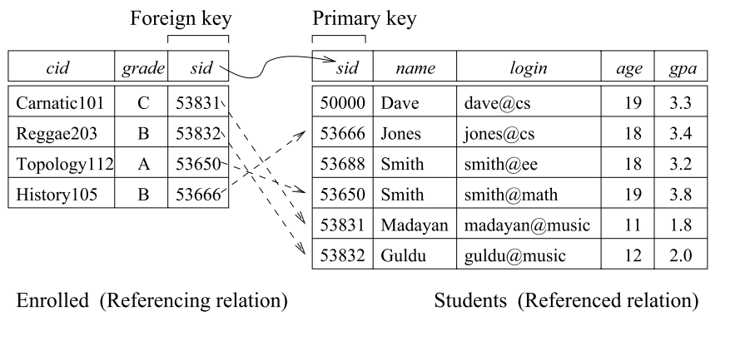
Foreign Key Constraints

Slide 47
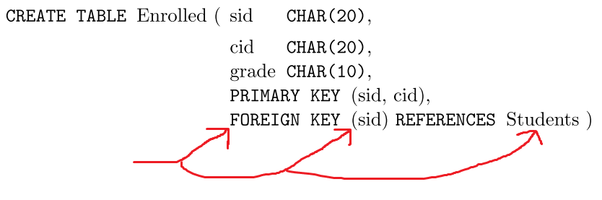
Specifying Foreign Keys
Foreign Key (sid) References Students(sid)
Foreign Key (cid) References Course(cid));

Slide 48
Foreign Key Example
Department
DeptID
DeptName
Location
Employee
EmpID
DeptID
EmpName
Primary Key
Foreign Key

Slide 49
Referential Integrity
Referential integrity states that every value of a foreign key must match a value of an existing primary key
For example (see previous slide)
  If EmpID = 4 in EMPLOYEE has a DeptID = 7 (a foreign key), a Department with DeptID = 7 must exist in DEPARTMENT

Slide 50
SQL for Data Definition: CREATE with CONSTRAINT
Creating database tables using PRIMARY KEY and FOREIGN KEY constraints
  The SQL CREATE TABLE statement
  The SQL CONSTRAINT keyword
  CREATE TABLE Emp_Skill (
  EmpID Integer Not Null,
  SkillID Integer Not Null,
  SkillLevel Integer,
  PRIMARY KEY (EmpID, SkillID),
  FOREIGN KEY (EmpID) REFERENCES Employee (EmpID),
  FOREIGN KEY (SkillID) REFERENCES Skill (SkillID)
  );

Slide 51
SQL for Data Definition: CREATE with CONSTRAINT
Creating database tables using PRIMARY KEY and FOREIGN KEY constraints
  The SQL CREATE TABLE statement
  The SQL CONSTRAINT keyword
  ON UPDATE CASCADE and ON DELETE CASCADE
  CREATE TABLE Emp_Skill (
  EmpID Integer Not Null,
  SkillID Integer Not Null,
  SkillLevel Integer,
  PRIMARY KEY (EmpID, SkillID),
  FOREIGN KEY (EmpID)
  REFERENCES Employee (EmpID)
  ON DELETE CASCADE,
  FOREIGN KEY (SkillID)
  REFERENCES Skill (SkillID)
  ON UPDATE CASCADE
  );
When the row of EmpID (primary key) in Employee TABLE is deleted, the EmpFK (foreign key) is deleted also.

Slide 52
Deleting Database Objects: DROP
To remove unwanted database objects from the database, use the SQL DROP statement
Warning… The DROP statement will permanently remove the object and all data
    DROP TABLE Employee;

Slide 53
Enforcing Integrity Constraints
Deletion of Enrolled tuples do not violate referential integrity, but insertions could.
  Inserting a tuple with an un-exist sid in Students.
Insertion of Students tuples do not violate referential integrity, but deletions could.
INSERT INTO Enrolled (sid, cid, grade) VALUES (51111, ‘Hindi101’, ‘B’);

Slide 54
Ways to handle foreign key violations
If an Enrolled row with un-existing sid is inserted, it is rejected.
If a Students row is deleted/updated,
  Option 1: Delete/Update all Enrolled rows that refer to the deleted sid in Students (CASCADE). Both are affected
  Option 2: Reject the deletion/updating of the Students row if an Enrolled row refers to it (NO ACTION ). [The default action for SQL]. None is affected.
  Option 3: Set the sid of Enrolled to some existing (default) sid value in Students for every involved Enrolled row (SET NULL / SET DEFAULT ). Both are affected.

Slide 55
Referential Integrity in SQL
When a Students row is deleted, all Enrolled rows that refer to it are to be deleted as well.
When a Students sid is modified, the update is to be rejected if an Enrolled row refers to the modified Students row.
CREATE TABLE Enrolled
(sid CHAR(20),
cid CHAR(20),
grade CHAR(2),
PRIMARY KEY (sid,cid),
FOREIGN KEY (sid)
REFERENCES Students (sid)
ON DELETE NO ACTION
ON UPDATE CASCADE);
Notes:
14
3.3

Slide 56
SQL Constraints
NOT NULL constraint
  Ensures that column does not accept nulls
UNIQUE constraint
  Ensures that all values in column are unique
DEFAULT constraint
  Assigns value to attribute when a new row is added to table
    CUS_AREACODE CHAR(3) DEFAULT ‘615’ NOT NULL
    CHECK (CUS_AREACODE IN (‘615’, ‘713’, 931’))

Slide 57
ER to Relational Model - Entities
Entity sets to tables:
  Attributes to columns
CREATE TABLE Employees
(ssn CHAR(11),
name CHAR(20),
lot INTEGER,
PRIMARY KEY (ssn))
name
ssn
lot
Employees

Slide 58
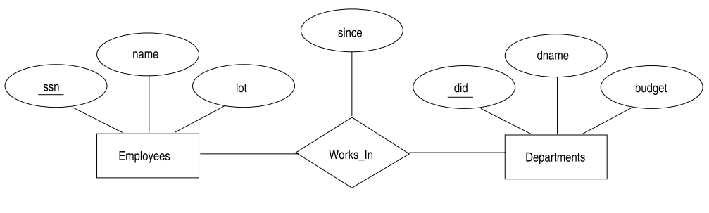
ER to Relational Model - Relationships
Since | Ssn | did
1/1/2019 | 1 | 2
1/1/2018 | 1 | 1
1/5/2020 | 2 | 3
CREATE TABLE EMP ….
CREATE TABLE DEPT …
CREATE TABLE works_in (
since date,
ssn_emp int,
did_dept int
primary key (ssn_emp, did_dept),
Foreign key (ssn_emp) references emp(ssn),
Foreign key (did_dept) references dept(Did));
Relationship Sets to Tables
  Attributes to columns
In translating a relationship set to a relation, attributes of the relation must include:
  Keys for each participating entity set (as foreign keys).
    This set of attributes forms a key for the relation.

Slide 59
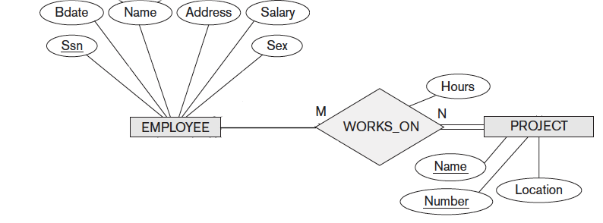
ER to Relational Model - Relationships
EMP (SSN: int primary key, name: varchar(32), etc…)
PROJ (Number: int primary key, Name: varchar(32), etc..)
CREATE TABLE EMP2PROJ (SSN int, Proj_num int not null, Hours int,
PRIMARY KEY (SSN, Proj_num),
Foreign Key (SSN) References EMP(SSN),
Foreign Key (Proj_num) References PROJ(Number));

Slide 60
Relationship Types to Relational Model
Possible cardinality ratio: 1:1, 1: N, N:1, and N:M
Easiest is N:M
  Every Entity is a relation
  Every Relationship is a relation
1
owns
1
Owner
Car
N
owns
1
Owner
Car
N
owns
M
Owner
Car

Slide 61
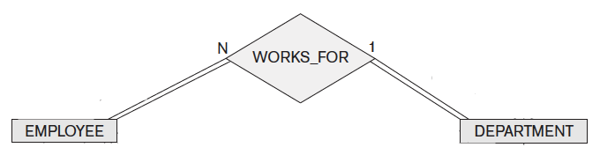
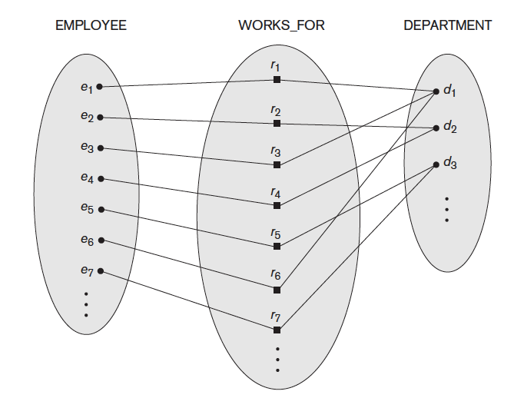
One-to-Many
Start with Each Entity as a relation
  EMP(eid: int, name: varchar(32), etc..)
  DEPT(did: int, dname: varchar(32), etc..)
Relationship needs special care on the 1-1 side
  Especially if total participation
Relationship must be merged with Emp
Result:
  EMP_works(eid: int,
  name: varchar(32)
  rank int,
  salary real,
  did: int not null,
  primary key(eid),
  foreign key (did) references DEPT(did))
  Replaces employee table
  Replaces works_for table

Slide 62
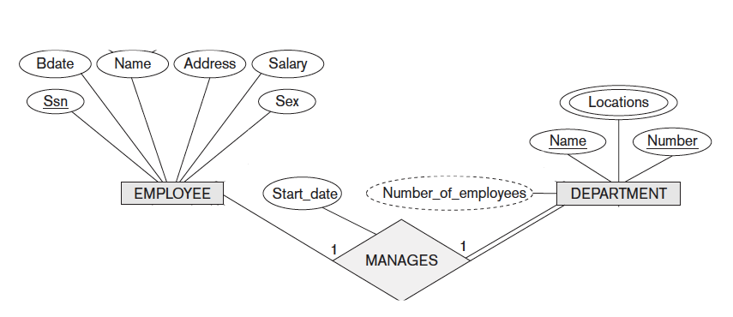
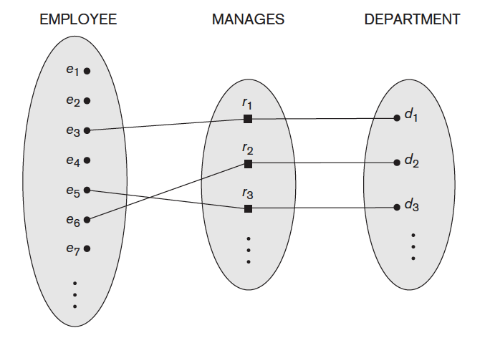
One-to-One
Start with Each Entity as a relation
  EMP(eid: int, name: varchar(32), etc..)
  DEPT(did: int, dname: varchar(32), etc..)
Relationship needs special care on the 1-1 side
  Especially if total participation
Relationship must be merged with DEPT
Result:
  DEPT( did int,
  name varchar(32),
  stdate date,
  mgr_ssn: int not null,
  primary key(did),
  foreign key (mgr_ssn)
  references EMP(eid));
  Dept_locations
  ( did int,
  Location int,
  Primary key( did, location),
  Foreign key (did) references dept(did));

Slide 63
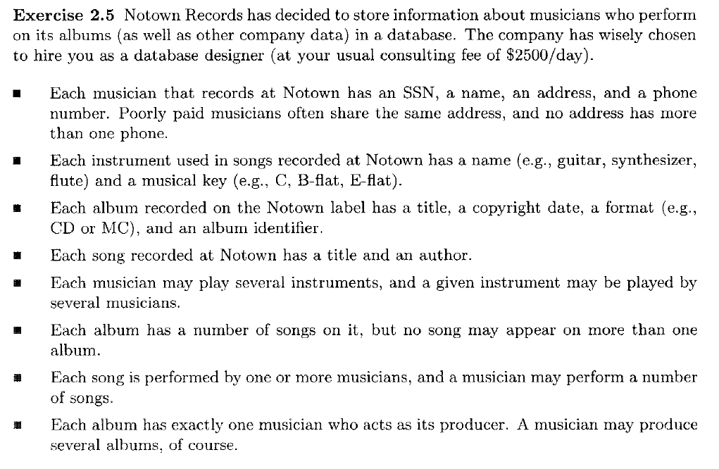
Musicians Example

Slide 64
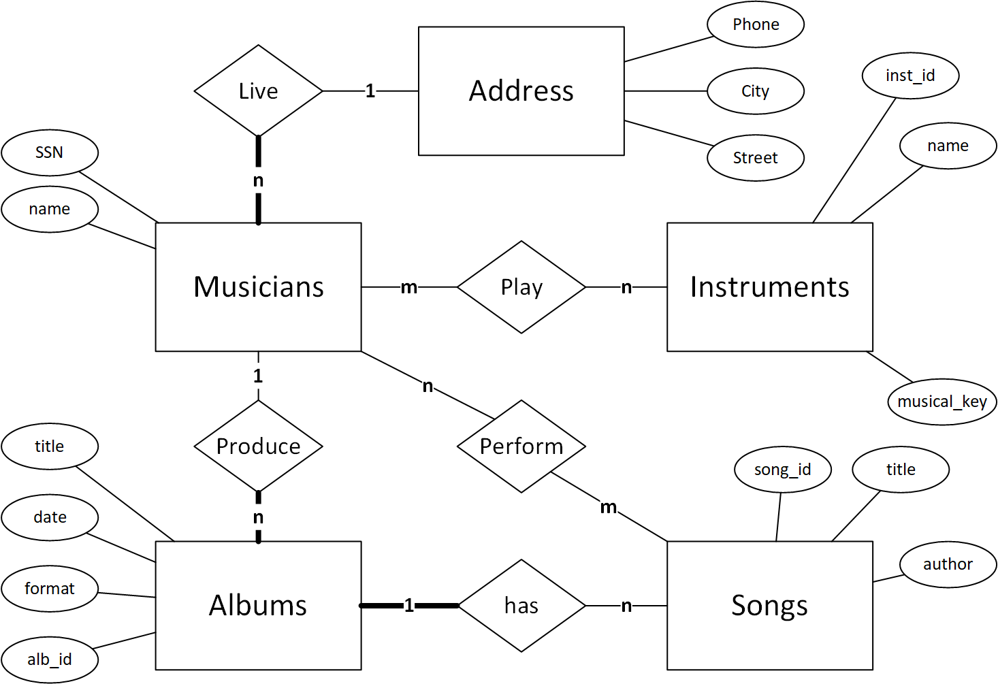
Create Table Address ( Phone int primary key, City varchar(16), Street varchar(32));
CREATE TABLE Musicians (Ssn int primary key,
Name char(32), Phone int,
Foreign key(phone) references Address(phone));
Create table instruments(Inst_id int primary key, Name varchar(32), Musical_key varchar(32));
Create table Mus2Inst( ssn int, inst_id int,
Primary key(ssn, inst_id),
Foreign key (ssn) references musicians(ssn),
Foreign key (inst_id) references instruments(inst_id));
Create table albums (alb_id int primary key, Prod_ssn int,
A_date date, format varchar(32), Title varchar(32),
Foreign key (prod_ssn) references musicians(ssn));
Create table Songs (song_id int primary key, title varchar(32), author varchar(32),
Alb_id int, foreign key (alb_id) references albums(alb_id));
Create table Mus2Songs(ssn int, song_id int, primary key (ssn, song_id),
Foreign key (ssn) References Musicians(ssn),
Foreign key (song_id) references Songs(song_id));

Slide 66
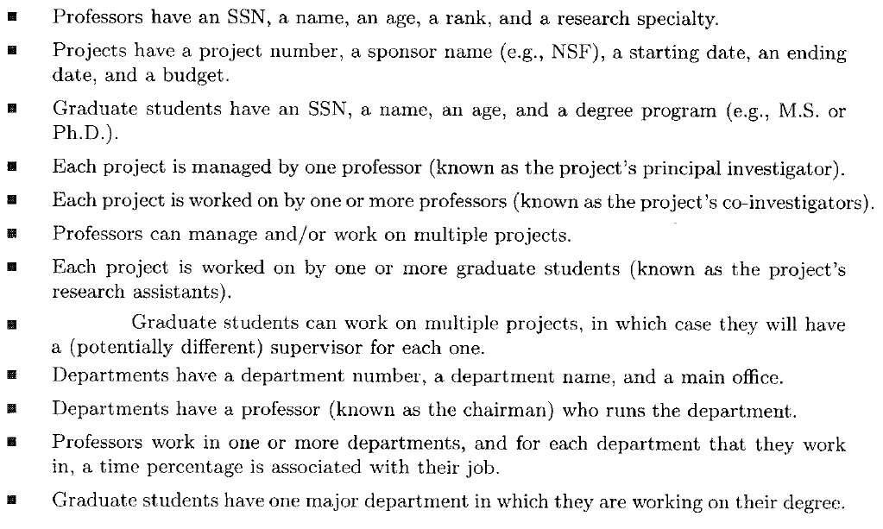
University Example

Slide 67
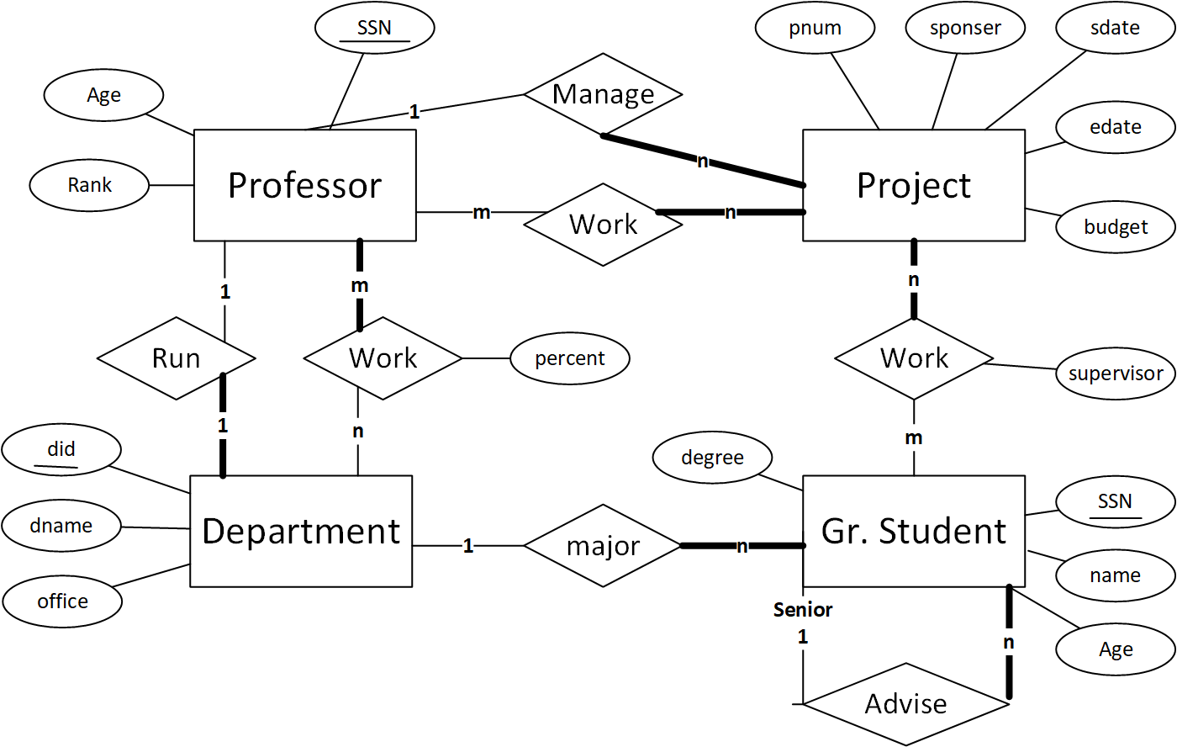
Create Table Prof(ssn int primary key, age int, rank int);
CREATE TABLE run_Dept (did int primary key, office varchar(32),
dname varchar(32), mgr_ssn int,
Foreign key(mgr_ssn) references Prof(ssn));
Create table Prof2DeptW( did int, ssn int, percent int,
Primary key(did, ssn),
Foreign key (ssn) references Prof(ssn),
Foreign key (did) references run_Dept(did));
Create table Proj(pnum int primary key, sponser varchar(32), sdate date,
Edate date, budget real, mgr_ssn int,
Foreign key (mgr_ssn) references Prof(ssn));
Create table Prof2ProjW(pnum int, ssn int, Primary key(pnum, ssn),
Foreign key (ssn) references Prof(ssn),
Foreign key (pnum) references Proj(pnum));
Create table gStudent(ssn int primary key, name varchar(32), age int,
degree varchar(32), senior_ssn int, major_did int,
Foreign key (major_did) references run_Dept(did));
Create table Student2ProjW(pnum int, ssn int, Primary key(pnum, ssn), supervisor varchar(32),
Foreign key (ssn) references gStudent(ssn), Foreign key (pnum) references Proj(pnum));

Slide 68
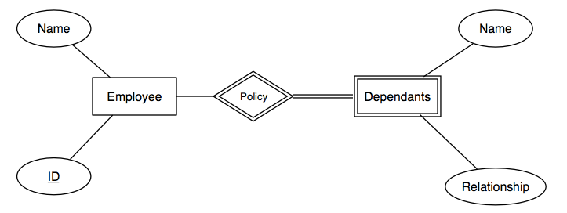
Relational Model for Weak Entity Sets
Start with Each Entity as a relation
  EMP(eid: int, name: varchar(32), etc..)
  Dependents(Name: varchar(32), relationship: varchar(32), etc..)
Weak Relationships needs special care
Relationship must be merged with Dependents
Dependents(Name: Varchar(32),
  Relationship: Varchar(32),
  emp_id: int not null,
  Primary key (emp_id*, Name),
  Foreign Key (emp_id)
  References EMP(eid)
  on delete cascade)

Slide 69
Relational Model for Recursive Relationships
EMP (employeeNo int primary key,
employeeName varchar(32),
ManagerSSN int))
employeeNAME
employeeNO
1
EMPLOYEE
1
manage
Empno | Emp name | Mgr_ssn
1 | Ahmad | -1
2 | Dania | 1

Slide 70
Relational Model for Class Hierarchies
name
ssn
lot
Just Hourly_Emps and Contract_Emps.
  Hourly_Emps: ssn, name, lot, hourly_wages, hours_worked.
  Each employee must be in one of these two subclasses.
Employees
hourly_wages
hours_worked
ISA
contractid
Hourly_Emps
Contract_Emps
General approach:
  3 relations: Employees, Hourly_Emps and Contract_Emps.
    Hourly_Emps: Every employee is recorded in Employees. For hourly emps, extra info recorded in Hourly_Emps (hourly_wages, hours_worked, ssn); must delete Hourly_Emps tuple if referenced Employees tuple is deleted).
    Queries involving all employees easy, those involving just Hourly_Emps require a join to get some attributes.

