Slide 1

Mechatronics System Design
Chapter 4: Motors Selection Criteria
Instructor: Dr. Ahmad Al-Balasie
First Semester - 2021/2022

Slide 2
4.1 Introduction
There are several types of continuous-drive actuators:
DC Motors.
DC Servomotors.
AC Induction Motors.
AC Synchronous Motors.
Permanent Magnet Synchronous Motors.
Hydraulic and Pneumatic Motors
Linear Actuators (electromagnetic, hydraulic, electromechanical ...)

Slide 3
4.2 Actuator Selection
One of the most critical decisions the mechatronics engineering designer has to make is the selection of the type and size of motor required for the mechatronic system.
The actuator system is the part that executes the requirements of the controller in the plant. It receives a signal from the controller (called the control signal) and send an output power signal (e.g. force, torque, heat power, pressure) to the plant. In order to do this, it needs a source of power, such as electrical power or pressure (e.g. hydraulic or pneumatic).

Slide 4
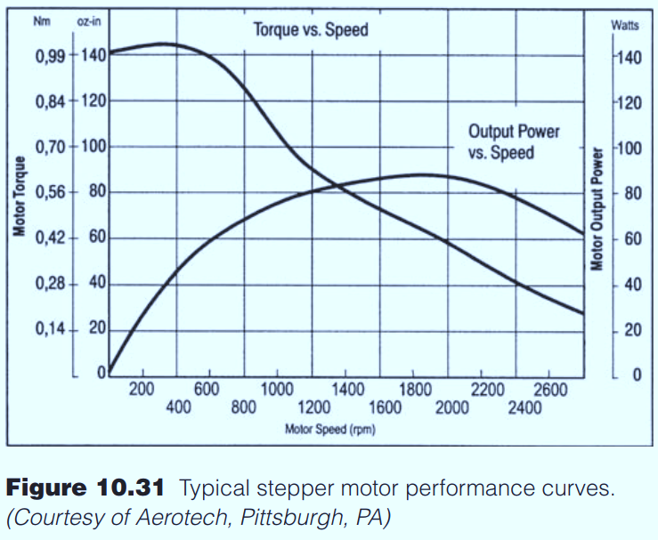
4.2 Actuator Selection
One of the most important issue is to select the proper motor. This is achieved by looking to the Torque –Speed curve and answering the following questions

Slide 5
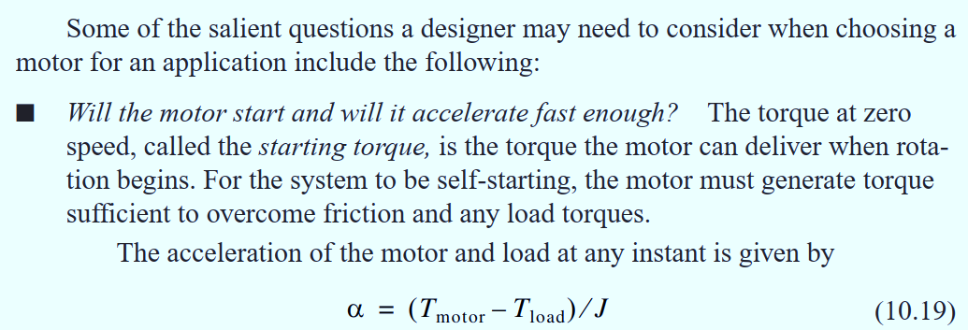
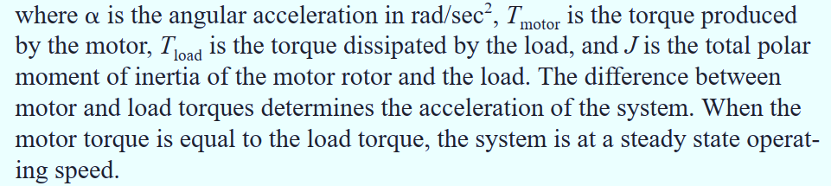
4.2 Actuator Selection

Slide 6
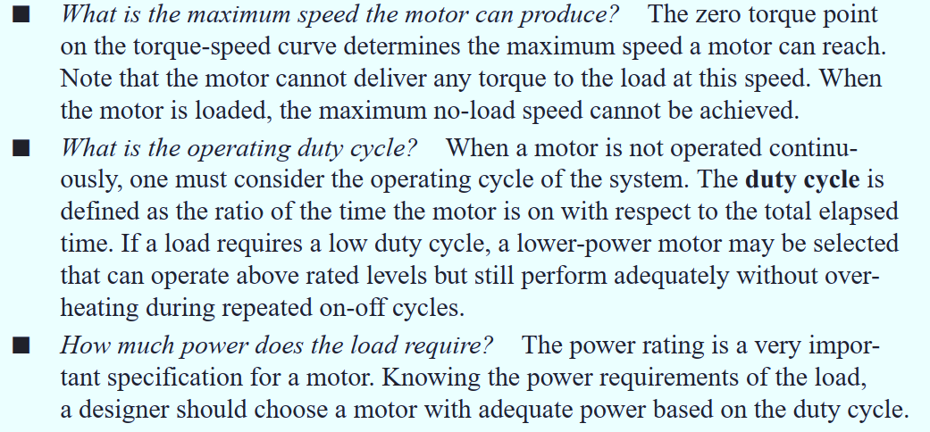
4.2 Actuator Selection

Slide 7
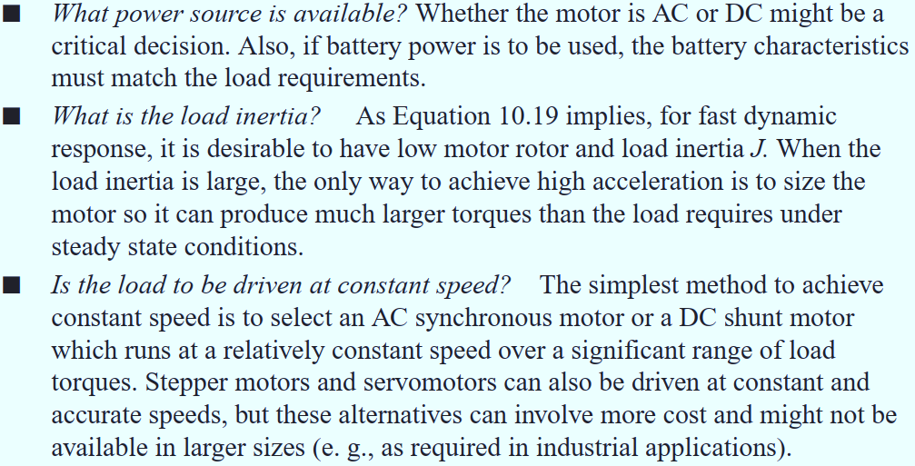
4.2 Actuator Selection

Slide 8
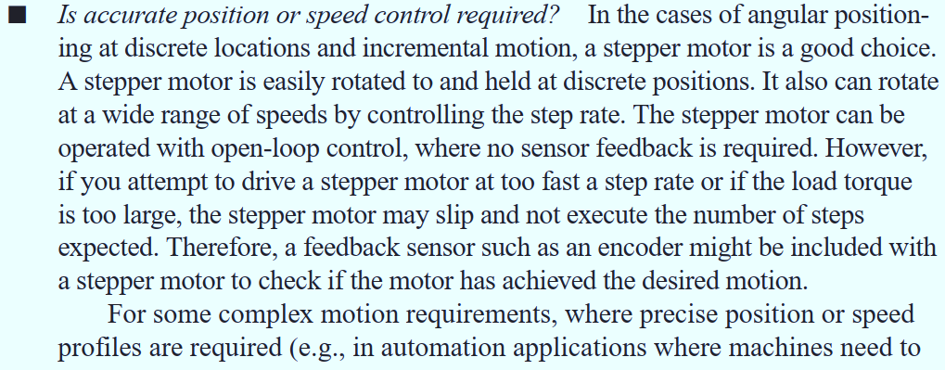
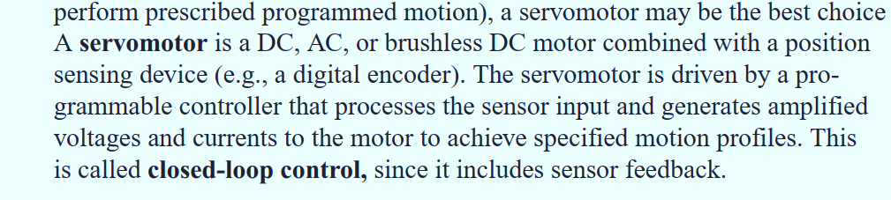
4.2 Actuator Selection

Slide 9
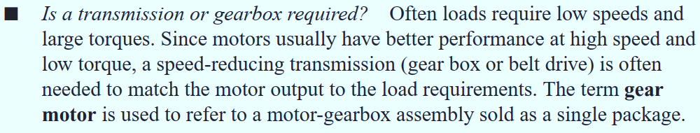
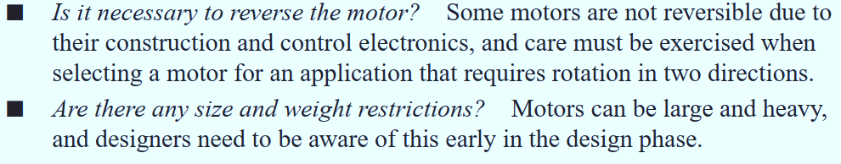
4.2 Actuator Selection

Slide 10
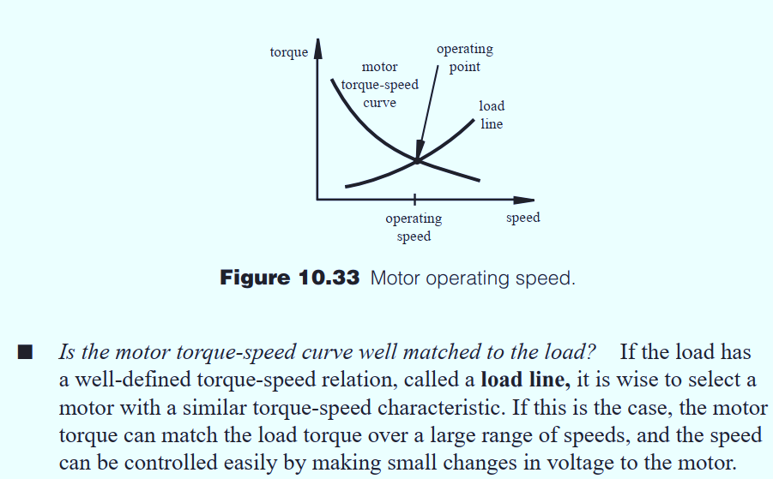
4.2 Actuator Selection

Slide 11
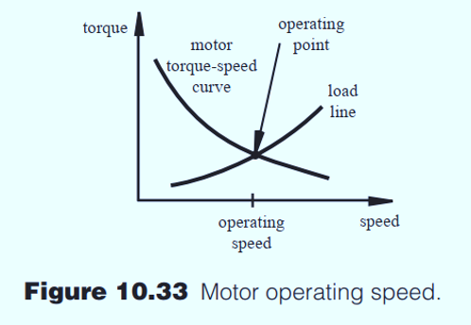
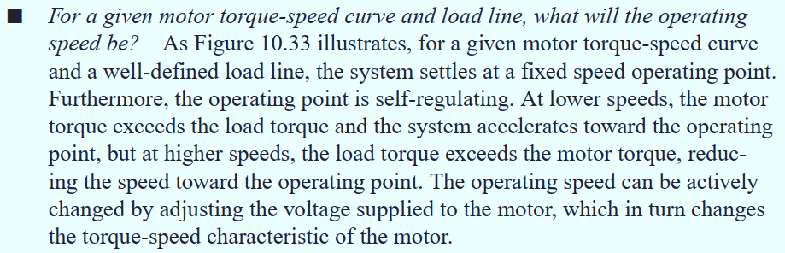
4.2 Actuator Selection

Slide 12
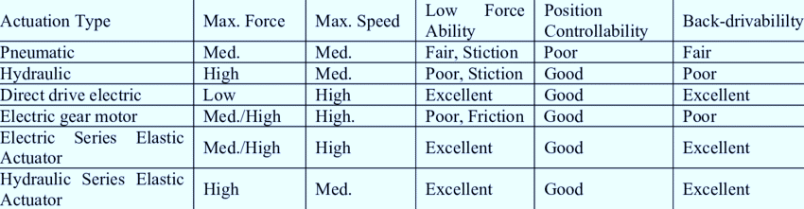
4.3 Comparison between various Actuators
The table below provides a comparison between the different types of motor along with their characteristics.

Slide 13
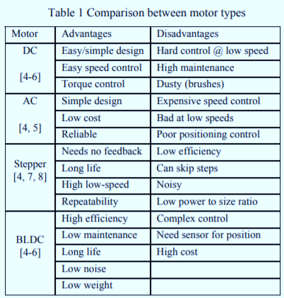
4.3 Comparison between various Motors

Slide 14
4.4 Components of the Actuator System
Variable speed drive: This is an optional component. It is usually built using power electronic devices.
Usually variable speed drives used today are either of the variable voltage type or variable frequency. The PWM technique (pulse width modulation) method is useful in order vary the effective voltage or current while still switching a device fully on and off.
2. The actuator: It is the main device that converts electrical energy to
mechanical energy.
Actuators can be classified in terms of their movement as:
Linear: The movement must be in a straight line.
Rotary: The movement must be rotational.
We can also classify the actuator in accordance with its method of operation as follows:
Electromagnetic: This includes rotatory AC and DC motor, as well as linear permanent magnetic actuators.

Slide 15
4.4 Components of the Actuator System
Pneumatic and Hydraulic: These are normally linear.
Piezo electric and magneto strictive: These usually operate a very small strokes/displacements(micro-actuators).
3. Mechanical Drive: This is also an optional component, and is placed at the
output of the actuator, in order to convert the output mechanical energy to
a suitable form (e.g. increase the torque, reduce speed and convert rotary
movement into linear movement).
These are a number of disadvantages to using a mechanical drive
They generate extra noise.
They cause losses and reduce efficiency.
They wear with use.
They take up extra space.
Mechanical drives are usually used for the following reasons:
Convert rotary motion to linear motion and vice versa.
Increase torque or force and reduce speed.

Slide 16
4.5 Examples
For the following systems, what is the most suitable rotary electromagnetic actuator to use? Explain the reasons for your decision. Use the following five criteria for actuator selection: power/torque value (large/small); positioning accuracy; speed range (e.g.,20 : 1); duty cycle; requirement for feedback.:
Quad-rotor (light weight with four propellers fitted to each motor).
In this case the power required from the motor is very small. Large speeds are required and thus the most suitable motor is a brushless dc motor. Positioning accuracy is not a requirement. The speed can be varied widely with a brushless dc motor, and this achieves different levels of thrust.

Slide 17
4.5 Examples
Passenger elevator that carries 8 passengers and runs at a speed of 1.6 m/s.
The power requirement in this case is large (around 5 kW ). Usually a squirrel cage induction motor is used. There is a need for feedback and this is achieved by using an incremental shaft encoder fitted to the non-drive end (NDE) of the motor. The motor is controlled using a variable frequency drive in order to allow the speed to be varied and to increase the positioning accuracy during stopping and starting.

Slide 18
4.5 Examples
3. 3D printer.
In this case, the positioning accuracy is very important and the power is low. So it is suitable to use a stepper motor (or two stepper motors to control two axes). Feedback is not required and it is assumed that the carriage will move to the required position. It is likely that the stepper motors will drive lead-screws.
4. Electrical passenger car that carries four people and runs at a speed of 100 km/h.
In this case the power is large, so we could either use a squirrel cage induction motor or a permanent magnet DC motor. It is customary to use a permanent magnet DC motor with a variable speed drive (e.g., chopper) fed from the battery in order to vary the torque and the speed. Shaft encoders can be fitted to the four motors to provide feedback. The DC motor offers a wide speed range.

Slide 19
4.5 Examples
5. A motor that will raise and lower a very heavy drawbridge on a river.
In this case the power is very high, there is no need for feedback from the motor and there is no need to vary the speed. So a squirrel cage induction motor driven by a soft starter is the most suitable motor. The soft-starter is used to reduce the starting shock and vibration and in order to reduce the starting current. The feedback is provided by the position of the bridge using limit roller switches. The motor in this case is suitable for the harsh industrial environment.
6. A limestone crushing mill that rotates at a speed of 5 rpm and contains 3000 kg of limestone.
In this case the power is very large and there is no need to vary the speed. So a direct-on-line squirrel cage induction motor is used with a large gearing ratio (as the speed of the crushing mill is very low: 5 rpm). The motor in this case is suitable for the harsh industrial environment.

Slide 20
DC Motor Sizing

Slide 21
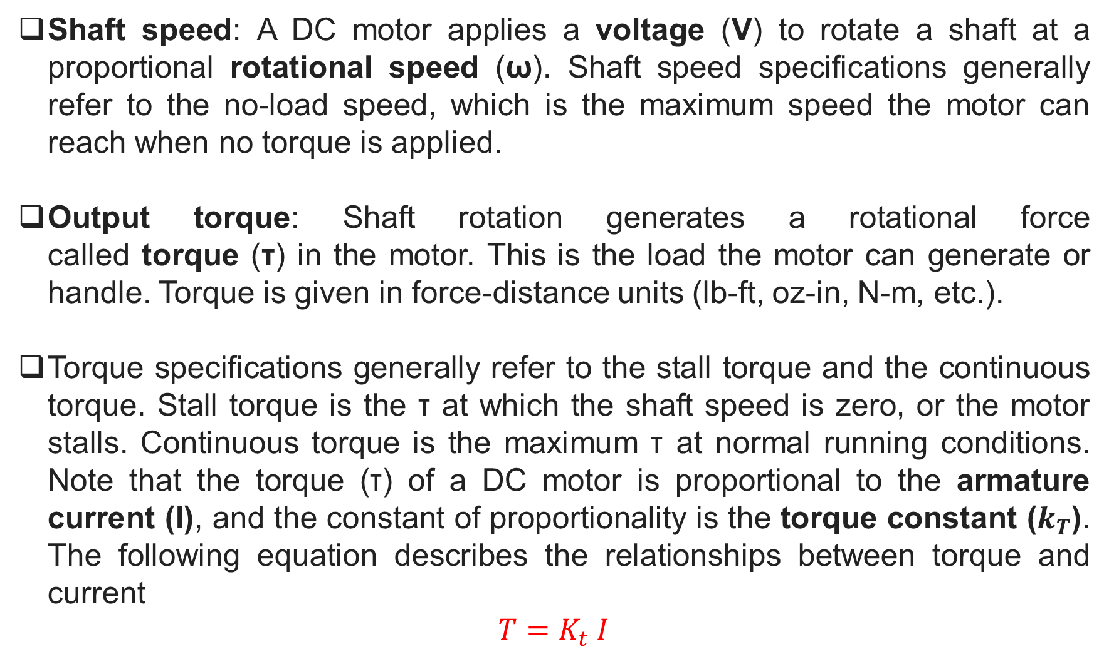
Shaft speed: A DC motor applies a voltage (V) to rotate a shaft at a proportional rotational speed (ω). Shaft speed specifications generally refer to the no-load speed, which is the maximum speed the motor can reach when no torque is applied.
Output torque: Shaft rotation generates a rotational force called torque (τ) in the motor. This is the load the motor can generate or handle. Torque is given in force-distance units (lb-ft, oz-in, N-m, etc.).
Torque specifications generally refer to the stall torque and the continuous torque. Stall torque is the τ at which the shaft speed is zero, or the motor stalls. Continuous torque is the maximum τ at normal running conditions. Note that the torque (τ) of a DC motor is proportional to the armature current (I), and the constant of proportionality is the torque constant ($k_{T}$). The following equation describes the relationships between torque and current
$$T=K_{t} I$$

Slide 22
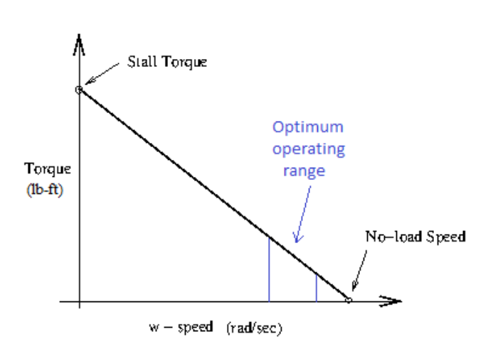
Available voltage: DC motors may be designed to operate at a specified voltage if only a small or specific range of power supplies is available. The specified voltage determines the motor's rated speed. Generally, voltage is given in volts (V).

Slide 23
Servo Motor Sizing

Slide 24
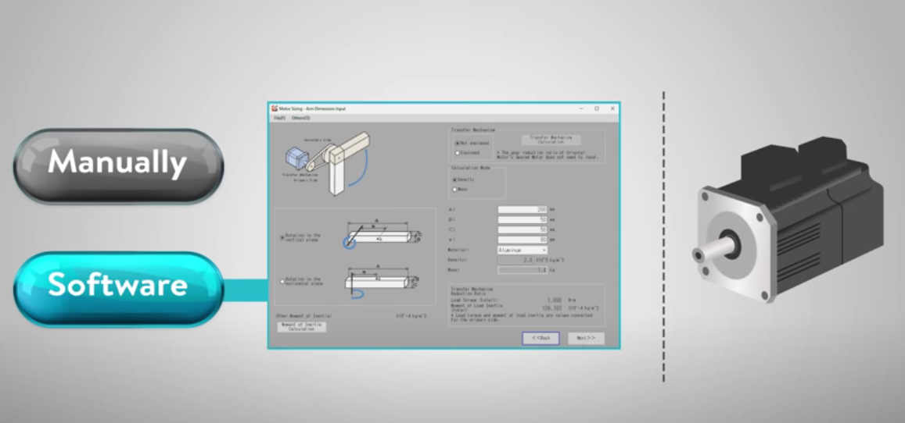
Size the motor by software or manual?

Slide 25
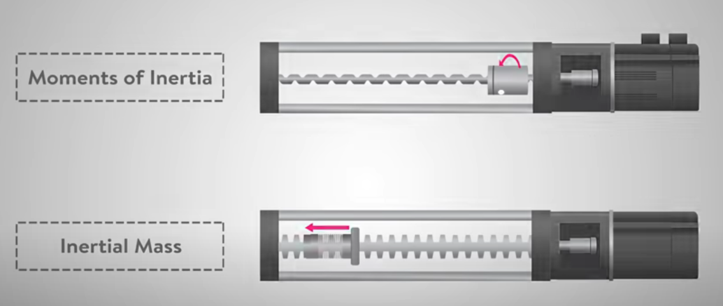

Moment of inertia for rotational motion $\sum{M=J_{total}α}$
Inertial Mass for linear motion $\sum{F=ma}$

Slide 26
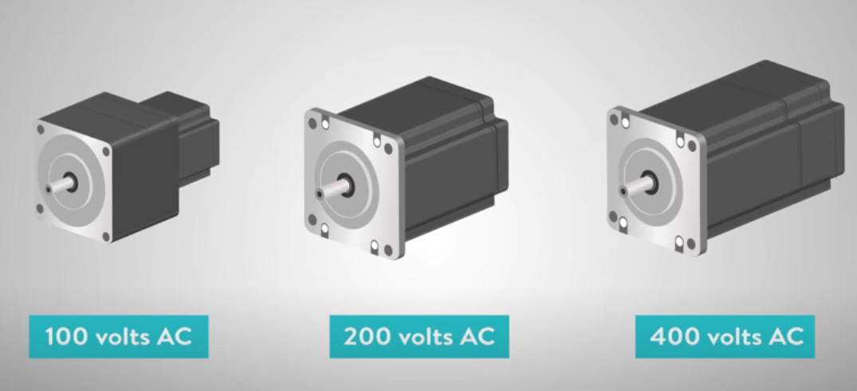
3 phases vs 1 phase
220 volts vs 110 volts for single phase

Slide 27
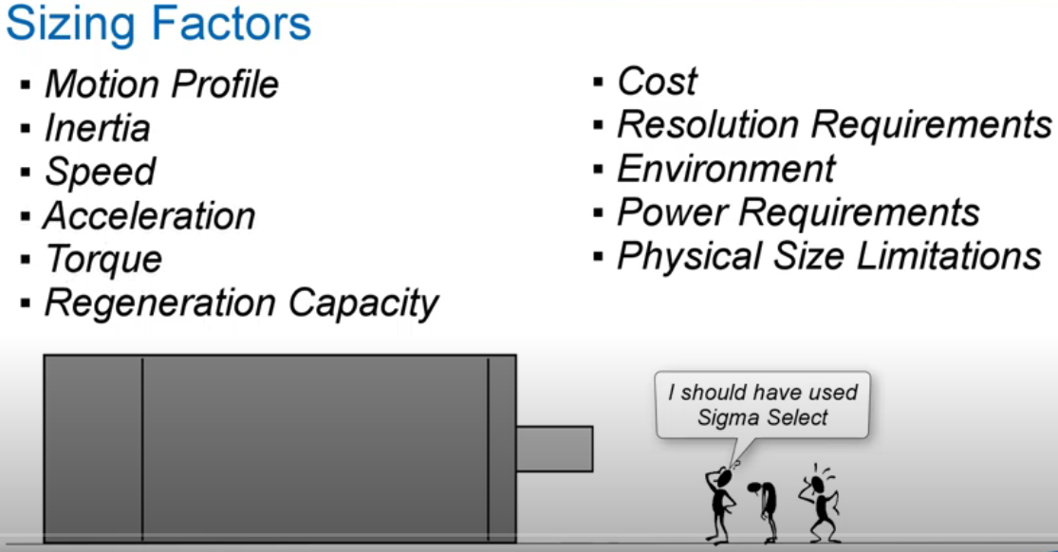

Slide 28
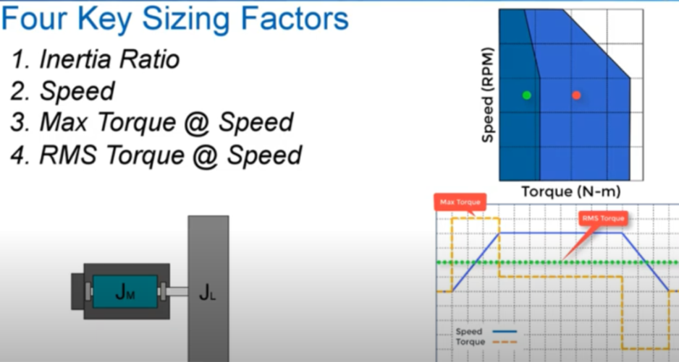

Slide 30
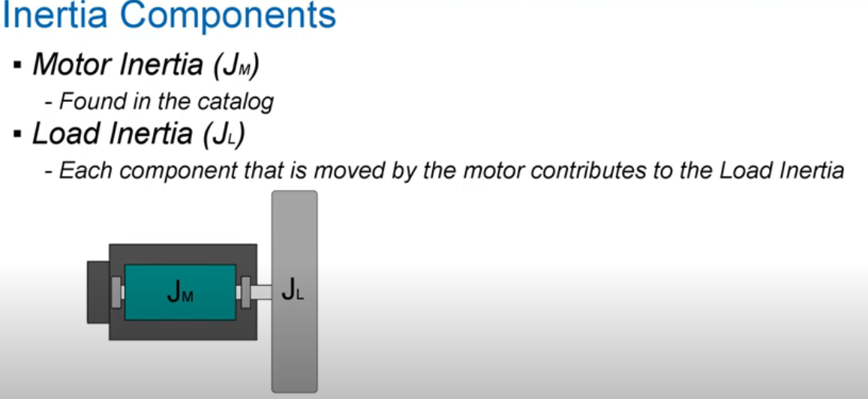

Slide 31
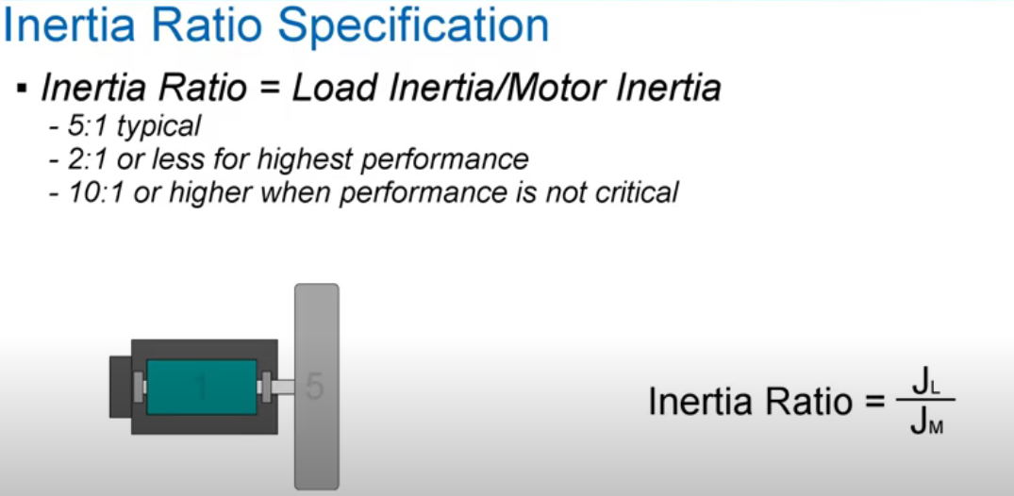

Slide 32
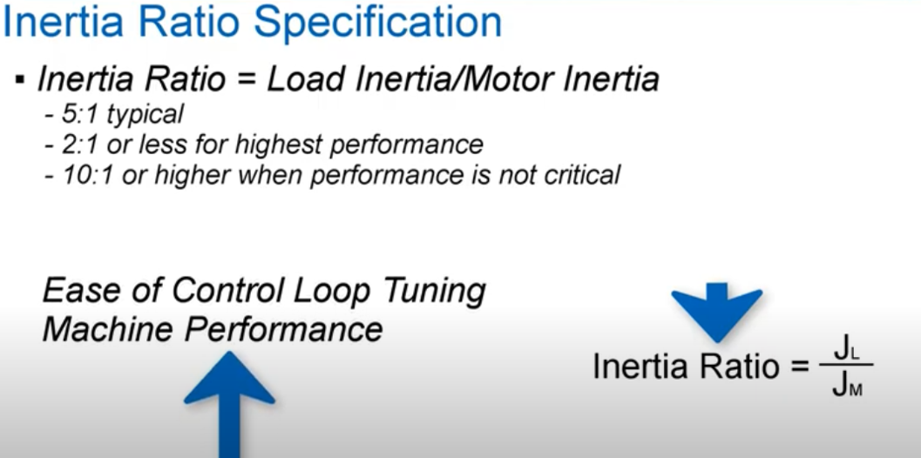

Slide 33
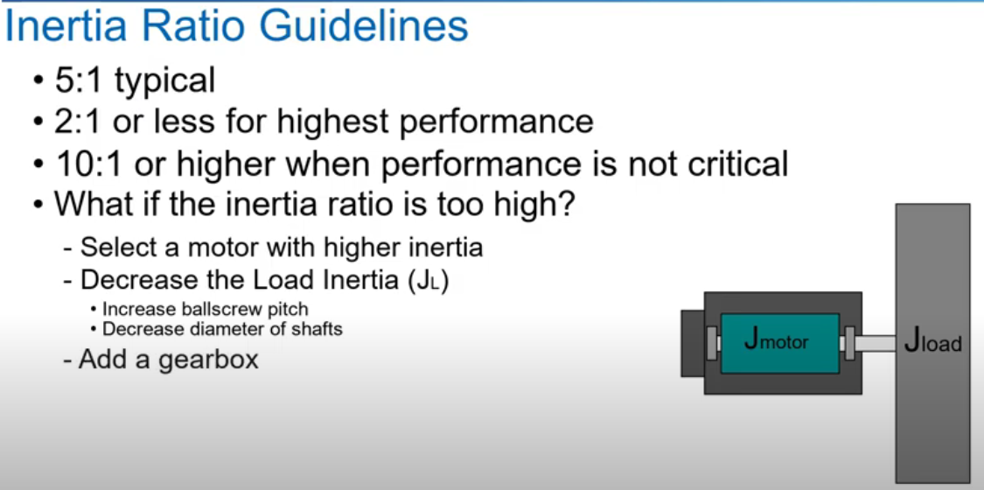

Slide 34
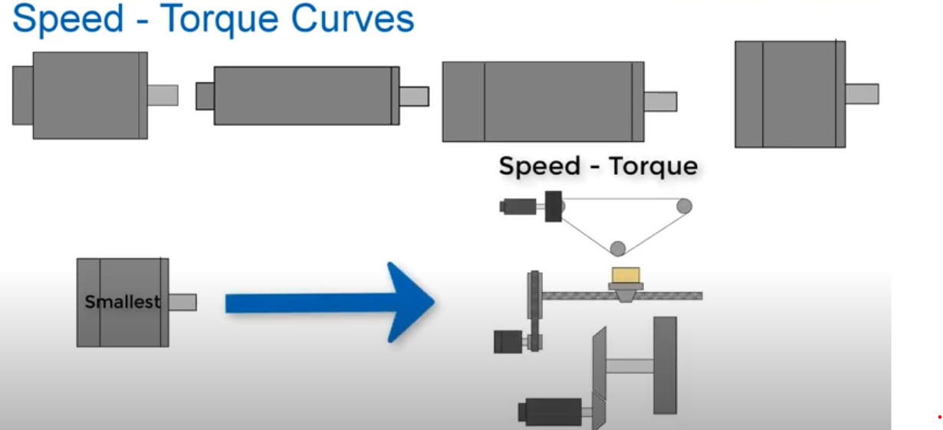

Slide 35
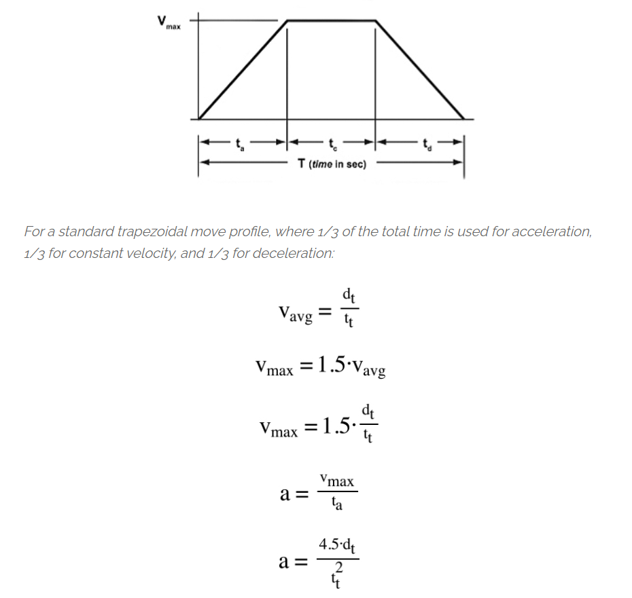

Slide 36
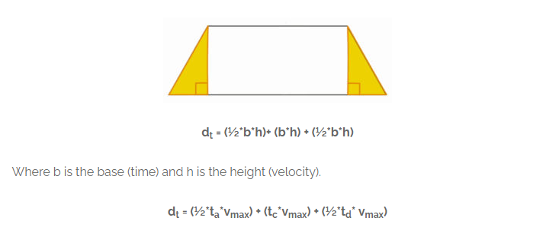
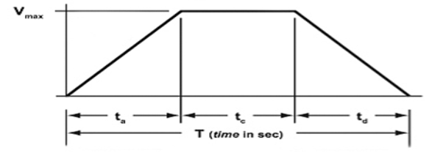
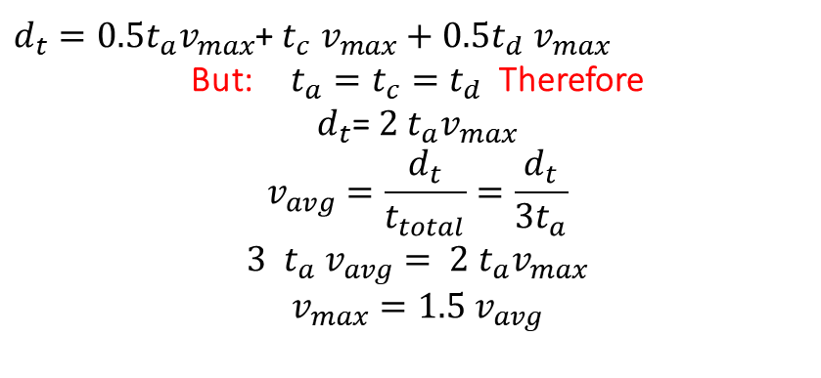
we derived the formula for total distance traveled in a trapezoidal motion profile, based on the areas of the two triangular portions (½*b*h) and the area of the rectangular portion (b*h).
$d_{t}=0.5t_{a}v_{max}$+ $t_{c}$ $v_{max}+0.5t_{d}$ $v_{max}$
But: $t_{a}=t_{c}=t_{d}$ Therefore
$d_{t}$= $2 t_{a}v_{max}$
$$v_{avg}=\frac{d_{t}}{t_{total}}=\frac{d_{t}}{3t_{a}}$$
${3 t_{a} v}_{avg}= 2 t_{a}v_{max}$
$$v_{max}=1.5{ v}_{avg}$$

Slide 37
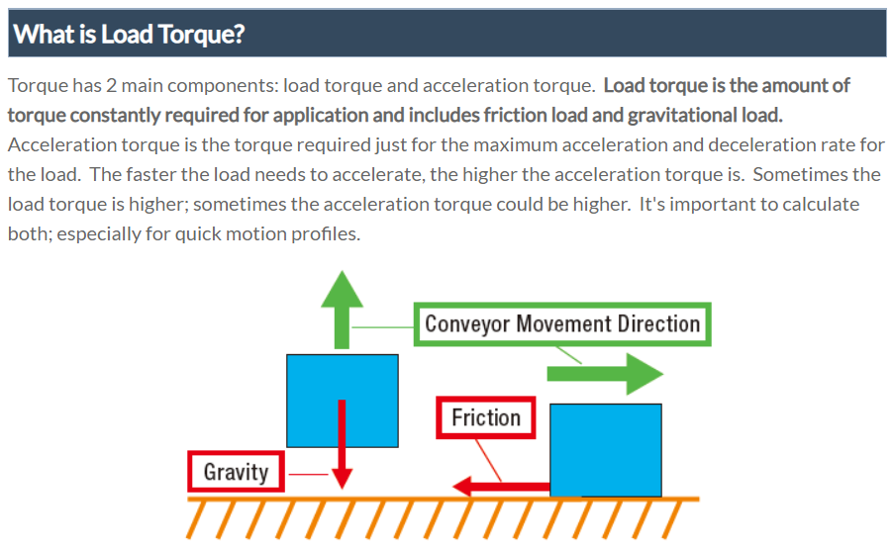

Slide 38
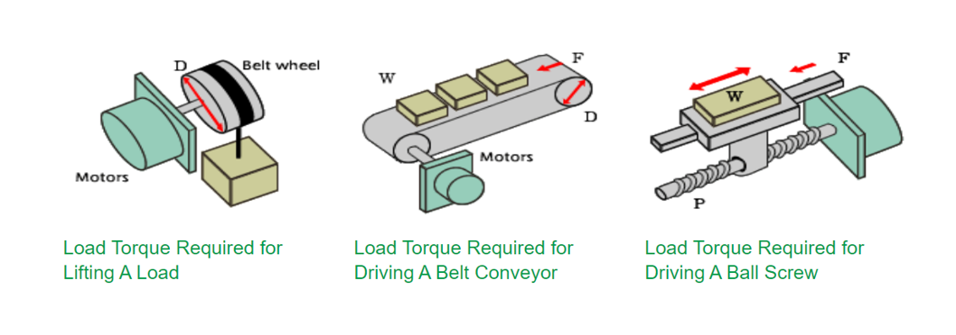

Slide 39
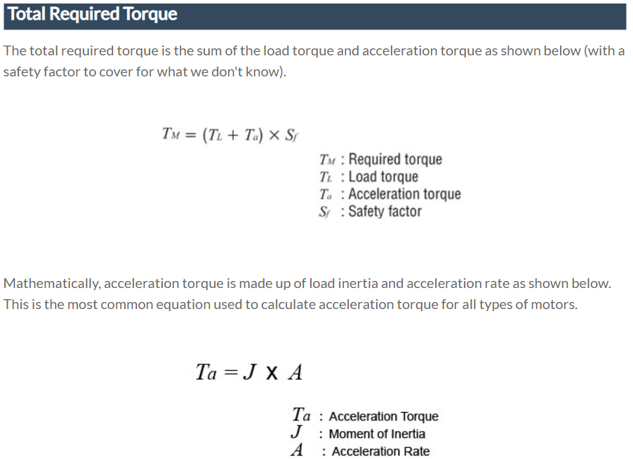
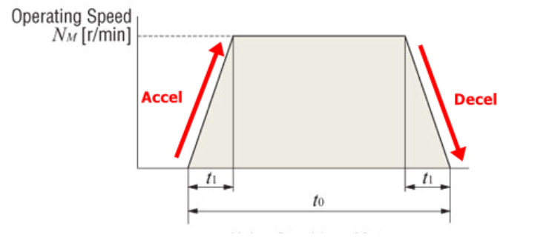


Slide 40
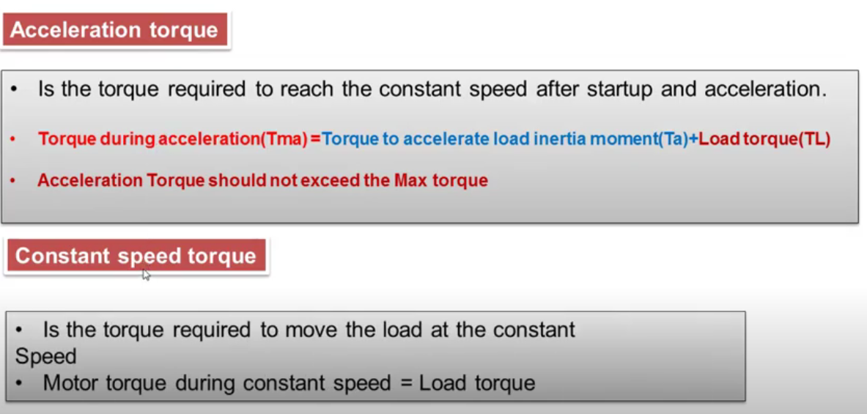
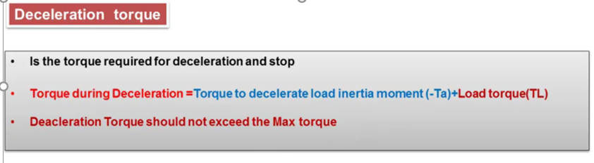

Slide 41
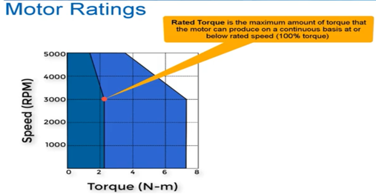
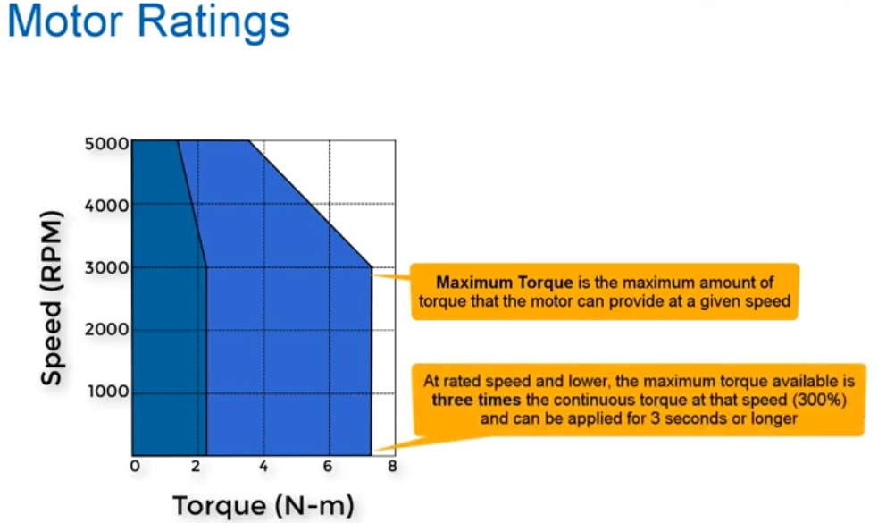
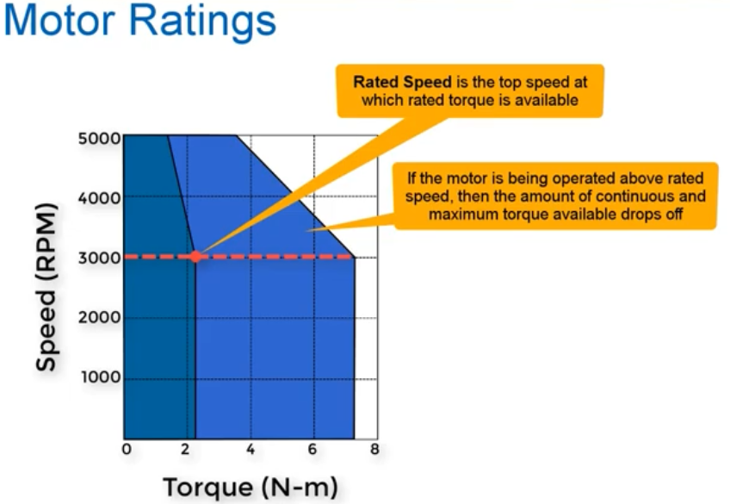
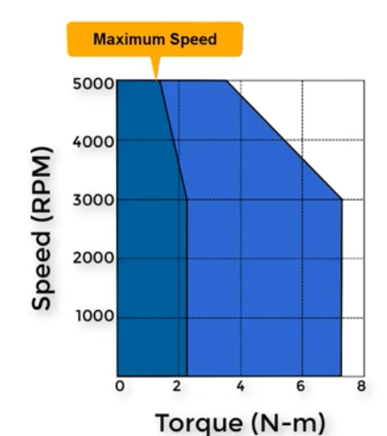

Slide 42
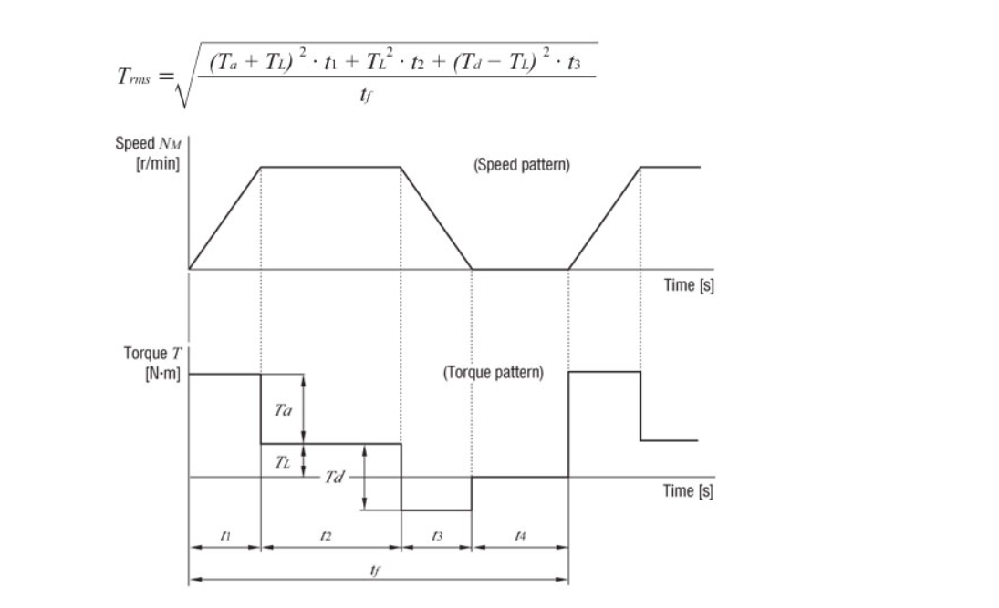
Method 1 Method 2

Slide 43
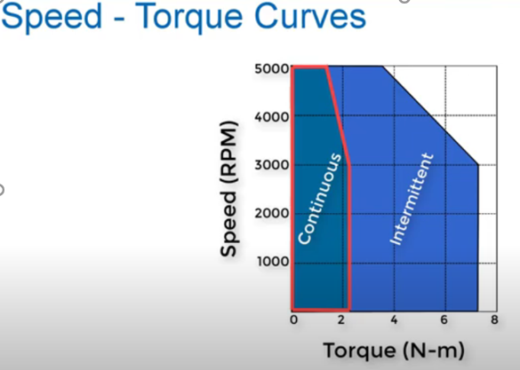
If the torque lies on the continuous region that means the motor can works with any torque and with any speed without the motor is over heat

Slide 44
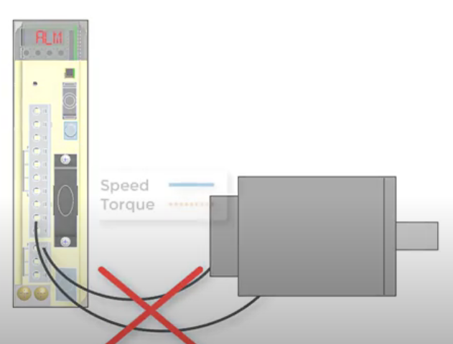
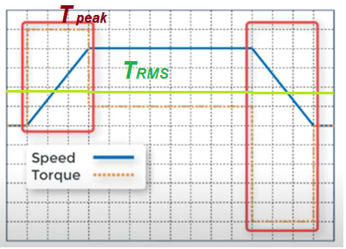
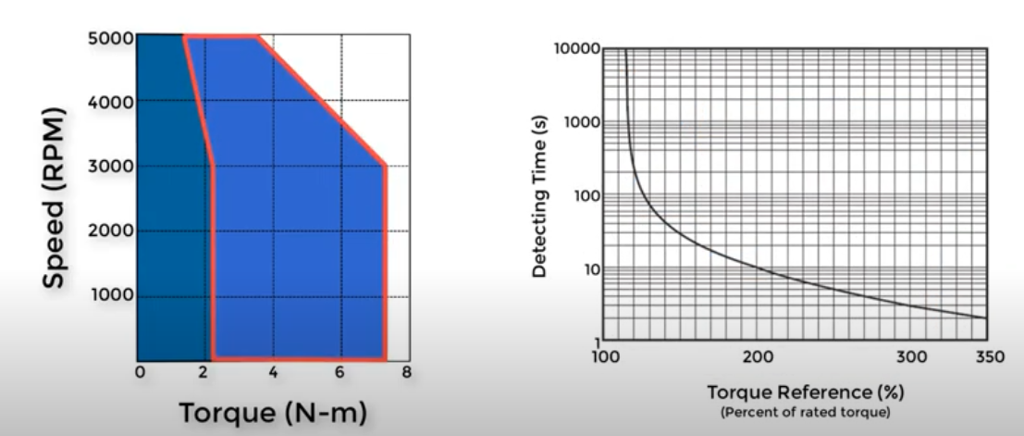
If the torque and speed combination lies on the intermittent region that means the motor can work for three seconds or a little bit longer and the motor can provide three times the rated torque which is called (peak torque).
To implement this the RMS torque must lies on continuous region. Otherwise the driver will turn off the motor to protect it.

Slide 45
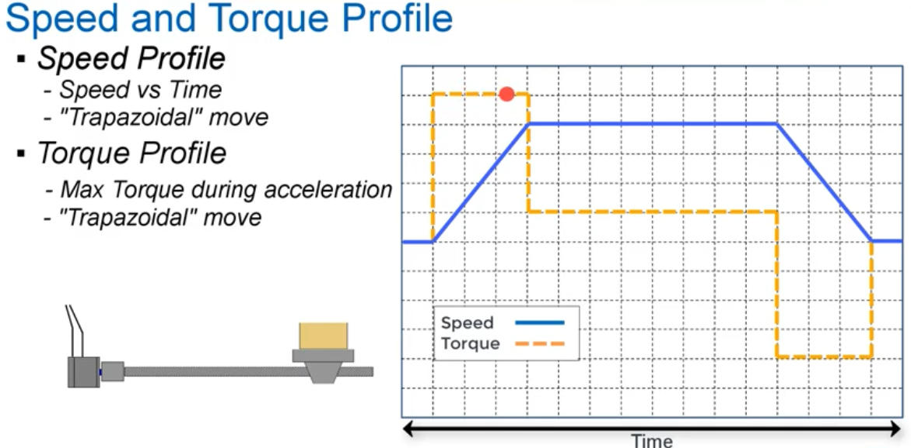

Slide 46
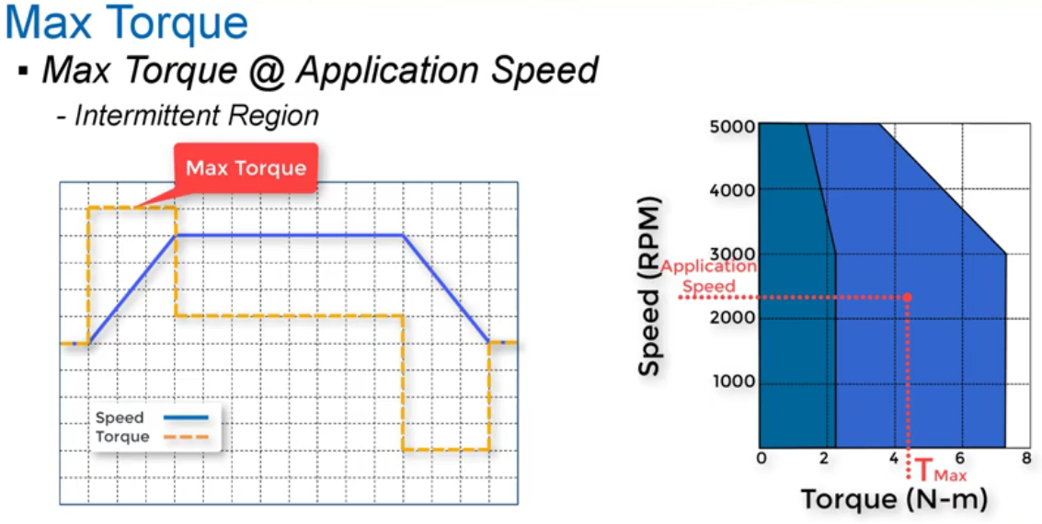

Slide 47
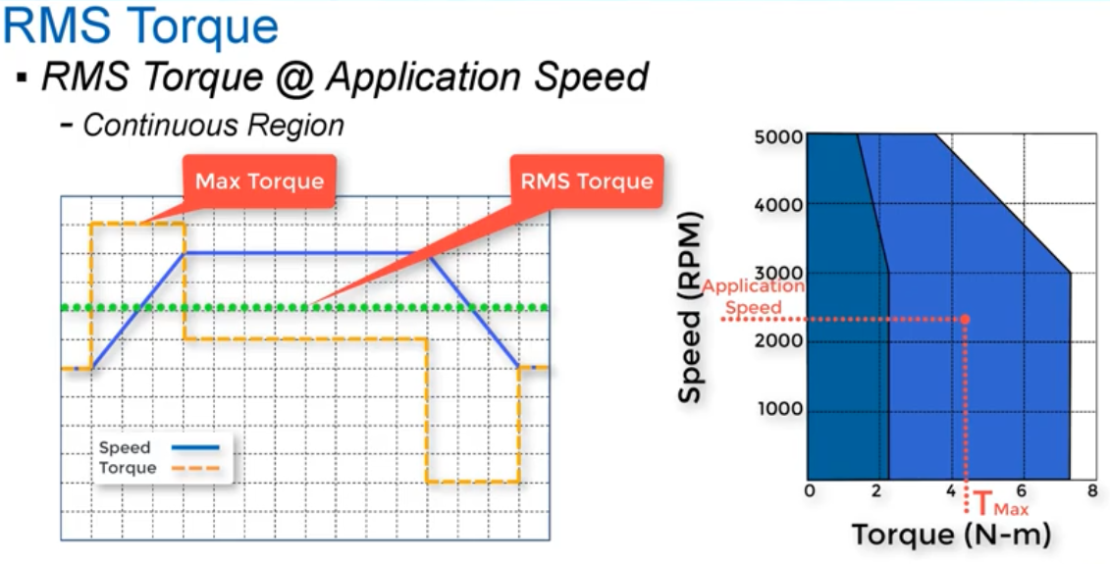

$$T_{RMS}$$

Slide 48
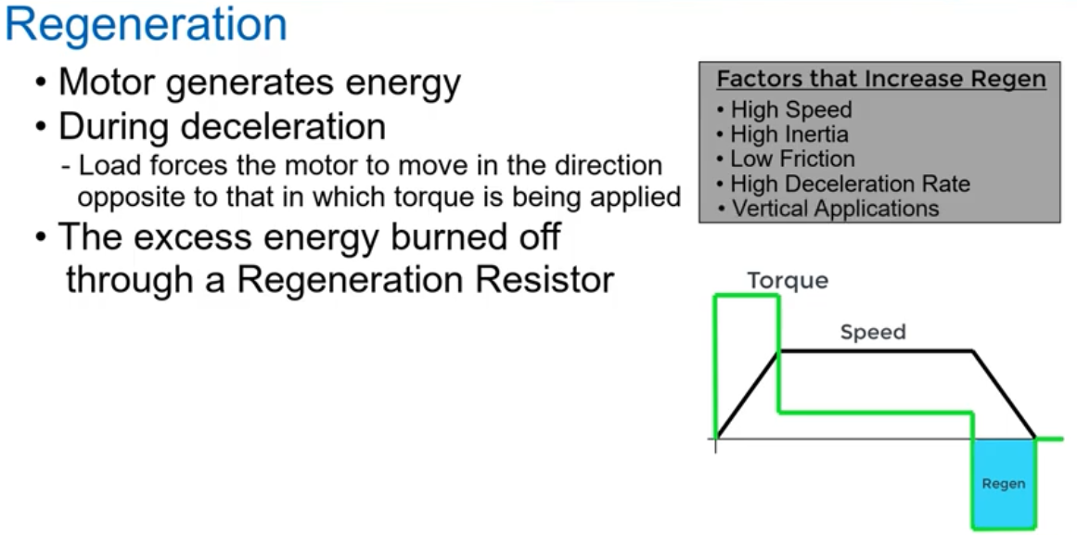

Slide 49
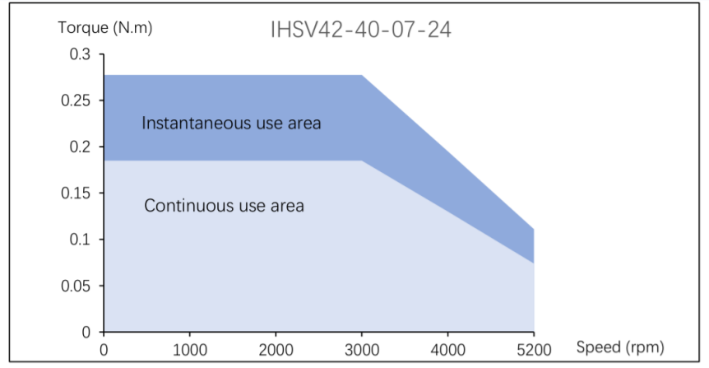


Calculate the motion profile for the HSS if the conveyor must stop each 1 m.
Note: the radius of the pully r = 5cm and $t_{f}$= 3 seconds.
$N_{o}$(driven)=100, and$N_{i}$(driver)=10.
Compute the load torque for the system.
Calculate the torque profile for the system.
Calculate the total required torque if the factor of safety is 2.
Calculate the RMS torque.
For a given speed-torque curve is this servomotor is suitable for the system

Slide 50



Slide 51







$C\text{onveyor}$ Side
Acceleration $m/s^{2}$
$$=1.5\left(\frac{1}{3}\right)=0.5 m/s$$
$$=\frac{4.5∗1}{3^{2}}=0.5 {m/s}^{2}$$

Slide 52








$HSS$ Side
Note: $N_{o}(driven)=100$ , $N_{i}(driver)=10$
$$r_{g}=\frac{N_{o}}{N_{i}}=\frac{100}{10}=10$$
$$\frac{θ_{HSS}}{θ_{LSS}}=\frac{N_{o}}{N_{i}}=r_{g}$$
But there is another ratio (r) between the linear position for the conveyor belt $(s(t))$and the angular position of the LSS ( $θ_{LSS}$)
$$s(t)=r θ_{LSS}$$
${\ddot{θ}}_{HSS}$ [rad/$s^{2}$]
$θ_{HSS}=r_{g}θ_{LSS}=\frac{r_{g} s(t)}{r}=$ $\frac{10 s(t)}{0.05}=200 s\left(t\right)$
$${\dot{θ}}_{HSS}=200 \dot{s} (t)$$
$${\ddot{θ}}_{HSS}=200 \ddot{s}(t)$$

Slide 53


Slide 54



Torque Profile:
Acceleration Phase:
$$\sum{T=J_{total}{\ddot{θ}}_{HSS (accelartion phase)}}$$
$$T_{D}−T_{L}=J_{total}{\ddot{θ}}_{HSS \left(accelartion phase\right)}$$
$$T_{D}=0.02453+4.4∗{10}^{−4}∗\left(100\right)$$
$=0.0685$ N.m
Max Velocity Phase
$$\sum{T=0}$$
$T_{D}−T_{L}=$0
$T_{D}=0.02453$N.m
Deacceleration Phase
$$\sum{T=J_{total}{\ddot{θ}}_{HSS (Deacceleration phase)}}$$
$$T_{D}−T_{L}=J_{total}{\ddot{θ}}_{HSS (Deceleration phase)}$$
$$T_{D}=0.02453+4.4∗{10}^{−4}∗\left(−100\right)$$
$=−0.0195$N.m
Torque [N.m]

Slide 55


Total Required Torque:
$T_{M}=(T_{L}$+ $T_{a}$)* $S_{f}$
$=\left(0.02453+4.4∗{10}^{−4}∗\left(100\right)\right)∗2$
= 0.1370 N.m

Slide 56




RMS Torque:
$$T_{RMS}$$
$$T_{RMS}=\sqrt{\frac{{\left(0.02453+4.4∗{10}^{−4}∗\left(100\right)\right)}^{2}∗1+{\left(0.02453\right)}^{2}∗1+{\left(0.02453+4.4∗{10}^{−4}∗\left(−100\right)\right)}^{2}∗1}{3}}$$
$$T_{RMS}=0.0435 N.m.$$

Slide 57



$${\dot{θ}}_{HSS}(rpm)=\frac{{\dot{θ}}_{HSS}[rad/s]∗60}{2π}$$
${\dot{θ}}_{HSS}(rpm)=$ $\frac{6000}{2π}=954.9$ rpm
This motor can work well but it is over size i.e. this servo has capability more than required
$$T_{Max}=0.0685$$
$$T_{RMS}=0.0435$$

Slide 58


Calculate the motion profile for the HSS if the conveyor must stop each 1 m. Use the quantic polynomial profile method.
Note: the radius of the pully r = 5cm and $t_{f}$= 3 seconds.
Compute the load torque for the system.
Calculate the torque profile for the system.
Calculate the total required torque if the factor of safety is 3.
Calculate the RMS torque.
For a given speed-torque curve is this servomotor is suitable for the system

Slide 59



$=100∗{10}^{−6}$+5$0∗{10}^{−6}+200∗{10}^{−6}+2∗{10}^{−3}+2∗{10}^{−3}+0.05∗\left(5+5\right)=0.5043 kg.m^{2}$
$$μ$$ | 0.1 |  | Coefficient of friction

Slide 60


$C\text{onveyor}$ Side

Slide 61


$HSS$ Side
But there is another ratio (r) between the linear position for the conveyor belt $(q(t))$and the angular position of the LSS ( $θ_{HSS}$)
$$q(t)=r θ_{HSS}$$
$θ_{HSS}=$ $\frac{q(t)}{0.05}=20 q\left(t\right)$
$${\dot{θ}}_{HSS}=20 \dot{q} (t)$$
$${\ddot{θ}}_{HSS}=20 \ddot{q}(t)$$

Slide 63



Torque Profile:
To calculate the peak torque we must compute at the max. acceleration (positive):
$$\sum{T=J_{total}{\ddot{θ}}_{HSS}}$$
$$T_{D}−T_{L}=J_{total}{\ddot{θ}}_{HSS \left(max\right)}$$
$$T_{D}=0.2453+0.5043∗\left(12.83\right)$$
$=6.7155$ N.m
To calculate the peak torque we must compute at the max. acceleration (positive):
$$\sum{T=J_{total}{\ddot{θ}}_{HSS}}$$
$$T_{D}−T_{L}=J_{total}{\ddot{θ}}_{HSS \left(max\right)}$$
$$T_{D}=0.2453+0.5043∗\left(−12.83\right)$$
$=−6.2249$ N.m

Slide 64

Total Required Torque:
$T_{M}=(T_{L}$+ $T_{a}$)* $S_{f}$
$=\left(0.2453+0.5043∗\left(12.83\right)\right)∗2$
= 13.4309 N.m

Slide 65


RMS Torque:
The previous can’t be used because there is no constant acceleration phase, max. velocity phase, and deacceleration phase. Therefore Matlab can be used
$T_{RMS}=rms\left(Torque\right)=$4.6457N.m.
$$T_{RMS}$$

Slide 66





$${\dot{θ}}_{HSS}(rpm)=\frac{{\dot{θ}}_{HSS}[rad/s]∗60}{2π}$$
${\dot{θ}}_{HSS}(rpm)=$ $\frac{12.5∗60}{2π}=119.3$ rpm
This motor is not fit to the system i.e. it is not suitable at all.
$$T_{Max}=6.7155$$
$$T_{RMS}=4.6457$$
$$N_{rpm}=119.3$$

Slide 67



2. Electronics Circuit based on H-bridge as a Closed Loop Control

Slide 68

Permeant Magnetic DC Motor (PMDC)

Slide 69

Permeant Magnetic DC Motor (PMDC)

Slide 70

Permeant Magnetic DC Motor (PMDC)

Slide 71

Permeant Magnetic DC Motor (PMDC)

Slide 72
Electronic Control of a Permanent Magnet DC
Motor
Electronic speed controllers are of two types:
1) Pulse width modulators (PWM).
2) Servo amplifiers.
PWM controllers have the advantage that they either drive bipolar power transistors rapidly between cutoff and saturation or they turn FETs on and off. In either case, power dissipation is small.
Servo amplifiers using linear power amplification are satisfactory but produce a lot of heat, because they function in the transistor linear region.

Slide 73

Electronic Control of a Permanent Magnet DC Motor

Slide 74

1. Electronics Control based on PWM as an Open Loop Control

Slide 75

1. Electronics Circuit based on PWM as an Closed Loop Control

Slide 76

2. Electronics Circuit based on H-bridge as an Closed Loop Control

Slide 77




Modeling of the DC Motor with a Suspended Load
The following analysis shows the modeling of a DC motor directly driving a suspended load via a sheave. It will be assumed that the DC motor is armature controlled in order to control the speed.
It is also assumed that it has constant field excitation (e.g., permanent magnet). It will also be assumed that it has an internal resistance R and an inductance L (the armature).
The input to the system is the armature voltage, v(t). We are assuming a variable voltage
that is used to vary the speed of the DC motor and its connected load. The output of the
system is the rotational speed of the output shaft, $ω(t)$ in rad/s. It will be assumed that the
no reduction gearing is applied between the motor and the output sheave raising the load.
The following equation applies to the motor:

Slide 78

4.7 Modeling of the DC Motor with a Suspended Load
The torque is proportional to both the armature current and the field excitation. But in
this case we have assumed that the magnetic flux density is constant. Hence the torque is
proportional to the armature current:

Slide 79



4.7 Modeling of the DC Motor with a Suspended Load

Slide 80

4.7 Modeling of the DC Motor with a Suspended Load

