Slide 1
To mix or not to mix – compatibilities of parenteral drug solutions

Slide 2
Mixing solutions of parenteral drugs is generally not recommended because of the potential for incompatibility and consequent loss of activity of one or both drugs .
However, in some circumstances there may be compelling reasons for mixing two or more parenteral drug solutions in the same infusion bag, in the same syringe or at a Y-site junction where two or more intravenous lines meet. Such circumstances include:
difficulties with venous access limiting the number of intravenous lines available for continuous administration of multiple drugs
multiple drugs requiring parenteral administration within a short time frame such as in a home visit by a general practitioner
patients at home requiring many drugs by simultaneous continuous infusion where multiple intravenous lines are not feasible, for example, use of a syringe driver during palliative care.

Slide 3
The decision to mix drugs should not be made without knowledge of their compatibility. If intravenous drugs are not mixed but are given consecutively, the infusion line should be flushed through with compatible fluid between each administration.

Slide 4
Mechanisms of incompatibility
Incompatibility problems are more likely to arise when small concentrated volumes are mixed in a syringe rather than in the larger volume of an infusion bag.
This is because of higher mutual drug concentrations and potentially greater pH changes in the more concentrated solution. The absence of any visible change to a solution upon mixing does not automatically exclude degradation of either or both components.

Slide 5
Drugs that precipitate upon dilution
Precipitation of a drug from its concentrated injection solution when it is diluted with water or saline is counter-intuitive.
However, a small number of injection solutions are formulated in non-aqueous solvents to allow dissolution of a poorly water soluble substance in a small volume.
In these formulations, dilution of the non-aqueous injection vehicle with water or saline may precipitate the drug.

Slide 6
The problem is frequently observed when diazepam injection is diluted. Diazepam is very poorly water soluble so it is formulated as an injection solution in a vehicle comprising 50% propylene glycol and 10% ethanol. At first, dilution produces a slight turbidity which clears upon mixing, but dilution beyond fourfold produces an opaque white precipitate which does not clear until substantial further dilution.
Other drugs which demonstrate solubility problems and which are formulated in injection vehicles other than simple aqueous solutions include digoxin, clonazepam, phenytoin, amiodarone and phytomenadione..

Slide 7
Precipitation of drugs due to pH change upon mixing
The water solubility of any drug is enhanced by ionisation of the molecule. For a drug molecule which acts as a proton acceptor (a Lowry-Bronsted base), ionisation is achieved by formulation in a low pH solution usually as a hydrochloride or hydrogen sulfate salt (for example, amiodarone hydrochloride or adrenaline acid tartrate).
Any change in pH towards the other end of the pH scale will reduce the proportion of ionised to un-ionised drug in solution and will therefore reduce the water solubility of the drug.
The most prominent example of a pH-related reduction in solubility is dilution of phenytoin sodium injection. The drug is formulated with non-aqueous solubilising agents and the solution is adjusted to a pH of 12. Glucose 5% infusion solution, which has a pH of 4.3-4.5, will precipitate phenytoin almost immediately. Indeed, phenytoin injection is so incompatible that it should generally not be mixed with any other solution.

Slide 8
Ionic reactions forming insoluble substances
The salts of monovalent cations, such as sodium and potassium, are generally more soluble than those of divalent cations, such as calcium and magnesium.
Mixing solutions containing calcium or magnesium ions has a substantial risk of forming an insoluble calcium or magnesium salt. Mixing magnesium sulfate 50% and calcium chloride 10% results in precipitation of insoluble calcium sulfate.
The mixing of drug salts of calcium, and to a lesser extent magnesium, with phosphates, carbonates, bicarbonates, tartrates or sulfates should also be avoided. A recent warning has been issued about mixing calcium-containing solutions, including Hartmann's solution, with ceftriaxone causing the formation of the insoluble ceftriaxone calcium salt.

Slide 9
Denaturation of biological molecules
Biological substances including blood products and insulin are prone to denaturation when exposed to variations in pH and osmolality. While published compatibility data exist for insulins and some of the blood products, most recently marketed biological drugs such as infliximab, interferons and recombinant coagulation factors have no such data available and mixing with other drugs is not recommended.

Slide 10
Evolution of gas
Addition of an acidic drug solution to a solution containing a carbonate or bicarbonate may result in production of carbon dioxide gas. However, the evolution of gas is a normal part of the reconstitution of some drugs, notably ceftazidime.

Slide 11
Special drugs administration
Diazepam solution
Diazepam solution contains diazepam dissolved in an aqueous medium and should not be confused with diazepam emulsion
Diazepam is a long-acting benzodiazepine with anxiolytic, anticonvulsant and central muscle relaxant properties.
Pre-treatment checks * Avoid in acute porphyria, respiratory depression. * Caution in patients with pulmonary insufficiency or myasthenia gravis. * Caution in patients with impaired renal and hepatic function (avoid in severe hepatic impairment)

Slide 12
Status epilepticus and convulsions due to poisoning: 10 mg by slow IV injection, repeated if necessary after 10 minutes. Once the seizure is controlled, recurrence may be prevented by a slow IV infusion (maximum total dose 3 mg/kg over 24 hours).
Reduce the dose on prolonged use to #risk of accumulation and CNS depression. Severe acute anxiety, acute muscle spasm (including tetanus) and acute states of excitement, delirium tremens: 10 mg by IV injection repeated after 4 hours if necessary. Intravenous injection Preparation and administration .
Withdraw the required dose. The solution should be clear and colourless to pale yellow. Inspect visually for particulate matter or discoloration prior to administration and discard if present. 3. Give by slow IV injection (maximum rate 5 mg/minute) into a large vein to avoid thrombosis. Intramuscular injection (use only if oral or IV route not possible) Preparation and administration 1. Withdraw the required dose. 2. Give by IM injection.

Slide 13
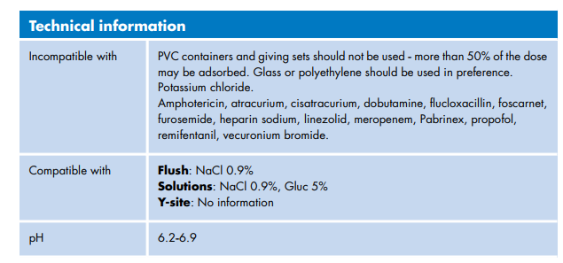

Slide 14
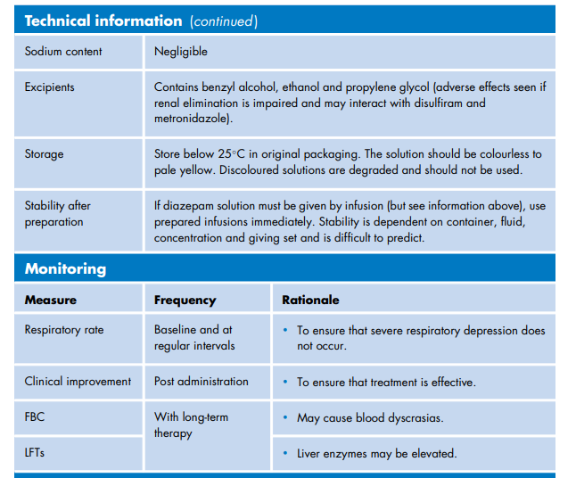

Slide 15
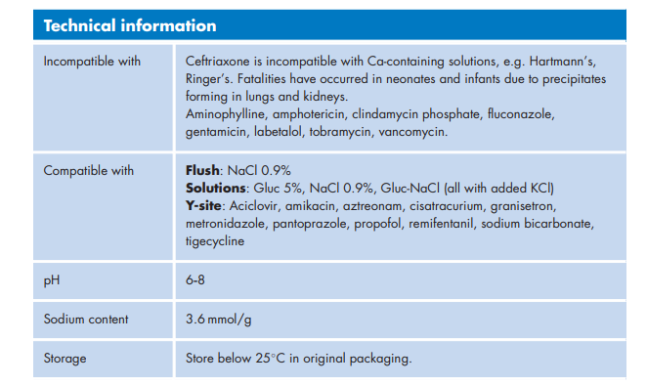
Ceftriaxone

Slide 16
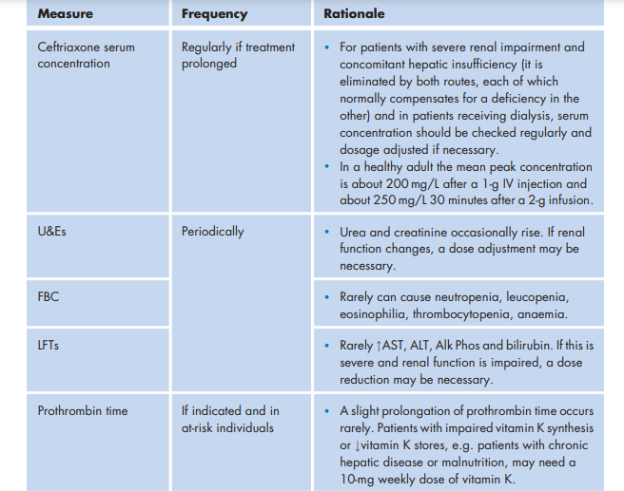

Slide 17
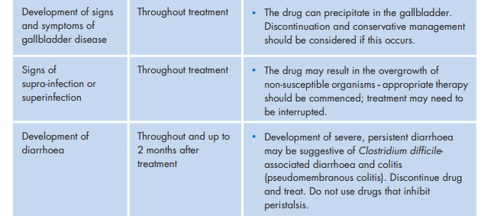

Slide 18
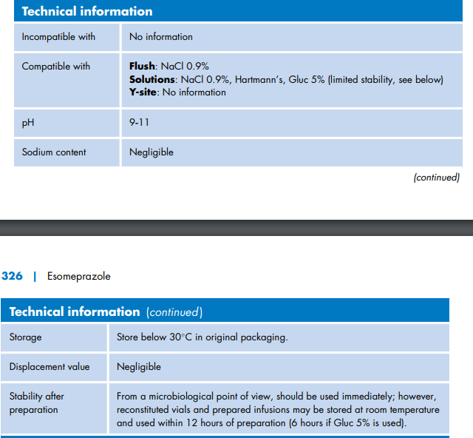
Esomeprazole

Slide 19
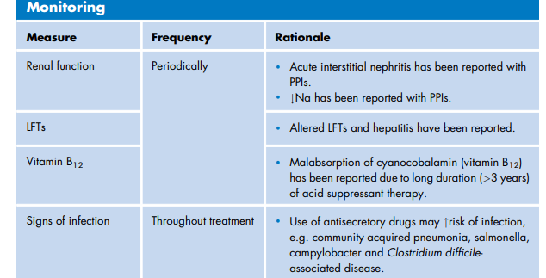

Slide 20
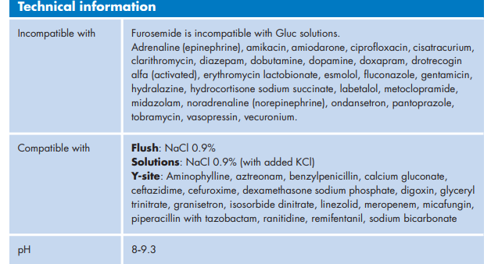
Furosemide

Slide 21
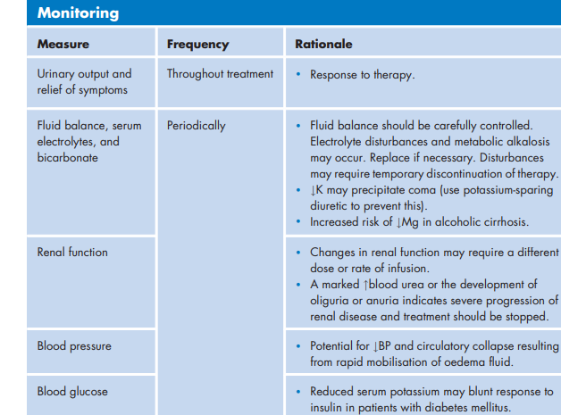

Slide 22
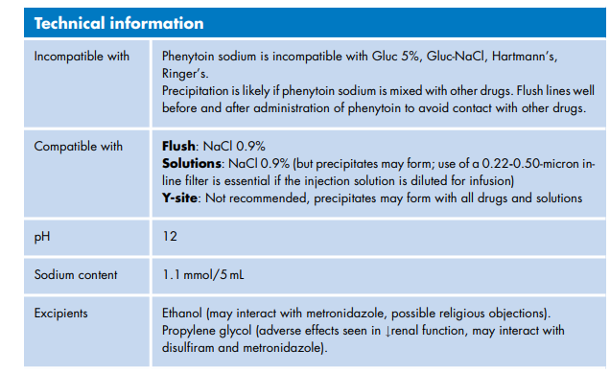
Phenytoin sodium

Slide 23
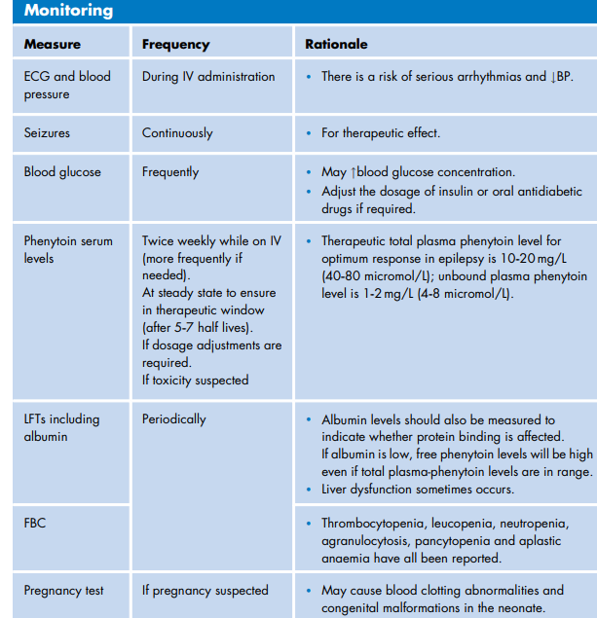

Slide 24
Reference
Injectable Drugs Guide
The Injectable Drugs Guide provides a user-friendly, single point of reference for health- care professionals in the prescribing, preparation, administration ...

