Slide 1
Sodium and Potassium
NUTD 334

Slide 2
Sodium and Pottassium
Sodium is mainly added to food as salt
  40% of salt content is sodium
  Processed food contains most salt
  75% of daily sodium intake is from processing
  15% of sodium intake is from adding salt to food
    At the table or while cooking
  Global mean intake is 4 g of sodium per day (10 g of salt)
  WHO recommend 2 g of sodium (5 g of salt)
Potassium
  In fruit, vegetables legumes, milk, grains, meat
  Processing reduces potassium content

Slide 3
Sodium and potassium function
Sodium and potassium are cat ions
Sodium outside the cell and potassium inside the cell
  The difference in charge is resting potential
  Outside the cell is slightly more positive
Stimuli result in depolirzation
  Influx of sodiun inside the cell
  Efflux of potassium
  The process is action potential required for
    Muscle contraction
    Nerve function
    Heart function
    Hormone release
  once this process done Na/K ATP dependant pump take 2 K into the cell and pumps 3 Na outside the cell until the resting potential is achieved.

Slide 4
Fluid distribution and balance
Fluid balance
  1/3 fluid of the body is outside cells (extracellular)
    Interstitial fluid (between cells)
    In the blood
  2/3 fluid is inside cell (intracellular)
Sodium and potassium play a role in guaranteeing equal distribution of fluid in cell compartments
Change in sodium concentration in blood can lead to edema
Urine sodium concentration is the best way to measure sodium intake

Slide 5
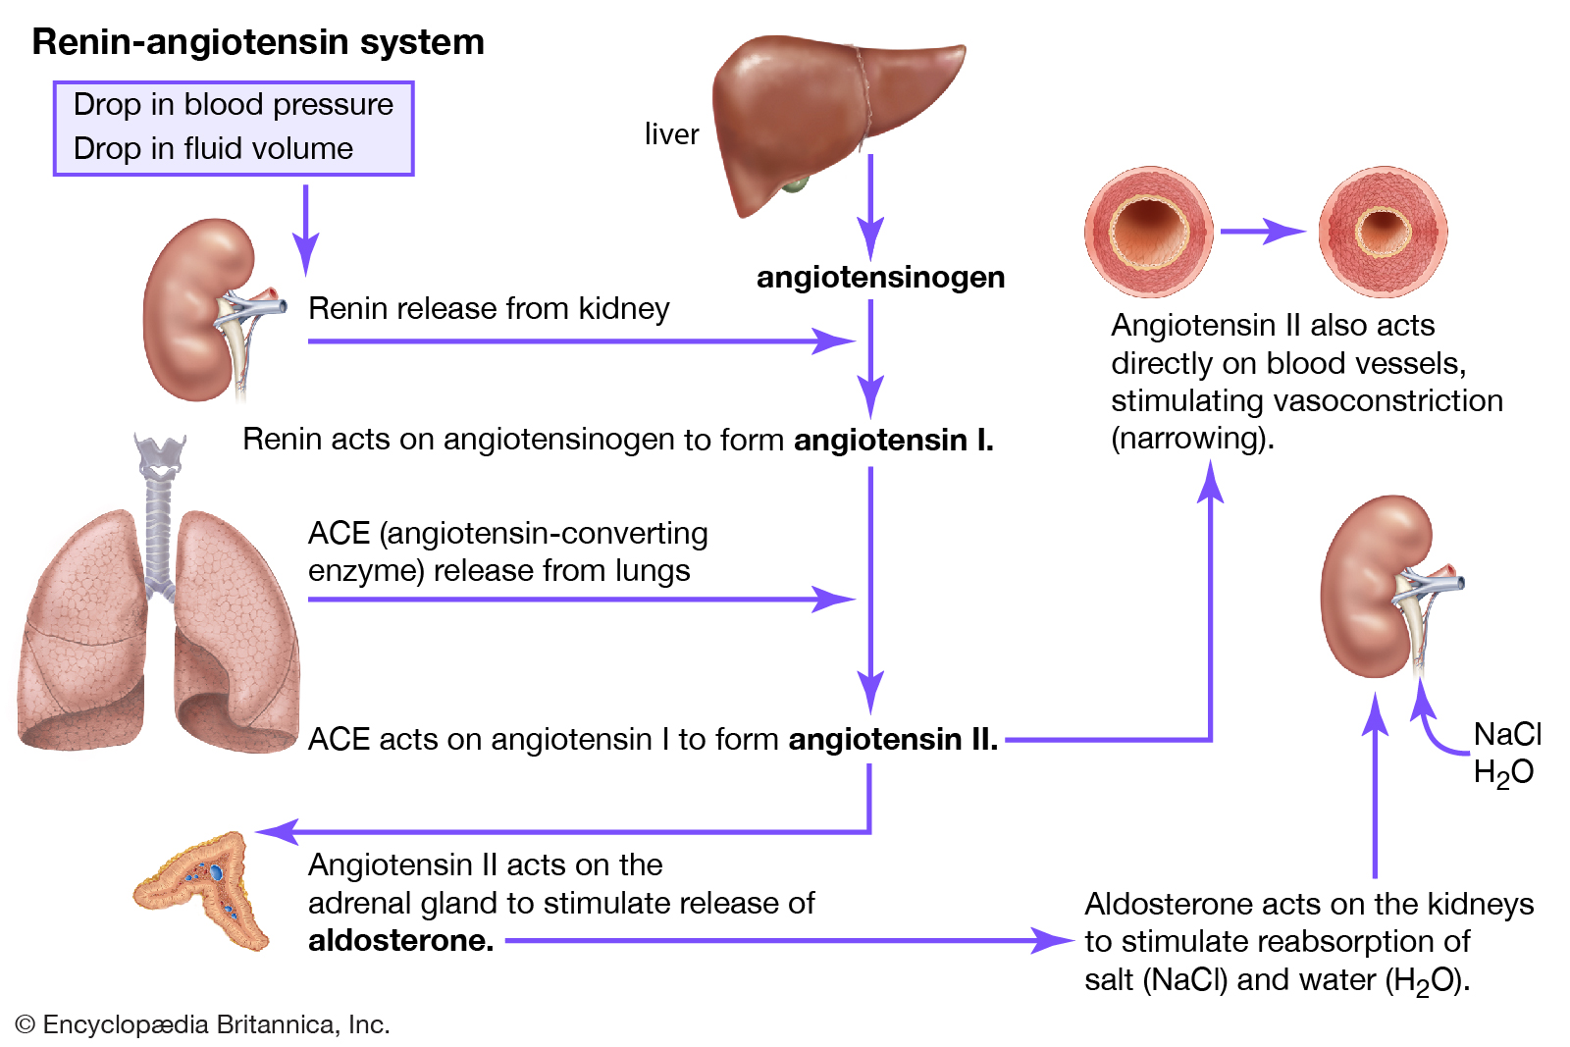
Sodium control

Slide 6
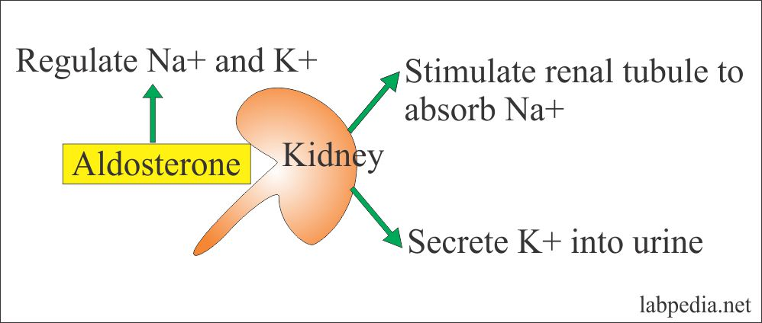
Important to remember
So what would happens in
  Hypoaldonesterism?
  Hyepraldoesterism?

Slide 7
Sodium and health
Sodium the biggest suspect for high blood pressure
2 grams of sodium intake per day is responsible for 1.65 million CVD death in 2010
Reduction in salt intake to 3g per day can reduce annual CVD death by 44000
Blood pressure also contributed to kidney diseases which further reduce life quality
Notes:
A recent cochrane review by queen mary university london suggests that milld reduction in salt intake for 4 wks can result in a lower blood pressure for both hypertensive and non hypertensive individuals

Slide 8
Salt reduction programs
Salt reduction programs aim at
  Reducing salt in processed foods
  Find alternatives for salt such as potassium chloride
  Reduce dependence on salt by increasing the sue of spices and herbs

Slide 9
Potassium highs and lows
Hyperkalemia
  Kidney diseases
  Cells lysis
  Acidosis
  Insulin deficiency
  Beta antagonists and alpha agonists
  Medical treatment
Hypokalemia
  Beta agonists
  Insulin
Notes:
Beta 2 adrenergic receptors with the effect of adrenaline increase potassium uptake inside the cell via Na/K ATP dependent pumps
Alpha adrenergic receptors with the effect of adrenaline increase potassium excretion outside the cell via calcium dependant potassium channels
Antagonist means blocks, agonist means help

