Slide 1
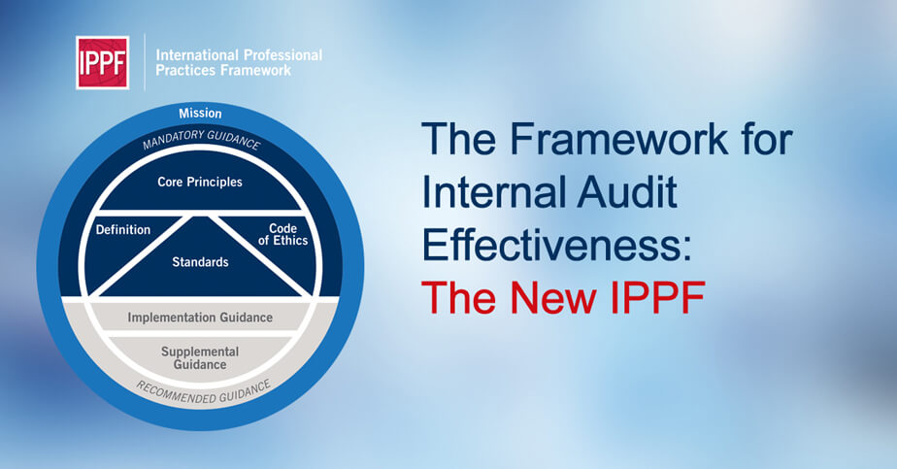
Chapter 2
International Professional Practices Framework (IPPF)
Internal Audit (ACCT 337)
Internal Audit & Risk Management
ACCT 337

Slide 2
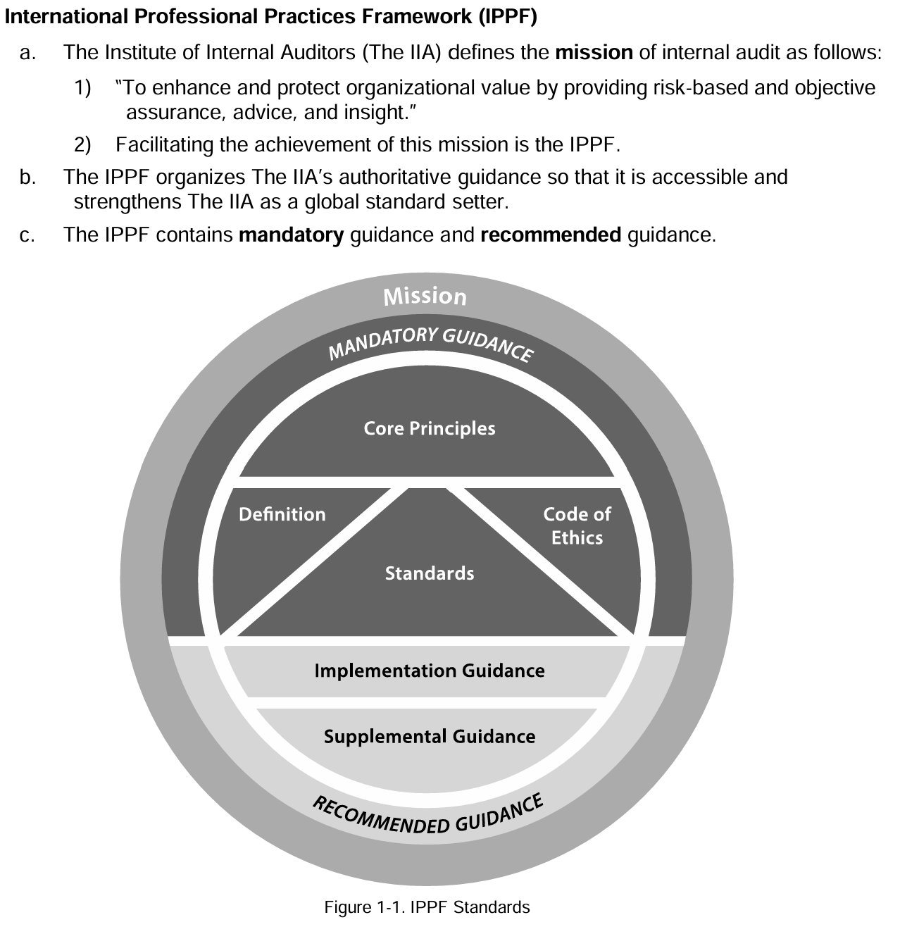
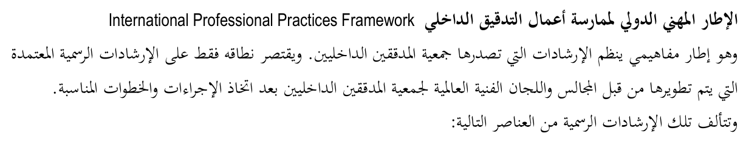
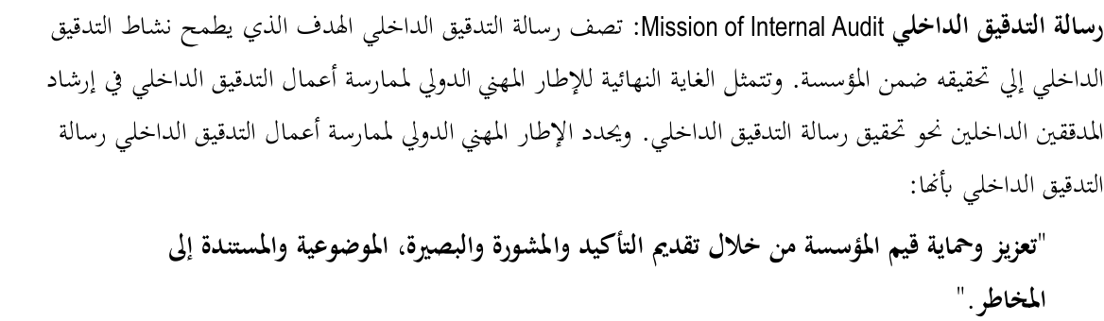

Slide 3
IPPF- 2017
Set by IIA since its inception 1941.
Global recognition: Authorized translations (32 languages).
The only globally recognized guidance for IA profession.
2 categories: Mandatory Guidance and Recommended Guidance.
6 components

Slide 4
Mandatory Guidance
The mandatory elements of the IPPF specify the essential organizational structure, relationships, and characteristics of the work units providing internal audit services, the attributes, competencies and behavioral norms of those delivering these services, and the essential features of the services themselves and the processes used to perform them.
Has 4 Components:
Core Principles
Definition of IA
Code of Ethics
The Standards
Mission of Internal Audit: The Mission of Internal Audit articulates what internal audit aspires to accomplish within an organization. Its place in the IPPF-2017 is deliberate, demonstrating how practitioners should leverage the entire framework to facilitate their ability to achieve the Mission.
To enhance and protect organizational value by providing risk-based and objective assurance, advice, and insight.
رسالة التدقيق الداخلي
"تعزيز وحماية قيمة المؤسسة من خلال تقديم التأكيد و المشورة والبصيرة، الموضوعية و المستندة
على المخاطر، لأصحاب المصلحة.

Slide 5
Mandatory Guidance – Core Principles
Core Principles for the Professional Practice of Internal Auditing: المبادئ الأساسية للممارسة المهنية للتدقيق الداخلي
The Core Principles, taken as a whole, articulate internal audit effectiveness. For an internal audit function to be considered effective, all Principles should be present and operating effectively.
As principles, they serve as fundamental propositions that form the basis for the Code of Ethics and the Standards as well as the other guidance that make up the IPPF.
How an internal auditor, as well as an internal audit activity, demonstrates achievement of the Core Principles may be quite different from organization to organization, but failure to achieve any of the Principles would imply that an internal audit activity was not as effective as it could be in achieving internal audit’s mission (see Mission of Internal Audit above).
Demonstrates integrity. إظهار نزاهة كاملة
Demonstrates competence and due professional care. إظهار الكفاءة والعناية المهنية اللازمة.
Is objective and free from undue influence (independent). أن يكون موضوعيا و متحررا من أي تأثيرات غير مناسبة (مستقل).
Aligns with the strategies, objectives, and risks of the organization. أن يكون متوافقا مع استراتيجيات، أهداف ومخاطر المؤسسة.
Is appropriately positioned and adequately resourced. أن يكون في المركز الوظيفي المناسب ويمتلك الموارد الكافية.
Demonstrates quality and continuous improvement. إظهار الجودة والتحسن المستمر.
Communicates effectively. التواصل بشكل فعّال.
Provides risk-based assurance. تقديم تأكيد مرتكز على المخاطر.
Is insightful, proactive, and future-focused. ذو بصيرة ، مبادر وذونظرة مستقبلية.
Promotes organizational improvement. يدعم تطوير وتحسين المؤسسة.

Slide 6
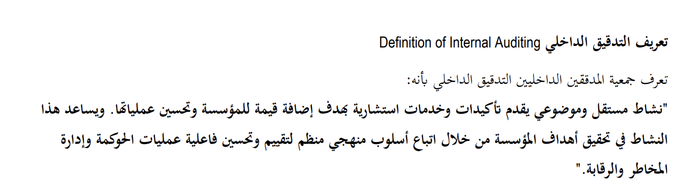
Mandatory Guidance -Definition of Internal Auditing
The IIA’s Board of Directors adopted the current definition of internal
auditing in 1999:
“Internal auditing is an independent, objective assurance and consulting activity designed to add value and improve an organization's operations. It helps an organization accomplish its objectives by bringing a systematic, disciplined approach to evaluate and improve the effectiveness of risk management, control, and governance processes”.
KEY TOPICS
T1- it helps an organization accomplish its objectives
T2- evaluate and improve the effectiveness of risk management, control, and governance processes
T3- assurance and consulting activity
T4- independent, objective
T5- a systematic, disciplined approach

Slide 7
Mandatory Guidance – Code of Ethics
Code of Ethics: to promote the ethical culture in IA profession
Code consists of two components that go beyond the Definition of Internal Auditing by expanding upon the necessary attributes and behaviors of the individuals providing internal audit services:
  Principles: 4 (Integrity/Objectivity/Confidentiality/Competency)
  Rules of Conduct: 12 behaviors IA must follow to apply the above principles.
Applies to all individuals and entities that provide IA services, not just to members of the Institute of Internal Auditors (IIA) or those with IIA certifications.
However, the IIA can only enforce this code on its members or those who are certified by or applying for certification from the IIA.
If they break the Code, the IIA can discipline them by issuing warnings, suspending or canceling their membership or certifications.
Additionally, behavior doesn’t have to be specifically listed in the Rules of Conduct to be considered wrong or damaging to the profession, and it can still lead to disciplinary actions.

Slide 8
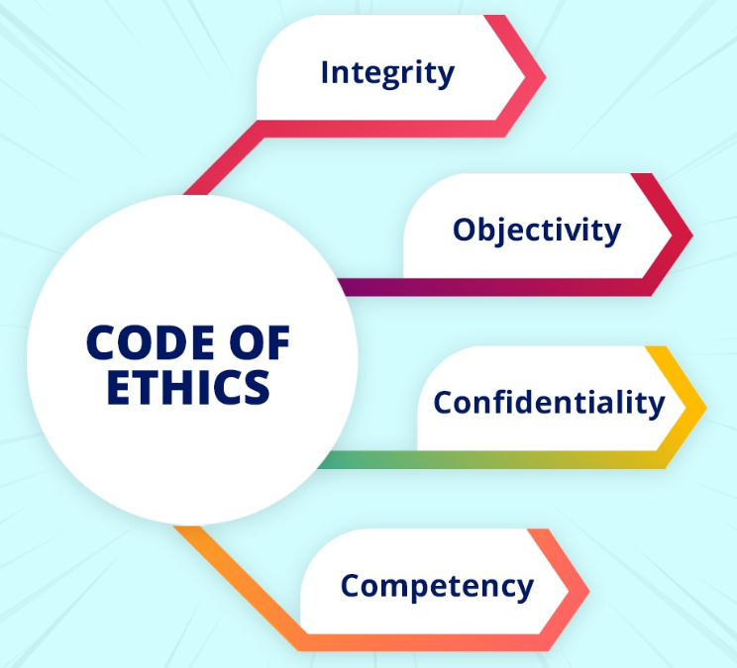
Code of Ethics- The Principles of the Code
The Principles of the Code express the four ideals internal audit professionals should aspire to maintain in conducting their work and represent the core values that internal auditors must uphold to earn the trust of those who rely on their services.
The Rules of Conduct describe 12 behavioral norms that internal auditors should follow to put the Principles into practice.

Slide 9
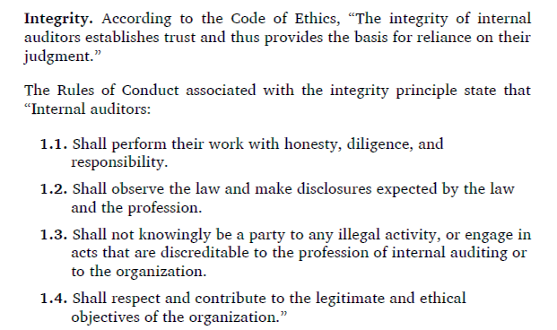

1st Principle- Integrity (4 rules of conduct)

Slide 10

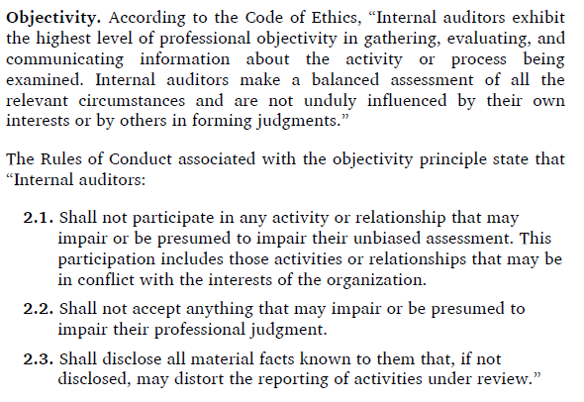
2nd Principle- Objectivity (3 rules of conduct)

Slide 11
2nd Principle- Objectivity (continued)
Objectivity is a fundamental attribute of internal auditing.
In performing their work, internal auditors must be aware of potential threats to their objectivity, such as personal relationships or conflicts of interest.
  For example, accepting gifts from auditees, auditing an operation in which their spouse works, or agreeing with the divisional manager to transfer to the division at the end of the audit would be perceived as impairing an internal auditor’s objectivity.
Moreover, internal auditors must be objective in their communications and avoid misleading language.
  For example, it is inappropriate to state that inventory controls were at the same level of effectiveness as in the last audit but neglect to point out that such controls were assessed as unsatisfactory at that time.

Slide 12


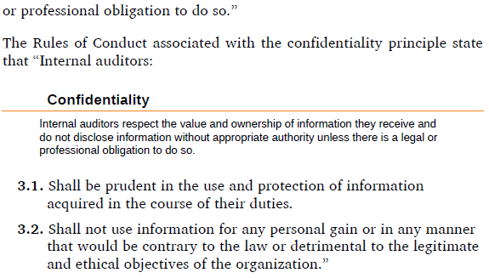
3rd Principle- Confidentiality (2 rules of conduct)

Slide 13
3rd Principle- Confidentiality (continued)
In providing internal audit services, the internal auditor needs unrestricted access to all relevant data. To grant such access, management must have confidence that the internal auditor will not inappropriately disclose or use data in such a manner that harms the organization, violates laws or regulations, or results in personal gain.
Similarly, internal auditors must protect data within their possession to ensure confidential information is not inadvertently disclosed to inappropriate parties. For instance, passwords, encryption, and other security measures should be used when carrying personally identifiable information on a laptop.
Likewise, an internal auditor who is aware of material nonpublic information cannot disclose it to outsiders or use it for personal gain (such as insider trading).

Slide 14
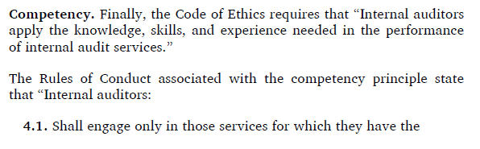

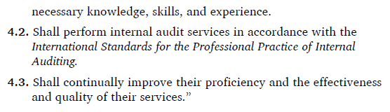
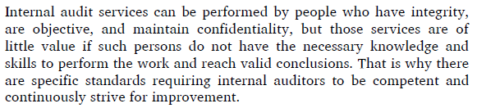
4th Principle- Competence (3 rules of conduct)

Slide 15
Mandatory Guidance – The International Standards
The Core Principles of internal auditing are embodied in The IIA’s Standards: The International Standards for the Professional Practice of Internal Auditing.
The Standards are a set of principles-focused, mandatory requirements consisting of:
Statements of core requirements for the professional practice of internal auditing and for evaluating the effectiveness of performance that are internationally applicable at organizational and individual levels.
Interpretations, clarifying terms or concepts within the Standards
There are 2 categories of standards:
1- Attribute Standards: address the attributes of organizations and individuals performing internal auditing. It’s for organizations and individuals (4 standards with 1000 series)
2- Performance Standards: describe the nature of internal auditing and provide quality criteria against which the performance of these services can be measured. (7 standards with 2000 series.)
Implementation Standards:
  expand upon the Attribute and Performance Standards by providing the requirements applicable to assurance or consulting activities, which is why they are not considered a third category of Standards.
  More stringent and numerous for assurance services than those for consulting services.

Slide 16
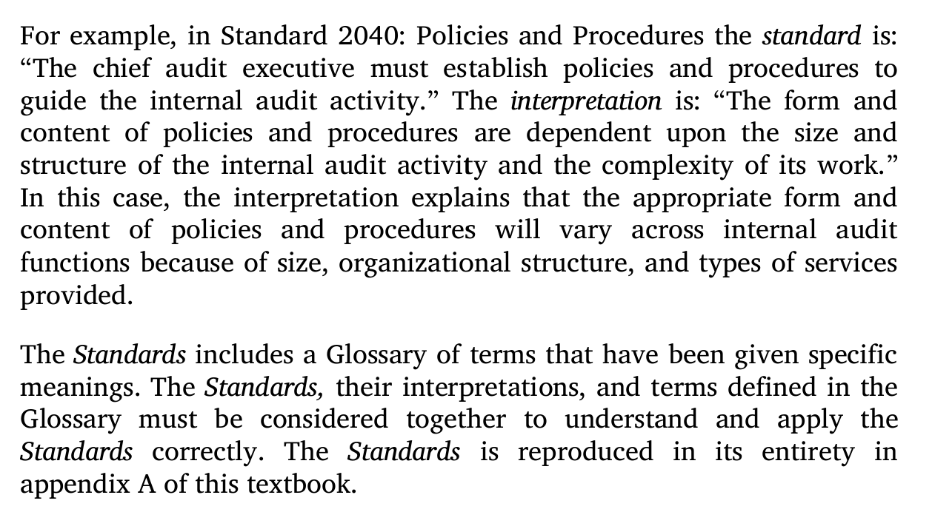
An example of a standard & interpretation

Slide 17
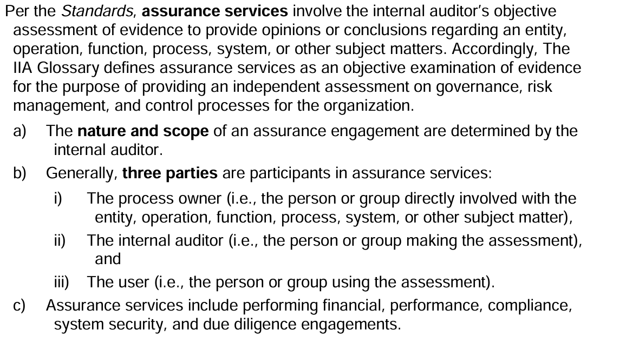
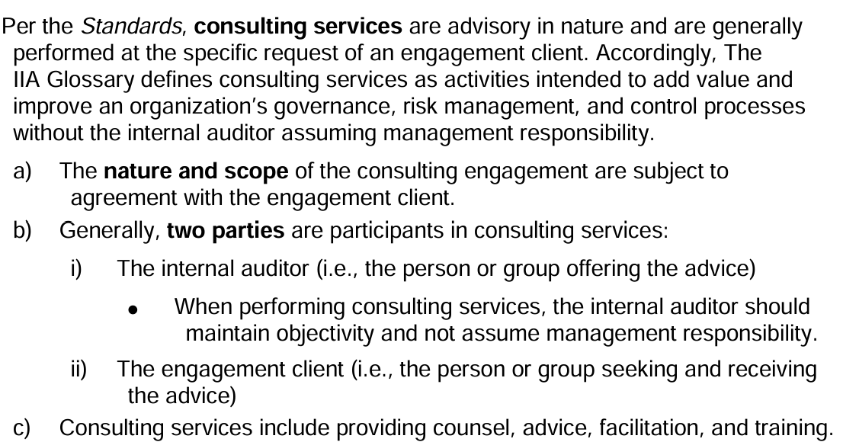
Assurance vs. Consulting Services

Slide 18
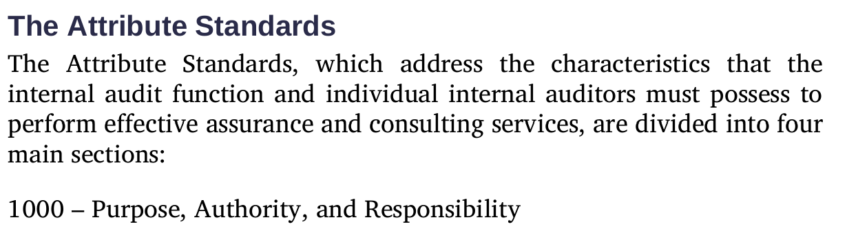
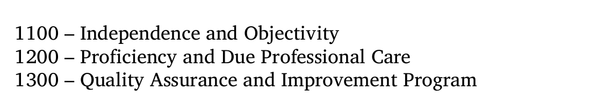
The Attribute Standards

Slide 19
1000 – Purpose, Authority, and Responsibility
The internal audit function must have a charter that clearly states the function’s purpose, authority, and responsibilities and specifies the nature of the assurance and consulting services the function provides.
The charter must be consistent with the Mission of Internal Audit. It also must acknowledge the internal audit function’s responsibility to adhere to the Core Principles, the Definition of Internal Auditing, the Code of Ethics, and the Standards.
The CAE “must periodically review the internal audit charter and present it to senior management and the board for approval” (Standard 1000: Purpose, Authority, and Responsibility).
Final approval of the charter is the responsibility of the board.

Slide 20
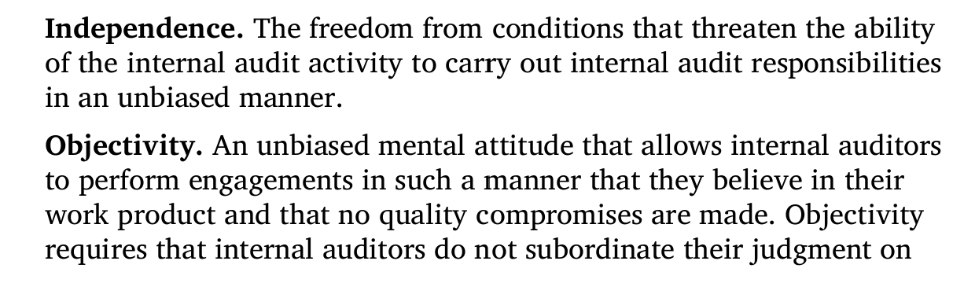
1100 – Independence and Objectivity
“The internal audit [function] must be independent, and internal auditors must be objective in performing their work” (Standard 1100: Independence and Objectivity).
The Glossary to the Standards defines independence and objectivity as follows:
Whereas independence is an attribute of the internal audit function, objectivity is an attribute of the individual auditor. This is a subtle, yet extremely important, distinction.

Slide 21
1100 – Independence and Objectivity
The extent to which an internal function can be independent depends on the relative status of the function within the organization.
Standard 1110: Organizational Independence states that “The chief audit executive must report to a level within the organization that allows the internal audit [function] to fulfill its responsibilities . . . and confirm to the board, at least annually, the organizational independence of the internal audit [function].”
Standard 1111: Direct Interaction with the Board requires the CAE to “communicate and interact directly with the board.”
Positioning the internal audit function at a high level within the organization facilitates broad audit coverage and promotes due consideration of engagement outcomes. Conversely, positioning the internal audit function lower within the organization greatly increases the risk of conflicts of interest that impair the function’s ability to provide objective assessments and advice.
For example, it would be difficult for an internal audit function to assess objectively the controls over financial reporting if the CAE reports to the controller who is responsible for the design adequacy and operating effectiveness of those controls.

Slide 22
1100 – Independence and Objectivity
Conflicts of interest impair independence and objectivity.
A conflict of interest is “a situation in which an internal auditor, who is in a position of trust, has a competing professional or personal interest” (Interpretation of Standard 1120: Individual Objectivity).
Potential conflicts of interest often arise as a result of naturally occurring events, such as:
  A senior manager from another area of the organization is asked to be the CAE.
  An employee moves into the internal audit function from another area of the organization or rotates through the internal audit function as part of his or her training regimen.
  An internal auditor with specialized accounting expertise is asked to assume a temporary accounting position.
  An internal auditor with management experience is asked to fill a vacated management position while the organization searches for a suitable replacement.
  An internal auditor is asked to design control policies and procedures in an area of the organization that does not have the requisite expertise to address existing control deficiencies.
  The CAE manages functions in addition to internal audit, such as risk management, information security, or compliance.
Task-related threats to independence and objectivity arise from the nature of the work itself. For example, an individual who recently joined the internal audit function might be asked to audit the area for which they were previously responsible. This individual would, in effect, be auditing his or her own work. Objectivity is threatened in such situations because people sometimes have trouble recognizing or acknowledging personal deficiencies or errors in their own work.
Independence and objectivity also can be undermined by incentives and personal relationships.
  Incentives involve conditions in which internal auditors have economic stakes in the outcomes of their work that could impair their judgment. Example: The auditee’s management promises to offer the internal auditor a job or support a promotion of the auditor if the engagement goes well and no problems are found.
  Personal relationships cause conflicts of interest when internal auditors perform engagements in areas of the organization in which relatives or close friends work as managers or employees. Such relationships may tempt internal auditors to overlook problems or soften negative conclusions.

Slide 23


1200 – Proficiency and Due Professional Care
Assurance and consulting services provided by internal auditors lacking the requisite knowledge, skills, and other competencies (that is, proficiencies) to perform the work or failing to apply the care and skills required will be of little, if any, value. Thus, the Standards requires that internal audit functions and individual auditors possess the knowledge, skills, and other competencies needed to fulfill their responsibilities and apply due professional care.
The Standards does not mandate a specific set of knowledge, skills, and other competencies.
One specific competency that is required by the Standards is knowledge of fraud risks. Standard 1210.A2 states that “Internal auditors must have sufficient knowledge to evaluate the risk of fraud and the manner in which it is managed by the organization . . .” They are not expected, however, “to have the expertise of a person whose primary responsibility is detecting and investigating fraud.”
Recommended guidance- The IIA’s Global Internal Audit Competency Framework (10 Core Competencies).

Slide 24
1200 – Proficiency and Due Professional Care
Proficiency applies to the internal audit function as a whole as well as to the individual internal auditor.
The CAE is responsible for ensuring that the internal audit function possesses the knowledge, skills, and other competencies required to fulfill the function’s responsibilities as specified in its charter. In cases in which the function lacks competencies required to perform all or part of an assurance engagement, the CAE “must obtain competent advice and assistance” from other sources (Standard 1210.A1).
When the internal audit function is asked to perform a consulting engagement for which the internal audit function does not possess the necessary competencies, the CAE “must either decline the consulting engagement or obtain competent advice and assistance” (Standard 1210.C1).
Standard 1220: Due Professional Care requires internal auditors to “apply the care and skill expected of a reasonably prudent and competent internal auditor.” This does not mean that internal auditors can never make mistakes or imperfect judgments, but rather that they will demonstrate the level of concern and competence expected of a professional. Due care also does not mean that internal auditors will examine every transaction, visit every location, or speak with every employee of the engagement auditee or customer. It does, however, mean that they will put forth the same level of effort as other internal audit professionals would in similar situations.

Slide 25
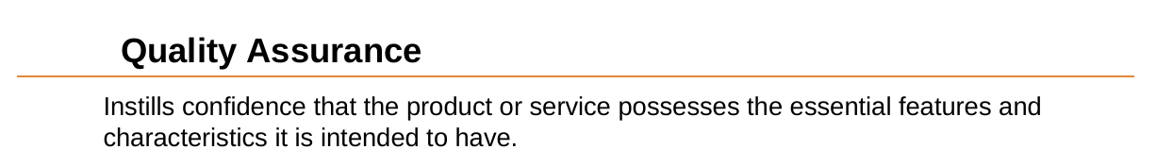
1300 – Quality Assurance and Improvement Program
An internal audit function’s quality assurance and improvement program “is designed to enable an evaluation of the internal audit [function’s] conformance with the Standards and an evaluation of whether internal auditors apply the Code of Ethics. The program also assesses the efficiency and effectiveness of the internal audit [function] and identifies opportunities for improvement” (Interpretation to Standard 1300: Quality Assurance and Improvement Program)

Slide 26
1300 – Quality Assurance and Improvement Program
“The chief audit executive must develop and maintain a quality assurance and improvement program that covers all aspects of the internal audit [function]” (Standard 1300: Quality Assurance and Improvement Program).
The CAE also “must communicate the results of the quality assurance and improvement program to senior management and the board” (Standard 1320: Reporting on the Quality Assurance and Improvement Program) and may state that the internal audit function conforms with the Standards “only if supported by the results of the quality assurance and improvement program” (Standard 1321: Use of “Conforms with the International Standards for the Professional Practice of Internal Auditing”).
“When nonconformance with the Code of Ethics or the Standards impacts the overall scope or operation of the internal audit [function], the chief audit executive must disclose the nonconformance and the impact to senior management and the board” (Standard 1322: Disclosure of Nonconformance).
Standard 1310: Requirements of the Quality Assurance and Improvement Program states that “The quality assurance and improvement program must include both internal and external assessments.” :
  Internal Assessment: (Ongoing Monitoring or Periodic Self-assessments)
  External Assessment: (once every 5 years by qualified, independent assessor/team)

Slide 27
The Performance Standards
    2000 Managing the IAF
    2100 Nature of Work
    2200 Engagement Planning
    2300 Performing the Engagement
    2400 Communicating the Results
    2500 Monitoring Progress
    2600 Resolution of Senior Management Acceptance of Risks

Slide 28
Recommended Guidance
Recommended guidance (Implementation Guidance and Supplemental Guidance) provides more specific, nonmandatory guidance. In some cases, recommended guidance may not be applicable to all internal audit functions. In other cases, it may represent only one of many acceptable alternatives. However, this guidance is authoritative in the sense that The IIA has endorsed it through a formal endorsement process, which includes review for consistency with the mandatory guidance.
1- Implementation Guidance (IG):
The Implementation Guidance component of the IPPF is provided in the Implementation Guides. These guides are not intended to give detailed processes and procedures but to provide potential or acceptable approaches to achieving conformance with the Standards. They assist Internal Auditors in applying the standards.Each of the Standards has an Implementation Guide (IG).
  Practice Advisories
  Concise and timely guidance: how to implement the standards
  IG 1000-1: Internal Audit Charter
2- Supplemental Guidance:
This component of the IPPF provides guidance for delivering internal audit services. This guidance, like the Implementation Guides, is not mandatory but is recommended and goes through an endorsement process. Supplemental Guidance is not organized by standard or other mandatory elements of the IPPF. Rather, the guidance addresses topic areas, industry sector specific issues, processes and procedures, various tools and techniques, and examples of deliverables.
  Practice Guides
  Detailed guidance on IA tools and techniques
  Guide to the Assessment of IT Risk (GAIT), for example

