Slide 1
CHAPTER 2
Theory of Interest Rates

Slide 2
2.1 THE RATE OF INTEREST
Consider a unit investment (i.e., of 1) for a period of 1 time unit, commencing at time t, and suppose that 1 + i(t) is returned at time t+1. We call i(t) the rate of interest for the period t to t+1.
One sometimes refers to i(t) as the effective rate of interest for the period.

Slide 3
2.1 THE RATE OF INTEREST
The accumulation of C from time t = 0 to time t = n (where n is some positive integer) is
If the rate of interest per period does not depend on the time t at which the investment is made, we write i(t) = i for all t. In this case the accumulation of an investment of C for any period of length n time units is,
The corresponding accumulation under simple interest at rate i per time unit is defined, as in Chapter 1, as

Slide 4
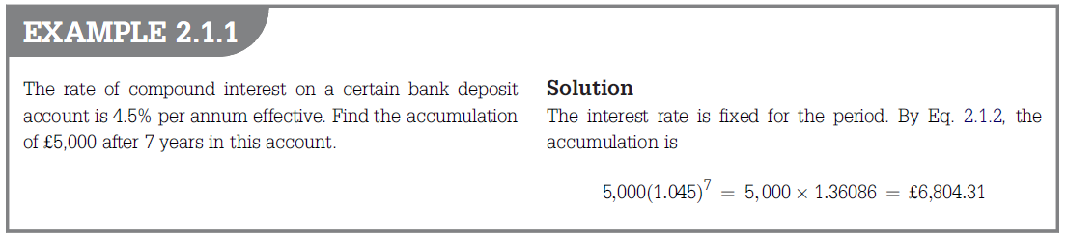

Slide 5
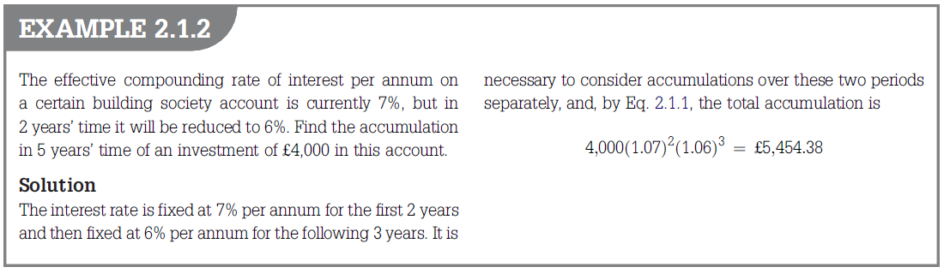

Slide 6
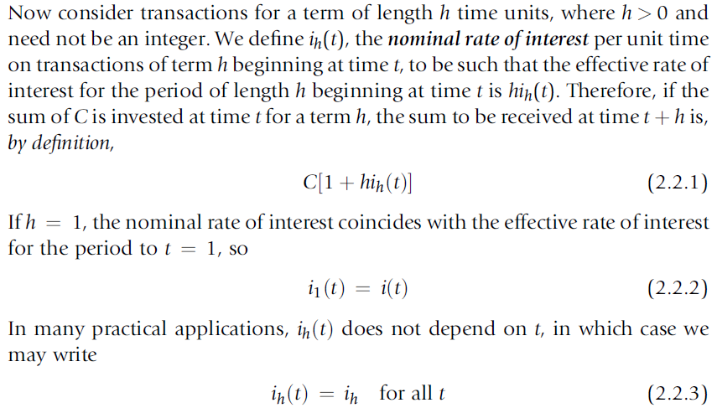
2.2 NOMINAL RATES OF INTEREST

Slide 7
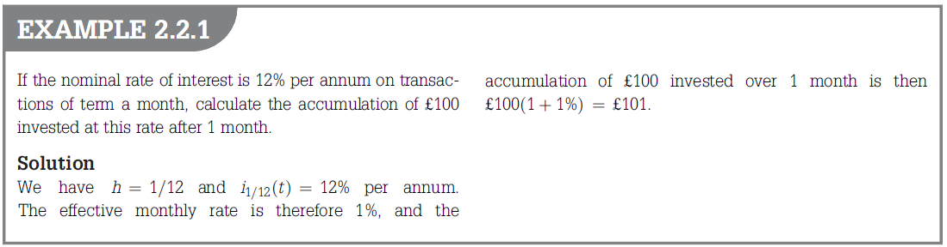

Slide 8
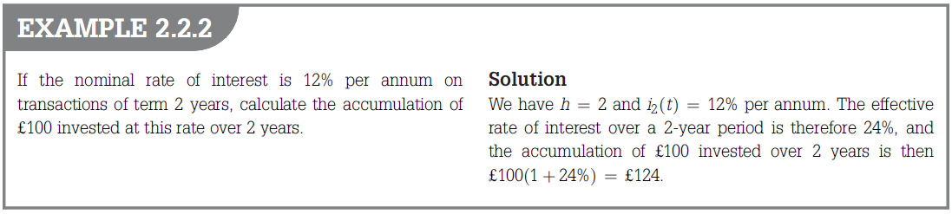

Slide 9
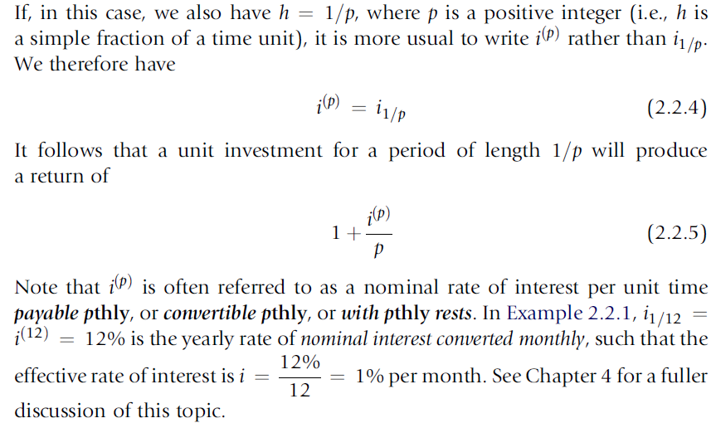
2.2 NOMINAL RATES OF INTEREST

Slide 10
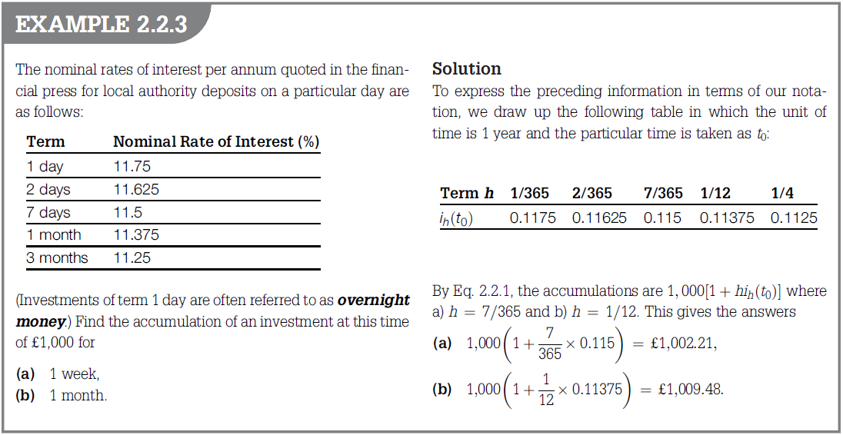

Slide 11
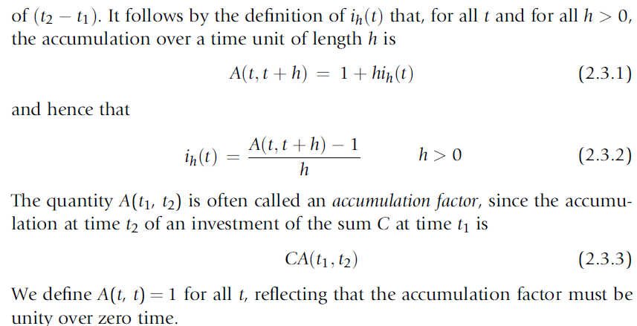
2.3 ACCUMULATION FACTORS

Slide 12
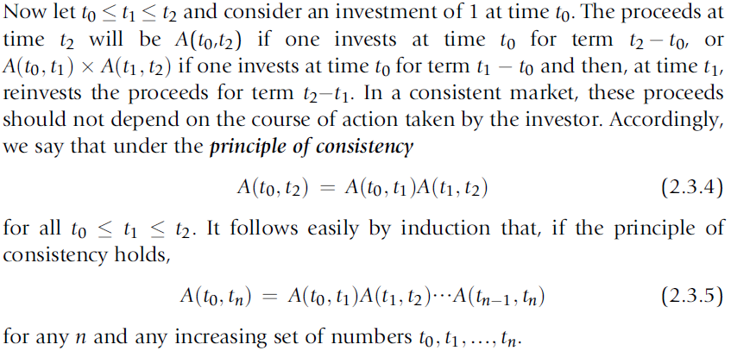
2.3 ACCUMULATION FACTORS

Slide 13
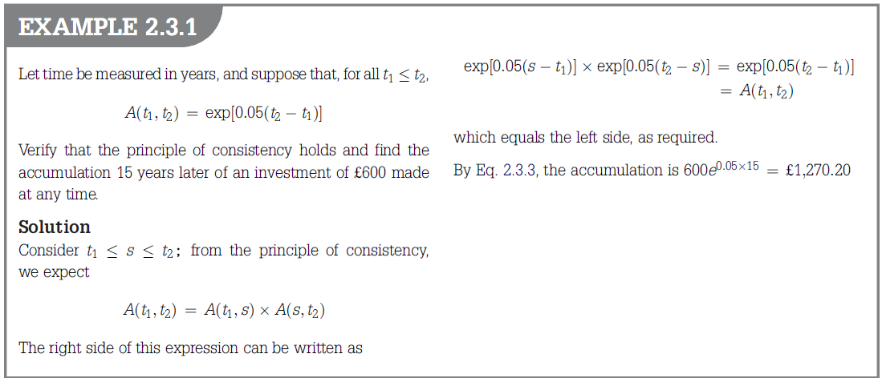

Slide 14
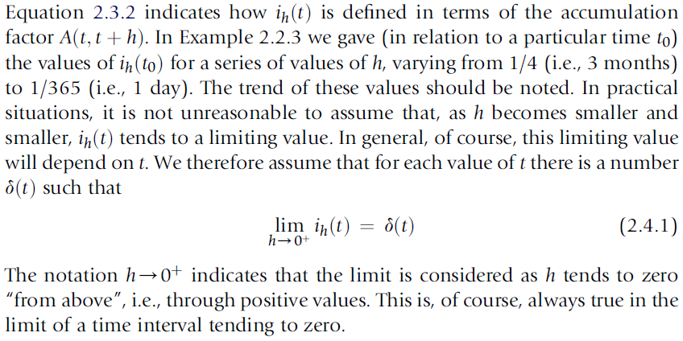
2.4 THE FORCE OF INTEREST

Slide 15
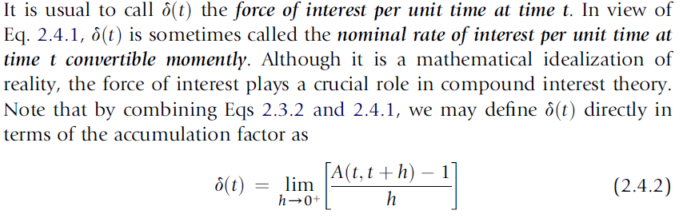
2.4 THE FORCE OF INTEREST

Slide 16
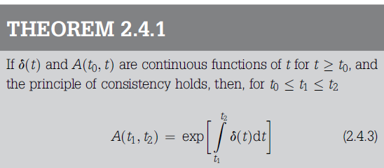
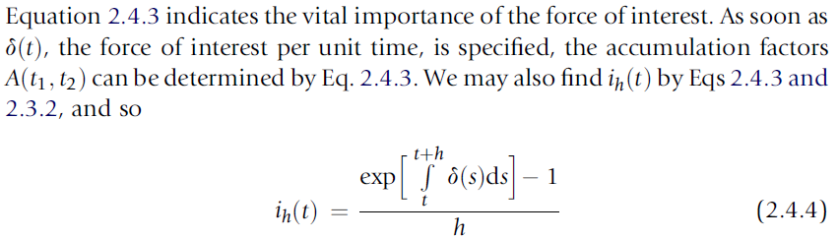
2.4 THE FORCE OF INTEREST

Slide 17
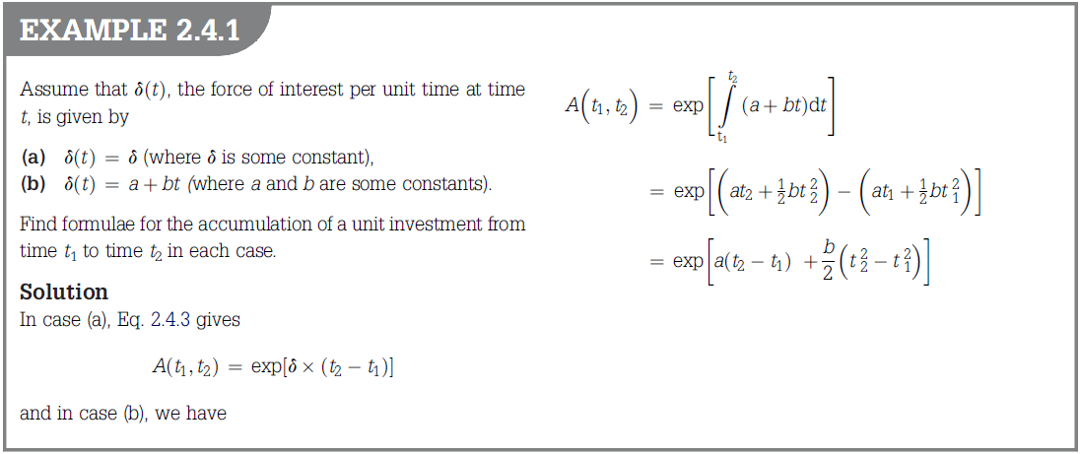

Slide 18
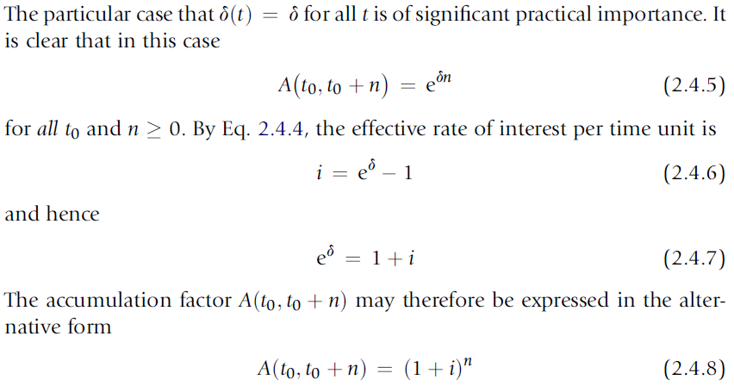
2.4 THE FORCE OF INTEREST

Slide 19
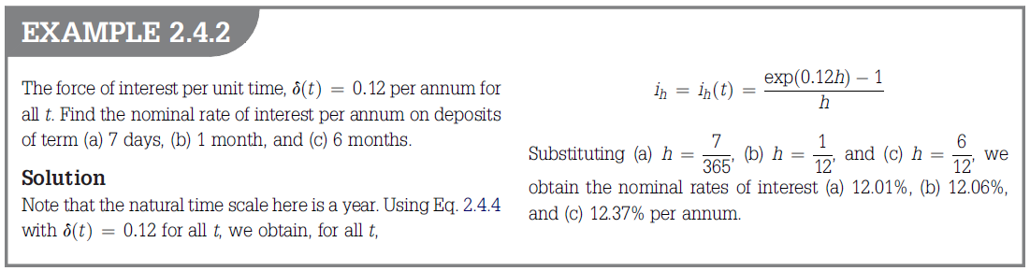

Slide 20
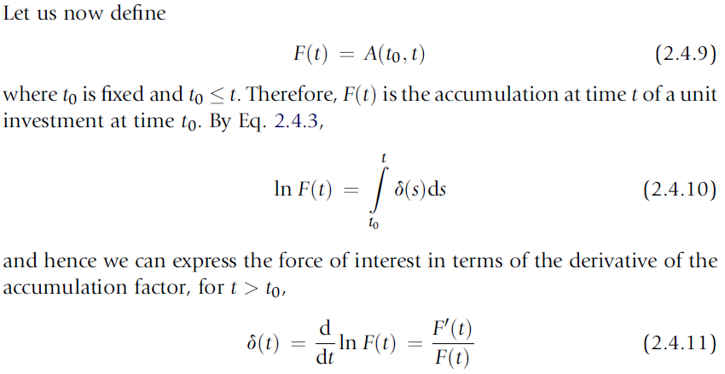
2.4 THE FORCE OF INTEREST

Slide 21
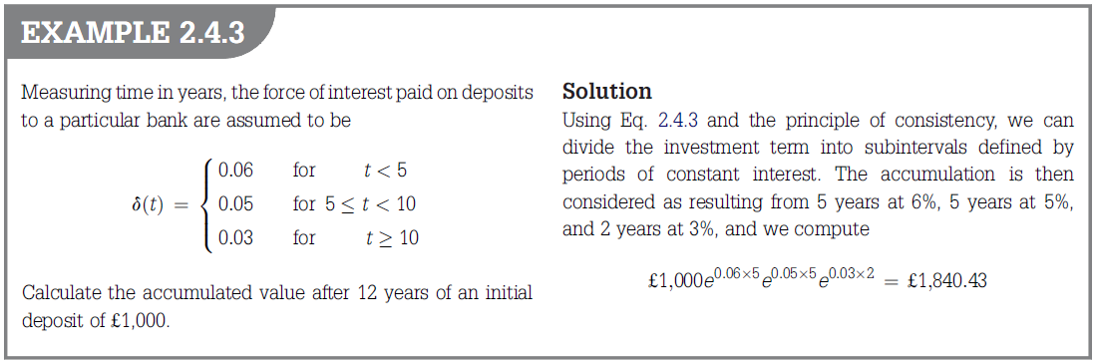

Slide 22
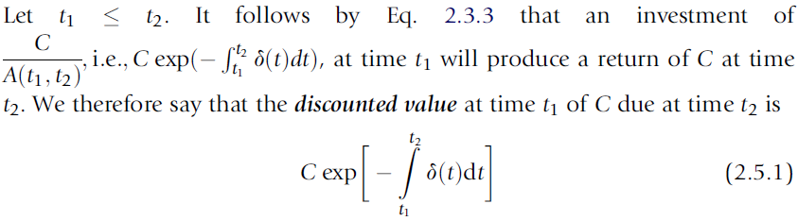
2.5 PRESENT VALUES
If one has a future liability of known amount at a known future time, how much should one invest now (at known interest rate) to cover this liability when it falls due? This leads us to the concept of present values.

Slide 23
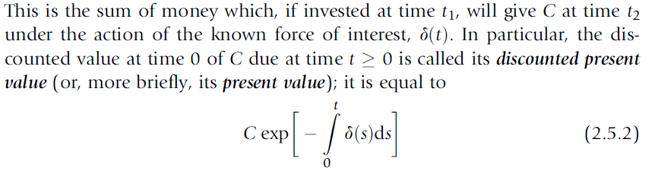
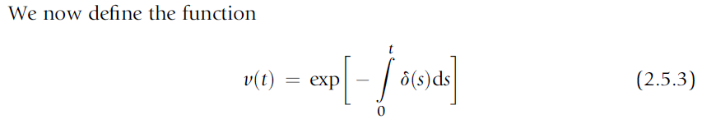
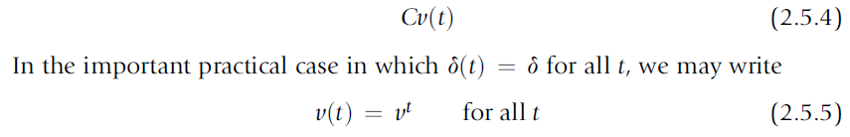
2.5 PRESENT VALUES
The discounted present value of C due at a non-negative time t is

Slide 24
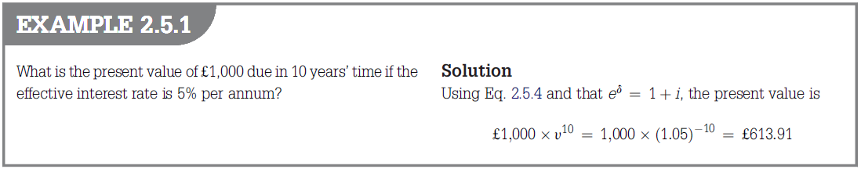

Slide 25
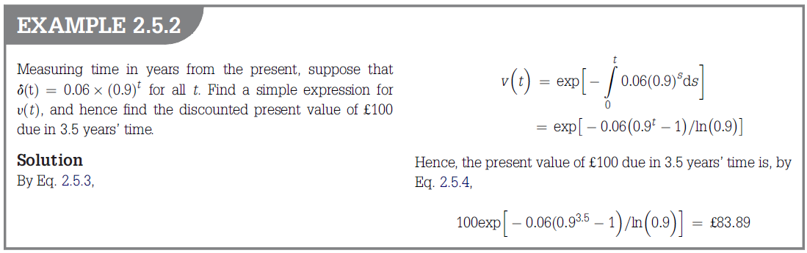
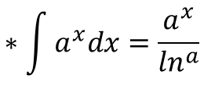
$$∗\int{a^{x}dx}=\frac{a^{x}}{\ln^{a}}$$

Slide 26
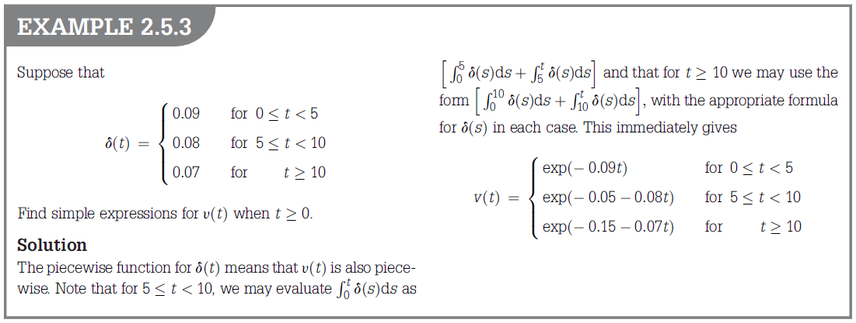

Slide 27
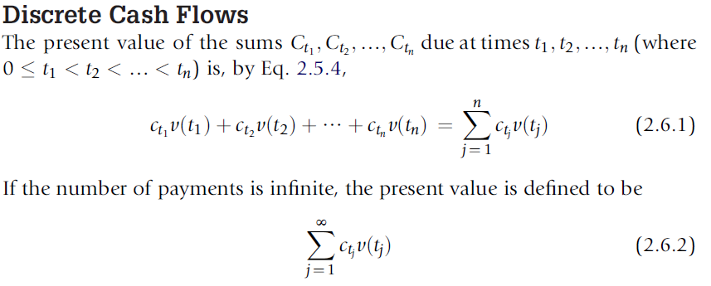
2.6 PRESENT VALUES OF CASH FLOWS

Slide 28
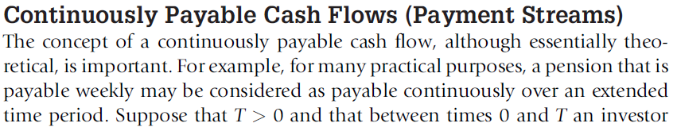
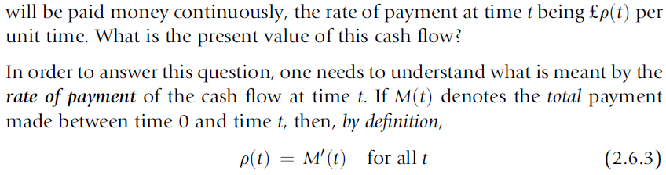
2.6 PRESENT VALUES OF CASH FLOWS

Slide 29
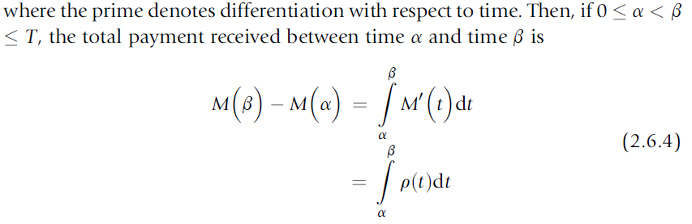
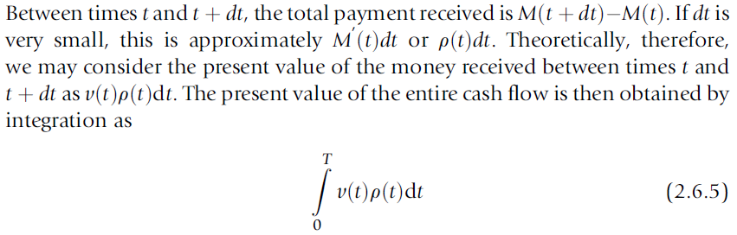
2.6 PRESENT VALUES OF CASH FLOWS

Slide 30
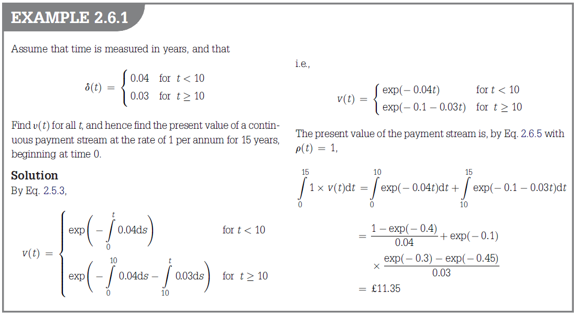

Slide 31
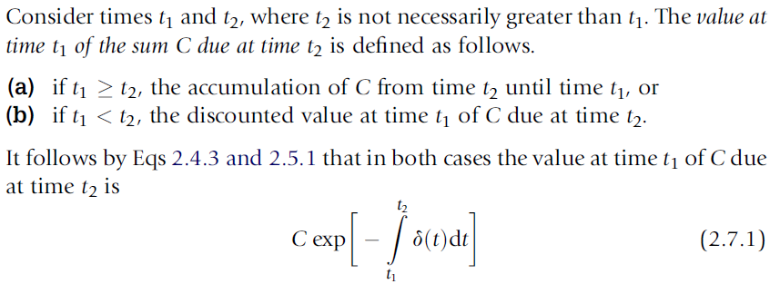
2.7 VALUING CASH FLOWS

Slide 32
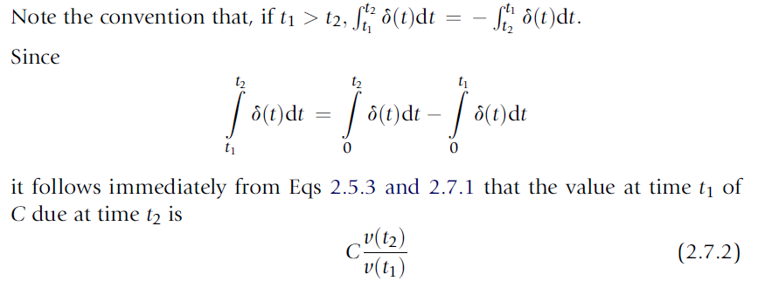
2.7 VALUING CASH FLOWS

Slide 33
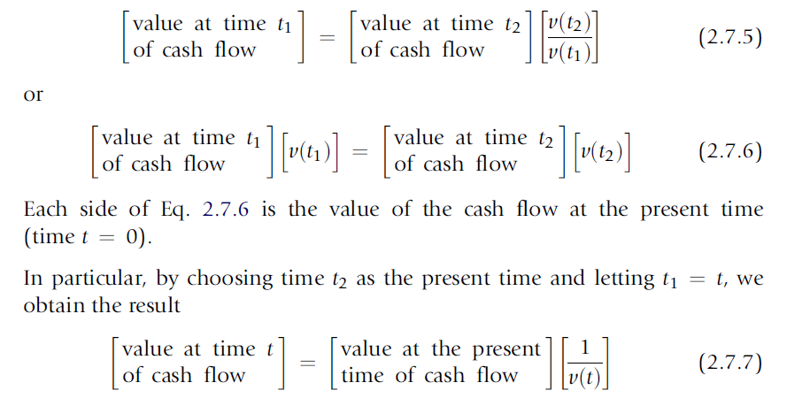
2.7 VALUING CASH FLOWS

Slide 34
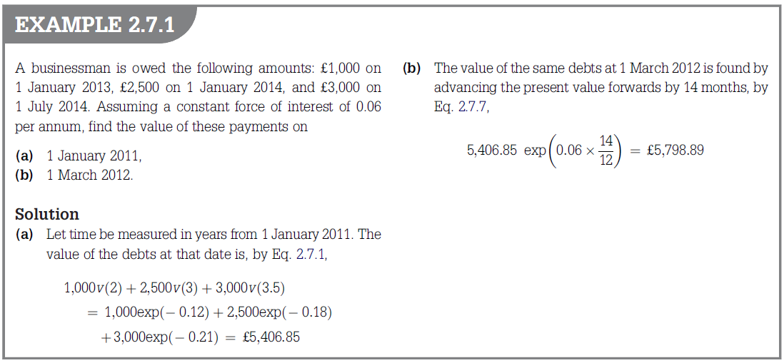

Slide 35
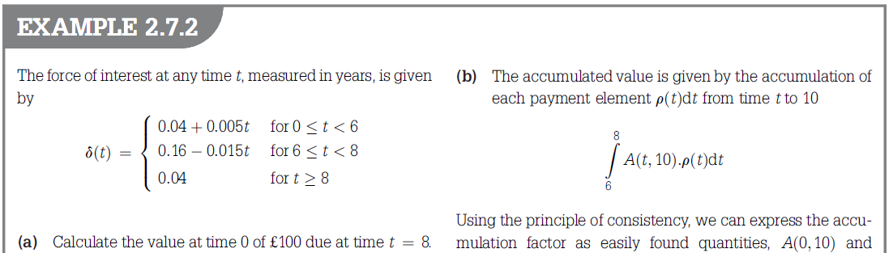
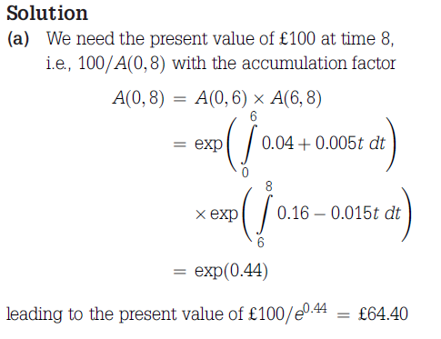

Slide 36
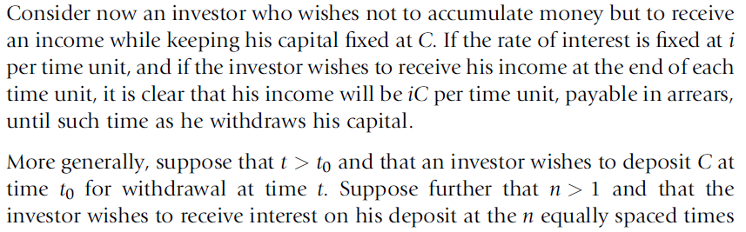
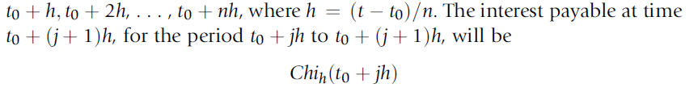
2.8 INTEREST INCOME

Slide 37
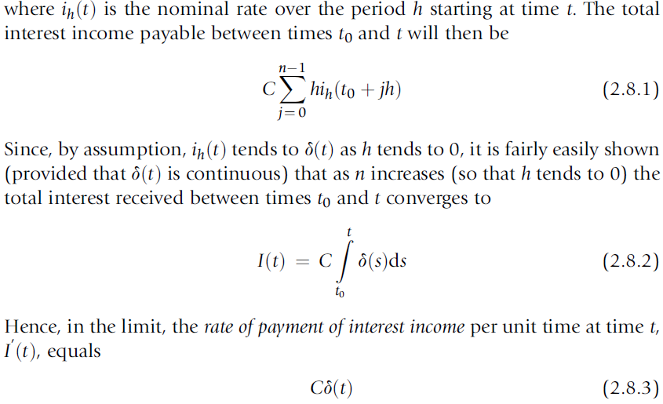
2.8 INTEREST INCOME

Slide 38
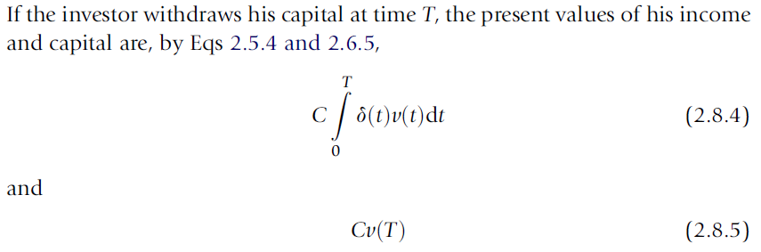
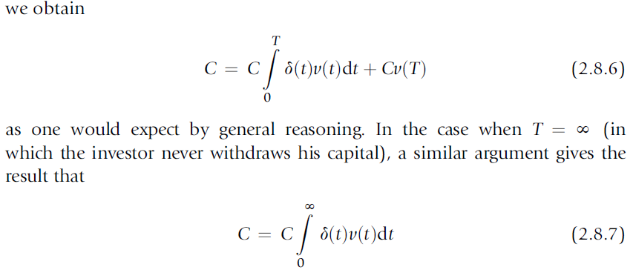
2.8 INTEREST INCOME

