Slide 1
Gluconeogenesis

Slide 2
When dietary intake of carbohydrate is low
Blood glucose concentration declines
Hormones including glucagon trigger accelerated glucose synthesis from noncarbohydrate sources in a process called gluconeogenesis.
Noncarbohydrate sources
Glycerol
Lactate
Amino acids
This occurs mainly in the liver
But in prolonged starvation→ kidney will also perform gluconeogenesis
Most of the glucose formed by the liver and the kidneys is released into the blood to maintain blood glucose levels.

Slide 3
Many steps in gluconeogenesis are the reverse of glycolysis.
Gluconeogenesis consumes ATP and NAD+
Most of the cytosolic enzymes involved in glycolysis catalyze their reactions reversibly and therefore provide the means for also converting pyruvate to glucose.
When the cell is oxidizing glucose for energy, it does not need to make glucose from gluconeogenesis so Both glycolysis and gluconeogenesis must be regulated.
The nonreversible reactions are regulated

Slide 4
In mammals, some tissues depend almost completely on glucose for their metabolic energy
  Human brain and nervous system(The brain alone requires about 120 g of glucose each day—more than half of all the glucose stored as glycogen in muscle and liver)
  Erythrocytes
  Testes, renal medulla, and embryonic tissues
The supply of glucose from glycogen stores is not always sufficient; between meals and during longer fasts, or after vigorous exercise, glycogen is depleted.

Slide 5
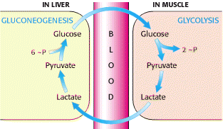
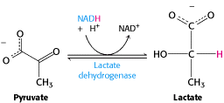
Cori Cycle
During muscular activity, the store of ATP needs to be constantly replenished.. Pyruvate→ TCA cycle
Intense workout- less O2--- lactic acid produced and NADH is reoxidized to NAD+ → more glycolysis
After vigorous exercise, lactate produced by anaerobic glycolysis in skeletal muscle returns to the liver and is converted to glucose, which moves back to muscle and is converted to glycogen ( if muscular activity has stopped )a circuit called the Cori cycle
Notes:
gluconeogenesis reverses both glycolysis and fermentation by converting lactate first into pyruvate, and finally back to glucose.

Slide 6
Three reactions in the glycolytic sequence are highly exergonic, highly regulated, and not reversible: those catalyzed by the enzymes glucokinase (hexokinase), phosphofructokinase, and pyruvate kinase (reactions 1, 3, and 10)
These three reactions have a large negative free-energy change, delta G, whereas other glycolytic reactions have a delta G near 0= equilibrium so direction will depend on substrate or reactant availability
The three irreversible reaction are bypassed in Gluconeogenesis

Slide 7
Step 1 The first of the bypass reaction
Conversion of pyruvate to phosphoenolpyruvate (PEP)
Occurs Matrix of Mitochondria
The bypass of the pyruvate kinase reaction involves the formation of oxaloacetate as an intermediate.
First Pyruvate from cytosol enters mitochondria
Mitochondrial pyruvate can be converted to oxaloacetate by pyruvate carboxylase ( found in mitochondria)
Anaplerotic process
  Pyruvate-→oxaloacetate
USES an ATP to attach a CO2 to Pyruvate

Slide 8
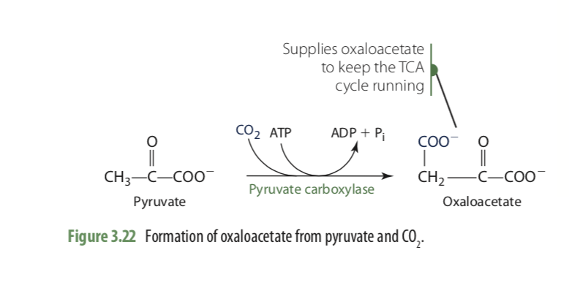
Requires Biotin as a cofactor
Additionally, Pyruvate can be generated in mitochondria from from alanine within by transamination reaction

Slide 9
Step 2 The first of the bypass reaction
Occurs in Cytoplasm
mitochondrial membrane has no transporter for oxaloacetate, before export to the cytosol the oxaloacetate formed from pyruvate must be reduced to malate by mitochondrial malate dehydrogenase, at the expense of NADH:
Oxaloacetate must be reduced to malate to move to cytoplasm
Oxaloacetate +NADH + H⁺ Malate + NAD⁺

Slide 10

Step 2 ( CONTINUED)
In the cytosol, malate is reoxidized to oxaloacetate, with the production of cytosolic NADH:
The oxaloacetate is then converted to PEP by phosphoenolpyruvate carboxykinase
Mg+2 -dependent reaction requires GTP as the phosphoryl group donor

Slide 11
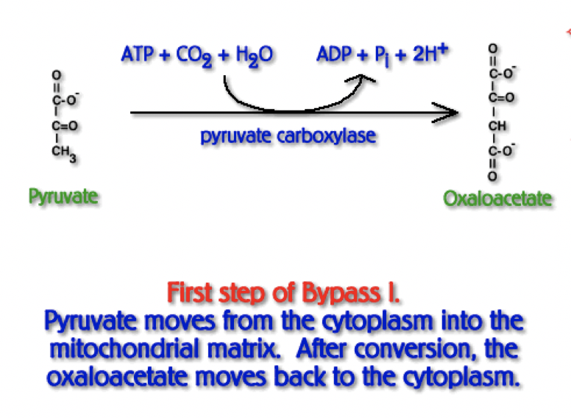

Slide 12
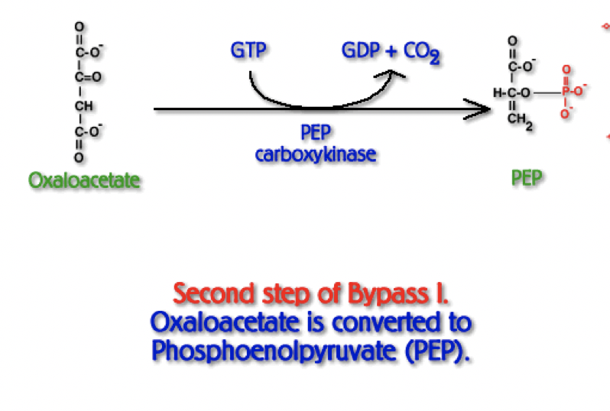

Slide 13
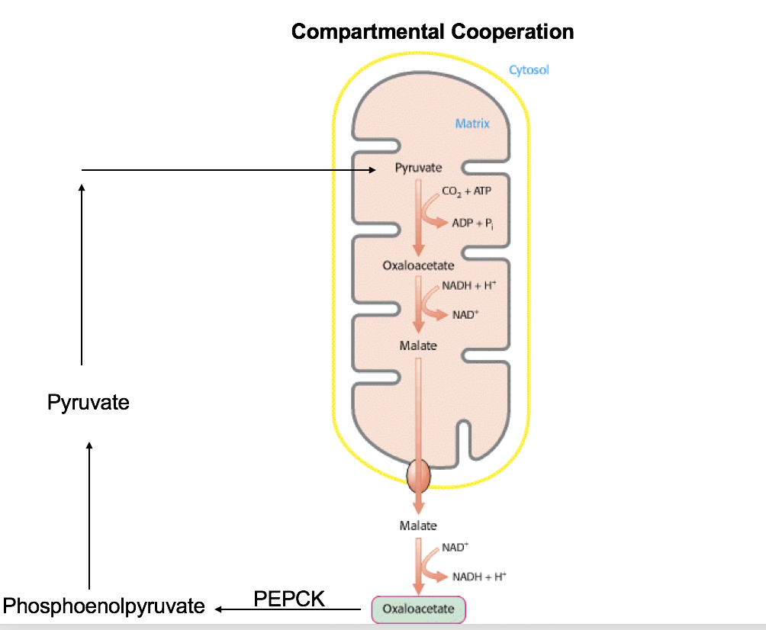

Slide 14
Phosphoenolpyruvate is converted to fructose 1,6-bisphosphate by reversal of the glycolytic reactions.

Slide 15
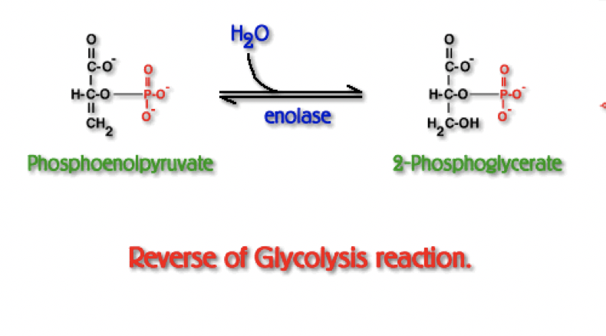

Slide 16
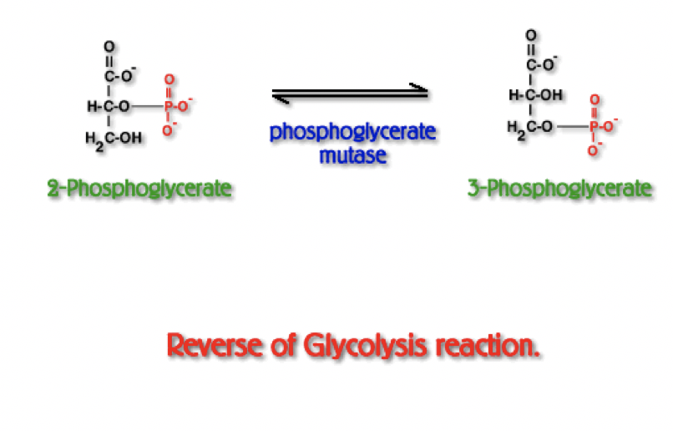

Slide 17
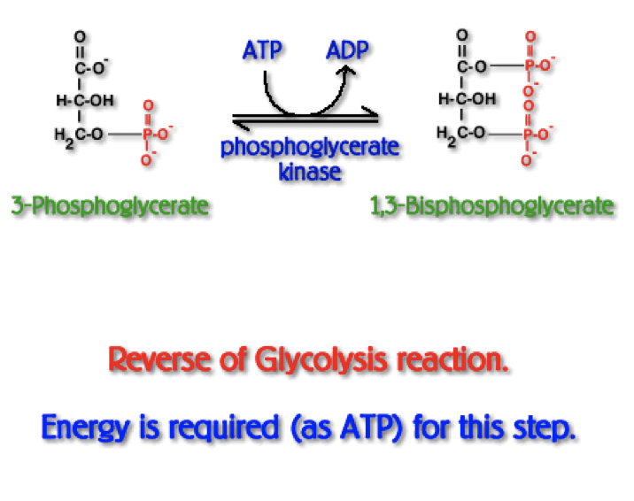

Slide 18
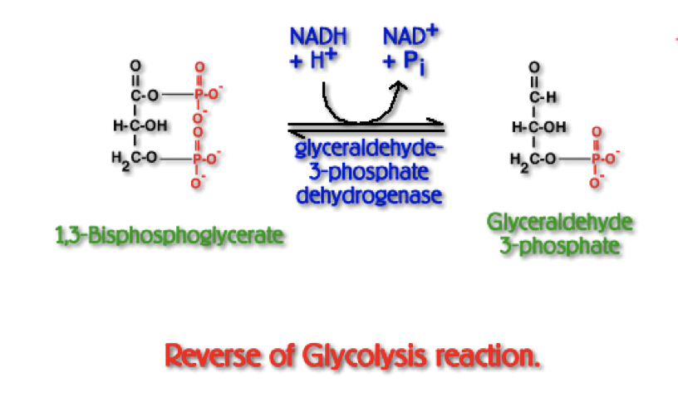

Slide 19
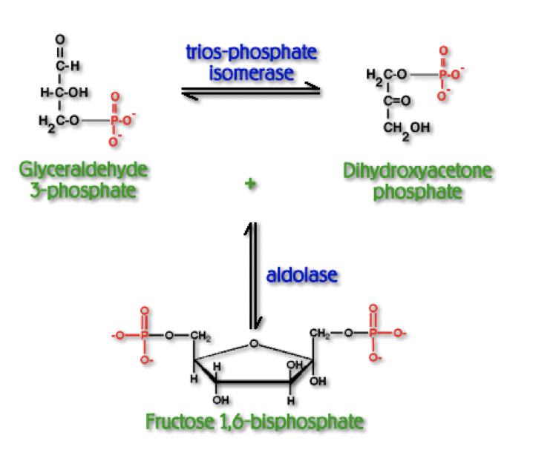

Slide 20
Conversion of Fructose 1,6-Bisphosphate to Fructose 6-Phosphate Is the Second Bypass
phosphorylation of fructose 6- phosphate by PFK-1 to fructose 1,6-bisphosphate is a highly exergonic and therefore irreversible in intact cells
The generation of fructose 6-phosphate from fructose 1,6-bisphosphate is catalyzed by a different Mg+2-dependent enzyme called fructose 1,6- bisphosphatase (FBPase-1)
Fructose 1,6-bisphosphate +H2O--------> fructose 6-phosphate +Pi
NO ATP produced instead hydrolysis of C-1 phosphate

Slide 21
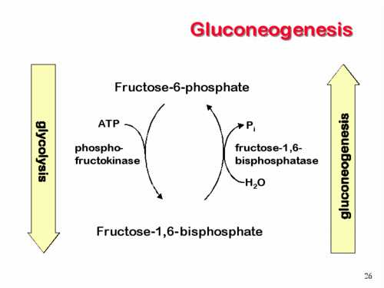

Slide 22
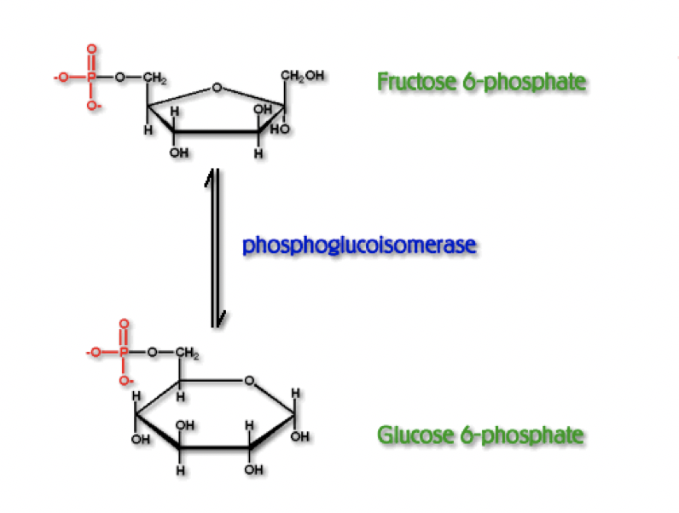

Slide 23
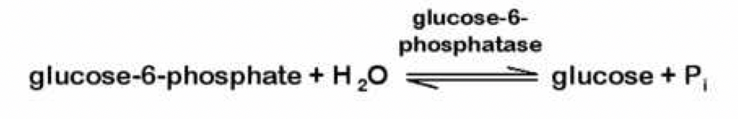
Third Bypass: conversion of Glucose 6-Phosphate to Glucose
Dephosphorylation of glucose 6-phosphate to yield glucose
phosphoryl group transfer from glucose 6-phosphate to ADP, forming ATP, an energetically unfavorable reaction
Catalyzed by glucose 6-phosphatase does not require synthesis of ATP; it is a simple hydrolysis of a phosphate
Mg+2-activated enzyme found on the lumenal side of the endoplasmic reticulum of hepatocytes and renal cells
Muscle and brain tissue do not contain this enzyme and so cannot carry out gluconeogenesis

Slide 24
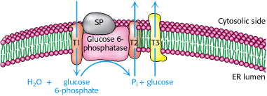

Slide 25
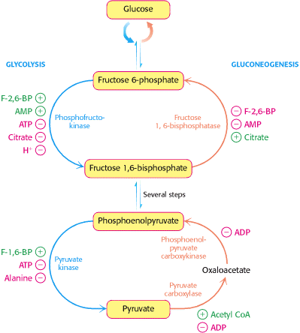

Slide 26
Lactate Utilization
Lactate is produced by red blood cells continuously and by skeletal muscle during strenuous physical exertion. The majority of lactate produced is released into the blood, where it travels to the liver for conversion to glucose via gluconeogenesis
The newly made glucose can, in turn, be released into the blood.
muscle cells lack glucose-6-phosphatase and cannot produce free glucose from noncarbohydrate sources.
The liver is able to prevent the accumulation of lactate while replenishing blood glucose. This is an important relationship between muscle and liver, especially during strenuous (anaerobic) physical activity when blood glucose is being used

Slide 27
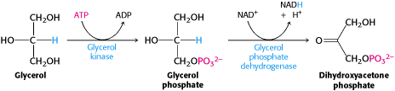
Glycerol Utilization
The hydrolysis of triacylglycerols stored in adipose tissue produces fatty acids and glycerol
Fatty acids catabolized to acetyl-CoA
The remaining glycerol molecule is released from adipose tissue into the blood, where it travels to the liver for conversion to glucose via gluconeogenesis.
Fatty acids cannot be used to make glucose because humans lack the necessary enzymes to convert acetyl-CoA to pyruvate or any intermediate along the gluconeogenic pathway.

Slide 28
To prevent the waste of a futile cycle, Glycolysis & Gluconeogenesis are reciprocally regulated.
Local Control includes reciprocal allosteric regulation by adenine nucleotides.
  Phosphofructokinase (Glycolysis) is inhibited by ATP and stimulated by AMP.
  Fructose-1,6-bisphosphatase (Gluconeogenesis) is inhibited by AMP.
This insures that when cellular ATP is high (AMP would then be low), glucose is not degraded to make ATP.
When ATP is low (AMP would then be high), the cell does not expend energy in synthesizing glucose

Slide 29
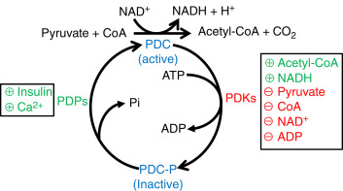
When fatty acids are readily available as fuels, their breakdown in liver mitochondria yields acetyl-CoA, a signal that further oxidation of glucose for fuel is not necessary.
Acetyl-CoA is a positive allosteric modulator of pyruvate carboxylase and a negative modulator of pyruvate dehydrogenase, through stimulation of a protein kinase that inactivates the dehydrogenase

Slide 30
When the cell’s energetic needs are being met, oxidative phosphorylation slows, NADH rises relative to NAD+ and inhibits the citric acid cycle, and acetyl-CoA accumulates.
Increased concentration of acetyl-CoA inhibits the pyruvate dehydrogenase complex, slowing the formation of acetyl-CoA from pyruvate, and stimulates gluconeogenesis by activating pyruvate carboxylase, allowing excess pyruvate to be converted to glucose.

Slide 31
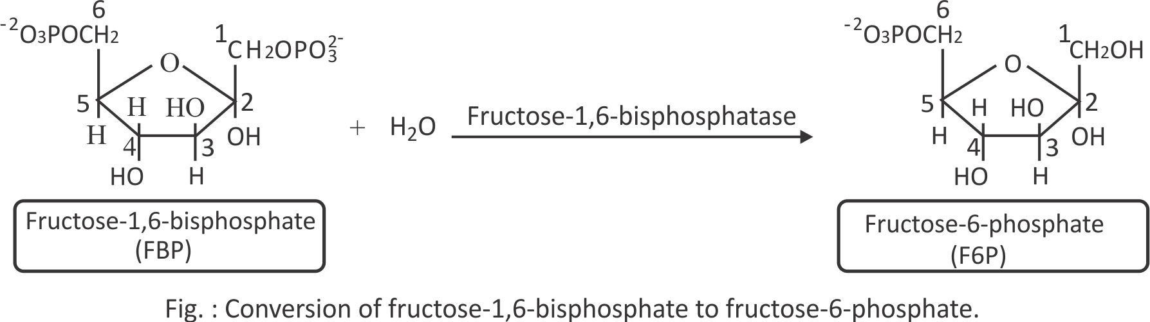
The second control point in gluconeogenesis is the reaction catalyzed by FBPase-1
fBPase-1 strongly inhibited by AMP. when sufficient concentrations of acetyl-CoA or citrate (the product of acetyl- CoA condensation with oxaloacetate) are present, or when a high proportion of the cell’s adenylate is in the form of ATP, gluconeogenesis is favored.

Slide 32
Role of liver in maintaining a constant blood glucose level
When the blood glucose level decreases, the hormone glucagon signals the liver to produce and release more glucose and to stop consuming it for its own needs.
One source of glucose is glycogen stored in the liver; another source is gluconeogenesis.
fructose 2,6-bisphosphate binds to its allosteric site on PFK-1, it increases that enzyme’s affinity for its substrate (Glycolysis)
PFK-1 is virtually inactive in the absence of fructose 2,6-bisphosphate. Fructose 2,6-bisphosphate activates PFK-1 stimulating glycolysis in liver and,
At the same time, inhibits FBPase-1, thereby slowing gluconeogenesis.

Slide 33
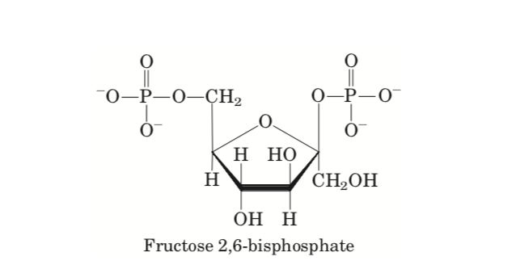
Fructose 2,6-bisphosphate is not an intermediate in gluconeogenesis or glycolysis; it is a regulator

Slide 34
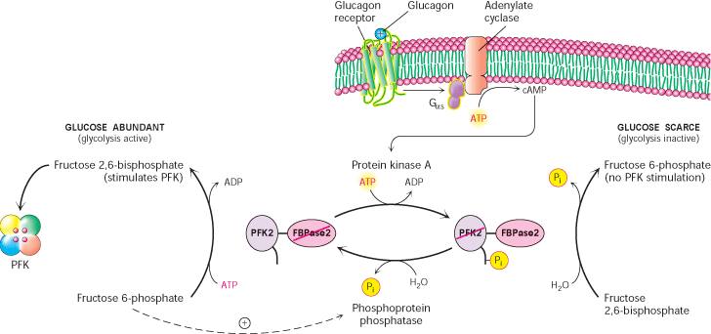
Glucagon stimulates the adenylyl cyclase of liver to synthesize 3’,5’-cyclic AMP (cAMP) from ATP. Then cAMP activates cAMP-dependent protein kinase, which transfers a phosphoryl group from ATP to the bifunctional protein PFK-2/FBPase-2. Phosphorylation of this protein enhances its FBPase-2 activity and inhibits its PFK-2 activity. Glucagon thereby lowers the cellular level of fructose 2,6-bisphosphate, inhibiting glycolysis and stimulating gluconeogenesis.

Slide 35
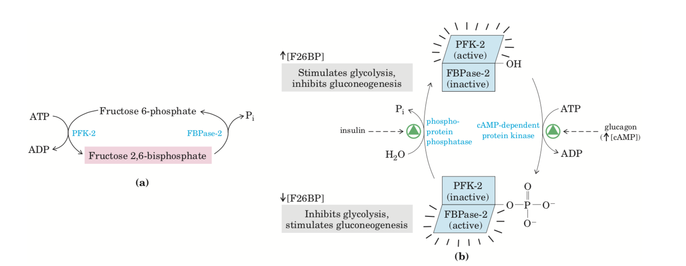
Insulin has the opposite effect, stimulating the activity of a phosphoprotein phosphatase that catalyzes removal of the phosphoryl group from the bifunctional protein PFK-2/FBPase-2, activating its PFK-2 activity, increasing the level of fructose 2,6-bisphosphate, stimulating glycolysis, and inhibiting gluconeogenesis.

Slide 36
Key Concepts in regulation of CHO metabolism
AMP, ADP, and ATP as Allosteric Modulators
Positive modulation by AMP: An increase in AMP (or ADP) concentration signifies a depletion of ATP and the need to produce more of this energy source- positively modulate energy releasing pathways
Examples:
1. positive regulator of phosphorylase ( an enzyme used in glycogenolysis)
2. Activation of phosphofructokinase

Slide 37
ATP—negative regulator of
  Pyruvate dehydrogenase complex
  Citrate synthase
  Isocitrate dehydrogenase.
NADH/NAD+ Ratio
NADH is a product of glycolysis. Its buildup would indicate the pathway is not needed to produce additional ATP. In the fasted state, the liver typically has more NAD+ because doing gluconeogenesis, muscle will be utilizing glucose—less NAD+/NADH ration
Covalent Regulation
Directional Shifts in Reversible Reactions (The concentration of the reactants and products in the cell)
Genetic Regulation
  The abundance of an enzyme can be either induced or suppressed( Gene expression may be influenced by hormones, dietary intake, environment )

