Slide 1
Fluid Mechanics I
Chapter 1
Introduction
Dr. Afif Akel Hasan
Mechanical & Mechatronics Engineering

Slide 2
Outline
Fluids
Units & dimensions
Properties o fluids
Viscosity

Slide 3
Fluid
Matter consist of two states ; fluid and solid .
A solid can resist sheer stress by a static deformation . The fluid move and deforms continuously as long as sheer stress is applied.
A fluid continues to flow for as long as the force is applied and will not recover its original form when the force is removed.
Shear force : force component tangent to the surface .
Shear stress is the sheer force per unit area τ = F/area .

Slide 4
Fluid Mechanics
Fluid Mechanics : is the study of the fluids either in motion or at rest and the effects of the fluid upon the boundaries.
Fluids: Gases and liquid.
Fluid at rest : fluid statics
Fluid in motion : fluid dynamics

Slide 5
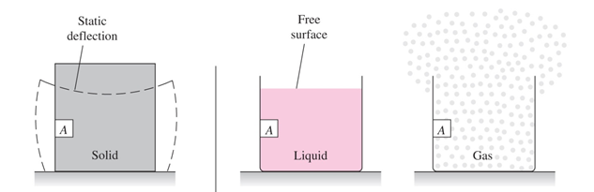
Fluids
Fluid of two classes: liquids and gases .
A liquid composed of relatively closed – packed molecules with strong cohesive forces ,
Gases are widely spaced molecules with negligible cohesive forces .
A gas has no definite volume

Slide 6
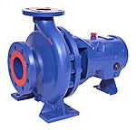
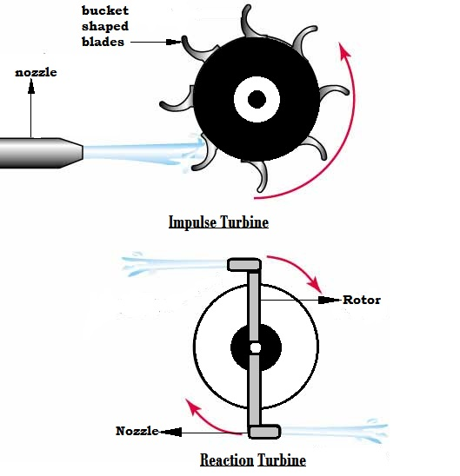

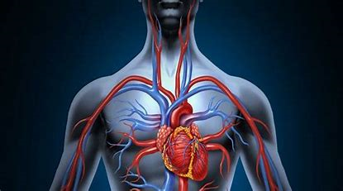

Engineering Application
Examples include breathing , blood flow, heart, swimming,
Equipment: Pumps, fans, turbines
Transport: ships, cars , air planes , plane engines , jets …

Slide 7
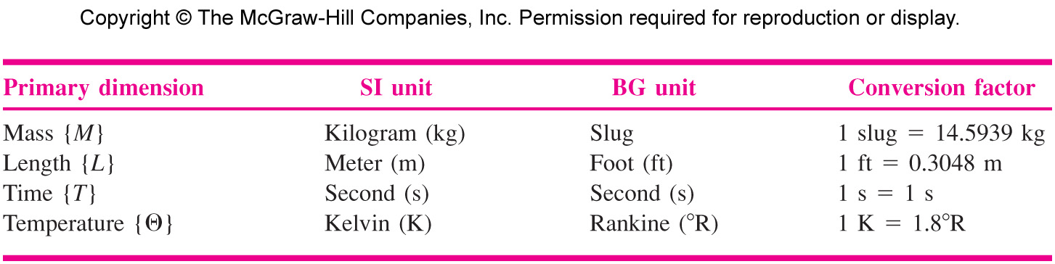
Dimensions and Units
Primary dimensions: from which all other dimensions can be derived : mass, length, time and temperature , for ones used in fluid mechanics see Table (1.1) P. 8 .

Slide 8
Primary unit systems
  There are three primary unit systems in use:
    the International System of Units (SI units - kg, N, m, s, K)
    the English Engineering System of Units (commonly called English units - lbm, lbf, ft, s, R)
    the British Gravitational System of Units (BG - slug, lbf, ft, s, ºR)
  Units must always have numbers associated with them.
  For example, length is a dimension, but it is measured in units of feet (ft) or meters (m).

Slide 9

Secondary dimensions
Derived or constructed from combinations of these four primary dimensions eg .
Acceleration L/T2 = LT⁻² dv/dt
Force F = m a (Newton's 2nd law)
F = M L T⁻²
i.e 1N = 1kg .m/s²
See table 1.2 p .9 for some secondary dimensions.

Slide 11
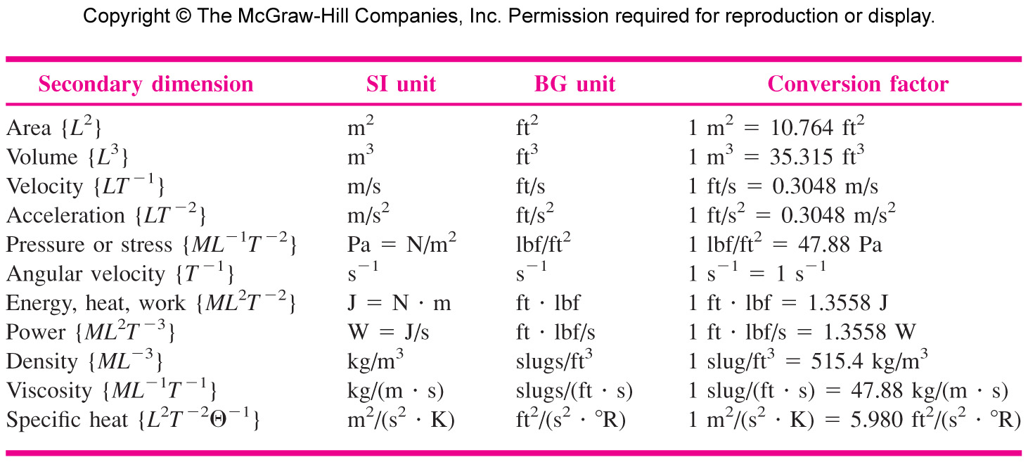
Secondary dimensions

Slide 12
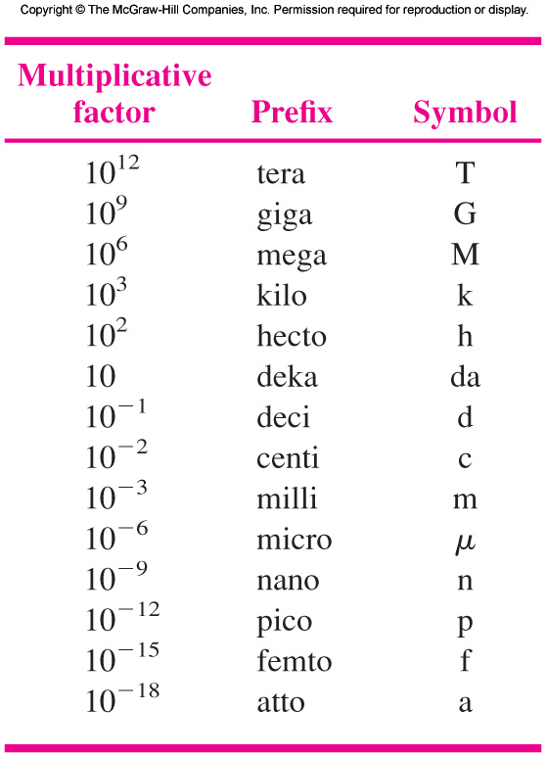
Prefix of units
tera- (T-) | 10¹² | 1 trillion
giga- (G-) | 10⁹ | 1 billion
mega- (M-) | 10⁶ | 1 million
kilo- (k-) | 10³ | 1 thousand
hecto- (h-) | 10² | 1 hundred
deka- (da-)** | 10 | 1 ten
deci- (d-) | 10⁻¹ | 1 tenth
centi- (c-) | 10⁻² | 1 hundredth
milli- (m-) | 10⁻³ | 1 thousandth
micro- (µ-) | 10⁻⁶ | 1 millionth
nano- (n-) | 10⁻⁹ | 1 billionth

Slide 13
EXAMPLE 1.1
A body weighs 1000 lbf when exposed to a standard earth gravity g 32.174 ft/s2.
  What is its mass in kg?
  (b) What will the weight of this body be in N if it is exposed to the moon’s standard acceleration gmoon 1.62 m/s2?
  (c) How fast will the body accelerate if a net force of 400 lbf is applied to it on the moon or on the earth?

Slide 14


Slide 15
EXAMPLE 1.2
An early viscosity unit in the cgs system is the poise (abbreviated P), or g/(cm. s). The viscosity of water (fresh or salt) at 293.16 K 20°C is approximately 0.01 P. Express this value in (a) SI and (b) BG units.

Slide 16
Thermodynamic Properties of a fluid
Most common properties
Pressure P
Density ρ
Temperature T
Others for work and energy calculations:
Internal energy u
Enthalpy h = u +P/r
Specific heat C_{p} , C_{v}
Entropy s
Viscosity µ
Thermal conductivity k
Two properties such as ( P,T) are sufficient to fix the value of all other properties for pure substances.

Slide 17
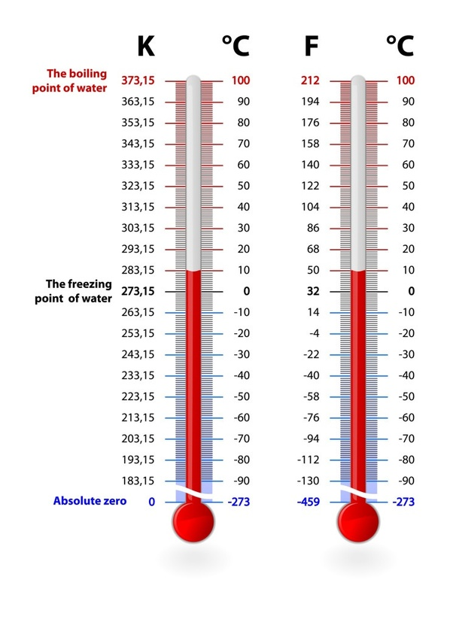
Pressure & temperature
Pressure: pressure is the stress at a point in a static fluid, or force per unit normal area P = F_{normal} / A_{area}
1 atmosphere = 101300 Pa = 101.30 kPa
Temperature : a measure of the internal energy level of a fluid,
Centigrade ( Celsius) and absolute K = C +273.16 .
Degree size is the same for C and K

Slide 18
Fluid density
Density : mass per unit volume , symbol ( ρ )
ρ = m/v [ kg/m³ ]
Density is nearly constant for liquids, while increasing proportional to pressure of gases .
Liquids are treated as incompressible fluid (density doesn’t change with changing pressure ) .
e.g water density 1000kg/m³, air density 1.2 kg/m³ at 300 K 1 atm.
Mercury 13600 kg/m³.

Slide 19
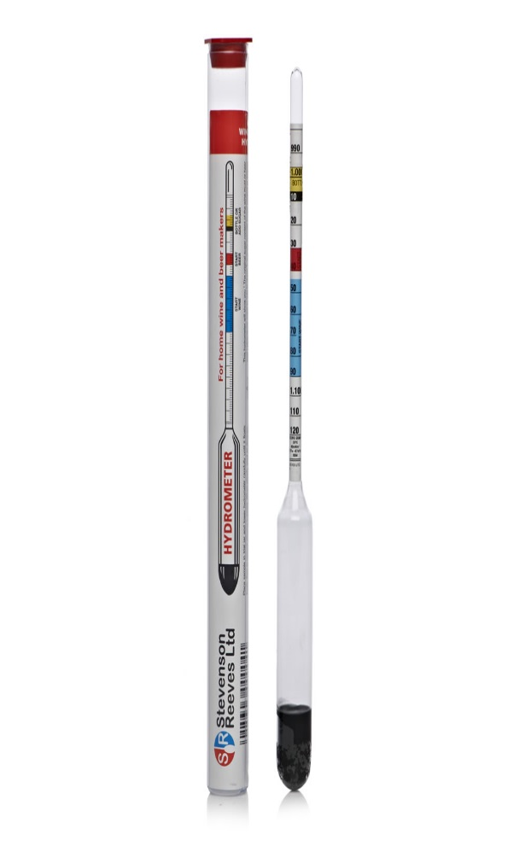
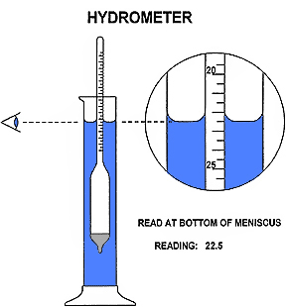
Specific gravity
Specific gravity SG : a ratio of a fluid density to standard reference fluid.
Reference fluids: water ( for liquids ) and air for gases .
SG _{gas} = ρ _{gas} / ρ _{air} = ρ _{gas} / 1.205 kg/m³
SG _{liquid} = ρ _{liquid} / ρ _{water} = ρ _{liquid} / 998 kg/m³
e.g SG _{Hg} = 13580 / 998 = 13.6

Slide 20
Specific weight
Specific weight: denoted by “ ɣ “ is the weight per unit volume ɣ = ρ g
since ɣ = mg /V = ρ g .
Hence units of [ɣ ] are N / m³ or lbf/ ft³ .
e.g ɣ _{air} = 1.205*9.8 = 11.8 N/m³ = 0.0752 lbf/ft³
  at 20 C ɣ _{water} = 9.807 *998 = 9790 N/m³ = 62.4 lbf/ft³
To remember: ɣ _{air} = 10 N/ m³ , ɣ _{water} = 10kN/m³

Slide 21
Potential and Kinetic Energy
Energy stored in a system by molecular, activity and molecular bonding forces is denoted as internal energy .
Potential energy equals the work required to move up the system mass ‘m’ from one elevation to another one against the gravity field . PE = mg ∆z
Kinetic energy equals the work required to change the speed of the ‘m’ from zero to velocity V , its value is ½mV² .
The total storage energy per unit mass in fluid mechanics is given as e = u + ½V² + gz

Slide 22
State relation of gases
Pure substance for a single – phase pure substance e.g water in liquid phase . Air can be consider to be a pure substance, two properties fixes state and value of other properties V = f( T,P ).
Gases at high temperature and low pressure are treated as perfect and ideal gases intermolecular forces are negligible.
Ideal gas PV = mRT
P = (m/V ) RT = ρRT
PV = n R` T
R` = universal gas constant = 8314 m²/s².K
R = R` /( M.wt) ➔ for air Mwt = 28.97
e.g R_{air} = 287 m²/s² .K
standard air density @ 25 C P_{atm} = 101300Pa
ρ_{air} = P/(RT) = 10300 [N/m² ]/ (287[m²/s².K] * 298[k]) = 1.205 kg/m³

Slide 23
Specific heat
for gases
Specific heat at constant volume C_{v} = ( du/dt )_{v}
Specific heat at constant pressure C_{p} = ( dh/dt )_{p}
Specific heat ratio K = (C_{p} /C_{v} ) > 1
For air k=1.4
For ideal gases internal energy and enthalpy are only function of temperature.
u = f(t) , h = f(t)
dh = C_{po} dT → ∆h = ∫ C_{po} dT
du = C_{vo} dT → ∆u = ∫ C_{vo} dT

Slide 24
Bulk modulus
A measure of compressibility of fluids is the coefficient of the Compressibility ß .
ß = - (1/v )( dv/dp)_{T}
Bulk modulus κ = 1/ ß = - v ( dp/dv)_{T}
For ideal gas: show that ß =1/P

Slide 25
Vapor pressure
It is the pressure developed above the liquid when liquid in a closed container or pressure at which liquid boils .
Vapor pressure is a function of temperature e.g for water
at 100 º C P_{vapor} =1 atm = 101.30kPa .
at 50 º C P_{vapor} = 12.350 kPa
Vapor pressure of water.

Slide 26
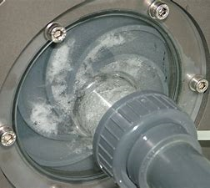
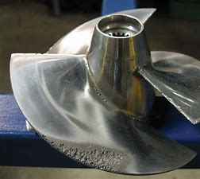
Cavitation
Cavitation occurs when pressure is lower than vapor pressure at given temp ,of liquid ( liquid will flash into vapor ).
For cavitation , dimensionless parameter called cavitation number is used
C_{a} = (P_{a} - P­_{v} )/ ½ρV²
Where : P_{a} = ambient pressure
P_{v} = vapor pressure
V = flow velocity
Critical cavitation number : value of Ca below which cavitation ( bubbles formation ) Take place in a flow.

Slide 27
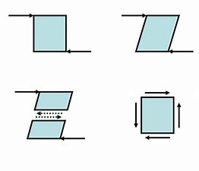
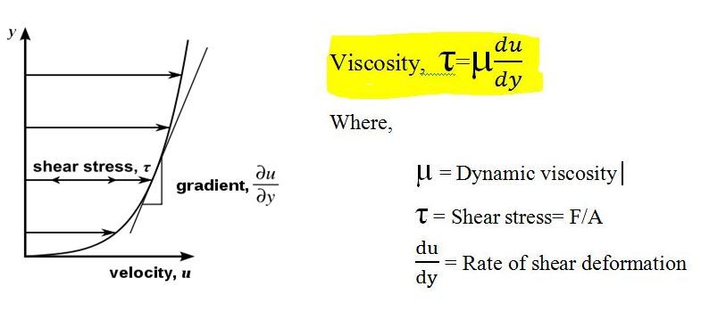
Newton law of viscosity

Slide 28
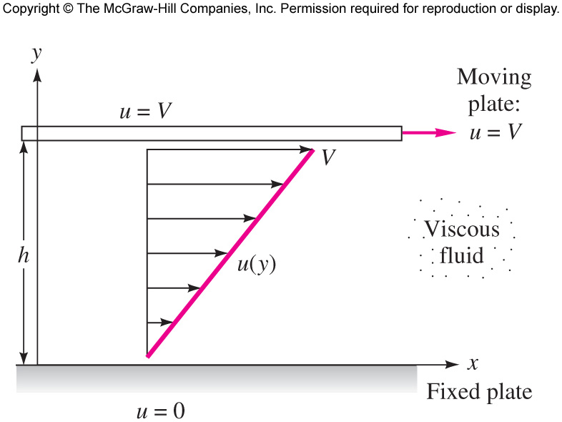
Newton law of viscosity
Consider a flow induced between a fixed lower plate and an upper plate moving at velocity “V” as force “F: is applied to the upper plate. Plate separation “h”, area of plate “A”.
It is found F = (AV/h) or
(F/A )= (V/h )
But (F/A ) = τ = sheer stress .

Slide 29
Newton's law of viscosity
It can be shown that (V/h) = (du / dy) = (V-0) /( h-0) = (∆u /∆y )
Where u = v at y = h
u = 0 at y = 0
For linear profile (V /h) = (∆u /∆y ) = (du /dy )
Then τ = μ (du /dy ) known as Newton's law of viscosity .
Note (du /dy ) is the rate at which one layer moves relative to the adjacent layer.
μ = viscosity
μ = signifies the resistant of the fluid to the shear stress.

Slide 30
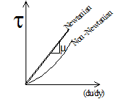
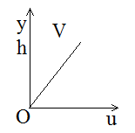
Shear stress
If τ vs ( du/dy ) is a straight line then the fluid is Newtonian , and the slope is μ.
Non- Newtonian fluid such as long chain hydrocarbons the τ vs ( du/dy ) is not linear.
For a linear velocity profile u(y) = a +by
from B.C.
At [ y =0 u = 0 , y = h u = v ] ➔ u = ( v/h) y

Slide 31
EXAMPLE 1.8
Suppose that the fluid being sheared in Fig. 1.6 is SAE 30 oil at 20°C. Compute the shear stress in the oil if V = 3 m/s and h = 2 cm.

Slide 32
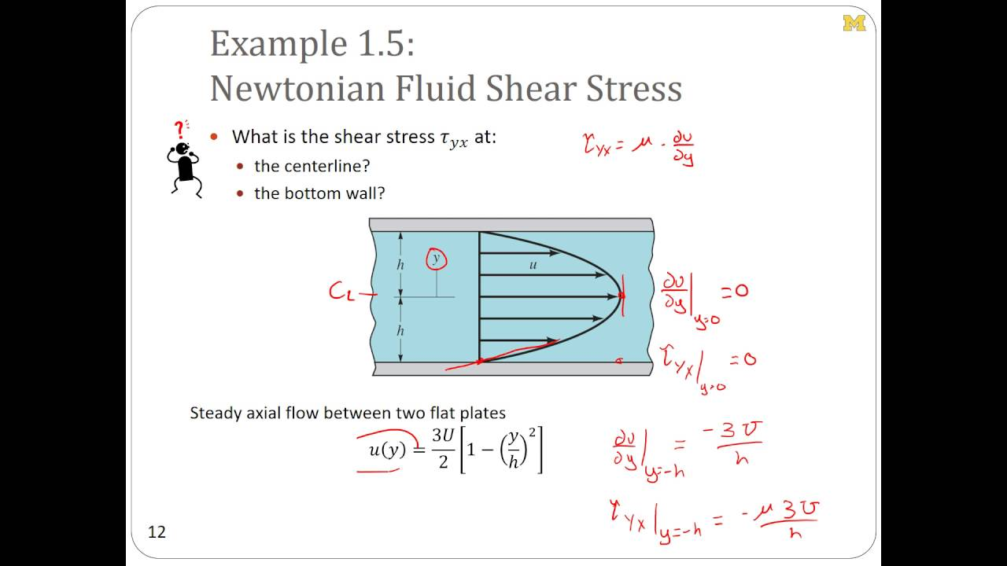

Slide 33
Unit of viscosity
μ = τ / (du /dy )
μ = (F/A)/(V /L ) = ( F/L²) / {(L/T)/L} but F = m a = ML/T²
[μ ] = { ML / T²L² }/(L/T)/L = (M / T L)
or [μ ] = FT / L²
[μ ] = M / TL
SI units [μ ] =kg/m.s or N.s/m²
US or BG [μ ] =slugs/ft.s
Other units poise = dynes \cm² 1N = 10⁵ dyne
1 N.s/m² = kg/m.s = 10 poise
centipoise = 10⁻² poise
see table 1.4 p.26 for typical values of μ more data in appendix A p.771
Kinematic viscosity ν = μ /ρ ➔ [υ] = L² /t ( fig .A.2 p.770) .
SI m²/s BG ft² /s

Slide 34
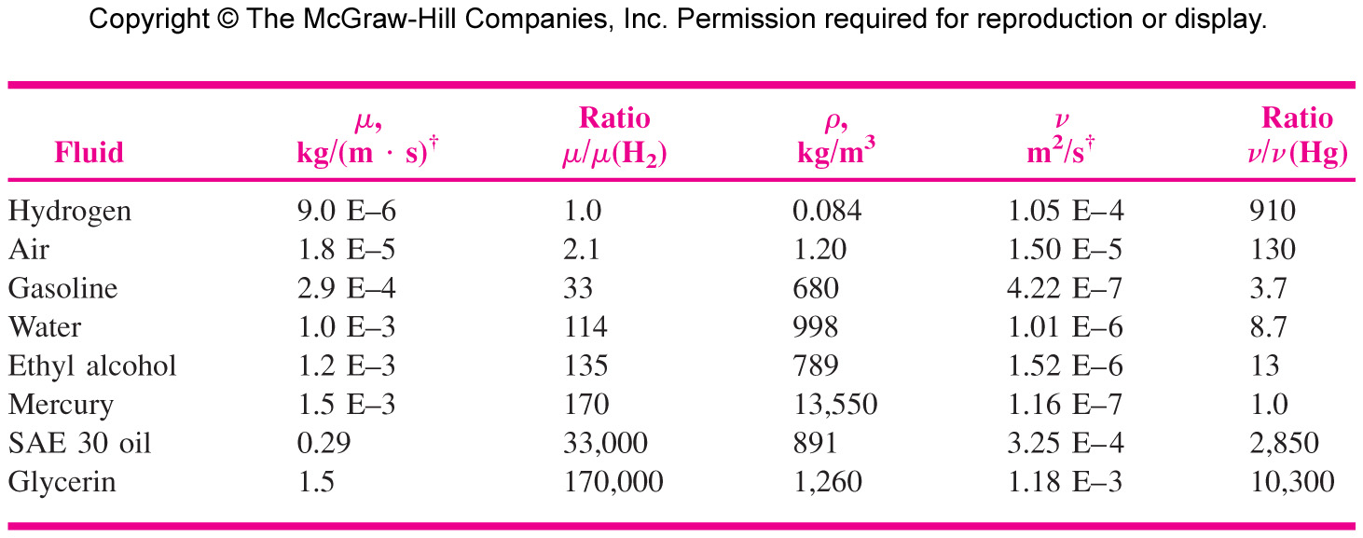
Viscosity data at 20 º C

Slide 35
EXAMPLE 1.2
An early viscosity unit in the cgs system is the poise (abbreviated P), or g/(cm. s). The viscosity of water (fresh or salt) at 293.16 K 20°C is approximately 0.01 P. Express this value in (a) SI and (b) BG units.

Slide 36
Temperature dependence of viscosity
Since the change in viscosity is only few percent up to 100 atm , pressure effects in viscosity is neglected .
Gas viscosity increases with temperature , power law (μ / μ_{o} ) = ( T / T_{o} ) ^{n} for air n = 0.7 and T : absolute temperature μ_{o} at reference T_{o} = 273 K .
liquid viscosity decreases with temperature and roughly exponential
μ = a e^{-bT}
or ln (μ / μ_{o} ) = a +b (T_{o} /T) + c (T_{o} /T)²
for water a = -1.94, b = -4.80 , c = 6.74 , T_{o} = 273.K , μ_{o} = 0.001792 kg /m .s

Slide 38
Table A.1 Viscosity and Density of Water at 1 atm
Table A.2 Viscosity and Density of
Air at 1 atm

Slide 39
Table A.3 Properties of Common
Liquids at 1 atm and 20°C (68°F)

Slide 40
Temperature dependence of viscosity
Resistance of a fluid to shear depends on its cohesion and its rate of molecular momentum transfer.
for liquids cohesive forces are predominant cause of viscosity , hence cohesive force decreases with increase in temperature , viscosity decreases with increasing temperature .
for gases molecular activity gives to an apparent shear stress which is more important than cohesive forces . Since molecular activity increases with temperature and consequently the gas viscosity increases with increase in temperature.

Slide 41
Reynold number
Primary number correlating the viscous behavior of fluids, Re
Re= ρVL/μ = VL/ν
Re used to distinguish flow types laminar or smooth and rough or turbulent.

Slide 42
Surface Tension
A liquid will form an interface with a second liquid or a gas .
Surface tension results from cohesive forces, between similar molecules , and “adhesive” force between unlike molecules .
At interface cohesive force from below ( liquid ) exceeds adhesive force ( gas/liquid ) hence resulting in surface tension .
Surface tension results in formation of liquid droplets and bubbles .
It is measured by stretching force required to form the film , surface energy per unit length .
Unit of [σ] : F/L SI N/m or lbf/ft
e.g water /air σ = 0.073N/m
air / mercury σ = 0.48 N/m

Slide 43
Examples of surface tension
Drops of water
Soap bubble
Insects walking on water
Needle (or paper clip) floating on water

Slide 44
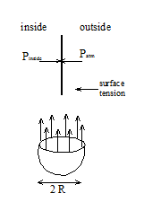
Droplet
Force of pressure inside gauge is balanced by the surface tension force .
P_{ig} π R² = σ (2πR) = ∆pπ R²
Where π R² = projected surface of hemisphere
2 π R = circumference of circle
∆p = Pig = 2 σ /R

Slide 45

Air bubble
Surface tension acts on inside and outside of the bubble wall hence
∆pπ R² = 2(2σ π R)
∆p = 4σ /R
P_{ig} = 4σ /R

Slide 46
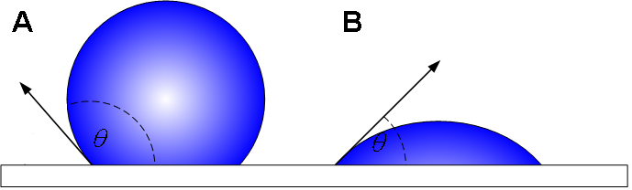
Contact angle
Surface tension occurs during a gas-liquid interface, but if that interface comes in contact with a solid surface - such as the walls of a container - the interface usually curves up or down near that surface. Such a concave or convex surface shape is known as a meniscus.

Slide 47
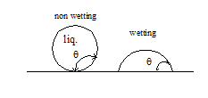
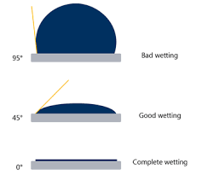
Capillary Action
contact angle ϴ appears when liquid intersect
with the a solid surface .
If ϴ < 90 wetting ( wets the solid )
If ϴ > 90 Non wetting liquid .
capillary action when liquid rises or falls in capillary tubes .
it is caused by surface tension and by the relative values of adhesive ( liquid to solid ) and cohesive force ( between the liquid molecules ).

Slide 48
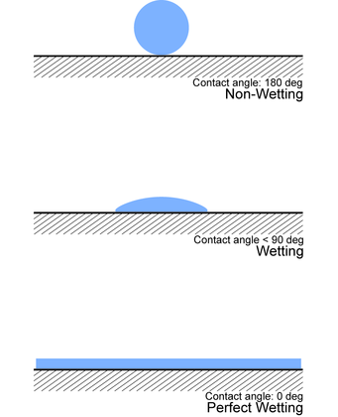

Slide 49
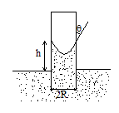
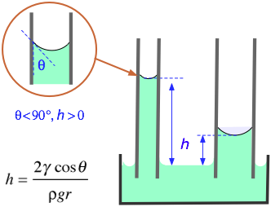
Example 1.9 p 31
Surface tension force at inter-face must balance the weight of the column of liquid of height (h )
(2σ π R) cosϴ = ɣ π R² h
then h = (2 σ cosϴ /ɤR)
h > 0 positive if ϴ < 90
h < 0 negative if ϴ > 90
a ) e.g for water – air –glass ϴ = 0 σ = 0.073 N/m
ρ = 1000kg/m³ R = 1 mm
h = 2(0.073cos ϴ / (1000*9.81*0.001) = 0.015 m = 1.5 cm .
b ) for mercury – air – glass
ϴ = 130, σ = 0.48 N/m ρ = 13600 kg /m³
R = 1 mm
h = 2*0.48 *cos130 / 13600*9.81*0.001 = -0.46

Slide 50
Basic Flow-Analysis Techniques
There are three basic ways to attack a fluid-flow problem;
  Control-volume, or integral analysis (Chap. 3)
  Infinitesimal system, or differential analysis (Chap. 4)
  Experimental study, or dimensional analysis (Chap. 5)
The flow must satisfy the three basic laws of mechanics plus a thermodynamic state relation and associated boundary conditions.
  Conservation of mass (continuity)
  Linear momentum (Newton’s second law)
  First law of thermodynamics (conservation of energy)
  A state relation like f(p, T)
  Appropriate boundary conditions at solid surfaces, interfaces, inlets, and exits

