Slide 1
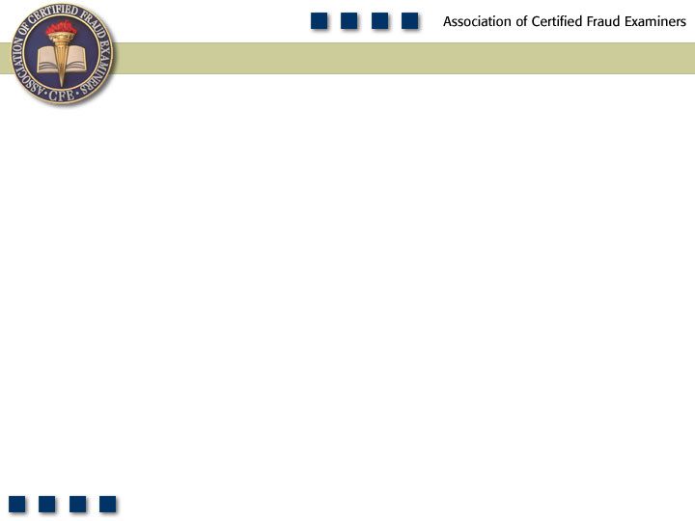
Chapter 7
Expense Reimbursement Schemes

Slide 2
Learning Objectives
Explain what constitutes expense reimbursement fraud.
Discuss the data on expense reimbursement fraud from the 2011 Global Fraud Survey.
Understand how mischaracterized expense reimbursement schemes are committed.
Be familiar with the controls identified in this chapter for preventing and detecting mischaracterized expense schemes.
Identify the methods employees use to overstate otherwise legitimate expenses on their expense reports.
Understand controls that can be used to prevent and detect overstated expense schemes.

Slide 3
Learning Objectives
Explain what a fictitious expense reimbursement scheme is and differentiate it from other forms of expense reimbursement fraud.
Identify red flags that are commonly associated with fictitious expense schemes.
Discuss what a multiple reimbursement scheme is and how this kind of fraud is committed.
Discuss the controls identified in this chapter for preventing and detecting multiple reimbursement schemes.
Be familiar with proactive audit tests that can be used to detect various forms of expense reimbursement fraud.

Slide 4
Expense
Reimbursement
Schemes
Mischaracterized
Expenses
Overstated
Expenses
Fictitious
Expenses
Multiple
Reimbursements

Slide 5
Frequency of Fraudulent Disbursements

Slide 6
Median Loss
Fraudulent Disbursements

Slide 7
Expense Reimbursement Schemes
Employees are reimbursed for expenses paid on behalf of their employer
  Airfare, hotel bills, business meals, mileage, etc.
Business purpose explained and receipts attached per the organization’s guidelines

Slide 8
Mischaracterized Expense Reimbursements
Purpose of reimbursement request is misstated
Fraudster seeks reimbursement for personal expenses
  Personal trips listed as a business trips
  Non-allowable meals with friends and family
Perpetrators are usually high-level employees, owners, or officers
Common element – lack of detailed expense reports

Slide 9
Preventing and Detecting
Mischaracterized Expenses
Establish and adhere to a system of controls
Require detailed expense reports with original support documentation
Require direct supervisory review of all travel and entertainment expenses
Establish a policy that clearly states what will and will not be reimbursed

Slide 10
Preventing and Detecting
Mischaracterized Expenses
Scrutinize any expense report that is approved outside the requestor’s department
Compare dates of claimed expenses to work schedules
Compare prior year expenses to current year expenses and to budgeted expenses

Slide 11
Overstated Expense Reimbursements
Altered receipts
Overpurchasing
Overstating another employee’s expenses
Orders to overstate expenses

Slide 12
Preventing and Detecting
Overstated Expense Reimbursements
Require original receipts for all expense reimbursements
If photocopied receipts are submitted, independently verify the expense
Book travel through company travel agent using designated company credit card
Compare employee’s expense reports with co-workers to identify inconsistencies
Spot check expense reports with customers

Slide 13
Fictitious Expenses
Producing fictitious receipts
  Computers
  Calculators
  Cut and paste
Obtaining blank receipts from vendors
Claiming the expenses of others

Slide 14
Preventing and Detecting Fictitious Expense Reimbursements
Look for:
  High dollar items that were paid in cash
  Expenses that are consistently rounded off, ending with “0” or “5”
  Expenses that are consistently for the same amount
  Reimbursement requests that consistently fall at or just below the reimbursement limit
  Receipts that are submitted over an extended time that are consecutively numbered
  Receipts that do not look professional or that lack information about the vendor

Slide 15
Multiple Reimbursement Schemes
A single expense item is submitted several times to receive multiple reimbursements
  Example: Airline ticket receipt and travel agency invoice
Submit the credit card receipt for items charged to the company’s credit card account
Submitting the same expenses to different budgets

Slide 16
Preventing and Detecting Multiple Reimbursement Schemes
Enforce a policy against accepting photocopies
Establish clearly what types of support documentation are acceptable
Scrutinize expense reports that are approved by supervisors outside the requestor’s department
Require that expense reimbursements be approved by the employee’s direct supervisor
Establish a policy that expenses must be submitted within a certain time limit

Slide 17
Mid-term Exam
Practice Questions

Slide 18
1. In a ______________ scheme, the perpetrator uses false documentation to cause a payment to be issued for a fraudulent purpose.
Purchasing
Skimming
Larceny
Billing

Slide 19
1. In a ______________ scheme, the perpetrator uses false documentation to cause a payment to be issued for a fraudulent purpose.
Purchasing
Skimming
Larceny
Billing

Slide 20
2. Mel Turner, the runner for a small bookstore, had a bad habit of helping himself to cash from the deposit on the way to the bank. He covered his tracks by substituting a check from the next day’s deposit for the amount he stole from the previous day. This is an example of what type of concealment?
Deposit in transit
Deposit lapping
Force balance depositing
None of the above

Slide 21
2. Mel Turner, the runner for a small bookstore, had a bad habit of helping himself to cash from the deposit on the way to the bank. He covered his tracks by substituting a check from the next day’s deposit for the amount he stole from the previous day. This is an example of what type of concealment?
Deposit in transit
Deposit lapping
Force balance depositing
None of the above

Slide 22
3. Which of the following is not considered to be a red flag for fictitious expenses?
An employee repeatedly uses the company credit card for business travel expenses.
An employee’s reimbursement requests are always for round-dollar amounts.
An employee submits reimbursement requests that consistently fall just below the reimbursement limit.
An employee frequently requests reimbursement for high-dollar items that he claims were paid for in cash.

Slide 23
3. Which of the following is not considered to be a red flag for fictitious expenses?
An employee repeatedly uses the company credit card for business travel expenses.
An employee’s reimbursement requests are always for round-dollar amounts.
An employee submits reimbursement requests that consistently fall just below the reimbursement limit.
An employee frequently requests reimbursement for high-dollar items that he claims were paid for in cash.

Slide 24
4. In order to prove that fraud occurred, four general elements must be present. Which of the following is not a general element of fraud?
A material false statement
Knowledge that the statement was false
Reliance on the false statement by the victim
Intent to cause the victim damages

Slide 25
4. In order to prove that fraud occurred, four general elements must be present. Which of the following is not a general element of fraud?
A material false statement
Knowledge that the statement was false
Reliance on the false statement by the victim
Intent to cause the victim damages

Slide 26
5. Check tampering includes both fraudulently preparing a company check for one’s own benefit and intercepting a company check that is intended for a third party and converting it for one’s own benefit.
True
False

Slide 27
5. Check tampering includes both fraudulently preparing a company check for one’s own benefit and intercepting a company check that is intended for a third party and converting it for one’s own benefit.
True
False

Slide 28
6. Which of the following procedures would not be useful in preventing and detecting sales skimming schemes?
Comparing register tapes to the cash drawer and investigating discrepancies
Summarizing the net sales by employee and extracting the top employees with low sales
Installing video cameras at cash entry points
Offering discounts to customers who do not get receipts for their purchases

Slide 29
6. Which of the following procedures would not be useful in preventing and detecting sales skimming schemes?
Comparing register tapes to the cash drawer and investigating discrepancies
Summarizing the net sales by employee and extracting the top employees with low sales
Installing video cameras at cash entry points
Offering discounts to customers who do not get receipts for their purchases

Slide 30
7. In the 2012 Report to the Nations on Occupational Fraud and Abuse, fraudulent financial statements schemes had a higher median loss than asset misappropriation and corruption schemes.
True
False

Slide 31
7. In the 2012 Report to the Nations on Occupational Fraud and Abuse, fraudulent financial statements schemes had a higher median loss than asset misappropriation and corruption schemes.
True
False

Slide 32
8. In one of the case studies in the textbook, Albert Miano, the facilities supervisor for a popular magazine, submitted phony invoices. When Miano received the checks for the phony invoices, he forged the contractor’s signature. He then endorsed the check in his own name. How was the fraud caught?
The auditors found a discrepancy in the invoices that were submitted.
The new chief of internal audit found it by accident.
A vendor received a check by mistake and called the accounts payable department.
The external audit found it in an audit sample of canceled checks.

Slide 33
8. In one of the case studies in the textbook, Albert Miano, the facilities supervisor for a popular magazine, submitted phony invoices. When Miano received the checks for the phony invoices, he forged the contractor’s signature. He then endorsed the check in his own name. How was the fraud caught?
The auditors found a discrepancy in the invoices that were submitted.
The new chief of internal audit found it by accident.
A vendor received a check by mistake and called the accounts payable department.
The external audit found it in an audit sample of canceled checks.

Slide 34
9. Which of the following is not a type of payroll scheme?
Ghost employee schemes
False deduction schemes
Falsified hours and salary schemes
Commission schemes

Slide 35
9. Which of the following is not a type of payroll scheme?
Ghost employee schemes
False deduction schemes
Falsified hours and salary schemes
Commission schemes

Slide 36
10. Mary Duncan is an internal auditor for the Western Realty Group. Recently, she ran a program that extracted checks that were out of sequence. She found that four or five checks were written every month that fit this category. Based on the information given, which of the following schemes is likely occurring?
Multiple reimbursement scheme
Shell company scheme
Personal purchases scheme
Forged maker scheme

Slide 37
10. Mary Duncan is an internal auditor for the Western Realty Group. Recently, she ran a program that extracted checks that were out of sequence. She found that four or five checks were written every month that fit this category. Based on the information given, which of the following schemes is likely occurring?
Multiple reimbursement scheme
Shell company scheme
Personal purchases scheme
Forged maker scheme

