Slide 1
Completing the tests in the sales and collections cycle: Accounts Receivable
Chapter 16

Slide 2
Chapter 16 Learning Objectives
16-1 Describe the methodology for designing tests of details of
balances using the audit risk model.
16-2 Design and perform substantive analytical procedures for
accounts in the sales and collection cycle.
16-3 Design and perform tests of details of balances for accounts
receivable.
16-4 Obtain and evaluate accounts receivable confirmations.
16-5 Design audit procedures for the audit of accounts receivable,
using an evidence-planning worksheet as a guide.

Slide 3
OBJECTIVE 16-1
Describe the methodology for designing tests of details of balances using the audit risk model.

Slide 4
Methodology for designing tests of details of balances
The appropriate evidence to be obtained from tests of details of balances must satisfy the eight balance-related objectives:
  Detail tie-in
  Existence
  Completeness
  Accuracy
  Classification
  Cutoff
  Realizable value
  Rights
The methodology for designing these tests is illustrated in Figure 16-1.

Slide 6
Methodology for designing tests of details of balances (cont.)
Identify Significant Risks and Assess the Risk of Material Misstatement for Accounts Receivable (Phase I):
Tests are based on the auditor’s risk assessment.
As part of the assessment of risk of material misstatement, the auditor determines whether any of the risks are a significant risk.
For most audits, revenue recognition is considered a significant risk.

Slide 7
Methodology for designing tests of details of balances (cont.)
Set Performance Materiality for Accounts Receivable (Phase I):
The auditor makes a preliminary judgment about materiality for the entire financial statement, then allocates the amount to each significant balance sheet account.
Accounts receivable is typically one of the most material accounts for companies that sell on credit.
Even when the ending balance in accounts receivable is small, the transactions occurring throughout the year in the sales and collection cycle are almost certain to be highly significant.

Slide 8
Methodology for designing tests of details of balances (cont.)
Assess Control Risk for the Sales and Collection Cycle (Phase I):
Internal controls over sales and cash receipts and related accounts receivable are reasonably effective for most companies because they want to maintain good relations with customers.
Auditors are especially concerned with three aspects of internal controls:
  Controls that prevent or detect embezzlement
  Controls over cutoff
  Controls related to the allowance for uncollectible accounts
The primary classes of transactions in the sales and collection cycle are shown in Figure 16-2.

Slide 10
Methodology for designing tests of details of balances (cont.)
Design and Perform Tests of Controls and Substantive Tests of Transactions (Phase II):
  Chapters 14 and 15 covered designing audit procedures for tests of controls and substantive tests of transactions, including deciding sample size and evaluating results.
  Auditors use results of substantive tests of transactions to determine the extent to which planned detection risk is satisfied for each accounts receivable balance-related audit objective.
Figure 16-7 shows three rows for control risk, two for substantive tests of transactions, one for sales, and one for cash receipts.

Slide 11
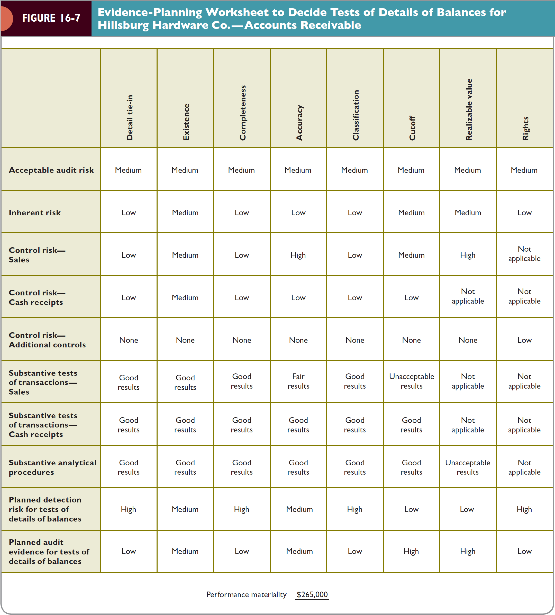

Slide 12
OBJECTIVE 16-2
Design and perform substantive analytical procedures for accounts in
the sales and collection cycle.

Slide 13
Design and perform substantive analytical procedures (phase III)
Most substantive analytical procedures performed during the detailed testing phase are done after the balance sheet date but before tests of details of balances.
Auditors perform both planning and substantive analytical procedures for the entire sales and collection cycle, not just accounts receivable.
  This is necessary because of the close relationship between these income statement and balance sheet accounts.
Table 16-1 presents common ratios and comparisons for the sales and collection cycle, including misstatements that may be uncovered.
Tables 16-2 and 16-3 show amounts for Hillsburg Co.

Slide 17
Design and perform substantive analytical procedures (phase III)(cont.)
The appropriate tests of details of balances depend on the factors listed in the evidence-planning worksheet in Figure 16-7 (p. 544).
The task of combining the factors that determine the planned detection risk is complex because
  The measurement for each factor is imprecise and
  The appropriate weight given to each factor is highly subjective.
The bottom row of Figure 16-7 shows the planned audit evidence for tests of details of balances for accounts receivable by objective.

Slide 18
OBJECTIVE 16-3
Design and perform tests of details of balances for accounts receivable.

Slide 19
Designing tests of details of balances
The Summation of Accounts Receivable Agrees with the Master File and the General Ledger:
Most tests of accounts receivable and the allowance for uncollectible accounts are based on the aged trial balance.
The aging
  Lists the balances in the accounts receivable master file at the balance sheet date for each individual customer
  Categorizes the balances due based on the time passed between the sale and the balance sheet date.
A typical aged trial balance is shown in Figure 16-3.

Slide 21
Designing tests of details of balances (cont.)
Recorded Accounts Receivable Exist: Confirmation of customer’s balances is the most important test of details of balances for determining existence.
Existing Accounts Receivable Are Included: It is difficult to test for account balances omitted from the aged trial balance except by relying on the self-balancing nature of the accounts receivable master file.
Accounts Receivable Are Accurate: Confirmation is the most common test for the accuracy of accounts receivable.

Slide 22
Designing tests of details of balances (cont.)
Accounts Receivable Are Properly Classified:
Normally classification of accounts receivable is relatively easy, by reviewing the aged trial balance for material receivables from affiliates, officers, directors, or other related parties.
Auditors should also verify whether any of the accounts or notes receivable are noncurrent and should be classified as such.

Slide 23
Designing tests of details of balances (cont.)
Cutoff for Accounts Receivable is Correct: Cutoff misstatements exist when current period transactions are recorded in the subsequent period or vice versa.
Cutoff misstatements can occur for sales, sales returns, and allowances and cash receipts. For each, auditors require a threefold approach to determine the reasonableness of cutoff:
  Decide on the appropriate criteria for cutoff.
  Evaluate whether the client has established adequate procedures to ensure a reasonable cutoff.
  Test whether the cutoff was correct.

Slide 24
Designing tests of details of balances (cont.)
Accounts Receivable Is Stated at Realizable Value:
  Accounting standards require that companies state accounts receivable at the amount that will ultimately be collected, the realizable value.
  The realizable value is equal to the gross accounts receivable less the allowance for uncollectible accounts.
  The allowance for uncollectible accounts is an estimate and it is necessary for auditors to determine if the client’s allowance is reasonable.
Figure 16-4 shows an analysis of the allowance for uncollectible accounts for the Hillsburg Company.

Slide 25
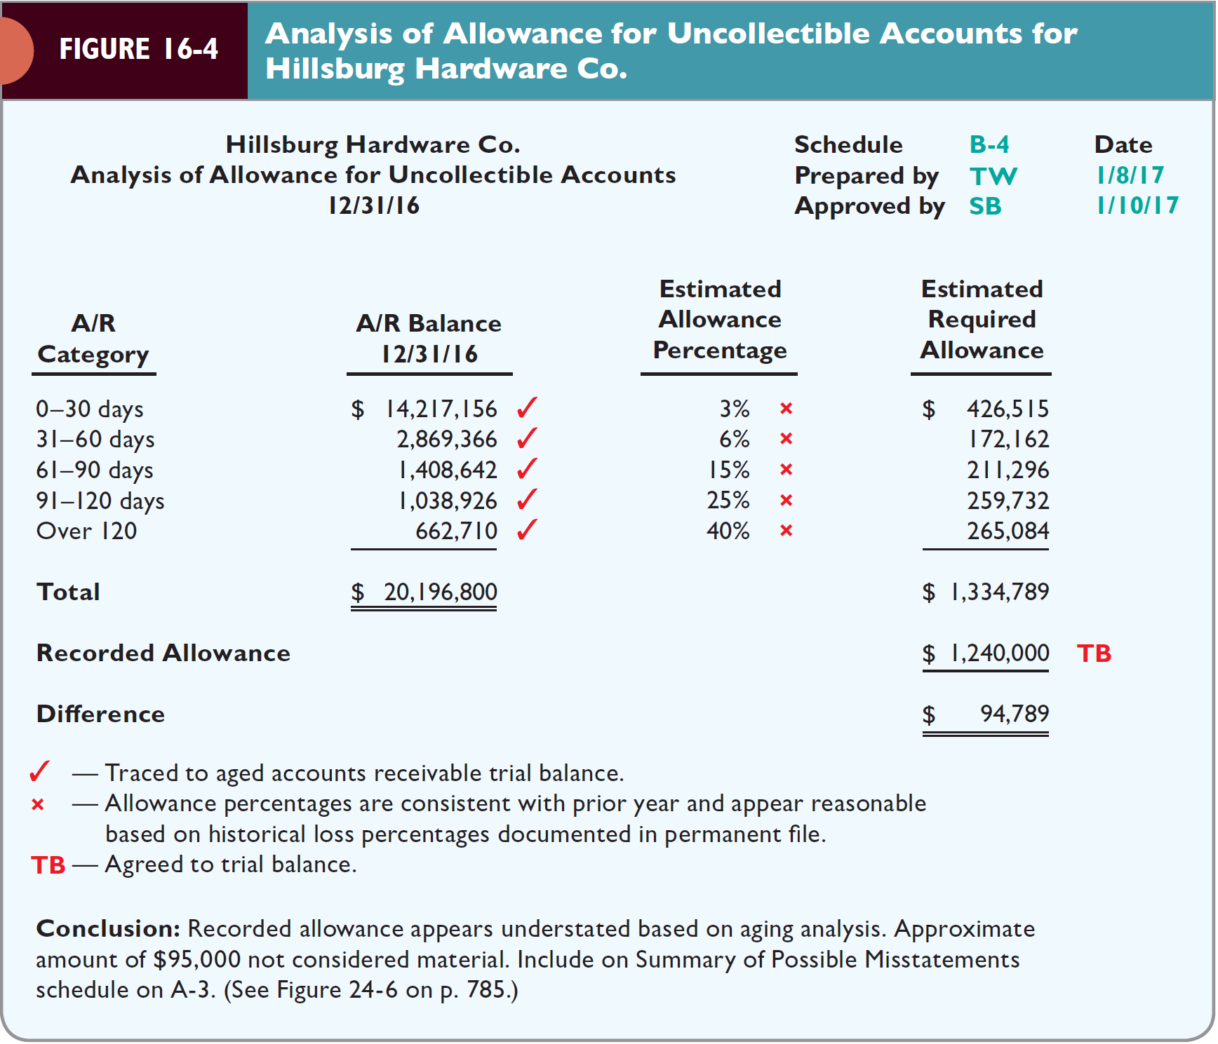

Slide 26
Designing tests of details of balances (cont.)
The Client Has Rights to Accounts Receivable: Normally, this is not a problem.
  The auditor must determine if any of the receivables are pledged, assigned, factored, or sold.
Accounts Receivable Presentation and Disclosure: Tests of the presentation and disclosure-related audit objectives are generally done as part of the completion phase of the audit.
  Some tests may be done with tests of balance-related audit objectives. For example, the auditor must evaluate whether the client has separated material amounts requiring separate disclosure, such as related party receivables.

Slide 27
OBJECTIVE 16-4
Obtain and evaluate accounts receivable confirmations.

Slide 28
Confirmation of accounts receivable
Auditing Standards Requirements:
Auditors should use external confirmations for accounts receivable unless:
  The overall accounts receivable balance is immaterial.
  The auditor considers confirmations ineffective evidence because response rates will likely be inadequate or unreliable.
  The auditor’s assessed level of the risk of material misstatement is low and other evidence can be accumulated to provide sufficient evidence.
If the auditor decides not to confirm accounts receivable that are material, the justification must be documented in the audit files.

Slide 29
Confirmation of accounts receivable (cont.)
Types of Confirmations:
Positive Confirmation: A communication addressed to the debtor requesting the recipient to confirm directly whether the balance as stated is correct or incorrect. Figure 16-5 is an example of a positive confirmation request.
Negative Confirmation: A communication addressed to the debtor, but requests a response only when the debtor disagrees with the stated amount. Figure 16-6 is an example of a negative confirmation.

Slide 32
Confirmation of accounts receivable (cont.)
Types of Confirmations (Cont):
Positive confirmations are more reliable, but negative confirmations are less costly.
Negative confirmations are acceptable as the sole substantive audit procedure only when all of the following circumstances are present:
  The auditor has assessed the risk of material misstatement as low.
  The population of items is made up of a large number of small, homogenous account balances.
  The auditor expects a low exception rate.
  The auditor reasonably believes that recipients of negative confirmation requests will give the requests adequate consideration.

Slide 33
Confirmation of accounts receivable (cont.)
Timing: The most reliable evidence from confirmations is obtained when they are sent as close to the balance sheet date as possible.
  To complete an audit in a timely manner, confirmation at an interim date is permissible if internal controls are adequate.
If the auditor decides to confirm accounts receivable before year-end, the auditor typically prepares a roll-forward schedule to reconcile accounts receivable at the confirmation date to accounts receivable at the balance sheet date.

Slide 34
Confirmation of accounts receivable (cont.)
Sampling Decisions:
  Sample size is based on the following factors:
    Performance materiality
    Inherent risk
    Control risk
    Achieved detection risk from other substantive tests
    Type of confirmation
Selection of the Items for Testing: Some type of stratification is desirable with most confirmations.

Slide 35
Confirmation of accounts receivable (cont.)
Verification of Addresses and Maintaining Control:
  The auditor should perform procedures to verify the addresses or email addresses used for confirmation.
  For confirmations sent by mail, the auditor must maintain control of the confirmations until they are returned from the customer.
  The client may assist in preparing the confirmations, but the auditor must be responsible for mailing and the return address should be the auditor’s to ensure that undeliverable confirmations are returned to the auditor, not the client.

Slide 36
Confirmation of accounts receivable (cont.)
Follow-Up on Nonresponses: Nonresponses to positive confirmations provide no audit evidence, though nonresponses to negative confirmations provide some evidence of the existence assertion. When positive confirmations are used, auditing standards require follow-up procedures. Documents and procedures may include:
  Subsequent Cash Receipts—Evidence of the receipt of cash for payment subsequent to the confirmation.
  Duplicate Sales Invoices—Examining duplicate sales invoices are useful in verifying the actual issuance of an invoice as well as verifying the date.
  Shipping Documents—These help to determine that a shipment was made to test cutoff.
  Correspondence with the Client—Can be used to discover any disputed balances.

Slide 37
Confirmation of accounts receivable (cont.)
Analysis of Differences: The most commonly reported types of differences in confirmations include:
  Payment Has Already Been Made—The customer has made payment prior to the confirmation date, but the client has not recorded it. These should be carefully investigated for cutoff misstatements, lapping, or theft of cash.
  Goods Have Not Been Received—Typically because the client records the sale on the ship date, but the customer may not have received the goods yet.
  The Goods Have Been Returned—The client may have failed to record a credit memo for a sales return.
  Clerical Errors and Disputed Amounts—Normally, the auditor will ask the client to reconcile the differences.

Slide 38
Confirmation of accounts receivable (cont.)
Drawing Conclusions:
When all differences have been resolved, the auditor must reevaluate internal control.
The misstatements must be analyzed to determine whether it was consistent or inconsistent with the original assessed level of control risk.
If a significant number of misstatements occurred that are inconsistent with the assessment of control risk, it is necessary to revise the assessment and consider the effect of the revision on the audit.

Slide 39
OBJECTIVE 16-5
Design audit procedures for the audit of accounts receivable, using an evidence-planning worksheet as a guide.

Slide 40
Developing tests of details audit program
The evidence-planning worksheet presented in Figure 16-7 is an aid for the auditor to decide the extent of planned tests of details of balances.
Balance-related audit objectives and audit procedures for Hillsburg Company are presented in Table 16-4.
The tests of details of balances audit program for Hillsburg Company is presented in Table 16-5.
The numbers in parentheses in Table 16-4 provide a cross-reference to Table 16-5.

Slide 43


