Slide 1
3
Adjusting The Accounts
Learning Objectives
Explain the accrual basis of accounting and the
reasons for adjusting entries.
1
2
Prepare adjusting entries for deferrals.
3
Prepare adjusting entries for accruals.
Describe the nature and purpose of an adjusted
trial balance.
4

Slide 2
LEARNING
OBJECTIVE
Explain the accrual basis of accounting
and the reasons for adjusting entries.
1
Accountants divide the economic life of a business into artificial time periods (Time Period Assumption).
. . . . .
Jan.
Feb.
Mar.
Apr.
Dec.
Generally a
month,
quarter, or
year.
Alternative Terminology
The time period assumption
is also called the
periodicity assumption.
LO 1

Slide 3
Fiscal and Calendar Years
Monthly and quarterly time periods are called interim periods.
Most large companies must prepare both quarterly and annual financial statements.
Fiscal Year = Accounting time period that is one year in length.
Calendar Year = January 1 to December 31.
LO 1

Slide 4
Fiscal and Calendar Years
Question
The time period assumption states that:
revenue should be recognized in the accounting period in which it is earned.
expenses should be matched with revenues.
the economic life of a business can be divided into artificial time periods.
the fiscal year should correspond with the calendar year.
LO 1

Slide 5
Accrual- versus Cash-Basis Accounting
Accrual-Basis Accounting
Transactions recorded in the periods in which the events occur.
Companies recognize revenues when they perform services (rather than when they receive cash).
Expenses are recognized when incurred (rather than when paid).
In accordance with generally accepted accounting principles (GAAP).
LO 1

Slide 6
Accrual- versus Cash-Basis Accounting
Cash-Basis Accounting
Revenues recognized when cash is received.
Expenses recognized when cash is paid.
Cash-basis accounting is not in accordance with generally accepted accounting principles (GAAP).
LO 1

Slide 7
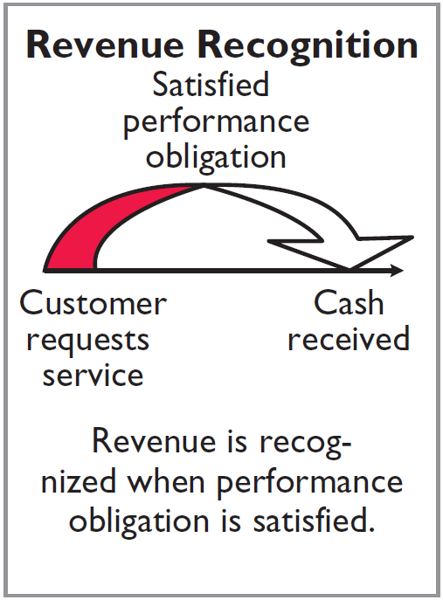
Recognizing Revenues and Expenses
REVENUE RECOGNITION PRINCIPLE
Recognize revenue in the accounting period in which the performance obligation is satisfied.
LO 1

Slide 8
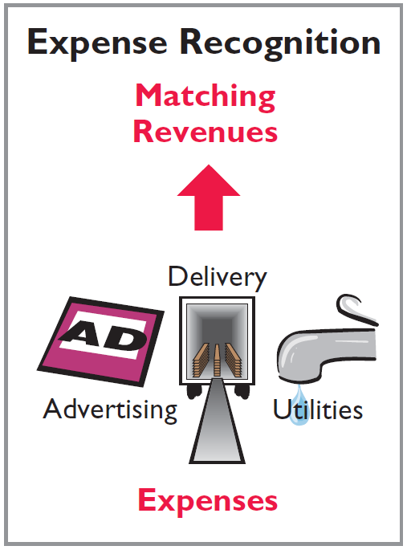
Recognizing Revenues and Expenses
EXPENSE RECOGNITION PRINCIPLE
Match expenses with revenues in the period when the company makes efforts that generate those revenues.
“Let the expenses follow the revenues.”
LO 1

Slide 9
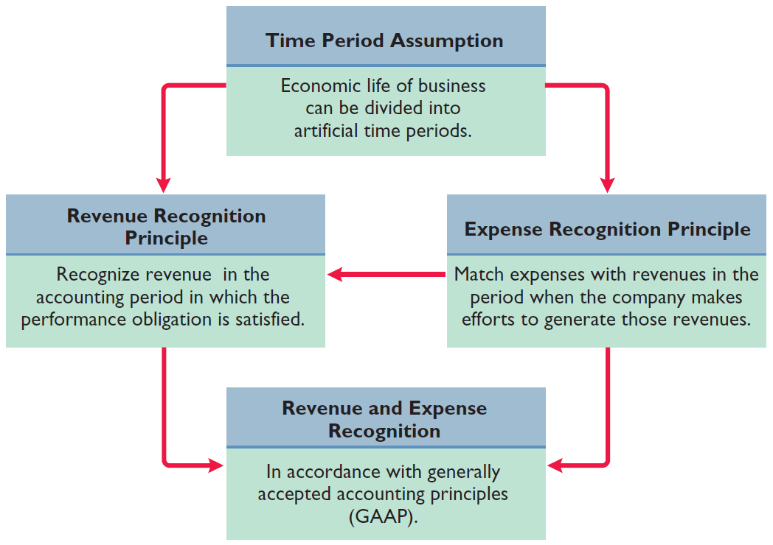
Illustration 3-1
GAAP relationships in revenue and expense recognition
LO 1

Slide 10
Recognizing Revenues and Expenses
Question
One of the following statements about the accrual basis of accounting is false? That statement is:
Events that change a company’s financial statements are recorded in the periods in which the events occur.
Revenue is recognized in the period in which the performance obligation is satisfied.
The accrual basis of accounting is in accord with generally accepted accounting principles.
Revenue is recorded only when cash is received, and expenses are recorded only when cash is paid.
LO 1

Slide 11
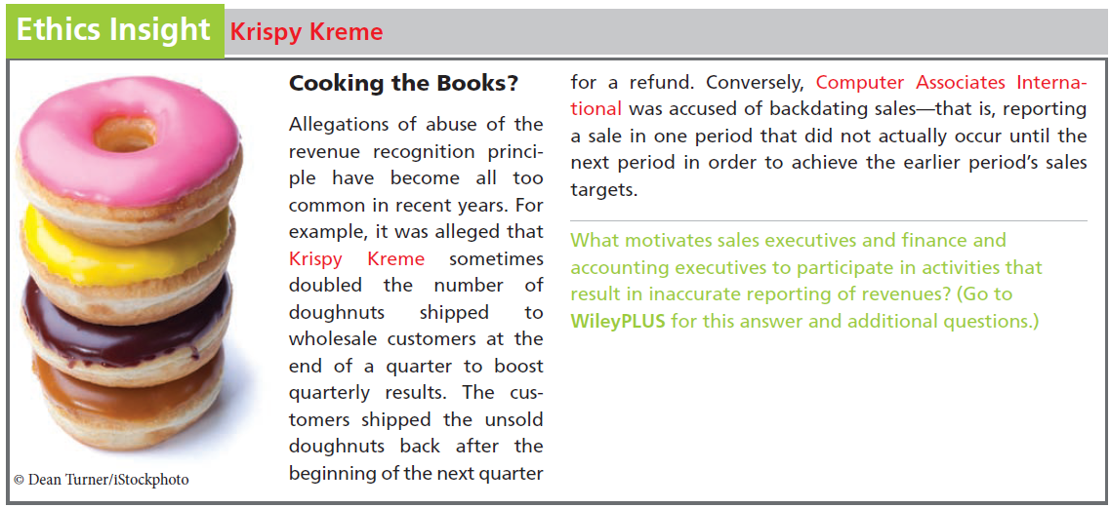
LO 1

Slide 12
The Need for Adjusting Entries
Adjusting Entries
Ensure that the revenue recognition and expense recognition principles are followed.
Necessary because the trial balance may not contain up-to-date and complete data.
Required every time a company prepares financial statements.
Will include one income statement account and one balance sheet account.
LO 1

Slide 13
The Need for Adjusting Entries
Question
Adjusting entries are made to ensure that:
expenses are recognized in the period in which they are incurred.
revenues are recorded in the period in which services are performed.
balance sheet and income statement accounts have correct balances at the end of an accounting period.
all of the above.
LO 1

Slide 14
Types of Adjusting Entries
Illustration 3-2
Categories of adjusting entries
Deferrals
Accruals
1. Prepaid Expenses. Expenses paid in cash before they are used or consumed.
1. Accrued Revenues. Revenues for services performed but not yet received in cash or recorded.
2. Unearned Revenues.
Cash received before services are performed.
2. Accrued Expenses. Expenses incurred but not yet paid in cash or recorded.
LO 1

Slide 15
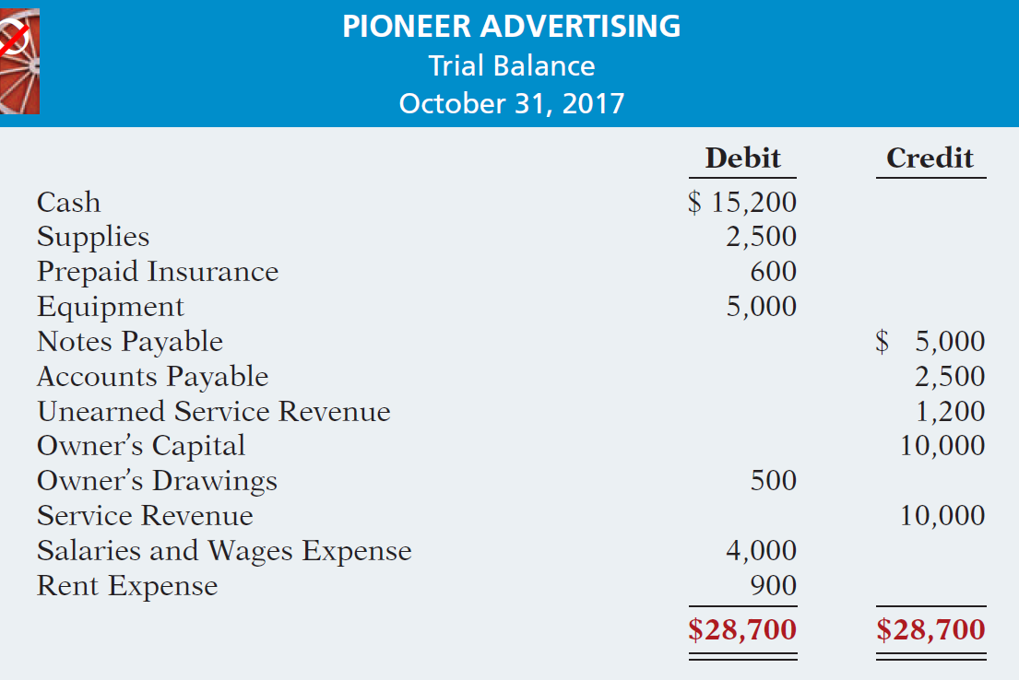
Types of Adjusting Entries
Trial Balance – Each account is analyzed to determine whether it is complete and up-to-date.
Illustration 3-3
LO 1

Slide 16

DO IT!
1
Timing Concepts
A list of concepts is provided in the left column below, with a description of the concept in the right column below. There are more descriptions provided than concepts. Match the description of the concept to the concept.
1. ___ Accrual-basis accounting.
2. ___ Calendar year.
3. ___ Time period assumption.
4. ___ Expense recognition principle.
f
Monthly and quarterly time periods.
Efforts (expenses) should be matched with results (revenues).
Accountants divide the economic life of a business into artificial time periods.
Companies record revenues when they receive cash and record expenses when they pay out cash.
An accounting time period that starts on January 1 and ends on December 31.
Companies record transactions in the period in which the events occur.
e
c
b
LO 1

Slide 17
LEARNING
OBJECTIVE
Prepare adjusting entries for deferrals.
2
Deferrals are expenses or revenues that are recognized at a date later than the point when cash was originally exchanged. There are two types:
Prepaid expenses
Unearned revenues
LO 2

Slide 18
Prepaid Expenses
Payment of cash, that is recorded as an asset to show the service or benefit the company will receive in the future.
Cash Payment
BEFORE
Expense Recorded
Prepayments often occur in regard to:
insurance
supplies
advertising
rent
equipment
buildings
LO 2

Slide 19
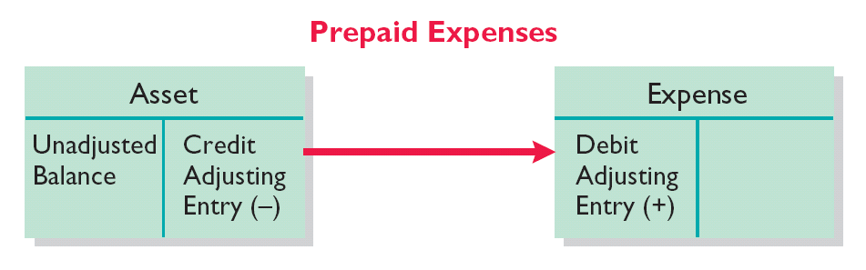
Prepaid Expenses
Expire either with the passage of time or through use.
Adjusting entry:
Increase (debit) to an expense account and
Decrease (credit) to an asset account.
Illustration 3-4
LO 2

Slide 20
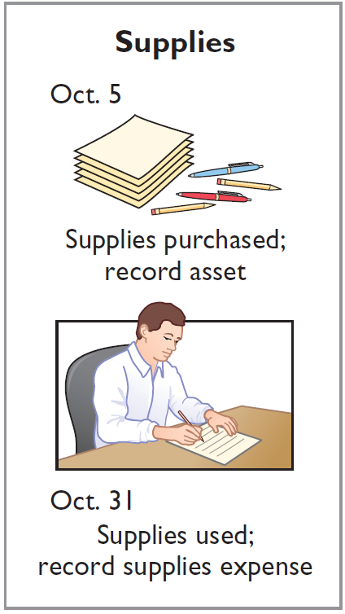
Supplies
Illustration: Pioneer Advertising purchased supplies costing $2,500 on October 5. Pioneer recorded the payment by increasing (debiting) the asset Supplies. This account shows a balance of $2,500 in the October 31 trial balance. An inventory count at the close of business on October 31 reveals that $1,000 of supplies are still on hand.
Oct. 31
Supplies Expense
1,500
Supplies
1,500
LO 2

Slide 21
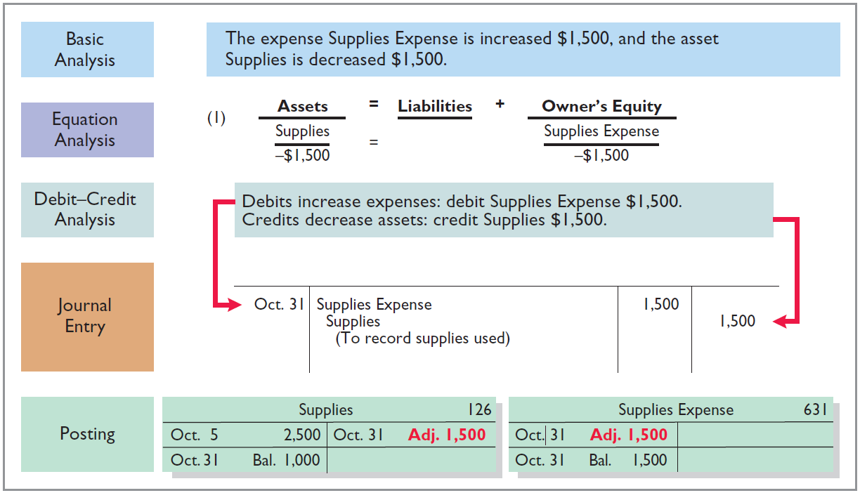
Supplies
Illustration 3-5
LO 2

Slide 22
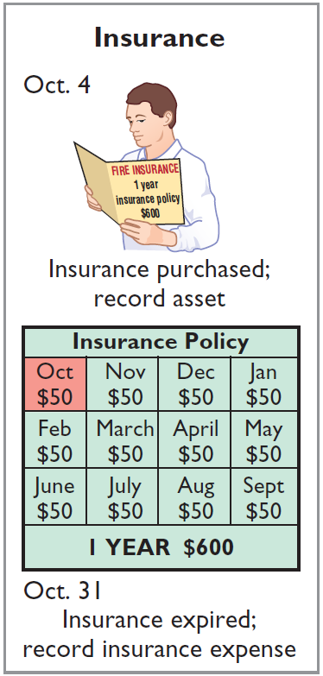
Insurance
Illustration: On October 4, Pioneer Advertising paid $600 for a one-year fire insurance policy. Coverage began on October 1. Pioneer recorded the payment by increasing (debiting) Prepaid Insurance. This account shows a balance of $600 in the October 31 trial balance. Insurance of $50 ($600 ÷ 12) expires each month.
Oct. 31
Insurance Expense
50
Prepaid Insurance
50
LO 2

Slide 23
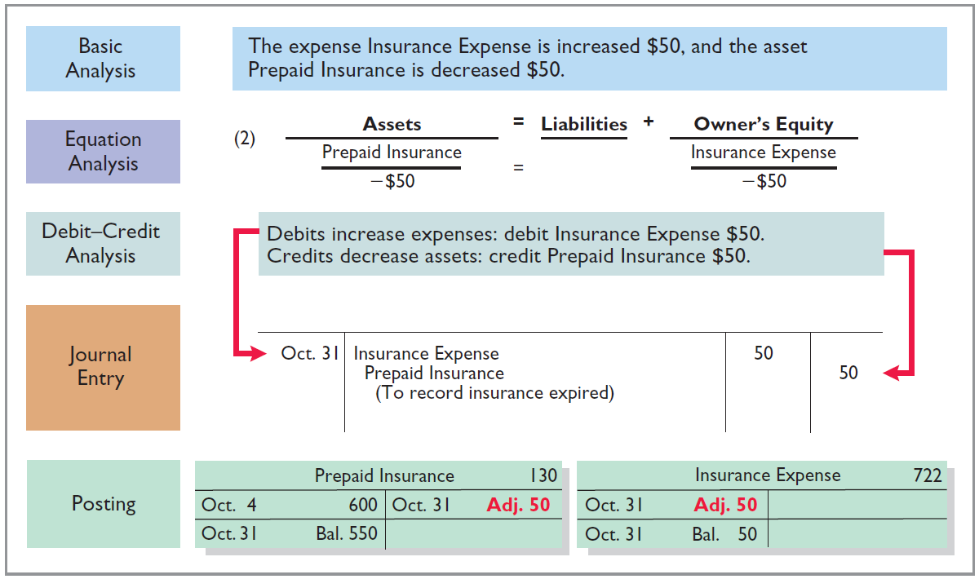
Insurance
Illustration 3-6
LO 2

Slide 24
Depreciation
Buildings, equipment, and motor vehicles (assets that provide service for many years) are recorded as assets, rather than an expense, on the date acquired.
Depreciation is the process of allocating the cost of an asset to expense over its useful life.
Depreciation does not attempt to report the actual change in the value of the asset.
Allocation concept, not a valuation concept.
LO 2

Slide 25
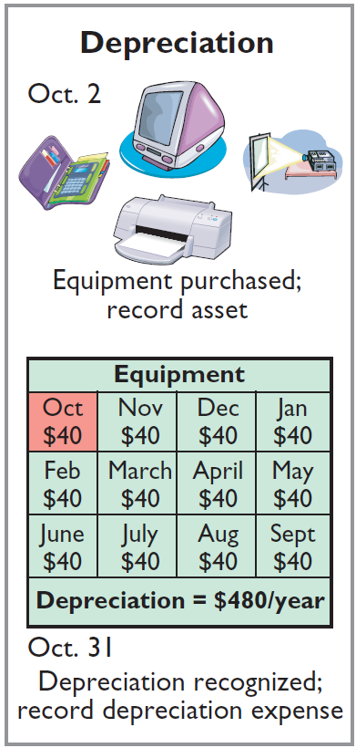
Depreciation
Illustration: For Pioneer Advertising, assume that depreciation on the equipment is $480 a year, or $40 per month.
Oct. 31
Depreciation expense
40
Accumulated depreciation
40
Accumulated Depreciation is called a contra asset account.
LO 2

Slide 26
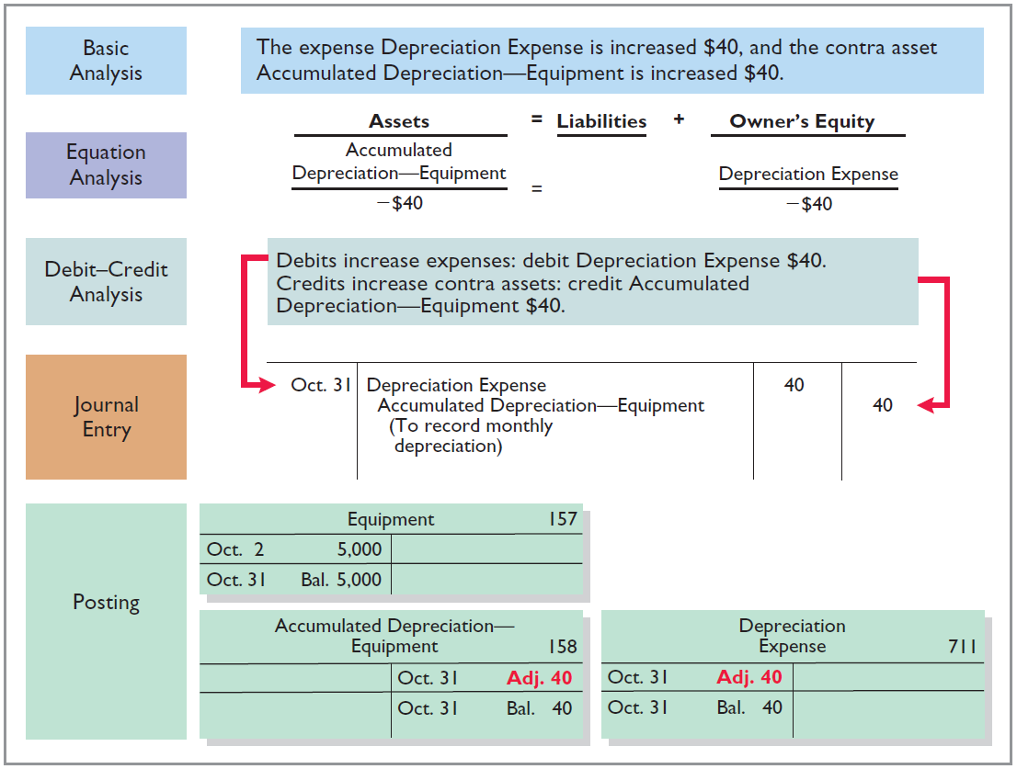
Illustration 3-7
LO 2

Slide 27
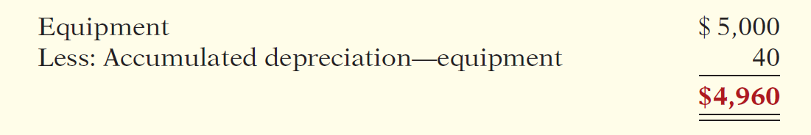
Depreciation
STATEMENT PRESENTATION
Accumulated Depreciation is a contra asset account (credit).
Offsets related asset account on the balance sheet.
Book value is the difference between the cost of any depreciable asset and its accumulated depreciation.
Illustration 3-8
LO 2

Slide 28
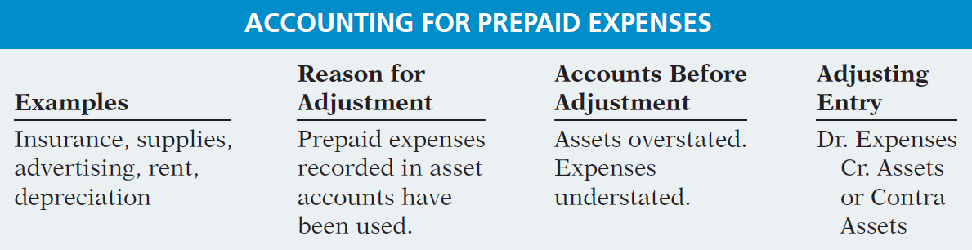
Prepaid Expenses
Summary of the accounting for prepaid expenses.
Illustration 3-9
Accounting for prepaid expenses
LO 2

Slide 29
Unearned Revenues
Receipt of cash that is recorded as a liability because the service has not been performed.
Cash Receipt
BEFORE
Revenue Recorded
Unearned revenues often occur in regard to:
Rent
Airline tickets
Magazine subscriptions
Customer deposits
LO 2

Slide 30
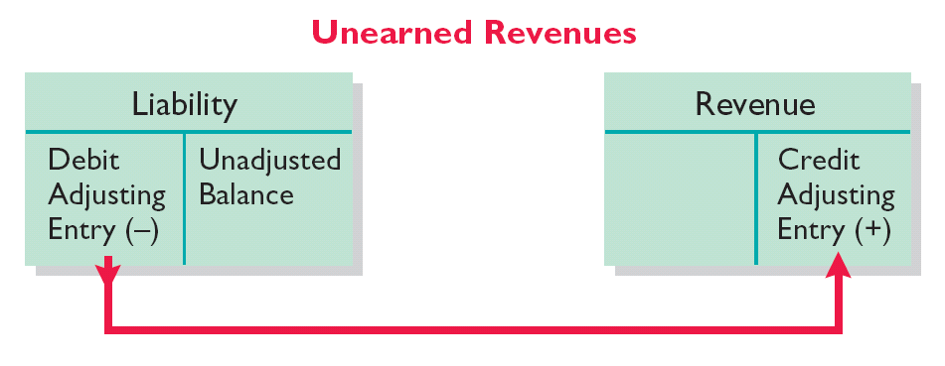
Unearned Revenues
Adjusting entry is made to record the revenue for services performed during the period and to show the liability that remains at the end of the period.
Results in a decrease (debit) to a liability account and an increase (credit) to a revenue account.
Illustration 3-10
LO 2

Slide 31
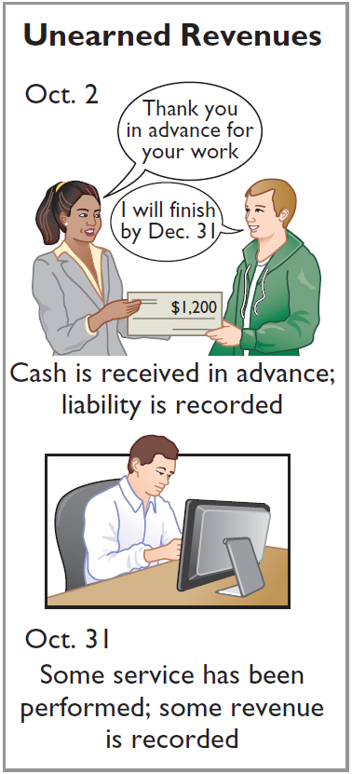
Unearned Revenues
Illustration: Pioneer Advertising received $1,200 on October 2 from R. Knox for advertising services expected to be completed by December 31. Unearned Service Revenue shows a balance of $1,200 in the October 31 trial balance. Analysis reveals that the company performed $400 of services in October.
Oct. 31
Unearned Service Revenue
400
Service Revenue
400
LO 2

Slide 32
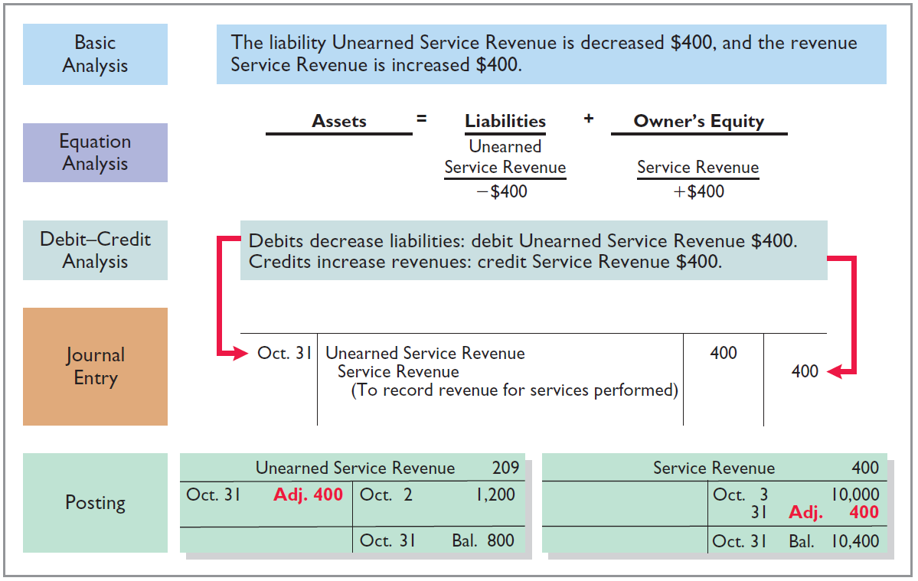
Unearned Revenues
Illustration 3-11
LO 2

Slide 33
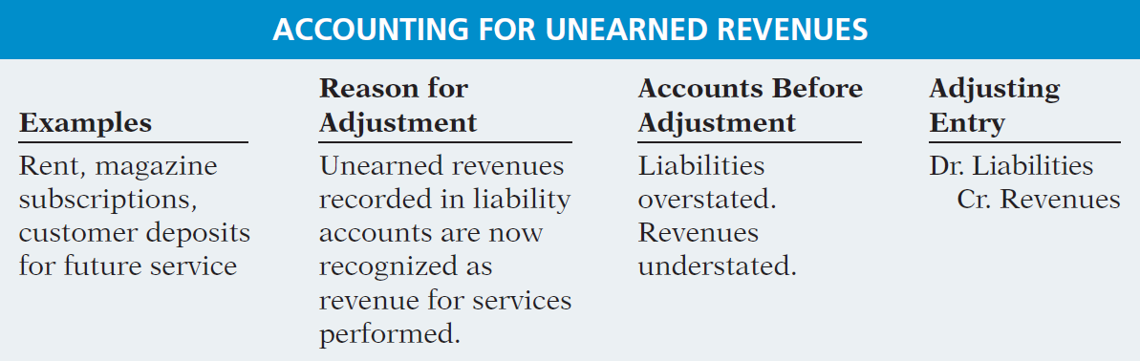
Unearned Revenues
Summary of the accounting for unearned revenues.
Illustration 3-12
LO 2

Slide 34
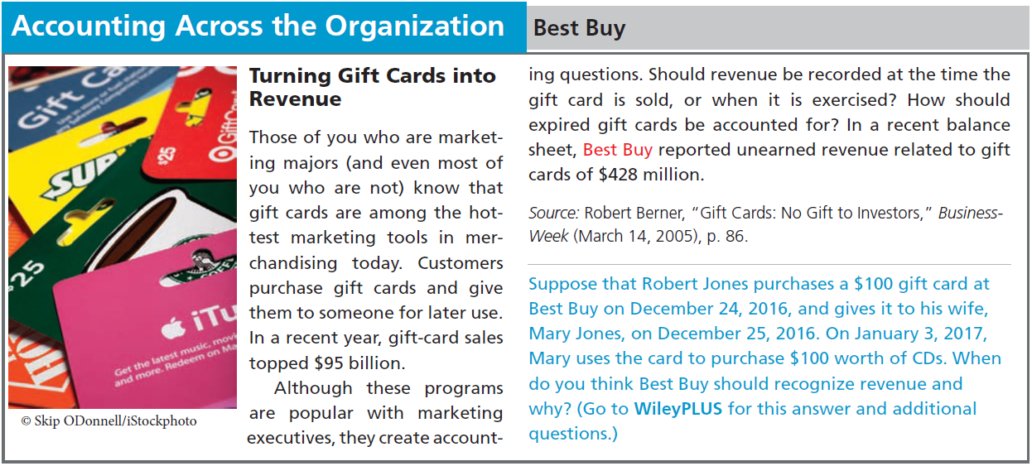
LO 2

Slide 35
DO IT!
2
Adjusting Entries for Deferrals
The ledger of Hammond Company, on March 31, 2017, includes these selected accounts before adjusting entries are prepared.
Debit Credit
Prepaid Insurance $ 3,600
Supplies 2,800
Equipment 25,000
Accumulated Depreciation—Equipment $5,000
Unearned Service Revenue 9,200
An analysis of the accounts shows the following.
Insurance expires at the rate of $100 per month.
Supplies on hand total $800.
The equipment depreciates $200 a month.
During March, services were performed for one-half of the unearned service revenue.
Prepare the adjusting entries for the month of March.
LO 2

Slide 36
DO IT!
2
Adjusting Entries for Deferrals
The ledger of Hammond Company, on March 31, 2017, includes these selected accounts before adjusting entries are prepared.
Debit Credit
Prepaid Insurance $ 3,600
Supplies 2,800
Equipment 25,000
Accumulated Depreciation—Equipment $5,000
Unearned Service Revenue 9,200
Prepare the adjusting entries for the month of March.
Insurance expires at the rate of $100 per month.
Insurance Expense 100
Prepaid Insurance 100
LO 2

Slide 37
DO IT!
2
Adjusting Entries for Deferrals
The ledger of Hammond Company, on March 31, 2017, includes these selected accounts before adjusting entries are prepared.
Debit Credit
Prepaid Insurance $ 3,600
Supplies 2,800
Equipment 25,000
Accumulated Depreciation—Equipment $5,000
Unearned Service Revenue 9,200
Prepare the adjusting entries for the month of March.
Supplies on hand total $800.
Supplies Expense 2,000
Supplies 2,000
LO 2

Slide 38
DO IT!
2
Adjusting Entries for Deferrals
The ledger of Hammond Company, on March 31, 2017, includes these selected accounts before adjusting entries are prepared.
Debit Credit
Prepaid Insurance $ 3,600
Supplies 2,800
Equipment 25,000
Accumulated Depreciation—Equipment $5,000
Unearned Service Revenue 9,200
Prepare the adjusting entries for the month of March.
The equipment depreciates $200 a month.
Depreciation Expense 200
Accumulated Depreciation—Equipment 200
LO 2

Slide 39
DO IT!
2
Adjusting Entries for Deferrals
The ledger of Hammond Company, on March 31, 2017, includes these selected accounts before adjusting entries are prepared.
Debit Credit
Prepaid Insurance $ 3,600
Supplies 2,800
Equipment 25,000
Accumulated Depreciation—Equipment $5,000
Unearned Service Revenue 9,200
Prepare the adjusting entries for the month of March.
During March, services were performed for one-half of the unearned service revenue.
Unearned Service Revenue 4,600
Service Revenue 4,600
LO 2

Slide 40
LEARNING
OBJECTIVE
Prepare adjusting entries for accruals.
3
Accruals are made to record
Revenues for services performed but not yet recorded at the statement date.
Expenses incurred but not yet paid or recorded at the statement date.
LO 3

Slide 41
Accrued Revenues
Revenues for services performed but not yet received in cash or recorded.
Revenue Recorded
BEFORE
Cash Receipt
Accrued revenues often occur in regard to:
Rent
Interest
Services
LO 3

Slide 42
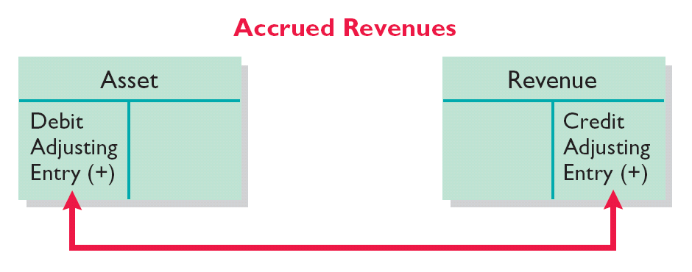
Accrued Revenues
Adjusting entry shows the receivable that exists and records the revenues for services performed.
Adjusting entry:
Increases (debits) an asset account and
Increases (credits) a revenue account.
Illustration 3-13
LO 3

Slide 43
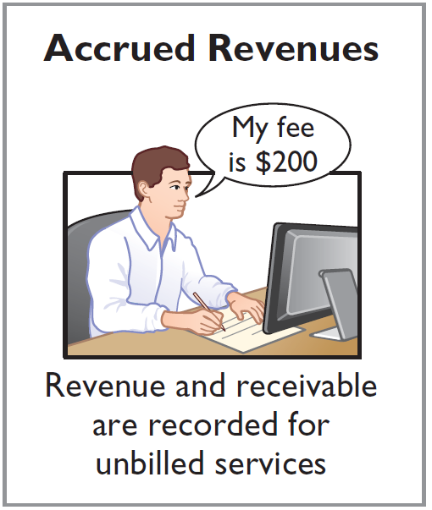
Accrued Revenues
Illustration: In October Pioneer Advertising performed services worth $200 that were not billed to clients on or before October 31.
Oct. 31
Accounts Receivable
200
Service Revenue
200
On November 10, Pioneer receives cash of $200 for the services performed.
Nov. 10
Cash
200
Accounts Receivable
200
LO 3

Slide 44
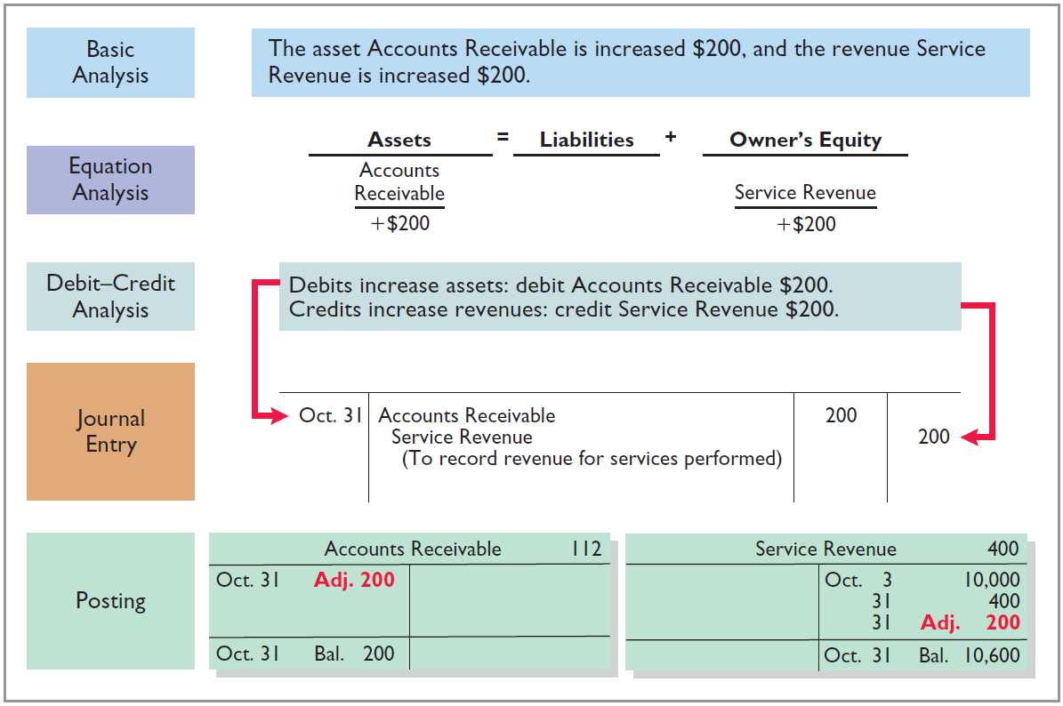
Accrued Revenues
Illustration 3-14
LO 3

Slide 45
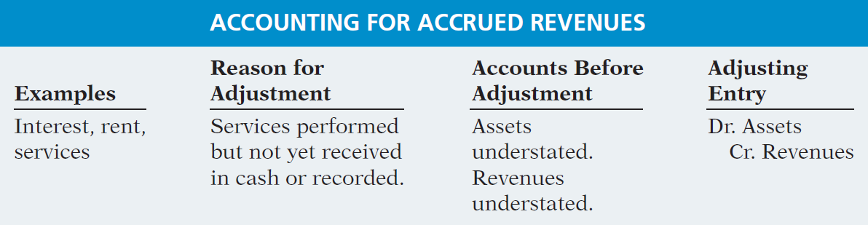
Accrued Revenues
Summary of the accounting for accrued revenues.
Illustration 3-15
LO 3

Slide 46
Accrued Expenses
Expenses incurred but not yet paid in cash or recorded.
Expense Recorded
BEFORE
Cash Payment
Accrued expenses often occur in regard to:
Rent
Interest
Taxes
Salaries
LO 3

Slide 47
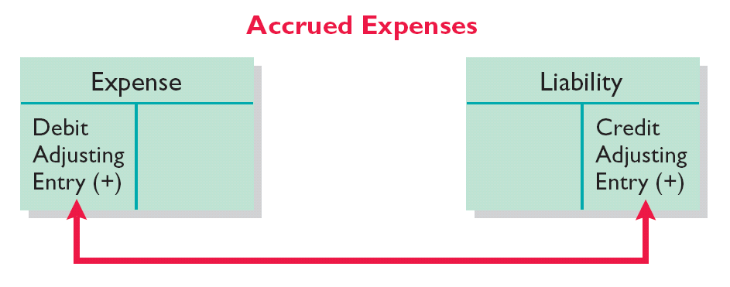
Accrued Expenses
Adjusting entry records the obligation and recognizes the expense.
Adjusting entry:
Increase (debit) an expense account and
Increase (credit) a liability account.
Illustration 3-16
LO 3

Slide 48
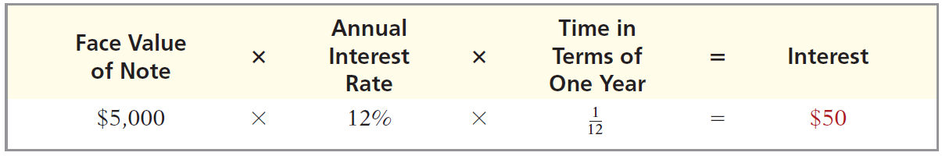
Accrued Expenses
ACCRUED INTEREST
Illustration: Pioneer Advertising signed a three-month note payable in the amount of $5,000 on October 1. The note requires Pioneer to pay interest at an annual rate of 12%.
Illustration 3-17
Oct. 31
Interest expense
50
Interest payable
50
LO 3

Slide 49
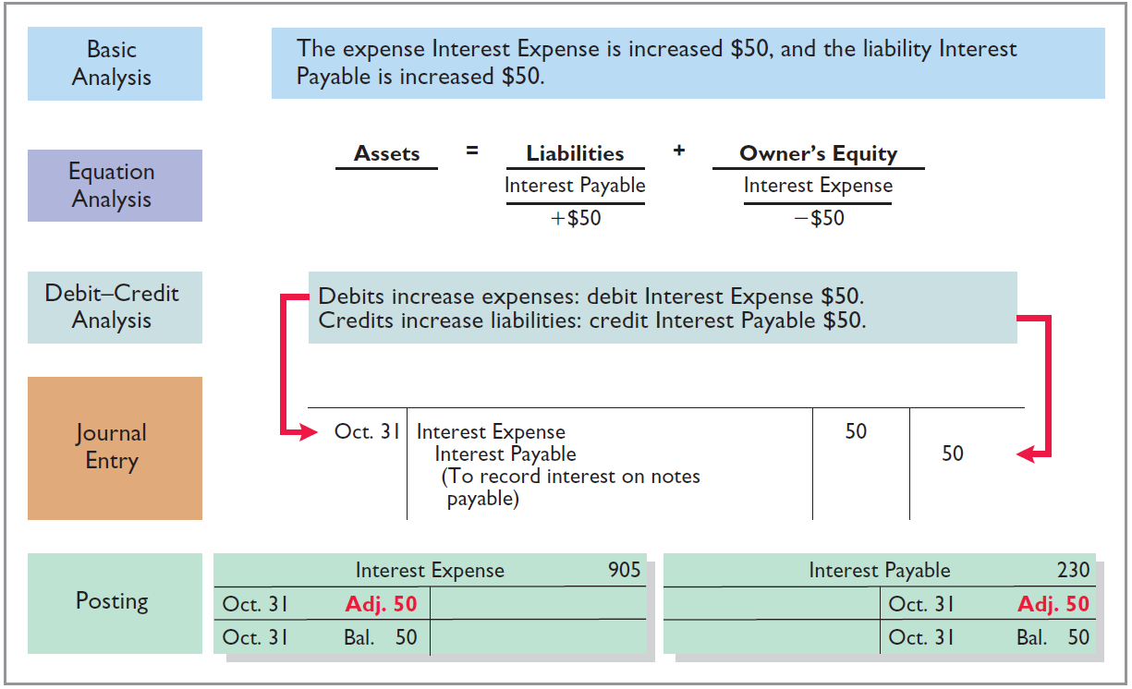
Accrued Expenses
Illustration 3-18
LO 3

Slide 50
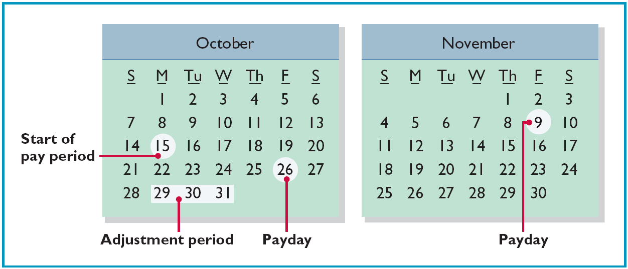
Accrued Expenses
ACCRUED INTEREST
Illustration: Pioneer Advertising paid salaries and wages on October 26; the next payment of salaries will not occur until November 9. The employees receive total salaries of $2,000 for a five-day work week, or $400 per day.
Illustration 3-19
LO 3

Slide 51
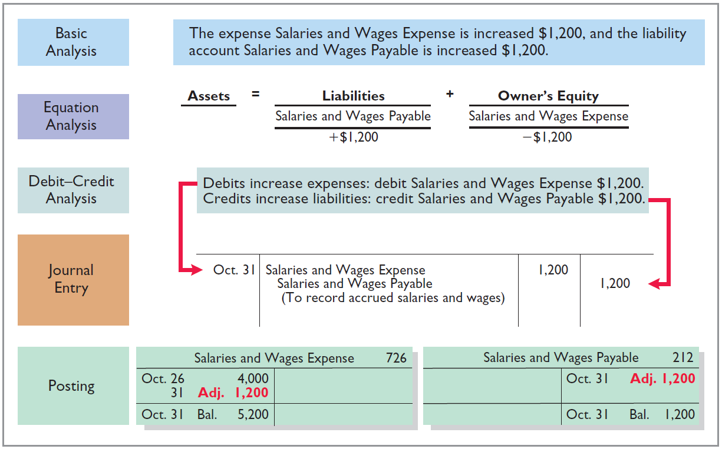
Accrued Expenses
Illustration 3-20
LO 3

Slide 52
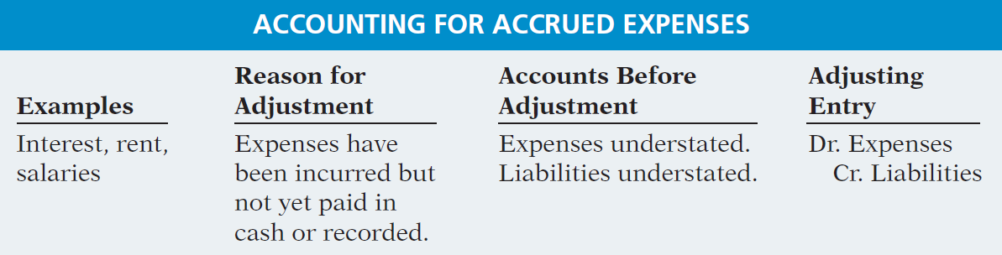
Accrued Expenses
Summary of the accounting for accrued expenses.
Illustration 3-21
LO 3

Slide 53

LO 3

Slide 54
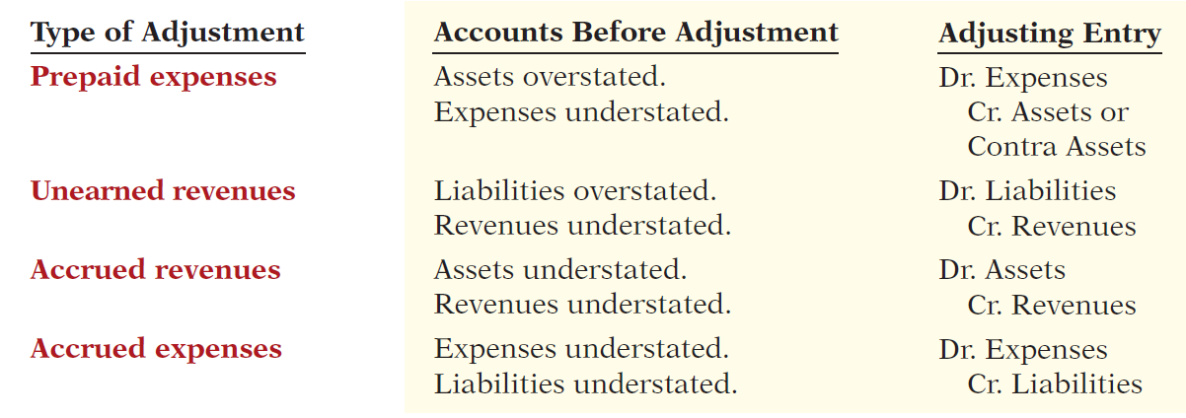
Summary of Basic Relationships
Illustration 3-22
LO 3

Slide 55
DO IT!
3
Adjusting Entries for Accruals
Micro Computer Services began operations on August 1, 2017. At the end of August 2017, management prepares monthly financial statements. The following information relates to August.
At August 31, the company owed its employees $800 in salaries and wages that will be paid on September 1.
On August 1, the company borrowed $30,000 from a local bank on a 15-year mortgage. The annual interest rate is 10%.
Revenue for services performed but unrecorded for August totaled $1,100.
Prepare the adjusting entries needed at August 31, 2017.
LO 3

Slide 56
DO IT!
3
Adjusting Entries for Accruals
Prepare the adjusting entries needed at August 31, 2017.
At August 31, the company owed its employees $800 in salaries and wages that will be paid on September 1.
On August 1, the company borrowed $30,000 from a local bank on a 15-year mortgage. The annual interest rate is 10%.
Revenue for services performed but unrecorded for August totaled $1,100.
Salaries and Wages Expense 800
Salaries and Wages Payable 800
Interest Expense 250
Interest Payable 250
Accounts Receivable 1,100
Service Revenue 1,100
LO 3

Slide 57
LEARNING
OBJECTIVE
Describe the nature and purpose of an adjusted trial balance.
4
Adjusted Trial Balance
Prepared after all adjusting entries are journalized and posted.
Purpose is to prove the equality of debit balances and credit balances in the ledger.
Is the primary basis for the preparation of financial statements.
LO 4

Slide 58
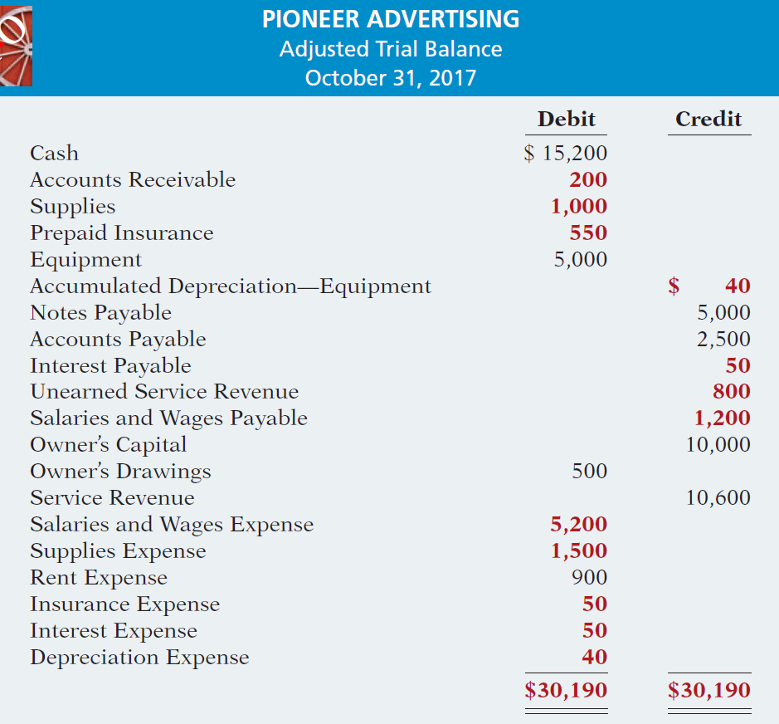

Illustration 3-25
LO 4

Slide 59
Adjusted Trial Balance
Question
Which of the following statements is incorrect concerning the adjusted trial balance?
An adjusted trial balance proves the equality of the total debit balances and the total credit balances in the ledger after all adjustments are made.
The adjusted trial balance provides the primary basis for the preparation of financial statements.
The adjusted trial balance lists the account balances segregated by assets and liabilities.
The adjusted trial balance is prepared after the adjusting entries have been journalized and posted.
LO 4

Slide 60
Preparing Financial Statements
Financial Statements are prepared directly from the Adjusted Trial Balance.
Income Statement
Owner’s Equity Statement
Balance Sheet
LO 4

Slide 61
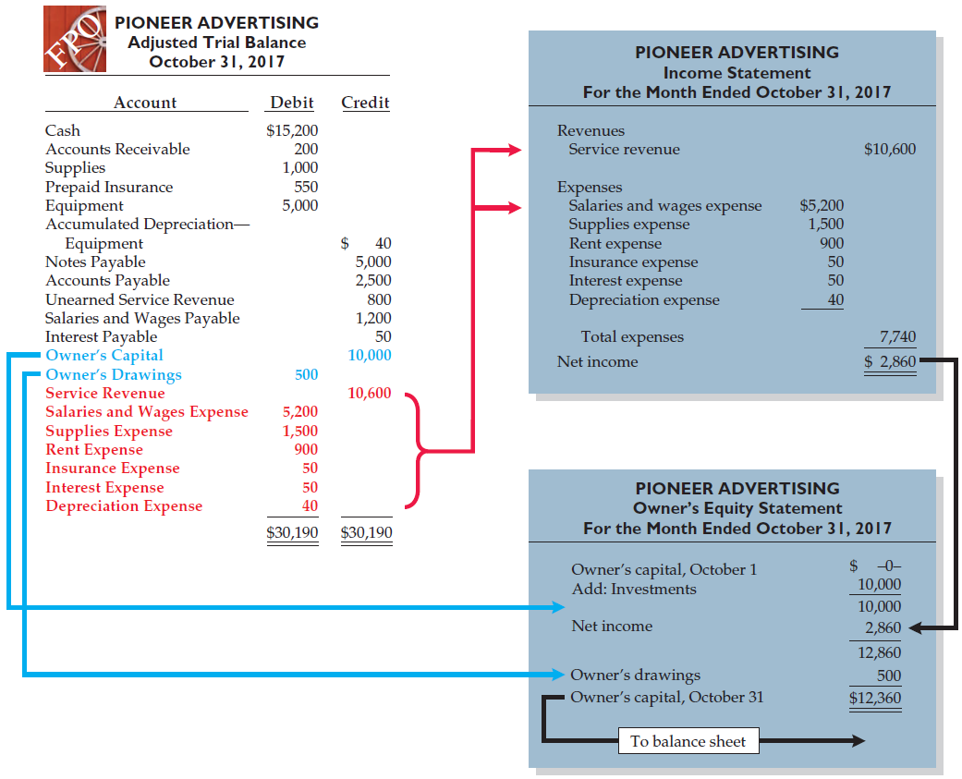
Illustration 3-26
Preparation of the income statement and owner’s equity statement from the adjusted trial balance

Slide 62
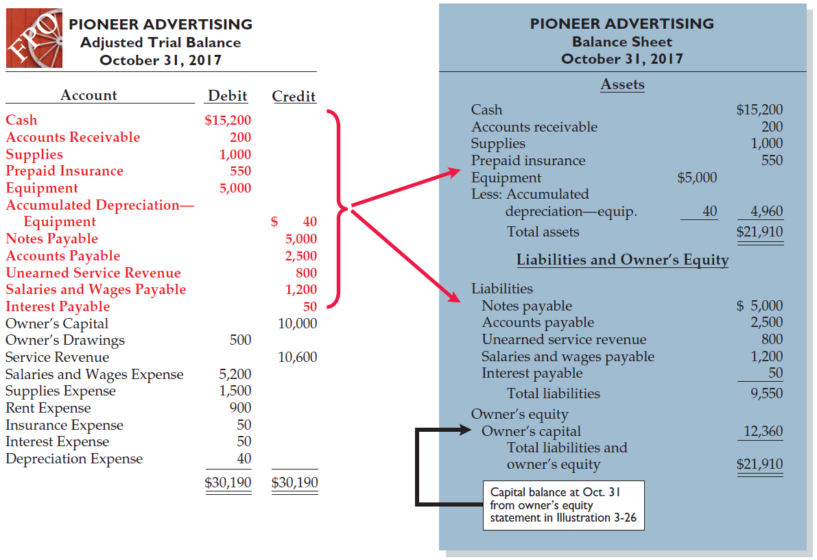
Illustration 3-27
Preparation of the balance sheet from the adjusted trial balance
LO 4

Slide 63
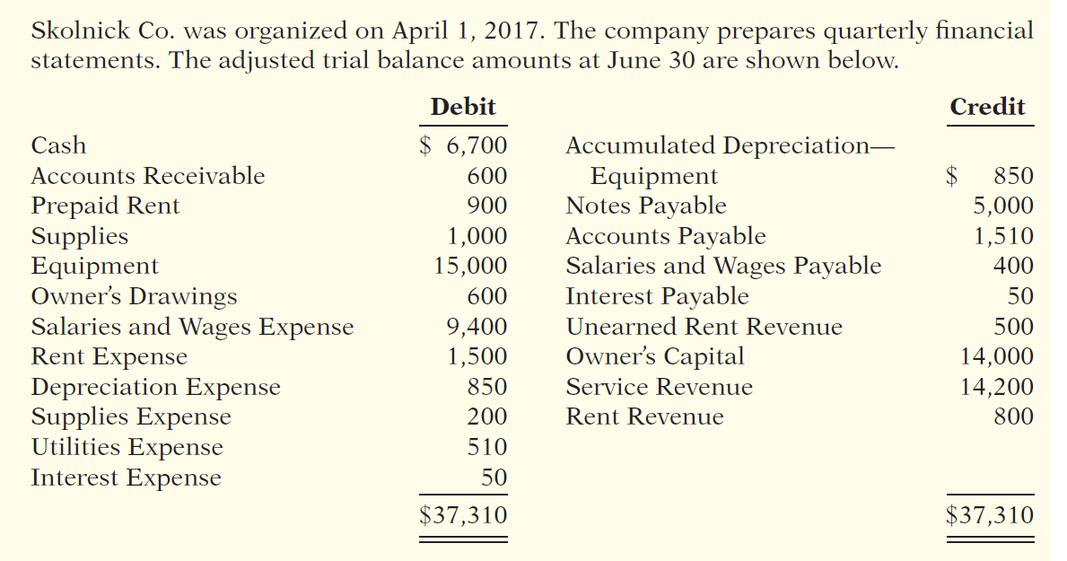
DO IT!
4
Trial Balance
(a) Determine the net income for the quarter April 1 to June 30.
(b) Determine the total assets and total liabilities at June 30, 2017, for Skolnick Co.
(c) Determine the amount of owner’s capital at June 30, 2017.
LO 4

Slide 64
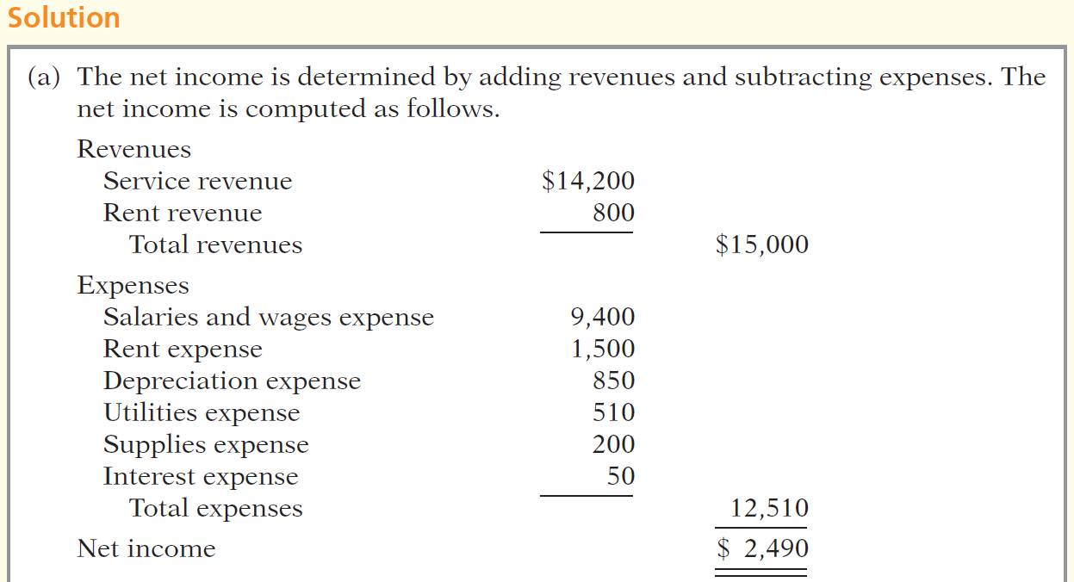
DO IT!
4
Trial Balance
LO 4

Slide 65
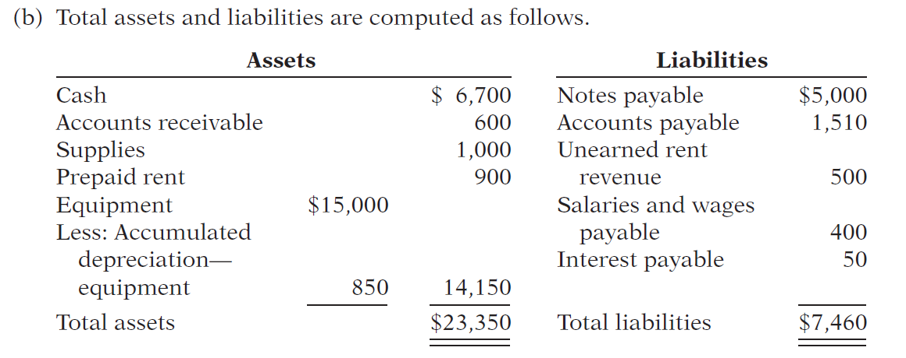
DO IT!
4
Trial Balance
LO 4

Slide 66
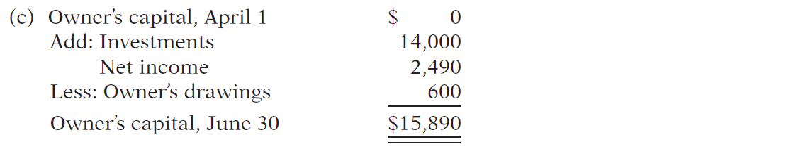
DO IT!
4
Trial Balance
LO 4

Slide 67
LEARNING
OBJECTIVE
APPENDIX 3A: Prepare adjusting entries for the alternative treatment of deferrals.
5
Alternate Treatment for Adjusting Entries
When a company prepays an expense, it debits that amount to an expense account.
When it receives payment for future services, it credits the amount to a revenue account.
LO 5

Slide 68
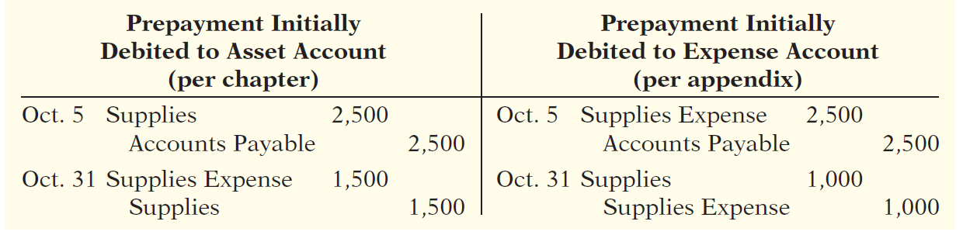
Prepaid Expenses
Company may choose to debit (increase) an expense account rather than an asset account. This alternative treatment is simply more convenient.
Illustration 3A-2
LO 5

Slide 69
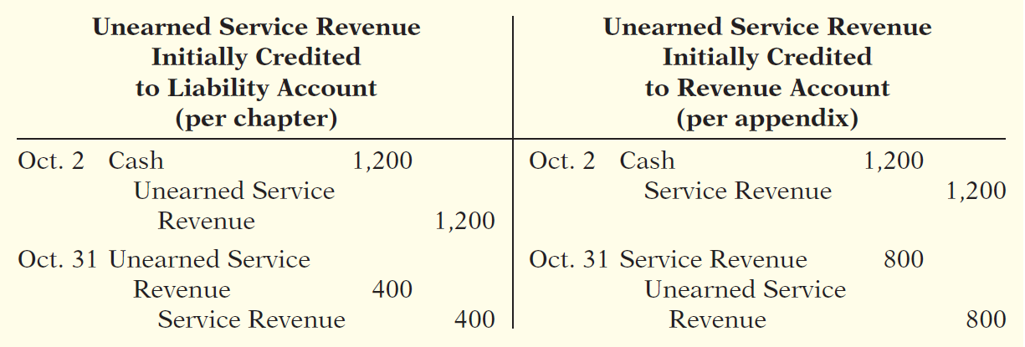
Unearned Revenues
Company may credit (increase) a revenue account when they receive cash for future services.
Illustration 3A-5
LO 5

Slide 70
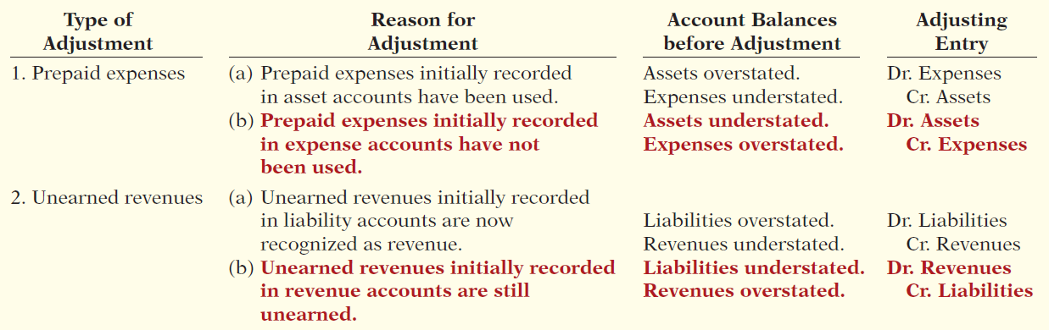
Summary of Additional Adjustments Relationships
Illustration 3A-7
LO 5

Slide 71
LEARNING
OBJECTIVE
APPENDIX 3B: Discuss financial reporting concepts.
6
Qualities of Useful Information
Two fundamental qualities, relevance and faithful representation.
Relevance
Make a difference in a business decision.
Provides information that has predictive value and confirmatory value.
Materiality is a company-specific aspect of relevance.
An item is material when its size makes it likely to influence the decision of an investor or creditor.
LO 6

Slide 72
Qualities of Useful Information
Two fundamental qualities, relevance and faithful representation.
Faithful Representation
Information accurately depicts what really happened.
Information must be
complete (nothing important has been omitted),
neutral (is not biased toward one position or another), and
free from error.
LO 6

Slide 73
Qualities of Useful Information
ENHANCING QUALITIES
Comparability results when different companies use the same accounting principles.
Information is verifiable if independent
observers, using the same methods, obtain similar results.
Information has the quality of understandability
if it is presented in a clear and concise fashion.
Consistency means that a company uses the same accounting
principles and methods from year to year.
For accounting information to have relevance, it must be timely.
LO 6

Slide 74
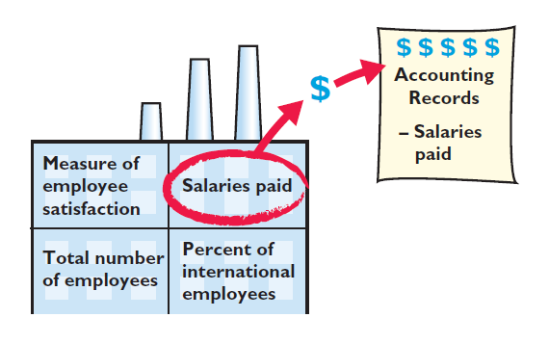
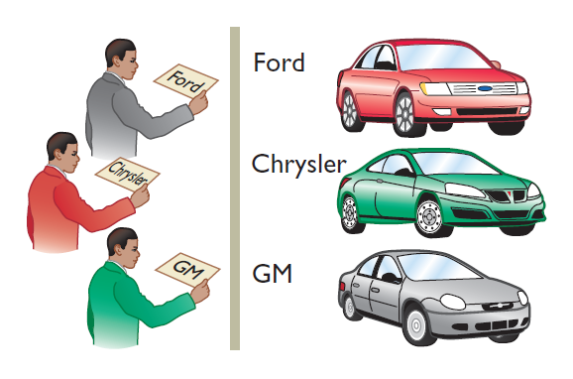
Assumptions in Financial Reporting
Illustration 3B-2
Monetary Unit
Economic Entity
Requires that only those things that can be expressed in money are included in the accounting records.
States that every economic entity can be separately identified and accounted for.
LO 6

Slide 75
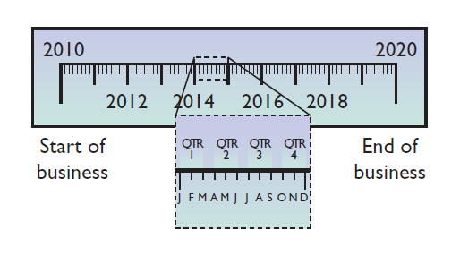

Assumptions in Financial Reporting
Illustration 3B-2
Time Period
Going Concern
States that the life of a business can be divided into artificial time periods.
The business will remain in operation for the foreseeable future.
LO 6

Slide 76
Principles of Financial Reporting
MEASUREMENT PRINCIPLES
Historical Cost
Fair Value
Or cost principle, dictates that companies record assets at their cost.
Indicates that assets and liabilities should be reported at fair value (the price received to sell an asset or settle
a liability).
LO 6

Slide 77
Principles of Financial Reporting
Revenue Recognition Principle
Expense Recognition Principle
Full Disclosure Principle
Requires that companies recognize revenue in the accounting period in which the performance obligation is satisfied.
Dictates that efforts (expenses) be matched with results (revenues). Thus, expenses follow revenues.
Requires that companies disclose all circumstances
and events that would make a difference to financial statement users.
LO 6

Slide 78
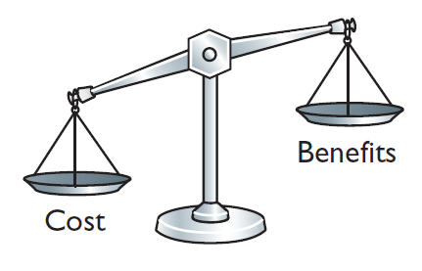
Cost Constraint
Cost Constraint
Accounting standard-setters weigh the cost that companies will incur to provide the information against the benefit that financial statement users will gain from having the information available.
LO 6

Slide 79

A Look at IFRS
LEARNING
OBJECTIVE
Compare the procedures for adjusting entries under GAAP and IFRS.
7
Key Points
Similarities
Companies applying IFRS also use accrual-basis accounting to ensure that they record transactions that change a company’s financial statements in the period in which events occur.
Similar to GAAP, cash-basis accounting is not in accordance with IFRS.
IFRS also divides the economic life of companies into artificial time periods. Under both GAAP and IFRS, this is referred to as the time period assumption.
LO 7

Slide 80

A Look at IFRS
Key Points
Similarities
The general revenue recognition principle required by GAAP that is used in this textbook is similar to that used under IFRS.
Revenue recognition fraud is a major issue in U.S. financial reporting. The same situation occurs in other countries, as evidenced by revenue recognition breakdowns at Dutch software company Baan NV, Japanese electronics giant NEC, and Dutch grocer Ahold NV.
LO 7

Slide 81
A Look at IFRS
Key Points
Differences
Under IFRS, revaluation (using fair value) of items such as land and buildings is permitted. IFRS allows depreciation based on revaluation of assets, which is not permitted under GAAP.
The terminology used for revenues and gains, and expenses and losses, differs somewhat between IFRS and GAAP. For example, income includes both revenues, which arise during the normal course of operating activities, and gains, which arise from activities outside of the normal sales of goods and services. The term income is not used this way under GAAP. Instead, under GAAP income refers to the net difference between revenues and expenses.
LO 7

Slide 82
A Look at IFRS
Key Points
Differences
Under IFRS, expenses include both those costs incurred in the normal course of operations as well as losses that are not part of normal operations. This is in contrast to GAAP, which defines each separately.
LO 7

Slide 83
A Look at IFRS
Looking into the Future
The IASB and FASB are completing a joint project on revenue recognition. The purpose of this project is to develop comprehensive guidance on when to recognize revenue. It is hoped that this approach will lead to more consistent accounting in this area. For more on this topic, see www.fasb.org/project/revenue_recognition.shtml.
LO 7

Slide 84
A Look at IFRS
IFRS Practice
IFRS:
uses accrual accounting.
uses cash-basis accounting.
allows revenue to be recognized when a customer makes an order.
requires that revenue not be recognized until cash is received.
LO 7

Slide 85
A Look at IFRS
IFRS Practice
Which of the following statements is false?
IFRS employs the periodicity assumption.
IFRS employs accrual accounting.
IFRS requires that revenues and costs must be capable of being measured reliably.
IFRS uses the cash basis of accounting.
LO 7

Slide 86
A Look at IFRS
IFRS Practice
As a result of the revenue recognition project being undertaken by the FASB and IASB:
revenue recognition places more emphasis on when the performance obligation is satisfied.
revenue recognition places more emphasis on when revenue is realized.
revenue recognition places more emphasis on when expenses are incurred.
revenue is no longer recorded unless cash has been received.
LO 7

Slide 87
Copyright
“Copyright © 2015 John Wiley & Sons, Inc. All rights reserved. Reproduction or translation of this work beyond that permitted in Section 117 of the 1976 United States Copyright Act without the express written permission of the copyright owner is unlawful. Request for further information should be addressed to the Permissions Department, John Wiley & Sons, Inc. The purchaser may make back-up copies for his/her own use only and not for distribution or resale. The Publisher assumes no responsibility for errors, omissions, or damages, caused by the use of these programs or from the use of the information contained herein.”

