Slide 1


Slide 2
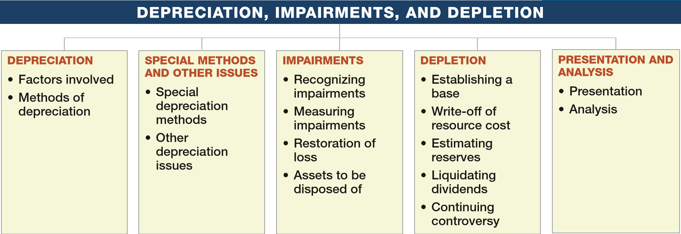
PREVIEW OF CHAPTER 11
Intermediate Accounting
16th Edition
Kieso ● Weygandt ● Warfield

Slide 3
LEARNING OBJECTIVES
11
Depreciation, Impairments, and Depletion
After studying this chapter, you should be able to:
Understand depreciation concepts and methods of depreciation.
Explain special depreciation methods and other depreciation issues.
Explain the accounting issues related to asset impairment.
Explain the accounting procedures for depletion of natural resources.
Explain how to report and analyze property, plant, equipment, and natural resources.
LO 1

Slide 4
DEPRECIATION—METHOD OF COST ALLOCATION
Depreciation is the accounting process of allocating the cost of tangible assets to expense in a systematic and rational manner to those periods expected to benefit from the use of the asset.
Allocating costs of long-lived assets:
Fixed assets = Depreciation expense
Intangibles = Amortization expense
Natural resources = Depletion expense
LO 1

Slide 5
METHOD OF COST ALLOCATION
Factors Involved in the Depreciation Process
Three basic questions:
What depreciable base is to be used?
What is the asset’s useful life?
What method of cost apportionment is best for this asset?
LO 1

Slide 6
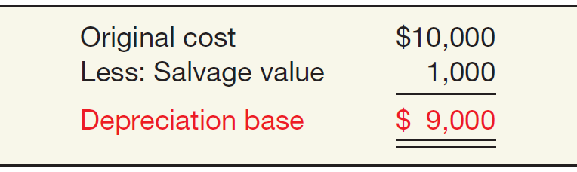
METHOD OF COST ALLOCATION
Factors Involved in the Depreciation Process
Depreciable Base for the Asset
ILLUSTRATION 11-1
Computation of Depreciation Base
LO 1

Slide 7
METHOD OF COST ALLOCATION
Factors Involved in the Depreciation Process
Estimation of Service Lives
Service life often differs from physical life.
Companies retire assets for two reasons:
Physical factors (casualty or expiration of physical life).
Economic factors (inadequacy, supersession, and obsolescence).
LO 1

Slide 8
WHAT DO THE NUMBERS MEAN? ALPHEBET DUPE
WHAT’S YOUR PRINCIPLE
Some companies try to imply that depreciation is not a cost. For example, in their press releases they will often make a bigger deal over earnings before interest, taxes, depreciation, and amortization (often referred to as EBITDA) than net income under GAAP. They like it because it “dresses up” their earnings numbers. Some on Wall Street buy this hype because they don’t like the allocations that are required to determine net income. Some banks, without batting an eyelash, even let companies base their loan covenants on EBITDA. For example, look at Premier Parks, which operates the Six Flags chain of amusement parks. Premier touts its EBITDA performance. But that number masks a big part of how the company operates—and how it spends its money. Premier argues that analysts should ignore depreciation for big-ticket items like roller coasters because the rides have a long life. Critics, however, say that the amusement industry has to spend as much as 50 percent of its EBITDA just to keep its rides and attractions current. Those expenses are not optional—let the rides get a little rusty, and ticket sales start to tail off. That means analysts really should view depreciation associated with the costs of maintaining the rides (or buying new ones) as an everyday expense.
(continued)
LO 1

Slide 9
WHAT DO THE NUMBERS MEAN? ALPHEBET DUPE
WHAT’S YOUR PRINCIPLE
It also means investors in those companies should have strong stomachs. What’s the risk of trusting a fad accounting measure? Just look at one year’s bankruptcy numbers. Of the 147 companies tracked by Moody’s that defaulted on their debt, most borrowed money based on EBITDA performance. The bankers in those deals probably wish they had looked at a few other factors. On the other hand, nonﬁnancial companies in the S&P 500 recently generated a substantial EBITDA margin of 20.9 percent. Some analysts are concerned that such a high number suggests that companies are reluctant to incur costs and want to stockpile cash. The lesson? Investors will do well to avoid focus on any single accounting measure.
Sources: Adapted from Herb Greenberg, “Alphabet Dupe: Why EBITDA Falls Short,” Fortune (July 10, 2000), p. 240; and V. Monga, “Operating Efficiency Runs High at U.S. Firms,” Wall Street Journal (February 28, 2012), p. B7.
LO 1

Slide 10
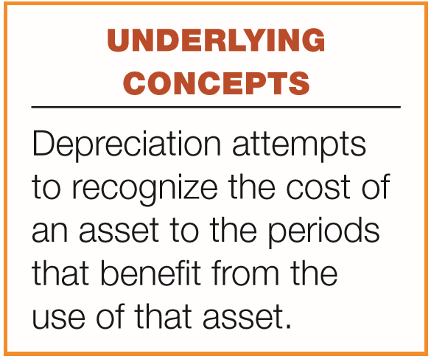
METHOD OF COST ALLOCATION
Methods of Depreciation
The profession requires the method employed be “systematic and rational.” Methods used include:
Activity method (units of use or production).
Straight-line method.
Sum-of-the-years’-digits.
Declining-balance method.
Group and composite methods.
Hybrid or combination methods.
Decreasing charge methods
Special methods
LO 1

Slide 11
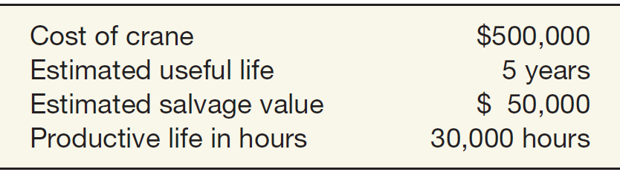
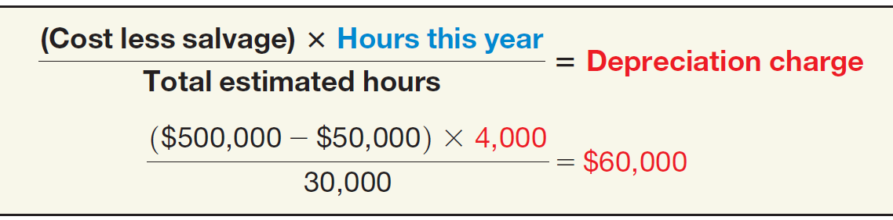
METHOD OF COST ALLOCATION
Activity Method
Illustration 11-2
Data Used to Illustrate Depreciation Methods
Stanley Coal Mines Facts
Illustration: If Stanley uses the crane for 4,000 hours the first year, the depreciation charge is:
Illustration 11-3
Depreciation Calculation, Activity Method—Crane Example
LO 1

Slide 12
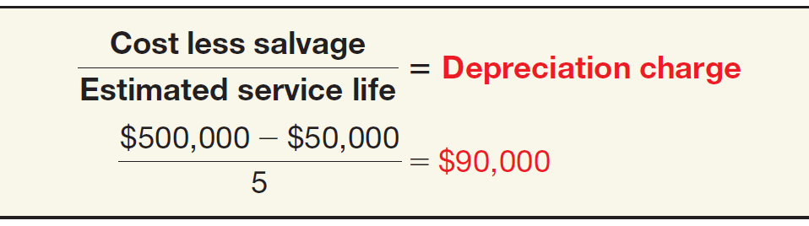
METHOD OF COST ALLOCATION
Straight-Line Method
Illustration 11-2
Data Used to Illustrate Depreciation Methods
Stanley Coal Mines Facts
Illustration: Stanley computes depreciation as follows:
Illustration 11-4
Depreciation Calculation, Straight-Line Method— Crane Example
LO 1

Slide 13
METHOD OF COST ALLOCATION
Decreasing-Charge Methods
Illustration 11-2
Data Used to Illustrate Depreciation Methods
Stanley Coal Mines Facts
Sum-of-the-Years’-Digits. Each fraction uses the sum of the years as a denominator (5 + 4 + 3 + 2 + 1 = 15). The numerator is the number of years of estimated life remaining as of the beginning of the year.
Alternate sum-of-the-years’ calculation
n(n+1)
5(5+1)
=
=
15
2
2
LO 1

Slide 14
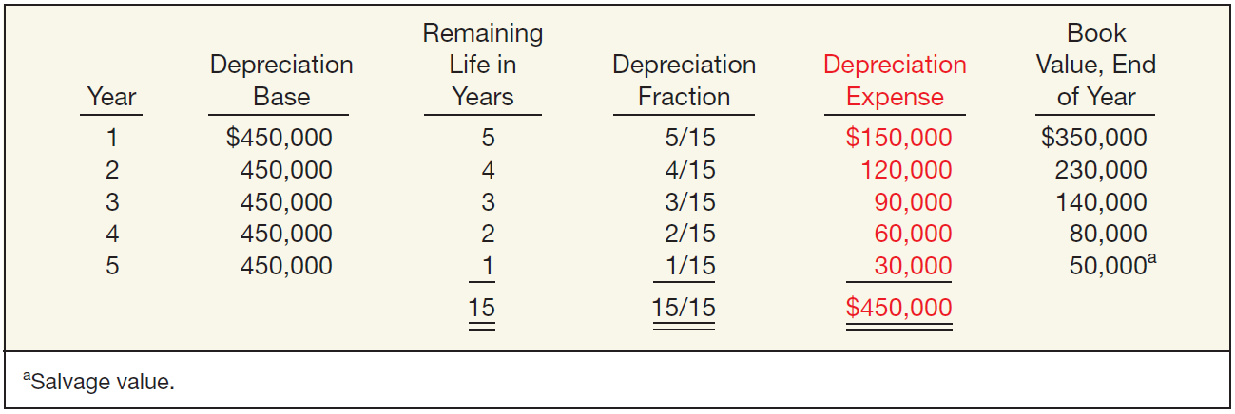
METHOD OF COST ALLOCATION
Sum-of-the-Years’-Digits
Illustration 11-6
Sum-of-the-Years’-Digits Depreciation Schedule— Crane Example
LO 1

Slide 15
METHOD OF COST ALLOCATION
Decreasing-Charge Methods
Illustration 11-2
Data Used to Illustrate Depreciation Methods
Stanley Coal Mines Facts
Declining-Balance Method
Utilizes a depreciation rate (percentage) that is some multiple of the straight-line method.
Does not deduct the salvage value in computing the depreciation base.
LO 1

Slide 16
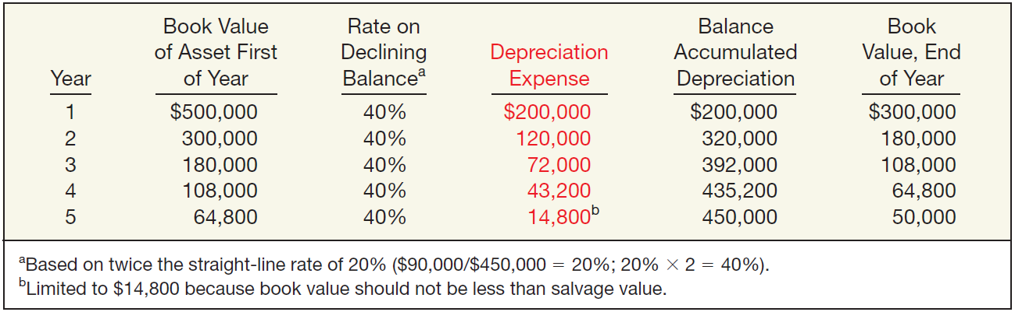
METHOD OF COST ALLOCATION
Declining-Balance Method
Illustration 11-7
Double-Declining Depreciation Schedule— Crane Example
LO 1

Slide 17
METHOD OF COST ALLOCATION
Illustration—(Four Methods): Maserati Corporation purchased a new machine for its assembly process on August 1, 2017. The cost of this machine was $150,000. The company estimated that the machine would have a salvage value of $24,000 at the end of its service life. Its life is estimated at 5 years and its working hours are estimated at 21,000 hours. Year-end is December 31.
Instructions: Compute the depreciation expense under the following methods.
(a) Straight-line depreciation. (c) Sum-of-the-years’-digits.
(b) Activity method (d) Double-declining balance.
LO 1

Slide 18
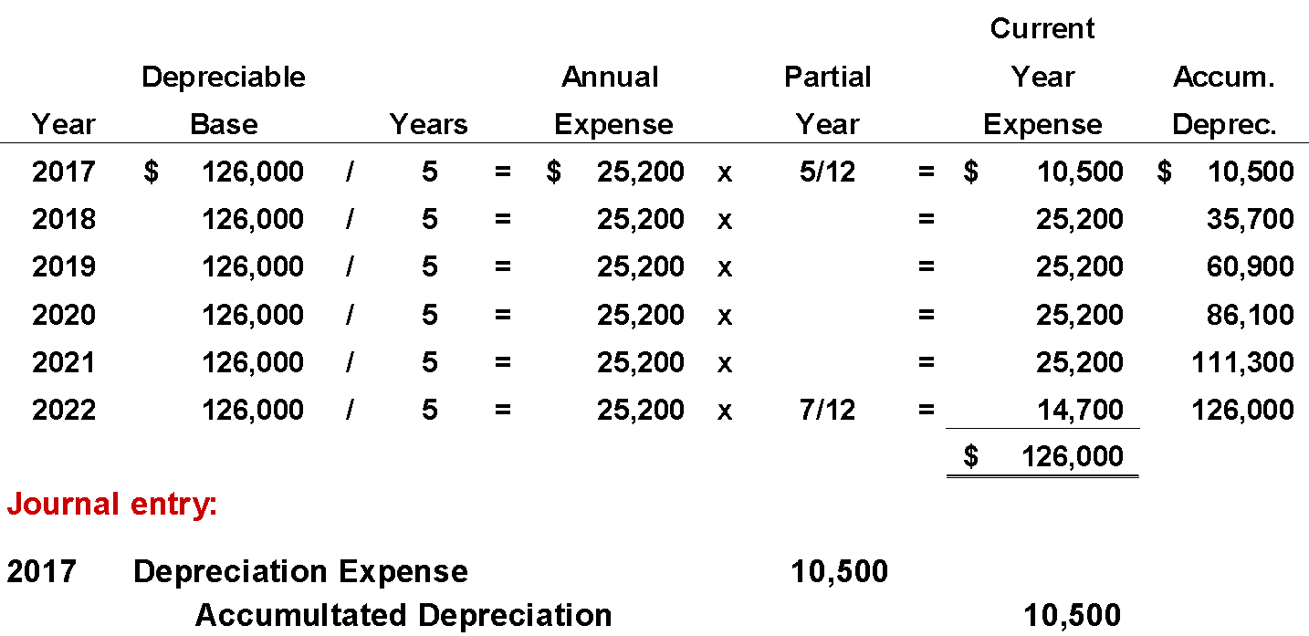
METHOD OF COST ALLOCATION
Straight-line Method
LO 1

Slide 19
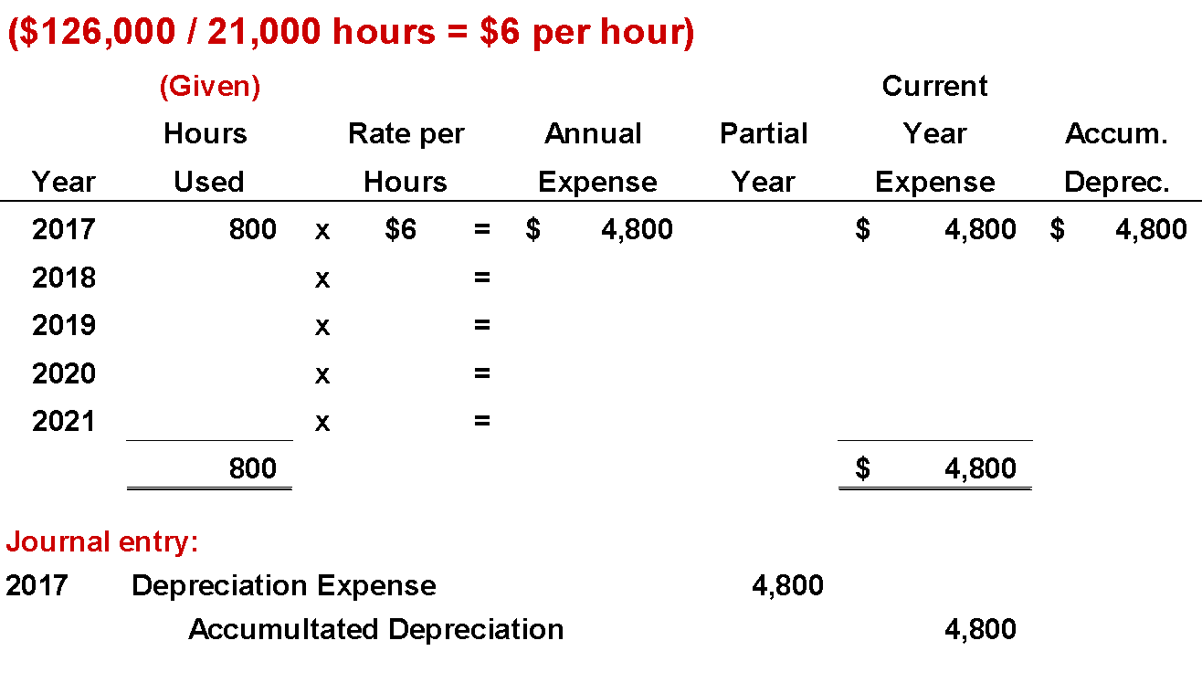
METHOD OF COST ALLOCATION
Activity Method
(Assume 800 hours used in 2017)
LO 1

Slide 20
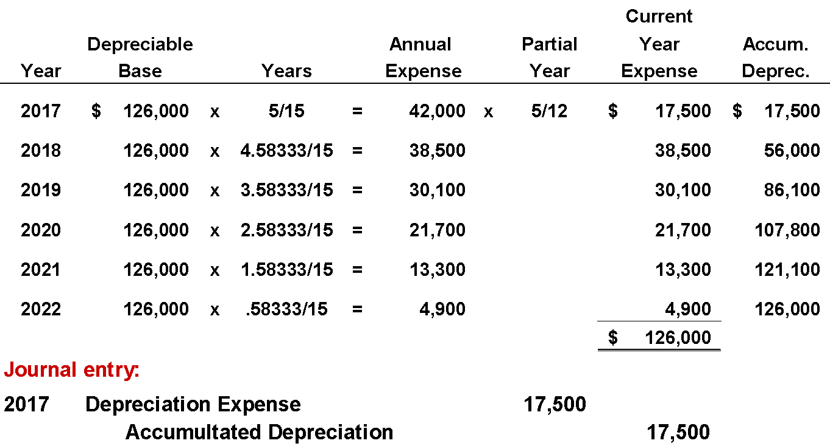
METHOD OF COST ALLOCATION
Sum-of-the-Years’-Digits Method
5/12 = .41667
7/12 = .58333
LO 1

Slide 21
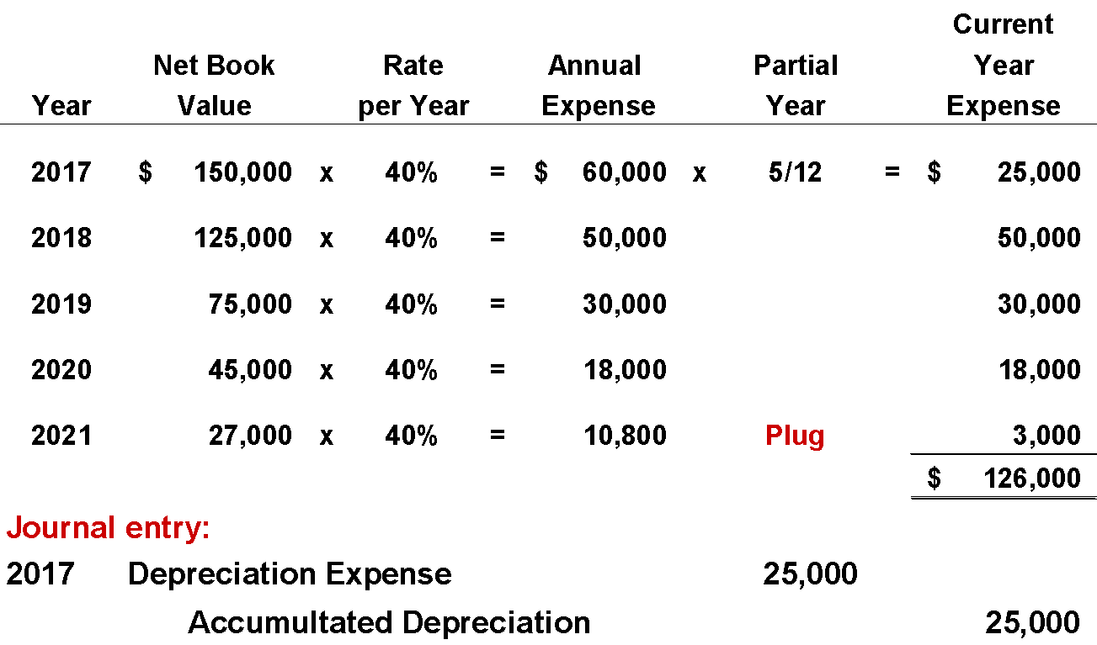
METHOD OF COST ALLOCATION
Double-Declining Balance Method
LO 1

Slide 22
LEARNING OBJECTIVES
11
Depreciation, Impairments, and Depletion
After studying this chapter, you should be able to:
Understand depreciation concepts and methods of depreciation.
Explain special depreciation methods and other depreciation issues.
Explain the accounting issues related to asset impairment.
Explain the accounting procedures for depletion of natural resources.
Explain how to report and analyze property, plant, equipment, and natural resources.
LO 2

Slide 23
SPECIAL DEPRECIATION METHODS AND OTHER ISSUES
Special Depreciation Methods
Two methods of depreciating multiple-asset accounts exist:
Group method used when the assets are similar in nature and have approximately the same useful lives.
Composite method used when the assets are dissimilar and have different lives.
The choice of method depends on the nature of the assets involved.
The computation for group or composite methods is essentially the same: find an average and depreciate on that basis.
LO 2

Slide 24
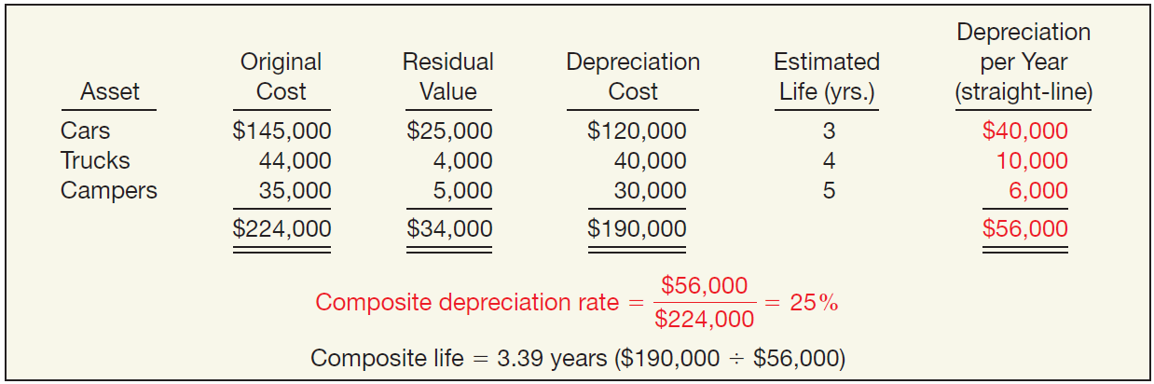
Group and Composite Methods
Illustration: Mooney Motors establishes the composite depreciation rate for its fleet of cars, trucks, and campers as shown below.
Illustration 11-8
Depreciation Calculation, Composite Basis
LO 2

Slide 25
Group and Composite Methods
If Mooney retires an asset before or after the average service life of the group is reached, it buries the resulting gain or loss in the Accumulated Depreciation account.
Illustration: Suppose that Mooney Motors sold one of the campers with a cost of $5,000 for $2,600 at the end of the third year. The entry is:
Accumulated Depreciation 2,400
Cash 2,600
Cars, Trucks, and Campers 5,000
LO 2

Slide 26
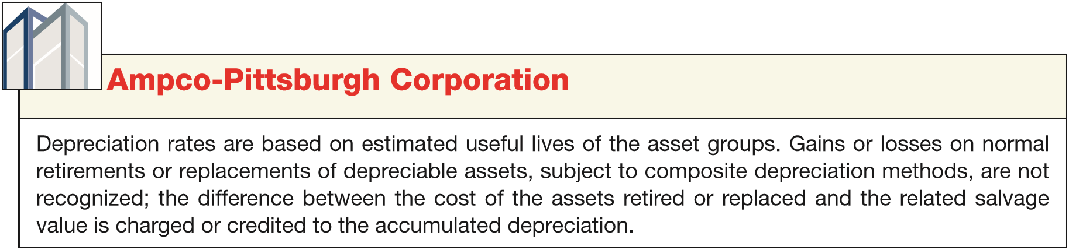
Group and Composite Methods
If Mooney purchases a new type of asset (mopeds, for example), it must compute a new depreciation rate and apply this rate in subsequent periods.
ILLUSTRATION 11-9
Disclosure of Group
Depreciation Method
LO 2

Slide 27
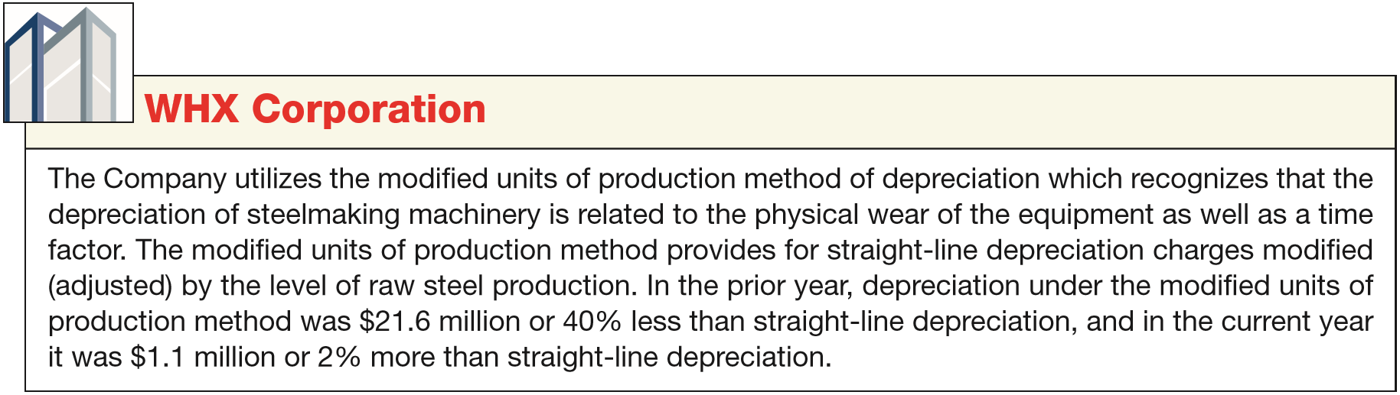
SPECIAL DEPRECIATION METHODS
Hybrid or Combination Methods
Companies are also free to develop tailor-made depreciation methods, provided the method results in the allocation of an asset’s cost over the asset’s life in a systematic and rational manner.
ILLUSTRATION 11-10
Disclosure of Hybrid Depreciation Method
LO 2

Slide 28
WHAT DO THE NUMBERS MEAN? DECELERATING DEPRECIATION
WHAT’S YOUR PRINCIPLE
Which depreciation method should management select? Many believe that the method that best matches revenues with expenses should be used. For example, if revenues generated by the asset are constant over its useful life, select straight-line depreciation. On the other hand, if revenues are higher (or lower) at the beginning of the asset’s life, then use a decreasing (or increasing) method. Thus, if a company can reliably estimate revenues from the asset, selecting a depreciation method that best matches costs with those revenues would seem to provide the most useful information to investors and creditors for assessing the future cash ﬂows from the asset. Managers in the real estate industry face a different challenge when considering depreciation choices. Real estate managers object to traditional depreciation methods because in their view, real estate often does not decline in value. In addition, because real estate is highly debt-ﬁnanced, most real estate concerns report losses in earlier years of operations when the sum of depreciation and interest exceeds the revenue from the real estate project. As a result, real estate companies, like Kimco Realty, argue for some form of increasing-charge method of depreciation (lower depreciation at the beginning and higher depreciation at the end). With such a method, companies would report higher total assets and net income in the earlier years of the project.
LO 2

Slide 29
METHOD OF COST ALLOCATION
Other Depreciation Issues
How should companies compute depreciation for partial periods?
Does depreciation provide for the replacement of assets?
How should companies handle revisions in depreciation rates?
See slides for LO 1
Funds for the replacement of assets come from revenues.
LO 2

Slide 30
Other Depreciation Issues
Revision of Depreciation Rates
Changes in estimates are a continual and inherent part of any estimation process.
Accounted for in the current period and prospective periods.
No change to previously reported results.
LO 2

Slide 31
Revision of Depreciation Rates
Arcadia HS, purchased equipment for $510,000 which was estimated to have a useful life of 10 years with a residual value of $10,000 at the end of that time. Depreciation has been recorded for 7 years on a straight-line basis. In 2017 (year 8), it is determined that the total estimated life should be 15 years with a residual value of $5,000 at the end of that time.
Questions:
What is the journal entry to correct the prior years’ depreciation?
Calculate the depreciation expense for 2017.
No Entry
Required
LO 2

Slide 32
Revision of Depreciation Rates
After 7 years
Equipment cost $510,000
Salvage value - 10,000
Depreciable base 500,000
Useful life (original) 10 years
Annual depreciation $ 50,000
First, establish NBV at date of change in estimate.
x 7 years = $350,000
Balance Sheet (Dec. 31, 2016)
Equipment
$510,000
Accumulated depreciation
350,000
Net book value (NBV)
$160,000
LO 2

Slide 33
Revision of Depreciation Rates
After 7 years
Net book value $160,000
Salvage value (new) 5,000
Depreciable base 155,000
Useful life remaining 8 years
Annual depreciation $ 19,375
Depreciation Expense calculation for 2017.
Journal entry for 2017
Depreciation Expense 19,375
Accumulated Depreciation 19,375
LO 2

Slide 34
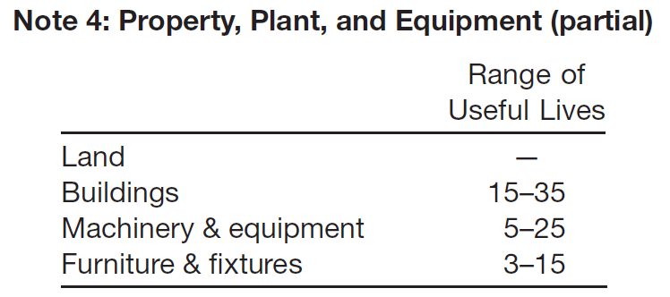
WHAT DO THE NUMBERS MEAN? DEPRECIATION CHOICES
WHAT’S YOUR PRINCIPLE
The amount of depreciation expense recorded depends on both the depreciation method used and estimates of service lives and salvage values of the assets. Differences in these choices and estimates can signiﬁcantly impact a company’s reported results and can make it difﬁcult to compare the depreciation numbers of different companies.
An analyst determines the impact of these management choices and judgments on the amount of depreciation expense by examining the notes to ﬁnancial statements. For example, Willamette Industries provided the note to the right to its ﬁnancial statements. As indicated, when Willamette Industries extended the estimated service lives of its machinery and equipment by ﬁve years, it increased income by nearly $54 million.
During the year, the estimated service lives for most machinery and equipment were extended five years. The change was based upon a study performed by the company’s engineering department, comparisons to typical industry practices, and the effect of the company’s extensive capital investments which have resulted in a mix of assets with longer productive lives due to technological advances. As a result of the change, net income was increased by $54,000,000.
LO 2

Slide 35
LEARNING OBJECTIVES
11
Depreciation, Impairments, and Depletion
After studying this chapter, you should be able to:
Understand depreciation concepts and methods of depreciation.
Explain special depreciation methods and other depreciation issues.
Explain the accounting issues related to asset impairment.
Explain the accounting procedures for depletion of natural resources.
Explain how to report and analyze property, plant, equipment, and natural resources.
LO 3

Slide 36
IMPAIRMENTS
When the carrying amount of an asset is not recoverable, a company records a write-off referred to as an impairment.
Events leading to an impairment:
A significant decrease in the fair value of an asset.
A significant change in the manner in which an asset is used.
A significant adverse change in legal factors or in the business climate that affects the value of an asset.
An accumulation of costs in excess of the amount originally expected to acquire or construct an asset.
A projection or forecast that demonstrates continuing losses associated with an asset.
LO 3

Slide 37
IMPAIRMENTS
Measuring Impairments
Review events for possible impairment.
If the review indicates impairment, apply the recoverability test. If the sum of the expected future net cash flows from the long-lived asset is less than the carrying amount of the asset, an impairment has occurred.
3. Assuming an impairment, the impairment loss is the amount by which the carrying amount of the asset exceeds the fair value of the asset. The fair value is the market value or the present value of expected future net cash flows.
LO 3

Slide 38
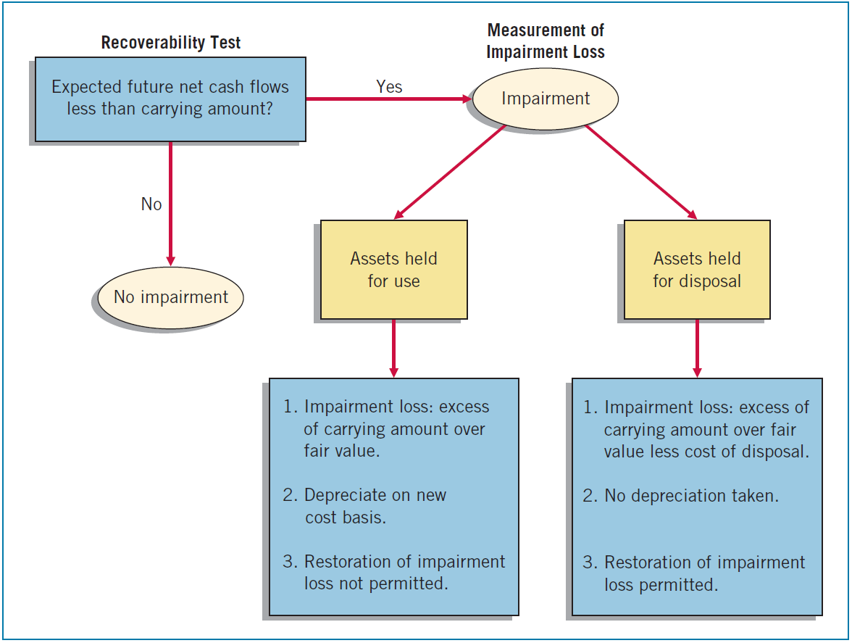
ILLUSTRATION 11-16
Graphic of Accounting for Impairments
Loss reported as part of income from continuing operations, in the “Other expenses and losses” section.
LO 3

Slide 39
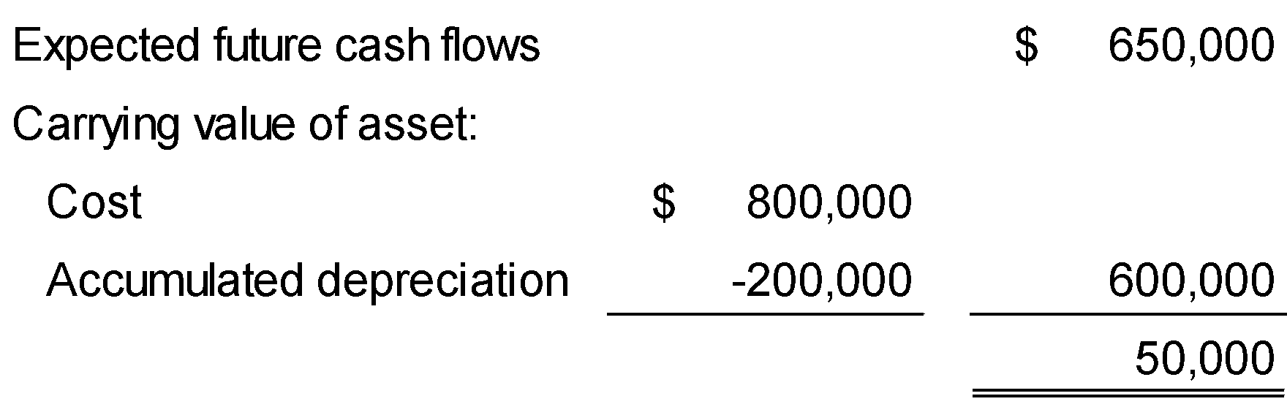
Recoverability Test
IMPAIRMENTS
Example 1: M. Alou Inc. has equipment that, due to changes in its use, it reviews for possible impairment. The equipment’s carrying amount is $600,000 ($800,000 cost less $200,000 accumulated depreciation). Alou determines the expected future net cash flows (undiscounted) from the use of the equipment and its eventual disposal to be $650,000. Determine whether an impairment has occurred.
No Impairment
LO 3

Slide 40

Recoverability Test
IMPAIRMENTS
Example 2: M. Alou Inc. has equipment that, due to changes in its use, it reviews for possible impairment. The equipment’s carrying amount is $600,000 ($800,000 cost less $200,000 accumulated depreciation). Alou determines the expected future net cash flows (undiscounted) from the use of the equipment and its eventual disposal to be $580,000. Determine whether an impairment has occurred.
Impairment
LO 3

Slide 41
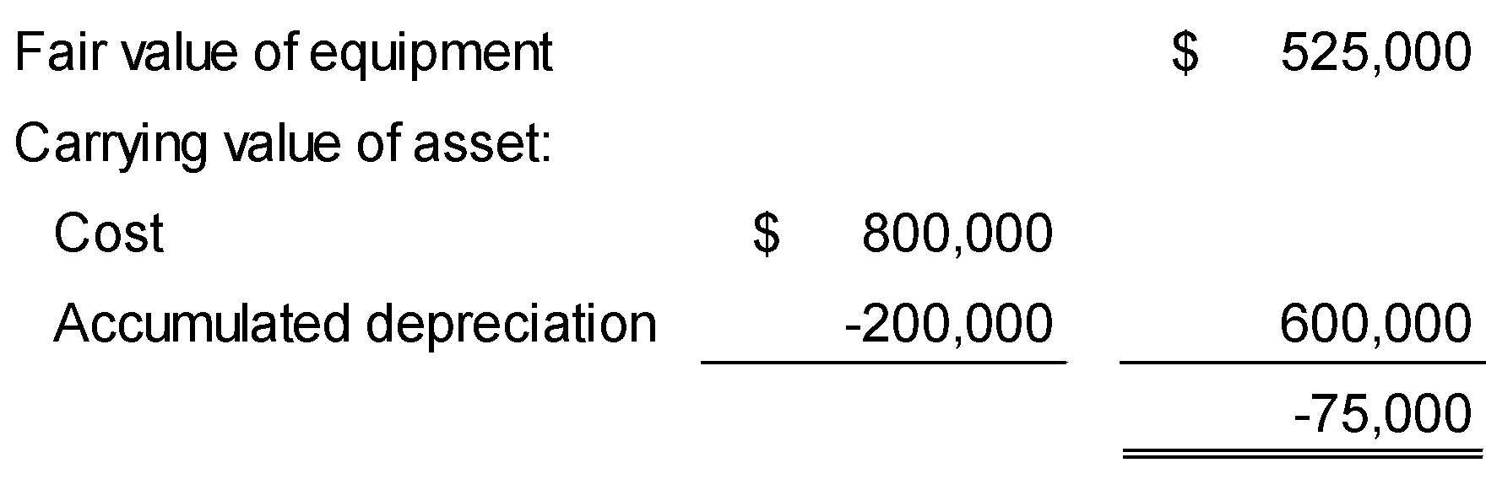
Measurement of Loss
IMPAIRMENTS
Example 2: The recoverability test indicates that the expected future net cash flows of $580,000 from the use of the asset are less than its carrying amount of $600,000. Therefore, an impairment has occurred. Assume this asset has a fair value of $525,000. Determine the impairment loss, if any.
Impairment
Loss
LO 3

Slide 42
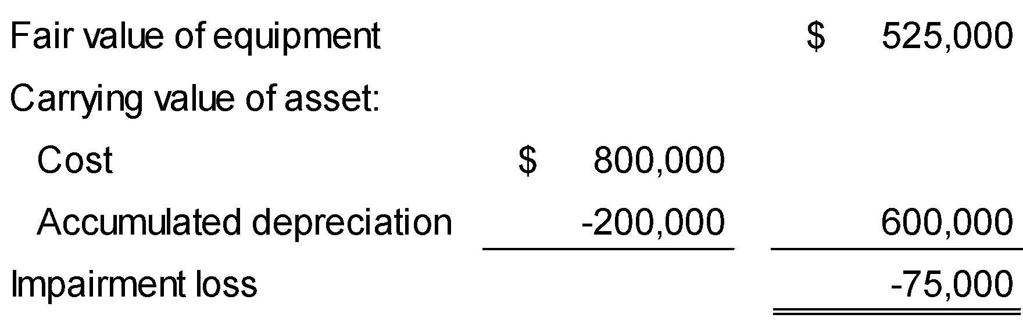
Measurement of Loss
IMPAIRMENTS
Example 2:
M. Alou records the impairment loss as follows:
Loss on Impairment 75,000
Accumulated Depreciation 75,000
LO 3

Slide 43
IMPAIRMENTS
Restoration of Impairment Loss
After recording an impairment loss,
the reduced carrying amount becomes its new cost basis.
No change in the new cost basis except for depreciation or amortization in future periods or for additional impairments.
No restoration of impairment loss for an asset held for use.
Rationale is that the new cost basis puts the impaired asset on an equal basis with other assets that are unimpaired.
LO 3

Slide 44
IMPAIRMENTS
Impairment of Assets to Be Disposed Of
Assets held for disposal are like inventory; companies
Should report them at the lower-of-cost-or-net realizable value.
Can write up or down an asset held for disposal in future periods, as long as the carrying value after the write-up never exceeds the carrying amount of the asset before the impairment.
Should report losses or gains related to these impaired assets as part of income from continuing operations.
LO 3

Slide 45
LEARNING OBJECTIVES
11
Depreciation, Impairments, and Depletion
After studying this chapter, you should be able to:
Understand depreciation concepts and methods of depreciation.
Explain special depreciation methods and other depreciation issues.
Explain the accounting issues related to asset impairment.
Explain the accounting procedures for depletion of natural resources.
Explain how to report and analyze property, plant, equipment, and natural resources.
LO 4

Slide 46
DEPLETION
Natural resources, often called wasting assets, include petroleum, minerals, and timber.
They have two main features:
complete removal (consumption) of the asset, and
replacement of the asset only by an act of nature.
Depletion is the process of allocating the cost of natural resources.
LO 4

Slide 47
DEPLETION
Establishing a Depletion Base
Computation of the depletion base involves four factors:
Acquisition cost.
Exploration costs.
Development costs.
Restoration costs.
LO 4

Slide 48
DEPLETION
Write-off of Resource Cost
Normally, companies compute depletion (cost depletion) on a units-of-production method (activity approach). Depletion is a function of the number of units extracted during the period.
Calculation:
Total cost – Salvage value
= Depletion cost per unit
Total estimated units available
Units extracted x Cost per unit
= Depletion
LO 4

Slide 49
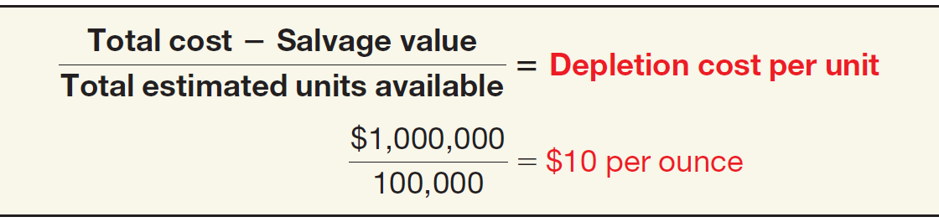

DEPLETION
Illustration: MaClede Co. acquired the right to use 1,000 acres of land in Alaska to mine for silver. The lease cost is $50,000, and the related exploration costs on the property are $100,000. Intangible development costs incurred in opening the mine are $850,000. MaClede estimates that the mine will provide approximately 100,000 ounces of silver.
ILLUSTRATION 11-17
Computation of Depletion Rate
LO 4

Slide 50
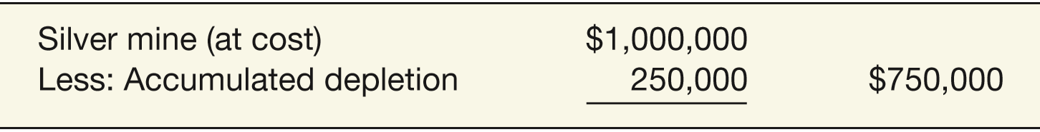
DEPLETION
If MaClede extracts 25,000 ounces in the first year, then the depletion for the year is $250,000 (25,000 ounces x $10).
Inventory (silver) 250,000
Silver Mine 250,000
Some companies use an Accumulated Depletion account. In that case, MaClede’s balance sheet would presented as follows:
MaClede debits Cost of Goods Sold when the silver is sold.
ILLUSTRATION 11-17
Computation of Depletion Rate
LO 4

Slide 51
DEPLETION
Estimating Recoverable Reserves
Same as accounting for changes in estimates.
Revise the depletion rate on a prospective basis.
Divide the remaining cost by the new estimate of the recoverable reserves.
LO 4

Slide 52
WHAT DO THE NUMBERS MEAN? RESERVE SURPRISE
WHAT’S YOUR PRINCIPLE
Cuts in the estimates of oil and natural gas reserves at Royal Dutch Shell, El Paso Corporation, and other energy companies at one time highlighted the importance of reserve disclosures. Investors believe that these disclosures provide useful information for assessing the future cash ﬂows from a company’s oil and gas reserves. For example, when Shell’s estimates turned out to be overly optimistic (to the tune of 3.9 billion barrels or 20 percent of reserves), Shell’s stock price fell.
The experience at Shell and other companies has led the SEC to look at how companies are estimating their “proved” reserves. Proved reserves are quantities of oil and gas that can be shown “with reasonable certainty to be recoverable in future years. . . .” The phrase “reasonable certainty” is crucial to this guidance, but differences in interpretation of what is reasonably certain can result in a wide range of estimates.
And the problem of evaluation is compounded by determining the prices for crude oil. For example, the price of crude oil fell more than 50 percent from $115 per barrel in June 2014 to $50 per barrel in early January 2015. These
(continued)
LO 4

Slide 53
WHAT DO THE NUMBERS MEAN? RESERVE SURPRISE
WHAT’S YOUR PRINCIPLE
rapidly changing oil prices can make it difﬁcult to judge the present value of assets for investment decisions on capital allocation or for evaluation of impairments. In one case, for example, ExxonMobil’s estimate was 29 percent higher than an estimate the SEC developed. ExxonMobil was more optimistic about the effects of new technology that enables the industry to retrieve more of the oil and gas it ﬁnds. Thus, to ensure the continued usefulness of reserve information disclosures, the SEC continues to work on measurement methodologies that keep up with technology changes in the oil and gas industry.
Sources: S. Labaton and J. Gerth, “At Shell, New Accounting and Rosier Outlook,” New York Times (nytimes.com) (March 12, 2004); J. Ball, C. Cummins, and B. Bahree, “Big Oil Differs with SEC on Methods to Calculate the Industry’s Reserves,” Wall Street Journal (February 24, 2005), p. C1; and H. Bashir and D. Holtam, “The Impact of Plummeting Crude Oil Prices on Company Finances,” Deloitte UK (2015), http://www2.deloitte.com/uk/en/pages/ energy-and-resources/articles/crude-awakening.html#.
LO 4

Slide 54
DEPLETION
Liquidating Dividends - Dividends greater than the amount of accumulated net income.
Illustration: Callahan Mining had a retained earnings balance of $1,650,000, accumulated depletion on mineral properties of $2,100,000, and paid-in capital in excess of par of $5,435,493. Callahan’s board declared a dividend of $3 a share on the 1,000,000 shares outstanding. It records the $3,000,000 cash dividend as follows.
Retained Earnings 1,650,000
Paid-in Capital in Excess of Par 1,350,000
Cash 3,000,000
LO 4

Slide 55
DEPLETION
Continuing Controversy
Cost of drilling
a dry hole is a cost needed to find the commercially profitable wells.
Oil and Gas Industry:
Full cost concept
Successful efforts concept
Companies should capitalize only the costs of successful projects.
LO 4

Slide 56
EVOLVING ISSUE FULL-COST OR SUCCESSFUL-EFFORTS?
WHAT’S YOUR PRINCIPLE
The controversy in the oil and gas industry provides a number of lessons. First, it demonstrates the strong inﬂuence that the federal government has in ﬁnancial reporting matters. Second, the concern for economic consequences places pressure on the FASB to weigh the economic effects of any required standard. Third, the experience with RRA highlights the problems that accompany any proposed change from an historical cost to a fair value approach. Fourth, this controversy illustrates the difﬁculty of establishing standards when affected groups have differing viewpoints.
Indeed, failure to consider the economic consequences of accounting principles is a frequent criticism of the profession. However, the neutrality concept requires that the statements be free from bias. Freedom from bias requires that the statements reﬂect economic reality, even if undesirable effects occur. Finally, the debate over oil and gas accounting reinforces the need for a conceptual framework with carefully developed guidelines for recognition, measurement, and reporting, so that interested parties can more easily resolve issues of this nature in the future.
LO 4

Slide 57
LEARNING OBJECTIVES
11
Depreciation, Impairments, and Depletion
After studying this chapter, you should be able to:
Understand depreciation concepts and methods of depreciation.
Explain special depreciation methods and other depreciation issues.
Explain the accounting issues related to asset impairment.
Explain the accounting procedures for depletion of natural resources.
Explain how to report and analyze property, plant, equipment, and natural resources.
LO 5

Slide 58
PRESENTATION AND ANALYSIS
Presentation of Property, Plant, Equipment, and Natural Resources
Because of the significant impact on the financial statements of the depreciation method(s) used, companies should disclose the following.
Depreciation expense for the period.
Balances of major classes of depreciable assets, by nature and function.
Accumulated depreciation.
A general description of the method or methods used in computing depreciation with respect to major classes of depreciable assets.
LO 5

Slide 59
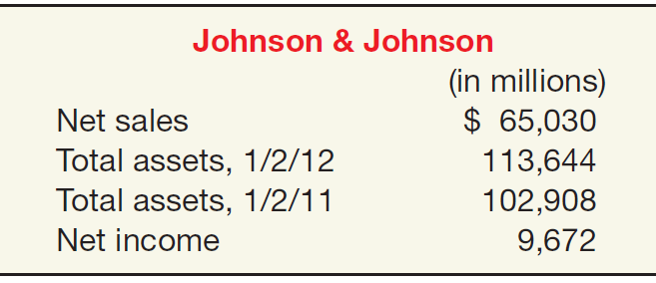

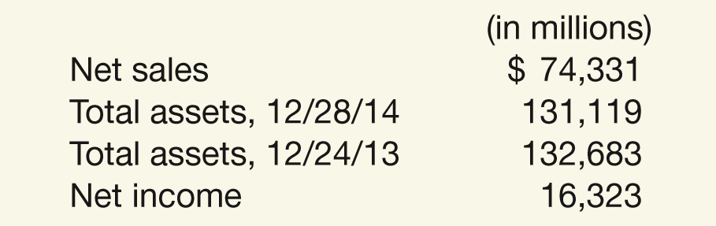
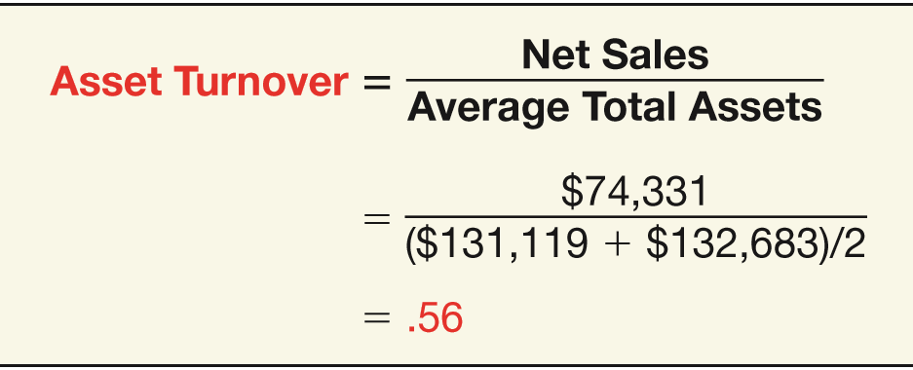

PRESENTATION AND ANALYSIS
Analysis of Property, Plant, and Equipment
Asset Turnover Ratio
Measure of a firm’s ability to generate sales from a particular investment in assets.
ILLUSTRATION 11-20
Asset Turnover
LO 5

Slide 60
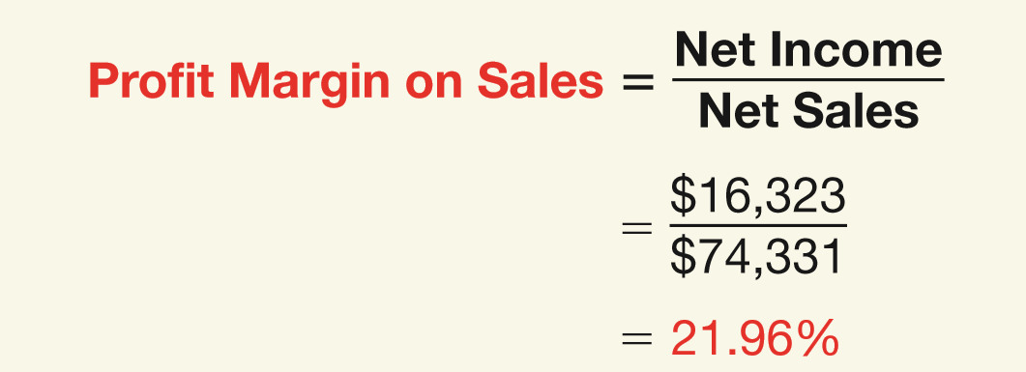
PRESENTATION AND ANALYSIS
Analysis of Property, Plant, and Equipment
Profit Margin on Sales
Measure of the ability to generate operating income from a particular level of sales.
ILLUSTRATION 11-21
Profit Margin on Sales
LO 5

Slide 61
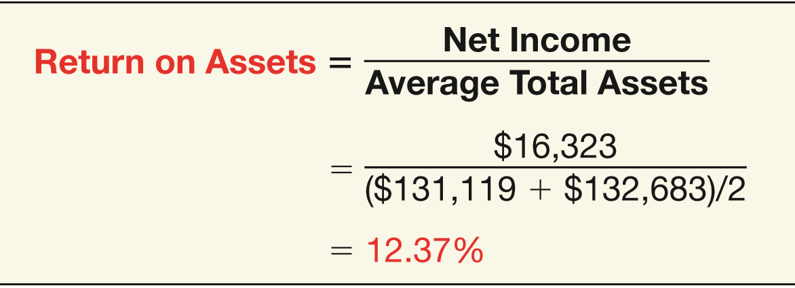
PRESENTATION AND ANALYSIS
Analysis of Property, Plant, and Equipment
Rate of Return on Assets
Measures a firm’s success in using assets to generate earnings.
ILLUSTRATION 11-22
Return on Assets
LO 5

Slide 62
PRESENTATION AND ANALYSIS
Analyst obtains further insight into the behavior of ROA by disaggregating it into components of profit margin on sales and asset turnover as follows:
Rate of Return on Assets
Profit Margin on Sales
Asset Turnover
=
x
Net Income
Net Income
Net Sales
=
x
Average Total Assets
Net Sales
Average Total Assets
LO 5

Slide 63
PRESENTATION AND ANALYSIS
Analyst obtains further insight into the behavior of ROA by disaggregating it into components of profit margin on sales and asset turnover as follows:
Rate of Return on Assets
Profit Margin on Sales
Asset Turnover
=
x
$16,323
$16,323
$74,331
=
x
($131,119 + $132,683) ÷ 2
$74,331
($131,119 + $132,683) ÷ 2
12.37%
=
21.96%
x
.56
LO 5

Slide 64
APPENDIX 11A
INCOME TAX DEPRECIATION
MODIFIED ACCELERATED COST RECOVERY SYSTEM
MACRS differs from GAAP in three respects:
a mandated tax life, which is generally shorter than the economic life;
cost recovery on an accelerated basis; and
an assigned salvage value of zero.
LO 6 Describe income tax methods of depreciation.

Slide 65
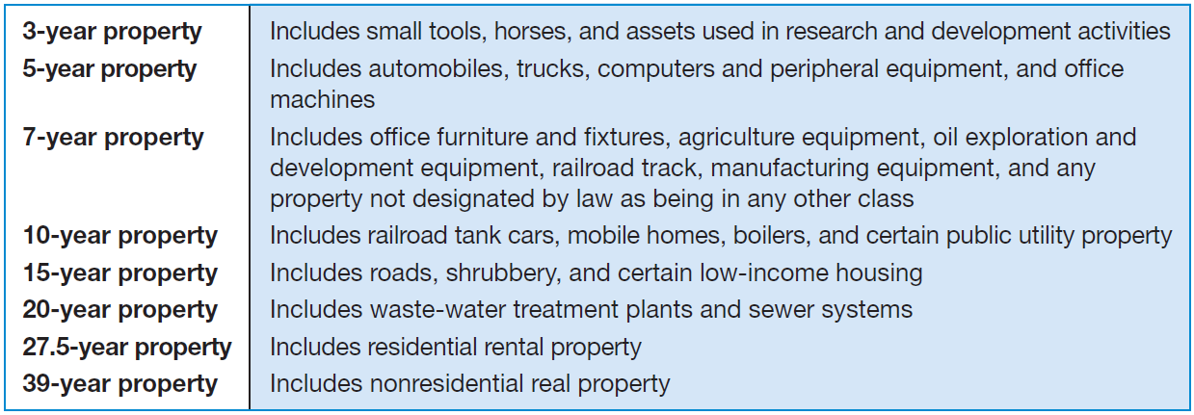
APPENDIX 11A
INCOME TAX DEPRECIATION
Modified Accelerated Cost Recovery System
Tax Lives (Recovery Periods)
ILLUSTRATION 11A-1
MACRS Property Classes
LO 6

Slide 66
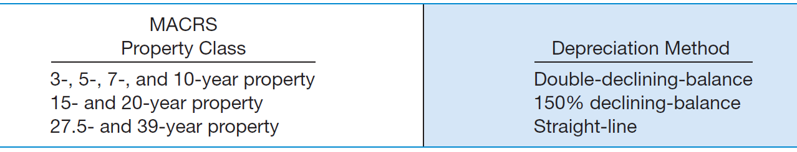
APPENDIX 11A
INCOME TAX DEPRECIATION
Modified Accelerated Cost Recovery System
Tax Depreciation Methods
ILLUSTRATION 11A-2
Depreciation Method for Various MACRS Property Classes
LO 6

Slide 67
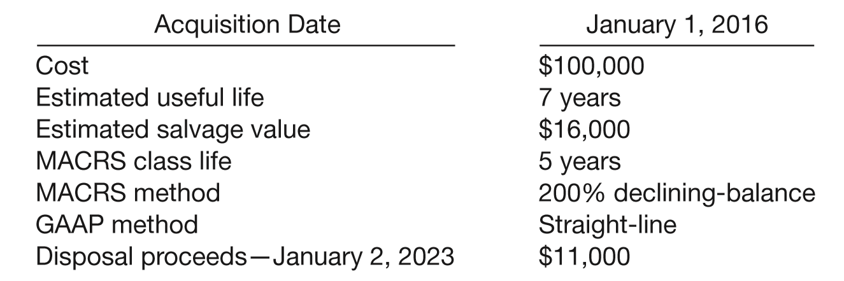
APPENDIX 11A
INCOME TAX DEPRECIATION
Modified Accelerated Cost Recovery System
Illustration: Computer and peripheral equipment purchased by Denise Rode Company on January 1, 2016.
LO 6

Slide 68
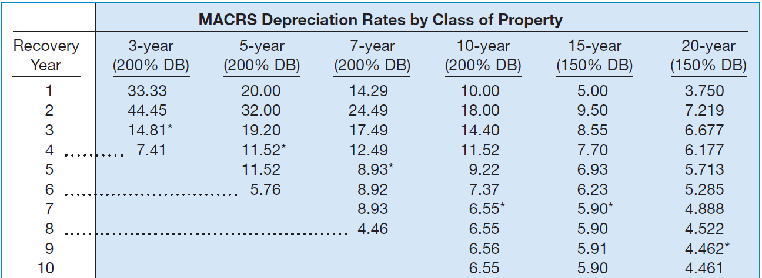
APPENDIX 11A
INCOME TAX DEPRECIATION
Modified Accelerated Cost Recovery System
Illustration:
ILLUSTRATION 11A-3
IRS Table of MACRS Depreciation Rates, by Property Class
LO 6

Slide 69
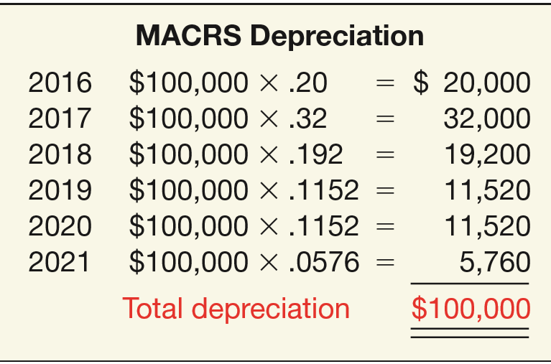
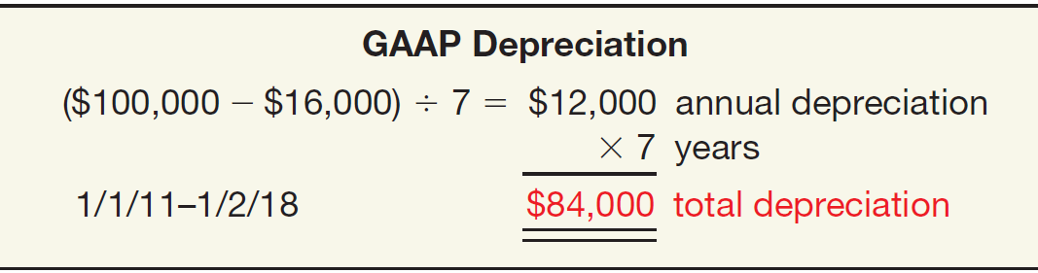
APPENDIX 11A
INCOME TAX DEPRECIATION
Modified Accelerated Cost Recovery System
Illustration: Using the rates from the MACRS depreciation rate schedule for a 5-year class of property, Rode computes depreciation as follows
ILLUSTRATION 11A-4
For GAAP, Rode used straight-line, with $16,000 salvage value and a useful life of 7 years.
ILLUSTRATION 11A-5
LO 6

Slide 70
APPENDIX 11A
INCOME TAX DEPRECIATION
OPTIONAL STRAIGHT-LINE METHOD
Applies to six classes of property previously described.
Applies the straight-line method to the MACRS recovery periods.
Ignores salvage value.
LO 6

Slide 71
APPENDIX 11A
INCOME TAX DEPRECIATION
TAX VERSUS BOOK DEPRECIATION
Tax laws and financial reporting have different objectives. The purpose of:
taxation is to raise revenue from constituents in an equitable manner.
financial reporting is to reflect the economic substance of a transaction as closely as possible and to help predict the amounts, timing, and uncertainty of future cash flows.
The adoption of one method for both tax and book purposes in all cases is not in accordance with GAAP.
LO 6

Slide 72
RELEVANT FACTS - Similarities
The definition of property, plant, and equipment is essentially the same under GAAP and IFRS.
Under both GAAP and IFRS, changes in depreciation method and changes in useful life are treated in the current and future periods. Prior periods are not affected.
The accounting for plant asset disposals is the same under GAAP and IFRS.
The accounting for the initial costs to acquire natural resources is similar under GAAP and IFRS.
Under both GAAP and IFRS, interest costs incurred during construction must be capitalized. Recently, IFRS converged to GAAP.
LO 7 Compare the accounting for property, plant, and equipment under GAAP and IFRS.

Slide 73
RELEVANT FACTS - Similarities
The accounting for exchanges of nonmonetary assets has recently converged between IFRS and GAAP. GAAP now requires that gains on exchanges of nonmonetary assets be recognized if the exchange has commercial substance. This is the same framework used in IFRS.
GAAP also views depreciation as allocation of cost over an asset’s life. GAAP permits the same depreciation methods (straight-line, diminishing-balance, units-of-production) as IFRS.
LO 7

Slide 74
RELEVANT FACTS - Differences
IFRS requires component depreciation. Under GAAP, component depreciation is permitted but is rarely used.
Under IFRS, companies can use either the historical cost model or the revaluation model. GAAP does not permit revaluations of property, plant, and equipment or mineral resources.
In testing for impairments of long-lived assets, GAAP uses a two-step model to test for impairments. As long as future undiscounted cash flows exceed the carrying amount of the asset, no impairment is recorded. The IFRS impairment test is stricter. However, unlike GAAP, reversals of impairment losses are permitted.
LO 7

Slide 75
ON THE HORIZON
With respect to revaluations, as part of the conceptual framework project, the Boards will examine the measurement bases used in accounting. It is too early to say whether a converged conceptual framework will recommend fair value measurement (and revaluation accounting) for property, plant, and equipment. However, this is likely to be one of the more contentious issues, given the long-standing use of historical cost as a measurement basis in GAAP.
LO 7

Slide 76
IFRS SELF-TEST QUESTION
Which of the following statements is correct?
Both IFRS and GAAP permit revaluation of property, plant, and equipment.
IFRS permits revaluation of property, plant, and equipment but not GAAP.
Both IFRS and GAAP do not permit revaluation of property, plant, and equipment.
GAAP permits revaluation of property, plant, and equipment but not IFRS.
LO 7

Slide 77
IFRS SELF-TEST QUESTION
Hilo Company has land that cost $350,000 but now a fair value of $500,000. Hilo Company decides to use the revaluation method specified in IFRS to account for the land. Which of the following statements is correct?
Hilo Company must continue to report the land at $350,000.
Hilo Company would report a net income increase of $150,000 due to an increase in the value of the land.
Hilo Company would debit Revaluation Surplus for $150,000.
Hilo Company would credit Revaluation Surplus by $150,000.
LO 7

Slide 78
IFRS SELF-TEST QUESTION
Under IFRS, value-in-use is defined as:
net realizable value.
fair value.
future cash flows discounted to present value.
total future undiscounted cash flows.
LO 7

Slide 79
COPYRIGHT
“Copyright © 2016 John Wiley & Sons, Inc. All rights reserved. Reproduction or translation of this work beyond that permitted in Section 117 of the 1976 United States Copyright Act without the express written permission of the copyright owner is unlawful. Request for further information should be addressed to the Permissions Department, John Wiley & Sons, Inc. The purchaser may make back-up copies for his/her own use only and not for distribution or resale. The Publisher assumes no responsibility for errors, omissions, or damages, caused by the use of these programs or from the use of the information contained herein.”

