Slide 1
Toddlerhood Exploring the World and Experimenting with Language

Slide 2
Toddlerhood is the period between about age 1 and age 3 years.

Slide 3
WhAT mAjOr LAnguAge-DeveLOpmenT miLeSTOneS Occur in TODDLerhOOD?
First words
Gestures
Theory of mind

Slide 4
First words
A baby’s first word marks the beginning of a transition from preverbal to verbal communication.
Researchers know that, on average, babies produce their first word around age 12 months.
Words are also symbolic and arbitrary.
For each word babies learn, they create an entry in their lexicon, or mental dictionary.

Slide 5
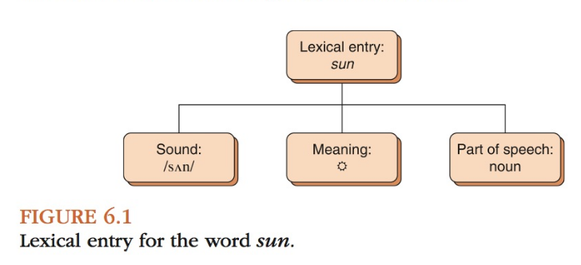
First words

Slide 6
First words
First words usually refer to salient people and objects in babies’ everyday lives. For a vocalization to be a true word, it must meet three important criteria.
First, the baby must produce the word with a clear purpose.
Second, a true word must have recognizable pronunciation similar to the adult form of the word.
The term phonetically consistent forms (PCF) describes the idiosyncratic word-like productions children use consistently and meaningfully but that do not approximate adult forms.
Example of PCF : the baby girl who uses the PCF “aaaah” to refer to water might also use this sound when requesting other objects or actions, such as when asking someone to pick her up or give her a toy. WHY ARE THEY IMPORANT? children learn the value of adopting a stable pronunciation for communicating in a particular situation
Third, a true word is a word a child uses consistently and extends beyond the original context

Slide 7
GESTURES
Toddlers come to rely less on gestures and more on words when making inferences about how to categorize or label new objects.
One study showed that 14-month-olds are able to interpret both words and gestures to determine what new words refer to, whereas 22-month-olds rely on others’ words, but not gestures alone.
Thus, as (hearing) toddlers develop, they seem to move from using a more generalized symbolic system (that equally accepts others’ use of words and gestures) to a more narrow and restricted symbolic system that privileges words.

Slide 8
GESTURE USE
Children who are beginning to transition from the prelinguistic stage to the one-word stage use referential gestures.
A referential gesture is one that indicates a precise referent and has stable meaning across different contexts. These gestures are different from the deictic gestures (e.g., pointing, showing, giving) that characterize infancy, as deictic gestures are gestures whose meanings change depending on the context.
An infant might point to a bottle and make a grabbing motion with his hand when he would like to drink his milk, and he might later point to a toy that he dropped from his high chair while making the same grabbing motion. What kind of gesture is this?

Slide 9
Gesture use
Furthermore, as children are preparing to transition from the one-word stage to the two-word stage, they begin to exhibit gesture–word combinations. For instance, a 24-month-old child might point to a chair while saying “mommy” as a way to request that her mother sit in a chair
a child at this age might use two-gesture combinations, such as pointing to a banana while pretending to eat it to request to be fed
Toddlers who use more gesture + speech combinations (particularly those conveying sentence-like ideas) at 18 months also demonstrate greater sentence complexity at 42 months of age (rowe & goldin-meadow, 2009).
When children begin to use two-word utterances, they stop combining two referential gestures.

Slide 10
Gestures use
Research has found that children’s gesture use at 14 months is a significant predictor of their vocabulary size at 42 months, above and beyond the effects of parent and child word use at 14 months (rowe, Özçalişkan, & goldin-meadow, 2008). parents’ gesture use at 14 months is also related to children’s gesture use Discussion Point at 14 months.

Slide 11
Mirror Neurons and Gestures
Mirror neurons, a type of visuomotor neurons (related both to vision and to muscular movement), activate when people perform actions (including communicative actions) and when they observe other people perform actions.
mirror neuron system in humans comes from neurophysiological and brain imaging studies whish illustrate that activation occur only in the left hemisphere and hands.

Slide 12
Theory of mind
Theory of mind (TOM) as the ability to understand one’s own mental or emotional state, to understand that others also have mental or emotional states, and to realize that others’ mental and emotional states, beliefs, intentions, and perspectives differ from one’s own.
Theory of mind develops from birth, and is evident by 18 months of age as toddlers are adept at reading the goals and intentions in other people’s actions.
One common measure of TOM development is a false-belief task (of which there are a number of variations). False-belief tasks assess whether children demonstrate understanding that another’s beliefs can differ from one’s own beliefs.
toddlers (18 to 21 months of age) who spend more time in coordinated joint engagement (active coordination of attention between objects and social partners) and toddlers (27 to 30 months of age) who spend more time in symbol-infused joint engagement, including conversations and pretend play, demonstrate higher scores on false-belief tasks in the preschool years (between 42 and 66 months of age).

Slide 13
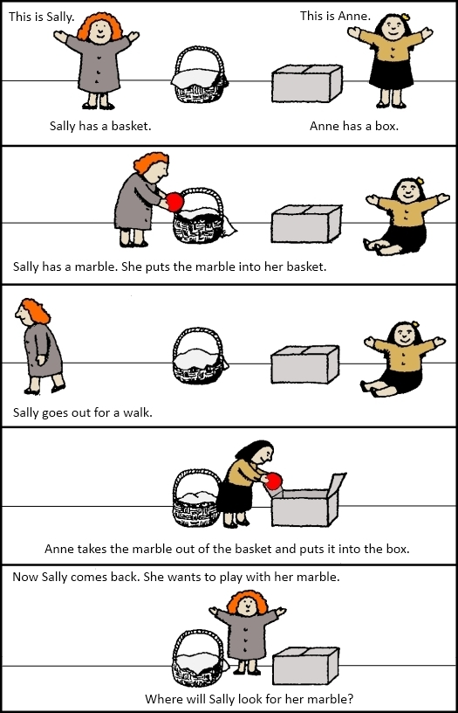
Theory of mind

Slide 14
WhAT mAjOr AchievemenTS in Language FOrm, content, And use characterize Toddlerhood
Language Form
Language Content
Language use

Slide 15
Language form
Achievements in Phonology :
Toddlers begin to acquire and refine their repertoire of speech sounds, or phonemes, and, as they do so, adults witness their phonological processes or those arguably rule-governed errors children make when pronouncing certain words.

Slide 16
Norms for Phoneme Attainment
The term customary age of production describes the age by which 50% of children can produce a given sound in multiple positions in words in an adultlike way.
The term age of mastery describes the age by which most children produce a sound in an adultlike manner.
How do we assess toddlers’ sound production abilities?
to obtain an accurate picture of children’s abilities, practitioners (Amaria test) usually ask children to produce speech sounds in various positions (e.g., initial position of words and final position of words) and with a variety of neighboring sounds (e.g., followed by a vowel, after certain consonants).

Slide 17
Phonological Processes
Phonological processes are systematic, rule-governed processes that characterize toddlers’ speech .
phonological process categories include
syllable structure changes: (water becomes “wa-wa” and Daddy becomes “Da-Da”).
assimilation ( dog becomes gog)
Place of articulation changes /kursi/ -> /tursi/
Manner of articulation changes /jeep/ ->/deep/

Slide 18
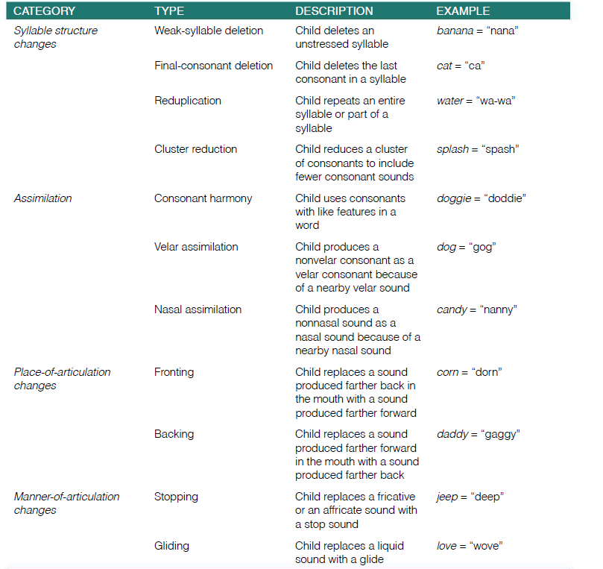

Slide 19
Phonological Perception
Toddlers become familiar with the differences in speech that do and do not signal a difference in meaning. Toddlers, unlike their younger infant counterparts, recognize that when different speakers say two identical words, they are the same word.
The time at around 18 months of age seems to mark a transitional period in phonological development.
A transitional period is a developmental time frame during which language abilities are emerging and changing. During a transitional period, it may sometimes appear that a toddler has mastered a certain ability, such as word learning, and at other times, it may appear that the same toddler has not mastered the same ability.
The transitional period in phonological perception is evidenced, in part, by toddlers’ successful learning of novel non-neighbors (new words that are not phonologically similar to known words) and difficulty in learning novel neighbors (new words that are phonologically similar to known words).
In terms of other developments in phonological perception in toddlerhood, research indicates that toddlers become increasingly adept at recognizing words after hearing only parts of the words, or what is called partial phonetic information.
It appears that speech-perception abilities are important not only to word learning that occurs in toddlerhood, but also to speech processing and language abilities throughout the life span.

Slide 20
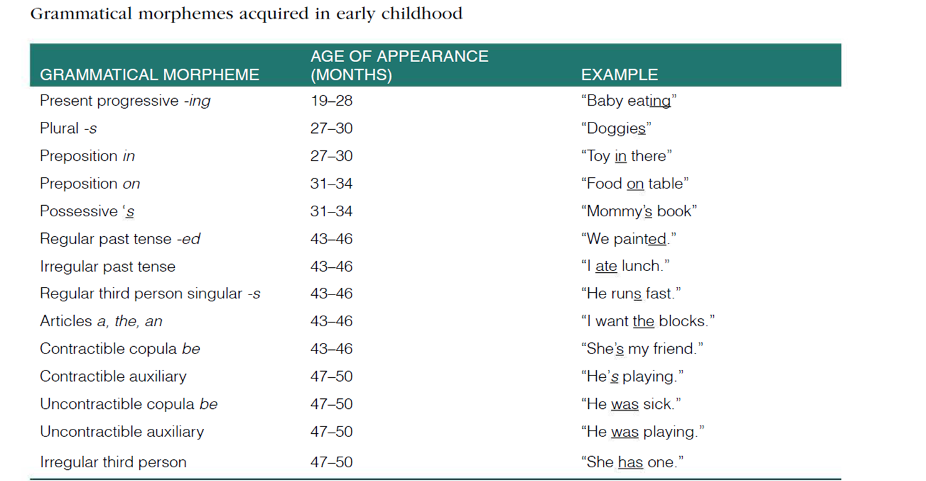
Achievements in Morphology
The 50-word mark for productive vocabulary, which toddlers reach between about ages 18 months and 2 years, signals some important changes, including the vocabulary spurt.
The 50-word mark also usually co-occurs with the appearance of children’s first grammatical morpheme

Slide 21
Grammatical Morphemes.
Grammatical morphemes are inflections we add to words to indicate aspects of grammar, such as the plural -s (two dogs ), the possessive ‘s (the dog’s bone), the past tense -ed (The dog barked), and the present progressive -ing (The dog is still barking).
grammatical morphemes begin to appear in children’s speech between ages 18 and 24 months—at about the time when they have learned their first 50 words.
the first grammatical morpheme children tend to produce is the present progressive -ing, as in Baby sleeping and they master it by age 28 months

Slide 22
Grammatical Morphemes.
Additional morphemes that appear during toddlerhood include the prepositions in and on, which children start to use at about age 2 years (in cup, on table). At this time, toddlers also start to use the regular plural -s, as in two dogs; the possessive’s, as in kitty’s bowl; and irregular past tense verbs, as in eat–ate and break–broke.
When you talk with toddlers, you will likely notice they tend to overgeneralize the rule for regular past tense verbs (“Add -ed”) by applying it to irregular verbs. As a result, toddlers often say things such as “i maked it” and “mommy goed to the store.”

Slide 23
Achievements in Syntax
In the two-word stage, toddlers begin to combine words to make utterances, and it marks the true beginning of syntax.
Some simple functions toddlers can express :
commenting (“Baby cry”)
negating (“no juice”)
requesting (“more juice”)
questioning (“What that?”).

Slide 24
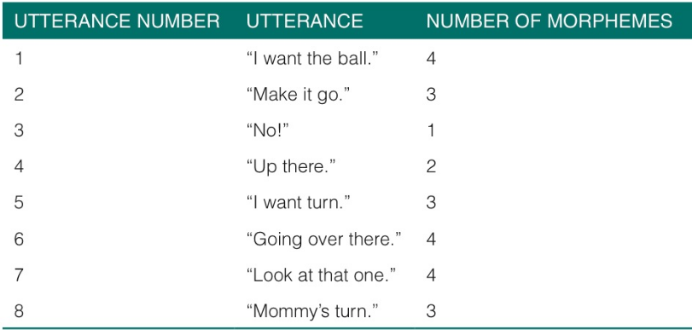
Mean length of utterance
We can calculate mLu by counting the total number of morphemes in a sample of 50–100 spontaneous utterances and then dividing that number by the total number of utterances:
MLU = Total number of morphemes /Total number of utterances)
There are additional conventions for counting morphemes including the following: Do not count fillers, such as umm or oh; count proper names, compound words (e.g., birthday) and ritualized reduplications (e.g., choo choo) as a single word; count catenatives (e.g.,gonna, wanna) as a single word, but count auxiliaries (e.g., is, have) as separate morphemes.

Slide 25
Sentence Forms
When grammatical morphemes first emerge and children begin to combine words, language exhibits a telegraphic quality that results when children omit key grammatical markers.
toddlers begin to use more adul-tlike forms for a variety of sentence types:
yes–no question (“Are we going, mommy?”)
wh- questions (“What’s that?”)
commands (“You do it”)
negatives (“me no want that”).

Slide 26
Language use
Discourse functions
instrumental functions, including requests, to satisfy their needs
regulatory functions, such as imperatives (commands), to control other people’s behavior
interactional functions to interact with others in a social way
personal functions to express their feelings about something.
heuristic functions by requesting information from other people to learn about the world
imaginative functions by telling stories to pretend
informative functions to provide information to other people.

Slide 27
Language use
Conversational Skills
conversational skill requires the ability to initiate a conversational topic, sustain the topic for several turns, then appropriately take leave of the conversation.
Toddlers are relatively poor conversationalists. Toddlers may demonstrate some skill in starting a conversation, but they cannot usually sustain it for more than one or two turns.
Toddlers also have difficulty keeping their audience’s needs in mind: They may use pronouns without appropriately defining to whom they refer (“he is cheating!”).
Toddlers may simply not respond or may respond non-contingently (off the topic).
Toddlers are not yet proficient at realizing when they are not following along in a conversation and are thus not likely to seek clarification

Slide 28
Language content receptive and Expressive Lexicons
Although young children begin acquiring new words relatively slowly, some researchers contend that toddlers’ word learning enters an explosive period between approximately 18 and 24 months of age, or at around the time they can produce 50 words. This period has been aptly termed the vocabulary spurt, word spurt, or naming explosion.
children may learn up to (7-9) new words per day.
Early in development, children often overextend, underextend, and overlap words. underextensions are more common than overextensions.
But why these errors happened??
Three types:
-categorical (same category).
-analogical (perceptually similar).
-rational (semantically or thematically related).
retrieval error diffucalty in restoring the word quickly so they use the closest on
Categorical error
pragmatical error: don’t know the name or word they should use so they use the close one

Slide 29
Acquisition of New words
Mapping: is the key to learning a new word successfully and may require more than meets the eye.
imagine, as philosopher W. v. O. Quine proposed, that you encounter a native speaker of a foreign language who utters the word gavagai in the presence of a rabbit. Should you infer the word gavagai means “rabbit,” “food,” “undetached rabbit part,”or something else?
the uncertainty surrounding the mapping of a word to its referent in the face of endless interpretations, Called the Quinean Conundrum ( The mapping problem) or induction problem.
challenges for all people learning a new language, but especially for infants and toddlers learning their first language

Slide 30
Lexical Principles framework for Acquiring New words
First-Tier Principles: do not require much linguistic sophistication, acquire words rely on cognitive-perceptual abilities.
Principles:
- Reference: states that words symbolize objects, actions, events, and concepts.
- Extendibility: conveys that words label categories of objects and not just the original exemplar. children commonly extend words to include objects of similar shape, size, colour, smell, and material makeup; shape is the most common feature.
- Object Scope: states that words map to whole objects. First, assume novel words label objects rather than actions. Second, whole object assumption, which means words label whole objects and not object parts

Slide 31
Lexical Principles framework for Acquiring New words
Second-Tier Principles: are more sophisticated and become available to children as they refine their hypotheses about the nature of words.
Principles:
- conventionality: states that for children to communicate successfully, they must adopt the terms that people in their language community understand. And refine their vocabulary and the reference principle in Tier 1 by using the conventionality principle when they recognize that some of their “baby” words, such as blankie for blanket, are not conventional among other speakers in their culture.
- categorical scope: builds on the Tier 1 principle of extendibility by limiting the basis for extension to words in the same category
novel name–nameless category (N3C): supports the Tier 1 principle of object scope by helping children select a nameless object as the recipient of a novel label. Have the same principle of mutual exclusivity.

Slide 32
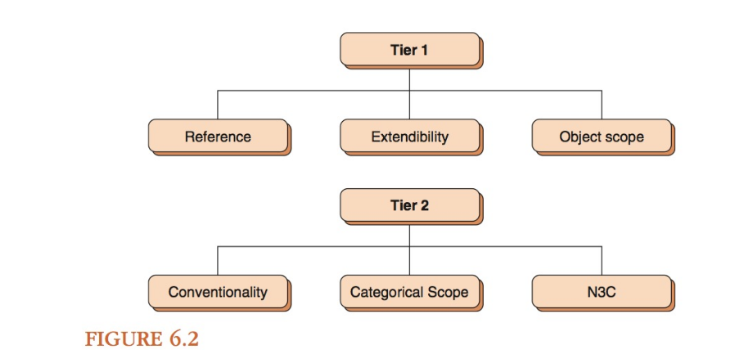
Lexical Principles framework for Acquiring New words

Slide 33
Social-Pragmatic framework for Acquiring New work
Proponents of the social-pragmatic view of word learning believe children do not require domain-specific mechanisms to acquire new words. Young children are adept at using social cues to determine what a speaker is referring to, and that understanding speakers’ referential intentions assists children in learning language.

Slide 34
fast Mapping
Fast mapping is a term that refers to the toddlers ability to pick up words after only a few incidental exposures, or even a single exposure.

Slide 35
Thematic roles Toddlers Acquire
A thematic role is the part a word plays in an event, and such roles include agent, theme, source, goal, and location (O’grady, 1997).
An agent is the entity that performs the action (Nicole ate pasta).
The theme is the entity undergoing an action or a movement (Tamika flew a kite).
A source is the starting point for movement A goal is the ending point for movement (Maurie drove from Richmond to Char- lottesvill).
Location is the place where an action occurs (Ryan hiked through the park).

Slide 36
WhAT FAcTOrS cOnTriBuTe TO TODDLerS’ inDiviDuAL AchievemenTS in LAnguAge?
Intra-individual Differences : check chapter 5
Inter-individual differences :
Gender
Birth order
parental education and socioeconomic status

Slide 37
hOW DO reSeArcherS AnD cLiniciAnS meASure LAnguAge DeveLOpmenT in TODDLerhOOD?
Resreachers | Clinicians
Naturalistic Observation Elicited Imitation Tasks Elicited production tasks The Picture Selection Task. The act out task Truth Value Judgment Tasks (grammatical skill). Grammaticality Judgment Tasks. | Screening Comprehensive evaluation Progress monitoring (just for read)

Slide 38
