Slide 1

Management History Module
1a - 1

Slide 2
Learning Objectives
Describe some early management examples.
Explain the various theories in the classical approach.
Discuss the development and uses of the behavioral approach.
Describe the quantitative approach.
Explain the various theories in the contemporary approach.

Slide 3
Early Management
Watch videos

Slide 4
Early Management
Ancient Management – Egypt (pyramids) and China (Great Wall)
Notes:
The Egyptian pyramids and the Great Wall of China are proof that projects of tremendous scope, employing tens of thousands of people, were completed in ancient times.

Slide 5


Early Management
Egypt (pyramids)
Great wall

Slide 6
Early Management
Adam Smith The Wealth of Nations in 1776
  Division of labor (job specialization) – the breakdown of jobs into narrow and repetitive tasks.(pin industry )-increased productivity
  Saving time ,increase workers skill
Industrial Revolution
  Substituted machine power for human labor
  Created large organizations in need of management
Notes:
In 1776, Adam Smith published The Wealth of Nations, in which he argued the economic advantages that organizations and society would gain from the division of labor (or job specialization)—that is, breaking down jobs into narrow and repetitive tasks.
Starting in the late eighteenth century when machine power was substituted for human power, a point in history known as the industrial revolution, it became more economical to manufacture goods in factories rather than at home. These large efficient factories needed someone to forecast demand, ensure that enough material was on hand to make products, assign tasks to people, direct daily activities, and so forth.

Slide 7
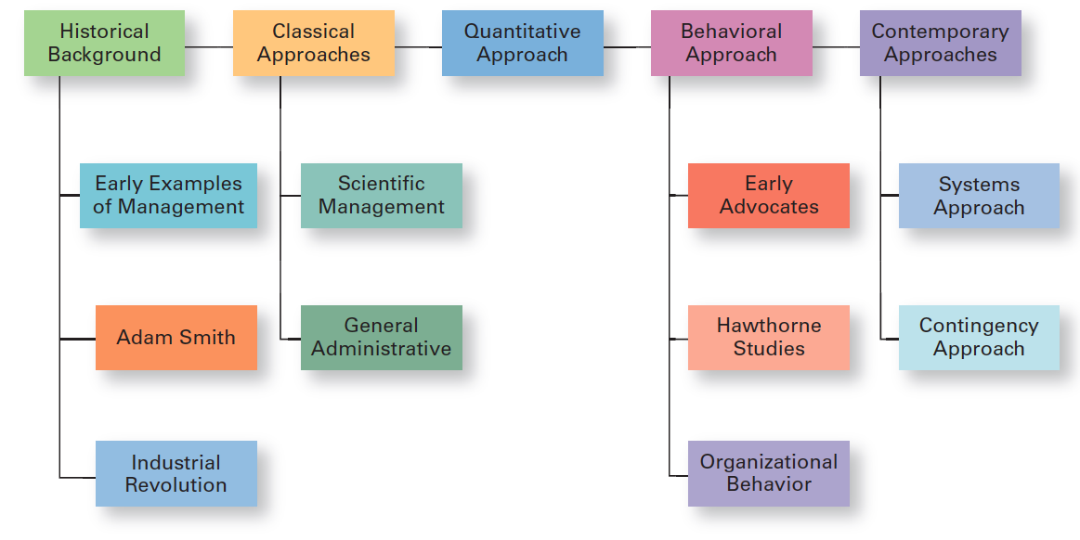
Exhibit MH-1
Major Approaches to Management
Notes:
In this module, we’ll look at four major approaches to management theory: classical, behavioral, quantitative, and contemporary. (See Exhibit MH-1 above.)

Slide 8
Classical Approach
Classical approach – first studies of management, which emphasized rationality and making organizations and workers as efficient as possible.
Notes:
The first studies of management, often called the classical approach, emphasized rationality and making organizations and workers as efficient as possible. Two major theories comprise the classical approach: scientific management and general administrative theory. The two most important contributors to scientific management theory were Frederick W. Taylor and the husband-wife team of Frank and Lillian Gilbreth. The two most important contributors to general administrative theory were Henri Fayol and Max Weber. Let’s take a look at each of these important figures in management history.

Slide 9
Classical Approach
Scientific Management
General administrative theory

Slide 10
Scientific Management
Fredrick Winslow Taylor
  The “father” of scientific management
Scientific management – an approach that involves using the scientific method to find the “one best way” for a job to be done.
Pig iron experiment (output 12.5 tons)-increase productivity to 47-48 tons per day
Notes:
If you had to pinpoint when modern management theory was born, 1911 might be a good choice. That was when Frederick Winslow Taylor’s Principles of Scientific Management was published. Its contents were widely embraced by managers around the world. Taylor’s book described the theory of scientific management – the use of scientific methods to define the “one best way” for a job to be done.

Slide 11
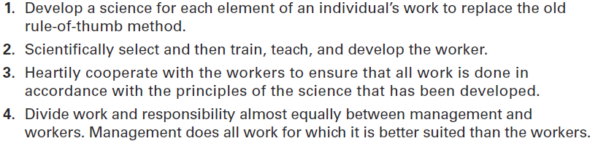
Exhibit MH-2
Taylor’s Scientific
Management Principles
Notes:
Taylor’s experiences led him to define clear guidelines for improving production efficiency. He argued that these four principles of management (see Exhibit MH-2 above) would result in prosperity for both workers and managers.

Slide 12
Frank and Lillian Gilbreth
Frank and Lillian Gilbreth were inspired by Taylor’s work and proceeded to study and develop their own methods of scientific management.
a. Frank Gilbreth is probably best known for his experiments in reducing the number of motions in bricklaying (conclusions laying exterior from 18 to 5 and interior brick from 18 to 2 ) : device called microhronometer
b. The Gilbreths were among the first to use motion picture films to study hand-and-body motions in order to eliminate wasteful motions.

Slide 13
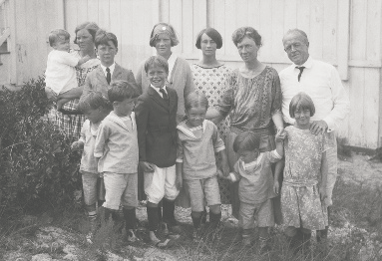
Frank and Lillian Gilbreth
Therbligs – a classification scheme for labeling basic hand motions
label 17 basic hand motions .
Notes:
Taylor’s most prominent followers were Frank and Lillian Gilbreth. Frank and his wife Lillian, a psychologist, studied work to eliminate inefficient hand-and-body motions. The Gilbreths also experimented with the design and use of the proper tools and equipment for optimizing work performance.
The Gilbreths also devised a classification scheme to label 17 basic hand motions (such as search, grasp, hold), which they called therbligs (Gilbreth spelled backward with the th transposed). This scheme gave the Gilbreths a more precise way of analyzing a worker’s exact hand movements.

Slide 14
General Administrative Theory
General administrative theory – an approach to management that focuses on describing what managers do and what constitutes good management practice.
Notes:
General administrative theory focused more on what managers do and what constituted good management practice.

Slide 15
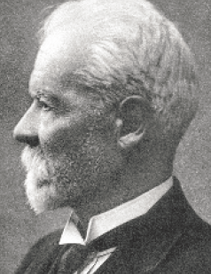
Henri Fayol
Fayol focused on activities common to all managers
Five functions(planning –organizing- commanding –coordinating and controlling )
Principles of management – Fundamental rules of management that could be applied in all organizational situations and taught in schools.(1,2,4&8)
Notes:
Henri Fayol described the practice of management as something distinct from accounting, finance, production, distribution, and other typical business functions. His belief that management was an activity common to all business endeavors, government, and even the home, led him to develop 14 principles of management—fundamental rules of management that could be applied to all organizational situations and taught in schools. These principles are shown in Exhibit MH-3.

Slide 16
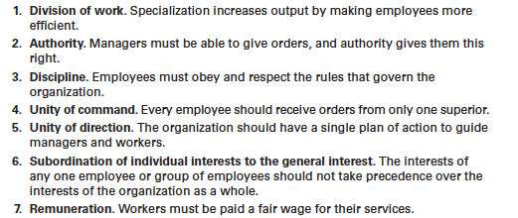
Exhibit MH-3
Fayol’s 14 Principles of Management

Slide 17
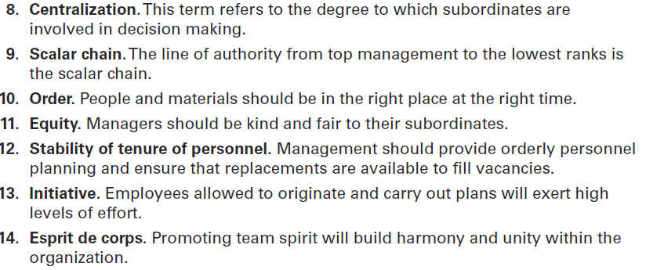
Exhibit MH-3
Fayol’s 14 Principles of Management (cont.)

Slide 18
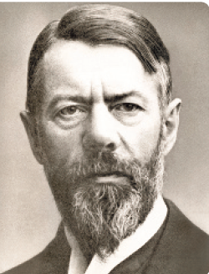
General Administrative Theory
Bureaucracy –Max Weber
was a German sociologist who wrote in the early twentieth century.
Weber developed a theory of authority structures and described organizational activity based on authority relations.
Notes:
Max Weber (pronounced VAY-ber) was a German sociologist who studied organizations. Writing in the early 1900s, he developed a theory of authority structures and relations based on an ideal type of organization he called a bureaucracy—a form of organization characterized by division of labor, a clearly defined hierarchy, detailed rules and regulations, and impersonal relationships. (See Exhibit MH-4.)

Slide 19
General Administrative Theory
He described the ideal form of organization as bureaucracy
a form of organization characterized by division of labor, a clearly defined hierarchy, detailed rules and regulations, and impersonal relationships.

Slide 20
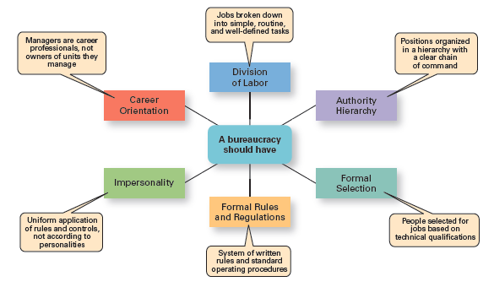
Exhibit MH-4
Characteristics of Weber’s Bureaucracy

Slide 21
Behavioral Approach
Organizational behavior (OB) – the study of the actions of people at work.
Organizational behavior (OB) research has contributed much of what we know about human resources management and contemporary views of motivation, leadership, trust, teamwork, and conflict management.
Notes:
The field of study that researches the actions (behavior) of people at work is called organizational behavior (OB). Much of what managers do today when managing people—motivating, leading, building trust, working with a team, managing conflict, and so forth—has come out of OB research.
Although a number of individuals in the early twentieth century recognized the importance of people to an organization’s success, four stand out as early advocates of the OB approach: Robert Owen, Hugo Munsterberg, Mary Parker Follett, and Chester Barnard. Their contributions were varied and distinct, yet all believed that people were the most important asset of the organization and should be managed accordingly.

Slide 22
Early Advocates of Organizational Behavior
Early OB Advocates
  Robert Owen
  Hugo Munsterberg
  Mary Parker Follett
  Chester Barnard
Importance of people to an organization ‘s success (the most important assets)

Slide 23
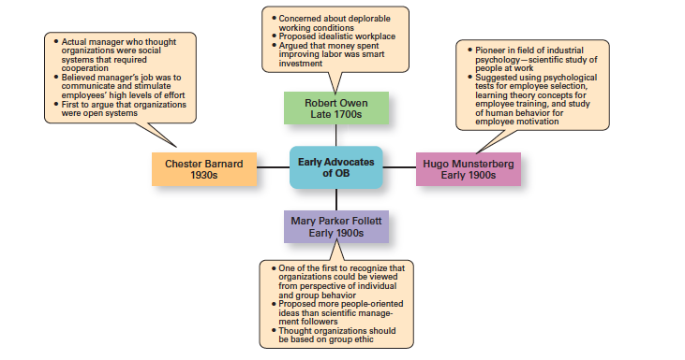
Exhibit MH-5
Early OB Advocates
Notes:
Exhibit MH- 5 summarizes each individual’s most important ideas.

Slide 24
The Hawthorne Studies
Hawthorne Studies – a series of studies during the 1920s and 1930s that provided new insights into individual and group behavior.
Notes:
Scholars generally agree that the Hawthorne Studies had a game-changing impact on management beliefs about the role of people in organizations. Elton Mayo conducted the Hawthorne Studies, a series of studies during the 1920s and 1930s that provided new insights into individual and group behavior. The studies concluded that people’s behavior and attitudes are closely related, that group factors significantly affect individual behavior, that group standards establish individual worker output, and that money is less a factor in determining output than group standards, group attitudes, and security. These conclusions led to a new emphasis on the human behavior factor in the management of organizations.

Slide 25
To examine the effect of various lighting levels on worker productivity
Experimental group
Control group
Exposed to various lighting intensities
Working under a constant intensity

Slide 26
The Hawthorne Studies
    After Harvard professor Elton Mayo and his associates joined the study as consultants, other experiments were included to look at redesigning jobs, make changes in workday and workweek length, introduce rest periods, and introduce individual versus group wage plans.
    The researchers concluded that social norms or group standards were key determinants of individual work behavior.

Slide 27
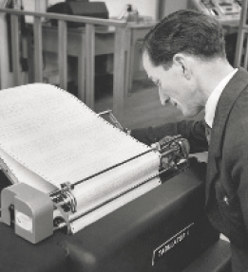
The Quantitative Approach
Quantitative approach – the use of quantitative techniques to improve decision making.
known as management science,
Notes:
The quantitative approach is the use of quantitative techniques to improve decision making. This approach also is known as management science. The quantitative approach evolved from mathematical and statistical solutions developed for military problems during World War II. After the war was over, many of these techniques used for military problems were applied to businesses.

Slide 28
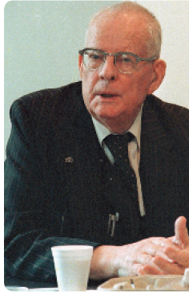
Total Quality Management (TQM)
Total quality management (TQM) – a philosophy of management that is driven by continuous improvement and responsiveness to customer needs and expectations.
1a - 28
Notes:
Another area where quantitative techniques are used frequently is in total quality management. A quality revolution swept through both the business and public sectors in the 1980s and 1990s. It was inspired by a small group of quality experts; the most famous was W. Edwards Deming (pictured above) and Joseph M. Juran. The ideas and techniques they advocated in the 1950s had few supporters in the United States but were enthusiastically embraced by Japanese organizations. As Japanese manufacturers began beating U.S. competitors in quality comparisons, however, Western managers soon took a more serious look at Deming’s and Juran’s ideas, which became the basis for today’s quality management programs.
Total quality management, or TQM, is a management philosophy devoted to continual improvement and responding to customer needs and expectations. (See Exhibit MH-6.) The term customer includes anyone who interacts with the organization’s product or services, internally or externally. It encompasses employees and suppliers as well as the people who purchase the organization’s goods or services.

Slide 29
Total Quality Management (TQM)
TQM was inspired by a small group of quality experts, including W. Edwards Deming, who was one of its chief proponents. And Joseph M. Juran .

Slide 30
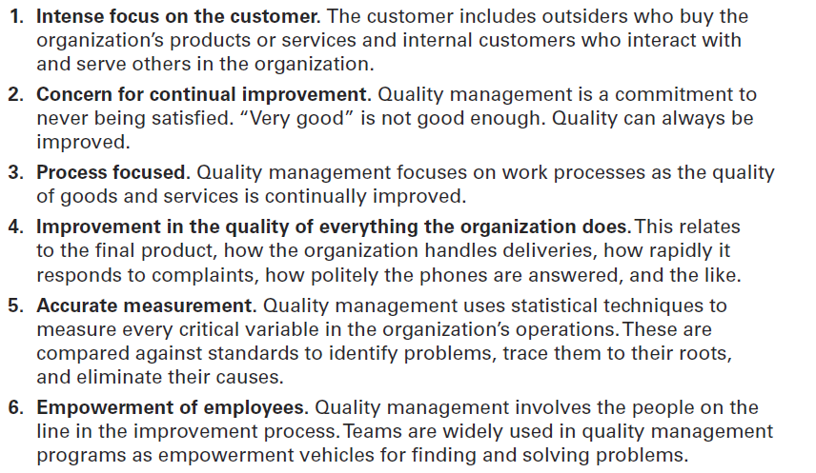
Exhibit MH-6 page 66
What Is Quality Management?

Slide 31
Contemporary Approaches
System – a set of interrelated and interdependent parts arranged in a manner that produces a unified whole.
Closed system – systems that are not influenced by and do not interact with their environment.
Open system – systems that interact with their environment.
Chester Barnard
Notes:
Most of these earlier approaches focused on managers’ concerns inside the organization. Starting in the 1960s, management researchers began to look at what was happening in the external environment outside the boundaries of the organization. Two contemporary management perspectives— systems and contingency—are part of this approach. Systems theory is a basic theory in the physical sciences, but had never been applied to organized human efforts.
A system is a set of interrelated and interdependent parts arranged in a manner that produces a unified whole. The two basic types of systems are closed and open. Closed systems are not influenced by and do not interact with their environment. In contrast, open systems are influenced by and do interact with their environment. Today, when we describe organizations as systems, we mean open systems.

Slide 32
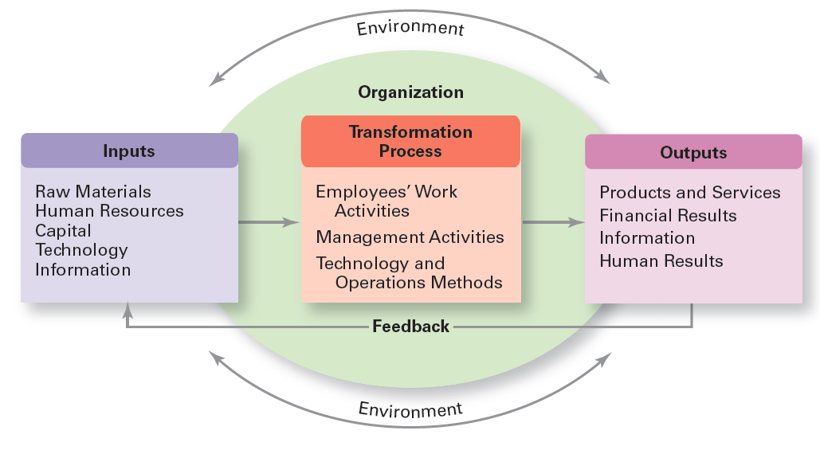
Exhibit MH-7
Organization as an Open System
Notes:
Exhibit MH-7 shows a diagram of an organization from an open systems’ perspective.

Slide 33
The Contingency Approach
Contingency approach – a management approach that recognizes organizations as different, which means they face different situations (contingencies) and require different ways of managing.
Called situational approach
A good way to describe contingency is “if ,then .”if this is the way my situation is, then this is the best way for me to mange in this situation.
Notes:
Different and changing situations require managers to use different approaches and techniques. The contingency approach (sometimes called the situational approach) says that organizations are different, face different situations (contingencies), and require different ways of managing.

Slide 34
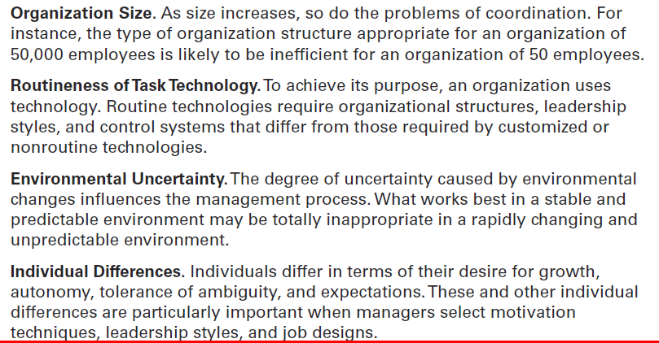
Exhibit MH-8
Popular Contingency Variables
Notes:
Exhibit MH-8 describes four popular contingency variables. Although the list is by no means comprehensive—more than 100 different variables have been identified— it represents those most widely used and gives you an idea of what we mean by the term contingency variable. The primary value of the contingency approach is that it stresses there are no simplistic or universal rules for managers to follow.

