Slide 1


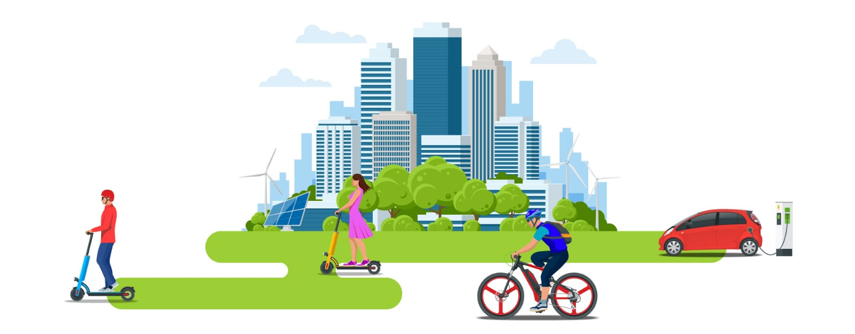
Sundus Saleh
1180461
Amal Bader 1182367
Batool Nobani 1182499
PRINCIPLES OF SPATIAL PLANNING
ENPL333
Sustainable Urban Mobility & TOD
Dr.Sanaa Anabtawi

Slide 2
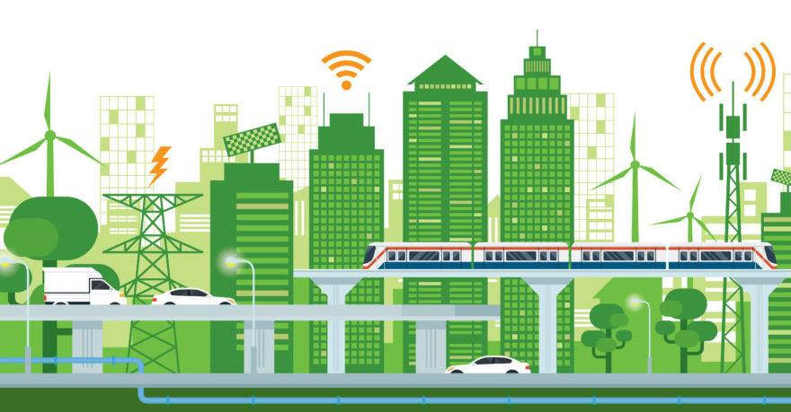
Sustainable urban mobility
“A Sustainable Urban Mobility Plan(SUMP) is a strategic plan designed to satisfy the mobility needs of people and businesses in cities and their surroundings for a better quality of life. It builds on existing planning practices and takes due consideration of integration, participation, and evaluation principles.”

Slide 3
Objectives and Aims
SUMP addresses all modes and forms of urban and regional transport.
provide sustainable and high-quality transport and mobility in the agglomeration and enhance its accessibility.
SUMP regards the entire urban area including its commuter hinterland Instead of addressing the needs of the administrative area only
SUMP integrates technical, infrastructure, policy, and soft measures to improve performance and cost-effectiveness.
It aims to meet the basic mobility needs of all users.
The SUMP concept emphasizes aspects of participatory planning, vertical and horizontal integration, and mechanisms for monitoring, evaluation and quality control.

Slide 4
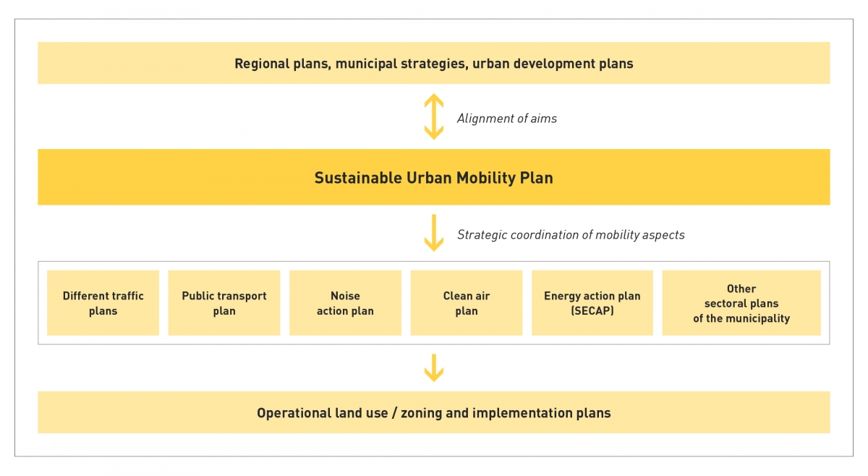
Planning requirements

Slide 5
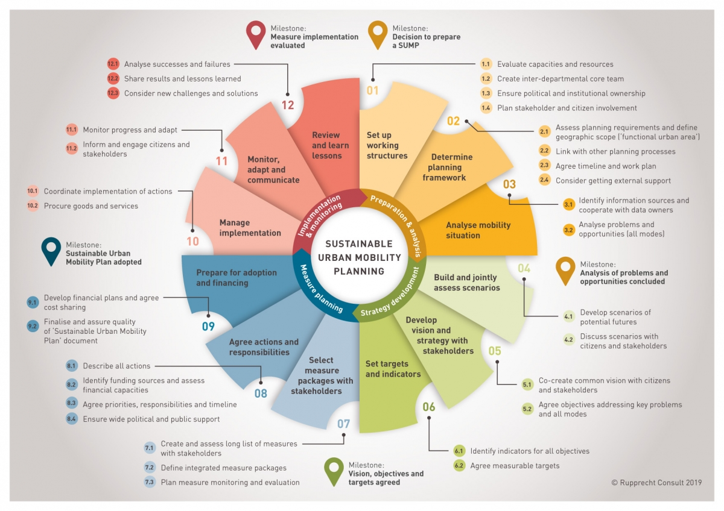

Slide 6
What are the benefits of SUMP?
Working for better health
health and safety
Getting there more easily, with fewer cars
Winning public support
Livability, a double win for people and business
Strength in unity

Slide 7
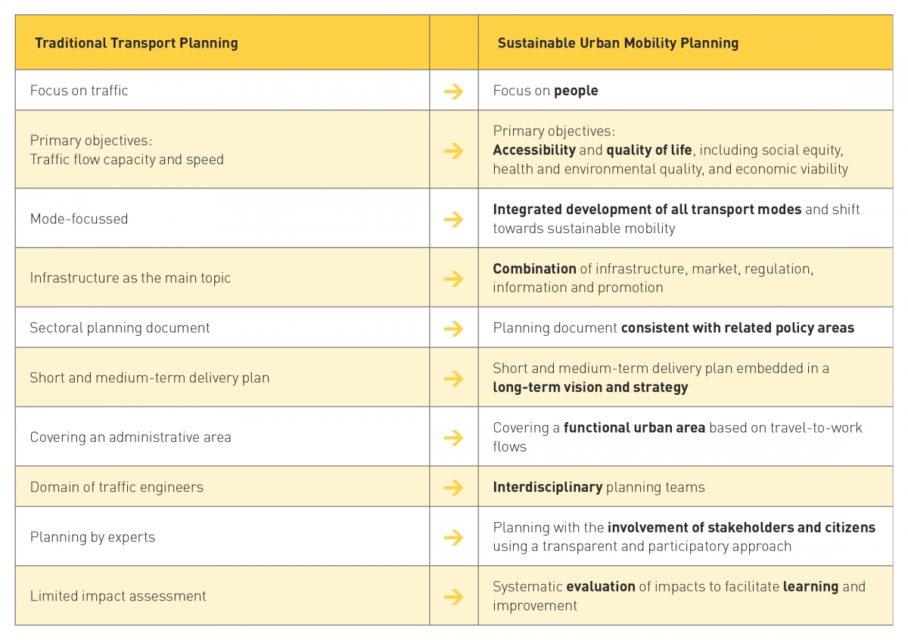

Slide 8
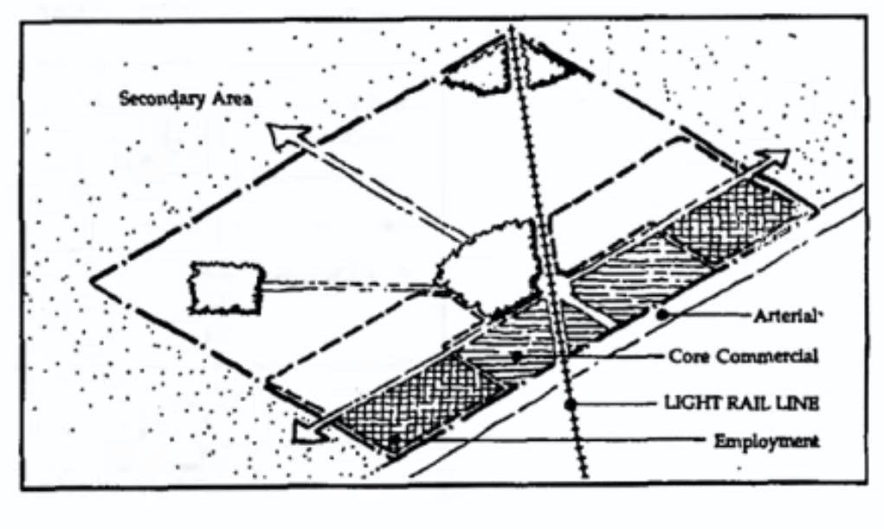
TOD
TOD, or transit-oriented development, means integrated urban places designed to bring people, activities, buildings, and public space together, with easy walking and cycling connection between them and near-excellent transit service to the rest of the city. It means inclusive access for all to local and citywide opportunities and resources by the most efficient and healthful combination of mobility modes, at the lowest financial and environmental cost, and with the highest resilience to disruptive events. Inclusive TOD is a necessary foundation for long-term sustainability, equity, shared prosperity, and civil peace in cities

Slide 9
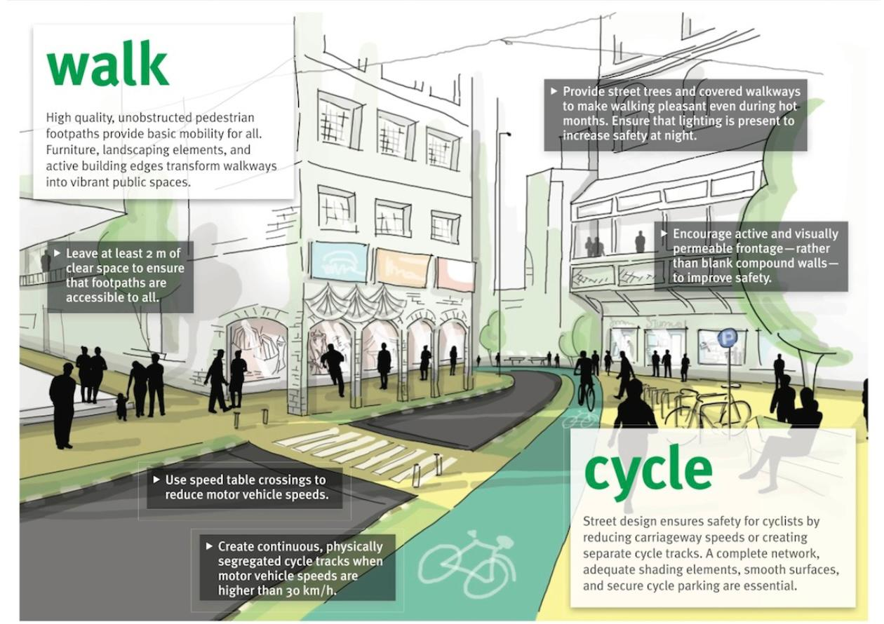

Slide 10
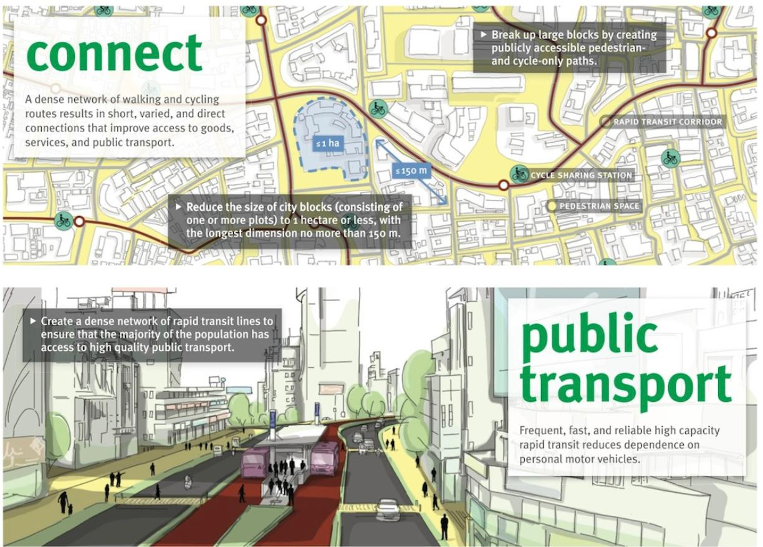

Slide 11
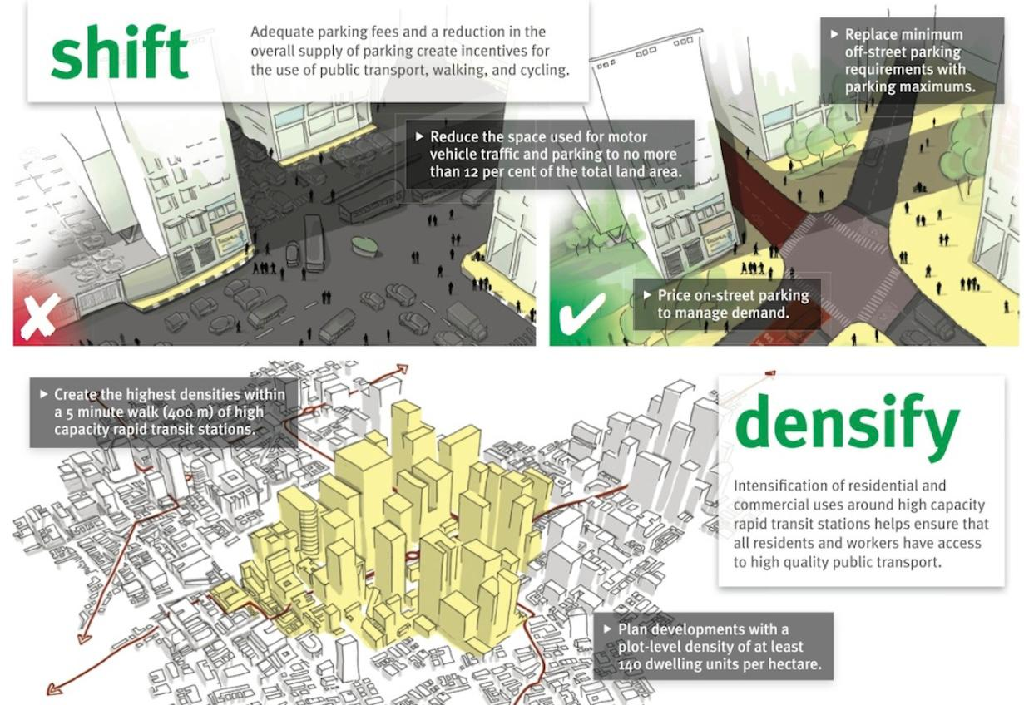

Slide 12
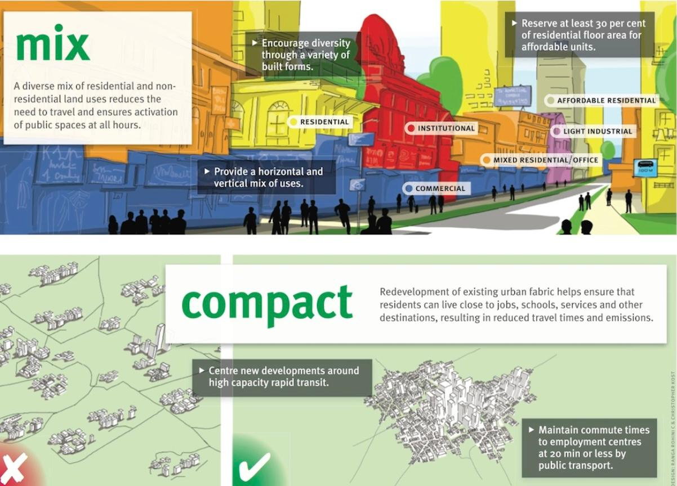

Slide 13
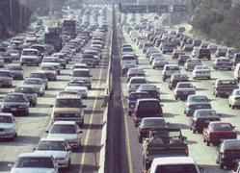
FACTORS DRIVING THE TREND TOWARD TOD
Rapidly growing, mind-numbing traffic congestion nation-wide
Growing distaste for suburbia and fry-pit strip development
Growing desire for quality urban lifestyle
Growing desire for more walkable lifestyles away from traffic
Changes in family structures: more singles, empty-nesters, etc
Growing national support for Smart Growth
New focus of Federal policy

Slide 14
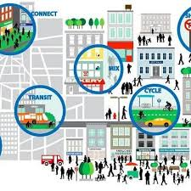
BENEFITS OF TOD
Higher quality of life with better places to live, work, and play
Greater mobility with ease of moving around
Increased transit ridership
Reduced traffic congestion, car accidents and injuries
Less expensive than building roads and sprawl
Greatly reduced dependence on foreign oil, reduced pollution and environmental damage

