Slide 1
The science and theory of language development

Slide 2
Learning goals
Explain who studies language development and why.
1
Describe some major approaches to studying language development.
2

Slide 3
INTRODUCTION
A theory is a claim or hypothesis that may be tested repeatedly with an array of scientific methods; when the accumulated evidence consistently supports a given theory throughout time, it becomes an accepted part of the knowledge base in a particular discipline, and we can then use the theory to make predictions about natural phenomena.
In the area of language development, theories provide explanations for how and why children develop their capacity for language across the different domains.

Slide 4
Theory and clinical practice
Evidence-based practice (EBP) involves integrating theoretical knowledge with scientific inquiry to inform decision-making.

Slide 5
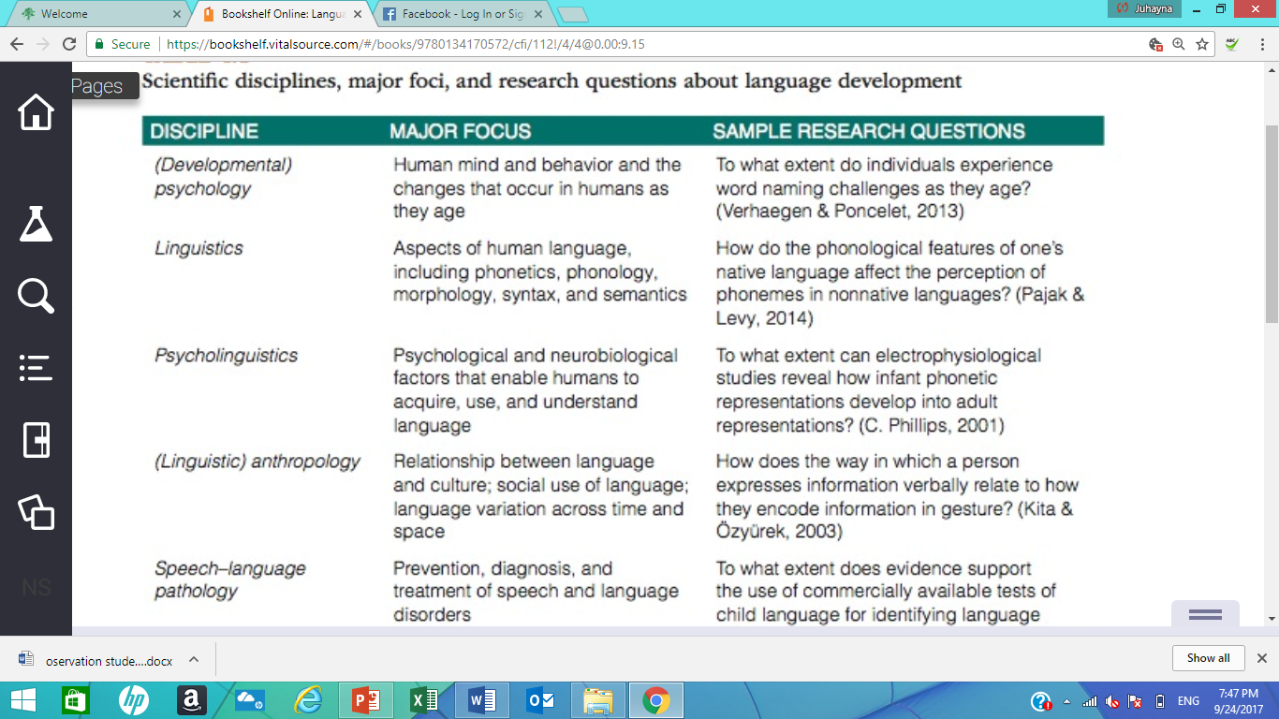
Who Studies Language Development?

Slide 6
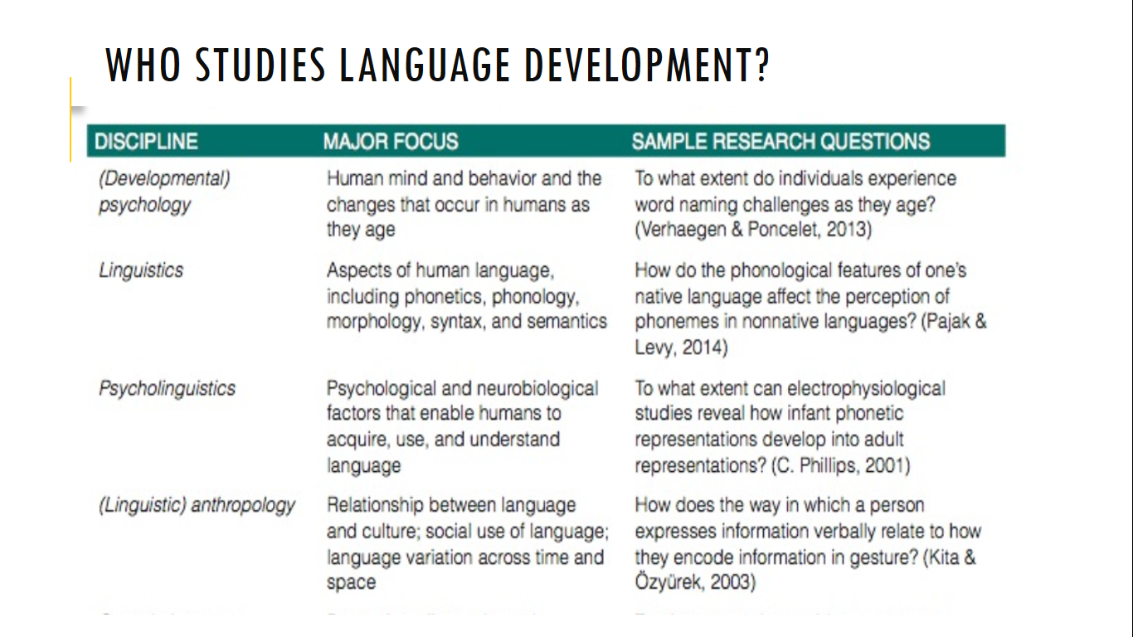
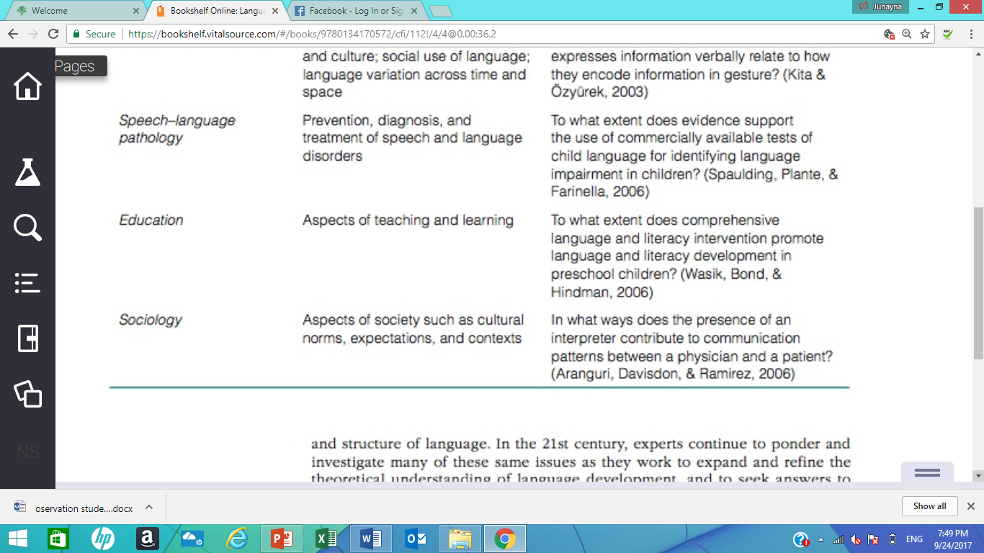
Who Studies Language Development?

Slide 7
Why study language development?
Basic research
Theoretical or basic research: In this type of researchers develop, test, and refine theories about language development. When the outcomes of basic research consistently confirm a theory, the theory becomes an accepted explanatory principle—akin to knowledge.
The purpose of basic research is to improve understanding of a particular phenomenon.
Example research topic : How children learn the meanings of words?

Slide 8
Why study language development? applied research
Applied research contributes to specific social needs by testing the viability of certain practices and approaches.
Applied researchers usually test language-development practices relevant to three main contexts: homes, clinical settings, and schools.
Example: research focusing on the identification of children at risk for language impairment.

Slide 9
What Are Some major Approaches TO Studying Language Development?
Speech perception
Language production
Language comprehension

Slide 10
Approaches to Studying Speech Perception
Goal of speech Perception studies understand how infants begin to parse the speech stream to begin to learn the sounds and words of their native language.
Methods for studying speech Perception
head-turn preference procedure.
high-amplitude nonnutritive sucking (HAS) procedure.
Brain imaging techniques.

Slide 11
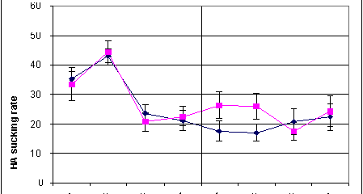
high-amplitude nonnutritive sucking
What is it used for?
  To test whether infants can discriminate different stimuli (e.g., sounds /ba/-/pa/, language X and Y)
  Age range: 0-4 months
Merits/demerits
  Can be used with very young infants
  Single observation per subject

Slide 12
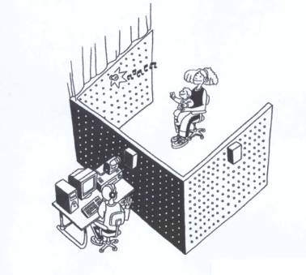
Head-turn preference procedure
What is it used for?
  To test whether children can discriminate one type of stimuli from another (e.g., infant- vs adult-directed speech; nativelike vs non-nativelike phonotactics)
  Age range: 4-24 months
Merits/demerits
  Low task demands
  Only works with long stimuli (e.g., passages, repeated words)
  Familiarity vs novelty

Slide 13
Approaches to Studying Language Production
Goal of language production studies is to help inform practitioners of children’s ability to use language expressively (emergent form, content, and use capabilities).
Such studies may involve normative research: experts compile data from individual on a certain aspect of language development and form these data determine and chart the ages or grades by which children typically meet certain milestones .
Methods for studying language Production
Observational
Experimental

Slide 14
Observational studies
The context of these studies can either be :
Natural
Semi-structured (manipulate the environment)
In observational studies, researchers typically record children’s language for a certain period, after which they transcribe the language and analyze it for specific properties or qualities.

Slide 15
Experimental studies
Experimental studies:
researchers are inventive in designing experiments to assess children’s production abilities
Manipulation variable of interest
May include pseudowords to assess phonological skills and repetition of sentences to assess grammatical skills

Slide 16
Approaches to Studying Language comprehension
Goal of language comprehension studies is to assess what children understand about language
Such studies may involve visual fixation on a stimulus, pointing , acting out sentences.

Slide 17
WhAT Are SOme mAJOr LAnguAge- DeveLOPmenT TheOrIeS?
Questions Language Theories Should Answer:
What do infants bring to the task of language learning?
What mechanisms drive language acquisition?
What types of input support the language-learning system?

Slide 18
What do infants bring to the task of language learning?
Some theorists propose infants arrive in the world essentially preprogrammed to acquire language Nature. Other theorists contend infants learn language through their experiences Nurture.
Nature vs Nurture

Slide 19
What Mechanisms Drive language acquisition?
Some theorists propose the processes people use to learn language are domain specific or dedicated solely to the tasks of comprehending and producing language. Other theorists contend that people use processes for learning language that are domain general , or the same as processes they use in other situations, such as solving problems and perceiving objects and events in the environment.
Remember the modularity concept?

Slide 20
What Types of input support the language-learning system?
Some theorists suggest that increasing knowledge of social conventions and a child’s desire to interact with others are the most important supports for language development. Other theorists propose that when children simply hear more and more language, they use “positive evidence” that other people provide to make assumptions about the structure of their native language.

Slide 21
major Language-Development Theories
Nurture-inspired theories are often called empiricist theories, and they rest on the notion that humans acquire language through experience.
Nature-inspired theories, also called nativist theories, generally hold that much knowledge is innate and genetically transmitted rather than learned by experience.
Interactionist theories acknowledge that language develops through the interaction between nature-related and nurture-related factors.

Slide 22
nurture-Inspired Theory
Behaviorist Theory B. F Skinner (1904–1990)
Notion of behaviorism : all learning is the result of operant conditioning (Skinner, 1957).
In operant conditioning, behaviors that are reinforced become strengthened, and behaviors that are punished become suppressed.
According to this theory, environmental stimuli elicit verbal responses, or language, from children. children then “learn” language as adults reinforce their verbalizations.

Slide 23
nurture-Inspired Theory
Social-Interactionist Theory
Lev vy- gotsky (1896–1934) stressed the importance of social interaction between an infant and other, increase the capability of language acquisition.
Vygotsky believed that before 2 years of age, general cognition and language are intertwined, but at about age 2 years, these two processes begin to develop as separate capabilities.
zone of proximal development: which is the difference between a child’s actual developmental leveland his or her level of potential development.
evolving skills vs acquired/mature skills

Slide 24
Zone of proximal development
Example
“Lori and her 4-year-old son, Alexander, are having a conversation about rhym- ing words in a storybook. Without assistance from Lori, Alexander cannot produce rhymes. For instance, she asks him, “What is a word that rhymes with cat?” and receives no response. however, when Lori provides Alexander with support, by telling him three words that rhyme with cat (bat, fat, mat), he can produce a rhym- ing word (rat)”

Slide 25
Nurture-inspired Theories
Cognitive Theory
Piaget (1923) viewed language as a domain-general ability that closely follows children’s general cognitive development.
Piaget viewed children as active agents in constructing their understanding of language. According to Piaget, children are egocentric and developmentally predisposed to view the world from only their perspective.
Children do not replace egocentric speech with true dialogue until they develop the ability to see others’ perspectives.

Slide 26
Nurture-inspired Theories
Intentionality Model (Bloom)
The child is responsible for driving language learning forward.
In this model children learn language when what they have in mind differs from what other individuals around them have in mind because they must express themselves to share this information.
To acquire language, then, children must be intentional, they must take strides to engage in social interaction, and they must put forth effort to construct linguistic representations for the ideas they want to express and then act to express these ideas.

Slide 27
Nurture-inspired Theories
Competition Model
The model describes specific mechanisms through which children acquire language. E.g, frequent language forms are acquired early while infrequent/rare language forms are acquired later in life.
Multiple language forms compete with one another until the input strengthens the correct representation and the child no longer produces an incorrect form.
Overgeneralization : E.g., I goed.

Slide 28
Refer to the book
Connectionist theories
Usage-Based Theory

Slide 29
nature-Inspired Theories
Universal Grammar noam chomsky (1965)
The term universal grammar (UG) describes the system of grammatical rules and constraints consistent in all world languages.
Chomsky postulated that language acquisition depends on an innate, species-specific module dedicated to language and not to other forms of learning. This module is called the language acquisition device.
According to UG theory, children are born with a basic set of grammatical rules and categories that exist in all languages. This implicit knowledge children have about language is called linguistic competence, whereas the actual comprehension and production of language in specific situations is called linguistic performance.
Mistakes and omissions in children’s speech indicate performance difficulties and not a lack of competence.

Slide 30
nature-Inspired Theories
Modularity Theory Fodor’s (1983)
A modularity perspective of language views it as an innate capacity localized to domain-specific processors that are encapsulated in their functions from other processors.
The concept of encapsulization means that language modules operate independently to perform dedicated functions, yet can interact with one another at higher levels to produce combinations of functions. Because language modules operate independently, different types of input drive language development forward in different areas (e.g., the lexicon, syntax, morphology).
For example, the number and kinds of words a young child hears form an environmental influence that helps shape the lexicon, whereas innately given syntactic rules help shape the child’s sentence formation abilities.

Slide 31
nature-Inspired Theories
Bootstrapping theories
Bootstrapping means accomplishing a goal by personal effort or with minimal outside assistance.
syntactic bootstrapping describes the process by which children use the syntactic frames surrounding unknown verbs to successfully constrain or limit their possible meanings.
semantic bootstrapping: After children acquire a large, diverse lexicon from their observations of objects and events in the world, they use correspondences between semantics and syntax to determine the syntactic category to each word.

Slide 32
Prosodic bootstrapping suggests infants use their sensitivity to the acoustic properties of speech (e.g., pitch, rhythm, pauses, stress) to make inferences about units of language, including clauses, phrases, and words.

Slide 33
A summary for the behaviorist perspective
Behaviorism stresses on the importance of environment
Children are viewed as empty tanks to be filled with experiences.
Child is viewed as having no knowledge of language rules
Parents are “credited” for teaching language by providing models for the child to imitate.
By selective reinforcement, parent shape child utterances into adult forms

Slide 34
Critics of the behaviorism view
The role of imitation is questioned :
children produce utterances that they never heard before or are never produced by adults e.g., daddy goed work .
Imitation decreases after the 2nd birthday, although a lot of language is acquired after this age.
If imitation is important, it would be evident throughout the language learning period.

Slide 35
Nativist interpretation
Nativists stress that language is innate or biologically-based. That is, humans are born with species-specific capacity for language that is realized with minimal assistance from the environment.
Noam Chomsky is a linguist that is closely associated with the Nativist view.

Slide 36
Practices Language Theories may Inform
Prevention
intervention and remediation
enrichment

