Slide 1

Mechatronics System Design
Chapter 3: Motion Planning
Instructor: Dr. Ahmad Al-Balasie
First Semester - 2021/2022

Slide 2
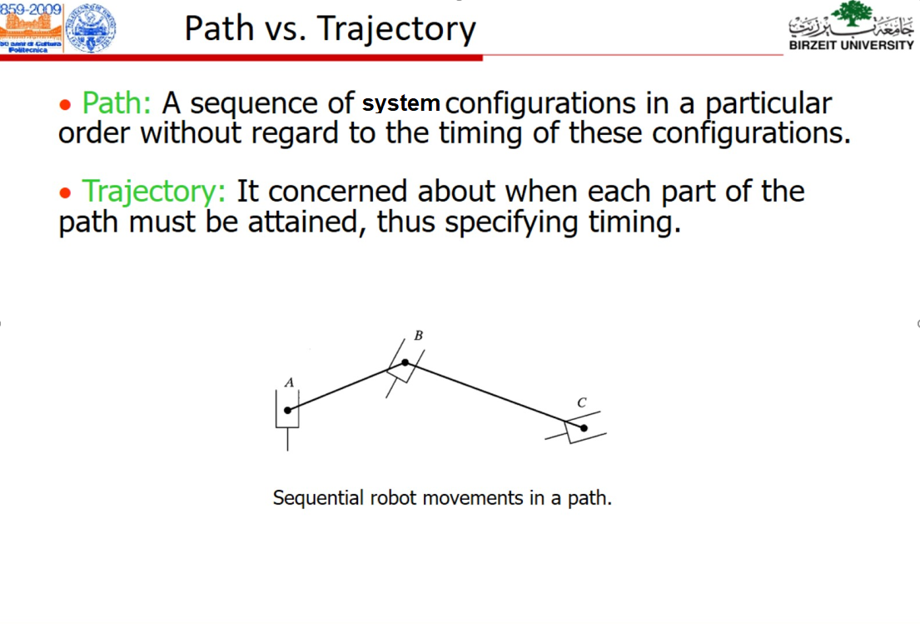

Slide 3
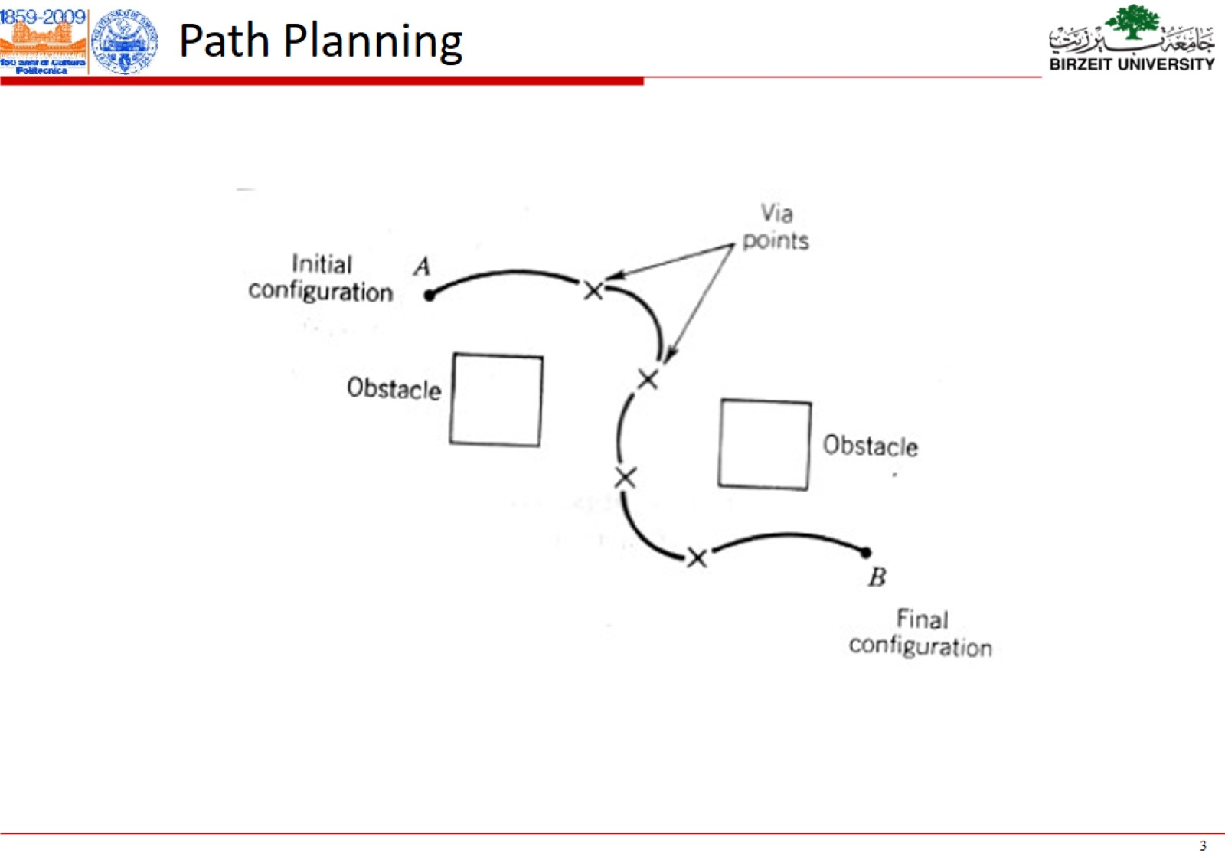

Slide 4
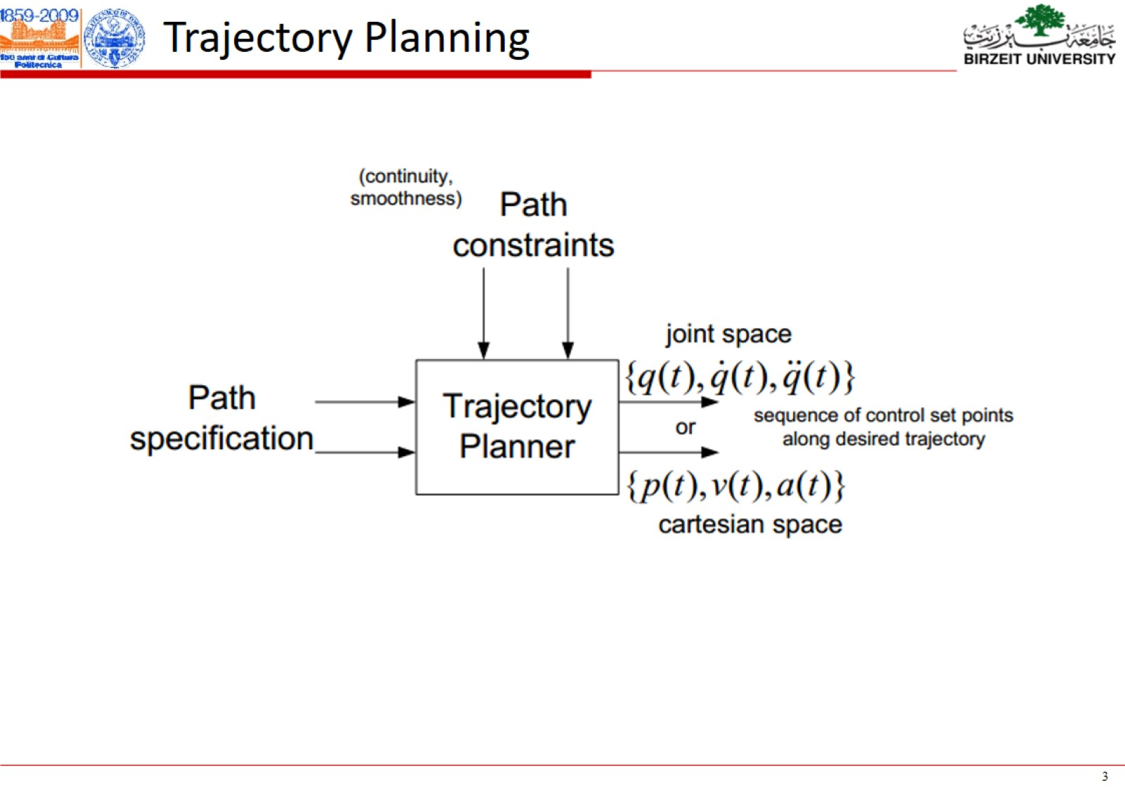

Slide 5
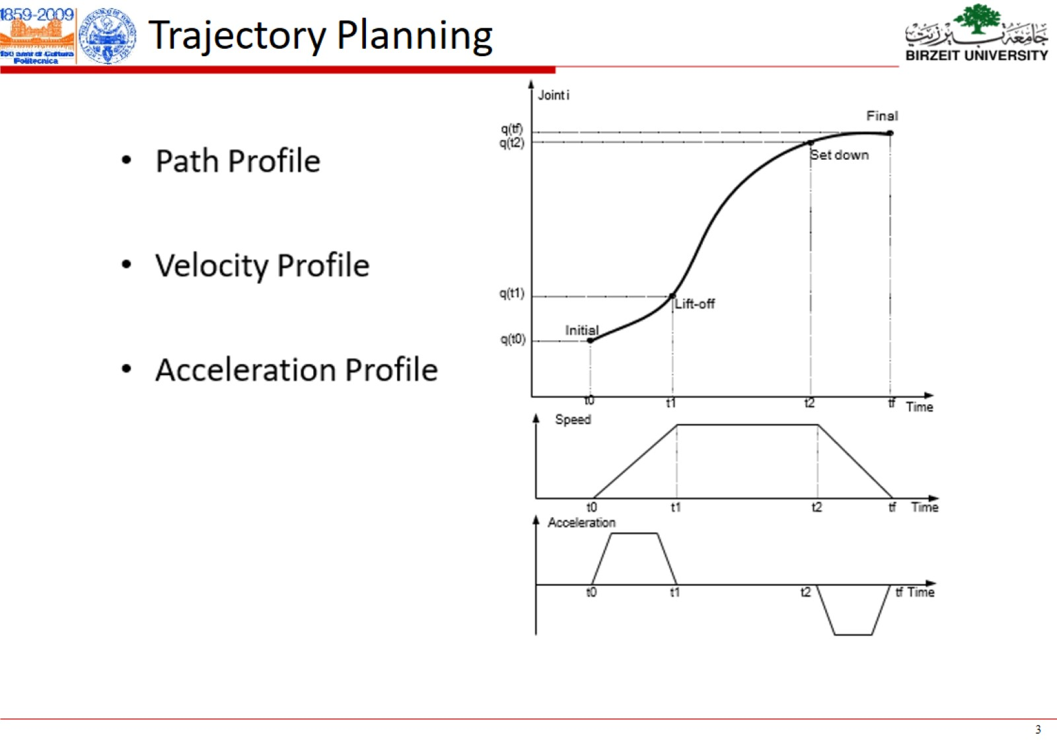

Slide 6
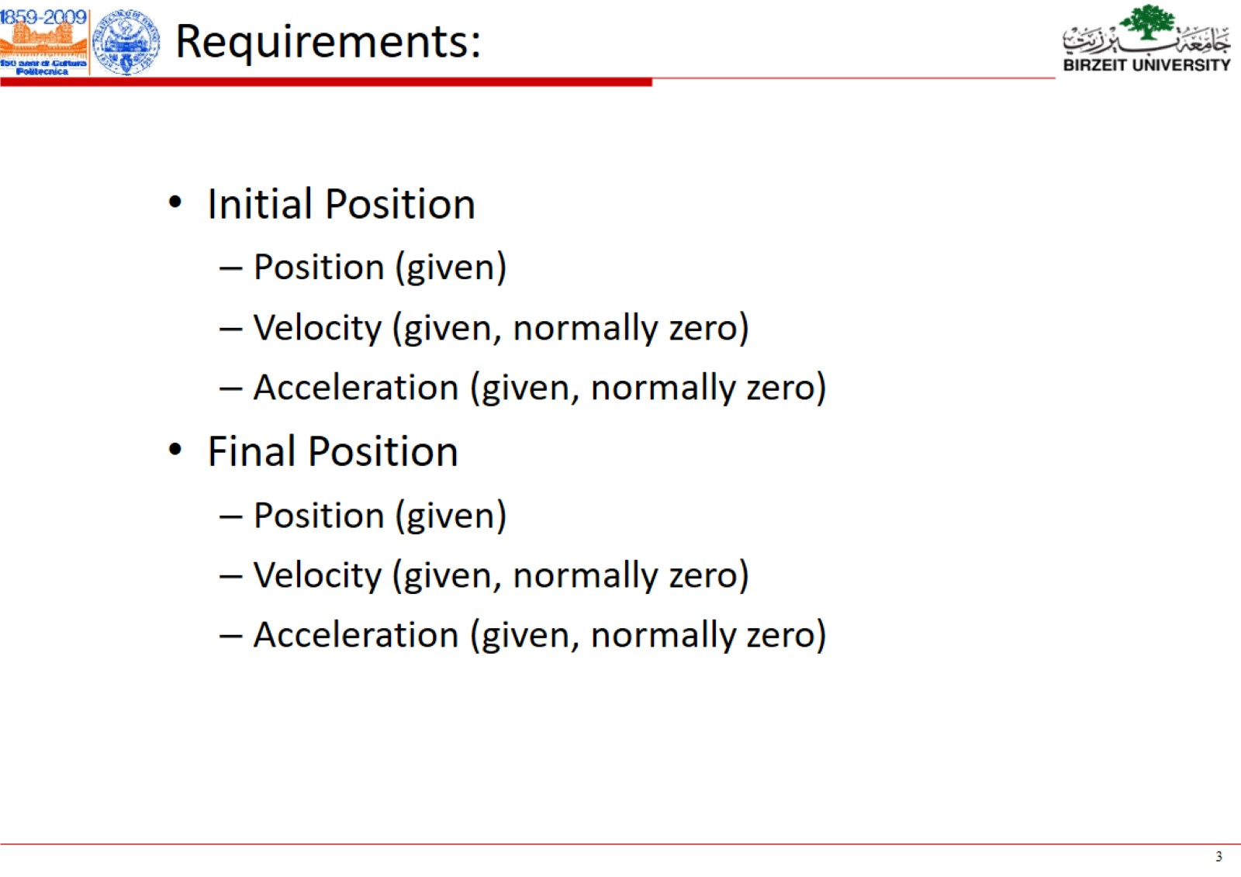

Slide 7
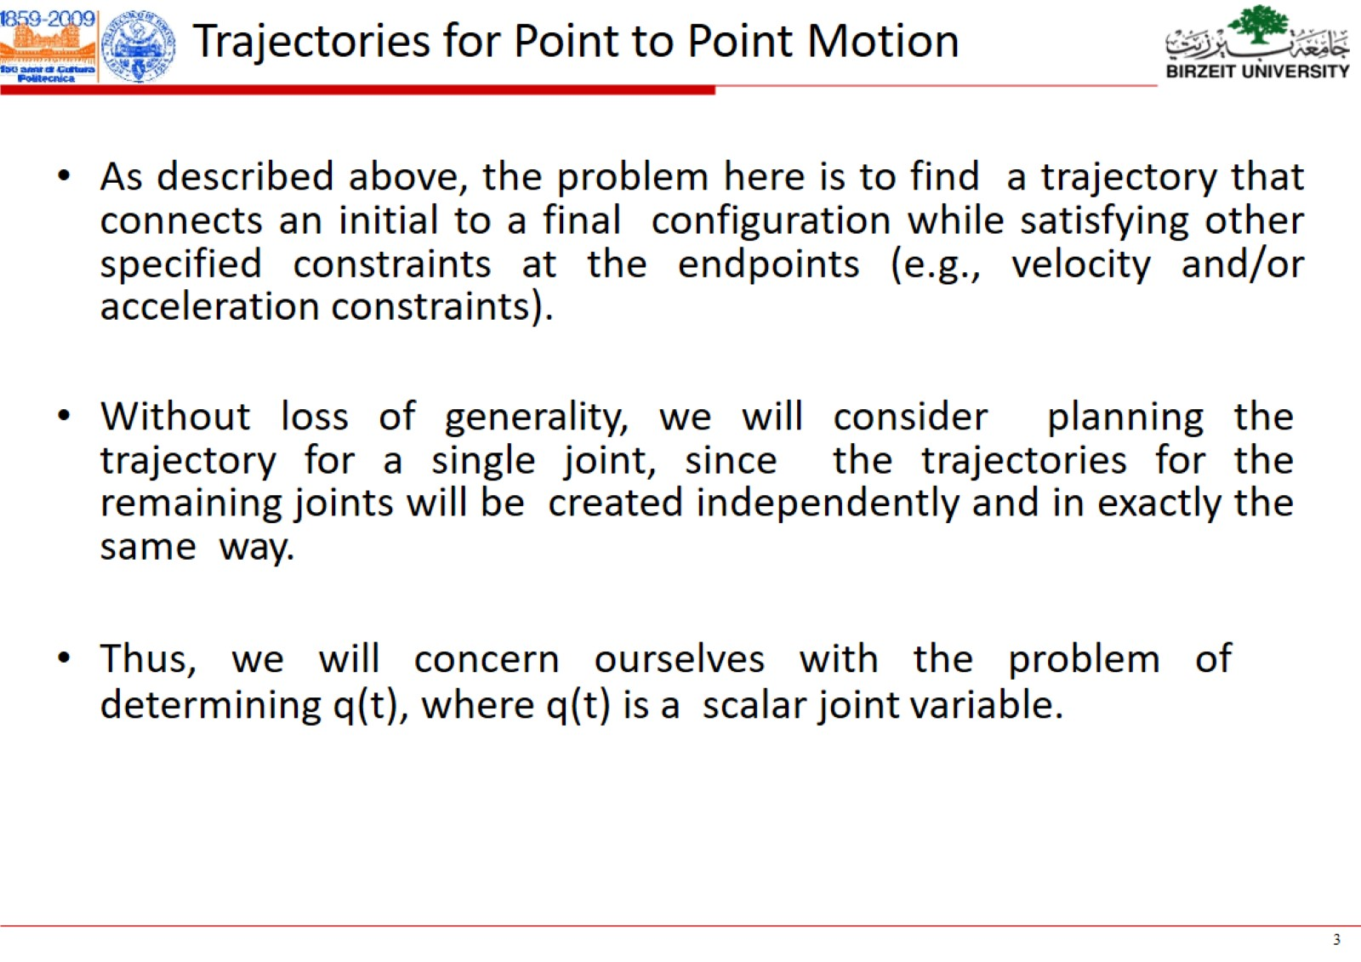

Slide 8
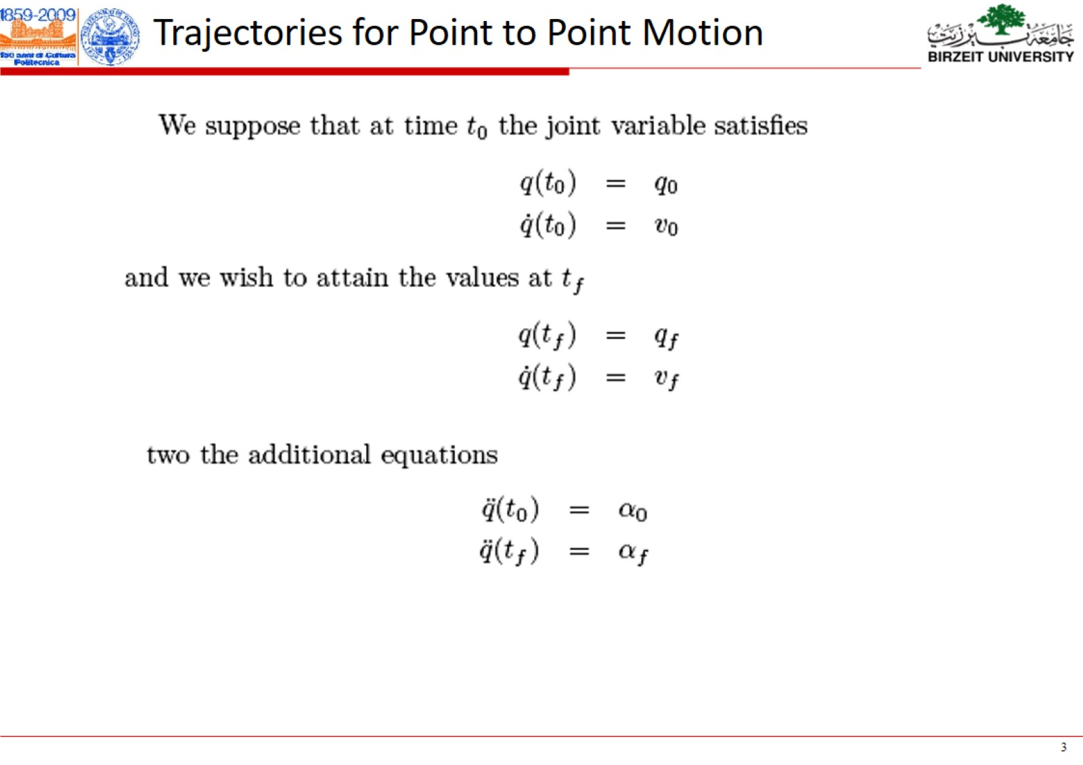

Slide 9
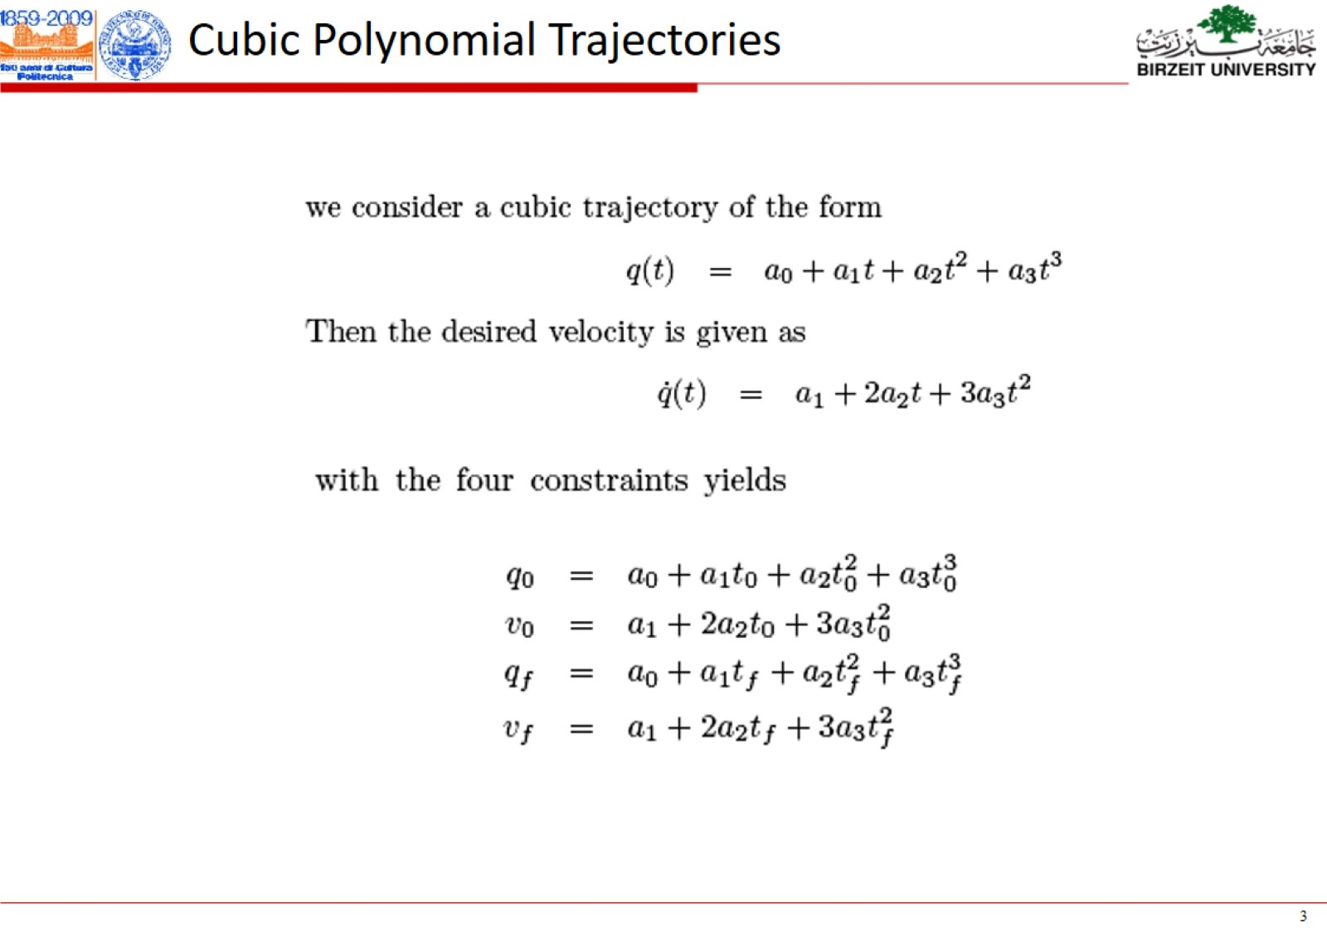

Slide 10
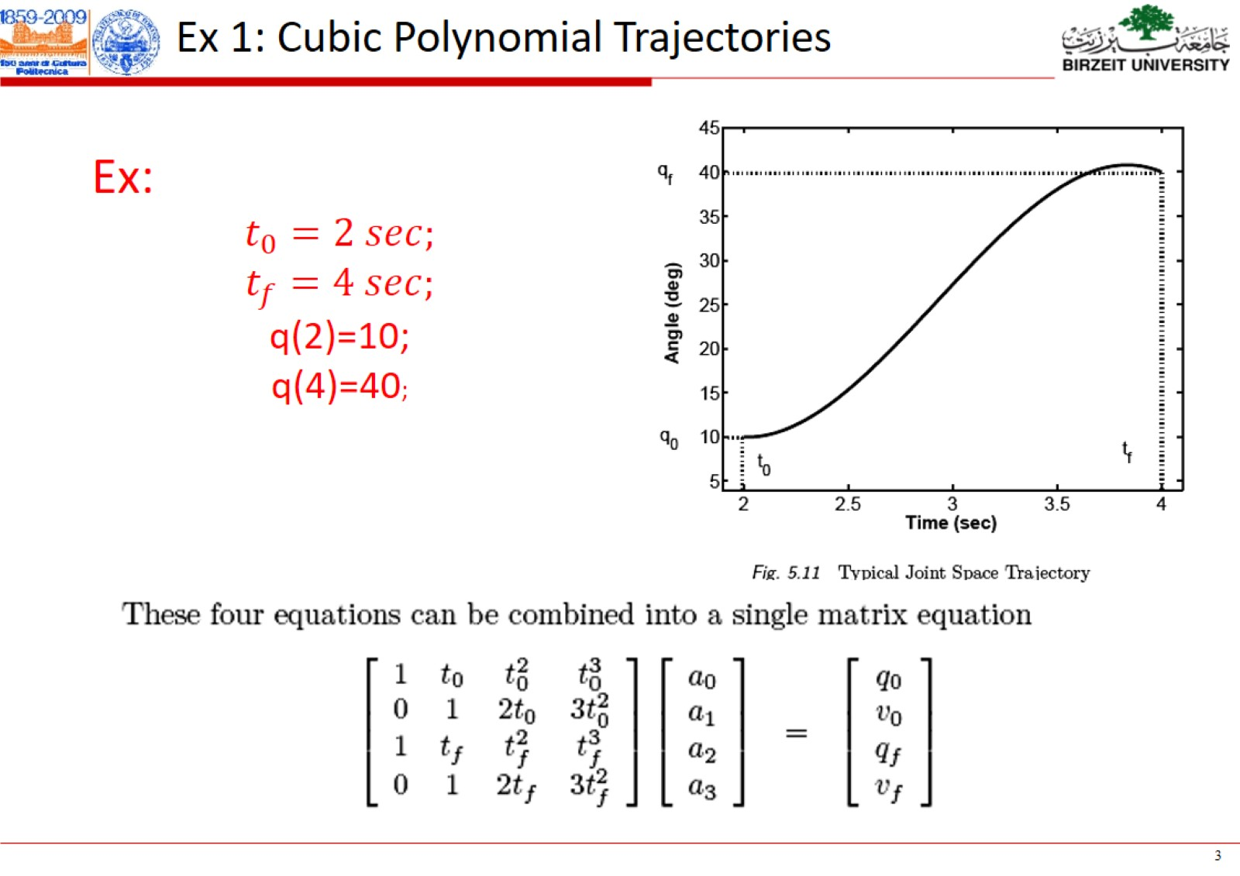

Slide 11
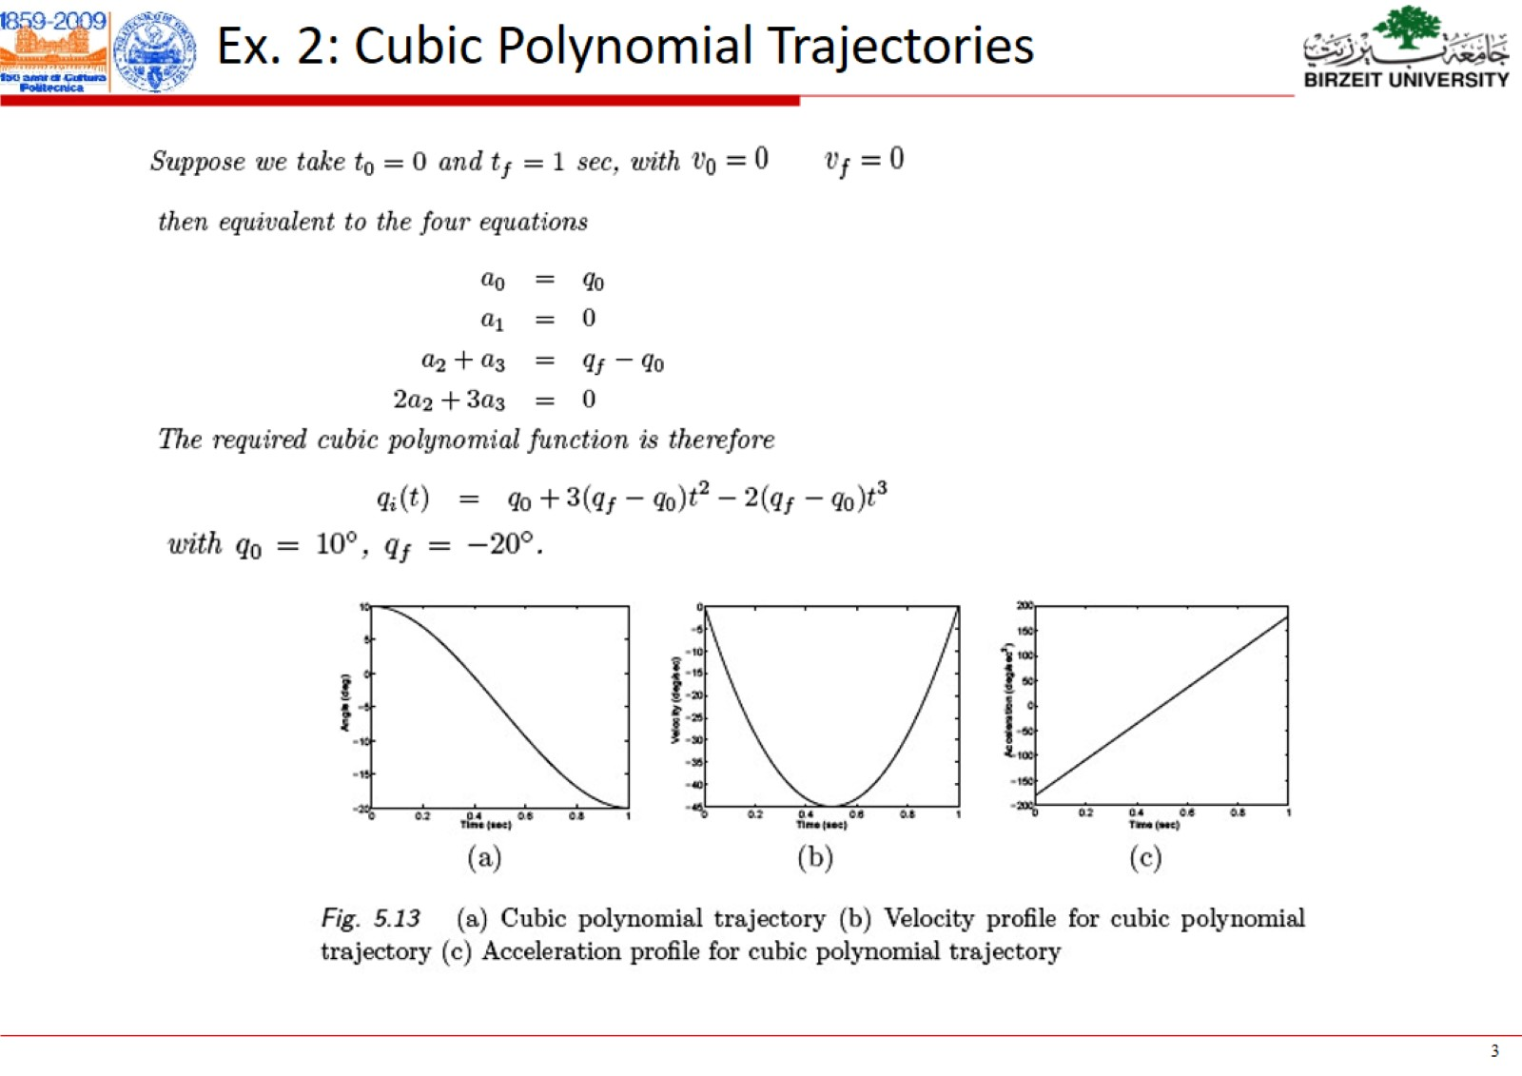

Slide 12
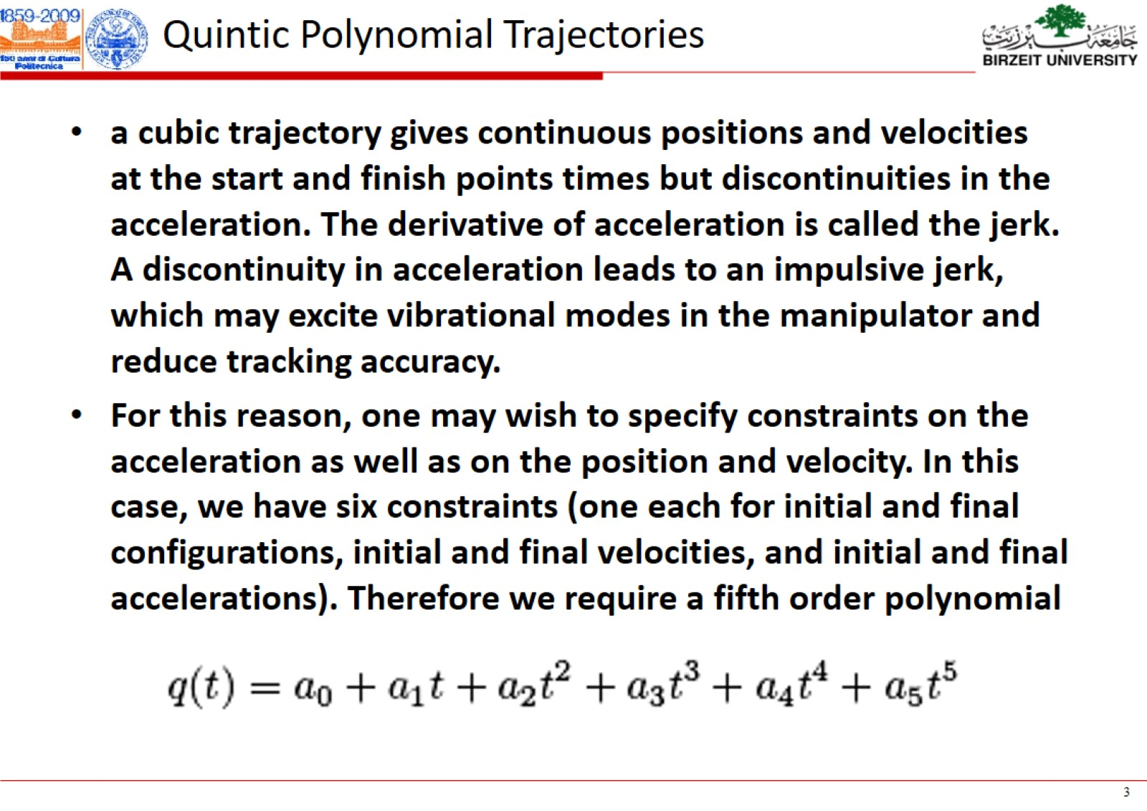

Slide 13
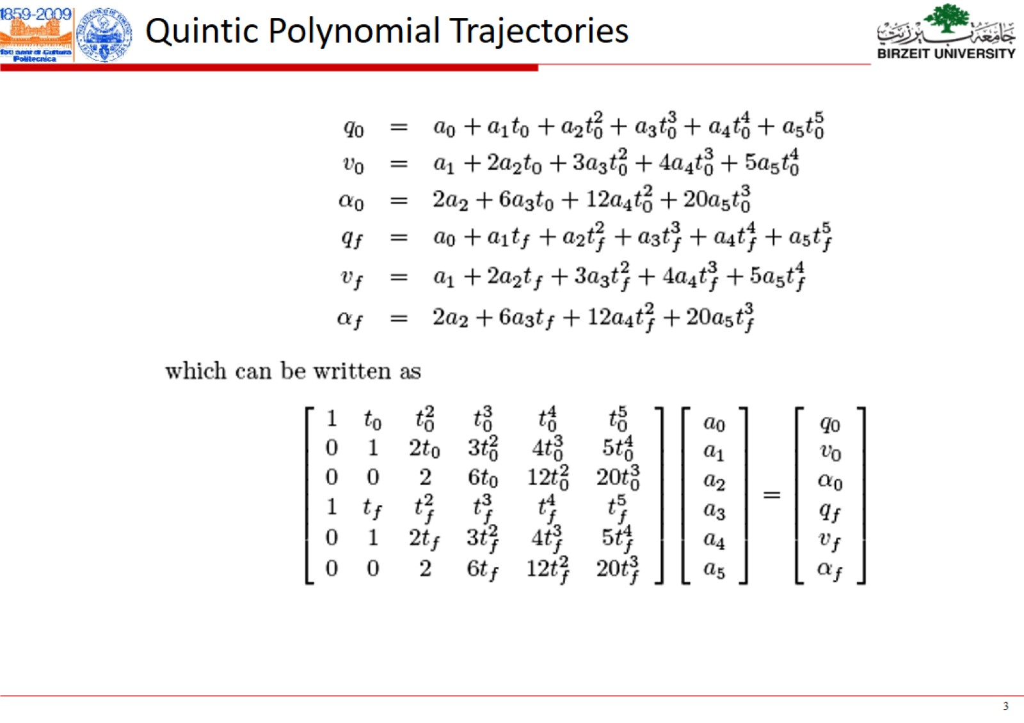

Slide 14
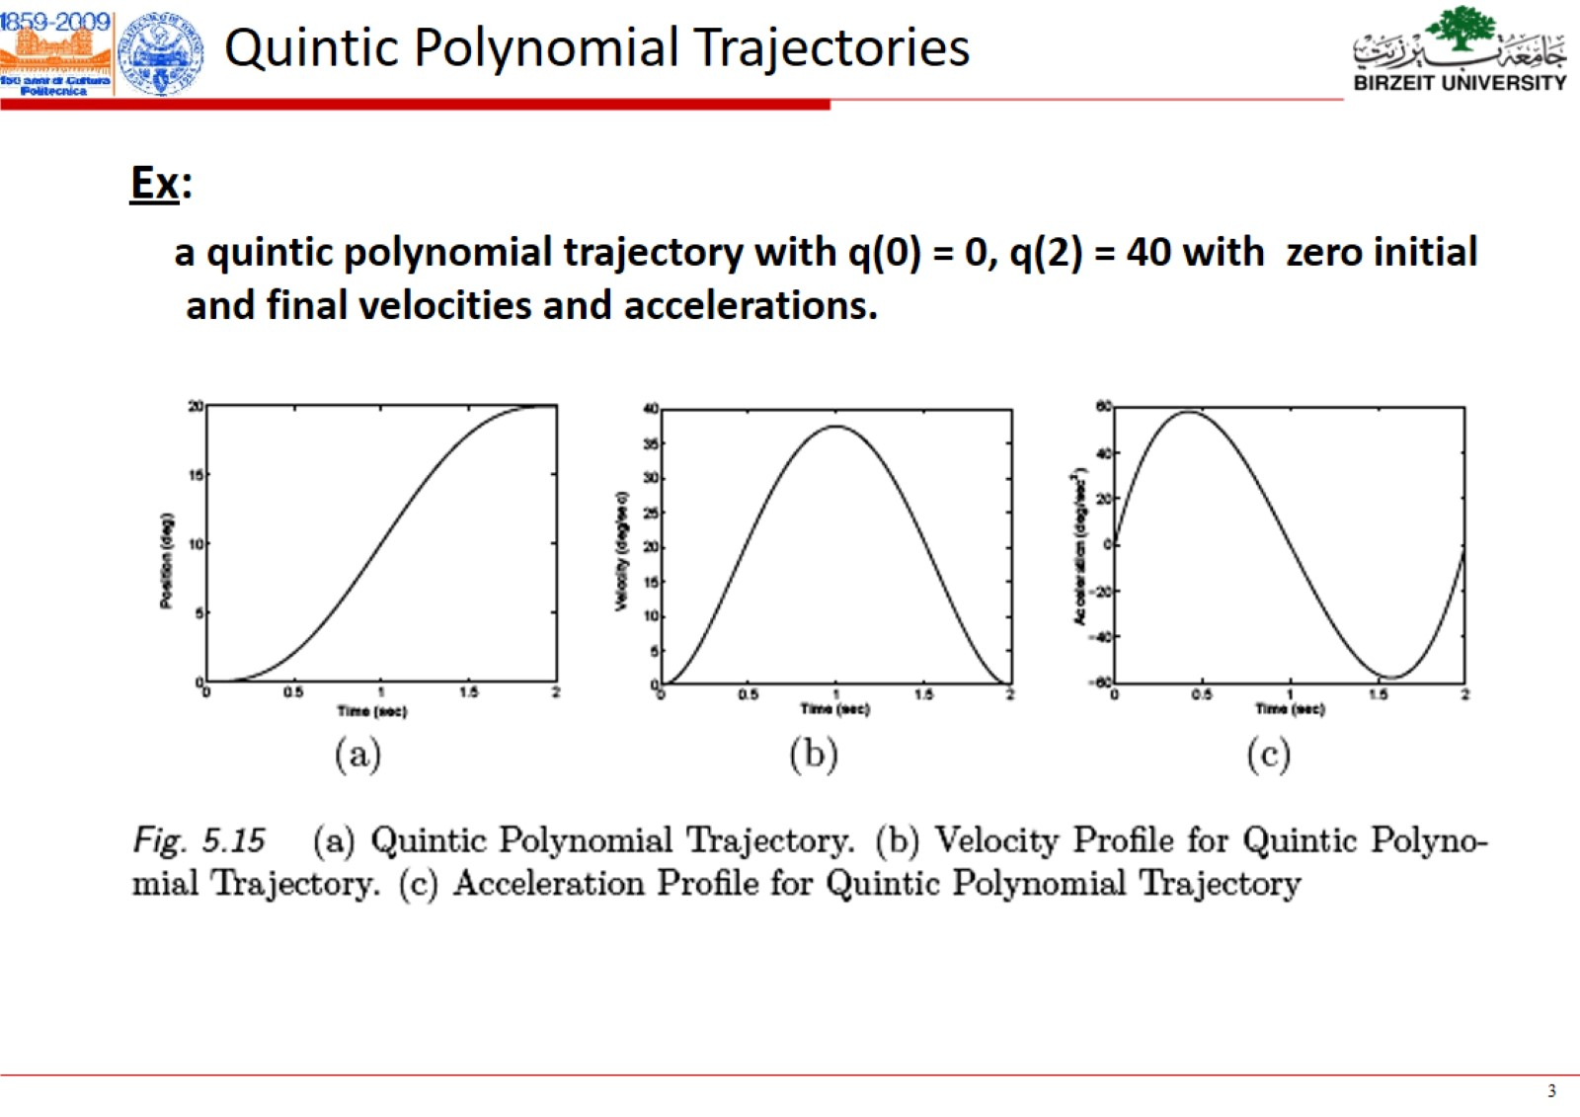

Slide 15
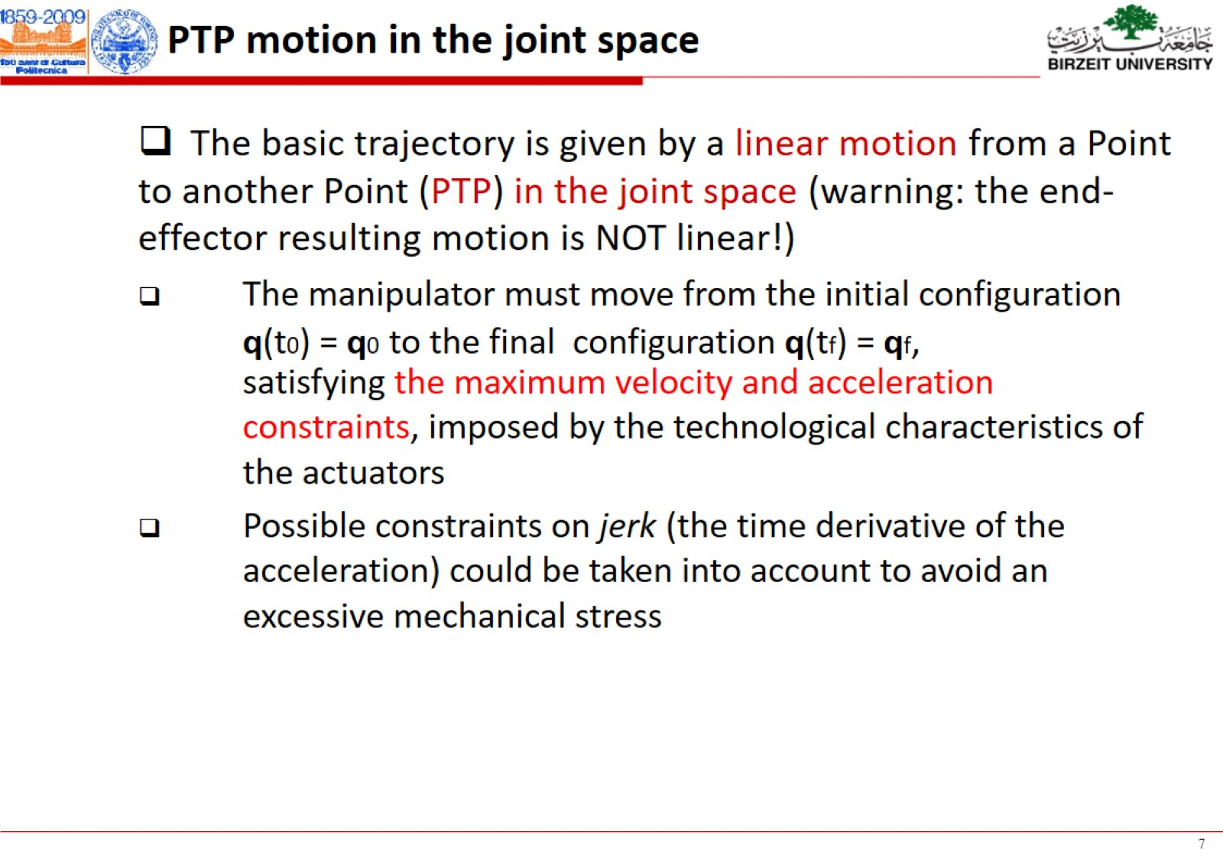

Slide 16
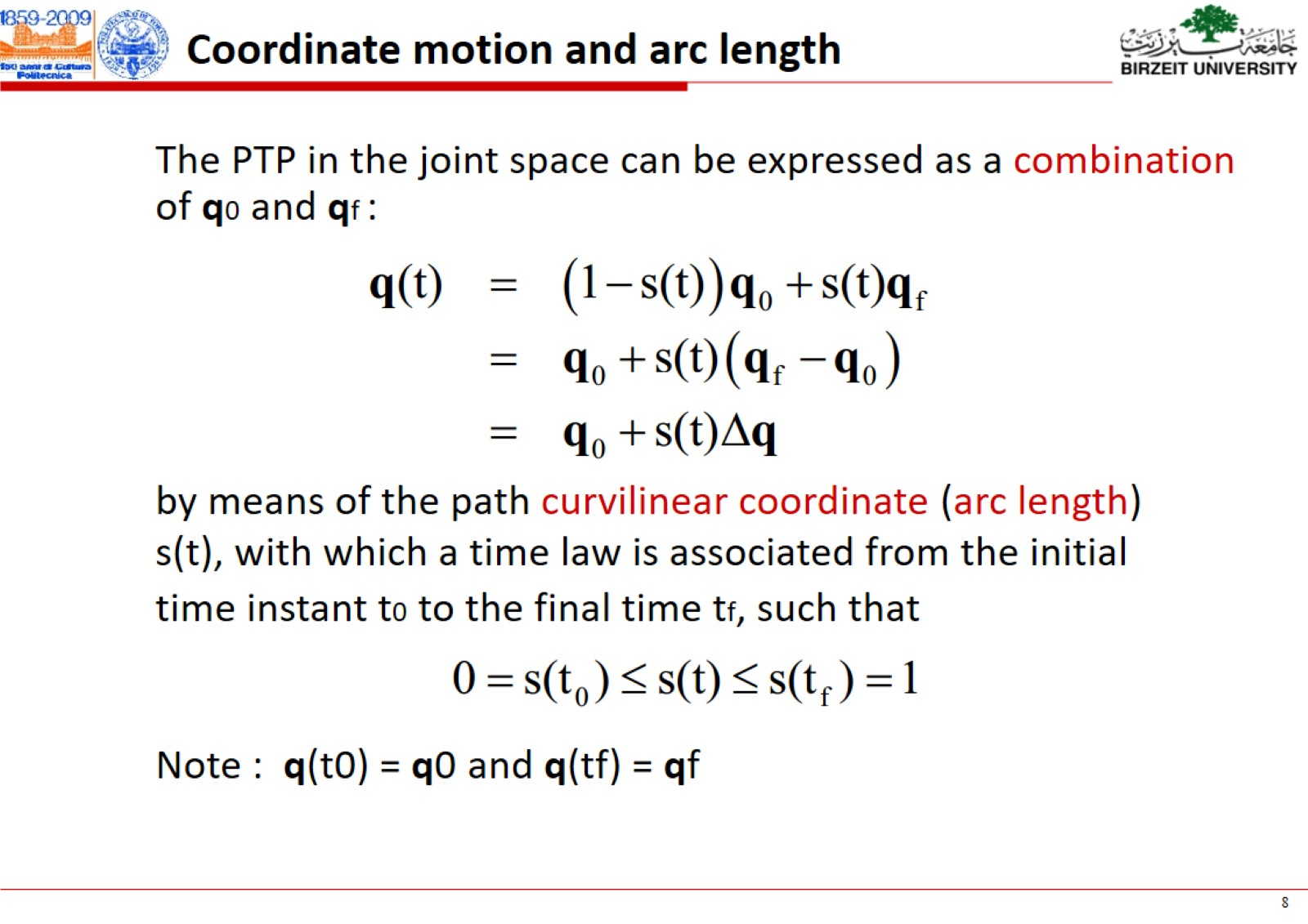

Slide 17
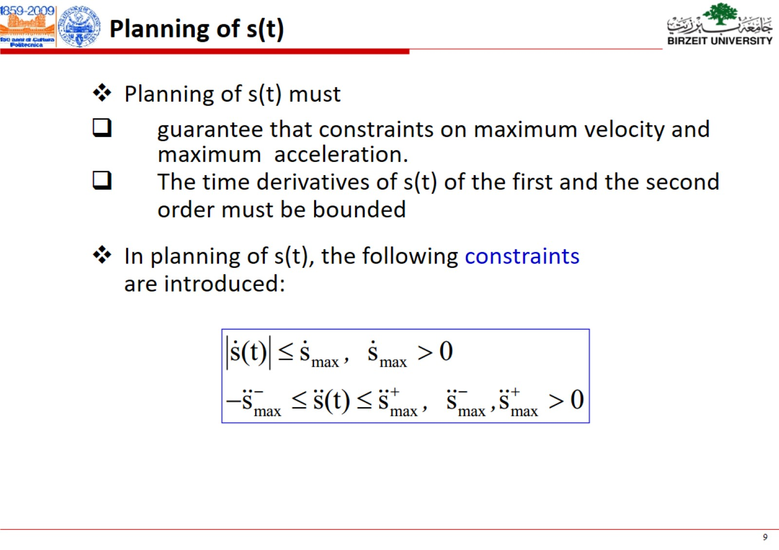

Slide 18
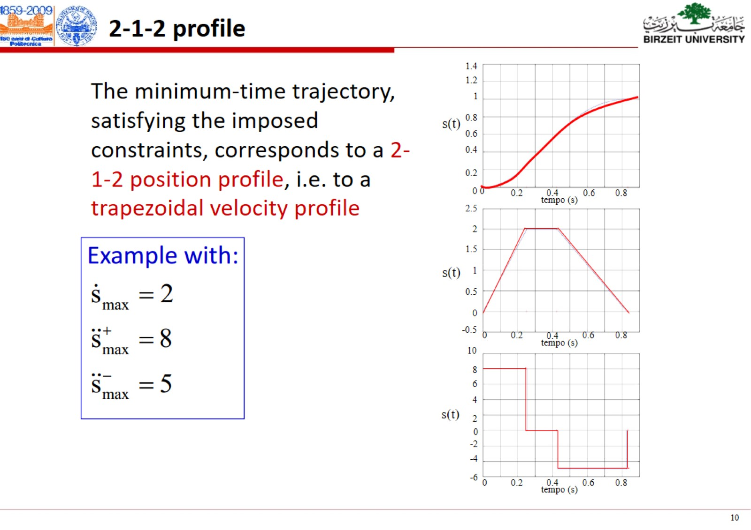

Slide 19
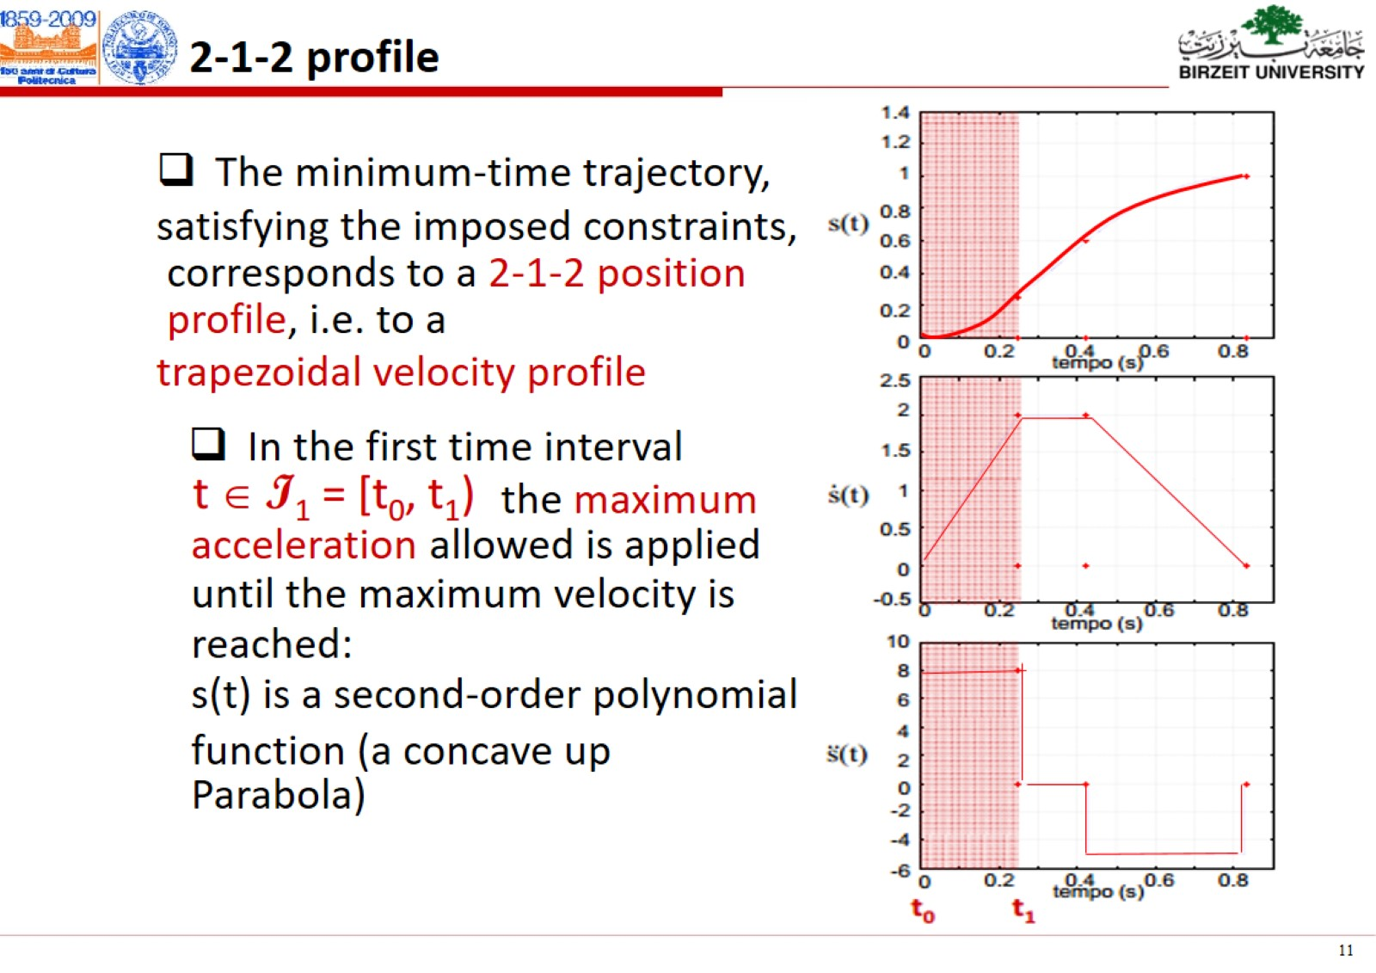

Slide 20
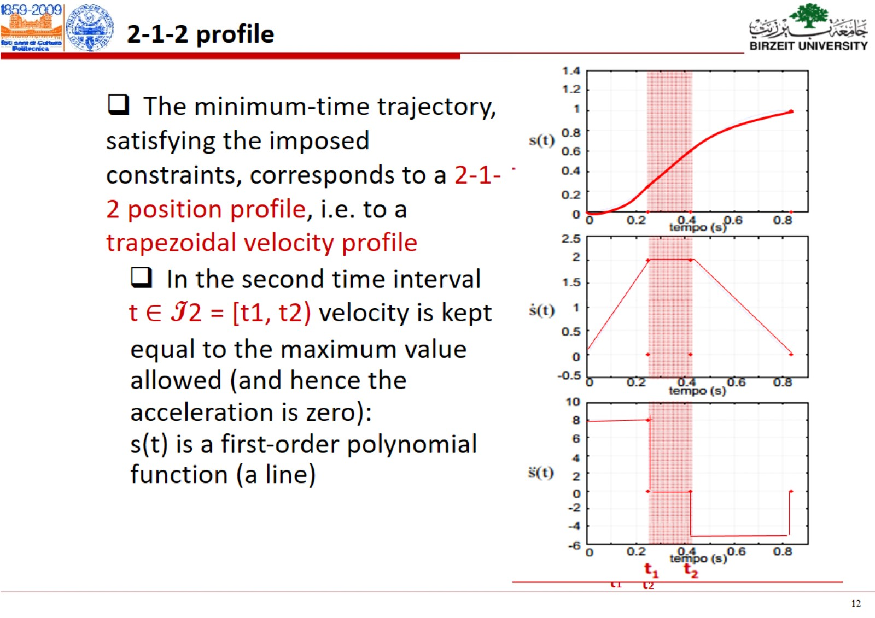

Slide 21
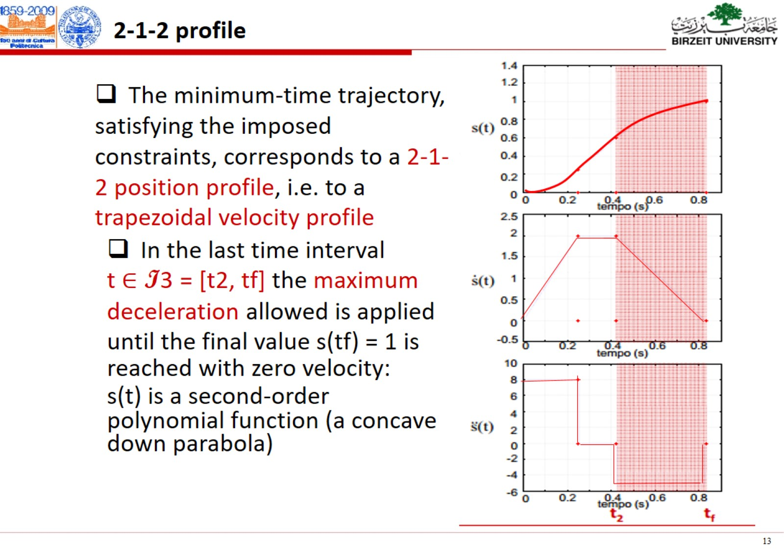

Slide 22
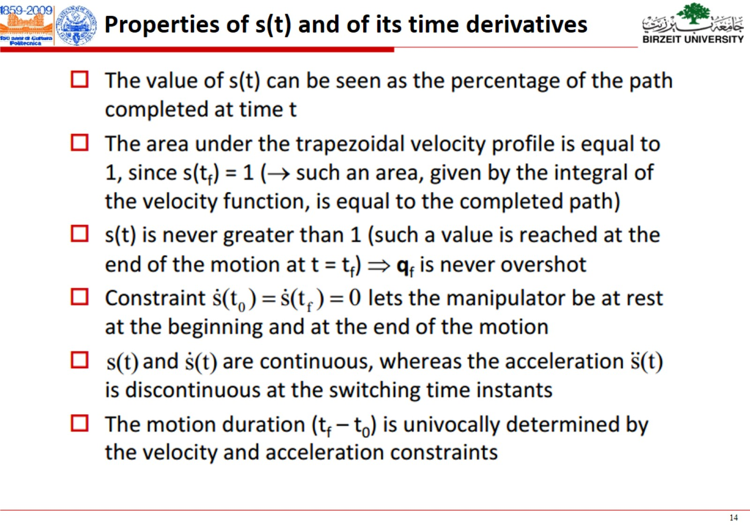

Slide 23
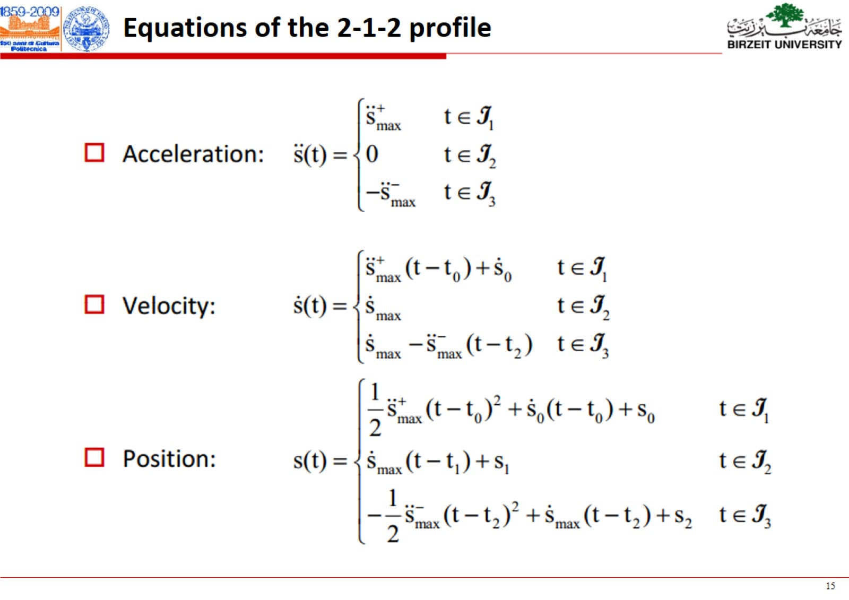

Slide 24
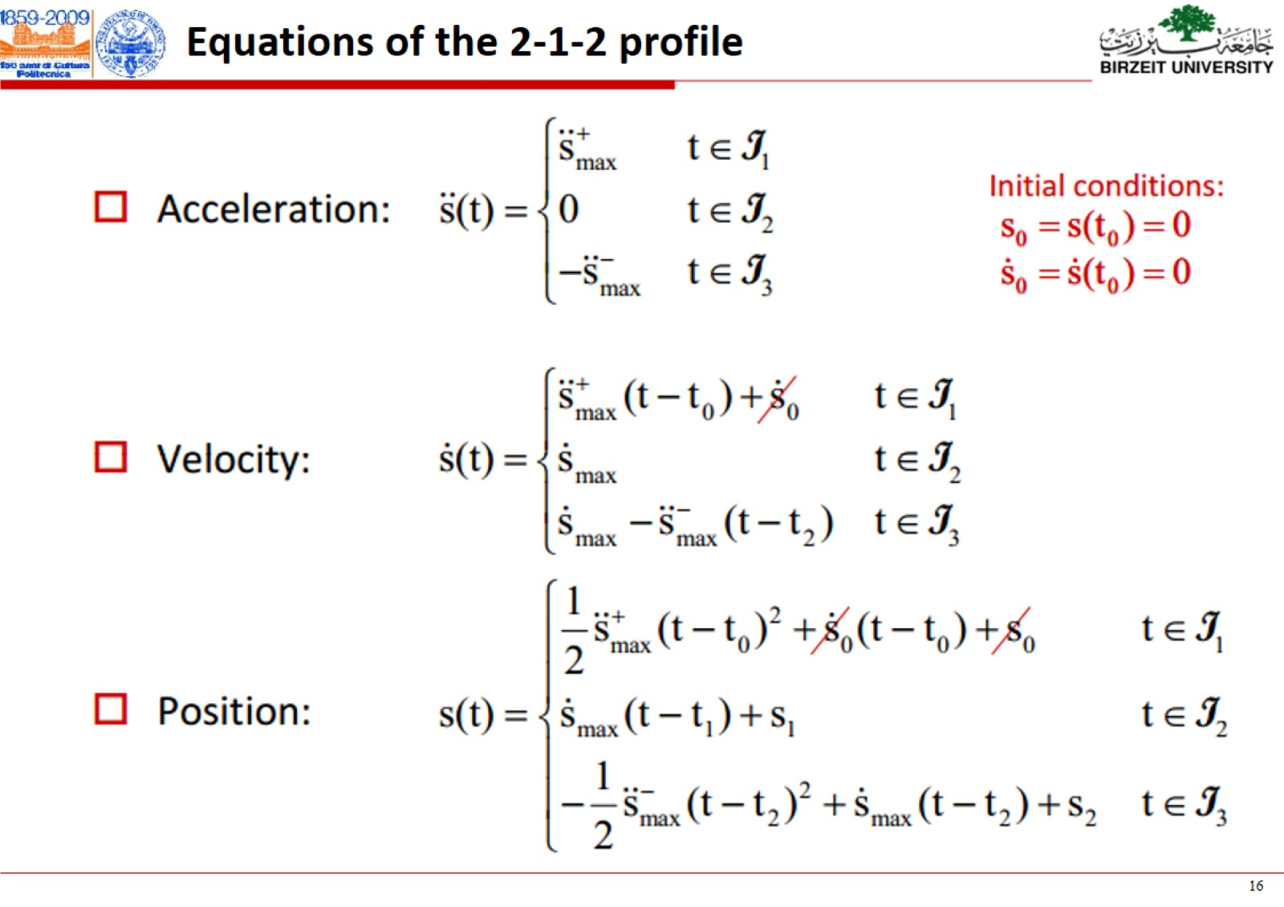

Slide 25
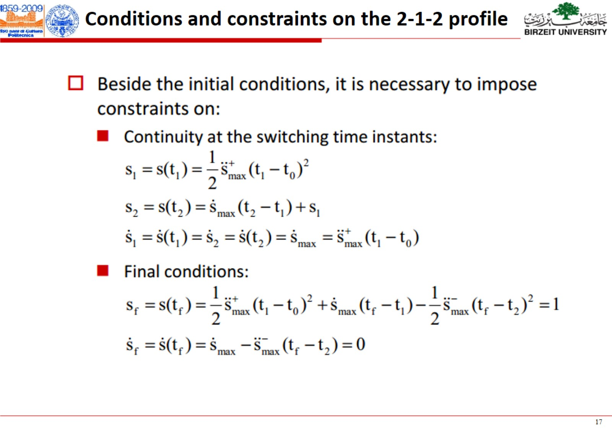

Slide 26
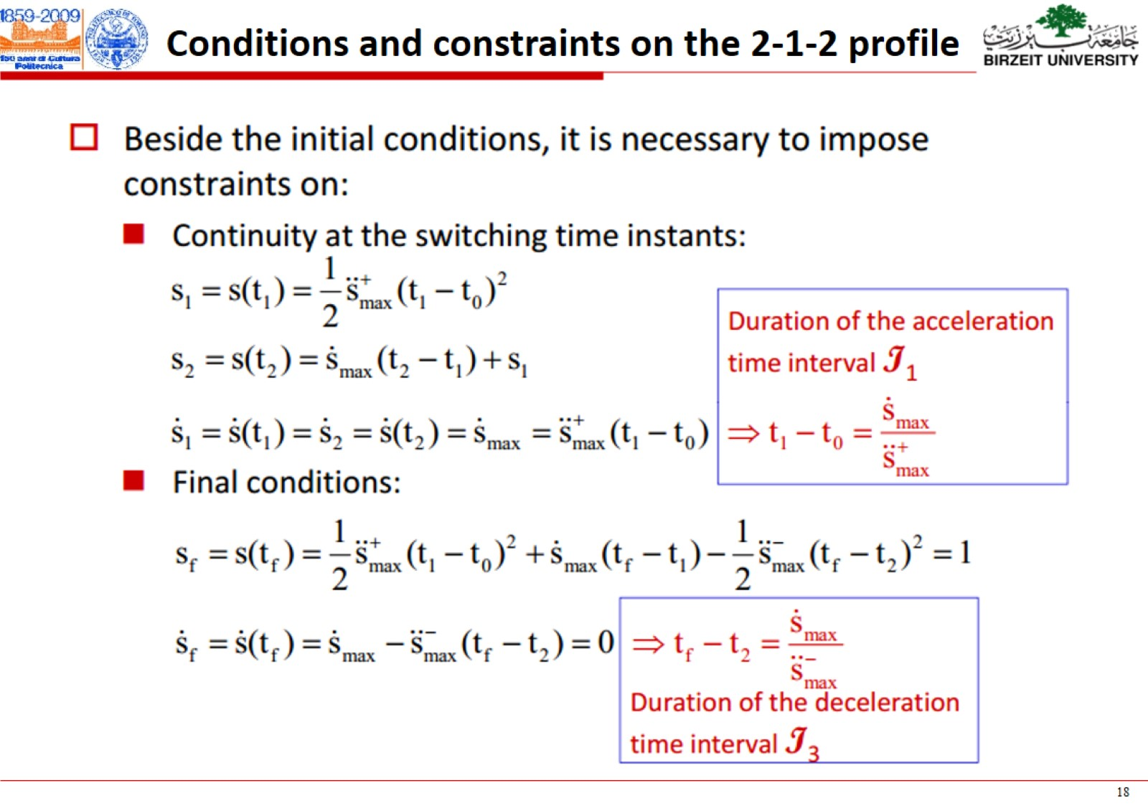

Slide 27
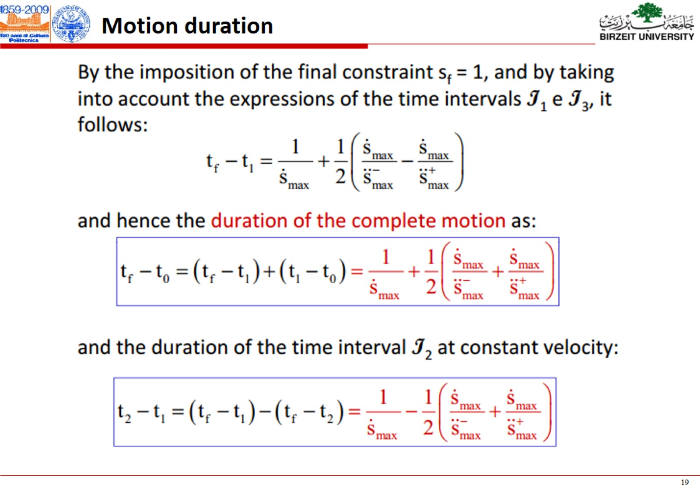

Slide 28
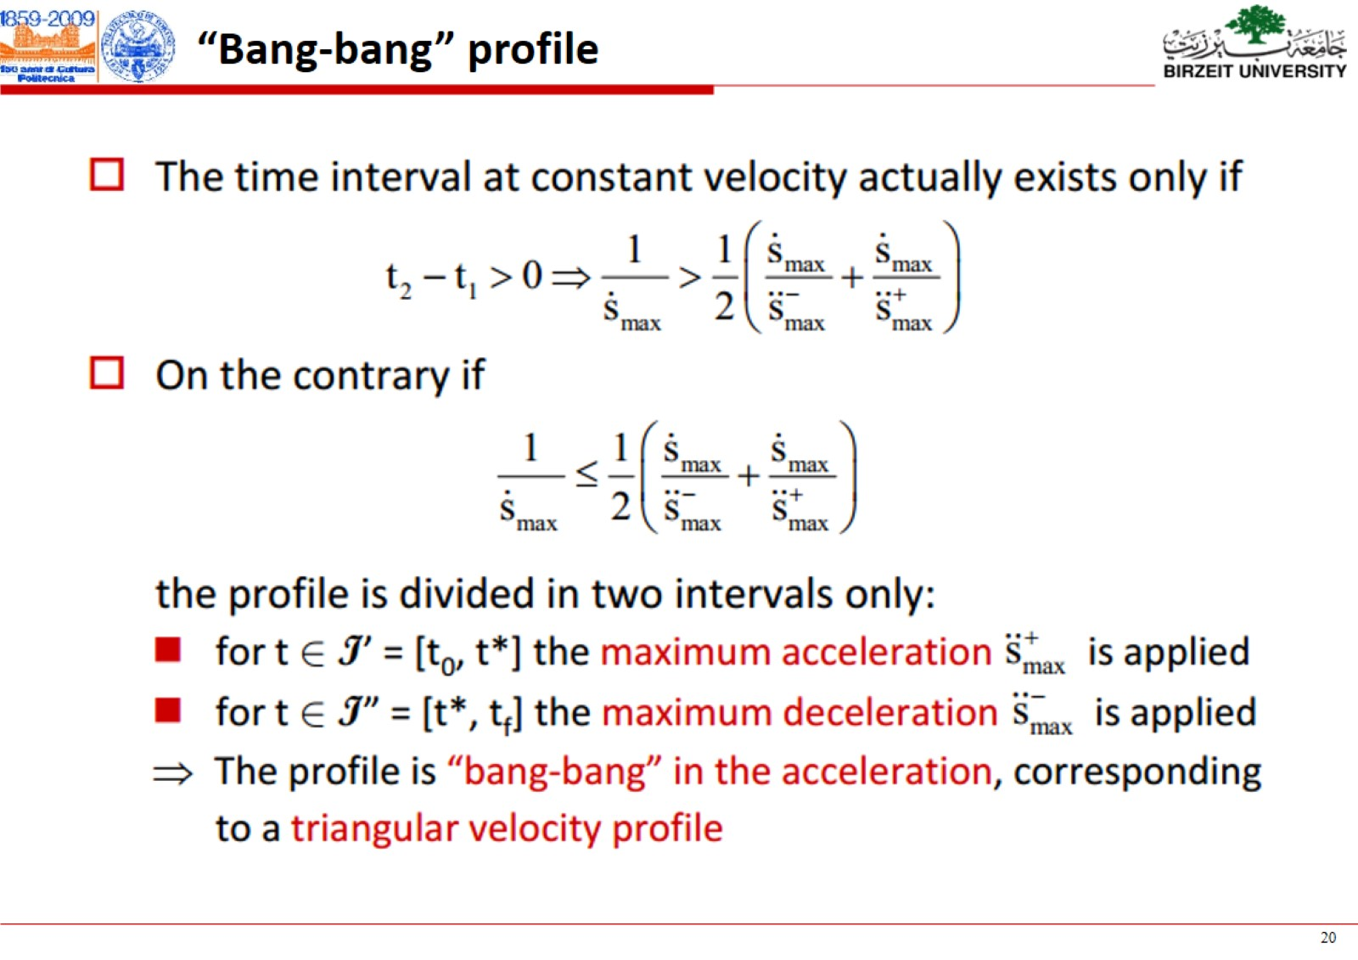

Slide 29
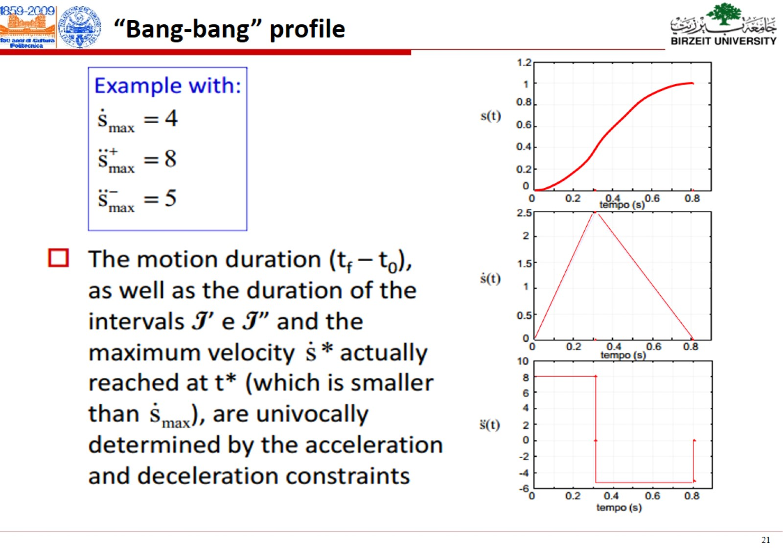

Slide 30
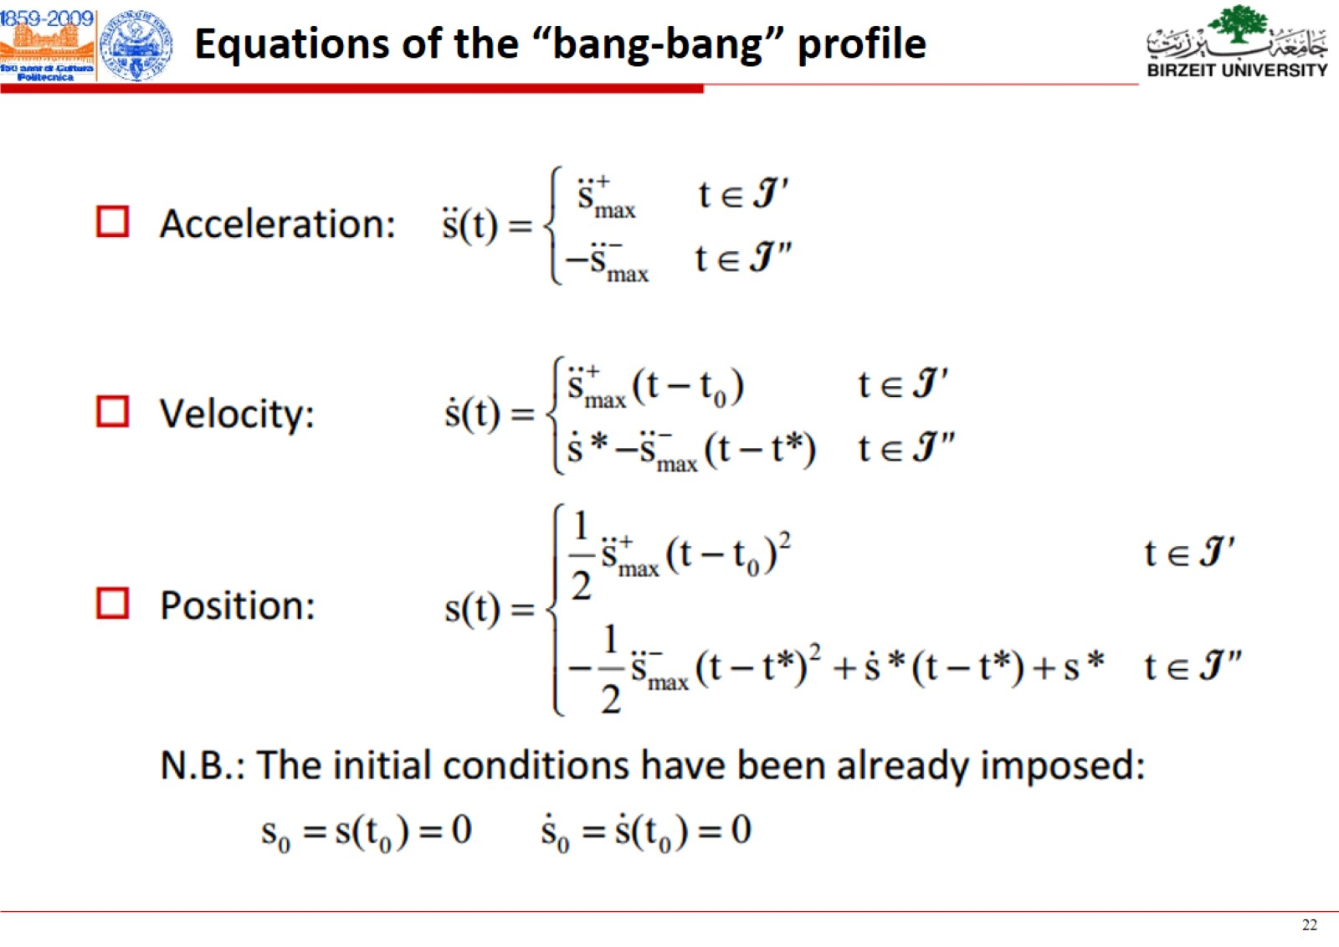

Slide 31
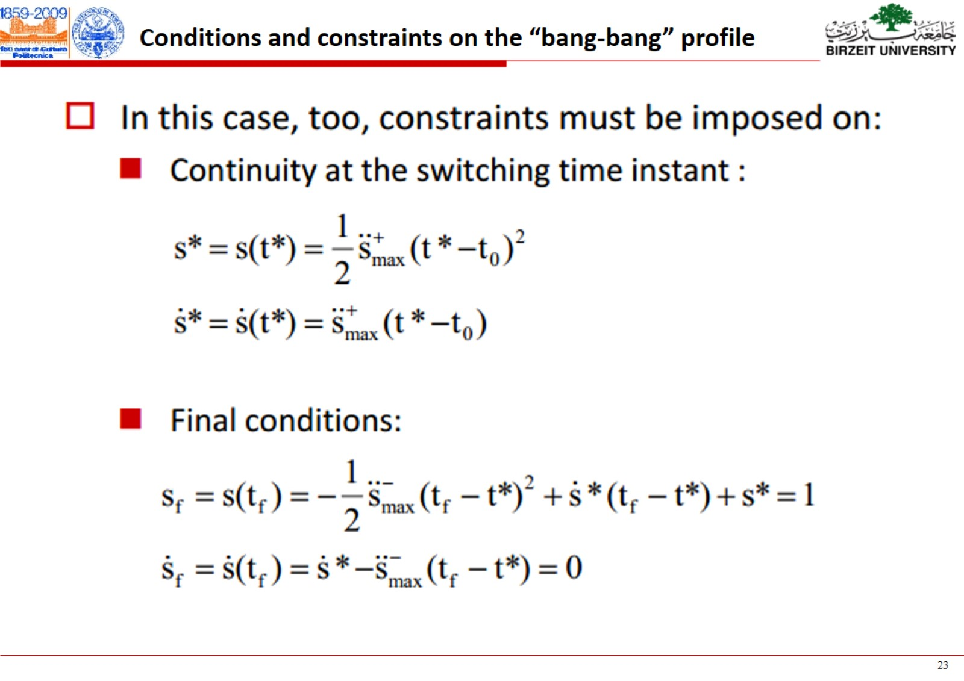

Slide 32
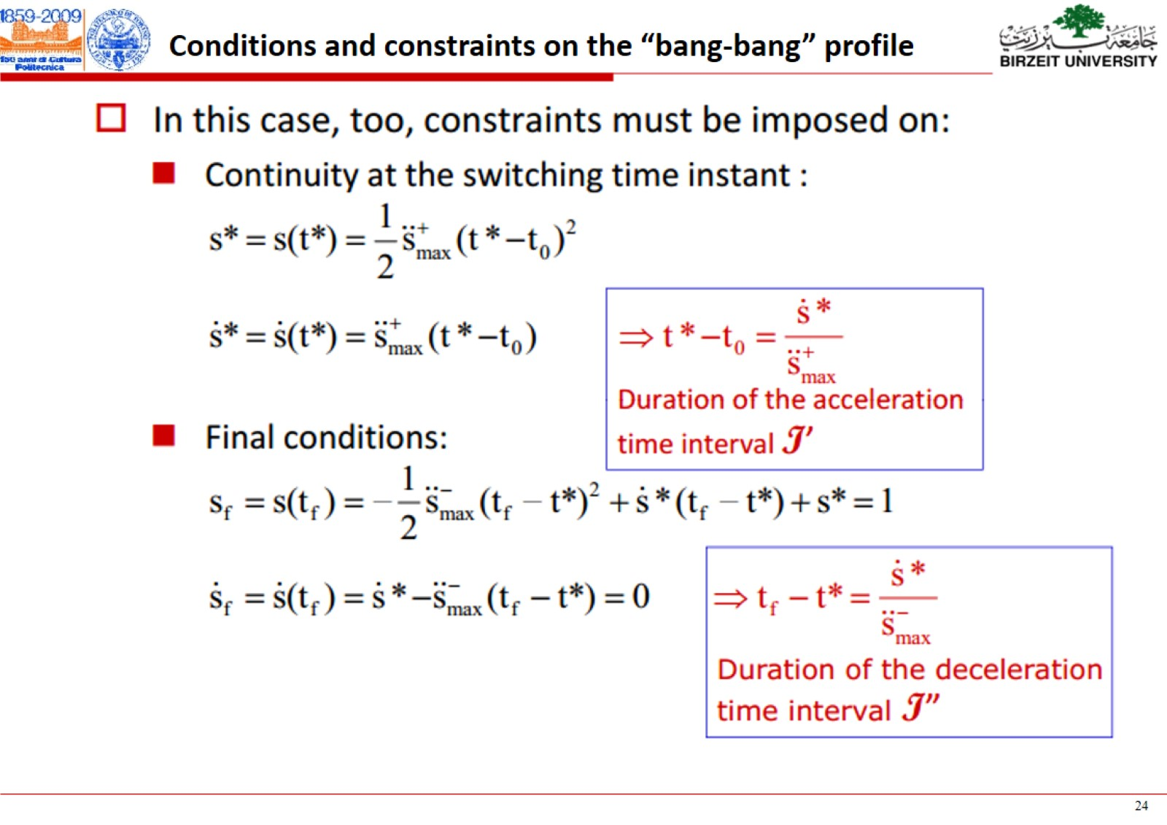

Slide 33
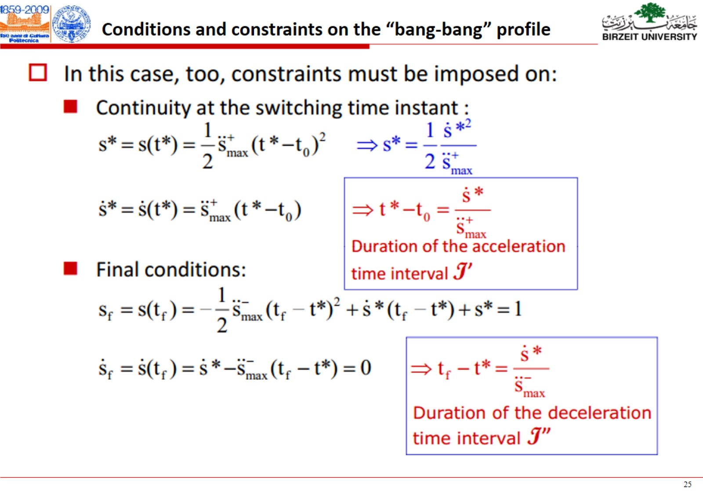

Slide 34
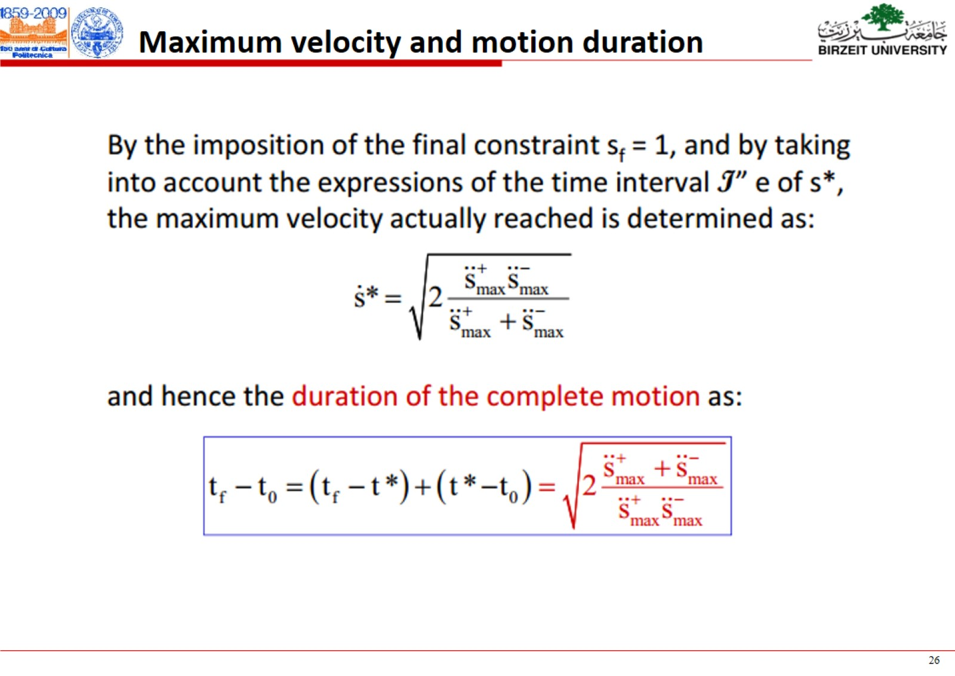

Slide 35
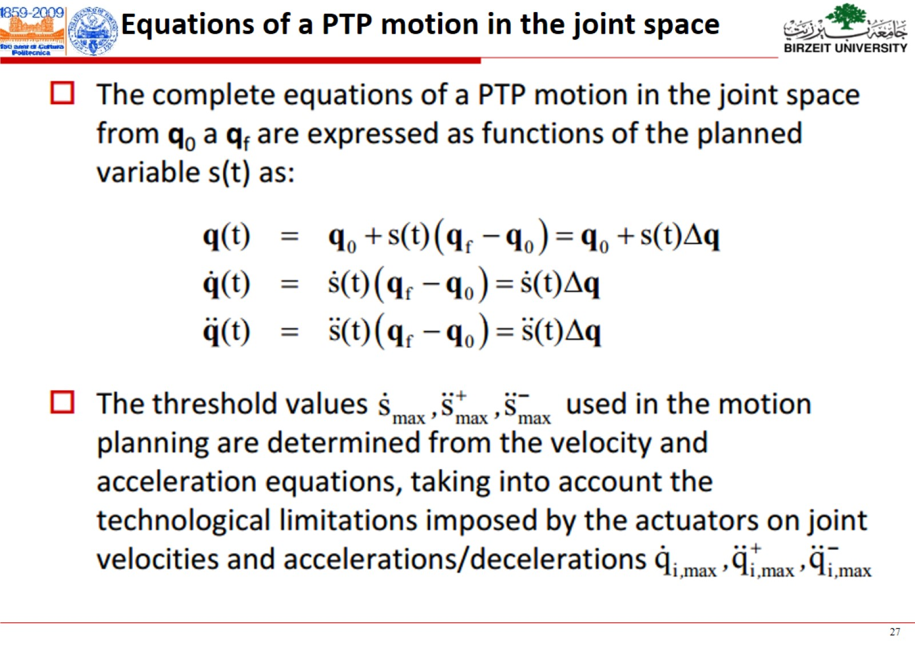

Slide 36
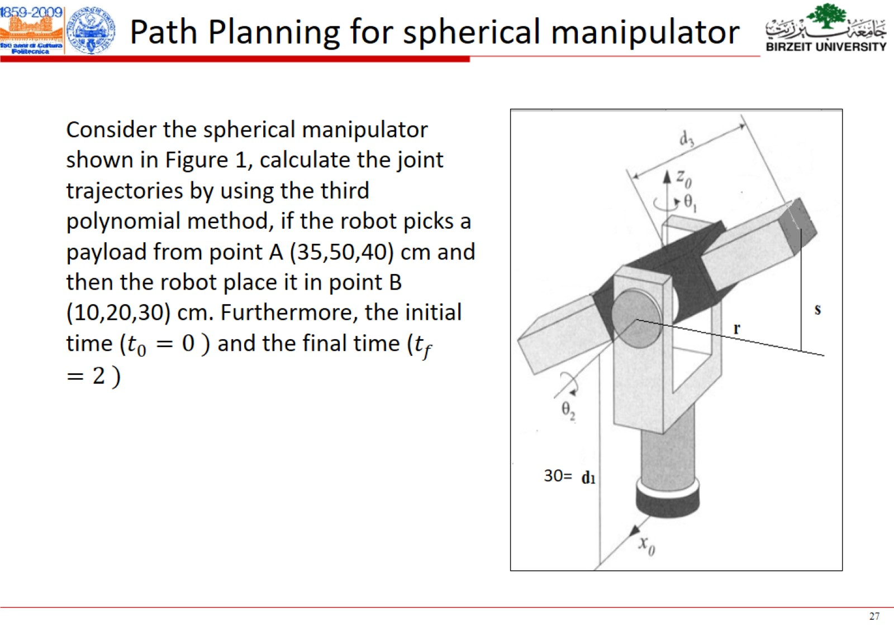

Slide 37
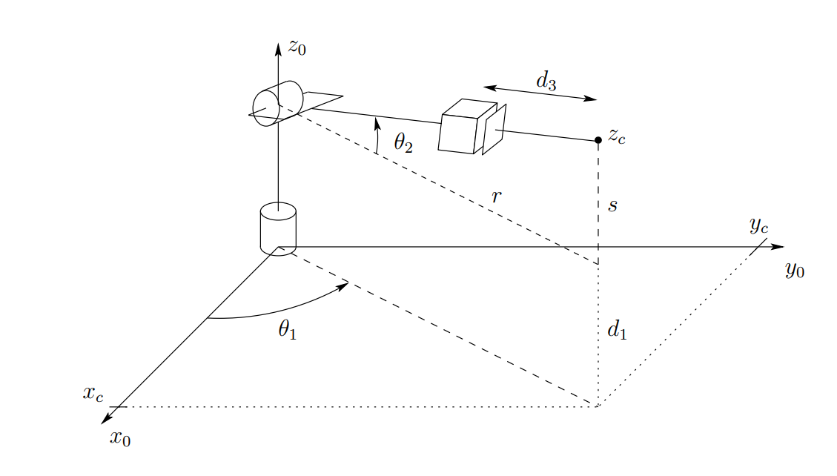

Slide 38
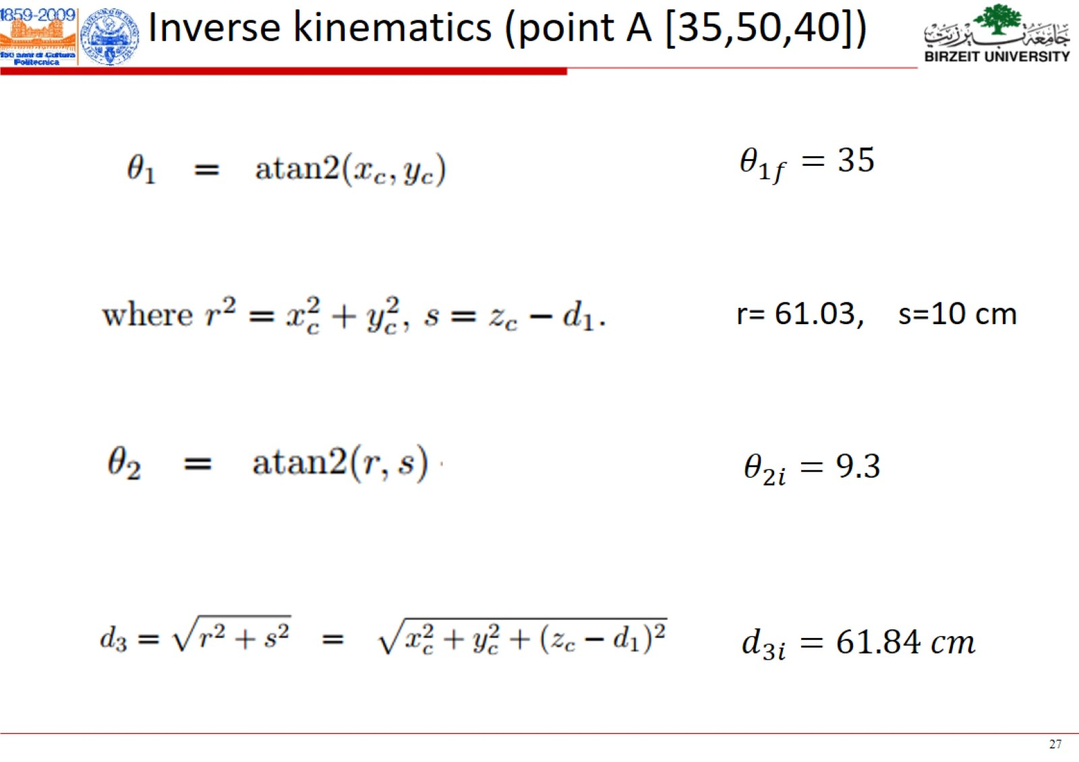

Slide 39
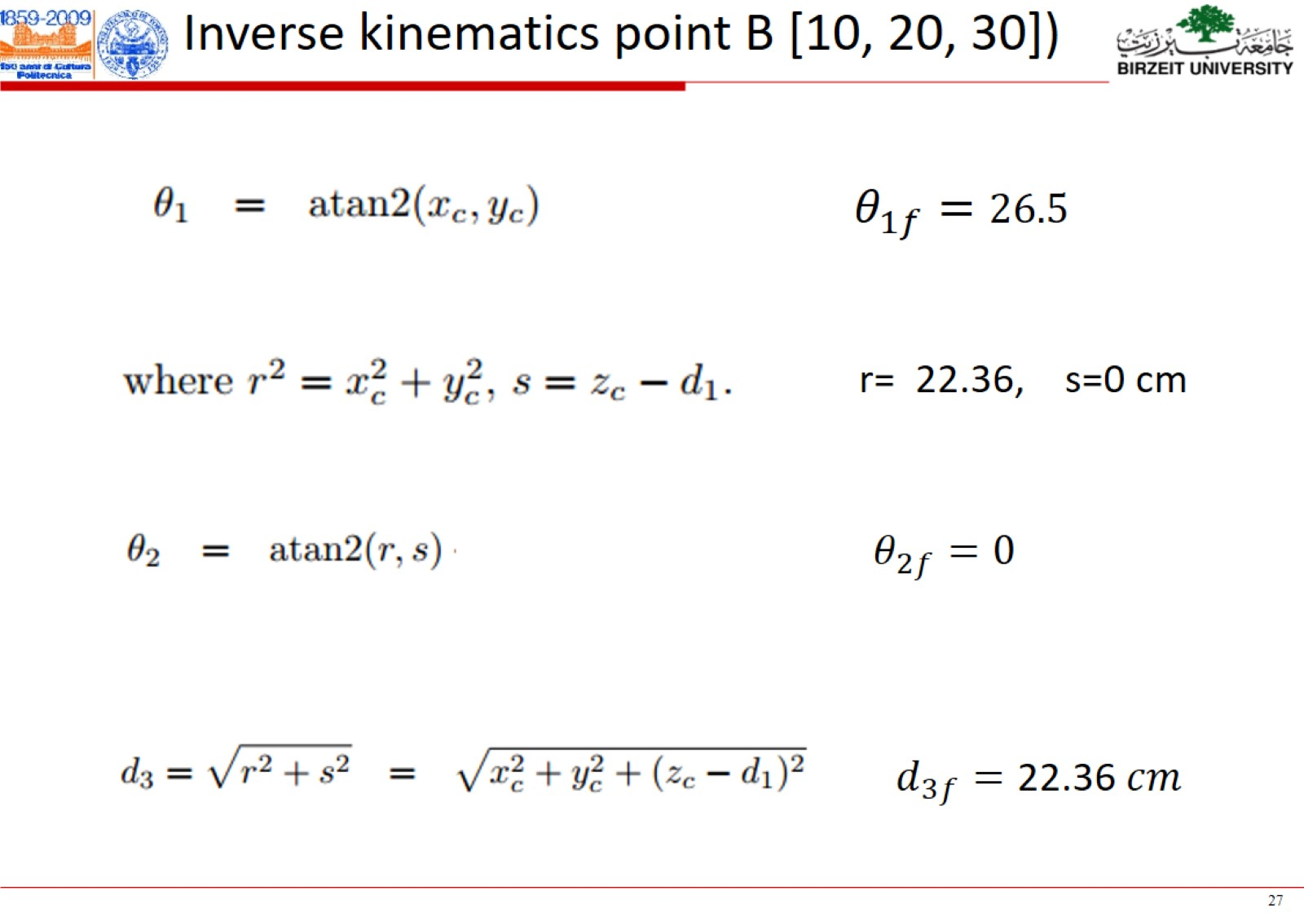

Slide 40
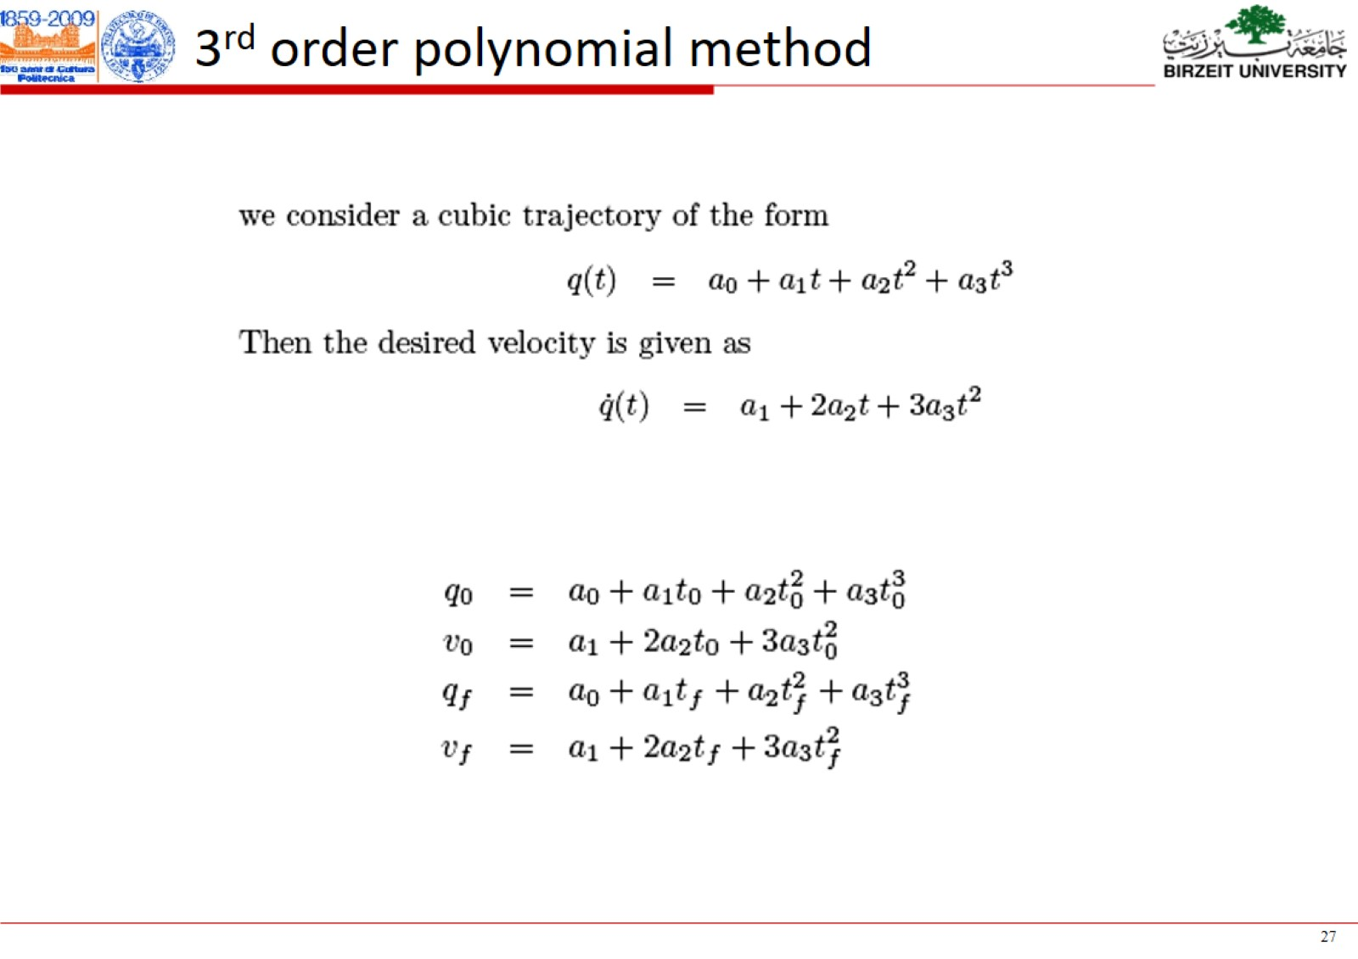

Slide 41
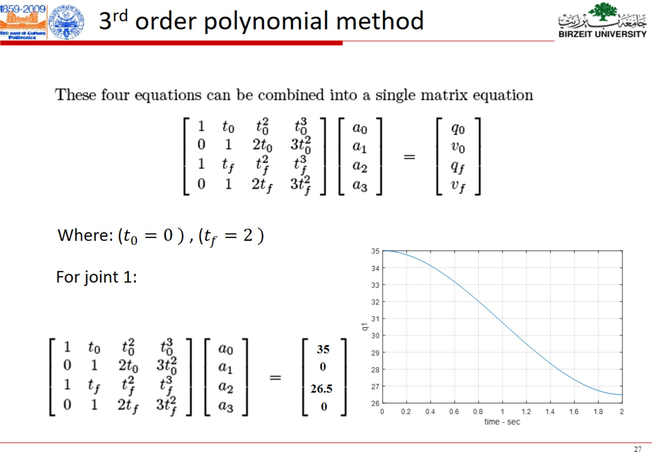

Slide 42
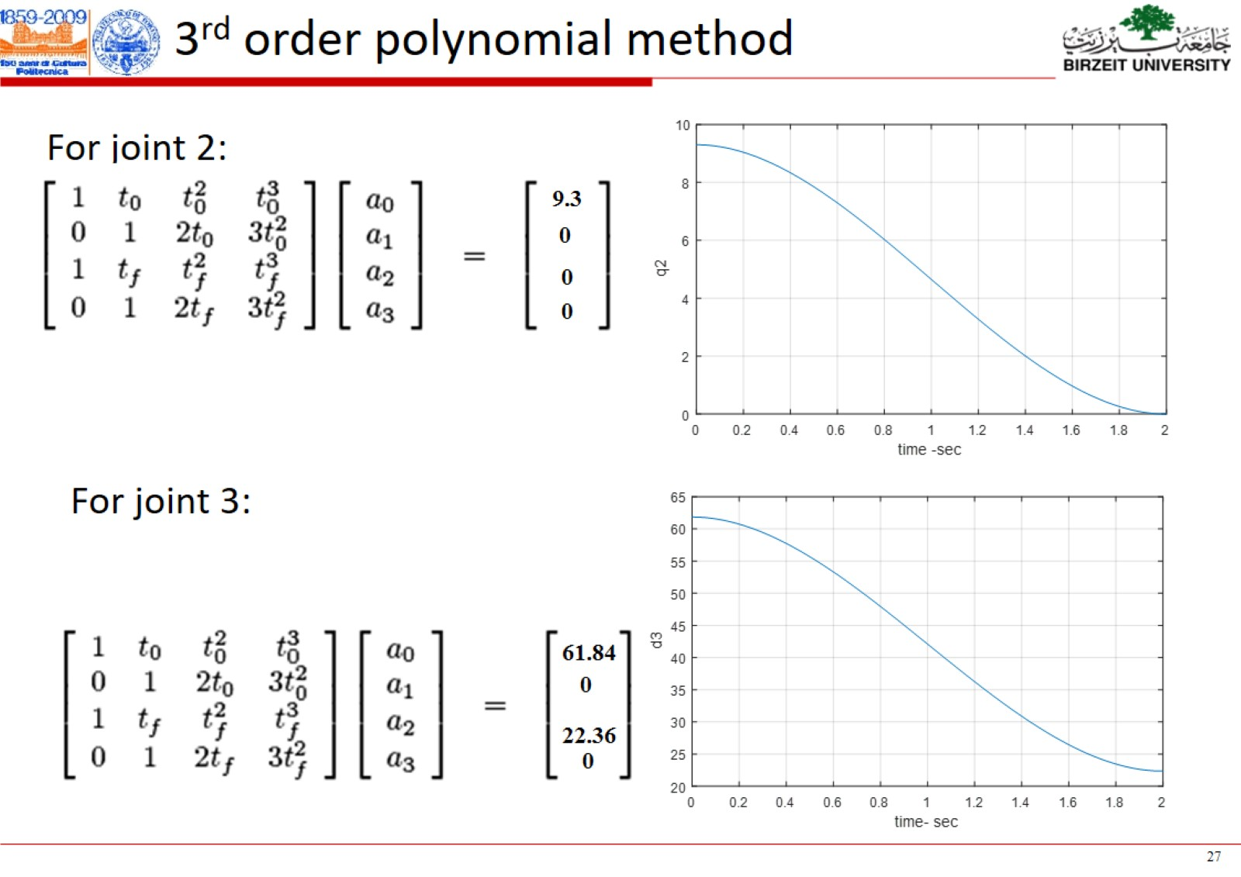

Slide 43
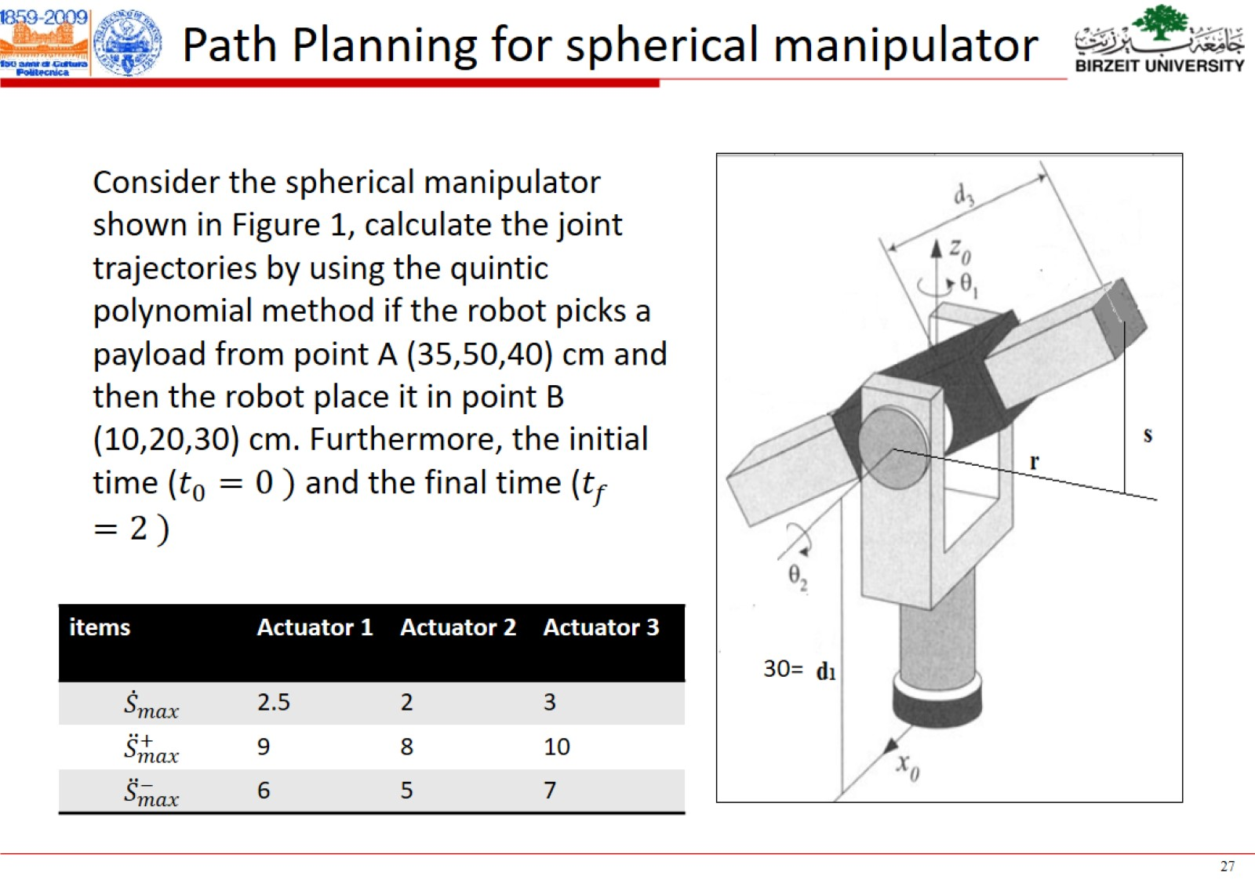

Slide 44
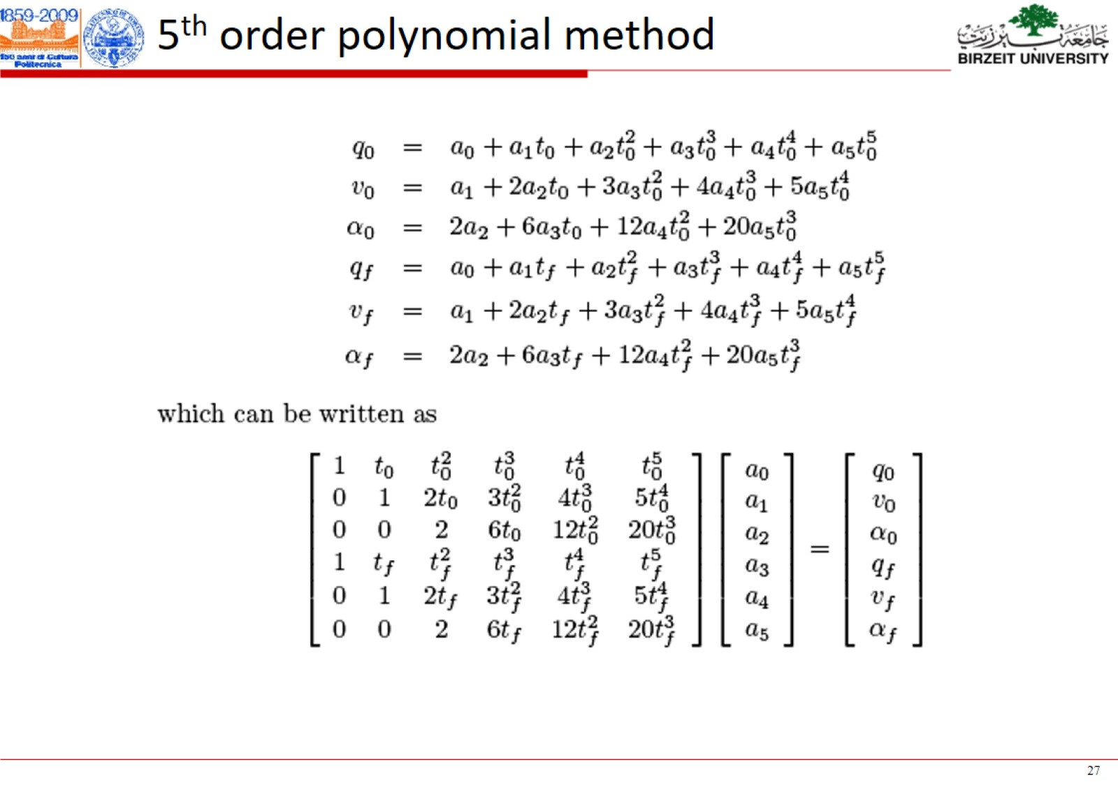

Slide 45
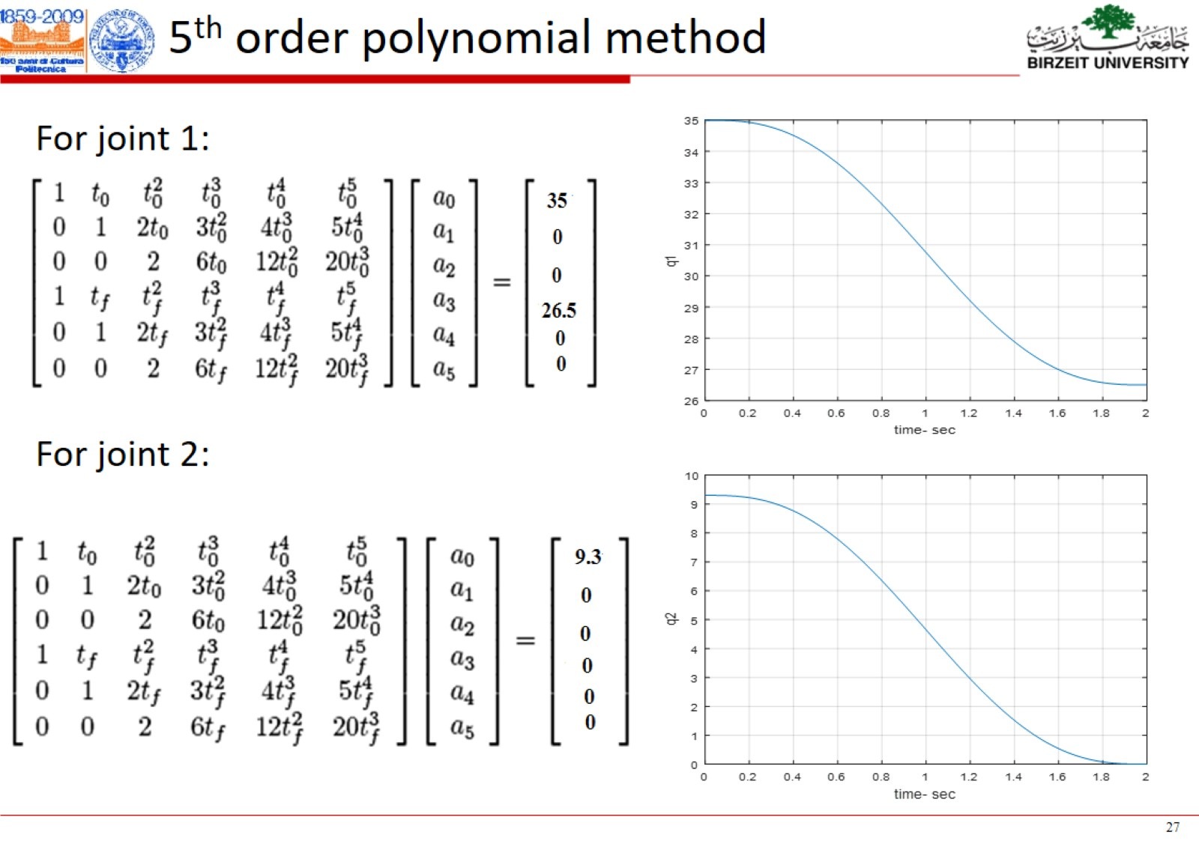

Slide 46
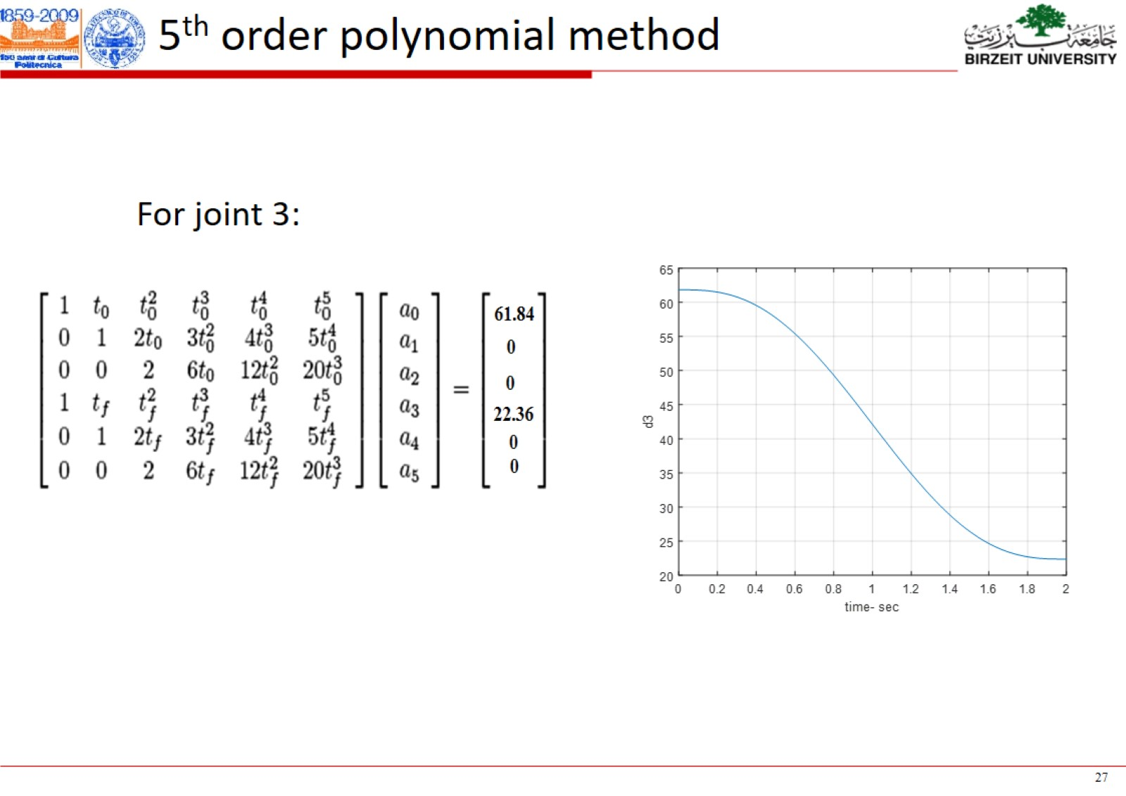

Slide 47
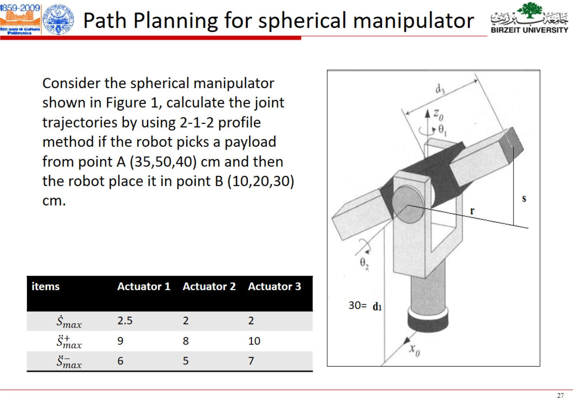

Slide 48
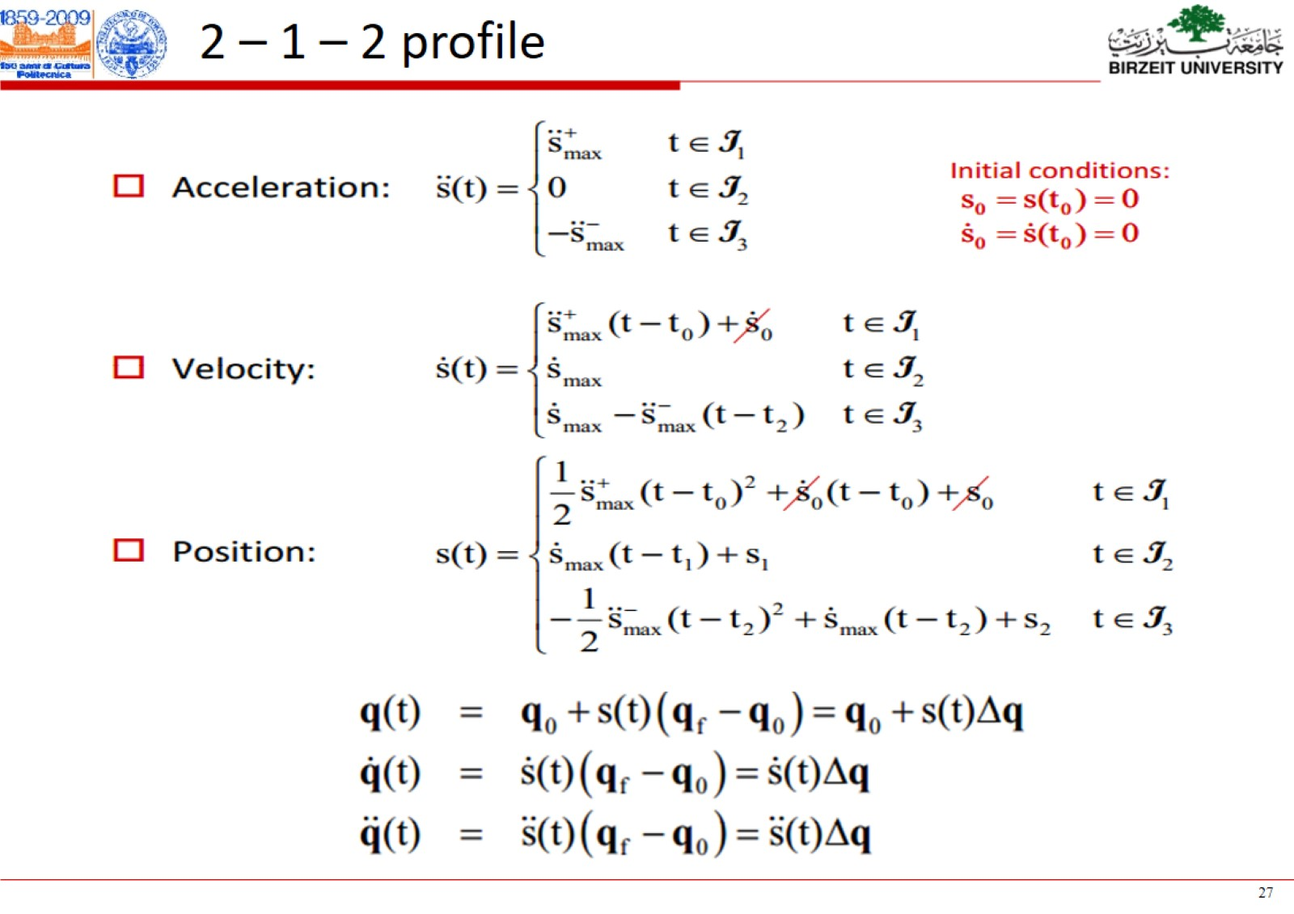

Slide 49
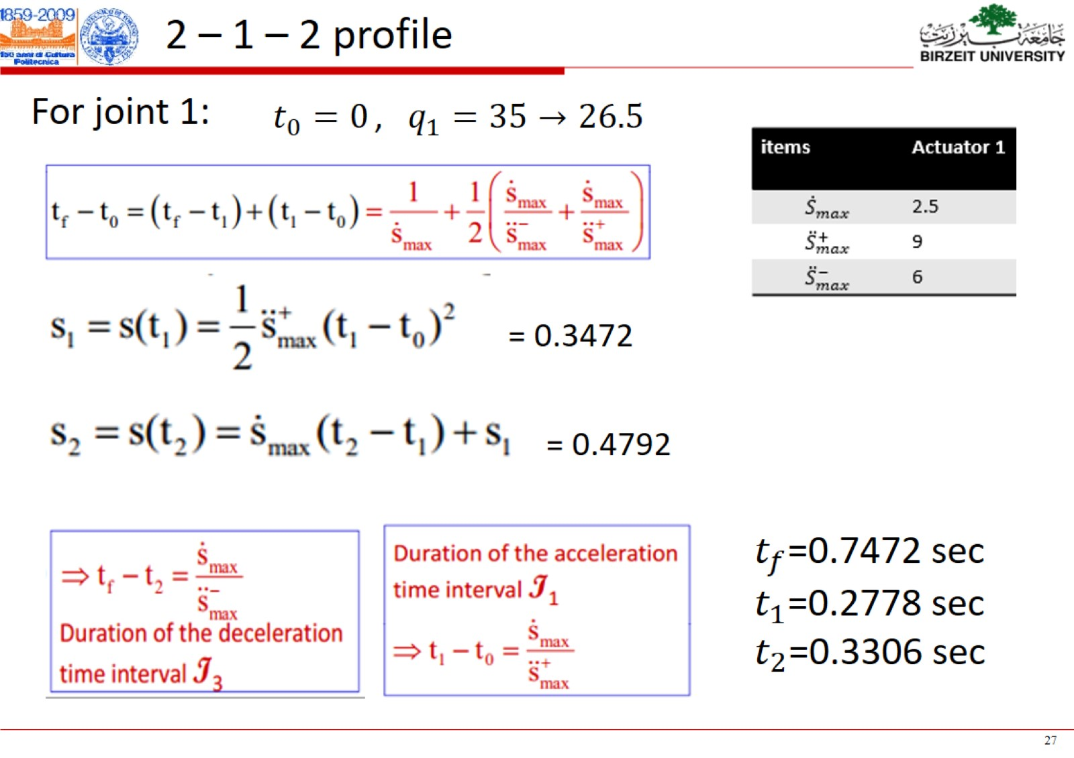

Slide 50
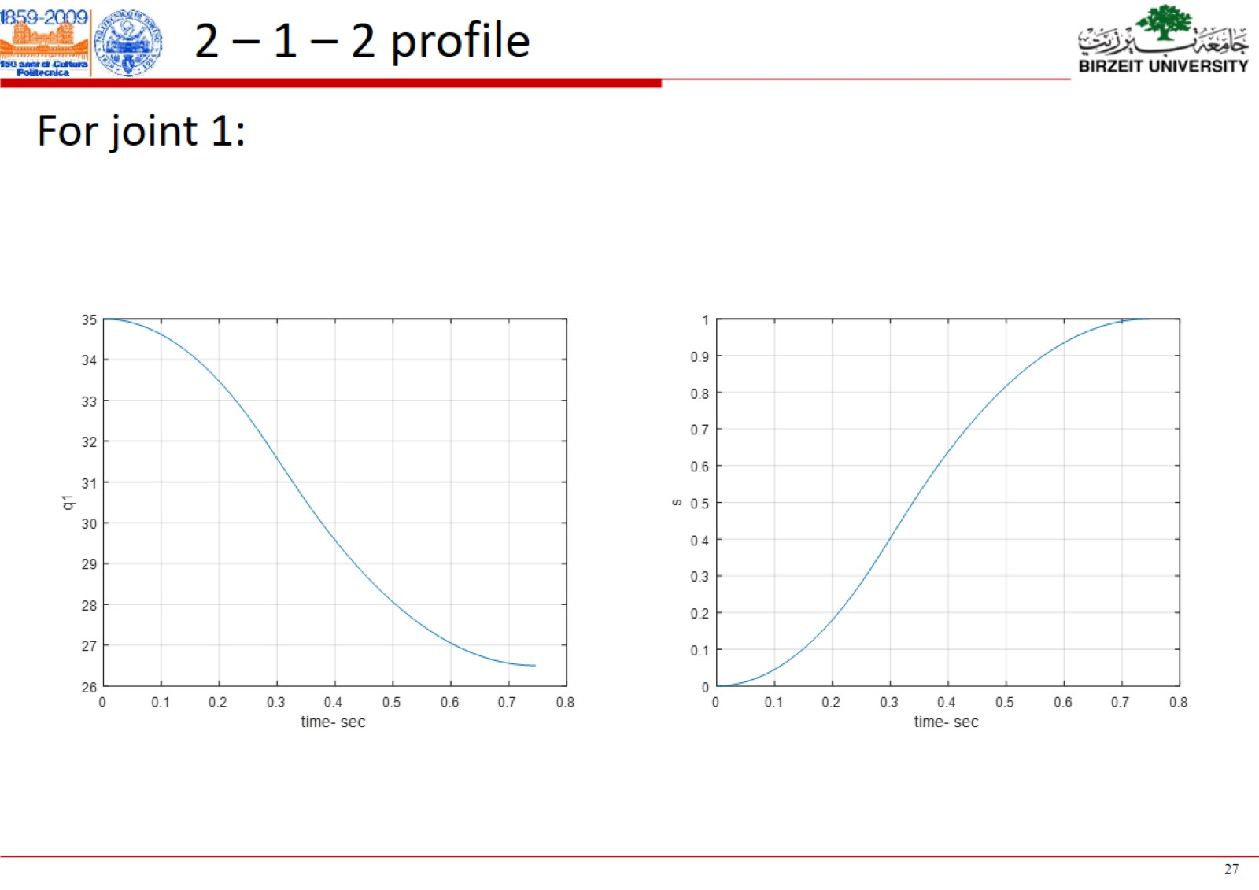

Slide 51
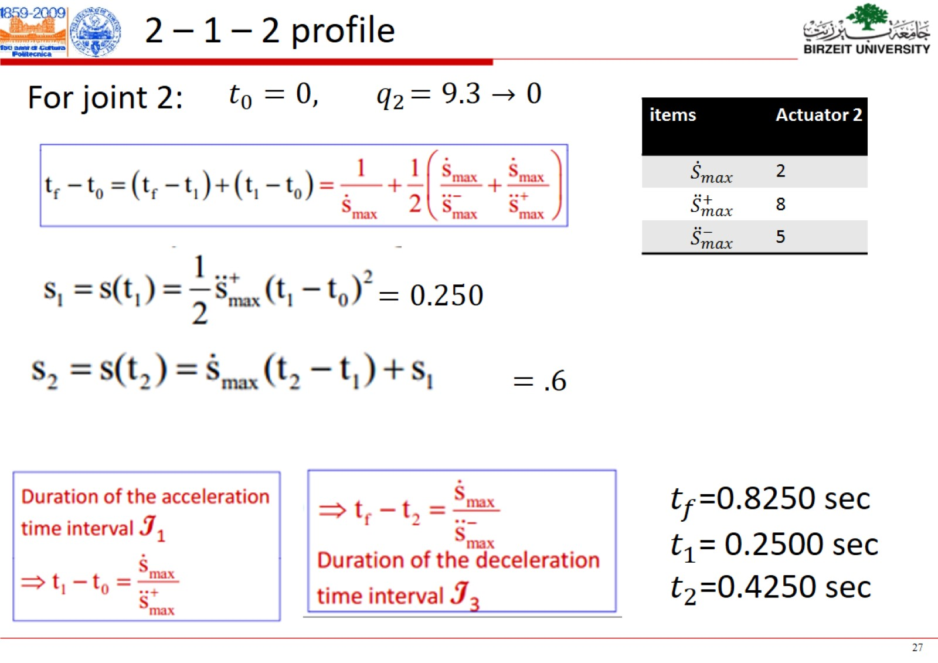

Slide 52


Slide 53


Slide 54


Slide 55


Slide 56


Slide 57


Slide 58


Slide 59


Slide 60


Slide 61


Slide 62


Slide 63


Calculate a quantic trajectory for this conveyor belt if d= 1 m and the radius of the pully r = 5cm and $t_{f}$= 2 seconds.
Note: $N_{o}(driven)=30$ , $N_{i}(driver)=10$

Slide 64



Slide 65



Quantic Profile on the Conveyor Belt Side

Slide 66




Quantic Profile on HSS
Note: $N_{o}(driven)=30$ , $N_{i}(driver)=10$
$$r_{g}=\frac{N_{o}}{N_{i}}=\frac{30}{10}=3$$
$$\frac{θ_{HSS}}{θ_{LSS}}=\frac{N_{o}}{N_{i}}=r_{g}$$
But there is another ratio (r) between the linear position for the conveyor belt $(q(t))$and the angular position of the LSS ( $θ_{LSS}$)
$$q(t)=r θ_{LSS}$$
$θ_{HSS}=r_{g}θ_{LSS}=\frac{r_{g} q(t)}{r}=$ $\frac{3 q(t)}{0.05}=60 q(t)$
$$θ_{HSS}=r_{g}∗q(t)=60∗\left( \right)$$

Slide 67
Quantic Profile on HSS
$$θ_{HSS}=r_{g}∗q(t)=60∗\left( \right)$$

Slide 68


Slide 69


Slide 70

Motion planning with a constant acceleration

