Slide 1
Policy Making

Slide 2
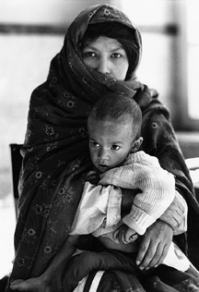
“Little Ones Doomed: Child Malnutrition a ‘Silent Emergency.’”
A newspaper article is an example of how an organization (UNICEF) used a particular strategy (a press release to the media) to help convince people that a serious problem (global childhood malnutrition) exists
Notes:
200 million children in developing countries under the age of 5 years are malnourished.

Slide 3
The Process of Policy Making
A Policy is a course of action chosen by public authorities to address a given problem
A Problem is a “substantial discrepancy between what is and what should be “
A gap between the current reality and the desired state

Slide 4
Policy
Policies are more like regulations and protocols that we collectively choose to live by. Policies can institute real and progressive change

Slide 5

Health-Related Policies
Examples
Policies prohibiting tobacco and alcohol use at the workplace
The Patient Protection and Affordable Care Act (ACA): This policy required people to have health insurance coverage, created more flexible options for health insurance, and removed preexisting conditions as a reason to be denied coverage.

Slide 6
Policy making
The process by which authorities decide which actions to take to address a problem or set of problems
1. Problem definition and agenda setting
The first step in the policy process is to convince other people that a public problem exists

Slide 7
Policy agenda
Once a problem is defined and gains attention, it is placed on the policy agenda
This agenda is not a written document or book but a set of controversial issues that exist within society. Agenda setting is a process in which people concerned about an issue work to bring the issue to the attention of the general public and policy makers
For example: an issue may be perceived as a problem only by a small group of people who lack the political power to get the issue on the agenda
On the other hand sometimes a major catastrophe, such as an earthquake, assassination, riot, or unusual human event, triggers a public outcry and pushes an issue onto the policy agenda

Slide 8

Television report “Hunger in America” in May 1968
The problem of malnutrition and the failure of major government feeding programs for families
Millions saw the televised images of starving and dying American children. The public reaction pushed the government to investigate hunger and malnutrition among America’s poor
One of the most effective ways to build public interest and support for an issue is to work through the media

Slide 9

How are issues placed on the policy agenda?
Build widespread public interest for the issue that deserves government attention
Media—radio, television, newspapers, and the Internet
1962 of Rachel Carson’s book Silent Spring
Launched the modern environmental movement.

Slide 10
We captured attention through media
Not enough to capture attention
Next step is winning support for the issue among “iron triangles”
Among government administrators, members of government and their staffs,, interest groups, professionals (e.g., dietitians, physicians, bankers, real estate agents), university faculty members, governors, and members of state and local governments, coalitions, and networks

Slide 11
2.Formulation of alternatives
Possible solutions to the problem are devised in this, the most creative phase of the policy-making process
Example:
Should families experiencing food insecurity be given greater access to food banks and food programs? Or should they receive job training to help them increase their income?
How can school food programs be improved to feed more children and teenagers?

Slide 12
2.Formulation of alternatives
Policy formulation
  Discussion of possible solutions to public problems
Interest groups, coalitions, and networks of experts and people interested in the issue craft a set of possible solutions and bring them forward to policy makers, who continue the discussion of solutions in legislative assemblies, government agencies, other institutions, congressional hearings, town hall meetings, and even focus groups

Slide 13
The tools or instruments for dealing with the problem are chosen
Examples : Regulations, cash grants, loans, tax breaks, certification, fines, price controls, quotas, public promotion, public investment, and government-sponsored programs
For example, ministry of health: Works to improve the level of health services provided by all levels of prevention, diagnosis and treatment at the Palestinian national level
Ministry of agriculture
Can be of interest to community nutritionist
Solve broad agricultural problems , ensure an adequate supply of food for all consumers;
Research and help government make better policies regarding agricultural policies and rural development
3. Policy adoption

Slide 14
Policy Implementation
The policy is modified to fit the needs, resources, and wants of the implementing agencies and the intended clientele
Putting a policy into action
Implementers : employees of governments, individuals who work with private organizations, interest groups, and other parties to carry out government policy.

Slide 15
5. Policy evaluation
The purpose of policy evaluation is to determine
If a program is achieving its stated goals
Reaching its intended audience
What the program is actually accomplishing, and who is benefiting from it
From almost the moment of their conception, public policies undergo both for- mal and informal evaluations by citizens, legislators, administrative agencies, the news media, academicians, research firms, auditors, and interest groups

Slide 16
Policy termination.
Can be terminated for example if
The public need was met
The nature of the problem changed
Government no longer had a mandate in the area
The policy lost political support
Private agencies relieved the need
Apolitical system or subgovernment ceased to function
The policy was too costly
Determining when a policy should be terminated is somewhat subjective- at what point do you decide that the public’s need has been met? What measures do you use to conclude that the problem was solved?

Slide 17
The People Who Make Policy
The people who make policy may be:
Executives
Administrator
Committees of the organization or company
Elected officials
Officers and employees of municipal,state,or federal agencies
Public health nutritionists and nurses
Public officers
School teachers
Judges and many other people working in government agencies

Slide 18
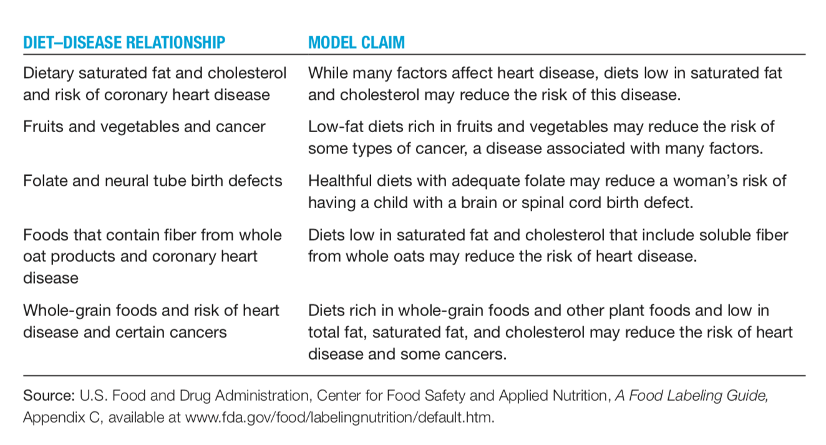
Example
the appearance of health claims on food labels indicates that consumers and food companies accept the FDA’s authority to allow this action.

Slide 19
Current Policy Issues
Policies are dynamic: in the food and nutrition arena, existing policies are constantly being challenged by market forces, scientific knowledge, and consumer practices and attitudes

Slide 20
The Academy of Nutrition and Dietetics is currently addressing seven public policy issues
Aging
Seek adequate funding for nutrition studies, programs, and services for older adults. Support efforts that allow food and nutrition practitioners to use their unique training and skills to help older adults remain independent longer and better manage their health.45

Slide 21
policy issues
Child Nutrition
Improve nutritional offerings to children. Expand local school well- ness policies and improve outcomes. Ensure the Dietary Guidelines are the foundation of federal food assistance and nutrition programs

Slide 22
policy issues
Food and Food Safety. Increase knowledge and encourage actions that overcome
  threats to the safety of the food supply. Improve consumer protections and information about food, food ingredients, and dietary supplements. Improve food and beverage nutrition labeling for health professionals and the public.
Health Literacy and Nutrition Advancement : increase awareness and access to healthy foods

Slide 23
policy issues
Medical Nutrition Therapy and Medicare/Medicaid
National Nutrition Monitoring and Research. Improve and expand nutrition research and related activities
Obesity. Put food and nutrition practitioners on the front lines in addressing over- weight and obesity in all populations.

Slide 24
Other Issues
Sustainable Food Systems and Public Health
The involvement of public health professionals in food and agricultural policy provides many opportunities for advancing the public’s health
public health professionals are advocating for food and agriculture policies that promote public health
societal costs of diet-related chronic diseases (the fact that the per calorie cost of fresh fruits and vegetables has become considerably higher than the per calorie cost of many highly processed foods)
Insufficient access and consumption of fruits and vegetables by consumers
Policies that help local producers
Require gardening and food preparation programs integrated into school curriculums
Protect urban agriculture
laws to encourage production of healthy foods

Slide 25
Other Issues/
Biotechnology
The science of using living things, and component of living things, to produce goods and services
It involves manipulating and modifying organisms, often at the molecular level, to create new and practical applications for agriculture, medicine and industry
Early applications of food biotechnology include the production of vinegar, alcoholic beverages, sourdough and cheese
Plant biotechnology- plants that are resistant to viruses, insects, fungi, and herbicides
Future biotechnology goals are to improve the nutritional quality of plants, increase harvest yield, and produce special oils, carbs, and proteins
Controversy/concern and policy issues: safety and environmental impact of genetically improved foods

Slide 26
Other Issues/ The Human Genome and Genetic Screening
Human Genome Project was an international effort to locate and identify the sequencing of all of the human genes- together known as the human genome
Genetic disorders can be passed on to family members who inherit a genetic variation or abnormality. When inherited, these variations can cause alterations in nutrient absorption, digestions, metabolism, and other individual differences
Advances are likely to alter disease management- possibility to complete a series of genetic tests to determine an individual’s susceptibility to certain diseases and receive counseling tailored to genetic characteristics

Slide 27
Policies in the food and nutrition arena will continue to evolve as our knowledge of foods and their relationship to health expands and the issues of public concern change

Slide 28
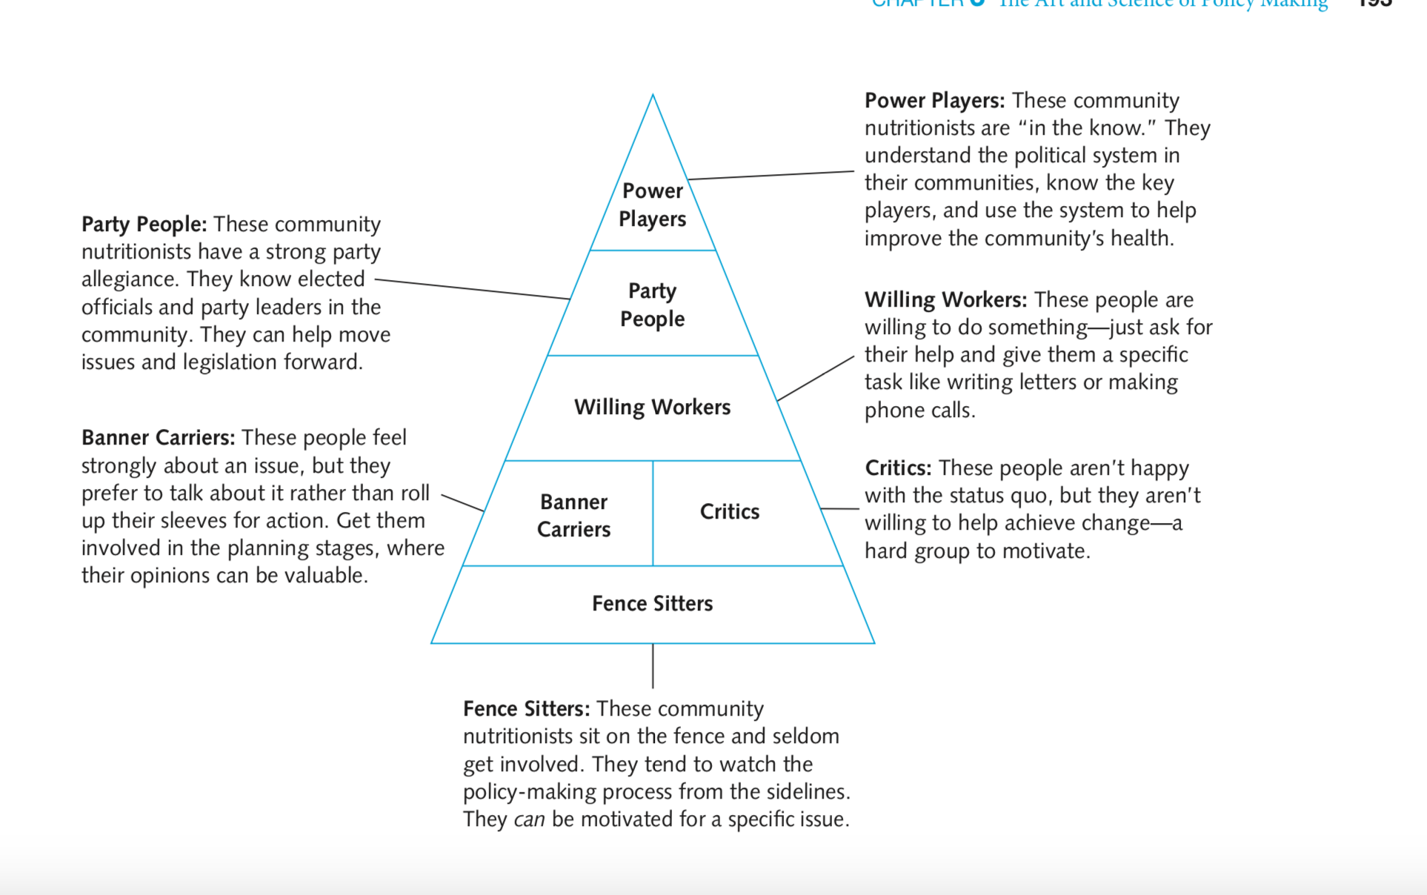
The Community Nutritionist in Action

Slide 29
Strategies for influencing and becoming involved in the political process
Your role as a community nutritionist

Slide 30
Your Role
Make your opinion known
Become Directly Involved
For example, initiate a campaign to bring an issue to the attention of the general public or policy makers, seek an elected position

Slide 31
Your Role
Join an Interest Group
Joining an interest group is another way of becoming involved in policy making. Interest groups are pressure groups that try to influence public policy in ways that are favorable to their members.
For example : Business by lobbyists from food companies, such as Kellogg, Procter & Gamble, and the Coca-Cola Company,
Trade associations, such as the American Meat Institute, the Sugar Association, and the American Beverage Association
Professional groups such as the Academy of Nutrition and Dietetics and the American Medical Association
PALESTINIAN FOOD AND NUTRITION ASSOCIATION (PFNA)
Public interest groups: work to achieve goals that do not directly benefit their membership but serve to inform, educate, and influence the legislative process. (Example: Bread for the World)
Other interest groups may represent particular segments of the population For example, Women organizations

Slide 32
Your Role
Take political actions
Usually, an interest group will have a Political Action Committees (PACs)
  The political arm of an interest group. It has the legal authority to raise funds from its members or employees to support candidates or political parties. The purpose of a PAC is to help elect candidates whose views are favorably aligned with the group’s mis- sion or goals

Slide 33
lobbying means talking to public officials and legislators to persuade them to consider the information you provide on an issue you believe is important.
“The U.S. Department of Agriculture's 1991 withdrawal of its Eating Right Pyramid food guide in response to pressure from meat and dairy producers”
Nestle M. Food lobbies, the food pyramid, and U.S. nutrition policy. Int J Health Serv. 1993;23(3):483-96. doi: 10.2190/32F2-2PFB-MEG7-8HPU. PMID: 8375951.

Slide 34
Take Political Action
Write Effective Letters
Make Effective Telephone Calls
Use E-mail Effectively
Work with the Media

Slide 35
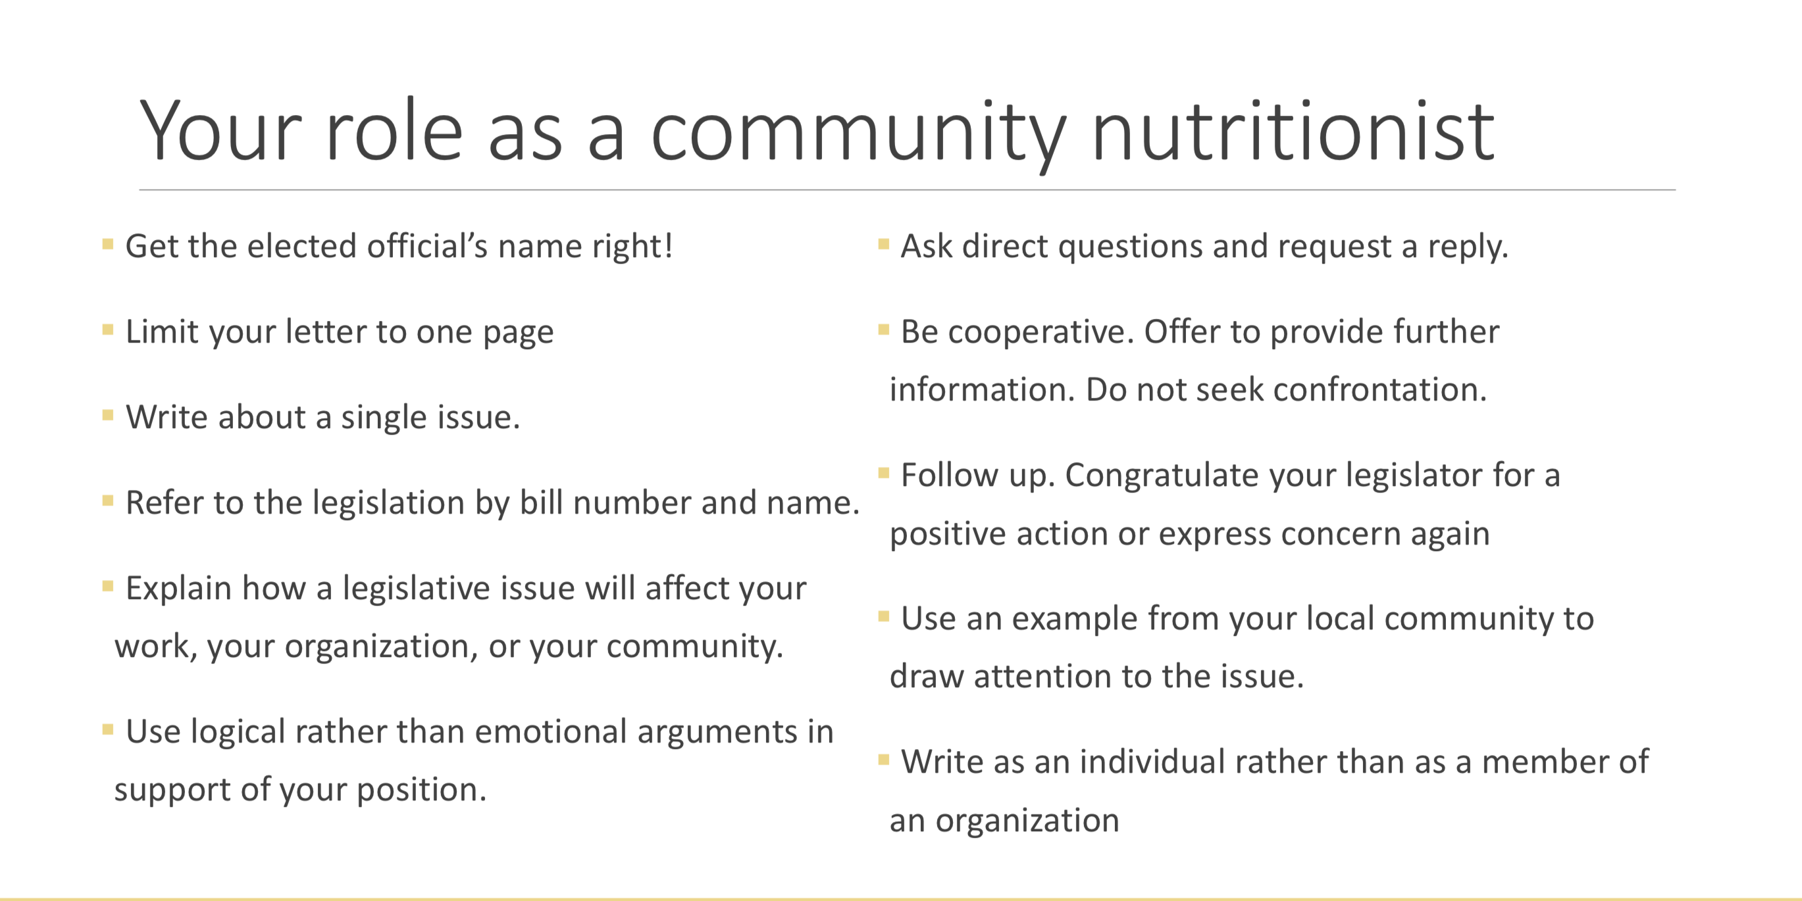

Slide 36
Policies in Palestine ?

Slide 37
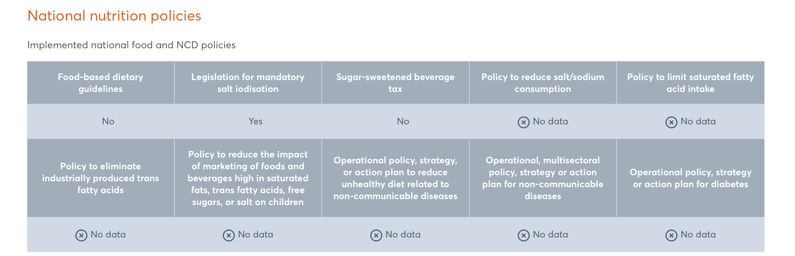
https://globalnutritionreport.org/resources/nutrition-profiles/asia/western-asia/state-palestine/#interventions-and-financing

Slide 38
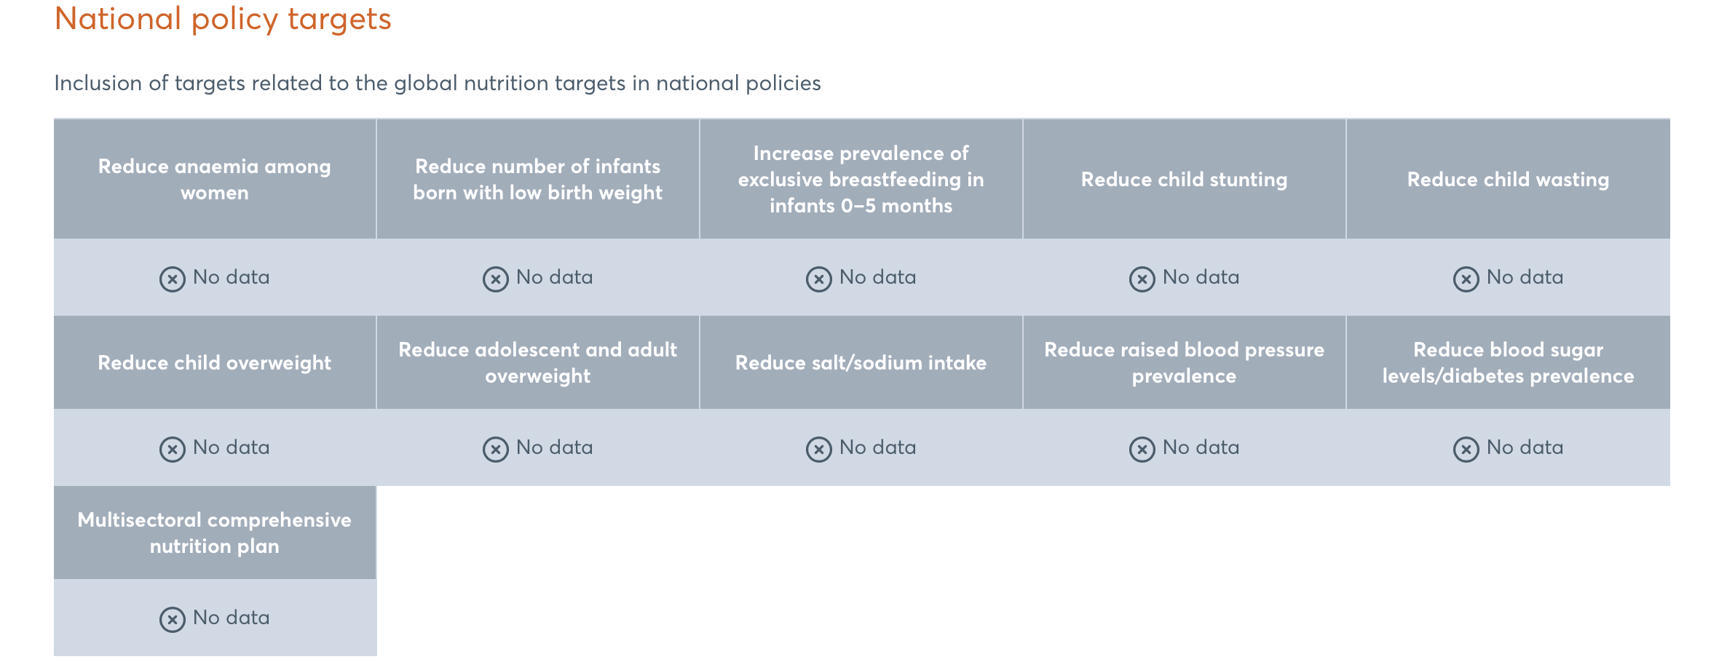
https://globalnutritionreport.org/resources/nutrition-profiles/asia/western-asia/state-palestine/#interventions-and-financing

Slide 39
