Slide 1
ENCS 3310
Advanced Digital Design
Testing Digital Circuits

Slide 2
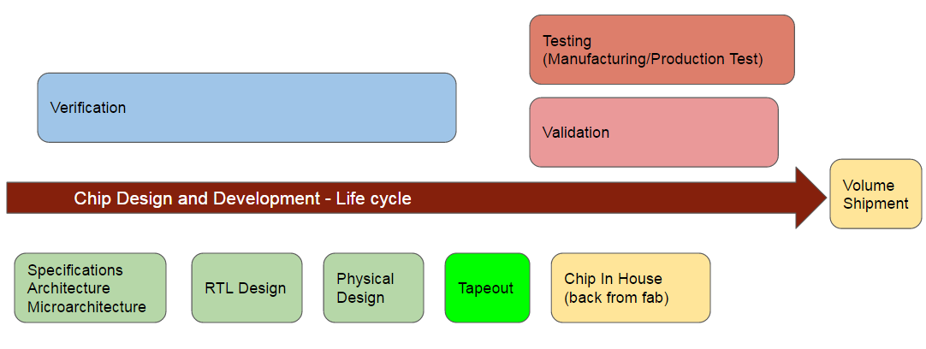
Chip Design and Development Life Cycle

Slide 3
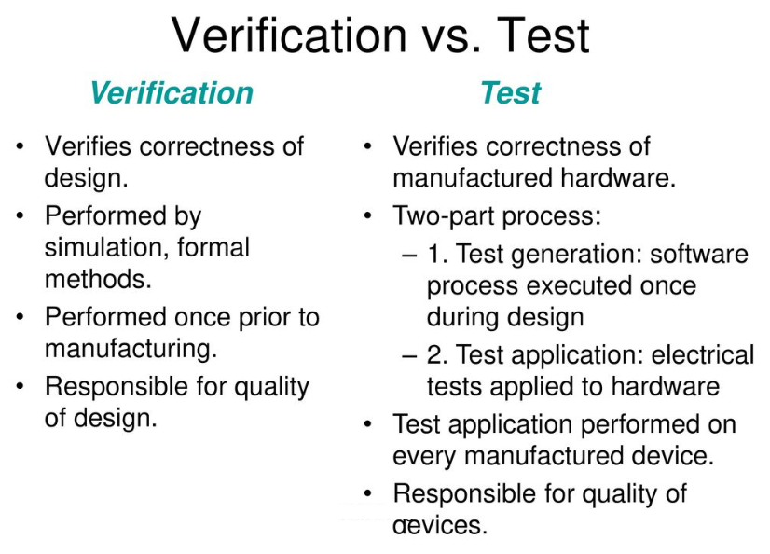

Slide 4
Why is Design For Testability Important ?
Easier to identify the structural defects in the chip and fix design errors before the product is shipped to customers.
Make the testing process more efficient, reducing the cost and time required for testing.
This can lead to significant cost savings during the manufacturing process.
Identify any defects early in the process, allowing for faster repairs and improvements in production yield.
Accelerate the development cycle by reducing the time and effort required for testing and debugging.
Easier to diagnose and fix problems in the chip design, reducing the effort required for maintenance and updates.

Slide 5
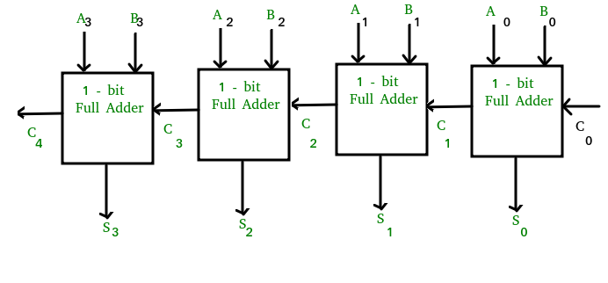
Testing Methods
Functional testing (Exhaustive testing)
4 bits Adder has 8 inputs
Possible combinations for input = 256 input
Test all combinations

Slide 6
Basic testing procedure
Initialise the circuit into a known state
Apply the test inputs
Compare outputs with expectation

Slide 7
Example
Simple example circuit
a | b | c | z
0 | 0 | 0 | 0
0 | 0 | 1 | 0
0 | 1 | 0 | 0
0 | 1 | 1 | 0
1 | 0 | 0 | 0
1 | 0 | 1 | 0
1 | 1 | 0 | 0
1 | 1 | 1 | 1
a
AND1
b
y
AND1
z
c

Slide 8
Example
One of the units has a fault
Node y has been short-circuited to a voltage supply rail
This node’s value is stuck at logic 0
a | b | c | z
0 | 0 | 0 | 0
0 | 0 | 1 | 0
0 | 1 | 0 | 0
0 | 1 | 1 | 0
1 | 0 | 0 | 0
1 | 0 | 1 | 0
1 | 1 | 0 | 0
1 | 1 | 1 | 1
0
a
AND1
b
y
AND1
z
c
1

Slide 9
Example
We cannot directly probe the node (it is inside the chip)
How do we detect this?
One of the units has a fault
Node y has been short-circuited to a voltage supply rail
This node’s value is stuck at logic 0
a | b | c | z | Faulty z
0 | 0 | 0 | 0 | 0
0 | 0 | 1 | 0 | 0
0 | 1 | 0 | 0 | 0
0 | 1 | 1 | 0 | 0
1 | 0 | 0 | 0 | 0
1 | 0 | 1 | 0 | 0
1 | 1 | 0 | 0 | 0
1 | 1 | 1 | 1 | 0
0
a
AND1
b
y
AND1
z
c
1

Slide 10
Exhaustive Testing
Apply all possible combinations of a, b, c
These inputs are called test vectors
Compare output of unit-under-test with expectation
If we find a difference, then the unit is faulty
This circuit requires 8 test vectors
(Truth table has 2³=8 rows)
a | b | c | e | Faulty z
0 | 0 | 0 | 0 | 0
0 | 0 | 1 | 0 | 0
0 | 1 | 0 | 0 | 0
0 | 1 | 1 | 0 | 0
1 | 0 | 0 | 0 | 0
1 | 0 | 1 | 0 | 0
1 | 1 | 0 | 0 | 0
1 | 1 | 1 | 1 | 0
0
a
AND1
b
y
AND1
z
c
1

Slide 11
Exhaustive test of combinational logic
Generalisation:
n-input combinational system requires 2^{n} test vectors
Example: system with 32 inputs.
  Needs 2³² = 4 × 10⁹ test inputs.
  Using a standard 100 MHz tester would take almost a minute for just one unit
  May not be acceptable if we have a high throughput manufacturing line
n

Slide 12
Exhaustive test of sequential logic
If system contains state memory, things get much worse.
The sequence in which we apply the inputs becomes significant.
System with n inputs and m state flip flops
2^{n} distinct inputs
2^{m} distinct sequences that we can apply these inputs in
Needs 2^{n+m} test vectors for exhaustive test.
n

Slide 13
Exhaustive test of sequential logic
Example: system with 32 inputs, containing 32 state bits
Need 2³²⁺³² = 2⁶⁴ = 2x10¹⁹ test vectors
100 MHz tester requires 6,000 years for one unit

Slide 14
Non-Exhaustive Testing (Structural )
We cannot afford to apply every possible test input
Instead we must select a few
Suppose we can use only two test inputs
Will we detect the fault?
a | b | c | z | Faulty z
0 | 0 | 0 | 0 | 0
0 | 0 | 1 | 0 | 0
0 | 1 | 0 | 0 | 0
0 | 1 | 1 | 0 | 0
1 | 0 | 0 | 0 | 0
1 | 0 | 1 | 0 | 0
1 | 1 | 0 | 0 | 0
1 | 1 | 1 | 1 | 0
0
a
AND1
b
y
AND1
z
c
1

Slide 15
Non-Exhaustive Testing (Structural )
We cannot afford to apply every possible test input
Instead we must select a few
Suppose we can use only two test inputs.
Will we detect the fault?
a | b | c | z | Faulty z
0 | 0 | 0 | 0 | 0
0 | 0 | 1 | 0 | 0
0 | 1 | 0 | 0 | 0
0 | 1 | 1 | 0 | 0
1 | 0 | 0 | 0 | 0
1 | 0 | 1 | 0 | 0
1 | 1 | 0 | 0 | 0
1 | 1 | 1 | 1 | 0
This is OK
Output of faulty unit is not identical to output of good unit: Fault is detected
0
a
AND1
b
y
AND1
z
c
1

Slide 16
Non-Exhaustive Testing (Structural )
We cannot afford to apply every possible test input
Instead we must select a few
Suppose we can use only two test inputs.
Will we detect the fault?
OK if we choose a set that includes abc=111
Otherwise fault is not detected
a | b | c | z | Faulty z
0 | 0 | 0 | 0 | 0
0 | 0 | 1 | 0 | 0
0 | 1 | 0 | 0 | 0
0 | 1 | 1 | 0 | 0
1 | 0 | 0 | 0 | 0
1 | 0 | 1 | 0 | 0
1 | 1 | 0 | 0 | 0
1 | 1 | 1 | 1 | 0
This is no good
Output of faulty unit is identical to output of good unit: Fault is missed
0
a
AND1
b
y
AND1
z
c
1

Slide 17
Non-Exhaustive Test (Structural )
If we can’t use all possible test vectors, we may miss faults
The percentage of faults that is detected by a set of test vectors is the fault coverage
If we can’t use all possible test vectors, fault coverage may be less than 100%.
Some choices of test vectors will have high fault coverage
Other choices will have low fault coverage
How do we choose test vectors that maximise fault coverage? (Ideally to 100%)

Slide 18
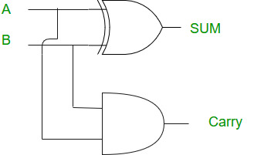
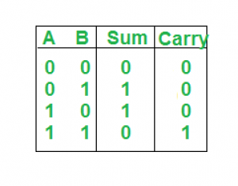
Testing Methods – Structural
Example : Half Adder
Exhaustive => 4 test vectors (tiny circuit)
Check if sum is stuck on Vcc, What test vectors can be used?
  We need to add test vectors that produce sum = 0
Check if sum is stuck on Gnd, What test vectors can be used?
  We need to add test vectors that produce sum =1
Test vector should produce opposite of fault value

Slide 19
Testing Methods – Structural
Example : Half Adder
use just 2 Test Vectors
 | Group 1 | Group 2 | Group 3 | Group 1
Test Vector 1 | 0 1 | 0 0 | 0 0 | 1 0
Test Vector 2 | 1 0 | 0 1 | 1 1 | 1 1
V1 Coverage
V2 Coverage
Fault Coverage
S => gnd
C => Vcc
S => Vcc
C => Vcc
S => Vcc
C => Vcc
S => gnd
C => Vcc
S => gnd
C => Vcc
S => gnd
C => Vcc
S => Vcc
C => gnd
S => Vcc
C => gnd
2/4 = 50%
3/4 = 75%
3/4 = 75%
4/4 = 100%

Slide 20
Fault Modeling
Stuck at 1
Stuck at 0
Bridging fault (short circuit)
Open circuit
Transition delay
Wire delay
Multiple stuck at fault

Slide 21
Fault Model
Course focus:
  Single stuck at 0 (S_{a0}) == Node short circuit with gnd
  Single stuck at 1 (S_{a1}) == Node short circuit Vcc
  Single stuck cant still discover multiple stuck points too

Slide 22
Path sensitization
For each node in the circuit:
  Assume the fault type (S-a-0 or S-a-1)
  Perform the the following steps:
    Backtrace phase: Send the non-fault value to the node under consideration
    Propagation phase: Steer the value of the node under consideration to one of the outputs
Only inputs nodes can be controlled
Only output nodes can be observed

Slide 23
Example problem
Is y s-a-0?
  Backtrace: Set y to 1 (Opposite to test value) => a.b=1
    A.b=1 => a=1 b=1 => y = 1 if no fault
    y = 0 if fault
  Propagation: y is not observable (internal). Propagate its value to z
    C must be 1 (if c = 0, z will always be 0 so no way to test)
    Z = 1 … no fault
    Z = 0 … fault
Test Vector ‘abc’ = 1 1 1
a
AND1
b
y
AND1
z
c

Slide 24
Example problem
Is y s-a-1?
  Backtrace: Set y to 0 (Opposite to test value) => a.b=0
    A.b=0 => a=1 b=0
    a=0 b=1 => y = 0 if no fault
    a=0 b=0 y = 1 if fault
  Propagation: y is not observable (internal). Propagate its value to z
    C must be 1 (if c = 0, z will always be 0 so no way to test)
    Z = 0 … no fault
    Z = 1 … fault
Test Vectors a b c
1 0 1
0 1 1
0 0 1
a
AND1
b
y
AND1
z
c

Slide 25
Example problem
Is a s-a-0?
  Backtrace: Set a to 1 (Opposite to test value) => a=1
    a = 1 if no fault
    a = 0 if fault
  Propagation: a is not observable (internal gate input). Propagate its value to y and z
    b must be 1 (if b = 0, y will always be 0 so no way to test)
      y = 1 … no fault
      y = 0 … fault
    c must be 1 (if b = 0, y will always be 0 so no way to test)
      z = 1 … no fault
      z = 0 … fault
Test Vector ‘abc’ = 1 1 1
a
AND1
b
y
AND1
z
c

Slide 26
Example problem
Is a s-a-1?
  Backtrace: Set a to 0 (Opposite to test value) => a=1
    a = 0 if no fault
    a = 1 if fault
  Propagation: a is not observable (internal gate input). Propagate its value to y and z
    b must be 1 (if b = 0, y will always be 0 so no way to test)
      y = 0 … no fault
      y = 1 … fault
    c must be 1 (if b = 0, y will always be 0 so no way to test)
      z = 0 … no fault
      z =1… fault
Test Vector ‘abc’ = 0 1 1
a
AND1
b
y
AND1
z
c

Slide 27
Example problem
Fault | Test Vectors a b c | Fault Free z | Faulty z
A s-a-0 |  | 1 | 0
B s-a-0 |  | 1 | 0
C s-a-0 |  | 1 | 0
Y s-a-0 |  | 1 | 0
Z s-a-0 |  | 1 | 0
A s-a-1 |  | 0 | 1
B s-a-1 |  | 0 | 1
C s-a-1 |  | 0 | 1
Y s-a-1 |  | 0 | 1
Z s-a-1 |  | 0 | 1
1 1 1
1 1 1
1 1 1
1 1 1 (to get 1 on z)
a
AND1
b
y
1 1 1 (to get 1 on z)
0 1 1
AND1
z
c
1 0 1
1 1 0
001, 011,101
Everything except 111 result in 0
000 001 010 011 100 101 110
Exhaustive test vectors = 8 vectors
Test Vector 1 1 1 is capable of testing 5 cases
Essential test vectors: vectors that no other vectors can cover
Minimal test vectors ABC
111
011
101
110
Such as 111 011 101 110

Slide 28
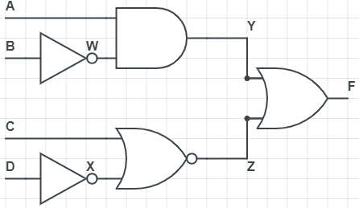
Example problem
Is Y s-a-0?
Is Y s-a-1?

Slide 29
Example problem
Is Y s-a-0?
  Backtrace: Set y to 1 (Opposite to test value)
  Y = 1 if no fault
    ___ Y = 0 if fault
  => AB = 10
  Propagation: Y is not observable (internal gate input). Propagate its value to F
    z must be 0
    ___ ___
    => CX = 0 1 => CD = 0 0
    1 0 1 1
    1 1 1 0
_______
Test Vectors : A B C D
1 0 0 0 => F = 1 no Fault
1 0 1 0 F = 0 Faulty
1 0 1 1

Slide 30
Example problem
Is Y s-a-1?
  Backtrace: Set y to 0 (Opposite to test value)
  __ __
    AW AB
  0 0 0 1 Y = 0 if no fault Y = 1 if fault
  0 1 0 0
  10 11
  Propagation: Y is not observable (internal gate input). Propagate its value to F z must be 0 ___ ___
  => CX = 0 1 => CD = 0 0
    1 1 1 0
    1 0 1 1
_______
Test Vectors : A B C D
0 0 0 0 => F = 0 no Fault
0 0 1 0 F = 1 Faulty
0 0 1 1
0 1 0 0
0 1 1 0
0 1 1 1
1 1 0 0
1 1 1 0
1 1 1 1

Slide 31
D Algorithm (5 value logic)
Provide convenient treatment Sa1 and Sa0 faults
The 5 values are
  logic 0
  Logic 1
  x unknown
  Introduce 2 new logic symbols:
    D: 1 in a good circuit / 0 in a faulty circuit
    D: 0 in a good circuit / 1 in a faulty circuit
  Goal of testing is to discriminate good circuits from faulty:
  Need to make at least one output go to D or D

Slide 32
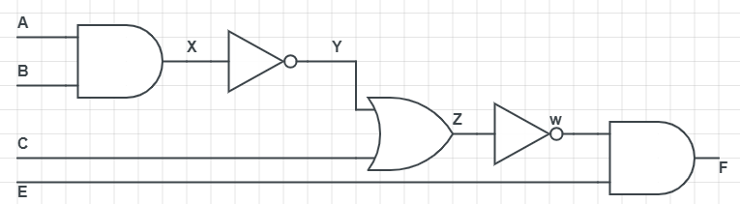
D Algorithm (5 value logic)
Test X s-a-0
X = 1 no fault, X = 0 fault
Y = 0 no fault, Y = 1 fault
W = 1 no fault, W = 0 fault
Always propagating 2 values
Prone to mistakes
  Introduce 2 new logic symbols:
    D: 1 No Fault / 0 on Fault
    D: 0 No Fault / 1 on Fault

Slide 33
D Algorithm (5 value logic)
Test X s-a-0
1
D
D
1
D
D
1
D
1

Slide 34
Reasoning about s-a-0, s-a-1 faults
Introduce 2 new logic symbols:
  D: 1 in a good circuit / 0 in a faulty circuit
  D: 0 in a good circuit / 1 in a faulty circuit
Goal of testing is to discriminate good circuits from faulty:
Need to make at least one output go to D or D
a | b | c | z | Faulty z
0 | 0 | 0 | 0 | 0
0 | 0 | 1 | 0 | 0
0 | 1 | 0 | 0 | 0
0 | 1 | 1 | 0 | 0
1 | 0 | 0 | 0 | 0
1 | 0 | 1 | 0 | 0
1 | 1 | 0 | 0 | 0
1 | 1 | 1 | 1 | 0
0
a
AND1
b
y
AND1
z
c
D
1

Slide 35
Reasoning about s-a-0, s-a-1 faults
Introduce 2 new logic symbols:
  D: 1 in a good circuit / 0 in a faulty circuit
  D: 0 in a good circuit / 1 in a faulty circuit
Goal of testing is to discriminate good circuits from faulty:
Need to make at least one output go to D or D
a | b | c | z
0 | 0 | 0 | 0
0 | 0 | 1 | 0
0 | 1 | 0 | 0
0 | 1 | 1 | 0
1 | 0 | 0 | 0
1 | 0 | 1 | 0
1 | 1 | 0 | 0
1 | 1 | 1 | D
Not useful to test for y s-a-0
0
a
AND1
b
y
AND1
z
c
Effective test
1

Slide 36
Fault oriented testing
If we know what fault we are looking for:
We don’t need to test whole truth table
Just find one effective test
Then continue checking process for all other possible faults
abc=111 tests for y s-a-0
a | b | c | z
0 | 0 | 0 | 0
0 | 0 | 1 | 0
0 | 1 | 0 | 0
0 | 1 | 1 | 0
1 | 0 | 0 | 0
1 | 0 | 1 | 0
1 | 1 | 0 | 0
1 | 1 | 1 | D
Not useful to test for y s-a-0
0
1
a
AND1
1
D
b
y
D
1
AND1
z
c
Effective test
1

Slide 37
Fault oriented testing
If we know what fault we are looking for
We don’t need to test whole truth table
Just find one effective test
Then continue checking process for all other possible faults
 | a | b | c | z
y s-a-0 | 1 | 1 | 1 | D
y s-a-1
z s-a-0
z s-a-1
a s-a-0
a s-a-1
b s-a-0
b s-a-1
c s-a-0
c s-a-1
0
a
AND1
b
y
AND1
z
c
1

Slide 38
Operations on 5 value logic
NOT Z = A
A | Z
0
1
X
D
D
1
0
X
D
D

Slide 39
Operations on 5 value logic
AND Z = A.B
B
 | 0 | 1 | X | D | D
0
1
X
D
D
0
0
0
0
0
0
1
X
D
D
A
0
X
X
X
X
0
D
X
D
0
0
D
X
0
D

Slide 40
Operations on 5 value logic
OR Z = A+B
B
 | 0 | 1 | X | D | D
0
1
X
D
D
0
1
X
D
D
1
1
1
1
1
A
X
1
X
X
X
D
1
X
D
1
D
1
X
1
D
Other Gates can be extracted from the basic AND OR NOT gates

Slide 41
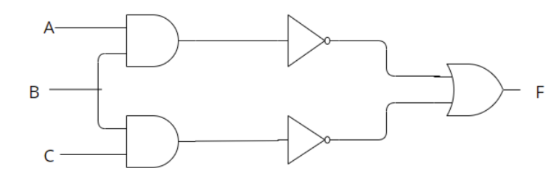
Example
X
W
Y
Z
Test B s-a-1
Can propagate B through one of 3 paths
  If one test vector is required, then any good path can result in one test vector
  If all test vectors are required, all paths should be tested
  To get the minimal set for the circuit all test vectors should be required
Check path BXWF
  Set 0 on B B = 0 No Fault and 1 Fault B = D
  A must be 1 X = D W = D
  To propagate to F, Z must be 0 Y = 1 BC = 11
  B must be 1 while initially it was set to 0 Contradiction Path Fails
Check Path BYZF Fails as it is symmetrical to path BXWF

Slide 42
Example
X
W
Y
Z
Test B s-a-1
Check the two paths BXWF and BYZF in parallel
  Set 0 on B B = 0 No Fault and 1 Fault B = D
  BXWF: A = 1 X = D W = D
  BYZF: C = 1 Y = D Z = D
  F = D+D = D (1 no fault, 0 on fault)
  If output is in D or D Then It is a good path and good test vector
  Test Vector ABC = 101

Slide 43
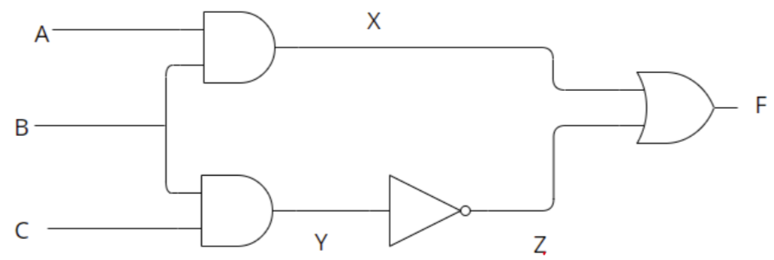
Example
Test B s-a-0
Check the two paths BXF and BYZF in parallel
  Set 1 on B B = 1 No Fault and 0 Fault B = D
  BXF: A = 1 X = D
  BYZF: C = 1 Y = D Z = D
  F = D+D = 1 (Output not in D or D so it can't be used for generating a test vector)
Try path BXF
  Set 1 on B B = 1 No Fault and 0 Fault B = D
  A = 1 X = D
  Z must be 0 Y = 1 BC must be 11 B MUST be 1
  B must be 1 while it was set to D D != 1 contradiction …. path fail
  Try ABC = 111 with and without B s-a-0 and notice contradiction (F will always be 1)

Slide 44
Example
Test B s-a-0
Try path BYZF
  Set 1 on B B = 1 No Fault and 0 Fault B = D
  BYZF: C = 1 Y = D Z = D
  Need to propagate Z to F then X must be 0
  X = 0 A.B = 0 B = D A = 0
  Test vector ABC = 011
  Try this test vector with and without Bs-a-0 (not fault F=0 while on Fault F=1 F = D)

Slide 45
Derivative
Derivative is rate of change
Rate of change of distance x with respect to time t
is big
x
is small
is zero
t
If derivative is zero, x is insensitive to t
If non-zero, then x is sensitive to t

Slide 46

Boolean Difference
We want to know if z is sensitive to a
Boolean difference of z with respect to a is
Digital equivalent of derivative
$$\frac{dz}{da}= 1$$
If then z is sensitive to a
If then z is not sensitive to a
a
AND1
b
y
AND1
z
c

Slide 47
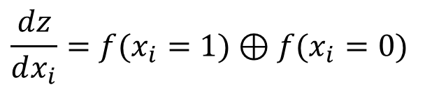
Computation of Boolean Difference
Boolean relation between f and x_{i} is
Work out value of this function with x_{i} set to 1
Work out value of this function with x_{i} set to 0
XOR the two together
This is the Boolean difference
$$\frac{dz}{dx_{i}}=f(x_{i}=1)⊕f(x_{i}=0)$$
x
1
x
2
x
3
z
XOR operator outputs a 1 when its arguments differ
x
n

Slide 48
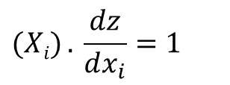
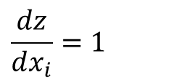
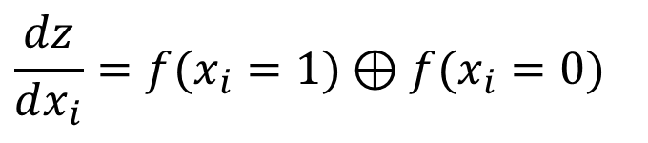

Computation of Boolean Difference
x
1
x
2
x
$$\frac{dz}{dx_{i}}=f(x_{i}=1)⊕f(x_{i}=0)$$
3
z
x
n
Boolean Difference and DFT
Z is sensitive to node x_{i} when
$$\frac{dz}{dx_{i}}=1$$
To test x_{i} _{s-a-0} :
$$(Xi) . \frac{dz}{dx_{i}}=1$$
To test x_{i} _{s-a-1} :
$$(Xi)` . \frac{dz}{dx_{i}}=1$$

Slide 49

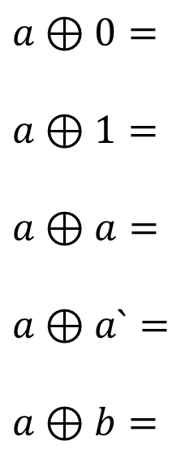




Computation of Boolean Difference
$$a⊕0=$$
$$a⊕1=$$
$$a⊕a=$$
$$a⊕a`=$$
$$a⊕b=$$
$$a$$
$$a`$$
$$0$$
$$1$$
$$ab`+a`b$$

Slide 50


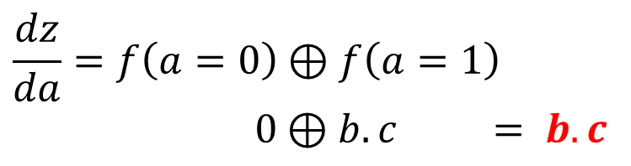
Using Boolean Differences
$$z=f\left(a,b,c\right)=a.b.c$$
Test for a s-a-0:
  Drive a with 1
  Make z sensitive to a, i.e. make
But
So we need to make b=1 and c=1
$$\frac{dz}{da}=f\left(a=0\right)⊕f\left(a=1\right)$$
$0⊕b.c = b.c$
Is a s-a-0?
$$z=f\left(a,b,c\right)=a.b.c$$
1
a
AND1
b
y
1
AND1
z
1
c

Slide 51

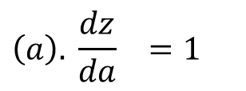
Using Boolean Differences
Is a s-a-0?
a is s-a-0 when
$$\left(a\right). \frac{dz}{da} =1$$
$$\left(a\right).b.c =1$$
a = 1 , b =1 , c = 1
Test Vector abc = 111
Is a s-a-0?
1
a
AND1
b
y
1
AND1
z
1
c

Slide 52

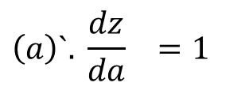
Using Boolean Differences
Is a s-a-1?
a is s-a-1 when
$$\left(a\right)`. \frac{dz}{da} =1$$
$$\left(a\right)`.b.c =1$$
a = 0 , b =1 , c = 1
Test Vector abc = 011
Is a s-a-1?
0
a
AND1
b
y
1
AND1
z
1
c

Slide 53
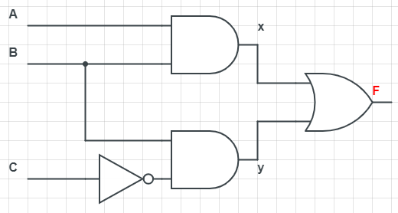










Using Boolean Differences – Example 2
Test node A
Is node F sensitive to node A?
$$F=f\left(A,B,C\right)=A.B+BC`$$
$$\frac{dF}{dA}=f\left(A=0\right)⊕f\left(A=1\right)$$
$= BC` ⊕ B+BC`$
$= BC` ⊕ B(1+C` )$
$= BC` ⊕ B$
Using identity X ⊕ Y = X`.Y + X.Y`
$= \left(BC`\right)`B+\left(BC`\right)B`$
Using De Morgan's Law
$= \left(B`+C\right)B+ 0$
$=BC$
$=BB`+BC$
$$\frac{dF}{dA}=1$$
F is sensitive to A when = BC = 1
BC = 11

Slide 54
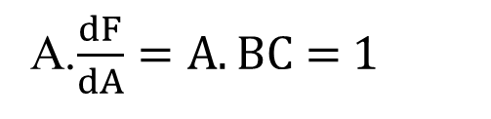

Using Boolean Differences – Example 2
Test node A
Is node A s-a-0 ?
A s-a-0 when
$A.$ $\frac{dF}{dA}$ = 1
A.$\frac{dF}{dA}=A.BC$ = 1
A s-a-0 when ABC = 1
ABC = 111

Slide 55
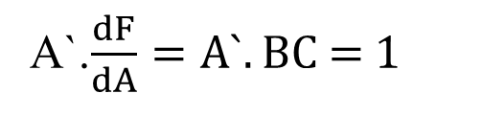

Using Boolean Differences – Example 2
Test node A
Is node A s-a-1 ?
A s-a-0 when
$A`.$ $\frac{dF}{dA}$ = 1
A`.$\frac{dF}{dA}=A`.BC$ = 1
A s-a-0 when A`BC = 1
ABC = 011

Slide 56



Using Boolean Differences – Example 2
Test node B
Is node F sensitive to node B?
$$F=f\left(A,B,C\right)=A.B+BC`$$
$$\frac{dF}{dB}=f\left(B=0\right)⊕f\left(B=1\right)$$
$= 0 ⊕ A+C`$
$= A+C`$
$$\frac{dF}{dA}=1$$
F is sensitive to A when = A+C` = 1
AC =
00
10
11

Slide 57
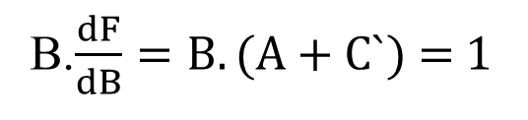

Using Boolean Differences – Example 2
Test node B
Is node B s-a-0 ?
B s-a-0 when
$B.$ $\frac{dF}{dB}$ = 1
B.$\frac{dF}{dB}=B.(A+C`)$ = 1
Will be 1 when both B and (A+C`) are 1
B AC
0 0
1 0
1 1
ABC
0 1 0
1 1 0
1 1 1
Test Vectors:

Slide 58
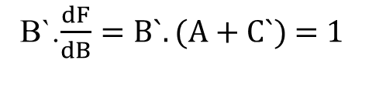

Using Boolean Differences – Example 2
Test node B
Is node B s-a-1 ?
B s-a-0 when
$B`.$ $\frac{dF}{dB}$ = 1
B`.$\frac{dF}{dB}=B`.(A+C`)$ = 1
Will be 1 when both B` and (A+C`) are 1
B AC
0 0 0
1 0
1 1
ABC
0 0 0
1 0 0
1 0 1
Test Vectors:

Slide 59






Using Boolean Differences – Example 2
Test node x
Is node F sensitive to node x?
$$F=f\left(x,B,C\right)=x+BC`$$
$$\frac{dF}{dx}=f\left(x=0\right)⊕f\left(x=1\right)$$
$= BC` ⊕ 1$
$= \left(BC`\right)`$
Using De Morgan's Law
$= B`+C$
$$\frac{dF}{dx}=1$$
F is sensitive to x when = B` + C = 1
BC =
11
01
00

Slide 60

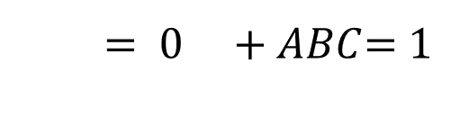
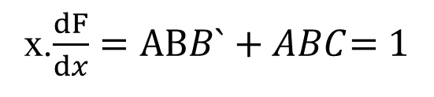
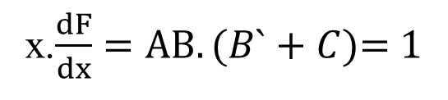

Using Boolean Differences – Example 2
Test node x
Test Vectors should be presented by input values not internal nodes
x=AB
Is node x s-a-0 ?
x s-a-0 when
$x.$ $\frac{dF}{dx}$ = 1
x.$\frac{dF}{dx}=AB.(B`+C)$= 1
x.$\frac{dF}{dx}=ABB`+ABC$= 1
$= 0 +ABC$= 1
$= ABC$= 1
x s-a-0 when ABC = 1
ABC = 111

Slide 61

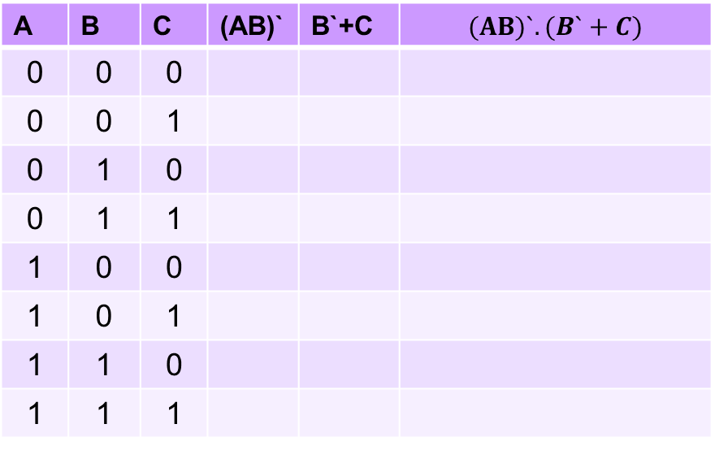
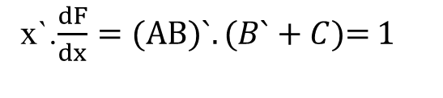

Using Boolean Differences – Example 2
Test node x
Is node x s-a-1 ?
B s-a-0 when
$x`.$ $\frac{dF}{dx}$ = 1
x`.$\frac{dF}{dx}=(AB)`.(B`+C)$= 1
Can use De Morgan's Law to simplify and get test vectors
Another option is to use the truth table to get test vectors
A | B | C | (AB)` | B`+C | $$(AB)`.(B`+C)$$
0 | 0 | 0
0 | 0 | 1
0 | 1 | 0
0 | 1 | 1
1 | 0 | 0
1 | 0 | 1
1 | 1 | 0
1 | 1 | 1
1
1
1
Select Test vectors where $(AB)`.(B`+C)$ = 1
1
1
1
1
0
0
ABC
0 0 0
0 0 1
0 1 1
1 0 0
1 0 1
1
1
1
1
1
1
1
1
1
0
0
0
0
1
0

Slide 62
Using Boolean Differences – Example 2
Test node y
Find Test vector to test y s-a-0 and y s-a-1

Slide 63



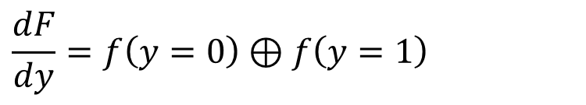


Using Boolean Differences – Example 2
Test node y
Is node F sensitive to node y?
$$F=f\left(y,A,B\right)=y+AB$$
$$\frac{dF}{dy}=f\left(y=0\right)⊕f\left(y=1\right)$$
$= AB ⊕ 1$
$= \left(AB\right)`$
Using De Morgan's Law
$= A`+B′$
$$\frac{dF}{dy}=1$$
F is sensitive to y when = A` + B’ = 1
AB =
00
01
10

Slide 64

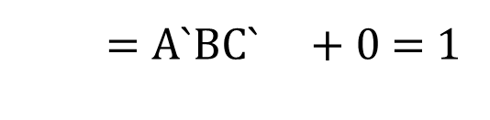
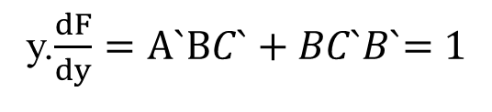
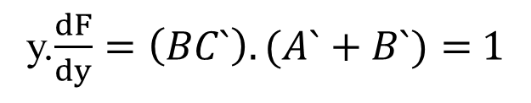

Using Boolean Differences – Example 2
Test node y
Test Vectors should be presented by input values not internal nodes
y=BC’
Is node y s-a-0 ?
y s-a-0 when
y$.$ $\frac{dF}{dy}$ = 1
y.$\frac{dF}{dy}=\left(BC`\right).(A`+B`)=$1
y.$\frac{dF}{dy}=A`BC`+BC`B`$= 1
$=A`BC` +0$= 1
$=A`BC`$= 1
y s-a-0 when A`BC` = 1
ABC = 010

Slide 65
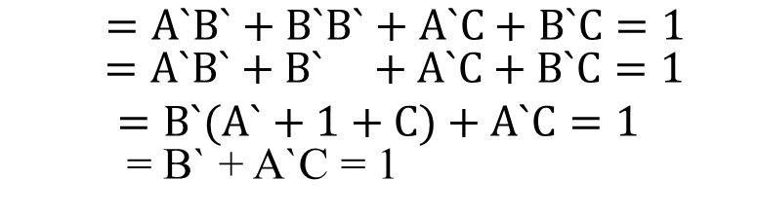
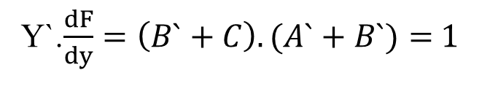
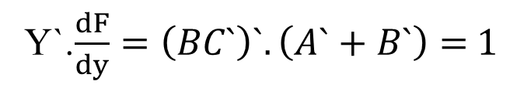

Using Boolean Differences – Example 2
Test node y
Is node y s-a-1 ?
y s-a-0 when
y$`.$ $\frac{dF}{dy}$ = 1
Y`.$\frac{dF}{dy}=\left(BC`\right)`.\left(A`+B`\right)=$1
Y`.$\frac{dF}{dy}=\left(B`+C\right).(A`+B`)=$1
$=A`B`+B`B`+A`C+B`C=1$
$=A`B`+B` +A`C+B`C=1$
$$=B`(A`+1+C)+A`C=1$$
= B` + A`C = 1
ABC = 000
001
100
101
011
y s-a-1 when B` + A`C = 1

Slide 66
Untestable Faults
Due to existence of redundant hardware
  Completely untestable node
  Partially untestable

Slide 67
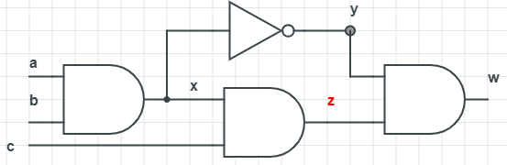
Untestable Faults
Test node x s-a-0
X s-a-0 set 1 to x ab = 11 (x = D)
If c= 0 z = 0 w =0
If c =1 z = D w = D.D = 0
W is not presented as D or D, X s-a-0 is untestable

Slide 68

Untestable Faults
Redundant Hardware
w
Test node x s-a-1
W is always 0
X s-a-1 set 0 to x ab = 00 , 01, 10
If c= 0 z = 0 w =0
If c =1 z = D w = D.D = 0
W is not presented as D or D, X s-a-1 is untestable
a | b | c | w
0 | 0 | 0 | 0
0 | 0 | 1 | 0
0 | 1 | 0 | 0
0 | 1 | 1 | 0
1 | 0 | 0 | 0
1 | 0 | 1 | 0
1 | 1 | 0 | 0
1 | 1 | 1 | 0
Node x is completely untestable!

Slide 69
Untestable Faults
Redundant Hardware
w
W is always 0
Simplify Digital Formula
W = (ab)` . abz
W = (a` + b`) . abz
W = a`abz + abb`z
W = 0 + 0
W = 0
Node x is completely untestable!

Slide 70
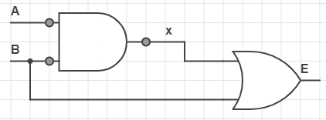
Partially Untestable Faults
Redundant Hardware
B
E
Test node x
X s-a-0 set 1 to x AB = 11 (x = D)
To propagate x to E B = 0 , Contradicts with AB = 1 x s-a-0 untestable
X s-a-1 set 0 to x AB = 00, 10, 01 (x = D)
To propagate x to E B = 0 AB = 00, 10
Node x is partially testable …. Redundant hardware
E = AB + B
= B (A+1)
= B

Slide 71
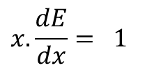




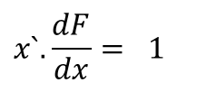
Partially Untestable Faults
Test node x
Is node E sensitive to node x?
E $=f\left(x,B\right)=B+X$
$$\frac{dE}{dx}=f\left(x=0\right)⊕f\left(x=1\right)$$
$= B ⊕ 1 = B`$
$$\frac{dF}{dx}=1$$
F is sensitive to x when = B` = 1 …… B = 0
$$x.\frac{dE}{dx}= 1$$
X.B` =1 AB.B` = 1 0 = 1 !!! Untestable
X s-a-0 :
$$x`.\frac{dF}{dx}= 1$$
X`.B` =1 (AB)’.B’ = 1
X s-a-1 :
= (A` + B`). B` = 1
For X s-a-1 A is don’t care.
Can be 0 or 1
Test vector AB
0 0
1 0
= A`B` + B` = 1
= (A` + 1). B` = 1
= B` = 1
B = 0

Slide 72


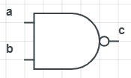

Fault Collapsing
Equivalent faults: Faults having exactly the same test vectors
  One test vector can cover both faults
a s-a-0 == b s-a-0 == c s-a-0
a s-a-1 == b s-a-1 == c s-a-1
ab = 11
ab = 00
x s-a-0 == y s-a-1
a s-a-0 == b s-a-0 == c s-a-1

Slide 73
Fault Collapsing
Dominant Fault: Fault F1 is said to dominate F2 if test vectors of F2 are subset of F1 test vectors
F1 F2
abc abc
000 111
111 101
101
F1 Dominates F2
Shall we adopt F1 test vectors or F2?
F2
As any of F2 test vectors can cover F1
The opposite is not true!

Slide 74
Fault Collapsing
Dominant Fault: Fault F1 is said to dominate F2 if test vectors of F2 are subset of F1 test vectors
a s-a-1 b s-a-1 c s-a-1
a s-a-0 b s-a-0 c s-a-0
ab
01
ab
10
ab
00
01
10
ab
10
ab
01
ab
01
10
11
Test Vectors
Test Vectors

Slide 75
Fault Collapsing
Dominant Fault: Fault F1 is said to dominate F2 if test vectors of F2 are subset of F1 test vectors
a s-a-1 b s-a-1 c s-a-0
a s-a-0 b s-a-0 c s-a-1
ab
01
ab
10
ab
00
01
10
ab
10
ab
01
ab
01
10
11
Test Vectors
Test Vectors

Slide 76
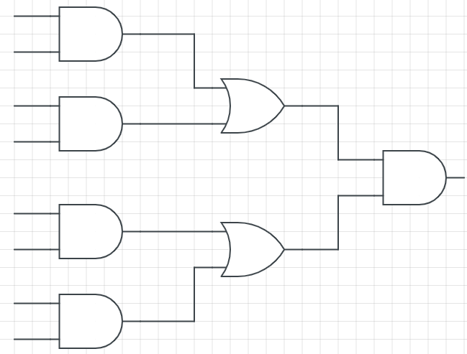
Fault Collapsing Example
Exhaustive Testing
8 inputs => 256 test vector
s-a-0
s-a-1
s-a-0
s-a-1
Structural (Fault Model)
s-a-0
s-a-1
15 node * 2 faults = 30 fault
Max 30 test vector
s-a-0
s-a-1
s-a-0
s-a-1
s-a-0
s-a-1
s-a-0
s-a-1
Fault Collapsing
s-a-0
15 test vector
s-a-0
s-a-1
s-a-1
s-a-0
s-a-1
s-a-0
s-a-1
Exhaustive Testing
9 inputs => 512 test vector
s-a-0
s-a-1
s-a-0
s-a-1
Structural Testing
16 node * 2 faults = max 32 test vector
s-a-0
s-a-1
s-a-0
s-a-1
What Will Happen With extra line
Fault Collapsing
16 test vector
s-a-0
s-a-1

Slide 77
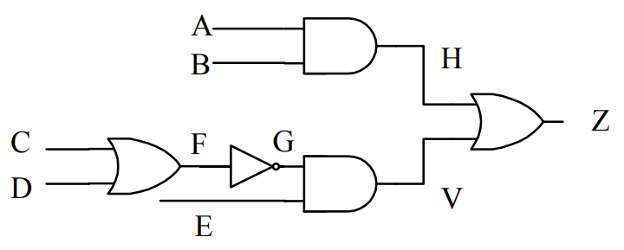
Fault Collapsing Example
Asa0
Asa1
X
X
Hsa0
Hsa1
X
Bsa1
Bsa0
X
X
Zsa0
Zsa1
X
X
X
X
Fsa0
Fsa1
Gsa0
Gsa1
Csa0
Csa1
X
Dsa0
Dsa1
X
X
Vsa0
Vsa1
Esa0
Esa1
X

Slide 78
Fault Collapsing
IMPORTANT NOTE:
  Fault equivalency and dominance save time
  No need to recalculate faults
  Pay attention in exam to save solving time

Slide 79
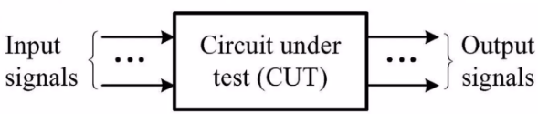
Design for Testability (DFT)
Testing is taken into account during the design phase
DFT: Adding extra logic to ease circuit testing after manufacturing
DFT enhances Construability and observability
Control
Observe

Slide 80
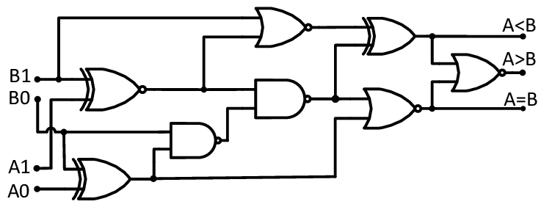
Design for Testability (DFT)
Additional Input
Additional Output
Additional Input increases controllability
Additional Output increases Observability

Slide 81
Design for Testability (DFT)
Ad-hoc Technique
  Adding minor changes into the design
  Target a specific problem
S1
S2
Inputs
outputs
Increasing Observability for S1
Test Output

Slide 82
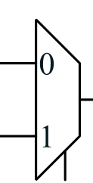
Design for Testability (DFT)
Ad-hoc Technique
  Adding minor changes into the design
  Target a specific problem
Test Input
S1
S2
Inputs
outputs
Select test/normal
Test Output

Slide 83
Design for Testability (DFT)
Structured Technique
Example
  To get comb. Logic 2 functional reg 2 has to be programmed
  To program reg 2 comb logic 1 should be functional
Solution: Design all registers as shift registers connected to each other
Reg 2 can be programed without going through comb logic 1 (scan design)
Test Output
Reg1
Comb Logic 1
Reg2
Comb Logic 2
Reg3
Inputs
outputs
Test Input (Shift reg input)

Slide 84
Built-in Self Test (BIST)
Circuit Has capability for self testing and detecting faults
R
E
G
Comb. Logic
REG
In normal mode, Registers are used normally as parallel in/out
In test mode, registers are used as test generators/test analyzer

Slide 85
Built-in Self Test (BIST)
Test Generator: Should be able to generate large number of test vectors
Counters can be used as a test generators but with major disadvantages:
  Counters are more complicated HW than normal registers
  To covers are inputs, all bits of a counter should be triggered. For large counters (e.g 64 bit) it will be impossible to trigger MSB of the counter

Slide 86
Linear Feedback Shift Register (LFSR)
Linear feedback shift register (LFSR) is a shift register whose input bit is the output of a linear function of two or more of its previous state
Produces a sequence of numbers. The next value of the sequence depends on the current value. The first value is usually called seed. Usually, the function XOR is used to link two consecutive values.
Seed can be any value except 0

Slide 87


Slide 88

3 bit LFSR
S0 S1 S2
1
1
1
Seed 111
Cycle S0 S1 S2
0 1 1 1
Generated all values between 1-7
1 0 1 1
2 0 0 1
No repeated value until all possible values are generated
3 1 0 0
4 0 1 0
5 1 0 1
6 1 1 0
7 1 1 1

Slide 89
4 bit LFSR
Cycle S0 S1 S2 S3
0 0 0 0 1
1 1 0 0 0
S0 S1 S2 S3
2 0 1 0 0
0
0
0
1
3 0 0 1 0
4 1 0 0 1
5 1 1 0 0
6 0 1 1 0
7 1 0 1 1
8 0 1 0 1
Generated all values between 1-5
9 1 0 1 0
10 1 1 0 1
No repeated value until all possible values are generated
11 1 1 1 0
12 1 1 1 1
13 0 1 1 1
14 0 0 1 1
15 0 0 0 1

Slide 90
Single Input Signature register (SISR)
Same as LFSR with an extra xor input from the circuit under test (CUT)
CUT
S0 S1 S2

Slide 91
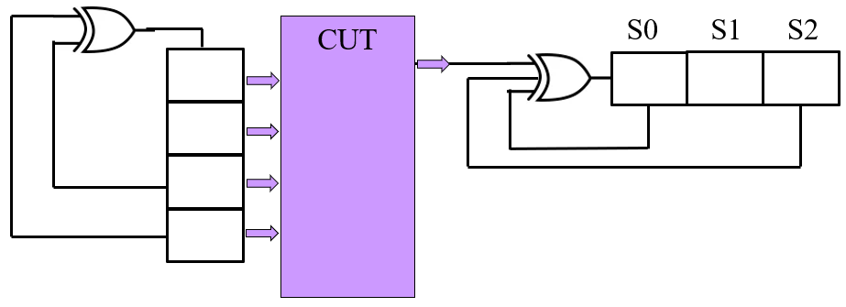
Single Input Signature register (SISR)
Example
Initial value (seed) = 000
SISR can use a seed of 0 as it has additional input
10111
Cycle | CUT | S0 | S1 | S2
0 | 1 | 0 | 0 | 0
1 | 1 | 1 | 0 | 0
2 | 1 | 0 | 1 | 0
3 | 0 | 1 | 0 | 1
4 | 1 | 0 | 1 | 0
0
0
0
Signature
010

Slide 92
Single Input Signature register (SISR)
Example
Faulty Output
Initial value (seed) = 000
SISR can use a seed of 0 as it has additional input
10101
Cycle | CUT | S0 | S1 | S2
0 | 1 | 0 | 0 | 0
1 | 0 | 1 | 0 | 0
2 | 1 | 1 | 1 | 0
3 | 0 | 0 | 1 | 1
4 | 1 | 1 | 0 | 1
0
0
0
Value != good Signature
FAULTY Circuit

Slide 93
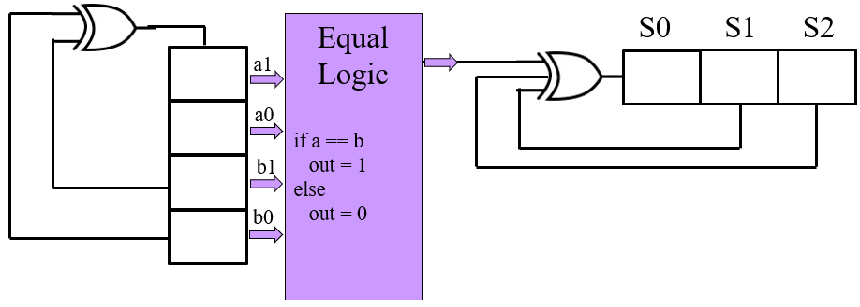
BIST Example
Seed 111
F
1
1
1
1
1
1
1
Seed 1111
Cycle | a1 | a0 | b1 | b0
1 | 1 | 1 | 1 | 1
2 | 0 | 1 | 1 | 1
3 | 0 | 0 | 1 | 1
4 | 0 | 0 | 0 | 1
F | S0 | S1 | S2
1 | 1 | 1 | 1
0 | 1 | 1 | 1
0 | 0 | 1 | 1
0 | 0 | 0 | 1
 | 1 | 0 | 0
Signature

Slide 94
BIST Example
F s-a-0
F
1
1
1
1
1
1
1
Cycle | a1 | a0 | b1 | b0
1 | 1 | 1 | 1 | 1
2 | 0 | 1 | 1 | 1
3 | 0 | 0 | 1 | 1
4 | 0 | 0 | 0 | 1
F | S0 | S1 | S2
0 | 1 | 1 | 1
0 | 0 | 1 | 1
0 | 0 | 0 | 1
0 | 1 | 0 | 0
 | 0 | 1 | 0
Bad Signature

Slide 95
Example
Equal
Logic
if a == b
out = 1
else
out = 0
S0 S1 S2
a1
a0
b1
b0

Slide 96
Multiple Input Signature register (MISR)
Parallel Loading Signature register
TPG
CUT
D3
D2
D1
D0
S3
S2
S1
S0

Slide 97
Built In Logic Block Observation (BILBO)
BILBO
Comb. Logic
BILBO
Comb. Logic
BILBO
Comb. Logic
BILBO
Comb. Logic
BILBO
Data Out
Data In
BILBO works as:
Parallel Load
Shift register to load/read TP
Test Pattern Generator (TPG)
Test Pattern Analyzer (TA)

Slide 98
Built-In Logic Block Observation (BILBO)
Example: 3 bit BILBO Structure
S1 S0
0 0 Normal Mode
0 1 Scan mode
0 LFSR (TPG)
1 1 MISR
A0
A1
A2
DFF
DFF
DFF
S0
MUX 4x1
S0
MUX 4x1
S0
MUX 4x1
S1
S1
S1
0
1
2
3
0
1
2
3
0
1
2
3
SI
A0
A0
A1
A1
I0
I1
I2
A2
A1
A0
I1
A1
I2
A2
A1
I0

Slide 99
Example
a=b
Equal
Logic
a1
a0
C2
a>b
b1
b0
A<b
C1
C0

Slide 100
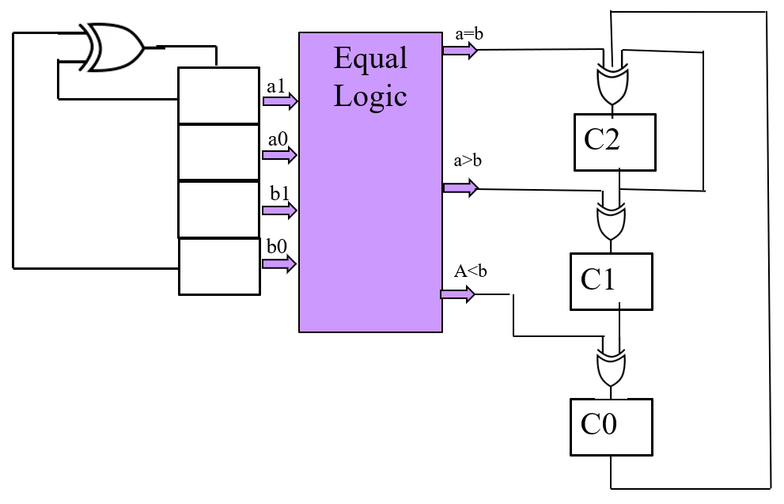
Example
1
0
0
0
Assume a=b output signal is stuck at 0
0
LFSR TPG
Output
MISR
0
a1 | a0 | b0 | b1 | a=b | a>b | a<b | C1 0 | C2 0 | C3 0 |  | a=b | a>b | a<b | C1 0 | C2 0 | C3 0
1 | 0 | 0 | 0 | 0 | 1 | 0 | 0 | 1 | 0 |  | 0 | 1 | 0 | 0 | 1 | 0
1 | 1 | 0 | 0 | 0 | 1 | 0 | 0 | 1 | 1 |  | 0 | 1 | 0 | 0 | 1 | 1
1 | 1 | 1 | 0 | 0 | 1 | 0 | 1 | 1 | 1 |  | 0 | 1 | 0 | 1 | 1 | 1
1 | 1 | 1 | 1 | 1 | 0 | 0 | 1 | 1 | 1 |  | 0 | 0 | 0 | 0 | 1 | 1
0 | 1 | 1 | 1 | 0 | 0 | 1 | 0 | 1 | 0 |  | 0 | 0 | 1 | 1 | 0 | 0
1 | 0 | 1 | 1 | 0 | 0 | 1 | 0 | 0 | 0 |  | 0 | 0 | 1 | 1 | 1 | 1
0 | 1 | 0 | 1 | 1 | 0 | 0 | 1 | 0 | 0 |  | 0 | 0 | 0 | 0 | 1 | 1
1 | 0 | 1 | 0 | 1 | 0 | 0 | 0 | 1 | 0 |  | 0 | 0 | 0 | 1 | 0 | 1
1 | 1 | 0 | 1 | 0 | 1 | 0 | 0 | 1 | 1 |  | 0 | 1 | 0 | 0 | 0 | 0
0 | 1 | 1 | 0 | 0 | 0 | 1 | 1 | 0 | 0 |  | 0 | 0 | 1 | 0 | 0 | 1
0 | 0 | 1 | 1 | 0 | 0 | 1 | 1 | 1 | 1 |  | 0 | 0 | 1 | 1 | 0 | 1
1 | 0 | 0 | 1 | 0 | 1 | 0 | 0 | 0 | 1 |  | 0 | 1 | 0 | 0 | 0 | 0
0 | 1 | 0 | 0 | 0 | 1 | 0 | 1 | 1 | 0 |  | 0 | 1 | 0 | 0 | 1 | 0
0 | 0 | 1 | 0 | 0 | 0 | 1 | 1 | 1 | 0 |  | 0 | 0 | 1 | 0 | 0 | 0
0 | 0 | 0 | 1 | 0 | 0 | 1 | 1 | 1 | 0 |  | 0 | 0 | 1 | 0 | 0 | 1
0
Bad Signature

