Slide 1
Chapter 19
Ionic Equilibria in Aqueous Systems
Copyright ©The McGraw-Hill Companies, Inc. Permission required for reproduction or display.
Notes:
‹#›

Slide 2
Ionic Equilibria in Aqueous Systems
19.1 Equilibria of Acid-Base Buffer Systems
19.2 Acid-Base Titration Curves
19.3 Equilibria of Slightly Soluble Ionic Compounds
19.4 Equilibria Involving Complex Ions
Notes:
‹#›

Slide 3
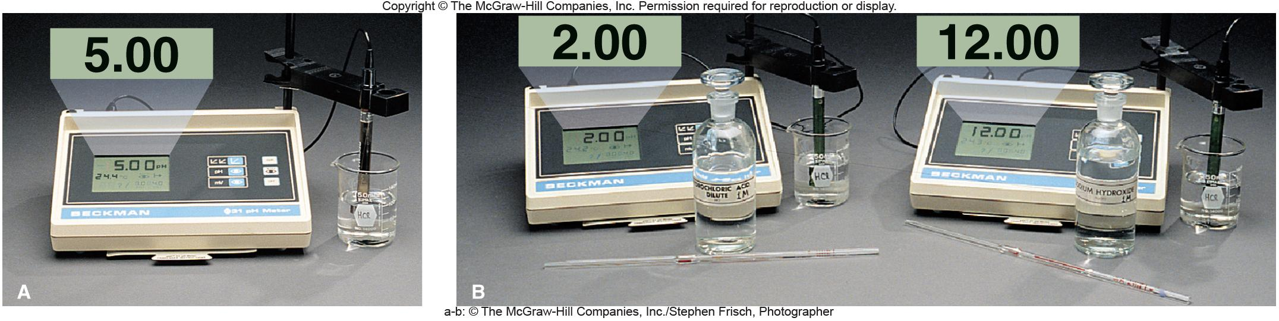
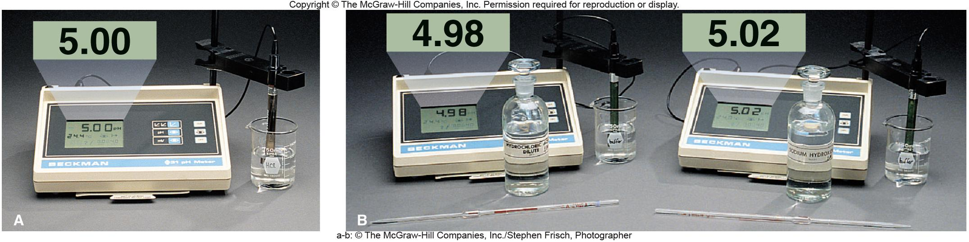
Figure 19.1
The effect of addition of acid or base to an unbuffered solution.
acid added
base added
Figure 19.2
The effect of addition of acid or base to a buffered solution.
acid added
base added
Notes:
‹#›

Slide 4
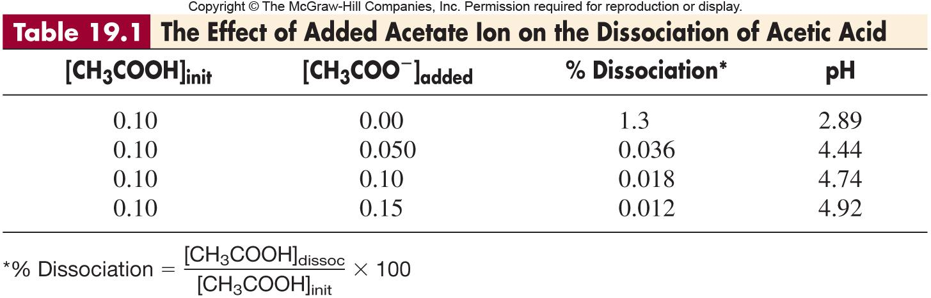
Notes:
‹#›

Slide 5
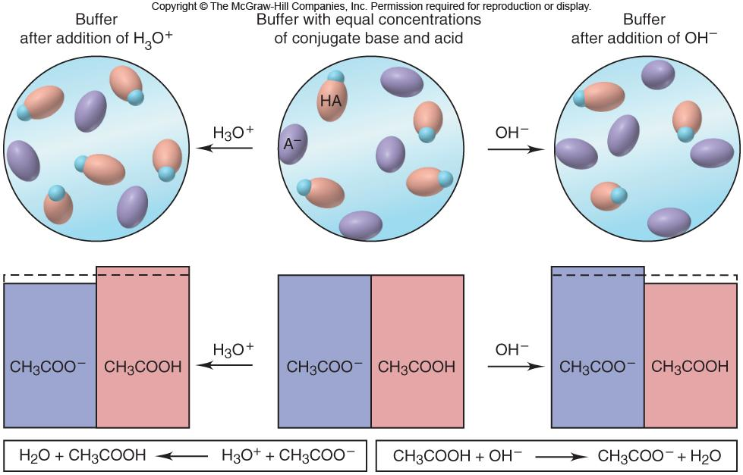
Figure 19.3
How a buffer works.
Notes:
‹#›

Slide 6

Sample Problem 19.1
Calculating the Effect of Added H₃O⁺ or OH⁻ on Buffer pH
PROBLEM:
Calculate the pH:
(a) Of a buffer solution consisting of 0.50 M CH₃COOH and 0.50 M CH₃COONa
(b) After adding 0.020 mol of solid NaOH to 1.0 L of the buffer solution in part (a)
(c) After adding 0.020 mol of HCl to 1.0 L of the buffer solution in part (a)
K_{a} of CH₃COOH = 1.8 x 10⁻⁵. (Assume the additions cause negligible volume changes.)
PLAN:
We know K_{a} and can find initial concentrations of conjugate acid and base. Make assumptions about the amount of acid dissociating relative to its initial concentration. Proceed step-wise through changes in the system.
SOLUTION:
(a)
Concentration (M)
CH₃COOH(aq) + H₂O(l) CH₃COO⁻(aq) + H₃O⁺(aq)
Initial
0.50
-
0.50
0
Change
- x
-
+ x
+ x
Equilibrium
0.50 - x
-
0.50 + x
x
Notes:
‹#›

Slide 7
Sample Problem 19.1
Calculating the Effect of Added H₃O⁺ or OH⁻ on Buffer pH
continued (2 of 4)
[H₃O⁺] = x
[CH₃COOH]_{equil} ≈ 0.50 M
[CH₃COO⁻]_{initial} ≈ 0.50 M
K_{a} =
[H₃O⁺][CH₃COOH]
[CH₃COOH]
[H₃O⁺] = x = K_{a}
= 1.8 x 10⁻⁵ M
pH = 4.74
[CH₃COO⁻]
[CH₃COO⁻]
1.8 x 10⁻⁵ M
Check the assumption:
X 100 = 3.6 x 10⁻³ %
0.50 M
(b)
0.020 mol OH⁻
[OH⁻]_{added} =
= 0.020 M OH⁻
1.0 L soln
Concentration (M)
CH₃COOH(aq) + OH⁻(aq) CH₃COO⁻(aq) + H₂O (l)
Initial
0.50
0.020
0.50
-
Change
- 0.020
- 0.020
+ 0.020
-
Final
0.48
0
0.52
-
Notes:
‹#›

Slide 8
Sample Problem 19.1
Calculating the Effect of Added H₃O⁺ or OH⁻ on Buffer pH
continued (3 of 4)
Set up a reaction table with the new values.
Concentration (M)
CH₃COOH(aq) + H₂O(l) CH₃COO⁻(aq) + H₃O⁺(aq)
Initial
0.48
-
0.52
0
Change
- x
-
+ x
+ x
Equilibrium
0.48 - x
-
0.52 + x
x
0.48
[H₃O⁺] = 1.8 x 10⁻⁵ x
= 1.7 x 10⁻⁵
pH = 4.77
0.52
0.020 mol H₃O⁺
(c)
[H₃O⁺]_{added} =
= 0.020 M H₃O⁺
1.0 L soln
Concentration (M)
CH₃COO⁻(aq) + H₃O⁺(aq) CH₃COOH(aq) + H₂O (l)
Initial
0.50
0.020
0.50
-
Change
- 0.020
- 0.020
+ 0.020
-
Final
0.48
0
0.52
-
Notes:
‹#›

Slide 9
Sample Problem 19.1
Calculating the Effect of Added H₃O⁺ or OH⁻ on Buffer pH
continued (4 of 4)
Set up a reaction table with the new values.
Concentration (M)
CH₃COOH(aq) + H₂O(l) CH₃COO⁻(aq) + H₃O⁺(aq)
Initial
0.52
-
0.48
0
Change
- x
-
+ x
+ x
Equilibrium
0.52 - x
-
0.48 + x
x
0.52
[H₃O⁺] = 1.8 x 10⁻⁵ x
= 2.0 x 10⁻⁵
pH = 4.70
0.48
Notes:
‹#›

Slide 10

The Henderson-Hasselbalch Equation
HA + H₂O H₃O⁺ + A⁻
[H₃O⁺] [A⁻]
K_{a} =
[HA]
[HA]
[H₃O⁺] = K_{a} x
[A⁻]
[A⁻]
- log[H₃O⁺] = - log K_{a} + log
[HA]
[base]
pH = pK_{a} + log
[acid]
Notes:
‹#›

Slide 11
Buffer Capacity and Buffer Range
Buffer capacity is the ability to resist pH change.
The more concentrated the components of a buffer, the greater
the buffer capacity.
The pH of a buffer is distinct from its buffer capacity.
A buffer has the highest capacity when the component
concentrations are equal.
Buffer range is the pH range over which the buffer acts effectively.
Buffers have a usable range within ± 1 pH unit of the pK_{a} of
its acid component.
Notes:
‹#›

Slide 12
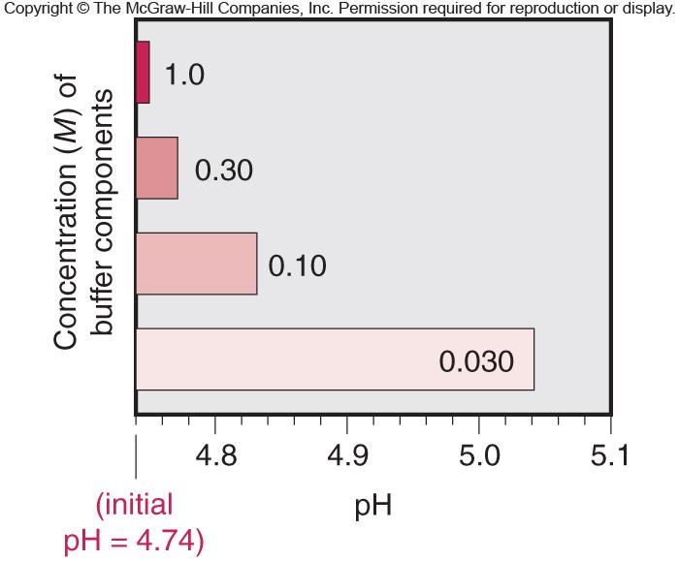
Figure 19.4
The relation between buffer capacity and pH change.
Notes:
‹#›

Slide 13
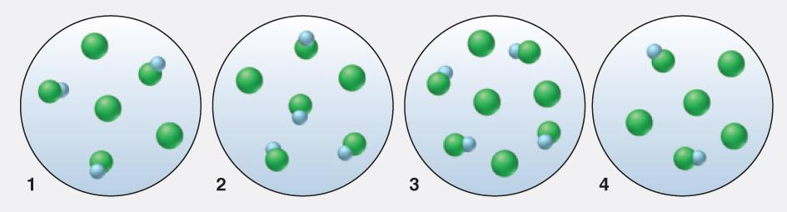
Sample Problem 19.2
Using Molecular Scenes to Examine Buffers
PROBLEM:
The molecular scenes below represent samples of four buffer solutions of HA and A. (HA is blue and green, A⁻ is green, and other ions and water are not shown.)
Which buffer solution has the highest pH?
Which buffer has the greatest capacity?
Should we add a small amount of concentrated strong acid or strong base to convert sample 1 to sample 2 (assuming no volume change)?
Notes:
‹#›

Slide 14
Sample Problem 19.2
Using Molecular Scenes to Examine Buffers
continued (2 of 3)
PLAN:
The number of each species represents its molarity.
Highest pH means the lowest [H⁺], causing the HA to dissociate. Find the scene with the highest [A⁻]/[HA] ratio.
(b) Find the scene with the [A⁻]/[HA] ratio closest to 1.
(c) Compare scenes 1 and 2 to see whether scene 2 has more HA or A⁻.
Notes:
‹#›

Slide 15
Sample Problem 19.2
Using Molecular Scenes to Examine Buffers
continued (3of 3)
SOLUTION:
The [A⁻]/[HA] ratios for the four scenes are: Sample 1, 3/3 = 1; sample 2 = 0.5; sample 3 = 1; sample 4 = 2. Sample 4 has the highest ratio, hence, the highest pH.
(b) Samples 1 and 3 have [A⁻]/[HA] ratio of 1, but sample 3 has the greater capacity because it has a higher concentration.
(c) Sample 2 has a lower [A⁻]/[HA] ratio than sample 1. To convert sample 1 to sample 2 strong acid should be added to convert some A⁻ to HA.

Slide 16
Preparing a Buffer
1. Choose the conjugate acid-base pair.
Calculate the ratio of buffer component concentrations
using the Henderson-Hasselbalch equation.
3. Determine the buffer concentration.
4. Mix the solution and adjust the pH.
Notes:
‹#›

Slide 17
Sample Problem 19.3
Preparing a Buffer
PROBLEM:
An environmental chemist needs a carbonate buffer of pH 10.00 to study the effects of the acid rain on limestone-rich soils. How many grams of Na₂CO₃ must she add to 1.5 L of freshly prepared 0.20 M NaHCO₃ to make the buffer? K_{a} of HCO₃⁻ is 4.7 x 10⁻¹¹.
PLAN:
We know the K_{a} and the conjugate acid-base pair. Convert pH to [H₃O⁺], find the number of moles of carbonate and convert to mass.
SOLUTION:
[CO₃²⁻][H₃O⁺]
HCO₃⁻(aq) + H₂O(l) CO₃²⁻(aq) + H₃O⁺(aq)
K_{a} =
[HCO₃⁻]
[CO₃²⁻](1.0 x 10⁻¹⁰)
pH = 10.00; [H₃O⁺] = 1.0 x 10⁻¹⁰
4.7 x 10⁻¹¹ =
[CO₃²⁻] = 0.094 M
[0.20]
moles of Na₂CO₃ = (1.5 L)(0.094 mol/L)
= 0.14
105.99 g
0.14 moles
= 15 g Na₂CO₃
mol
Notes:
‹#›

Slide 18
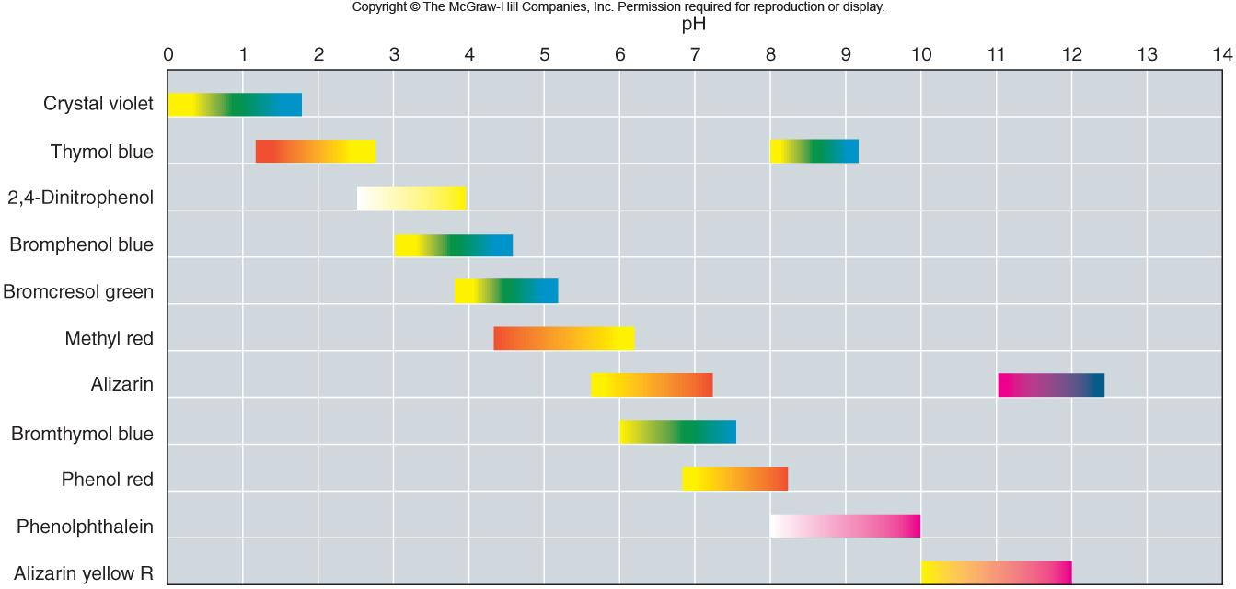
Colors and approximate pH range of some common acid-base indicators.
Figure 19.5
Notes:
‹#›

Slide 19
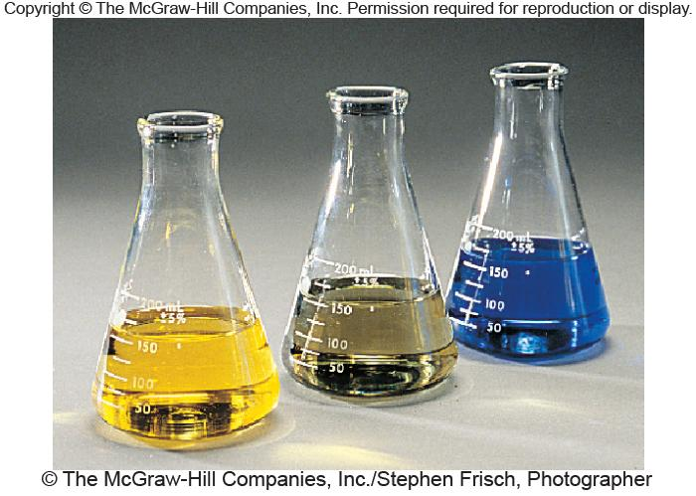
Figure 19.6
The color change of the indicator bromthymol blue.
basic
acidic
change occurs over ~2 pH units
Notes:
‹#›

Slide 20
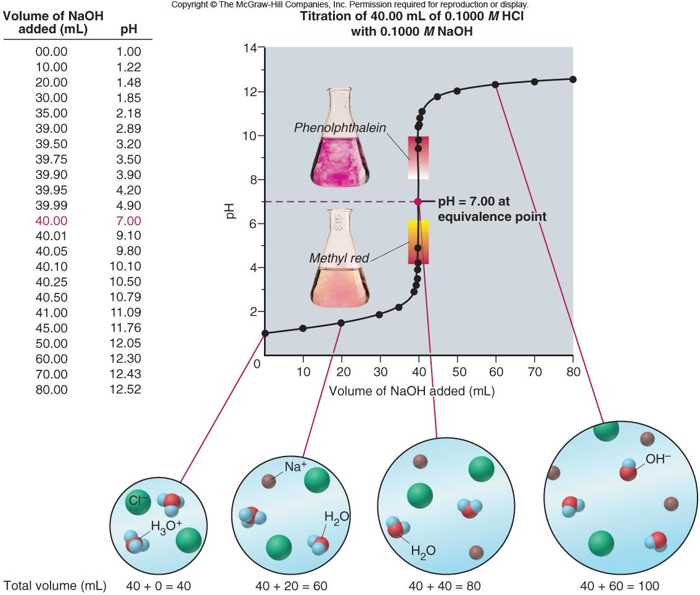
Figure 19.7
Curve for a strong acid-strong base titration.
Notes:
‹#›

Slide 21
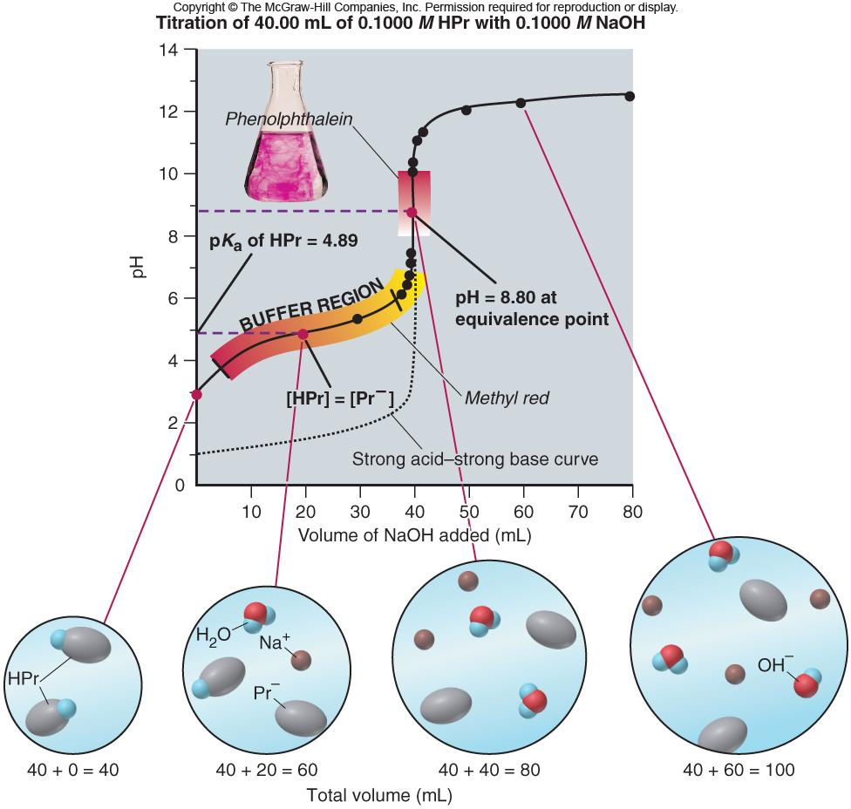
Figure 19.8
Titration of 40.00 mL of 0.1000 M HPr with 0.1000 M NaOH
Curve for a weak acid-strong base titration.
Notes:
‹#›

Slide 22
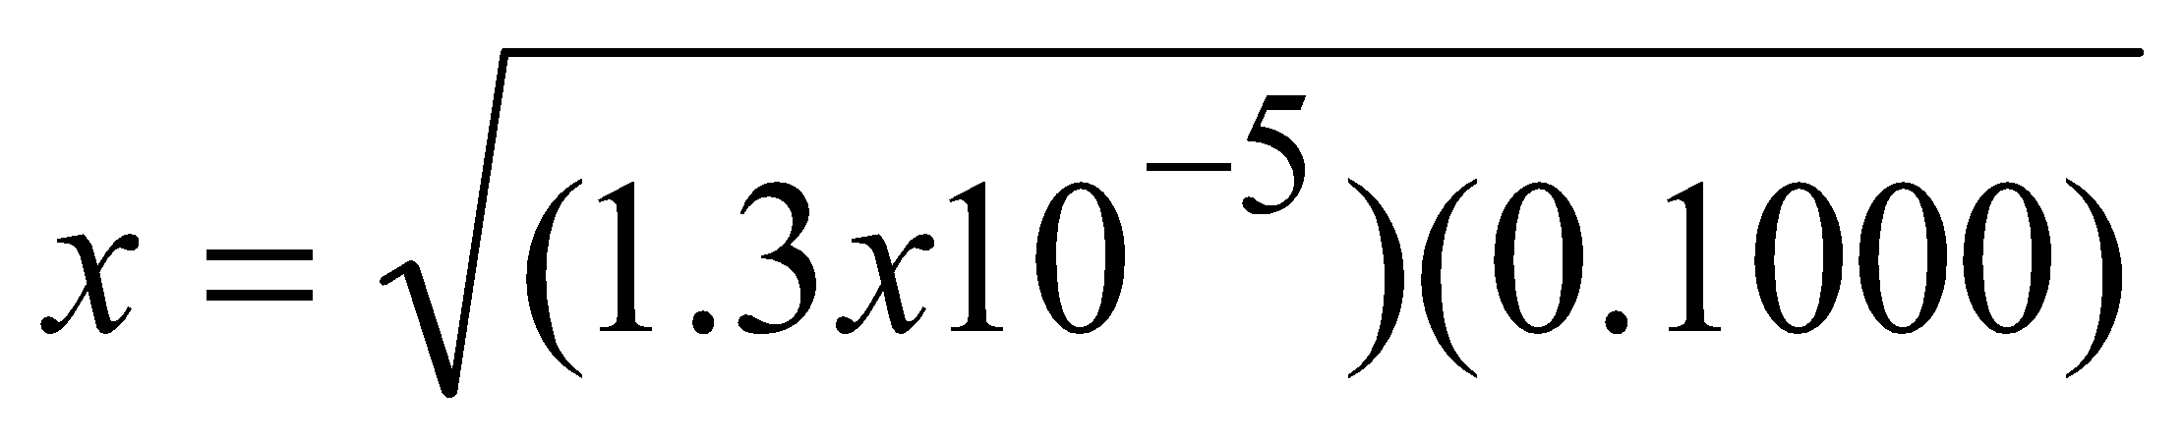
Sample Problem 19.4
Finding the pH During a Weak Acid-Strong Base Titration
PROBLEM:
Calculate the pH during the titration of 40.00 mL of 0.1000 M propanoic acid (HPr; K_{a} = 1.3 x 10⁻⁵) after adding the following volumes of 0.1000 M NaOH:
(a) 0.00 mL
(b) 30.00 mL
(c) 40.00 mL
(d) 50.00 mL
PLAN:
The amounts of HPr and Pr ⁻ will be changing during the titration. Remember to adjust the total volume of solution after each addition.
SOLUTION:
(a) Find the starting pH using the methods of Sample Problem 18.8.
[Pr ⁻][H₃O⁺]
K_{a} =
[Pr ⁻] = x = [H₃O⁺]
[HPr]
x = 1.1 x 10⁻³ ; pH = 2.96
(b)
Amount (mol)
HPr(aq) + OH⁻(aq) Pr ⁻(aq) + H₂O (l)
Initial
0.004000
-
0
-
Change
-
0.003000
-
-
Final
0.001000
0
0.003000
-
Notes:
‹#›

Slide 23
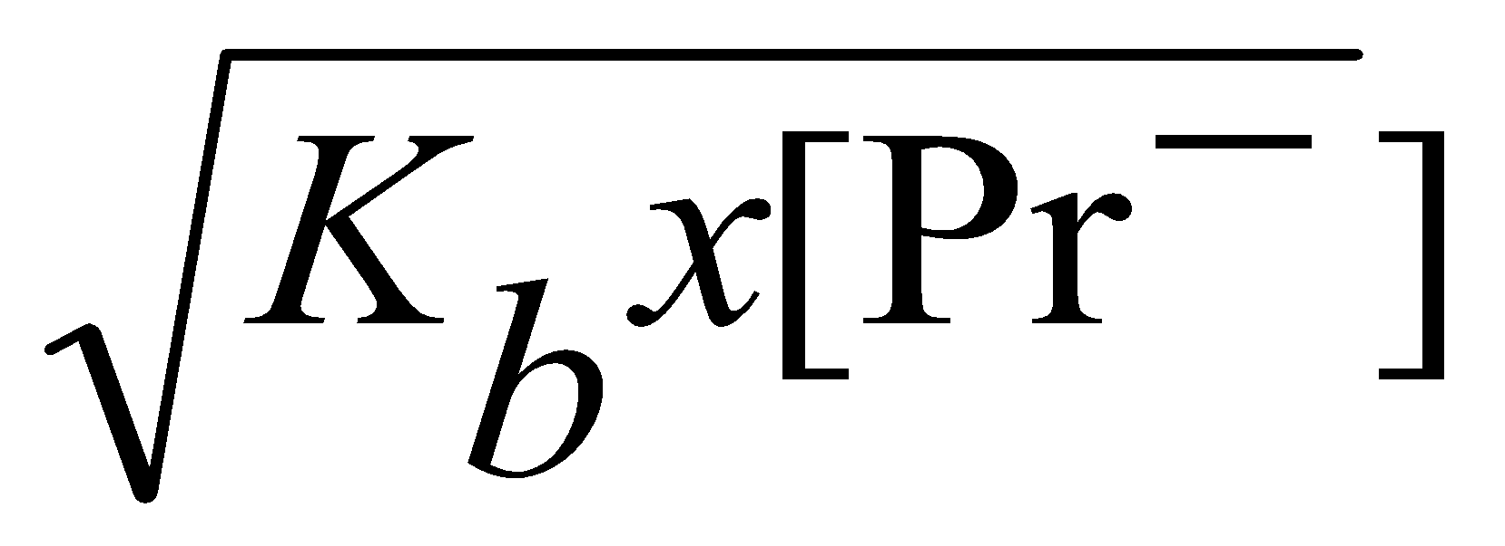
Sample Problem 19.4
Finding the pH During a Weak Acid-Strong Base Titration
continued (2 of 3)
0.001000 mol
[H₃O⁺] = 1.3 x 10⁻⁵ x
= 4.3 x 10⁻⁶ M
pH = 5.37
0.003000 mol
(c) When 40.00 mL of NaOH are added, all of the HPr will be reacted and the [Pr ⁻] will be
(0.004000 mol)
= 0.05000 M
(0.004000 L) + (0.004000 L)
K_{w}
1.0 x 10⁻¹⁴
K_{a} x K_{b} = K_{w}
K_{b} = = = 7.7 x 10⁻¹⁰
K_{a}
1.3 x 10⁻⁵
K_{w}
[H₃O⁺] = = 1.6 x 10⁻⁹M
pH = 8.80
Notes:
‹#›

Slide 24
Sample Problem 19.4
Finding the pH During a Weak Acid-Strong Base Titration
continued (3 of 3)
(d) 50.00 mL of NaOH will produce an excess of OH⁻.
mol excess base = (0.1000 M)(0.05000 L - 0.04000 L) = 0.00100 mol
M = (0.00100 mol)
1.0 x 10⁻¹⁴
M = 0.01111
[H₃O⁺] = = 9.0 x 10⁻¹³M
(0.0900 L)
0.01111
pH = 12.05
Notes:
‹#›

Slide 25
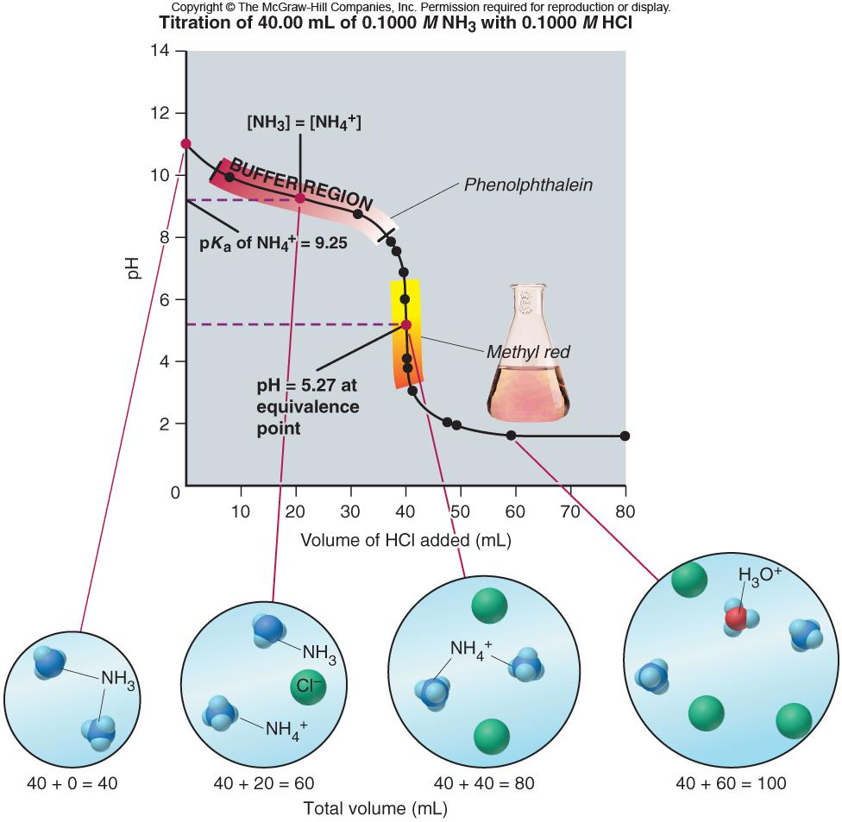
Figure 19.9
Curve for a weak base-strong acid titration.
Titration of 40.00 mL of 0.1000 M NH₃ with 0.1000 M HCl
Notes:
‹#›

Slide 26
Ion-Product Expression (Q_{sp})
and Solubility Product Constant (K_{sp})
For the hypothetical compound, M_{p}X_{q}
At equilibrium Q_{sp} = [M^{n+}]^{p} [X^{z-}]^{q} = K_{sp}
Notes:
‹#›

Slide 27
Sample Problem 19.5
Writing Ion-Product Expressions for Slightly Soluble Ionic Compounds
PROBLEM:
Write the ion-product expression for each of the following compounds:
(a) Magnesium carbonate
(b) Iron(II) hydroxide
(c) Calcium phosphate
(d) Silver sulfide
PLAN:
Write an equation which describes a saturated solution. Take note of the sulfide ion produced in part (d).
SOLUTION:
(a) MgCO₃(s) Mg²⁺(aq) + CO₃²⁻(aq)
K_{sp} = [Mg²⁺][CO₃²⁻]
(b) Fe(OH)₂(s) Fe²⁺(aq) + 2OH⁻ (aq)
K_{sp} = [Fe²⁺][OH⁻] ²
(c) Ca₃(PO₄)₂(s) 3Ca²⁺(aq) + 2PO₄³⁻(aq)
K_{sp} = [Ca²⁺]³[PO₄³⁻]²
(d) Ag₂S(s) 2Ag⁺(aq) + S²⁻(aq)
S²⁻(aq) + H₂O(l) HS⁻(aq) + OH⁻(aq)
K_{sp} = [Ag⁺]²[HS⁻][OH⁻]
Ag₂S(s) + H₂O(l) 2Ag⁺(aq) + HS⁻(aq) + OH⁻(aq)
Notes:
‹#›

Slide 28
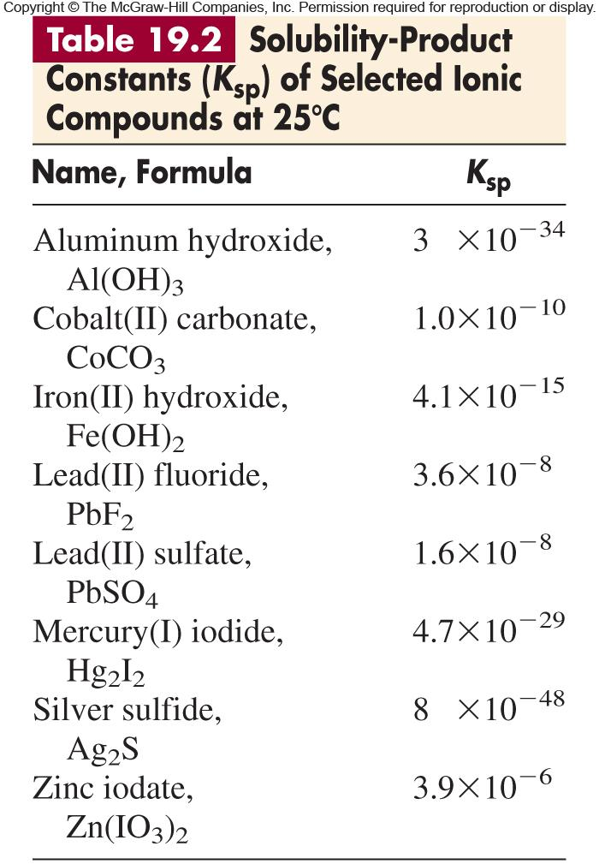
Notes:
‹#›

Slide 29
Sample Problem 19.6
Determining K_{sp} from Solubility
PROBLEM:
(a) Lead(II) sulfate is a key component in lead-acid car batteries. Its solubility in water at 25ºC is 4.25 x 10⁻³ g/100 mL solution. What is the K_{sp} of PbSO₄?
(b) When lead(II) fluoride (PbF₂) is shaken with pure water at 25ºC, the solubility is found to be 0.64 g/L. Calculate the K_{sp} of PbF₂.
PLAN:
Write the dissolution equation; find moles of dissociated ions; convert solubility to M and substitute values into solubility product constant expression.
SOLUTION:
(a)
PbSO₄(s) Pb²⁺(aq) + SO₄²⁻(aq)
K_{sp} = [Pb²⁺][SO₄²⁻]
4.25 x 10⁻³ g
1000 mL
mol PbSO₄
= 1.40 x 10⁻⁴ M PbSO₄
100 mL soln
L
303.3 g PbSO₄
K_{sp} = [Pb²⁺][SO₄²⁻] = (1.40 x 10⁻⁴)² =
1.96 x 10⁻⁸
Notes:
‹#›

Slide 30
Sample Problem 19.6
Determining K_{sp} from Solubility
continued
(b) PbF₂(s) Pb²⁺(aq) + 2F⁻(aq) K_{sp} = [Pb²⁺][F⁻]²
0.64 g
mol PbF₂
= 2.6 x 10⁻³ M
L soln
245.2 g PbF₂
K_{sp} = [Pb²⁺][F⁻]² = (2.6 x 10⁻³)(5.2 x 10⁻³)² =
7.0 x 10⁻⁸
Notes:
‹#›

Slide 31
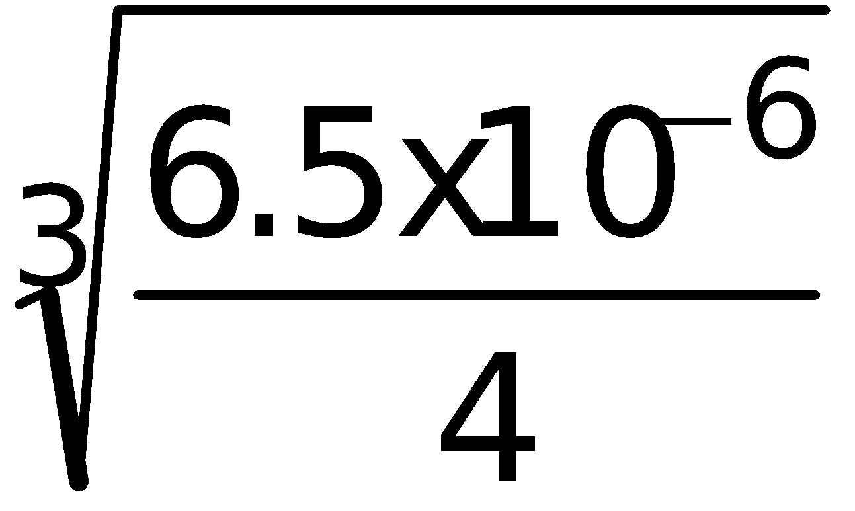
Sample Problem 19.7
Determining Solubility from K_{sp}
PROBLEM:
Calcium hydroxide (slaked lime) is a major component of mortar, plaster, and cement, and solutions of Ca(OH)₂ are used in industry as a cheap, strong base. Calculate the solubility of Ca(OH)₂ in water if the K_{sp} is 6.5 x 10⁻⁶.
PLAN:
Write out a dissociation equation and K_{sp} expression; find the molar solubility (S) using a table.
SOLUTION:
Ca(OH)₂(s) Ca²⁺(aq) + 2OH⁻(aq) K_{sp} = [Ca²⁺][OH⁻]²
Concentration (M)
Ca(OH)₂(s) Ca²⁺(aq) + 2OH⁻(aq)
Initial
-
0
0
Change
-
+ S
+ 2S
Equilibrium
-
S
2S
K_{sp} = (S)(2S)²
S =
= 1.2 x 10⁻² M
Notes:
‹#›

Slide 32
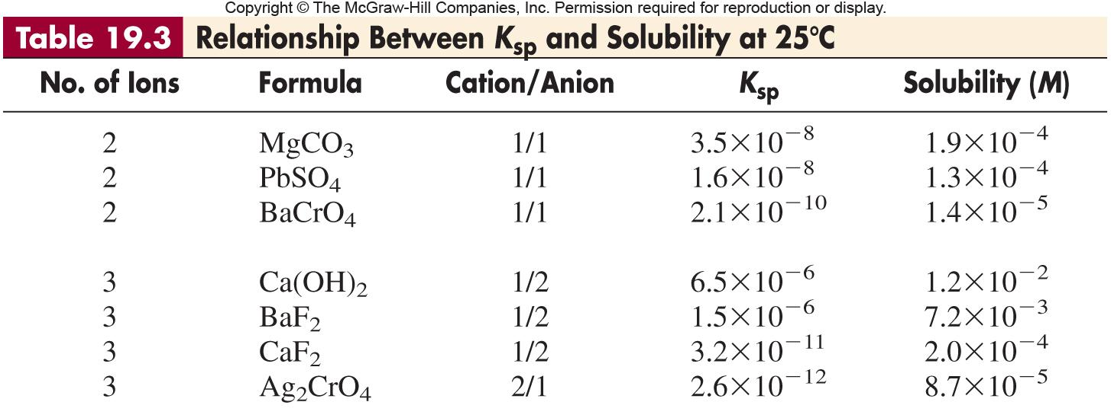
Notes:
‹#›

Slide 33
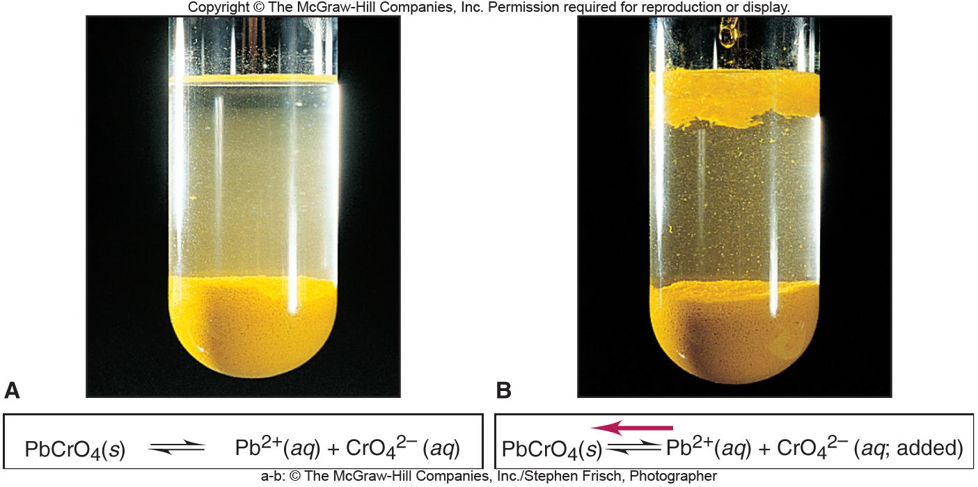
Figure 19.10
The effect of a common ion on solubility.
Notes:
‹#›

Slide 34
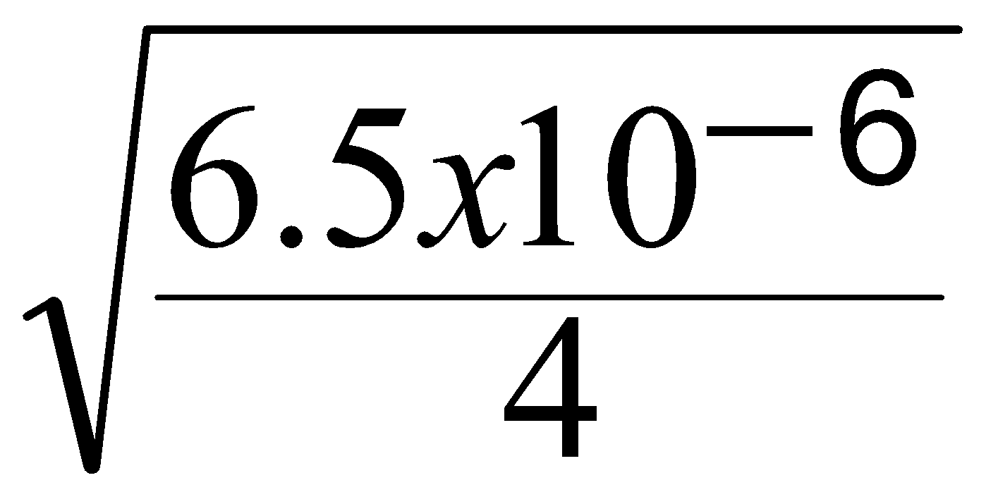
Sample Problem 19.8
Calculating the Effect of a Common Ion on Solubility
continued
SOLUTION:
Ca(OH)₂(s) Ca²⁺(aq) + 2OH⁻(aq)
Concentration (M)
Ca(OH)₂(s) Ca²⁺(aq) + 2OH⁻(aq)
Initial
-
0.10
0
Change
-
+ S
+ 2S
Equilibrium
-
0.10 + S
2S
K_{sp} = 6.5 x 10⁻⁶ = (0.10 + S)(2S)² = (0.10)(2S)²
S << 0.10 M
Check the assumption:
S =
= 4.0x10⁻³ M
4.0 x 10⁻³ M
x 100 =
4.0%
0.10 M
Notes:
‹#›

Slide 35
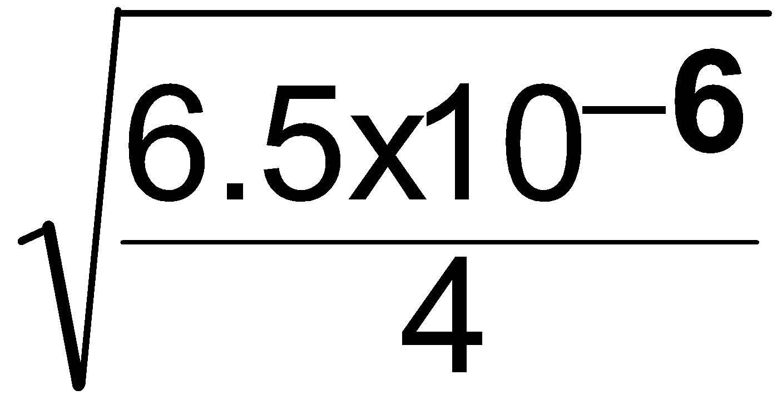
Sample Problem 19.8
Calculating the Effect of a Common Ion on Solubility
PROBLEM:
In Sample Problem 19.7, we calculated the solubility of Ca(OH)₂ in water. What is its solubility in 0.10 M Ca(NO₃)₂? K_{sp} of Ca(OH)₂ is 6.5 x 10⁻⁶.
PLAN:
Set up a reaction equation and table for the dissolution of Ca(OH)₂. The Ca(NO₃)₂ will supply extra [Ca²⁺] and will relate to the molar solubility of the ions involved.
SOLUTION:
Concentration (M)
Ca(OH)₂(s) Ca²⁺(aq) + 2OH⁻(aq)
Initial
-
0.10
0
Change
-
+ S
+ 2S
Equilibrium
-
0.10 + S
2S
K_{sp} = 6.5 x 10⁻⁶ = (0.10 + S)(2S)² = (0.10)(2S)²
S << 0.10 M
S =
Check the assumption:
= 4.0 x 10⁻³ M
4.0 x 10⁻³ M
x 100 =
4.0%
0.10 M
Notes:
‹#›

Slide 36
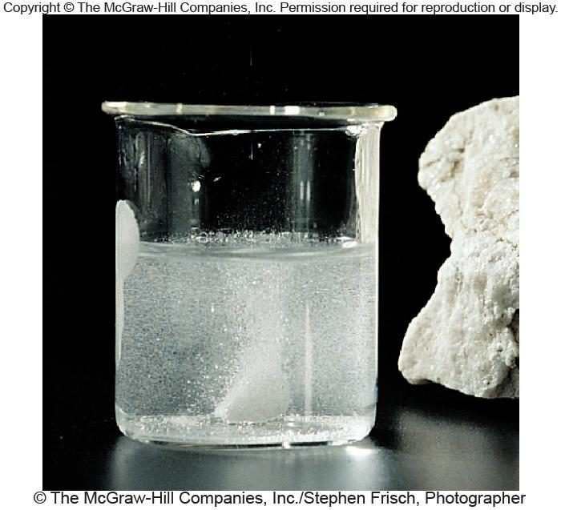
Figure 19.11
Test for the presence of a carbonate.
Notes:
‹#›

Slide 37

Sample Problem 19.9
Predicting the Effect on Solubility of Adding Strong Acid
PROBLEM:
Write balanced equations to explain whether addition of H₃O⁺ from a strong acid affects the solubility of these ionic compounds:
(a) Lead(II) bromide
(b) Copper(II) hydroxide
(c) Iron(II) sulfide
PLAN:
Write dissolution equations and consider how a strong acid would affect the anion component.
SOLUTION:
(a) PbBr₂(s) Pb²⁺(aq) + 2Br ⁻(aq)
Br ⁻ is the anion of a strong acid.
No effect.
(b) Cu(OH)₂(s) Cu²⁺(aq) + 2OH⁻(aq)
OH⁻ is the anion of water, which is a weak acid. Therefore, it will shift the solubility equation to the right and increase solubility.
(c) FeS(s) Fe²⁺(aq) + S²⁻(aq)
S²⁻ is the anion of a weak acid and will react with water to produce OH⁻.
FeS(s) + H₂O(l) Fe²⁺(aq) + HS⁻(aq) + OH⁻(aq)
Both weak acids serve to increase the solubility of FeS.
Notes:
‹#›

Slide 38
Sample Problem 19.10
Predicting Whether a Precipitate Will Form
PROBLEM:
A common laboratory method for preparing a precipitate is to mix solutions of the component ions. Does a precipitate form when 0.100 L of 0.30 M Ca(NO₃)₂ is mixed with 0.200 L of 0.060 M NaF?
PLAN:
Write out a reaction equation to see which salt would be formed. Look up the K_{sp} values in a table. Treat this as a reaction quotient, Q, problem and calculate whether the concentrations of ions are > or < K_{sp}. Remember to consider the volume of the final diluted solution when calculating concentrations.
Notes:
‹#›

Slide 39
Sample Problem 19.10
Predicting Whether a Precipitate Will Form
continued
SOLUTION:
CaF₂(s) Ca²⁺(aq) + 2F⁻(aq) K_{sp} = 3.2 x 10⁻¹¹
mol Ca²⁺ = 0.100 L(0.30 mol/L) = 0.030 mol
0.030 mol
[Ca²⁺] = = 0.10 M
0.300 L
mol F⁻ = 0.200 L(0.060 mol/L) = 0.012 mol
0.012 mol
[F⁻] = = 0.040 M
0.300 L
Q_{sp} = [Ca²⁺][F⁻]² =
(0.10)(0.040)² = 1.6 x 10⁻⁴
Q is >> K_{sp} and CaF₂ WILL precipitate.
Notes:
‹#›

Slide 40
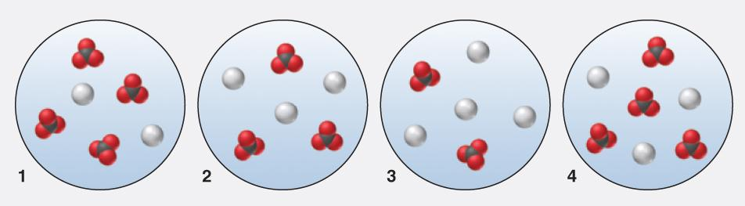
Sample Problem 19.11
Using Molecular Scenes to Predict Whether a Precipitate Will Form
PROBLEM:
The following molecular scenes represent four solutions of silver (gray) and carbonate (black and red) ions that are above solid silver carbonate. (For clarity, the solid, other ions, and water are not shown.)
Which scene best represents the solution at equilibrium with the solid?
In which, if any, other scene(s) will additional solid be formed?
Explain how, if at all, addition of a small volume of concentrated strong acid affects the [Ag⁺] in scene 4 and mass of solid present.
Notes:
‹#›

Slide 41
Sample Problem 19.11
Using Molecular Scenes to Predict Whether a Precipitate Will Form
continued (2 of 3)
PLAN:
At equilibrium the ratio of Ag⁺ to CO₃⁻ is the same in the solution as in the solid.
(b) Solid will form when ion product is greater than K_{sp}. Compare Q_{sp} with K_{sp}.
(c) Write equations and see what shift in reaction, if any, will be caused by adding strong acid.
Notes:
‹#›

Slide 42
Sample Problem 19.11
Using Molecular Scenes to Predict Whether a Precipitate Will Form
continued (3 of 3)
SOLUTION:
Scene 3 has the correct ratio for Ag⁺ to CO₃²⁻ of 2:1.
(b) K_{sp} = 32; the ion products are:
Scene 1: Q_{sp} = (2)²(4) = 16 Scene 2: Q_{sp} = (3)²(3) = 27
Scene 3: Q_{sp} = (4)²(2) = 32 Scene 4: Q_{sp} = (3)²(4) = 36
(c) Ag₂CO₃(s) 2Ag⁺(aq) + CO₃²⁻(aq)
CO₃²⁻(aq) + 2H₃O⁺(aq) 🡪 H₂CO₃(aq) + 2H₂O(l) 🡪 3H₂O(l) + CO₂(g)
Adding a small amount of acid will deplete the solution of CO₃²⁻ by forming CO₂(g);
Ag⁺ in solution will increase and the mass of Ag₂CO₃ will decrease.
Scene 4 has Q_{sp} ≥ 32, the equilibrium condition, so a precipitate will form.

Slide 43
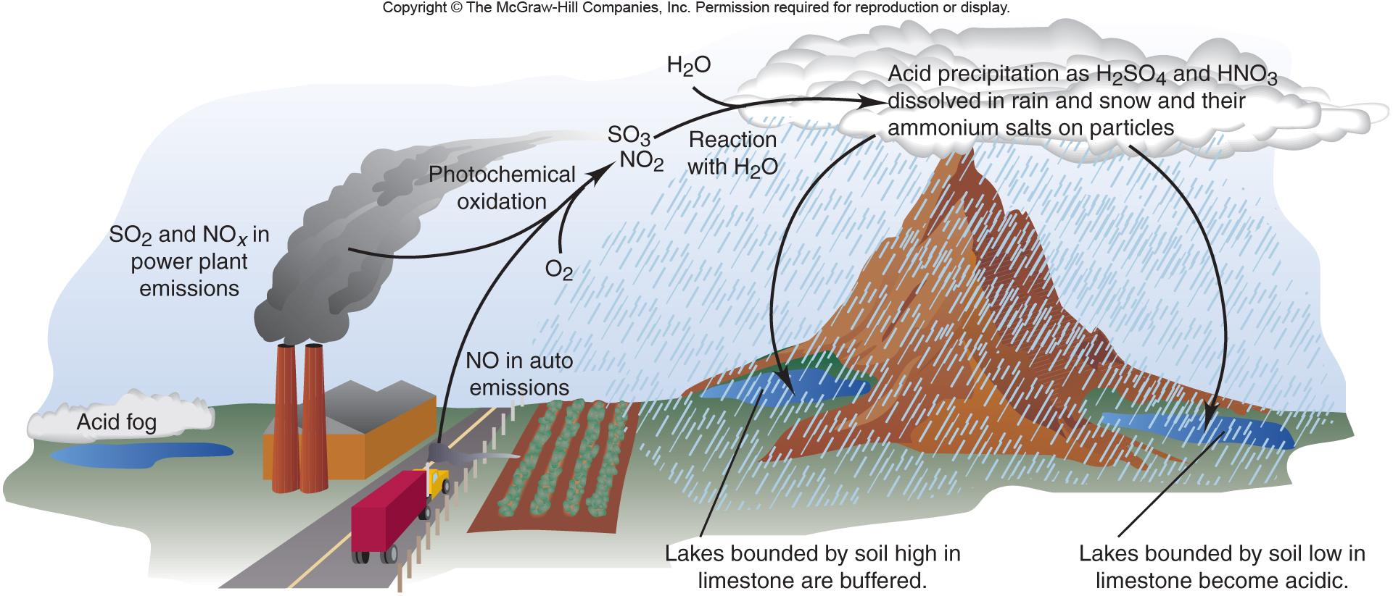
Figure 19.12
Formation of acidic precipitation.
Notes:
‹#›

Slide 44
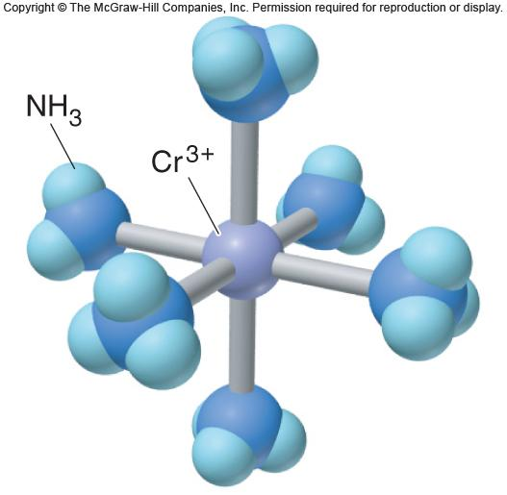
Figure 19.13
Cr(NH₃)₆³⁺, a typical complex ion.
Notes:
‹#›

Slide 45
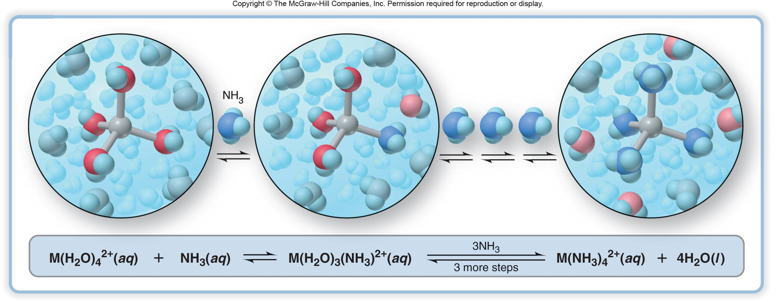
Figure 19.14
The stepwise exchange of NH₃ for H₂O in M(H₂O)₄²⁺.
Notes:
‹#›

Slide 46
Sample Problem 19.12
Calculating the Effect of Complex-Ion Formation on Solubility
PROBLEM:
In black-and-white film developing, excess AgBr is removed from the film negative by “hypo”, an aqueous solution of sodium thiosulfate (Na₂S₂O₃), which forms the complex ion Ag(S₂O₃)₂³⁻. Calculate the solubility of AgBr in (a) H₂O; (b) 1.0 M hypo. K_{f} of Ag(S₂O₃)₂³⁻ is 4.7 x 10¹³ and K_{sp} AgBr is 5.0 x 10⁻¹³.
PLAN:
Write equations for the reactions involved. Use K_{sp} to find S, the molar solubility. Consider the shifts in equilibria upon the addition of the complexing agent.
SOLUTION:
AgBr(s) Ag⁺(aq) + Br ⁻(aq) K_{sp} = [Ag⁺][Br ⁻]
(a)
S = [AgBr]_{dissolved} = [Ag⁺] = [Br ⁻]
K_{sp} = S² = 5.0 x 10⁻¹³ ; S = 7.1 x 10⁻⁷ M
(b)
AgBr(s) Ag⁺(aq) + Br ⁻(aq)
Ag⁺(aq) + 2S₂O₃²⁻(aq) Ag(S₂O₃)₂³⁻(aq)
AgBr(s) + 2S₂O₃²⁻(aq) Ag(S₂O₃)₂³⁻ (aq) + Br ⁻ (aq)
Notes:
‹#›

Slide 47
Sample Problem 19.12
Calculating the Effect of Complex-Ion Formation on Solubility
continued
[Ag(S₂O₃]₂³⁻[Br ⁻]
K_{overall} = K_{sp} x K_{f} =
= (5.0 x 10⁻¹³)(4.7 x 10¹³)
= 24
[S₂O₃²⁻]²
Concentration (M)
AgBr(s) + 2S₂O₃²⁻(aq) Br ⁻(aq) + Ag(S₂O₃)₂³⁻(aq)
Initial
-
1.0
0
0
Change
-
- 2S
+ S
+ S
Equilibrium
-
1.0 - 2S
S
S
S²
S
K_{overall} =
= 24
= √24
(1.0 - 2S)²
1.0 - 2S
S = [Ag(S₂O₃)₂³⁻] = 0.45 M
Notes:
‹#›

