Slide 1
Organic Chemistry, Fourth Edition
Janice Gorzynski Smith
University of Hawai’i
Chapter 12
Lecture Outline
Prepared by Layne A. Morsch
The University of Illinois - Springfield
Copyright © 2014 The McGraw-Hill Companies, Inc. Permission required for reproduction or display.
‹#›

Slide 2
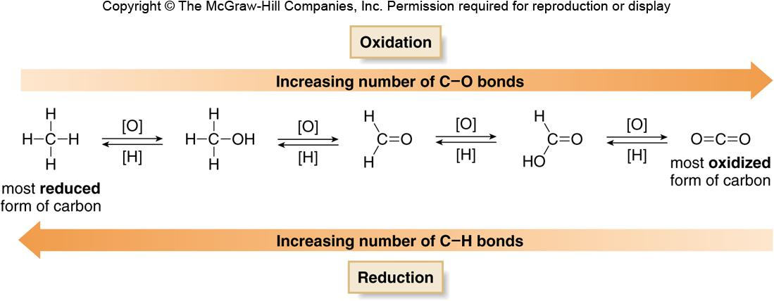
Oxidation and Reduction of Organic Molecules
Oxidation results in an increase in the number of
C−Z bonds (usually C−O bonds) or a decrease in
the number of C−H bonds.
Reduction results in a decrease in the number of
C−Z bonds (usually C−O bonds) or an increase in
the number of C−H bonds.
Figure 12.1
‹#›

Slide 3
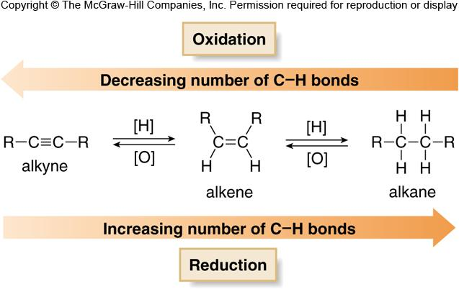
Oxidation and Reduction of Hydrocarbons
Sometimes, two carbon atoms are involved in a single oxidation or reduction reaction, and the net change in the number of C−H or C−Z bonds at both atoms must be taken into account.
  The conversion of an alkyne to an alkene, or an alkene to an alkane, are examples of reduction because each process adds two new C−H bonds to the starting material.
Figure 12.2
‹#›

Slide 4
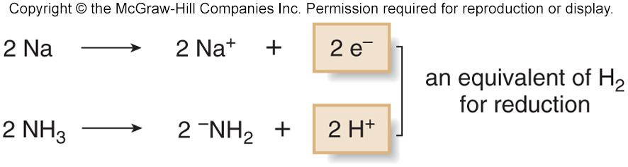
Reductions of Organic Molecules
There are three types of reductions differing in how H₂ is added.
The simplest reducing agent is H₂. Reductions using H₂ are carried out with a metal catalyst.
A second way is to add two protons and two electrons to a substrate—that is, H₂ = 2H⁺ + 2e⁻.
    Reductions of this sort use alkali metals as a source of electrons, and liquid ammonia as a source of protons.
    These are called dissolving metal reductions.
‹#›

Slide 5
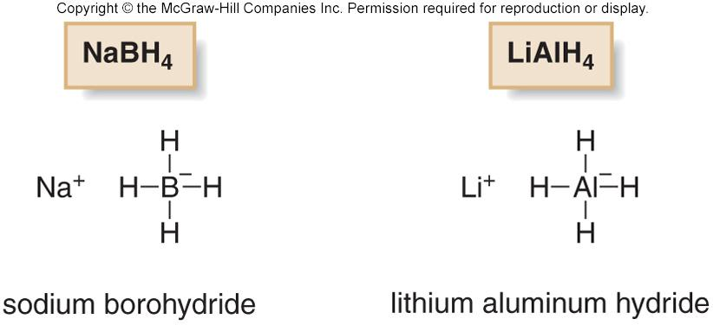
Hydride Reduction
The third way to add H₂ is to add hydride (H¯) and a proton (H⁺).
The most common hydride reducing agents contain a hydrogen atom bonded to boron or aluminum.
Simple examples include sodium borohydride (NaBH₄) and lithium aluminum hydride (LiAlH₄).
NaBH₄ and LiAlH₄ deliver H¯ to the substrate, and then a proton is added from H₂O or an alcohol.
‹#›

Slide 6
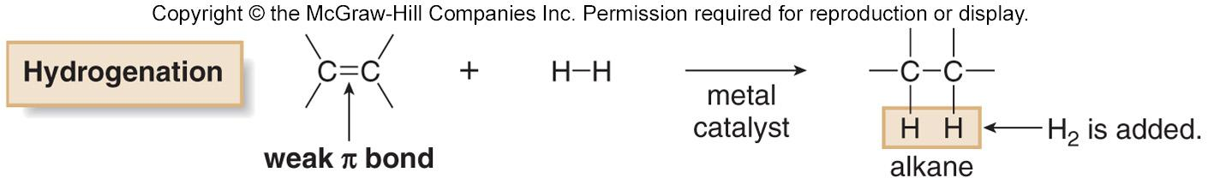
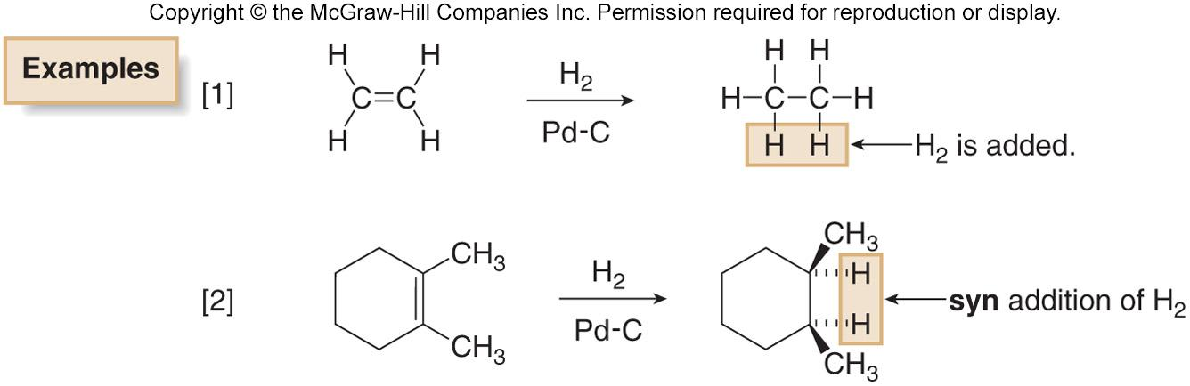
Catalytic Hydrogenation
The addition of H₂ occurs only in the presence of a metal catalyst, and thus it is called catalytic hydrogenation.
The catalyst consists of a metal—usually Pd, Pt, or Ni, adsorbed onto a finely divided inert solid, such as charcoal.
H₂ adds in a syn fashion.
‹#›

Slide 7
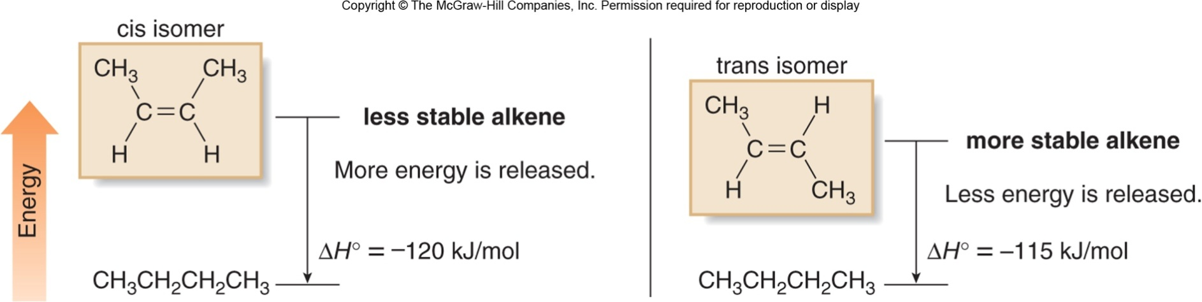
Relative Energies of Alkenes
Both cis and trans 2-butene are hydrogenated to butane.
The heat of hydrogenation of the trans isomer is less than that of the cis isomer.
Because less energy is released in converting the trans alkene to butane, it must be lower in energy to begin with.
Figure 12.3
‹#›

Slide 8
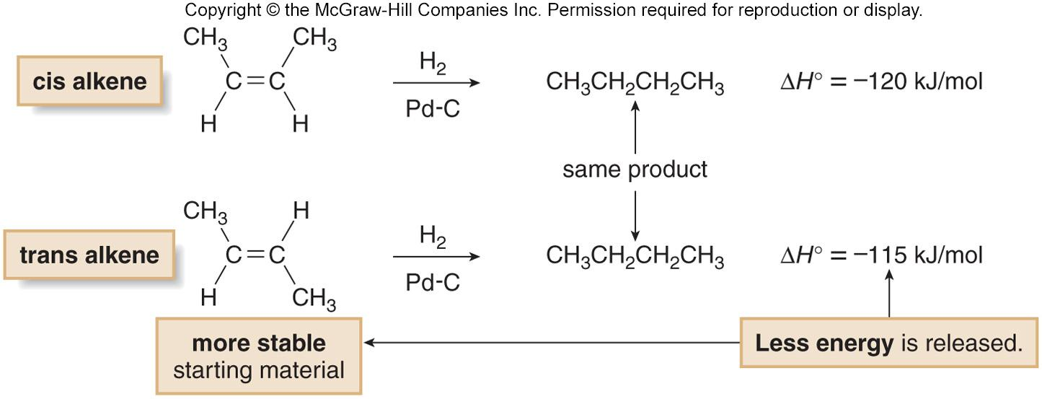
Heats of Hydrogenation and Stability
The ΔHº of hydrogenation, also known as the heat of hydrogenation, can be used as a measure of the relative stability of two different alkenes that are hydrogenated to form the same alkane.
When hydrogenation of two alkenes gives the same alkane, the more stable alkene has the smaller heat of hydrogenation.
‹#›

Slide 9
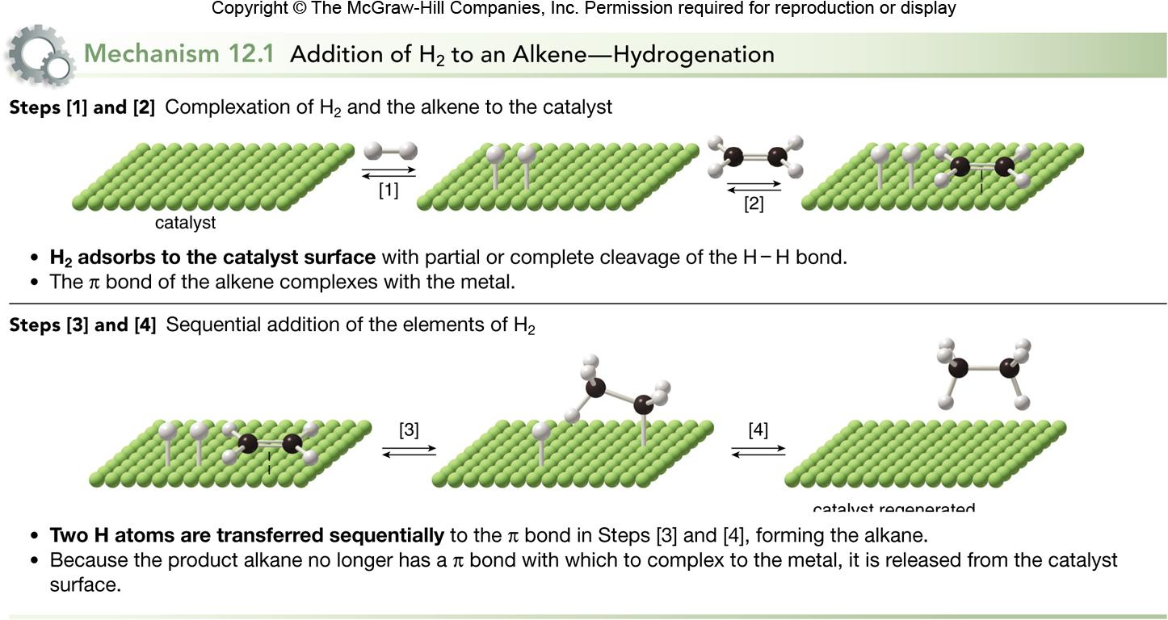
Catalytic Hydrogenation Mechanism
‹#›

Slide 10
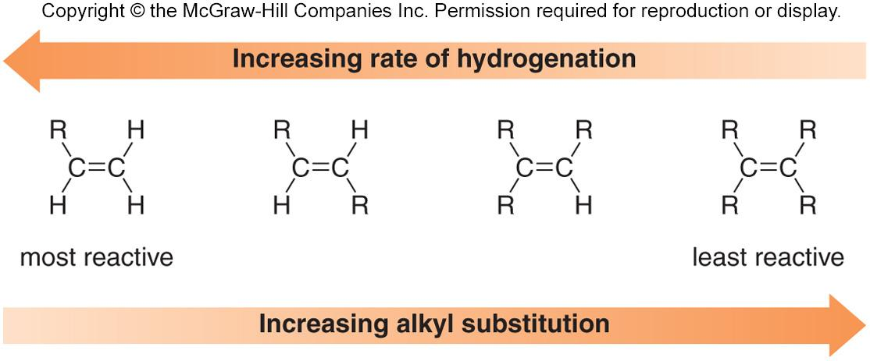
Rate of Catalytic Hydrogenation
The mechanism explains two facts about hydrogenation:
  Rapid, sequential addition of H₂ occurs from the side of the alkene complexed to the metal surface, resulting in syn addition.
  Less crowded double bonds complex more readily to the catalyst surface, resulting in faster reaction.
‹#›

Slide 11
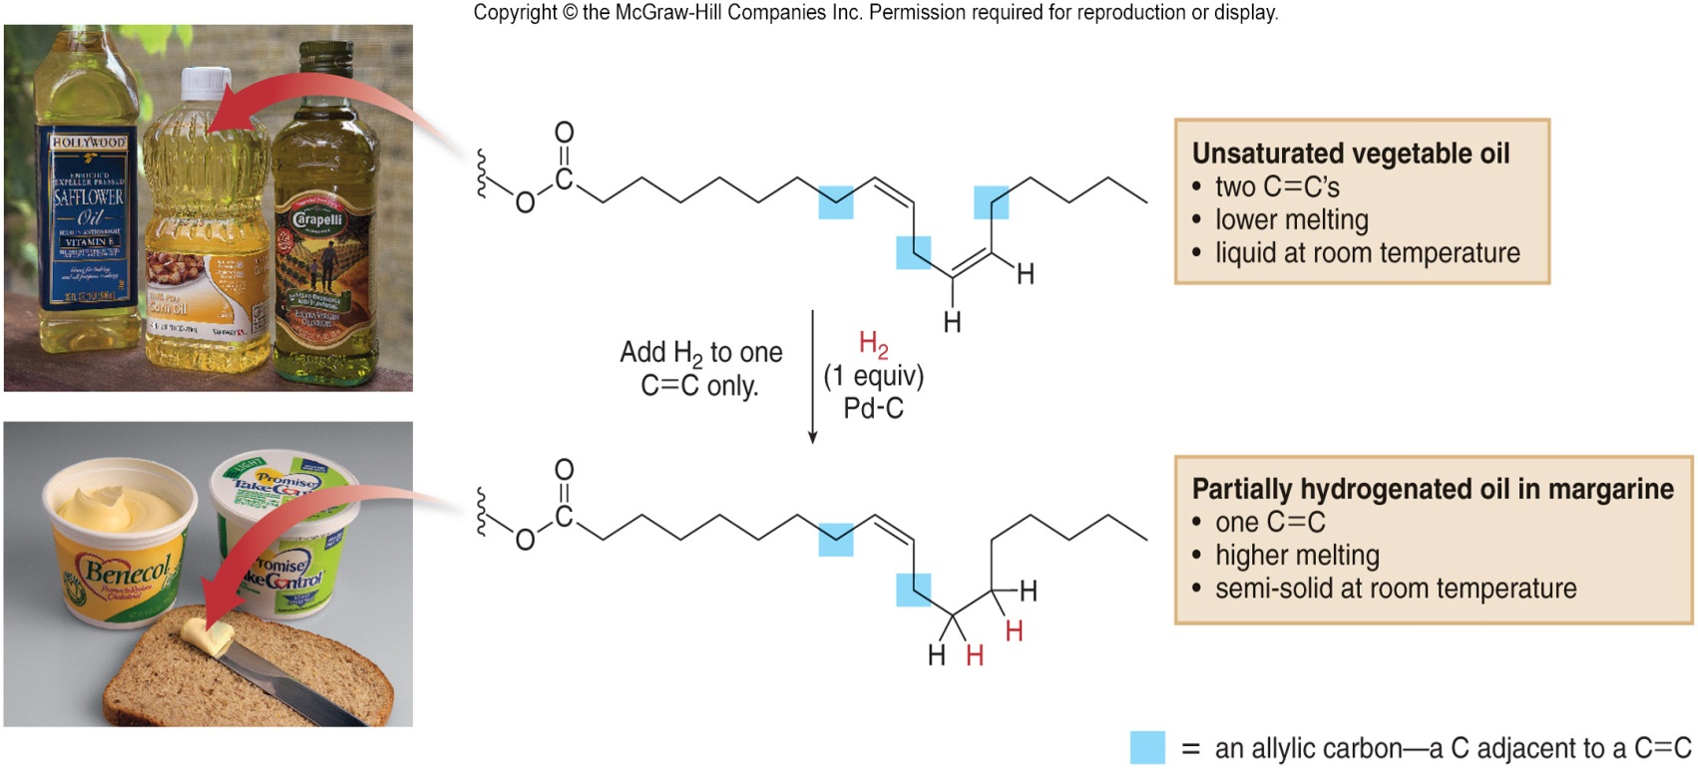
Hydrogenation of Vegetable Oil
When unsaturated vegetable oil is treated with hydrogen, some or all of the π bonds add H₂.
  This increases the melting point of the oil.
Margarine is prepared by partially hydrogenating vegetable oils to give a product with a consistency that more closely resembles butter.
Figure 12.4
‹#›

Slide 12
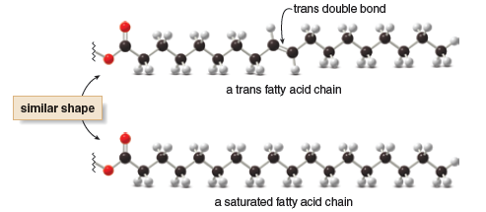
Trans Fatty Acids
The steps in hydrogenation of fatty acids are reversible.
H atoms are added sequentially rather than in a concerted step.
Therefore, cis alkenes can isomerize to the more stable trans alkene.
This is how “trans fats” are formed.
“Trans fats” stimulate cholesterol synthesis in the liver, increasing blood cholesterol levels.
‹#›

Slide 13
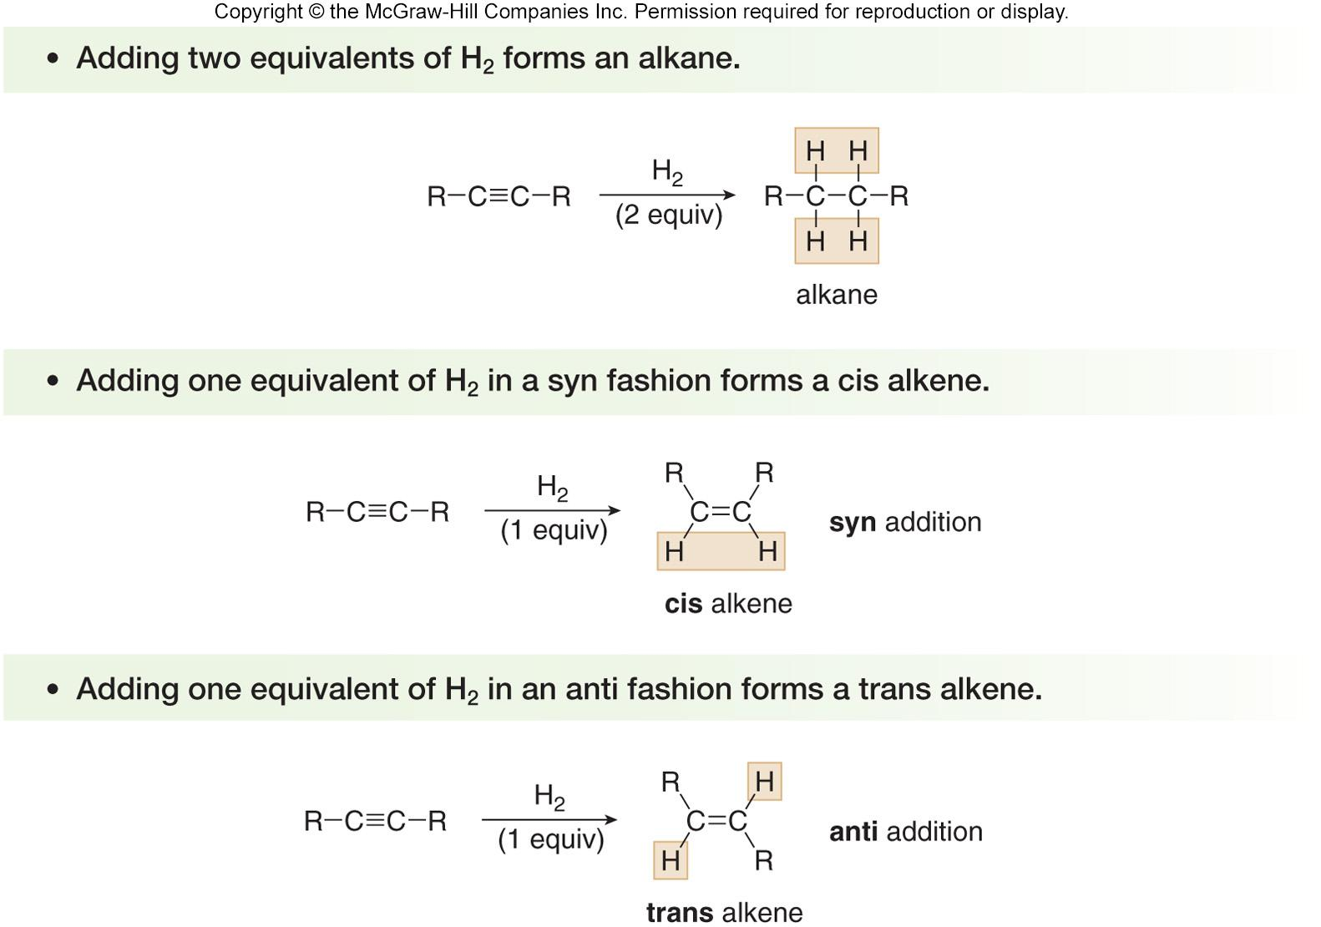
Reduction of Alkynes
There are three different ways in which H₂ can add to the triple bond:
‹#›

Slide 14
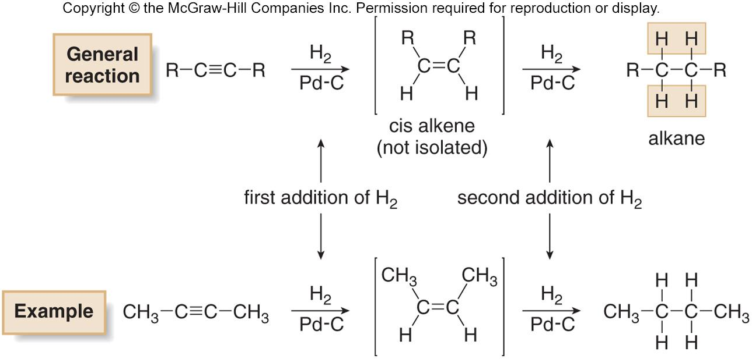
Catalytic Hydrogenation of Alkynes
‹#›

Slide 15
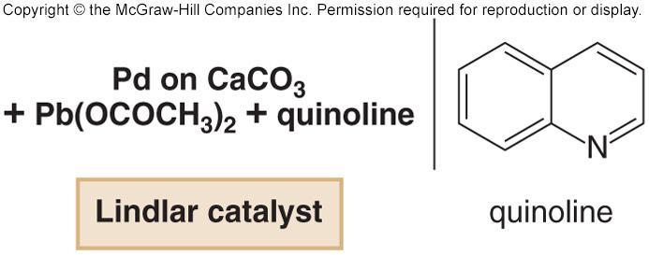
Reduction of Alkynes to Cis Alkenes
Palladium metal is too reactive to allow hydrogenation of an alkyne to stop after one equivalent of H₂ adds.
To stop at a cis alkene, a less active Pd catalyst (Lindlar’s catalyst) is used—Pd adsorbed onto CaCO₃ with added lead(II) acetate and quinoline.
Compared to Pd metal, Lindlar’s catalyst is deactivated or “poisoned.”
With the Lindlar catalyst, one equivalent of H₂ adds to an alkyne to form the cis product.
The cis alkene product is unreactive to further reduction.
‹#›

Slide 16
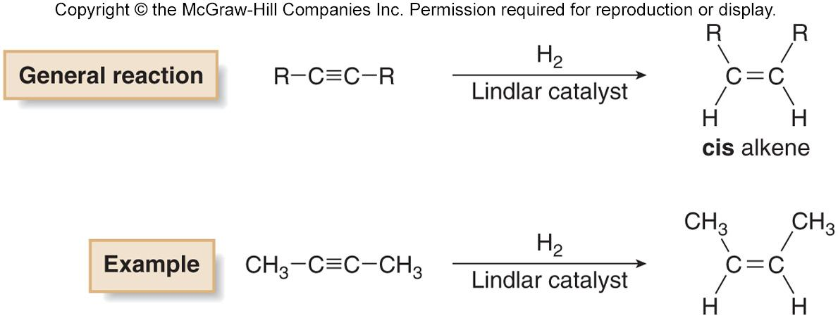
Reduction of Alkynes Using Lindlar’s Catalyst
Reduction of an alkyne to a cis alkene is a stereoselective reaction, because only one stereoisomer is formed.
‹#›

Slide 17
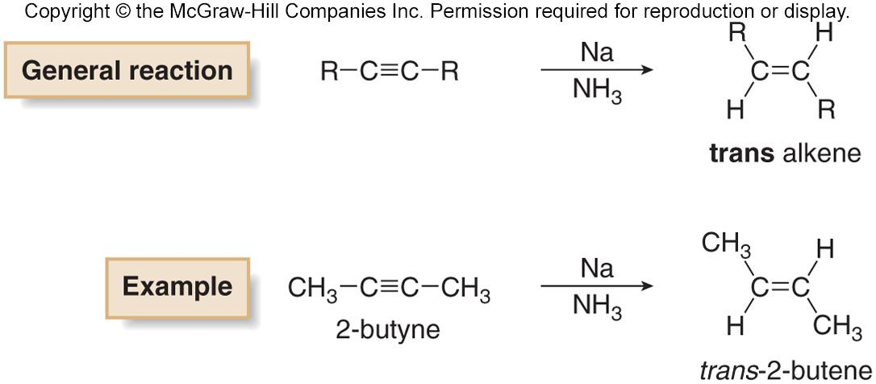
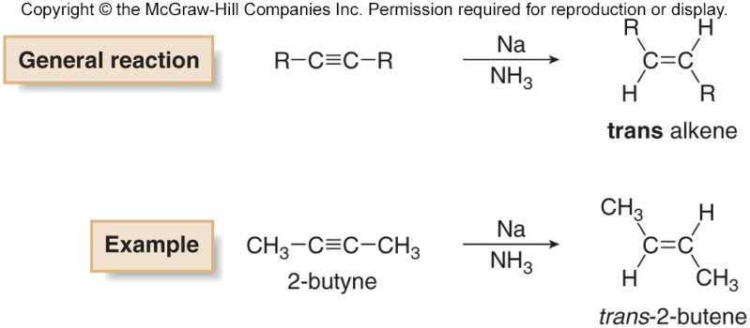
Dissolving Metal Reduction of Alkynes
In a dissolving metal reduction (such as Na in NH₃), the elements of H₂ are added in an anti fashion to form a
trans alkene.
‹#›

Slide 18
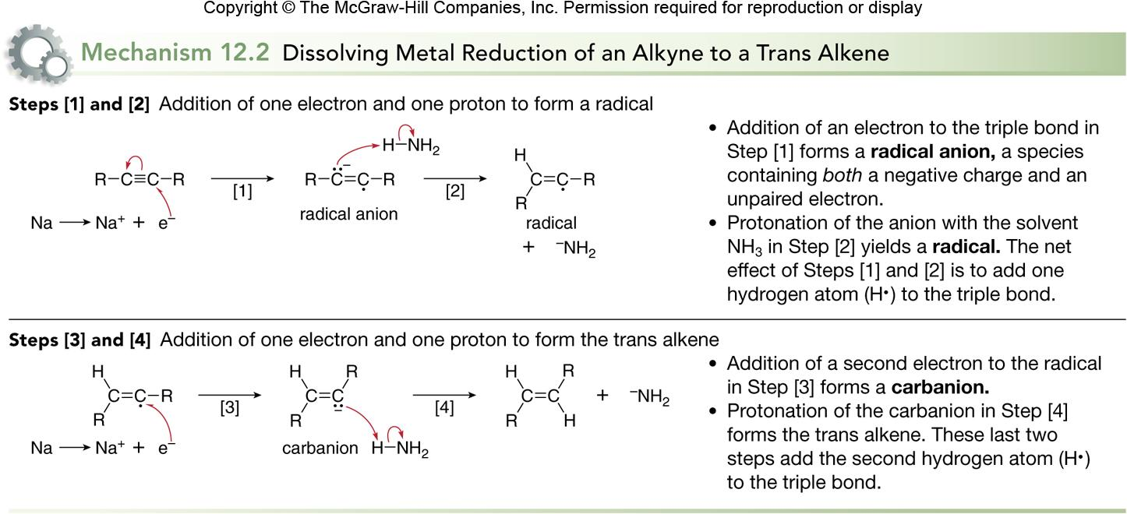
Mechanism of Dissolving Metal Reduction
‹#›

Slide 19
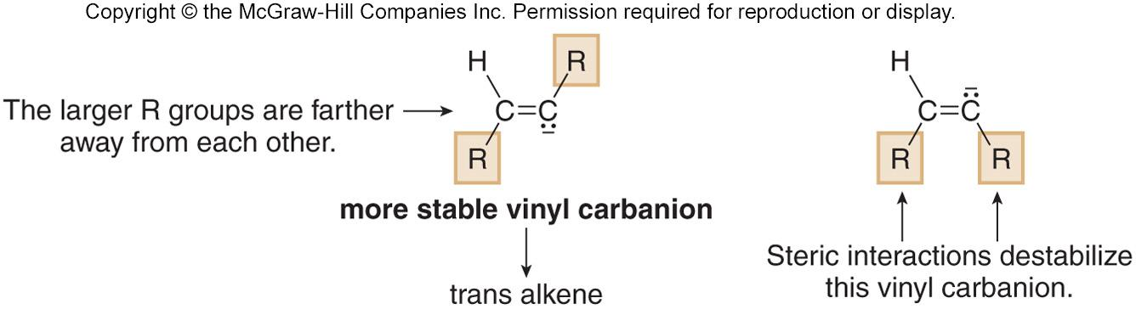
Summary of Dissolving Metal Reductions
Dissolving metal reduction of a triple bond with Na in NH₃ is a stereoselective reaction because it forms a trans product exclusively.
Dissolving metal reductions always form the more stable trans product preferentially.
The trans alkene is formed because the vinyl carbanion intermediate that is formed is more stable when the larger R groups are further away from each other to avoid steric interactions.
Protonation of this anion leads to the more stable trans adduct.
‹#›

Slide 20
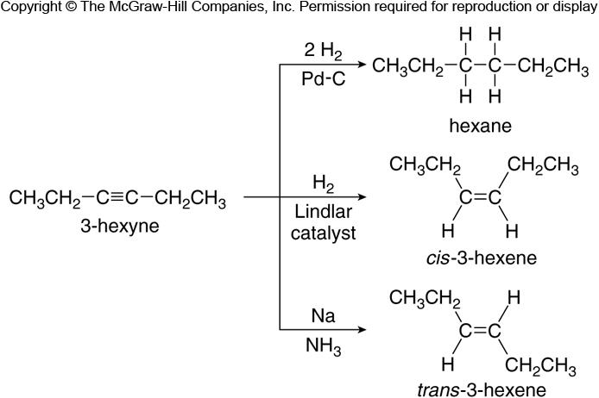
Summary of Alkyne Reductions
Figure 12.5
‹#›

Slide 21
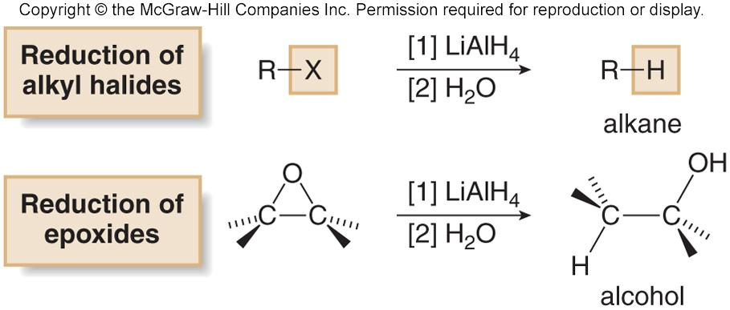
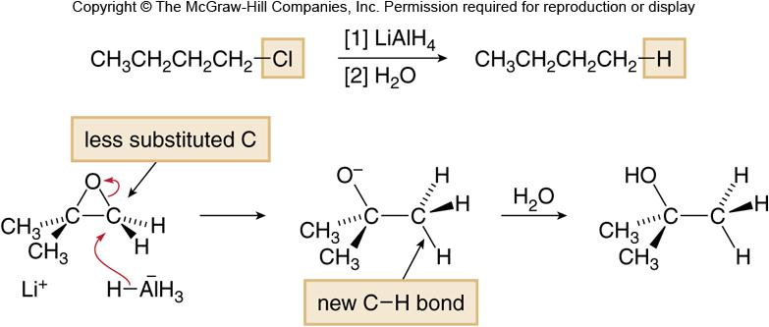
Reduction of Polar C-X σ Bonds with LiAlH₄
Alkyl halides can be reduced to alkanes with LiAlH₄.
Epoxide rings can be opened with LiAlH₄ to form alcohols.
Figure 12.6
‹#›

Slide 22
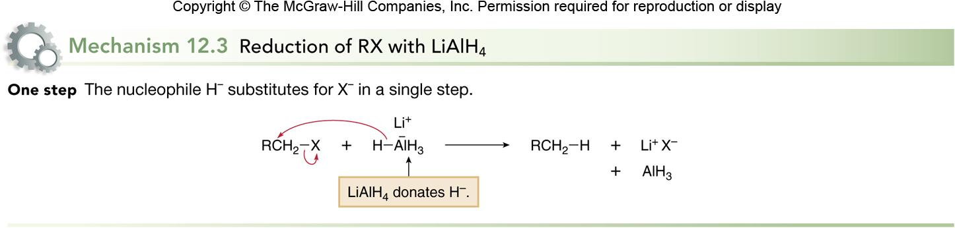
Mechanism of LiAlH₄ Reduction
This reaction follows an S_{N}2 mechanism.
Unhindered CH₃X and 1° alkyl halides are more easily reduced than more substituted 2° and 3° halides.
In unsymmetrical epoxides, nucleophilic attack of H¯ (from LiAlH₄) occurs at the less substituted carbon atom.
‹#›

Slide 23
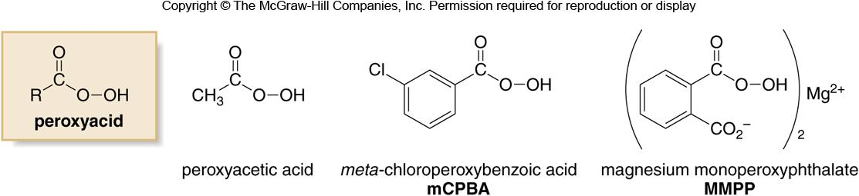
Peroxide Oxidizing Agents
There are two main categories of oxidizing agents:
  Reagents that contain an oxygen-oxygen bond; and
  Reagents that contain metal-oxygen bonds.
Oxidizing agents containing an O-O bond include O₂,
O₃ (ozone), H₂O₂ (hydrogen peroxide), (CH₃)COOH (tert-butyl hydroperoxide), and peroxyacids.
Peroxyacids (or peracids) have the general formula RCO₃H.
Figure 12.7
Common peroxyacids
‹#›

Slide 24
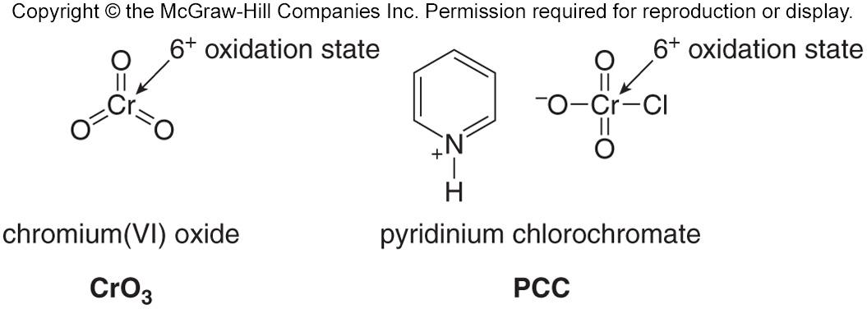
Oxidizing Agents with Metal Oxygen Bonds
The most common oxidizing agents with metal-oxygen bonds contain either chromium +6 or manganese +7.
Common Cr⁶⁺ reagents include CrO₃ and sodium or potassium dichromate (Na₂Cr₂O₇ and K₂Cr₂O₇).
Pyridinium chlorochromate (PCC) is a more selective Cr⁶⁺ oxidant.
The most common Mn⁷⁺ reagent is KMnO₄ (potassium permanganate).
Other oxidizing agents that contain metals include OsO₄ (osmium tetroxide) and Ag₂O [silver(I) oxide].
‹#›

Slide 25
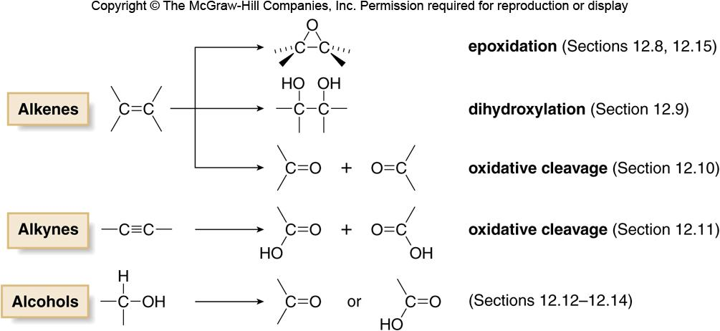
Oxidation Reactions
Figure 12.8
‹#›

Slide 26
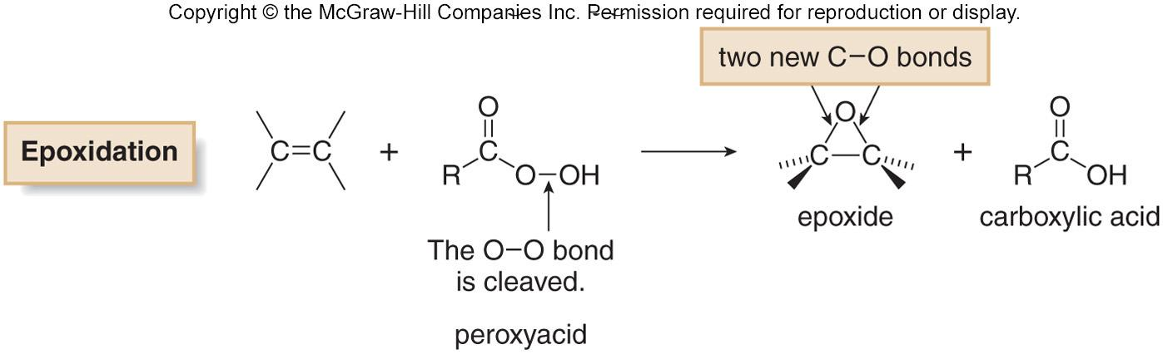
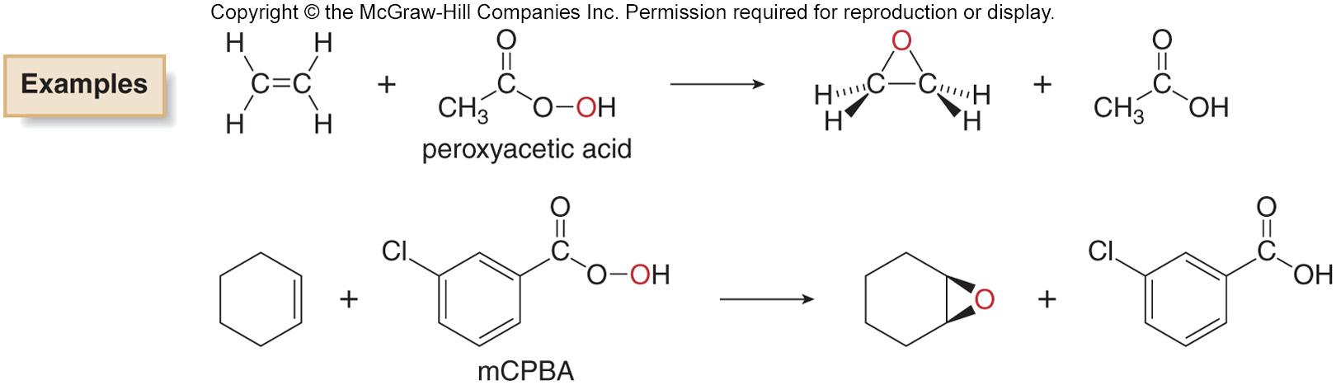
Epoxidation
Epoxidation is the addition of a single oxygen atom to an alkene to form an epoxide.
Epoxidation is typically carried out with a peroxyacid.
‹#›

Slide 27
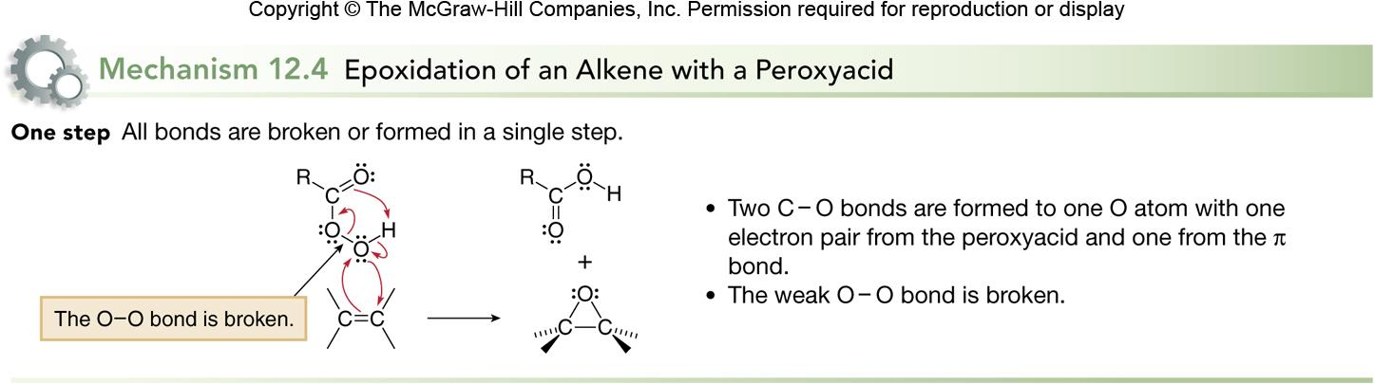
Epoxidation Mechanism
Epoxidation occurs via syn addition of an O atom to either side of a planar double bond.
Epoxidation is stereospecific because cis and trans alkenes yield different stereoisomers as products.
A cis alkene gives an epoxide with cis substituents.
A trans alkene gives an epoxide with trans substituents.
‹#›

Slide 28
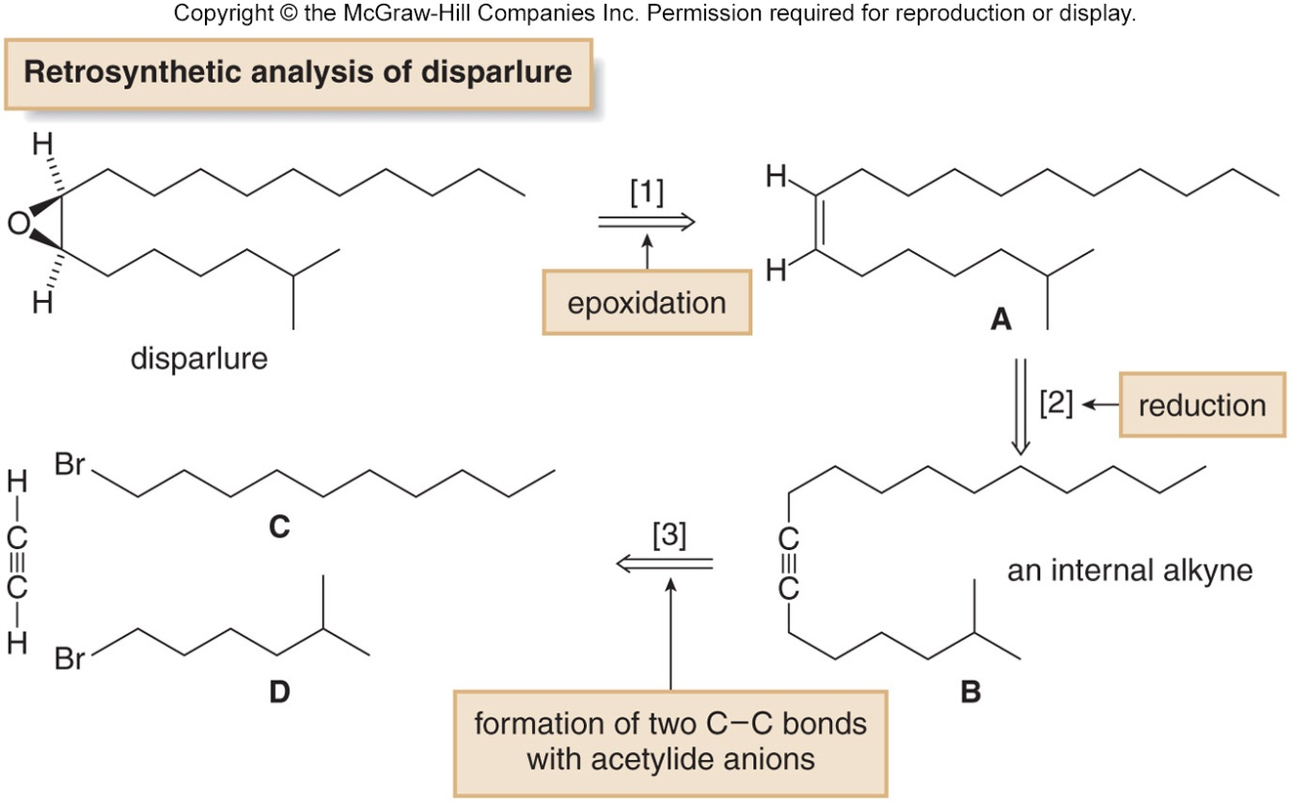
Retrosynthetic Analysis of Disparlure
Disparlure, the sex pheromone of the gypsy moth, is synthesized by a stepwise sequence that uses an epoxidation reaction as the final step.
Retrosynthetic analysis of disparlure illustrates three key operations:
‹#›

Slide 29
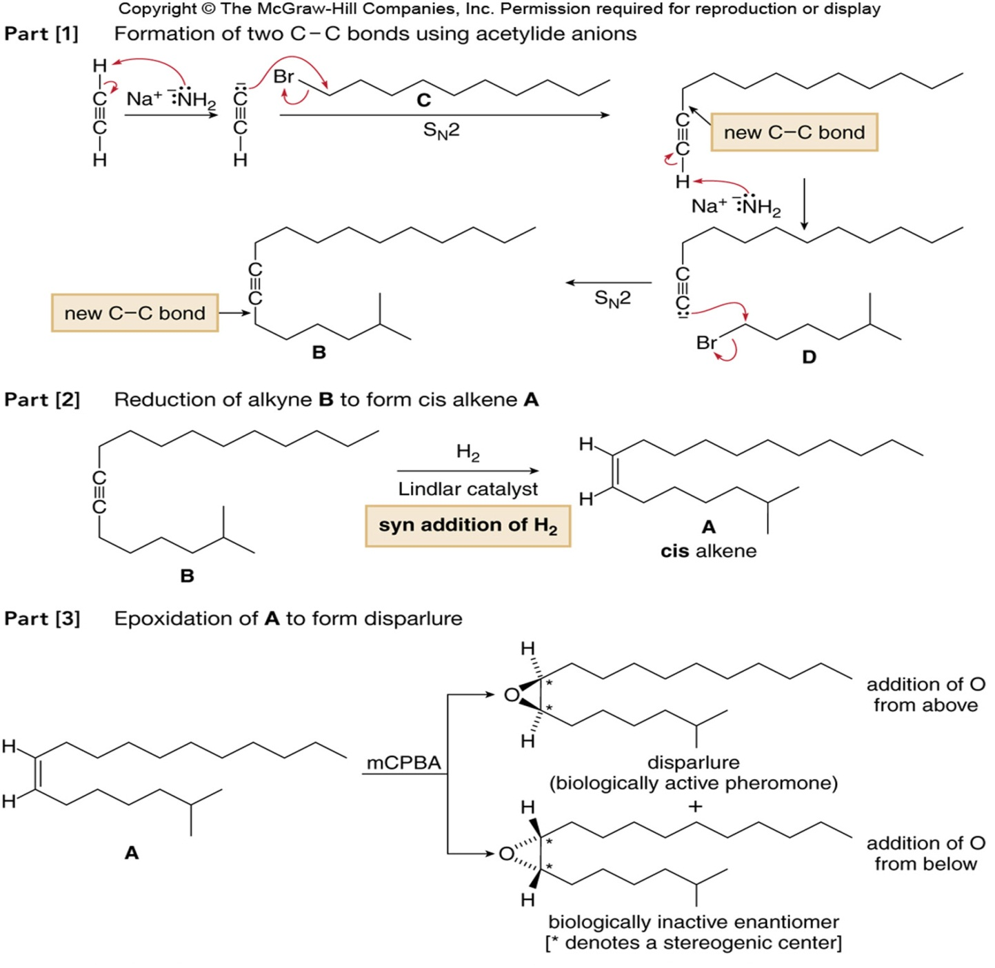
Synthesis of Disparlure
Figure 12.9
‹#›

Slide 30
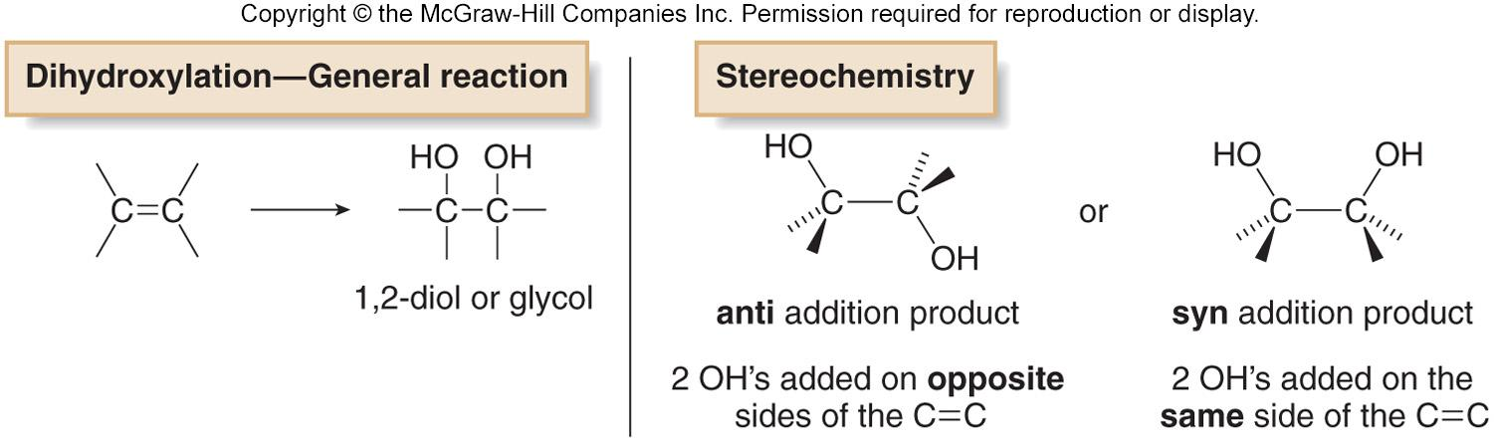
Dihydroxylation
Dihydroxylation is the addition of two hydroxy groups to a double bond, forming a 1,2-diol or glycol.
Depending on the reagent, the two new OH groups can be added to the opposite sides (anti addition) or the same side (syn addition) of the double bond.
‹#›

Slide 31
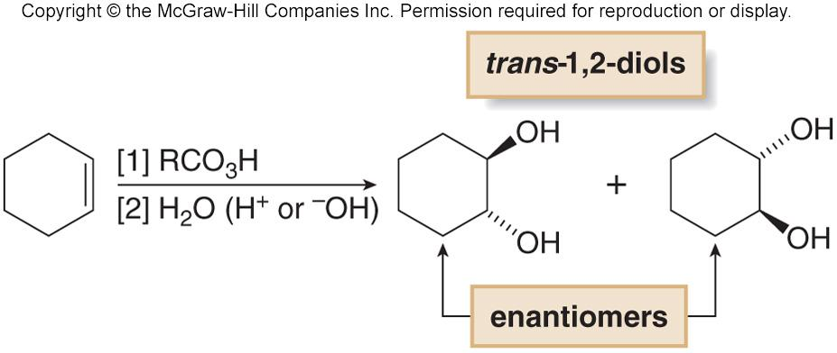
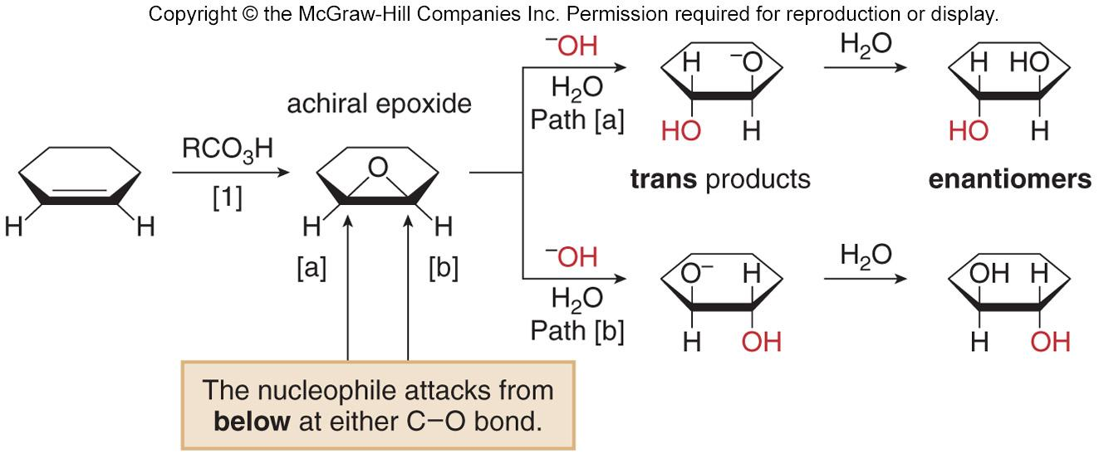
Anti Dihydroxylation via Epoxide
Anti dihydroxylation is achieved in two steps—epoxidation, followed by ring opening with ¯OH or H₃O⁺.
‹#›

Slide 32
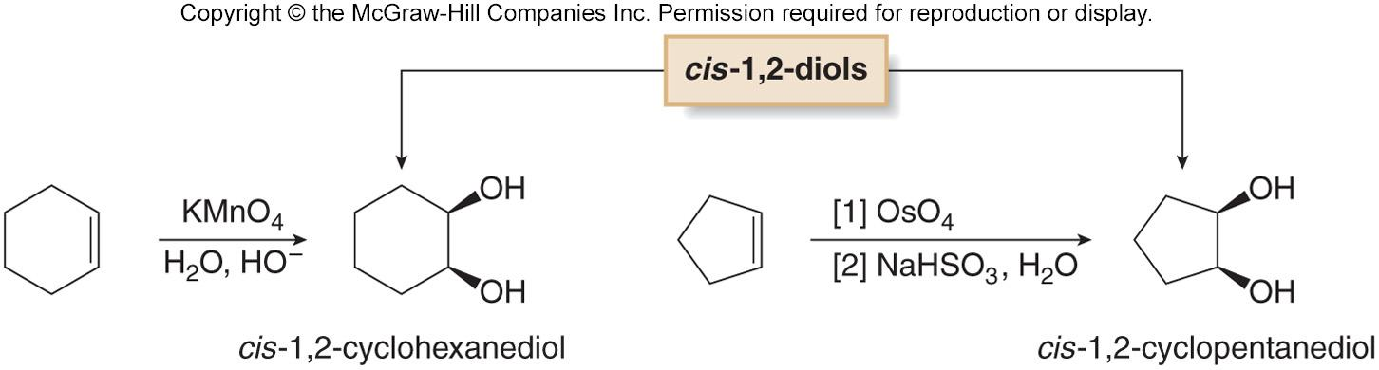
Syn Dihydroxylation
Syn hydroxylation results when an alkene is treated with either KMnO₄ or OsO₄.
‹#›

Slide 33
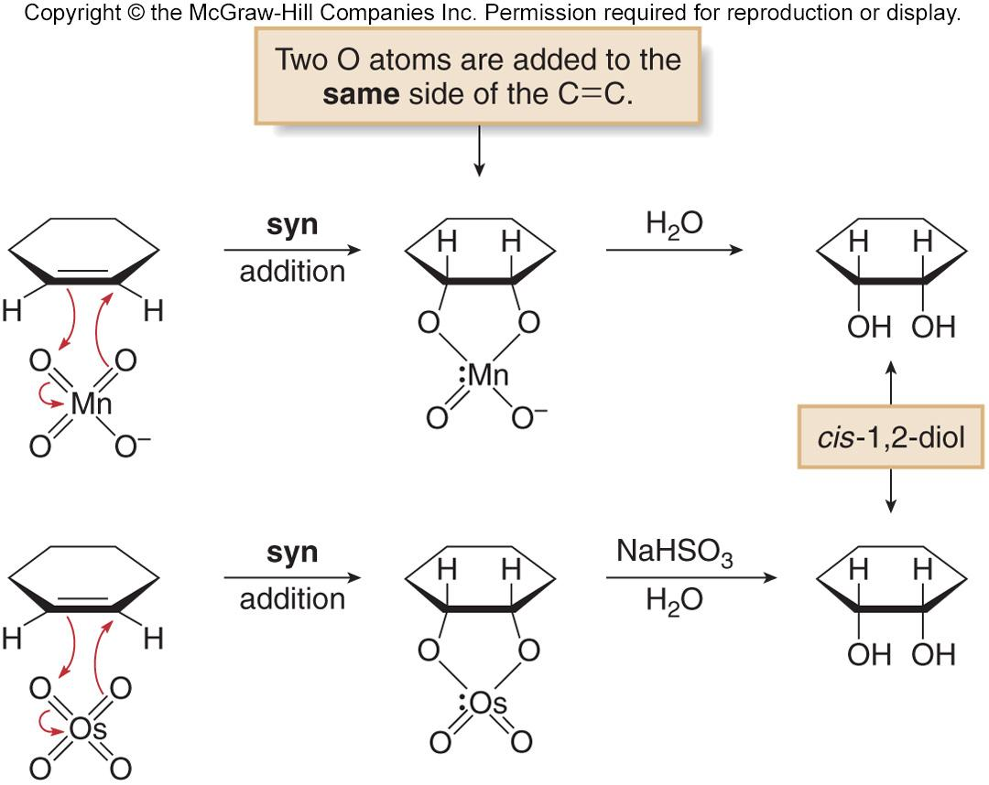
Mechanism of Syn Dihydroxylation
Each reagent adds two oxygen atoms in a syn fashion.
Hydrolysis of the cyclic intermediate cleaves the metal oxygen bonds, forming a cis-1,2-diol.
‹#›

Slide 34
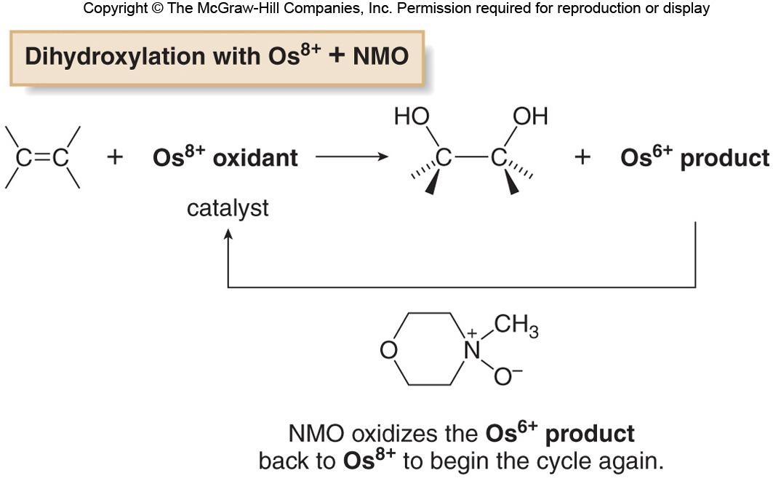
Catalytic Syn Dihydroxylation
Dihydroxylation can also be carried out by using a catalytic amount of OsO₄, if the oxidant N-methylmorpholine N-oxide (NMO) is added.
In the catalytic process, dihydroxylation of the double bond converts the Os⁸⁺ oxidant into an Os⁶⁺ product, which is then
re-oxidized by NMO to Os⁸⁺.
‹#›

Slide 35
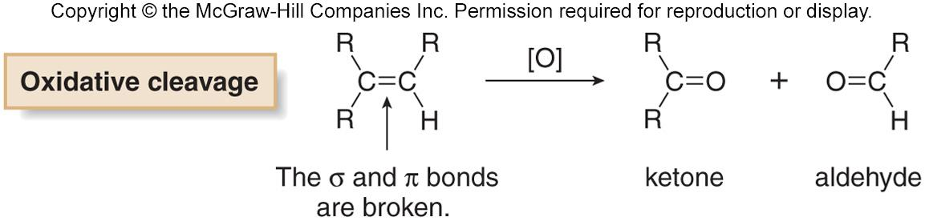

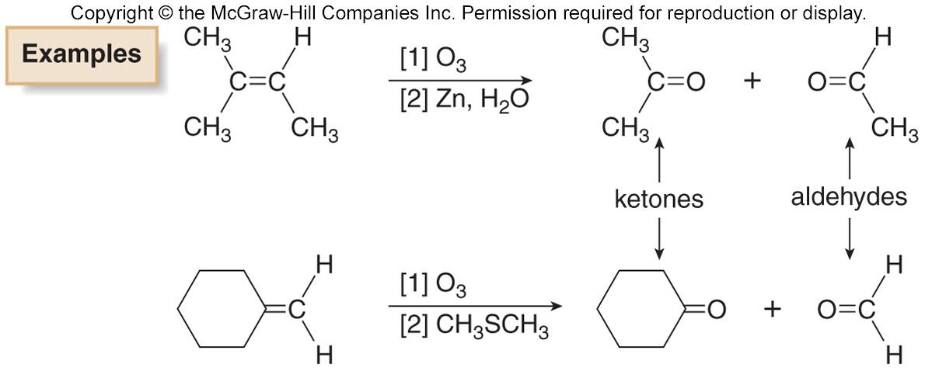
Ozonolysis: Oxidative Cleavage of Alkenes
Oxidative cleavage of an alkene breaks both the σ and π bonds of the double bond to form two carbonyl compounds.
Cleavage with ozone (O₃) is called ozonolysis.
‹#›

Slide 36
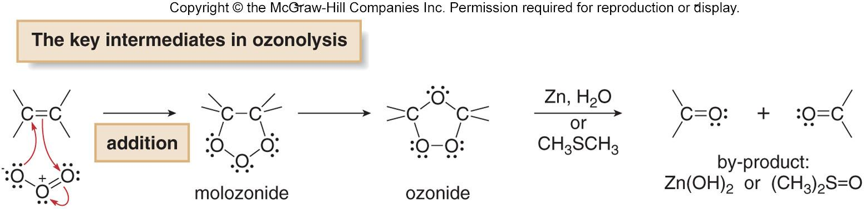
Mechanism of Ozonolysis
Addition of O₃ to the π bond of an alkene forms an unstable intermediate called a molozonide, which rearranges to an ozonide in a stepwise process.
The unstable ozonide is reduced to afford carbonyl compounds. Zn (in H₂O) or dimethylsulfide (CH₃SCH₃) are two common reagents used to convert the ozonide into carbonyl compounds.
‹#›

Slide 37
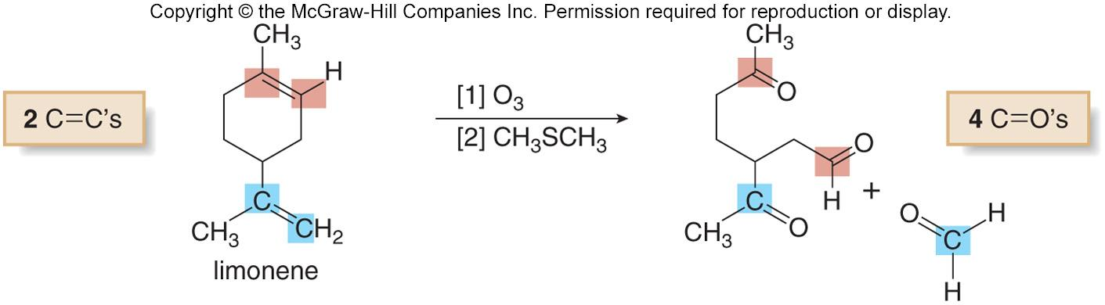
Oxidative Cleavage of Rings
Ozonolysis of dienes or other polyenes results in oxidative cleavage of all C=C bonds.
When oxidative cleavage involves a double bond that is part of a ring, the ring opens up affording a single chain with two carbonyls at the carbons where the double bonds were originally.
Oxidative cleavage is a valuable tool in structure determination, helping to pinpoint the location of double bonds in complex alkene structures.
‹#›

Slide 38
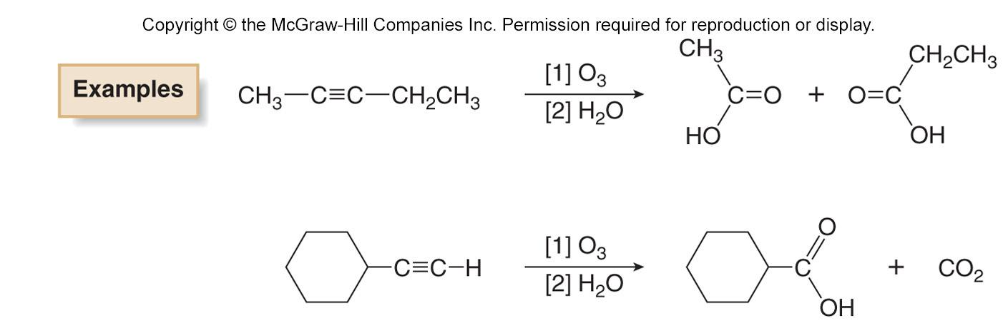
Oxidative Cleavage of Alkynes
Alkynes undergo oxidative cleavage of the σ and both π bonds of the triple bond.
Internal alkynes are oxidized to carboxylic acids (RCOOH).
Terminal alkynes afford a carboxylic acid and CO₂ from the
sp hybridized C-H bond.
‹#›

Slide 39
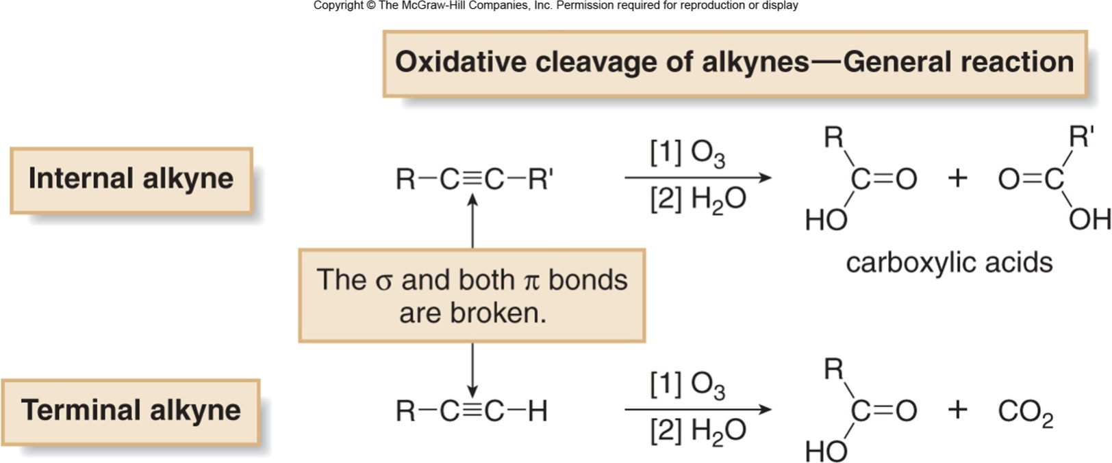
Oxidative Cleavage of Alkynes
Alkynes undergo oxidative cleavage of the σ and both π bonds of the triple bond.
Internal alkynes are oxidized to carboxylic acids (RCOOH).
Terminal alkynes afford a carboxylic acid and CO₂ from the
sp hybridized C-H bond.
‹#›

Slide 40
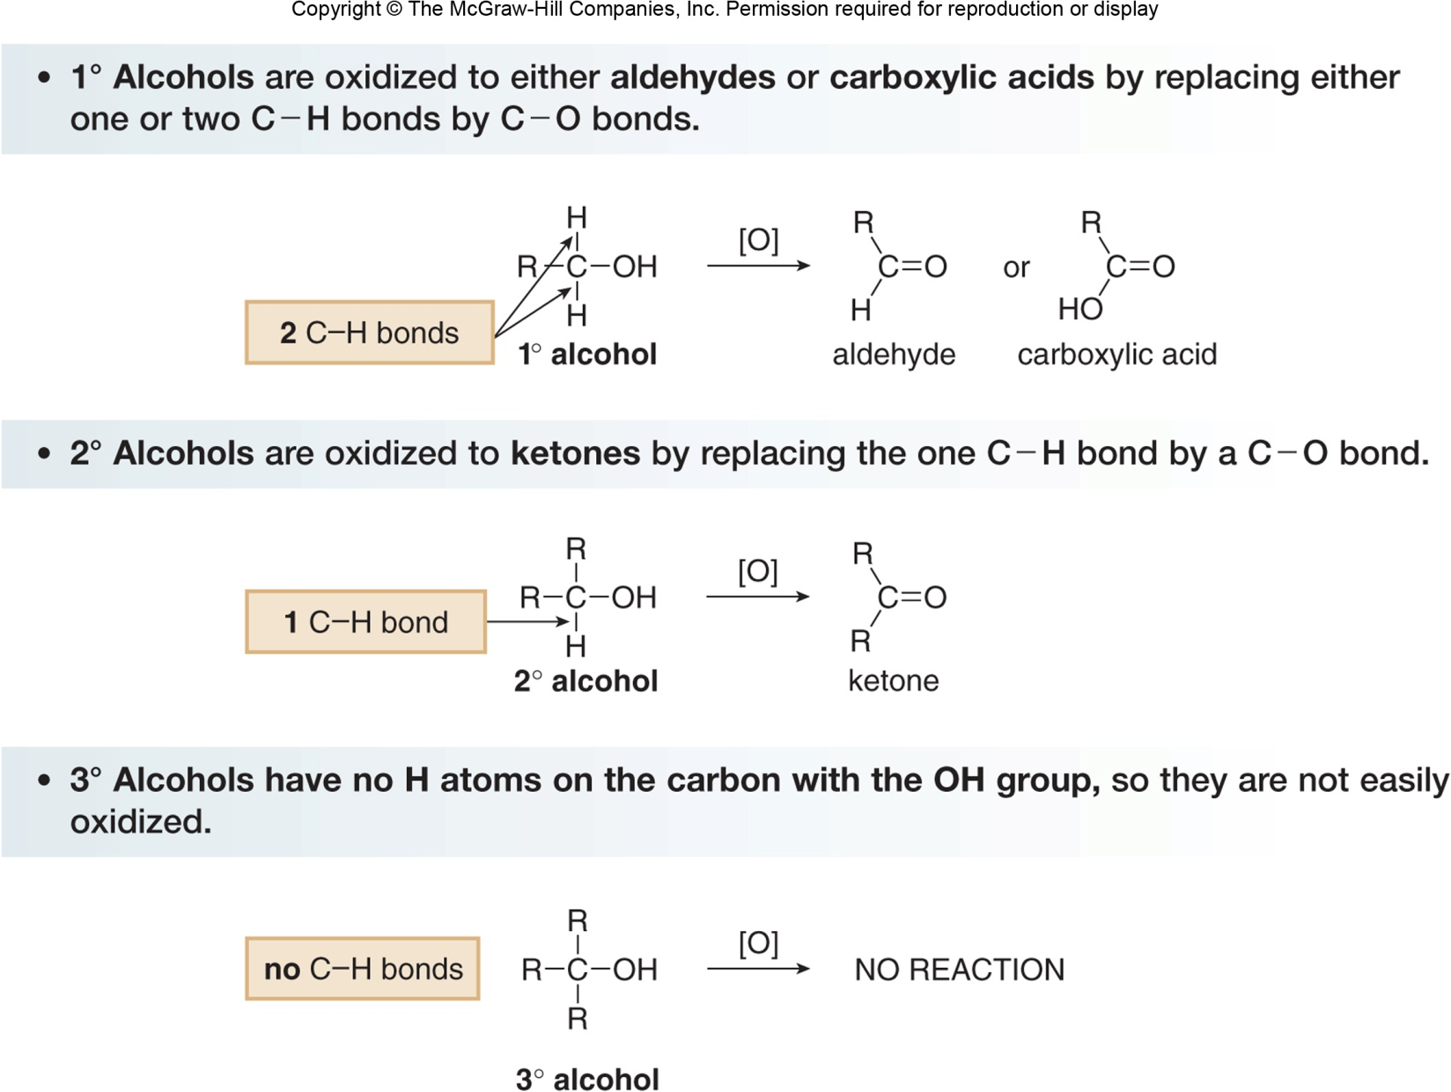
Oxidation of Alcohols
Alcohols are oxidized to a variety of carbonyl compounds.
‹#›

Slide 41

Chromium Oxidizing Reagents
Oxidation of alcohols to carbonyl compounds is typically carried out with Cr⁶⁺ oxidants, which are reduced to Cr³⁺ products.
CrO₃, Na₂Cr₂O₇, and K₂Cr₂O₇ are strong, nonselective oxidants used in aqueous acid (H₂SO₄ + H₂O).
PCC is soluble in CH₂Cl₂ (dichloromethane) and can be used without strong acid present, making it a more selective, milder oxidant.
‹#›

Slide 42
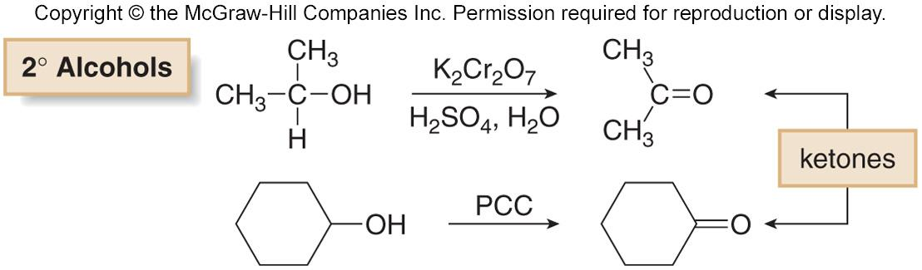
Oxidation of 2° Alcohols
Any of the Cr⁶⁺ oxidants effectively oxidize 2° alcohols to ketones.
‹#›

Slide 43
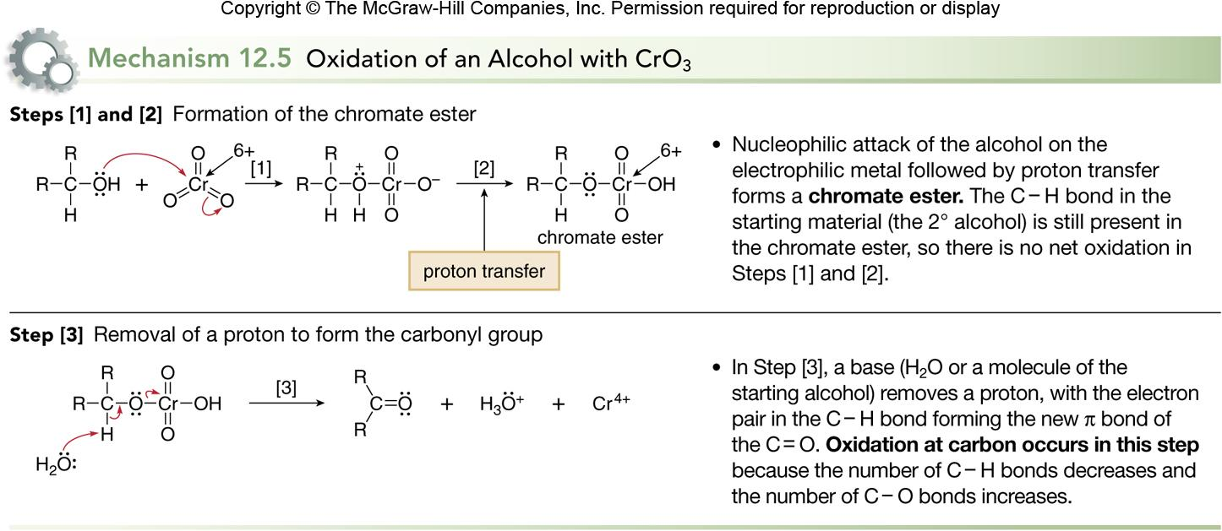
Mechanism of CrO₃ Oxidation of Alcohols
‹#›

Slide 44
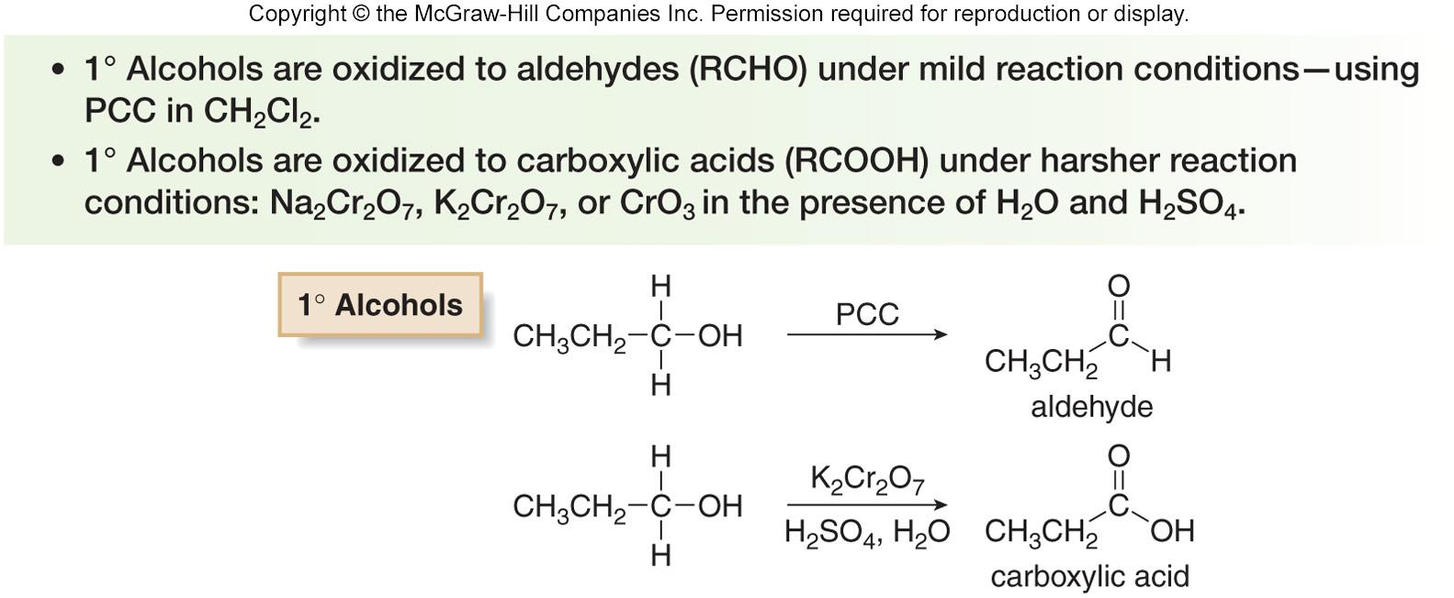
Oxidation of 1° Alcohols
Primary alcohols are oxidized to either aldehydes or carboxylic acids, depending on the reagent.
‹#›

Slide 45
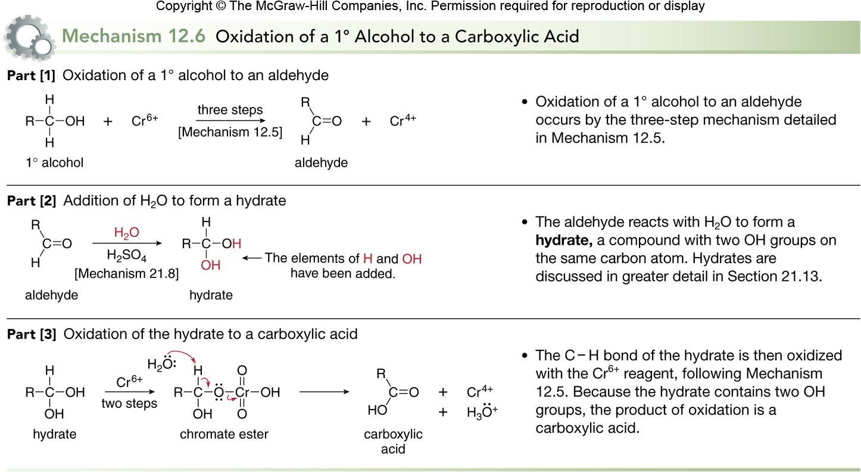
Mechanism of Oxidation of 1° Alcohols
‹#›

Slide 46
Blood Alcohol Screening for 1° Alcohols
Cr⁶⁺ oxidations are characterized by a color change, as the red-orange Cr⁶⁺ reagent is reduced to green Cr³⁺.
Some devices used to measure blood alcohol content make use of this color change.
Blood alcohol level can be determined by having an individual blow into a tube containing K₂Cr₂O₇, H₂SO₄, and an inert solid.
The higher the concentration of CH₃CH₂OH in the breath, the more Cr⁶⁺ is reduced, and the farther the green Cr³⁺ color extends down the length of the sample tube.
The higher the concentration of the extent of the green color is then correlated with blood alcohol levels.
‹#›

Slide 47
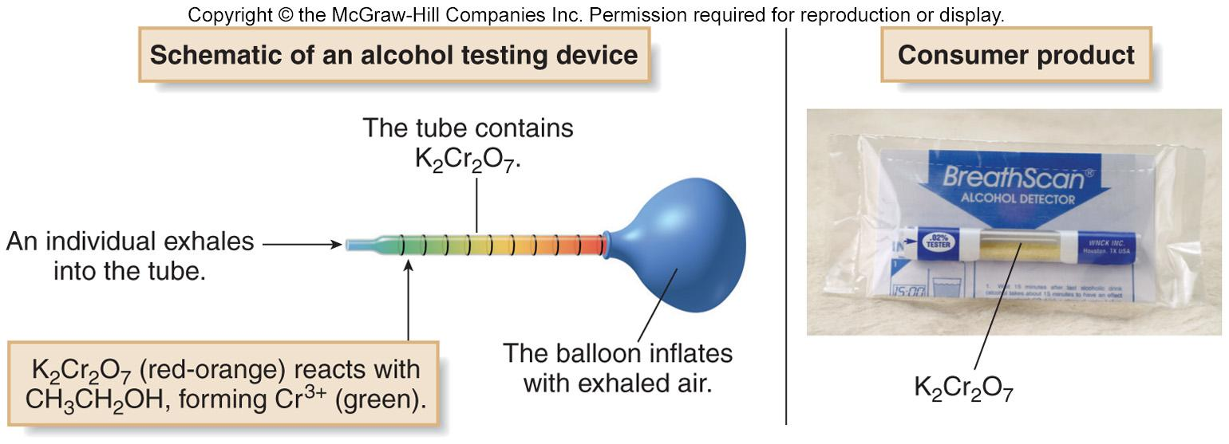
Blood Alcohol Screening for 1° Alcohols
The oxidation of CH₃CH₂OH with K₂Cr₂O₇ to form CH₃COOH and Cr³⁺ was the first available method for the routine testing of alcohol concentration in exhaled air.
Figure 12.10
‹#›

Slide 48
Green Chemistry
Green chemistry is the use of environmentally benign methods to synthesize compounds.
Its purpose is to use safer reagents and less solvent, and develop reactions that form fewer by-products and generate less waste.
Since many oxidation methods use toxic reagents (such as OsO₄ and O₃) and corrosive acids such as H₂SO₄, or generate carcinogenic by-products (such as Cr³⁺), alternative less problematic regents have been developed.
    One method uses a polymer supported Cr³⁺ reagent—Amberlyte A-26 resin-HCrO₄—that avoids the use of strong acid, and forms a Cr³⁺ by-product that can easily be removed from the product by filtration.
‹#›

Slide 49


A Green Oxidizing Reagent
Heating the insoluble polymeric reagent with an alcohol results in oxidation to a carbonyl compound.
With Amberlyst A-26 resin-HCrO₄¯, 1° alcohols are oxidized to aldehydes and 2° alcohols are oxidized to ketones.
‹#›

Slide 50

Green Oxidizing Reagent - Oxone
Potassium peroxymonosulfate, KHSO₅ is a sulfur derivative of hydrogen peroxide.
Sold as a triple salt (2 KHSO₅.KHSO₄.K₂SO₄) called Oxone.
Oxone oxidizes a variety of functional groups without the presence of a heavy metal like chromium or magnesium.
The weak oxygen-oxygen bond of the reagent is cleaved during oxidation.
‹#›

Slide 51

Metabolism of Ethanol
In the body, ingested ethanol is oxidized in the liver first to CH₃CHO (acetaldehyde), and then to CH₃COO⁻ (the acetate anion) catalyzed by alcohol dehydrogenase.
If more ethanol is ingested than can be metabolized, the concentration of acetaldehyde increases.
Acetaldehyde, which is toxic, is responsible for the feelings associated with a hangover.
‹#›

Slide 52

Metabolism of Methanol
If methanol is ingested, it is metabolized by the same enzyme to give an aldehyde and an acid: formaldehyde and formic acid.
These compounds are extremely toxic since they cannot be used by the body.
Blood pH decreases, and blindness and death can follow.
‹#›

Slide 53

Achiral Reactions
Achiral starting materials react with achiral reagents to give either achiral products, or a racemic mixture of two enantiomers.
‹#›

Slide 54

The Sharpless Epoxidation–
An Enantioselective Reaction
In the Sharpless epoxidation, the double bonds of allylic alcohols are oxidized to epoxides.
Since the formation of only one enantiomer is favored, the reaction is said to be enantioselective.
An enantioselective reaction affords predominantly or exclusively one enantiomer.
A reaction that converts an achiral starting material into predominantly one enantiomer is called an asymmetric reaction.
‹#›

Slide 55

Sharpless Epoxidation Reagents
The Sharpless reagent consists of three different components: tert-butylhydroperoxide (CH₃)₃COOH; a titanium catalyst—usually titanium(IV) isopropoxide, Ti[OCH(CH₃)₂]₄; and diethyl tartrate (DET).
There are two different chiral diethyl tartrate isomers, labeled as (+)-DET or (−)-DET to indicate the direction in which they rotate plane polarized light.
The identity of the DET isomer determines which enantiomer is the major product obtained in the epoxidation.
‹#›

Slide 56

Sharpless Epoxidation
Reactions [1] and [2] are highly enantioselective as each has an enantiomeric excess of 95% (i.e., 97.5% of the major enantiomer and 2.5% of the minor enantiomer).
‹#›

Slide 57

Determining the Product of Sharpless Epoxidation
To determine which enantiomer is formed from a given isomer of DET, draw the allylic alcohol in a plane, with the OH group in the bottom right hand corner.
  Epoxidation with (−)-DET adds an oxygen atom from above the plane.
  Epoxidation with (+)-DET adds an oxygen atom from below the plane.
‹#›

Slide 58

Synthesis using Asymmetric Epoxidation
Synthesis of chiral insect pheromones using Sharpless Asymmetric Epoxidation as a key step.
Figure 12.11
‹#›

