Slide 1
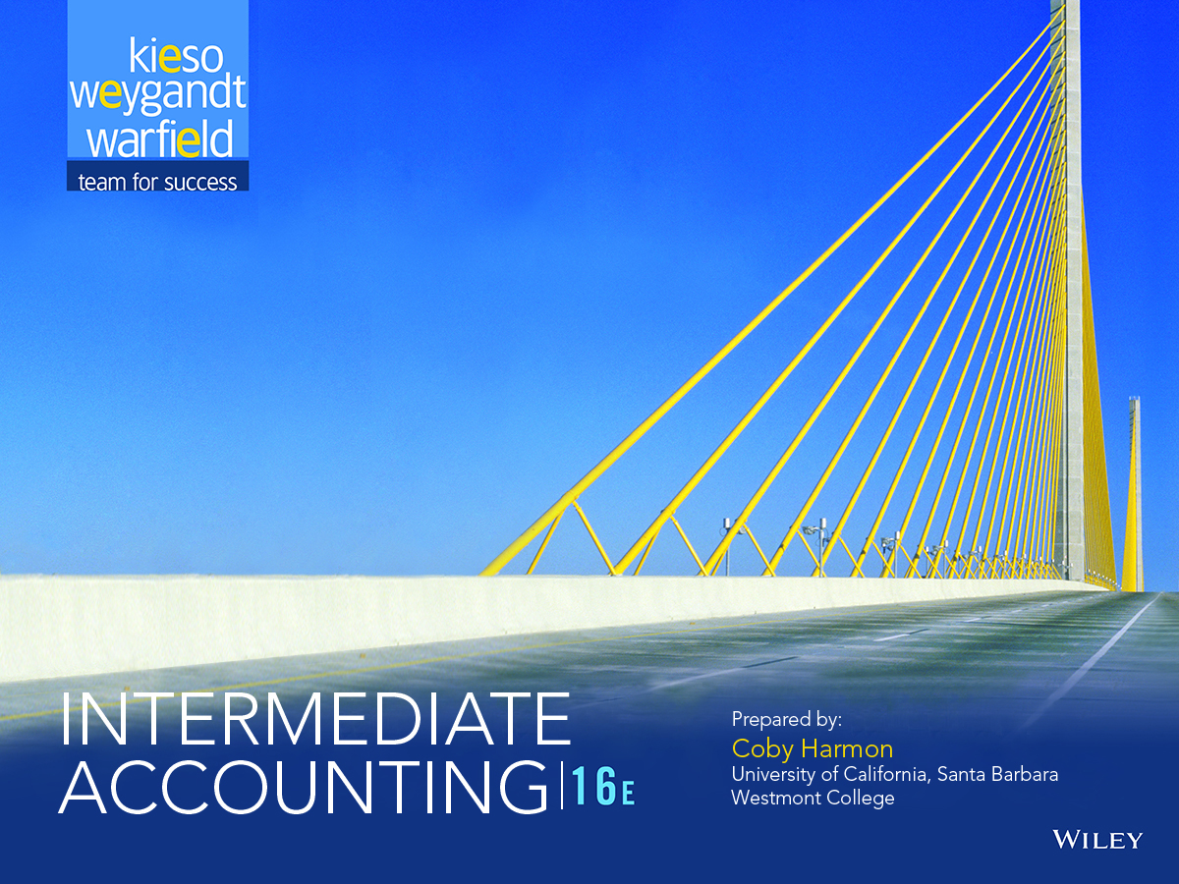

Slide 2
LEARNING OBJECTIVES
12
Intangible Assets
After studying this chapter, you should be able to:
1 Describe the characteristics, valuation, and amortization of intangible assets.
2 Describe the accounting for various types of intangible assets.
3 Explain the accounting issues for recording goodwill.
4 Explain impairment procedures and presentation requirements for intangible assets.
5 Describe accounting and presentation for research and development and similar costs.

Slide 3
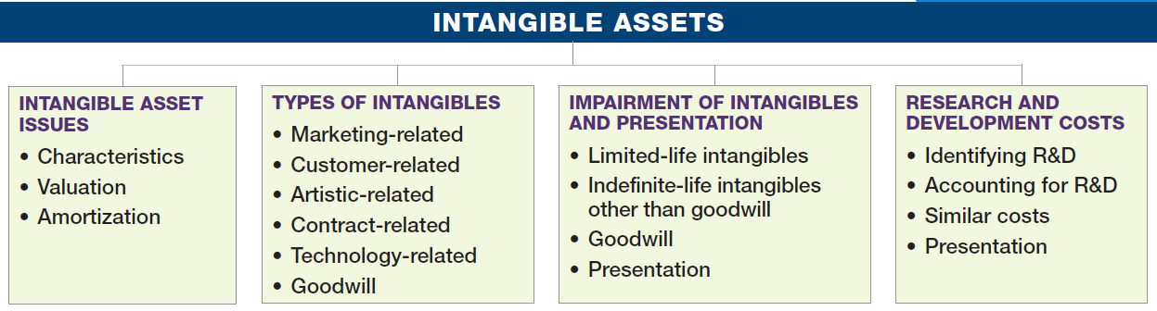
PREVIEW OF CHAPTER 12
Intermediate Accounting
16th Edition
Kieso ● Weygandt ● Warfield

Slide 4
INTANGIBLE ASSET ISSUES
The Coca-Cola Company’s success comes from its secret formula for making Coca-Cola, not
its plant facilities.
Characteristics
Lack physical existence.
Not financial instruments.
Normally classified as long-term asset.
Common types of intangibles:
Patents
Copyrights
Franchises or licenses
Trademarks or trade names
Goodwill
LO 1 Describe the characteristics, valuation, and amortization of intangible assets.

Slide 5
INTANGIBLE ASSET ISSUES
Valuation
Purchased Intangibles
Recorded at cost.
Includes all costs necessary to make the intangible asset ready for its intended use.
Typical costs include:
Purchase price.
Legal fees.
Other incidental expenses.
LO 1

Slide 6
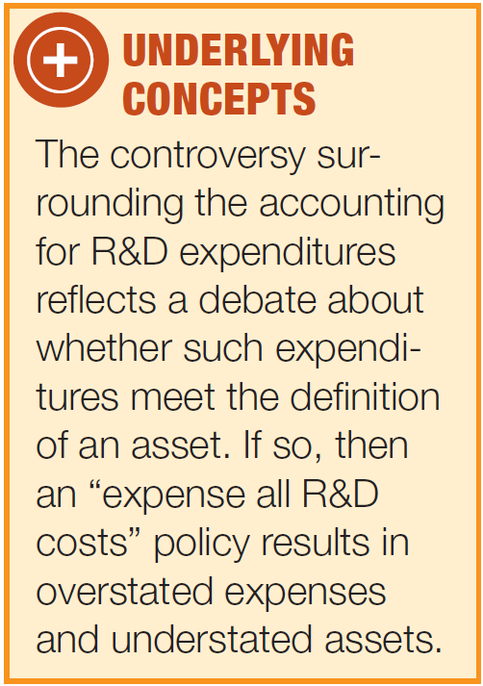
INTANGIBLE ASSET ISSUES
Valuation
Internally Created Intangibles
Recorded at cost.
Generally expensed.
Only capitalize direct costs incurred in developing the intangible, such as legal costs.
Google expensed the R&D costs incurred to develop its valuable search engine.
LO 1

Slide 7
INTANGIBLE ASSET ISSUES
Amortization of Intangibles
Limited-Life Intangibles
Amortize to expense over useful life.
Credit asset account or accumulated amortization.
Useful life should reflect the periods over which the asset will contribute to cash flows.
Amortization should be cost less residual value.
Companies should evaluate the limited-life intangibles for impairment.
LO 1

Slide 8
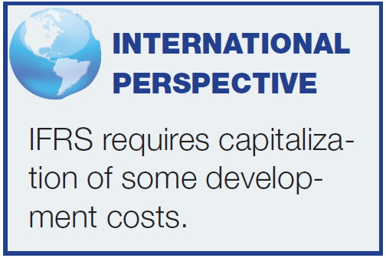
INTANGIBLE ASSET ISSUES
Amortization of Intangibles
Indefinite-Life Intangibles
No foreseeable limit on time the asset is expected to provide cash flows.
Must test indefinite-life intangibles for impairment at least annually.
No amortization.
LO 1

Slide 9
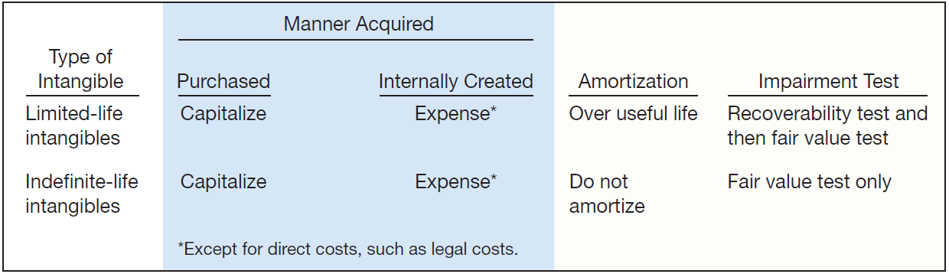
INTANGIBLE ASSET ISSUES
Amortization of Intangibles
ILLUSTRATION 12-1
Accounting Treatment for Intangibles
LO 1

Slide 10
WHAT DO THE NUMBERS MEAN? ARE ALL BRANDS THE SAME?
Does it matter how a company builds brand value? In a word, yes. If the brand is internally developed, its value does not appear in the financial statements. This is the case for The Coca-Cola Company, whose brand value is estimated to be roughly worth $79.2 billion but its balance sheet values its “trademarks within definite-lives” (i.e., brands) at just $6.7 billion. As you are learning in this chapter, this reporting results because the accounting rules prohibit companies from recognizing brands and many other “intangible” assets if they created them themselves. In contrast, when Procter & Gamble (P&G) acquired Gillette in 2005, it realized an additional $24 billion in intangible assets on its balance sheet. That is, P&G paid $57 billion for Gillette and
estimated the Gillette brand value to be worth $24 billion of the total paid.
Some have criticized this inconsistency in accounting, noting that information about the value of a brand is important to investors in consumer-product companies. Those supporting the difference in accounting cite the difficulty in arriving at reliable estimates of internally generated intangible assets. This latter argument seems to be carrying the day in support of the current accounting, under which only purchased brands and other intangible assets are recognized in accounting reports.
Source: “Untouchable Intangibles: Sometimes You See Brands on the Balance Sheet, Sometimes You Don’t,” The Economist (August 30, 2014).
LO 1

Slide 11
TYPES OF INTANGIBLE ASSETS
Six Major Categories:
Marketing-related.
Customer-related.
Artistic-related.
Contract-related.
Technology-related.
Goodwill.
LO 2 Describe the accounting for various types of intangible assets.

Slide 12


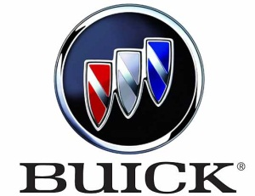

TYPES OF INTANGIBLE ASSETS
Marketing-Related Intangible Assets
Examples:
Trademarks or trade names, newspaper mastheads, Internet domain names, and non-competition agreements.
In the United States trademarks or trade names have legal protection for indefinite number of 10 year renewal periods.
Capitalize acquisition costs.
No amortization.
LO 2

Slide 13
WHAT DO THE NUMBERS MEAN? KEEP YOUR HANDS OFF MY INTANGIBLES?
Companies go to great extremes to protect their valuable intangible assets. Consider how the creators of the highly successful game Trivial Pursuit protected their creation. First, they copyrighted the 6,000 questions that are at the heart of the game. Then they shielded the Trivial Pursuit name by applying for a registered trademark. As a third mode of protection, they obtained a design patent on the playing board’s design as a unique graphic creation.
Another more recent example is the case of Converse and its efforts to protect its classic Chuck Taylor trademark. Converse (owned by Nike) accused 31 companies (including Wal-Mart Stores Inc., Kmart, and Skechers) of trademark infringement for co-opting its widely recognizable Chuck
Taylor® sneakers. While Converse is suing for monetary damages, its main goal is to get these imposters off store shelves. The company went as far as filing a separate complaint with the International Trade Commission to stop any shoes considered to be counterfeit from entering the country. That Converse (Nike) is going to these ends to protect its trademark is understandable given the Nike reinvigorated the brand by expanding the franchise, introducing more colors and styles, and helping to push All Stars® into overseas markets.
Source: “Converse Sues to Product Its Chuck Taylor All Stars,” The New
Work Times (October 14, 2014).
LO 2

Slide 14
TYPES OF INTANGIBLE ASSETS
Customer-Related Intangible Assets
Examples:
Customer lists, order or production backlogs, and both contractual and non-contractual customer relationships.
Capitalize acquisition costs.
Amortized to expense over useful life.
LO 2

Slide 15
TYPES OF INTANGIBLE ASSETS
Illustration: Green Market Inc. acquires the customer list of a large newspaper for $6,000,000 on January 1, 2017. Green Market expects to benefit from the information evenly over a three-year period. Record the purchase of the customer list and the amortization of the customer list at the end of each year.
Jan. 1
2017
Customer List 6,000,000
Cash 6,000,000
Dec. 31
2017
2018
2019
Amortization Expense 2,000,000
Customer List * 2,000,000
* or Accumulated Amortization
LO 2

Slide 16

TYPES OF INTANGIBLE ASSETS
Artistic-Related Intangible Assets
Examples:
Plays, literary works, musical works, pictures, photographs, and video and audiovisual material.
Copyright granted for the life of the creator plus 70 years.
Capitalize costs of acquiring and defending.
Amortized to expense over useful life.
Mickey Mouse
and
LO 2

Slide 17

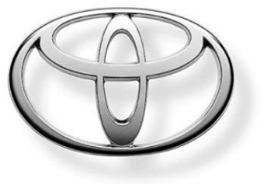



TYPES OF INTANGIBLE ASSETS
Contract-Related Intangible Assets
Examples:
Franchise and licensing agreements, construction permits, broadcast rights, and service or supply contracts.
Franchise (or license) with a limited life should be amortized to expense over the life of the franchise.
Franchise with an indefinite life should be carried at cost and not amortized.
LO 2

Slide 18


TYPES OF INTANGIBLE ASSETS
Technology-Related Intangible Assets
Examples:
Patented technology and trade secrets granted by the U.S. Patent and Trademark Office.
Patent gives holder exclusive use for 20 years.
Capitalize costs of purchasing a patent.
Expense any R&D costs in developing a patent.
Amortize over legal life or useful life, whichever is shorter.
LO 2

Slide 19
WHAT DO THE NUMBERS MEAN? PATENT BATTLES?
The smartphone industry has been a patent battleground. For example, Nokia filed patent lawsuits against Apple (and Apple countersued) over cell phone features such as swiping gestures on touch screens and the “app store” for downloading software. Apple also targeted HTC for infringing on Apple’s patented feature that allows screens to detect more than one finger touch at a time. This facilitates the popular zoom-in and zoom-out capability. HTC, in turn, sued Apple for infringing on patented technology that helps extend battery life. The activity-tracker product space is another patent battleground. Competition in that market heated up when Under Armour recently paid $150 million to acquire MapMyFitness, which has 20 million people registered to use its websites and mobile applications to
map, record, and share their workouts. To protect the value of the patent related to its miCoach fitness tracking system, adidas AG sued Under Armour. The lawsuit alleges that Under Armour infringed on 10 adidas patents, underscoring the growing importance of gadgetry and personal technology for sportswear makers that traditionally focused on shoes and apparel.
Sources: J. Mintz, “Smart Phone Makers in Legal Fights over Patents,” Wisconsin State Journal (December 19, 2010), p. F4; and S. Germano, “Adidas Sues Under Armour Over Patents: Company Alleges Under Armour Infringes on 10 MiCoach Patents,” Wall Street Journal (February 4, 2014).
LO 2

Slide 20
TYPES OF INTANGIBLE ASSETS
Illustration: Harcott Co. incurs $180,000 in legal costs on January 1, 2017, to successfully defend a patent. The patent’s useful life is 12 years, amortized on a straight-line basis. Harcott records the legal fees and the amortization at the end of 2017 as follows.
Jan. 1
Patents 180,000
Cash 180,000
Dec. 31
Amortization Expense 15,000
Patents (or Accumulated Amortization) 15,000
LO 2

Slide 21
WHAT DO THE NUMBERS MEAN? VALUE OF SECRET FORMULA?
After several espionage cases were uncovered, the secrets contained within the Los Alamos nuclear lab seemed easier to check out than a library book. But The Coca-Cola Company has managed to keep the recipe for the world’s best-selling soft drink under wraps for more than 100 years. The company offers almost no information about its lifeblood, and the only written copy of the formula resides in a bank vault in Atlanta. This handwritten sheet is available to no one except by vote of Coca-Cola’s board of directors.
Can’t science offer some clues? Coke purportedly contains 17 to 18 ingredients. That includes the usual caramel color and corn syrup, as well as a blend of oils known as 7X (rumored to be a mix of orange, lemon, cinnamon, and others).
Distilling natural products like these is complicated since they are made of thousands of compounds. One ingredient you will not find, by the way, is cocaine. Although the original formula did contain trace amounts, today’s Coke doesn’t. When was it removed? That too is a secret.
Some experts indicate that the power of the Coca-Cola formula and related brand image account for almost $79.2 billion, or roughly 43 percent, of Coke’s $182.2 billion stock value.
Sources: Adapted from Reed Tucker, “How Has Coke’s Formula Stayeda Secret?” Fortune (July 24, 2000), p. 42; and “Best Global Brands 2011,” www.interbrand.com (accessed August 30, 2014).
LO 2

Slide 22
TYPES OF INTANGIBLE ASSETS
Goodwill
Conceptually, represents the future economic benefits arising from the other assets acquired in a business combination that are not individually identified and separately recognized.
Only recorded when an entire business is purchased.
Goodwill is measured as the ...
excess of cost of the purchase over the FMV of the identifiable net assets (assets less liabilities) purchased.
Internally created goodwill should not be capitalized.
LO 3 Explain the accounting issues for recording goodwill.

Slide 23
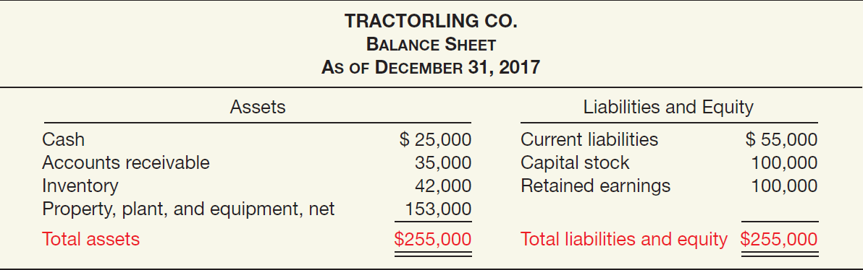
Recording Goodwill
Illustration: Multi-Diversified, Inc. decides that it needs a parts division to supplement its existing tractor distributorship. The president of Multi-Diversified is interested in buying Tractorling Company. The illustration presents the statement of financial position of Tractorling Company.
ILLUSTRATION 12-3
Tractorling Co. Balance Sheet
LO 3

Slide 24
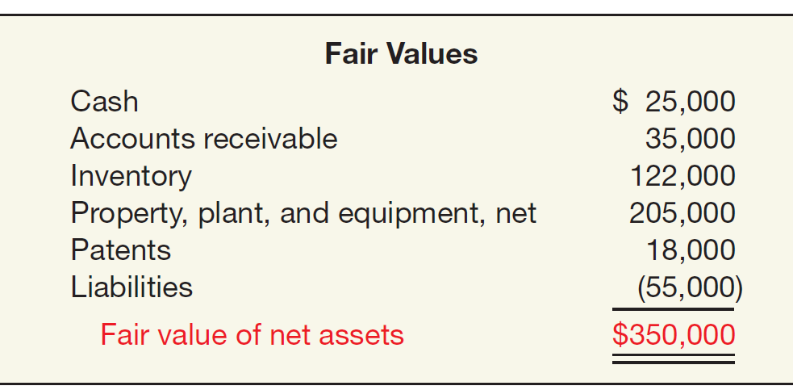
Recording Goodwill
Multi-Diversified investigates Tractorling’s underlying assets to determine their fair values.
ILLUSTRATION 12-4
Fair Value of Tractorling’s Net Assets
LO 3

Slide 25
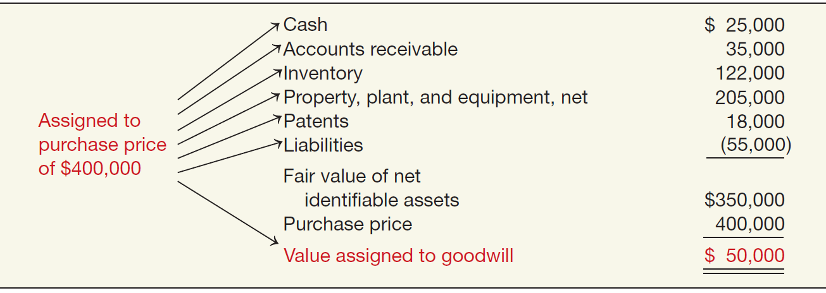
Recording Goodwill
Tractorling Company decides to accept Multi-Diversified’s offer of $400,000. What is the value of the goodwill, if any?
ILLUSTRATION 12-5
Determination of Goodwill—Master Valuation Approach
LO 3

Slide 26
Recording Goodwill
Multi-Diversified records this transaction as follows.
Cash 25,000
Accounts Receivables 35,000
Inventory 122,000
Property, Plant, and Equipment 205,000
Patents 18,000
Goodwill 50,000
Liabilities 55,000
Cash 400,000
LO 3

Slide 27
Recording Goodwill
Example: Global Corporation purchased the net assets of Local Company for $300,000 on December 31, 2017. The balance sheet of Local Company just prior to acquisition is:
FMV of Net Assets = $200,000
LO 3

Slide 28
Recording Goodwill
Example: Global Corporation purchased the net assets of Local Company for $300,000 on December 31, 2017. The value assigned to goodwill is determined as follows:
Book Value = $130,000
Revaluation
$70,000
Fair Value = $200,000
Goodwill
$100,000
Purchase Price = $300,000
LO 3

Slide 29
Recording Goodwill
Example: Global Corporation purchased the net assets of Local Company for $300,000 on December 31, 2017. The value assigned to goodwill is determined as follows:
LO 3

Slide 30
Recording Goodwill
Example: Global Corporation purchased the net assets of Local Company for $300,000 on December 31, 2017. Prepare the journal entry to record the purchase of the net assets of Local.
Journal entry recorded by Global:
Cash 15,000
Receivables 10,000
Inventory 70,000
Equipment 130,000
Goodwill 100,000
Accounts Payable 25,000
Cash 300,000
LO 3

Slide 31
Goodwill
Goodwill Write-Off
Goodwill considered to have an indefinite life.
Should not be amortized.
Only adjust carrying value when goodwill is impaired.
Bargain Purchase
Purchase price less than the fair value of net assets acquired.
Amount is recorded as a gain by the purchaser.
LO 3

Slide 32
IMPAIRMENT OF INTANGIBLE ASSETS
Impairment of Limited-Life Intangibles
Same as impairment for long-lived assets in Chapter 11.
If the sum of the expected future net cash flows (undiscounted) is less than the carrying amount of the asset, an impairment has occurred (recoverability test).
The impairment loss is the amount by which the carrying amount of the asset exceeds the fair value of the asset (fair value test).
The loss is reported as part of income from continuing operations, “Other expenses and losses” section.
LO 4 Explain impairment procedures and presentation requirements for intangible assets.

Slide 33
IMPAIRMENT OF INTANGIBLE ASSETS
Illustration: Lerch, Inc. has a patent on how to extract oil from shale rock. Unfortunately, several recent non-shale oil discoveries adversely affected the demand for shale-oil technology. As a result, Lerch performs a recoverability test. It finds that the expected future net cash flows from this patent are $35 million. Lerch’s patent has a carrying amount of $60 million. Discounting the expected future net cash flows at its market rate of interest, Lerch determines the fair value of its patent to be $20 million. Perform the recoverability test.
Expected future net cash flows $ 35,000,000
Carrying value 60,000,000
Asset impaired $ (25,000,000)
LO 4

Slide 34
IMPAIRMENT OF INTANGIBLE ASSETS
Illustration: Perform the fair value test and the journal entry (if any) to record the impairment of the asset.
Carrying amount of patent $ 60,000,000
Fair value 20,000,000
Loss on impairment $ 40,000,000
Loss on Impairment 40,000,000
Patents 40,000,000
Companies may not recognize restoration of the previously recognized impairment loss.
LO 4

Slide 35
IMPAIRMENT OF INTANGIBLE ASSETS
Impairment of Indefinite-Life Intangibles Other than Goodwill
Should be tested for impairment at least annually.
Impairment test is a fair value test.
If the fair value of asset is less than the carrying amount, an impairment loss is recognized for the difference.
Recoverability test is not used.
LO 4

Slide 36
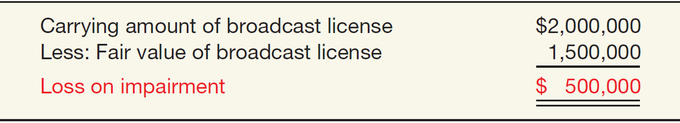
IMPAIRMENT OF INTANGIBLE ASSETS
Illustration: Arcon Radio purchased a broadcast license for $2,000,000. Arcon Radio has renewed the license with the FCC twice, at a minimal cost. Because it expects cash flows to last indefinitely, Arcon reports the license as an indefinite-life intangible asset. Recently the FCC decided to auction these licenses to the highest bidder instead of renewing them. Arcon Radio expects cash flows for the remaining two years of its existing license. It performs an impairment test and determines that the fair value of the intangible asset is $1,500,000.
ILLUSTRATION 12-7
Computation of Loss on Impairment of Broadcast License
LO 4

Slide 37
IMPAIRMENT OF INTANGIBLE ASSETS
Impairment of Goodwill
Two Step Process:
Step 1: If fair value is less than the carrying amount of the net assets (including goodwill), then perform a second step to determine possible impairment.
Step 2: Determine the fair value of the goodwill (implied value of goodwill) and compare to carrying amount.
LO 4

Slide 38
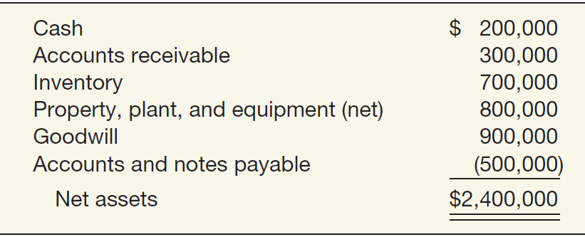
Impairment of Goodwill
Illustration: Kohlbuy Corporation purchased one division, Pritt Products, four years ago for $2 million. Kohlbuy management is now reviewing the division for purposes of recognizing an impairment. Illustration 12-8 lists the Pritt Division’s net assets, including the associated goodwill of $900,000 from the purchase.
ILLUSTRATION 12-8
Net Assets of Pritt Division, Including Goodwill
Assume that the fair value of the Pritt Division is $1,900,000.
LO 4

Slide 39
Impairment of Goodwill
Illustration: Prepare the journal entry (if any) to record the impairment.
ILLUSTRATIONS 12-9 and 12-10
Step 1:
The fair value of the reporting unit is below its carrying value. Therefore, an impairment has occurred.
Step 2:
$ 1,900,000
1,500,000
400,000
900,000
$ (500,000)
Loss on Impairment 500,000
Goodwill 500,000
LO 4

Slide 40
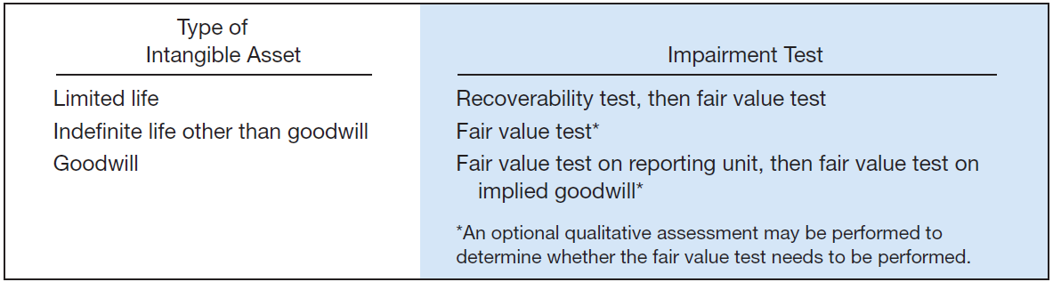
IMPAIRMENT OF INTANGIBLE ASSETS
Impairment Summary
ILLUSTRATION 12-11
Summary of Intangible Asset Impairment Tests
LO 4

Slide 41
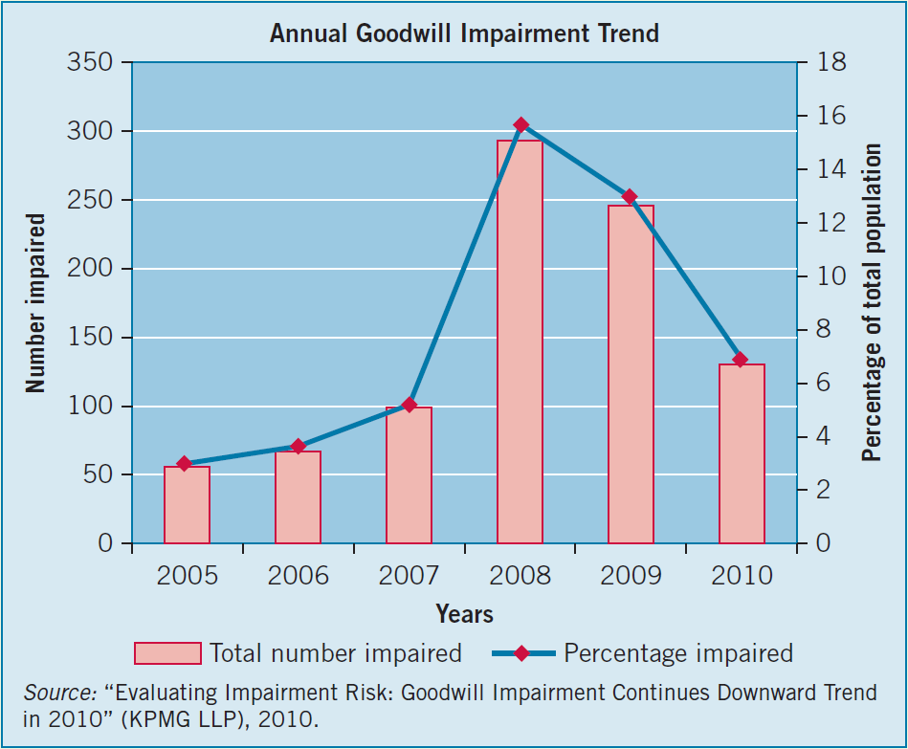
WHAT DO THE NUMBERS MEAN? IMPAIRMENT RISK
As shown in the chart below, goodwill impairments spiked in 2008 and 2009, coinciding with the stock market downturn in the wake of the financial crisis.
LO 4

Slide 42
Presentation of Intangible Assets
Balance Sheet
Intangible assets shown as a separate item.
Reporting is similar to the reporting of property, plant, and equipment.
Contra accounts are not normally shown for intangibles.
Companies should report as a separate item all intangible assets other than goodwill.
LO 4

Slide 43
Presentation of Intangible Assets
Income Statement
Report amortization expense and impairment losses in continuing operations.
Goodwill impairment losses should also be presented as a separate line item in the continuing operations section, unless the goodwill impairment is associated with a discontinued operation.
LO 4

Slide 44
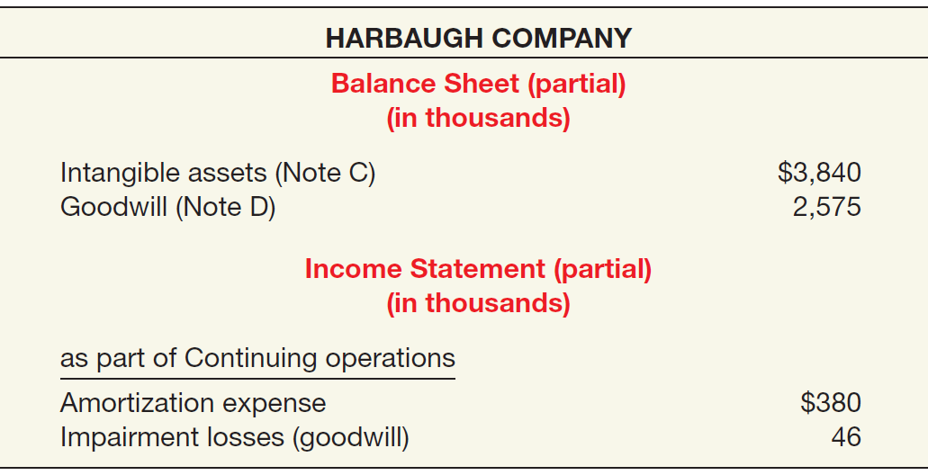
Presentation of Intangible Assets
ILLUSTRATION 12-12
Intangible Asset
LO 4

Slide 45
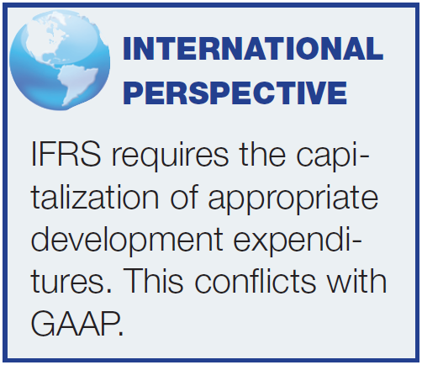
RESEARCH AND DEVELOPMENT COSTS
Research and development (R&D) costs are not in themselves intangible assets.
Frequently results in something that a company patents or copyrights such as:
new product,
process,
idea,
formula,
composition, or
literary work.
Companies must expense all research and development costs when incurred.
LO 5 Describe accounting and presentation for research and development and similar costs.

Slide 46
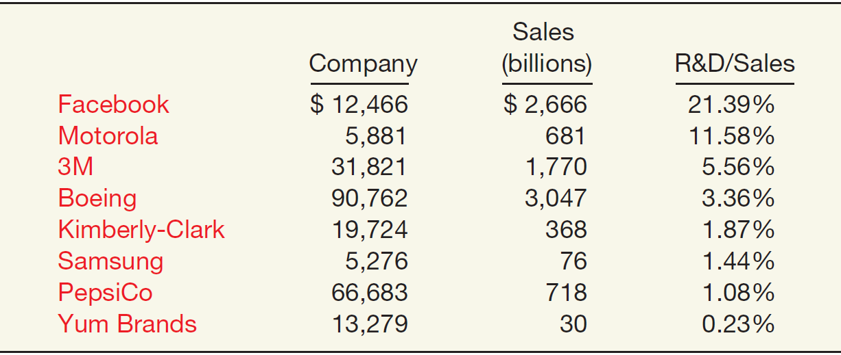
RESEARCH AND DEVELOPMENT COSTS
Companies spend considerable sums on research and development.
ILLUSTRATION 12-13
R&D Outlays, as a Percentage of Sales
LO 5

Slide 47
RESEARCH AND DEVELOPMENT COSTS
Identifying R & D Activities
Research Activities
Planned search or critical investigation aimed at discovery of new knowledge.
Examples
Laboratory research aimed at discovery of new knowledge; searching for applications of new research findings.
Development Activities
Translation of research findings or other knowledge into a plan or design for a new product or process or for a significant improvement to an existing product or process whether intended for sale or use.
Examples
Conceptual formulation and design of possible product or process alternatives; construction of prototypes and
operation of pilot plants.
LO 5

Slide 48
RESEARCH AND DEVELOPMENT COSTS
Accounting for R & D Activities
Costs Associated with R&D Activities:
Materials, Equipment, and Facilities.
Personnel.
Purchased Intangibles.
Contract Services.
Indirect Costs.
LO 5

Slide 49
RESEARCH AND DEVELOPMENT COSTS
E12-1: Indicate how items on the list below would generally be reported in the financial statements.
Item
Classification
1. Investment in a subsidiary company.
2. Timberland.
3. Cost of engineering activity required to advance the design of a product to the manufacturing stage.
4. Lease prepayment.
5. Cost of equipment obtained.
6. Cost of searching for applications of new research findings.
Long-term investments
PP&E
R&D expense
Prepaid rent
PP&E
R&D expense
LO 5

Slide 50
RESEARCH AND DEVELOPMENT COSTS
Item
Classification
Cost incurred in the formation of a corporation.
Operating losses incurred in the start-up of a business.
Training costs incurred in start-up of new operation.
Purchase cost of a franchise.
Goodwill generated internally.
Cost of testing in search of product alternatives.
Expense
Operating loss
Expense
Intangible
Not recorded
R&D expense
LO 5

Slide 51
RESEARCH AND DEVELOPMENT COSTS
Item
Classification
Goodwill acquired in the purchase of a business.
Cost of developing a patent.
Cost of purchasing a patent from an inventor.
Legal costs incurred in securing a patent.
Unrecovered costs of a successful legal suit to protect the patent.
Intangible
R&D expense
Intangible
Intangible
Intangible
LO 5

Slide 52
RESEARCH AND DEVELOPMENT COSTS
Item
Classification
Cost of conceptual formulation of possible product alternatives.
Cost of purchasing a copyright.
Research and development costs.
Long-term receivables.
Cost of developing a trademark.
Cost of purchasing a trademark.
R&D expense
Intangible
R&D expense
Long-term investment
Expense
Intangible
LO 5

Slide 53
RESEARCH AND DEVELOPMENT COSTS
Costs Similar to R & D Costs
Start-up costs for a new operation.
Initial operating losses.
Advertising costs.
Computer software costs.
LO 5

Slide 54
RESEARCH AND DEVELOPMENT COSTS
E12-17: Compute the amount to be reported as research and development expense.
$280,000 ÷ 5 = $56,000
R&D Expense
Cost of equipment acquired that will have alternative uses in future R&D projects over the next 5 years.
$280,000
$56,000
Materials consumed in R&D projects
59,000
59,000
Consulting fees paid to outsiders for R&D projects
100,000
100,000
Personnel costs of persons involved in R&D projects
128,000
128,000
Indirect costs reasonably allocable to R&D projects
50,000
50,000
Materials purchased for future R&D projects
34,000
0
$393,000
LO 5

Slide 55
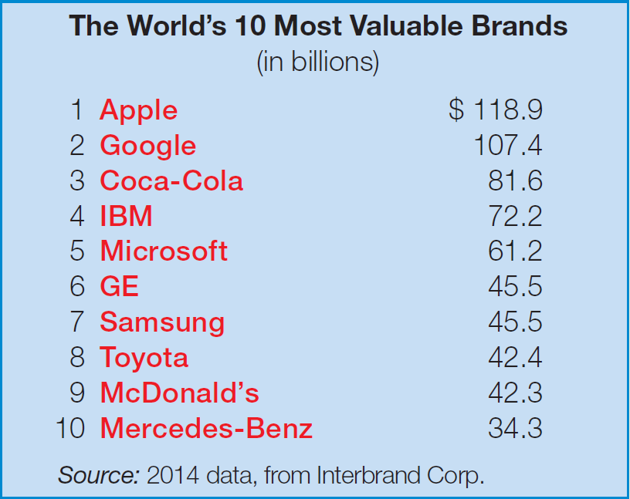
WHAT DO THE NUMBERS MEAN? BRANDED
For many companies, developing a strong brand image is as important as developing the products they sell. Now more than ever, companies see the power of a strong brand, enhanced by significant and effective advertising investments. As the following chart indicates, the value of brand investments is substantial. Apple heads the list with an estimated brand value of about $119 billion.
LO 5

Slide 56
WHAT DO THE NUMBERS MEAN? BRANDED
Occasionally you may find the value of a brand included in a company’s financial statements under goodwill. But generally you will not find the estimated values of brands recorded in companies’ balance sheets. The reason? The subjectivity that goes into estimating a brand’s value. In some cases, analysts base an estimate of brand value on opinion polls or on some multiple of ad spending. For example, in estimating the brand values shown to the left, Interbrand Corp. estimates the percentage of the overall future revenues the brand will generate and then discounts the net cash flows, to arrive at a present value. Some analysts believe that information on brand values is relevant. Others voice valid concerns about the reliability of brand value estimates due to subjectivity in the estimates for revenues, costs, and the risk component of the discount rate. For example, another brand valuation firm, Millward Brown, ranks Apple as number one with an estimated brand value of $183 billion (or about one-third of Apple’s market value). These data support the highly subjective nature of brand valuation estimates.
Sources: “Best Global Brands 2014,” www.interbrand.com; and S. Vranica and J. Hansegard, “Ikea Discloses an $11 Billion Secret,” Wall Street Journal (August 9, 2012).
LO 5

Slide 57
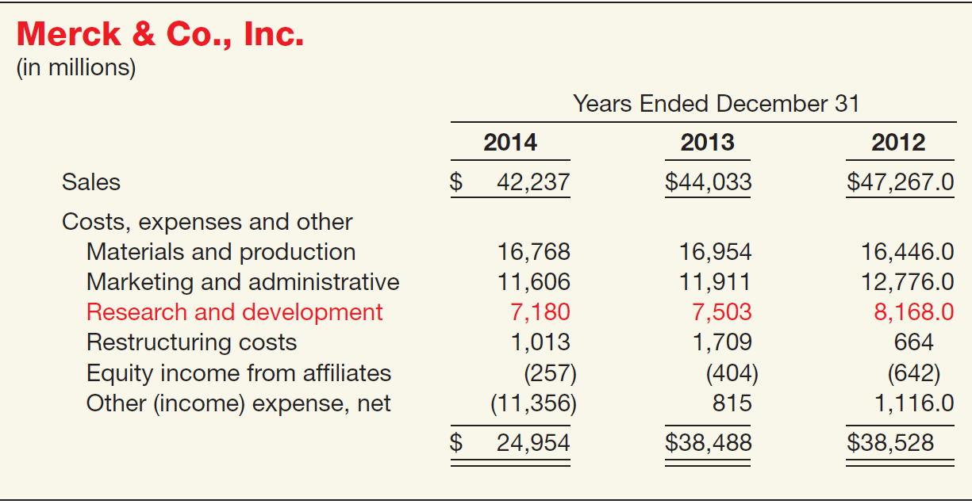
Presentation of Research and Development Costs
ILLUSTRATION 12-16
Income Statement Disclosure of R&D Costs
LO 5

Slide 58

RELEVANT FACTS
Similarities
Like GAAP, under IFRS intangible assets (1) lack physical substance and (2) are not financial instruments. In addition, under IFRS an intangible asset is identifiable. To be identifiable, an intangible asset must either be separable from the company (can be sold or transferred) or it arises from a contractual or legal right from which economic benefits will flow to the company. Fair value is used as the measurement basis for intangible assets under IFRS, if it is more clearly evident.
LO 6 Compare the accounting for intangible assets under GAAP and IFRS.

Slide 59
RELEVANT FACTS
Similarities
IFRS and GAAP are very similar for intangibles acquired in a business combination. That is, companies recognize an intangible asset separately from goodwill if the intangible represents contractual or legal rights or is capable of being separated or divided and sold, transferred, licensed, rented, or exchanged. In addition, under both GAAP and IFRS, companies recognize acquired in-process research and development (IPR&D) as a separate intangible asset if it meets the definition of an intangible asset and its fair value can be measured reliably.
As in GAAP, under IFRS the costs associated with research and development are segregated into the two components. Costs in the research phase are always expensed under both IFRS and GAAP.
LO 6

Slide 60
RELEVANT FACTS
Differences
IFRS permits revaluation on limited-life intangible assets. Revaluations are not permitted for goodwill and other indefinite-life intangible assets.
IFRS permits some capitalization of internally generated intangible assets (e.g., brand value) if it is probable there will be a future benefit and the amount can be reliably measured. GAAP requires expensing of all costs associated with internally generated intangibles.
IFRS requires an impairment test at each reporting date for long-lived assets and intangibles, and records an impairment if the asset’s carrying amount exceeds its recoverable amount. The recoverable amount is the higher of the asset’s fair value less costs to sell and its value-in-use. Value-in-use is the future cash flows to be derived from the particular assets, discounted to present value. Under GAAP, impairment loss is measured as the excess of the carrying amount over the asset’s fair value.
LO 6

Slide 61
RELEVANT FACTS
Differences
IFRS allows reversal of impairment losses when there has been a change in economic conditions or in the expected use of limited-life intangibles. Under GAAP, impairment losses cannot be reversed for assets to be held and used; the impairment loss results in a new cost basis for the asset. IFRS and GAAP are similar in the accounting for impairments of assets held for disposal.
Under IFRS, costs in the development phase of a research and development project are capitalized once technological feasibility (referred to as economic viability) is achieved.
LO 6

Slide 62
ON THE HORIZON
At one time, the IASB and FASB identified a project that would consider expanded recognition of internally generated intangible assets. As indicated, IFRS permits more recognition of intangibles compared to GAAP. Thus, it will be challenging to develop converged standards for intangible assets, given the long-standing prohibition on capitalizing internally generated intangible assets and research and development in GAAP. At present, this project is not active.
LO 6

Slide 63
IFRS SELF-TEST QUESTIONS
Research and development costs are:
expensed under GAAP.
expensed under IFRS.
expensed under both GAAP and IFRS.
None of the above.
LO 6

Slide 64
IFRS SELF-TEST QUESTIONS
A loss on impairment of an intangible asset under IFRS is the asset’s:
carrying amount less the expected future net cash flows.
carrying amount less its recoverable amount.
recoverable amount less the expected future net cash flows.
book value less its fair value.
LO 6

Slide 65
IFRS SELF-TEST QUESTIONS
Recovery of impairment is recognized for all the following except:
patent held for sale.
patent held for use.
trademark.
goodwill.
LO 6

Slide 66
COPYRIGHT
“Copyright © 2016 John Wiley & Sons, Inc. All rights reserved. Reproduction or translation of this work beyond that permitted in Section 117 of the 1976 United States Copyright Act without the express written permission of the copyright owner is unlawful. Request for further information should be addressed to the Permissions Department, John Wiley & Sons, Inc. The purchaser may make back-up copies for his/her own use only and not for distribution or resale. The Publisher assumes no responsibility for errors, omissions, or damages, caused by the use of these programs or from the use of the information contained herein.”

