Slide 1
CHAPTER 3
The Basic Compound Interest Functions

Slide 2
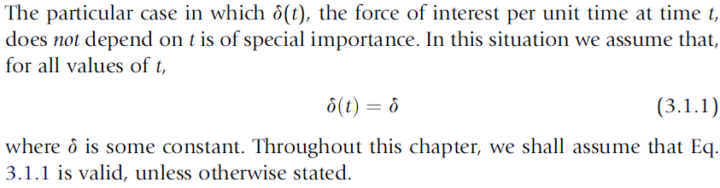
3.1 INTEREST RATE QUANTITIES

Slide 3
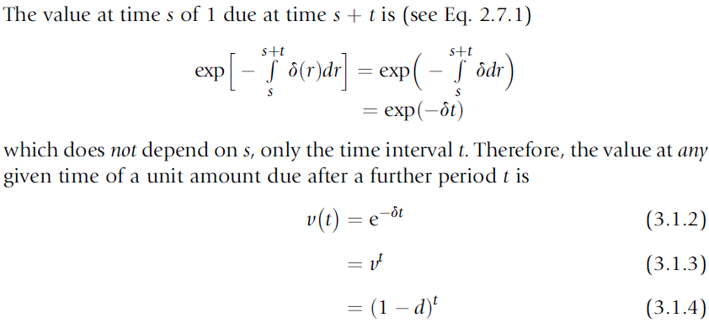
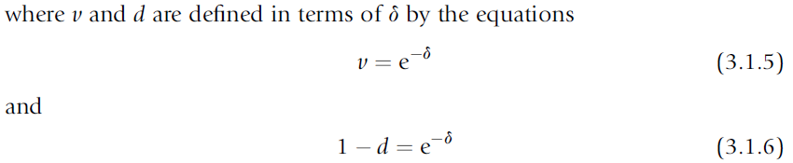
3.1 INTEREST RATE QUANTITIES

Slide 4
3.1 INTEREST RATE QUANTITIES
Then, in return for a repayment of a unit amount at time 1, an investor will lend an amount (1 - d) at time 0. The sum of (1 - d) may be considered as a loan of 1 (to be repaid after 1 unit of time) on which interest of amount d is payable in advance. For this reason, d is called the effective rate of discount per unit time.

Slide 5
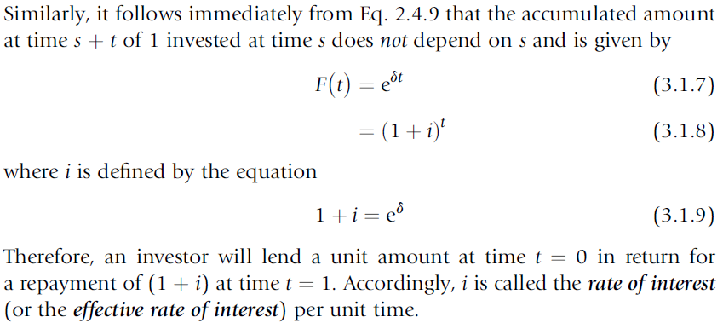
3.1 INTEREST RATE QUANTITIES

Slide 6
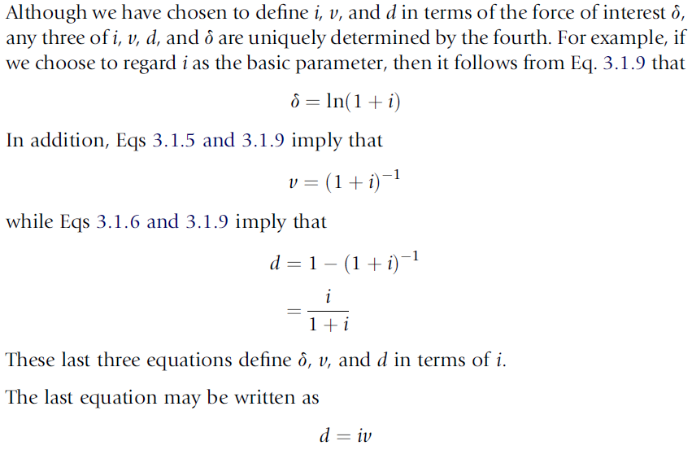
3.1 INTEREST RATE QUANTITIES

Slide 7
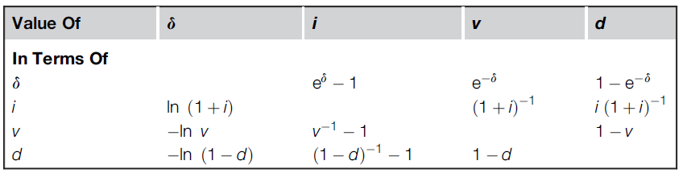
3.1 INTEREST RATE QUANTITIES

Slide 8
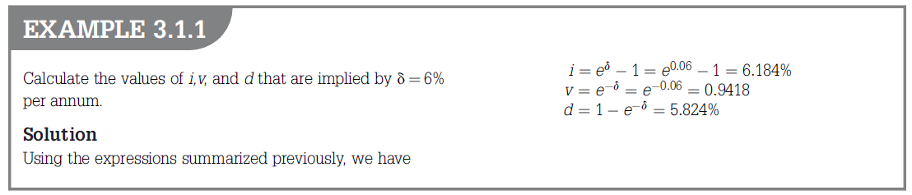

Slide 9
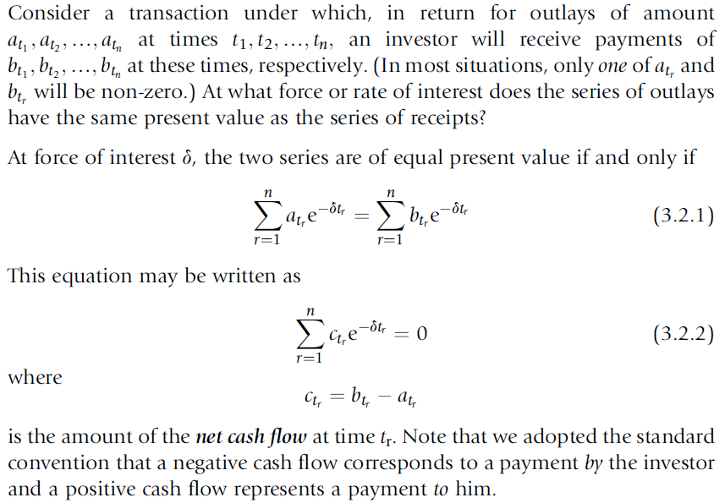
3.2 THE EQUATION OF VALUE

Slide 10
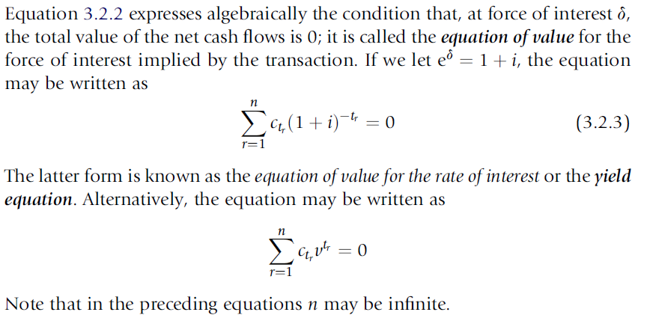
3.2 THE EQUATION OF VALUE

Slide 11
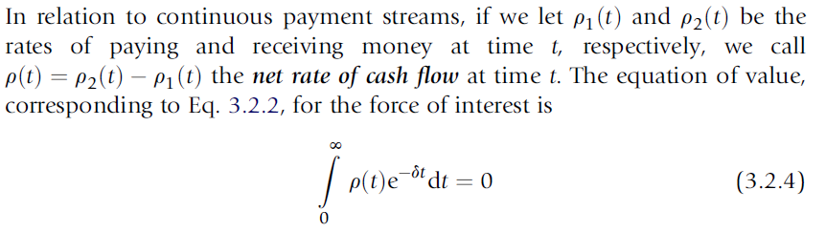
3.2 THE EQUATION OF VALUE

Slide 12
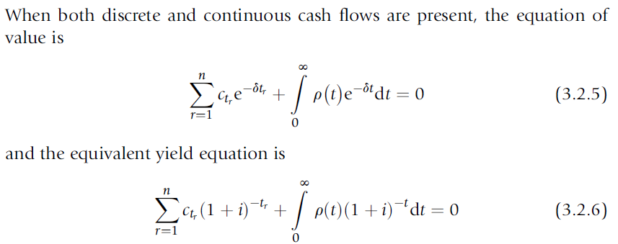
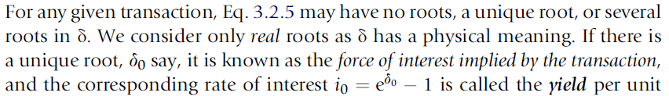
3.2 THE EQUATION OF VALUE

Slide 13
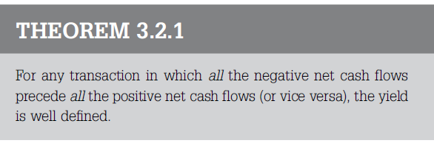
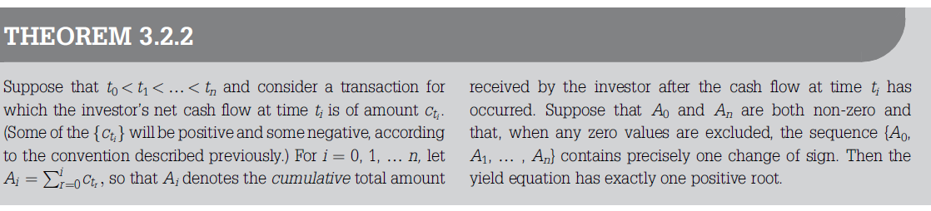

Slide 14
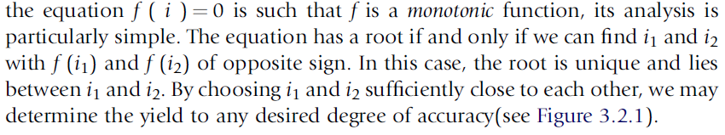
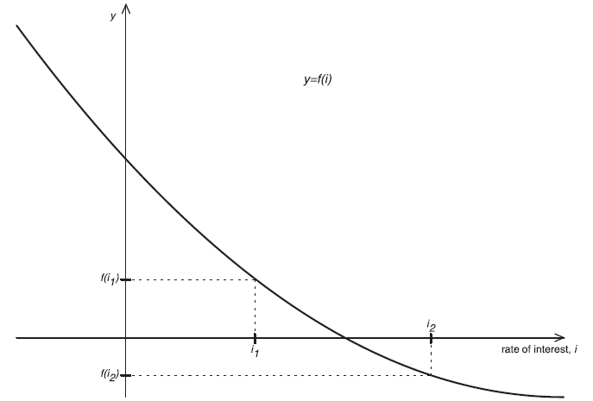
3.2 THE EQUATION OF VALUE

Slide 15
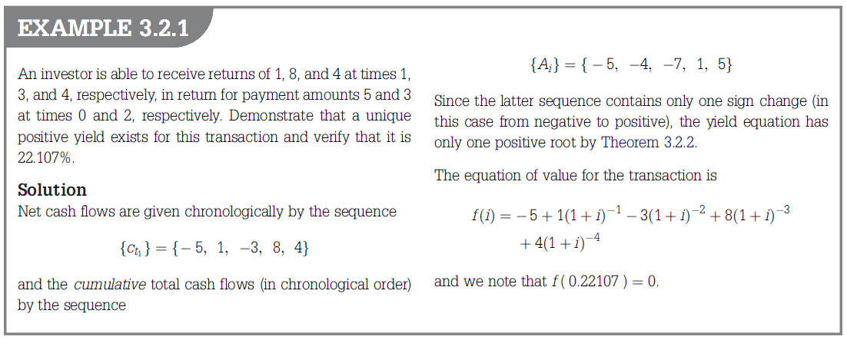

Slide 16
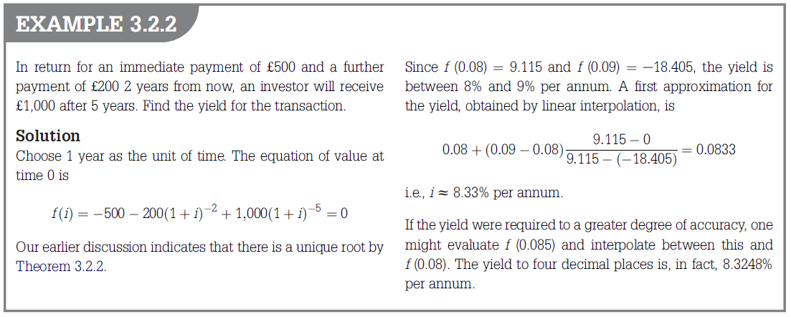
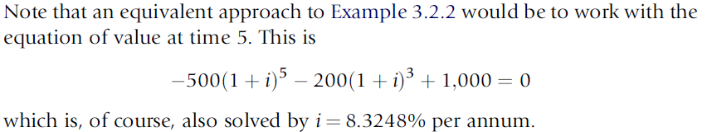
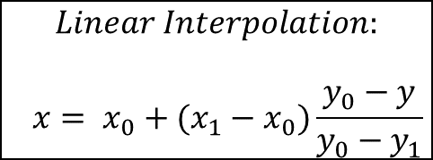
$$Linear Interpolation:$$
$$x= x_{0}+(x_{1}−x_{0})\frac{y_{0}−y}{y_{0}−y_{1}}$$

Slide 17
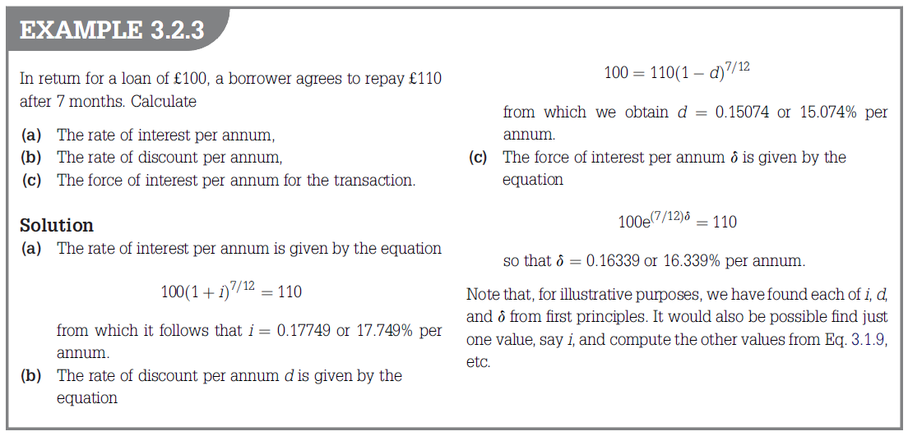

Slide 18
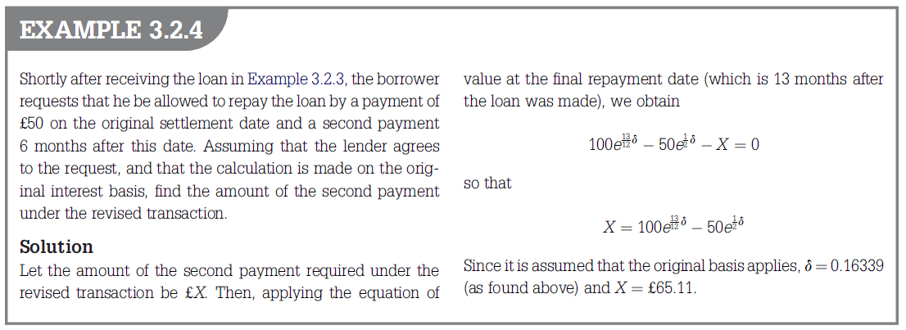

We can use I
the borrower wishes to replace the originally agreed payment of £110 by a payment of £50; i.e., he wishes to defer a payment of £60 due on the original repayment date by a period of 6 months. The deferred payment (of amount £X) must have the same value as the £60 it replaces. Equating these values at the final repayment date, we obtain

Slide 19
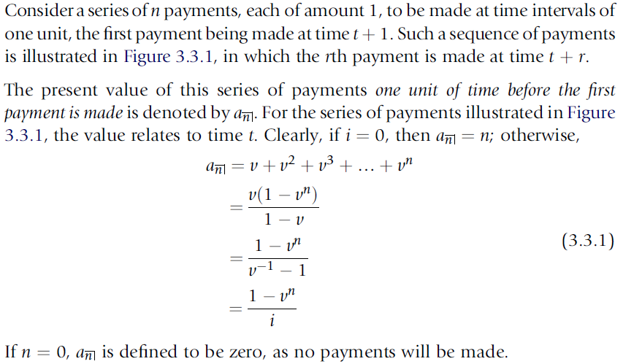
3.3 ANNUITIES-CERTAIN: PRESENT VALUES
AND ACCUMULATIONS

Slide 20
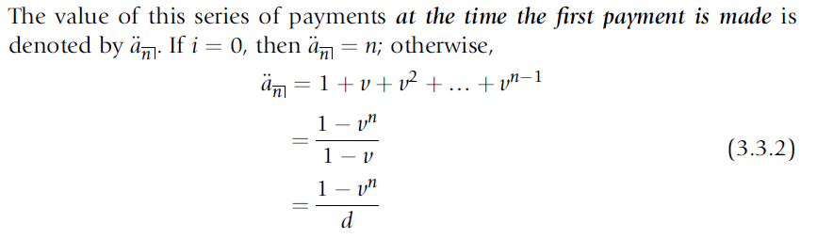
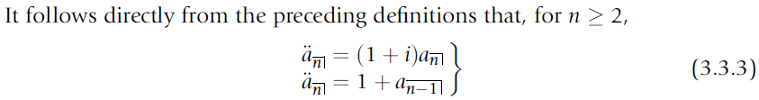
3.3 ANNUITIES-CERTAIN: PRESENT VALUES
AND ACCUMULATIONS

Slide 21
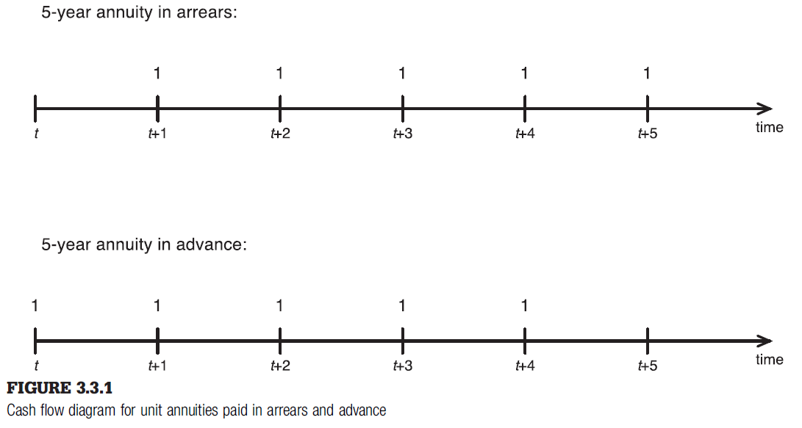


: the present value of the immediate annuity or simply the present value of an n-year annuity paid in arrears.
: the present value of the annuity-due or simply the present value of an n-year paid in advance.

Slide 22
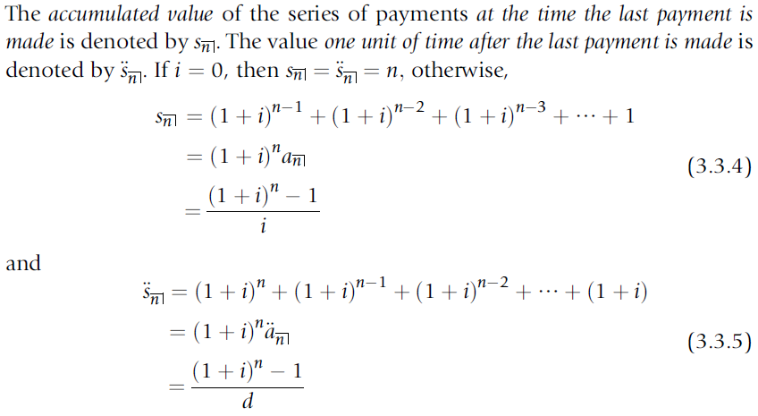
3.3 ANNUITIES-CERTAIN: PRESENT VALUES
AND ACCUMULATIONS

Slide 23
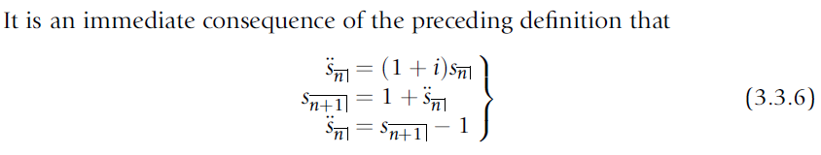
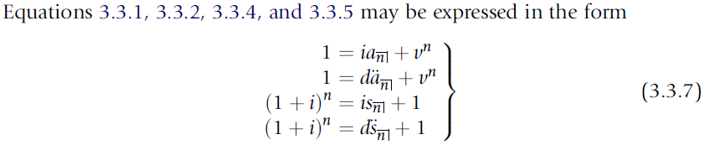
3.3 ANNUITIES-CERTAIN: PRESENT VALUES
AND ACCUMULATIONS

Slide 24
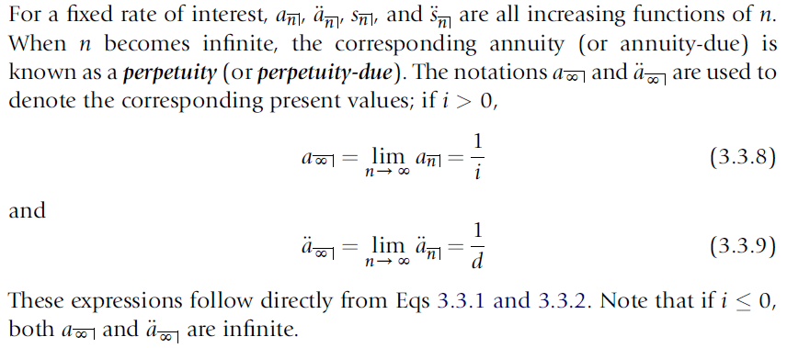
3.3 ANNUITIES-CERTAIN: PRESENT VALUES
AND ACCUMULATIONS

Slide 25
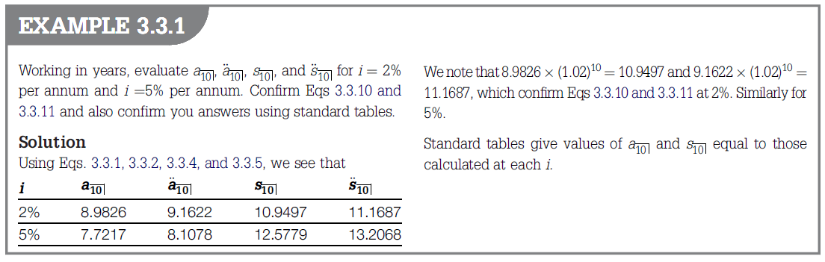

Slide 26
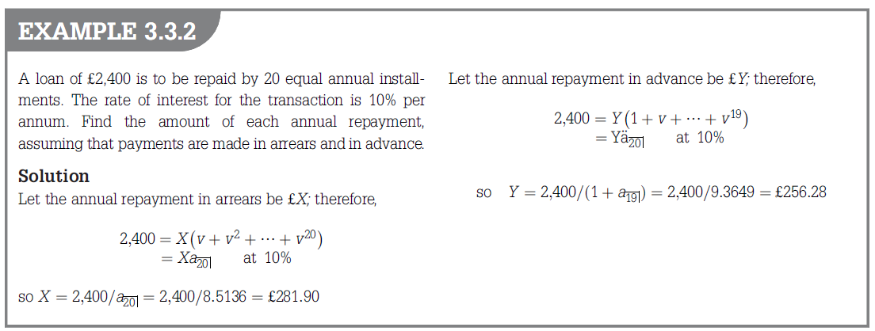

Slide 27
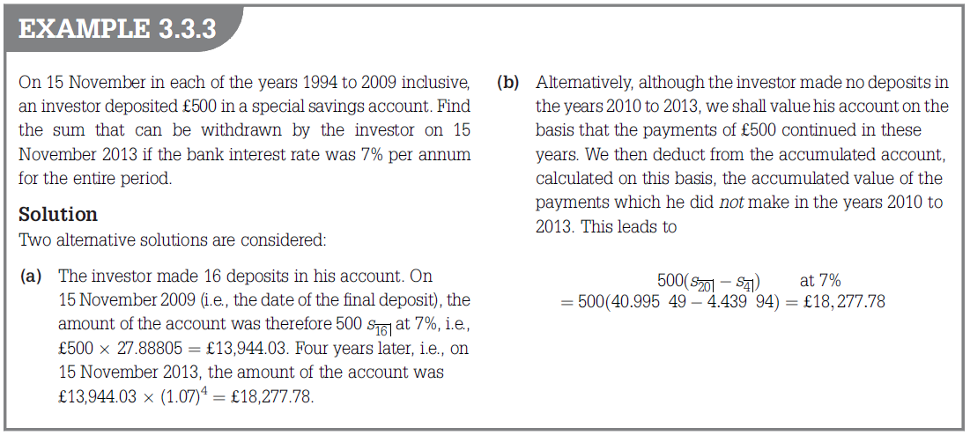

Slide 28
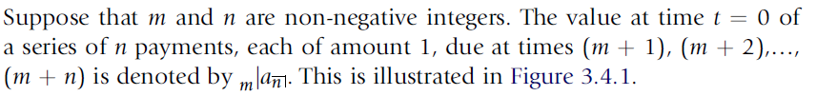
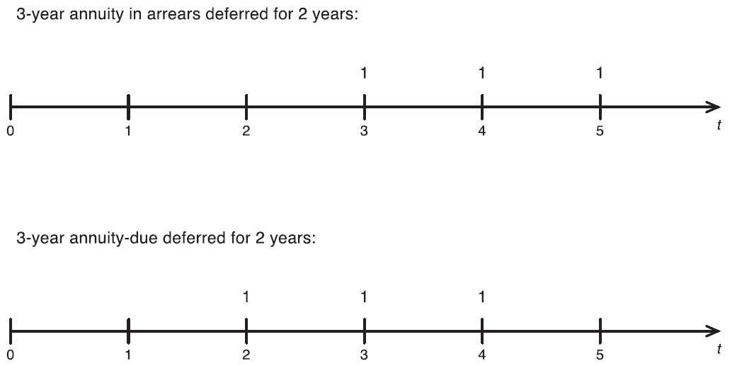
3.4 DEFERRED ANNUITIES

Slide 29
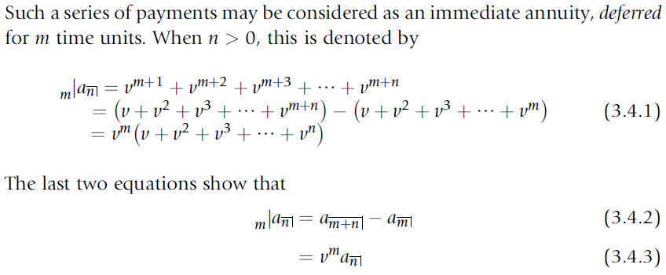
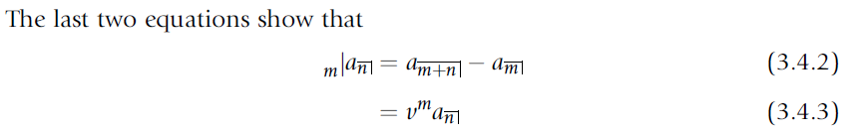
3.4 DEFERRED ANNUITIES

Slide 30

3.4 DEFERRED ANNUITIES

Slide 31
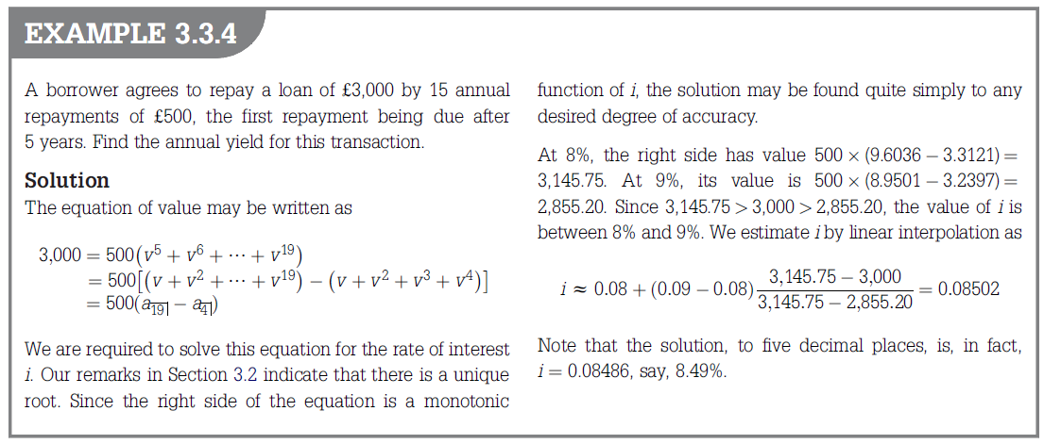

Slide 32
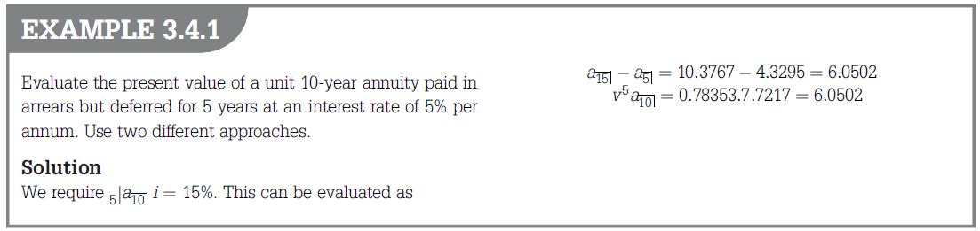

Slide 33
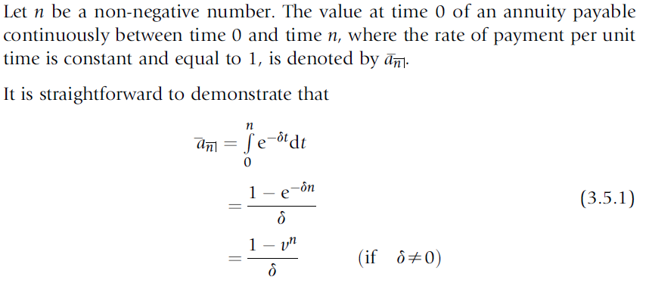
3.5 CONTINUOUSLY PAYABLE ANNUITIES

Slide 34
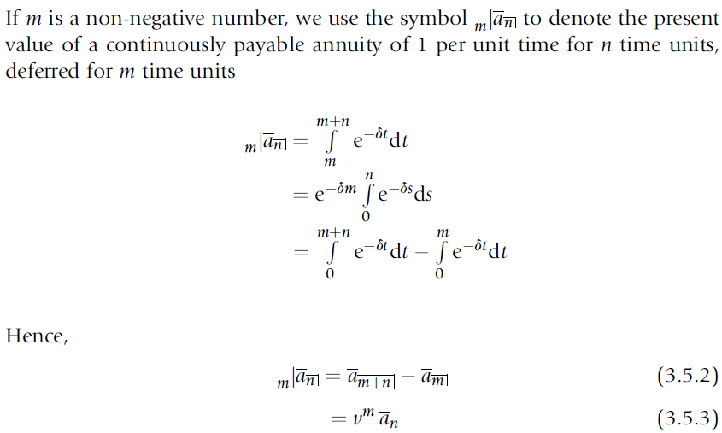
3.5 CONTINUOUSLY PAYABLE ANNUITIES

Slide 35
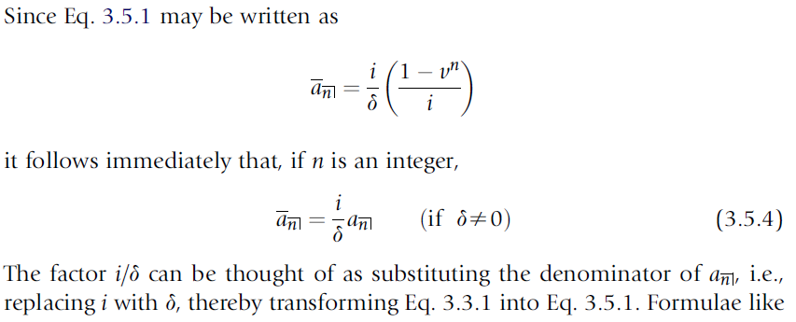
3.5 CONTINUOUSLY PAYABLE ANNUITIES

Slide 36
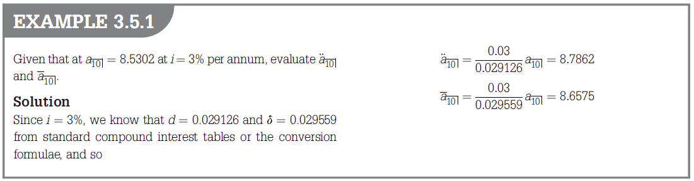

Slide 37
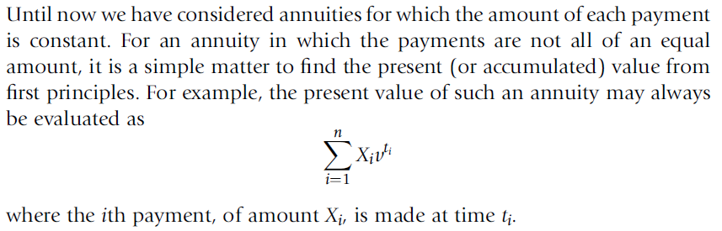
3.6 VARYING ANNUITIES

Slide 38
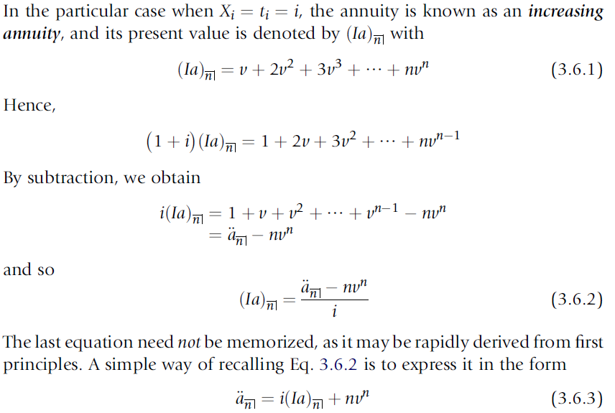
3.6 VARYING ANNUITIES

Slide 39


3.6 VARYING ANNUITIES
If the first payment of such an annuity is P and the second payment is (P + Q), the $t^{th}$ payment is (P - Q) + Qt, and the present value of the annuity is therefore

Slide 40
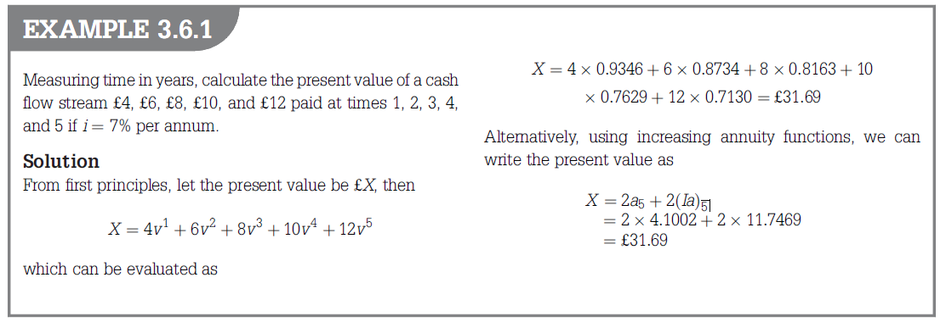

Slide 41
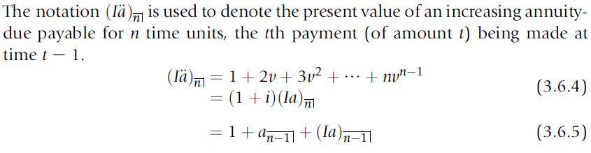
3.6 VARYING ANNUITIES

Slide 42
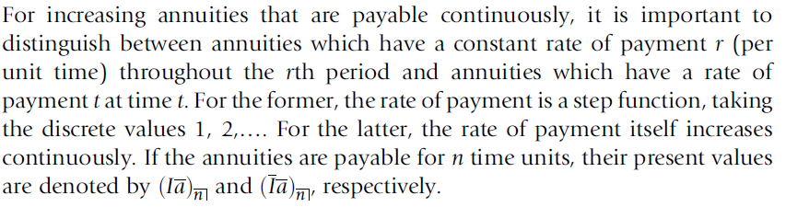
3.6 VARYING ANNUITIES

Slide 43
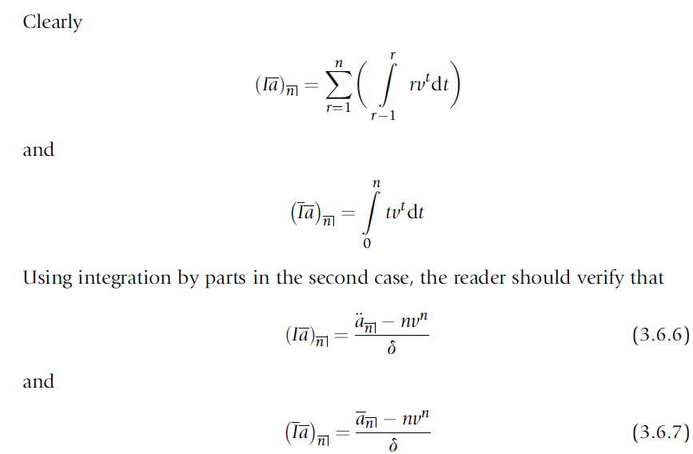
3.6 VARYING ANNUITIES

Slide 44

3.6 VARYING ANNUITIES

Slide 45


Slide 46


