Slide 1


Slide 2
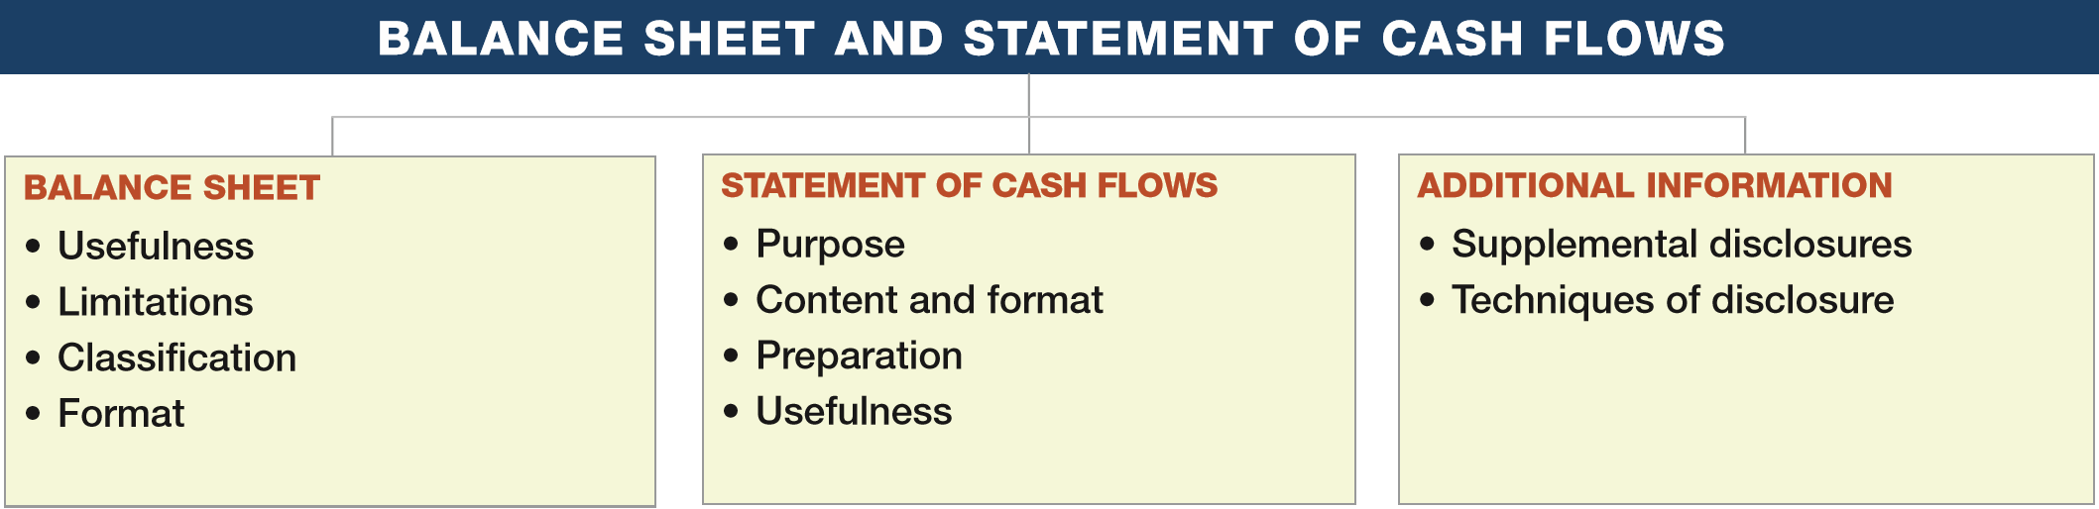
PREVIEW OF CHAPTER 5
Intermediate Accounting
16th Edition
Kieso ● Weygandt ● Warfield

Slide 3
LEARNING OBJECTIVES
5
Balance Sheet and Statement of Cash Flows
After studying this chapter, you should be able to:
Explain the uses and limitations of a balance sheet.
Identify the major classifications of the balance sheet.
Prepare a classified balance sheet using the report and account formats.
Identify the purpose and content of the statement of cash flows.
Prepare a basic statement of cash flows.
Understand the usefulness of the statement of cash flows.
Determine which balance sheet information requires supplemental disclosure.
Describe the major disclosure techniques for the balance sheet.
LO 1

Slide 4
BALANCE SHEET
Balance Sheet, sometimes referred to as the statement of financial position:
  Reports assets, liabilities, and equity at a specific date.
  Provides information about resources, obligations to creditors, and equity in net resources.
  Helps in predicting amounts, timing, and uncertainty of future cash flows.
LO 1

Slide 5
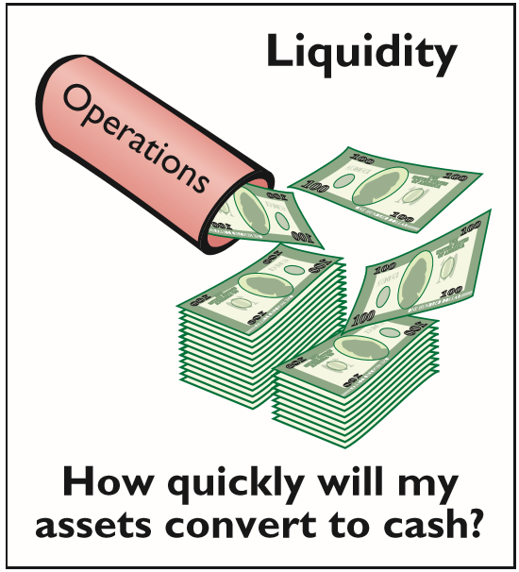
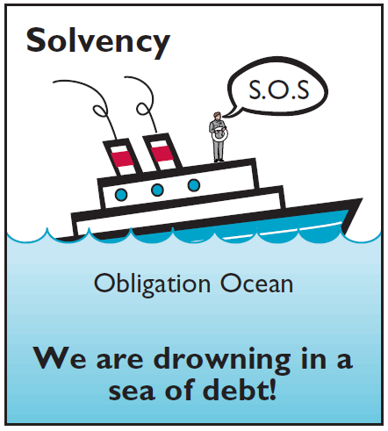
BALANCE SHEET
Usefulness of the Balance Sheet
Computing rates of return.
Evaluating the capital structure.
Assess risk and future cash flows.
Analyze the company’s:
  Liquidity,
  Solvency, and
  Financial flexibility.
LO 1

Slide 6
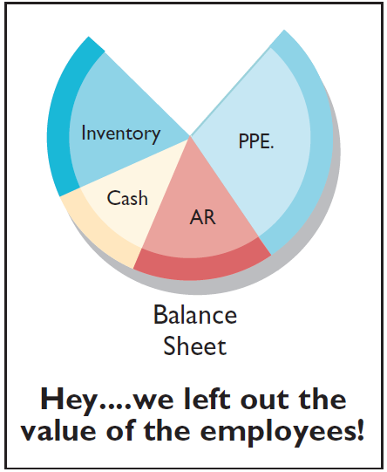
BALANCE SHEET
Limitations of the Balance Sheet
Most assets and liabilities are reported at historical cost.
Use of judgments and estimates.
Many items of financial value are omitted.
LO 1

Slide 7
WHAT DO THE NUMBERS MEAN? GROUNDED
WHAT’S YOUR PRINCIPLE
The terrorist attacks of September 11, 2001, showed how vulnerable the major airlines are to falling demand for their services. Since that infamous date, major airlines have reduced capacity and slashed jobs to avoid bankruptcy. United Airlines, Northwest Airlines, US Airways, and several smaller competitors ﬁled for bankruptcy in the wake of 9/11.
Delta Airlines made the following statements in its annual report issued shortly after 9/11:
“If we are unsuccessful in further reducing our operating costs . . . we will need to restructure our costs under Chapter 11 of the U.S. Bankruptcy Code. . . . We have substantial liquidity needs and there is no assurance that we will be able to obtain the necessary ﬁnancing to meet those needs on acceptable terms, if at all.”
continued
LO 1

Slide 8
WHAT DO THE NUMBERS MEAN? GROUNDED
WHAT’S YOUR PRINCIPLE
These ﬁnancial ﬂexibility challenges have continued, exacerbated by volatile fuel prices, labor costs, and the unpredictability of the global economic environment. Not surprisingly, several of the major airlines (Delta and Northwest, Continental and United, Airtran and Southwest, and American Airlines and US Airways) merged recently as a way to build some competitive synergies and to bolster their ﬁnancial ﬂexibility. There is no question that running an airline is a difﬁcult task. As superstar investor Warren Buffett said, “I have an 800 number now that I call if I get the urge to buy an airline stock,” adding that his “aeroholic” buddies “talk me down.”
Sources: R. Seaney, “Airline Mergers: Good for Travelers?” http://abcnews.go.com/Travel/airline-merger-mania-cost/story?id=16227892 (April 27, 2012); and T. Reed, “Buffett Decries Airline Investing Even Though at Worst He Broke Even,” Forbes (May 13, 2013).
LO 1

Slide 9
LEARNING OBJECTIVES
5
Balance Sheet and Statement of Cash Flows
After studying this chapter, you should be able to:
Explain the uses and limitations of a balance sheet.
Identify the major classifications of the balance sheet.
Prepare a classified balance sheet using the report and account formats.
Identify the purpose and content of the statement of cash flows.
Prepare a basic statement of cash flows.
Understand the usefulness of the statement of cash flows.
Determine which balance sheet information requires supplemental disclosure.
Describe the major disclosure techniques for the balance sheet.
LO 2

Slide 10
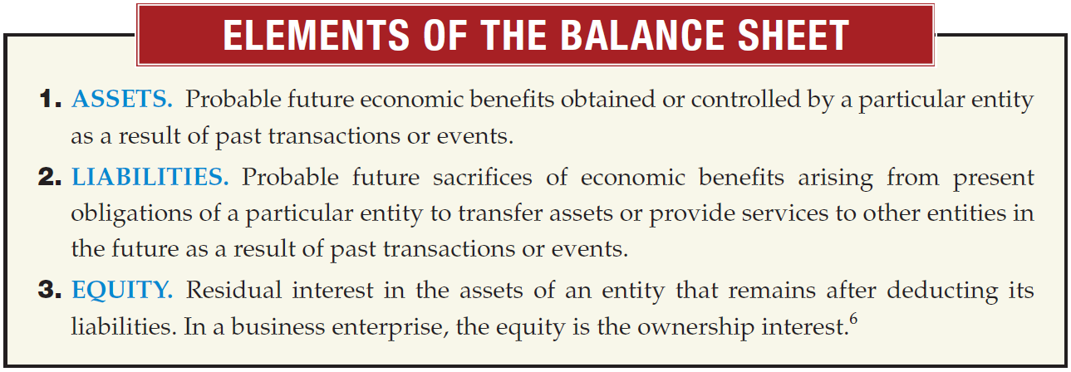
BALANCE SHEET
Classification in the Balance Sheet
LO 2

Slide 11
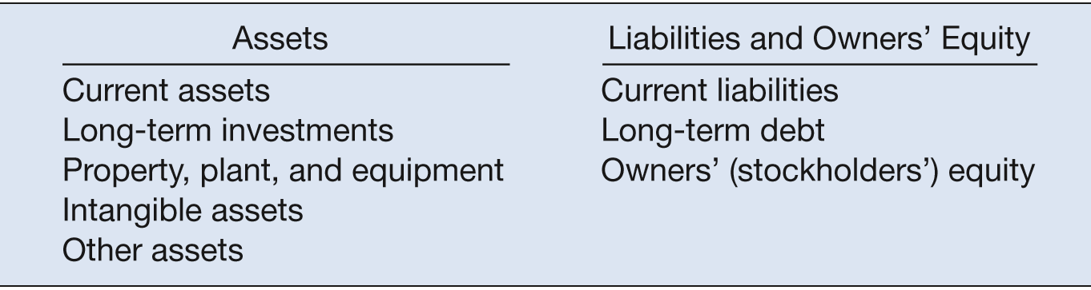
BALANCE SHEET
Classification in the Balance Sheet
ILLUSTRATION 5-1
Balance Sheet Classiﬁcations
In practice you usually see little departure from these major subdivisions.
LO 2

Slide 12
Classification in the Balance Sheet
Question
The correct order to present current assets is
  Cash, accounts receivable, prepaid items, inventories.
  Cash, accounts receivable, inventories, prepaid items.
  Cash, inventories, accounts receivable, prepaid items.
  Cash, inventories, prepaid items, accounts receivable.
Order of Liquidity
LO 2

Slide 13
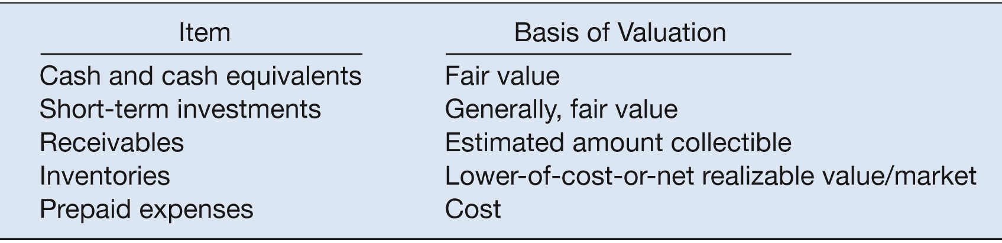
BALANCE SHEET – “Current Assets”
Current assets
  Cash and other assets a company expects to convert into cash, sell, or consume either in one year or in the operating cycle, whichever is longer.
  Presented in the balance sheet in order of liquidity.
ILLUSTRATION 5-2
Current Assets and Basis of Valuation
LO 2

Slide 14
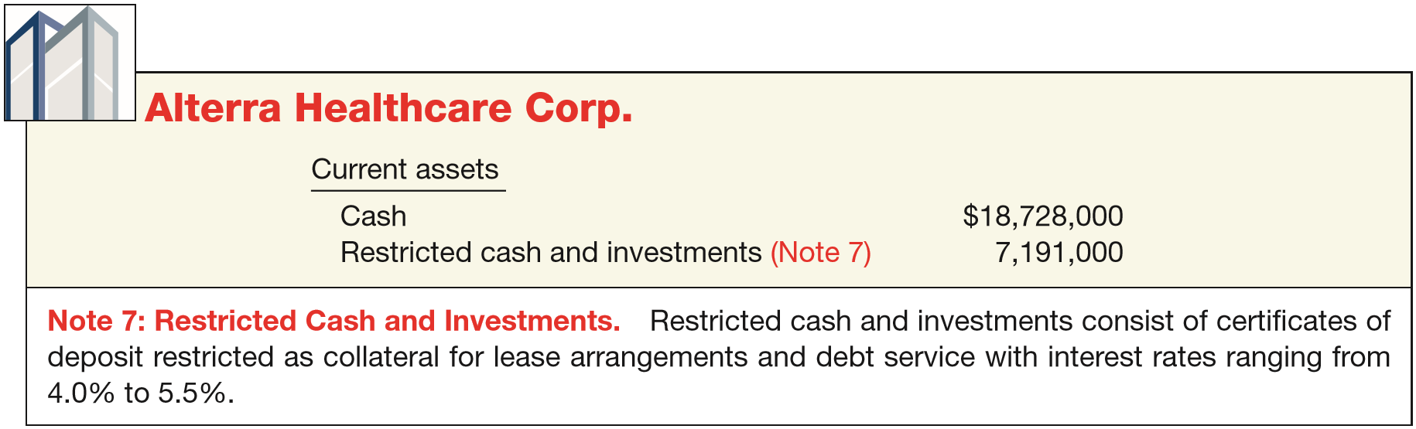
BALANCE SHEET – “Current Assets”
Cash
  Generally any monies available “on demand.”
  Cash equivalents - short-term highly liquid investments that mature within three months or less.
  Restrictions or commitments must be disclosed.
ILLUSTRATION 5-3
Balance Sheet Presentation of Restricted Cash
LO 2

Slide 15
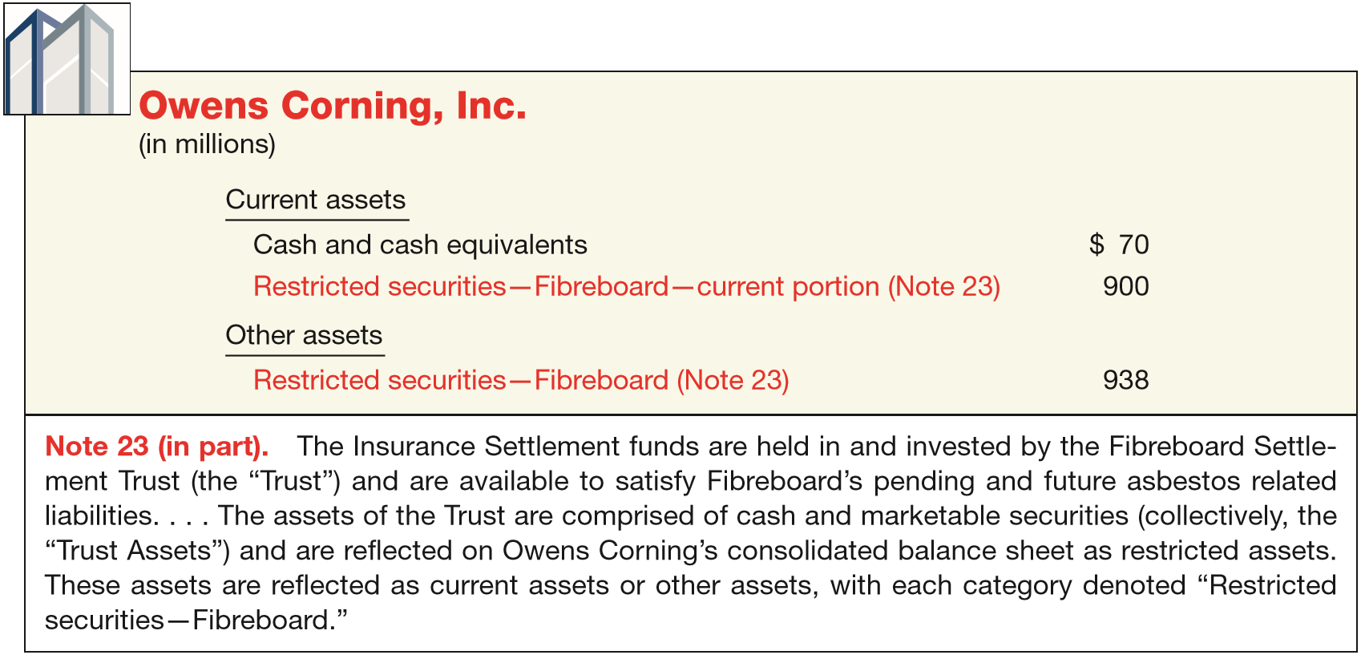
BALANCE SHEET – “Current Assets”
Cash
ILLUSTRATION 5-4
Balance Sheet Presentation of Current and Noncurrent Restricted Cash
LO 2

Slide 16
BALANCE SHEET – “Current Assets”
Short-Term Investments
Portfolios
Type
Valuation
Classification
Held-to-Maturity
Debt
Amortized
Cost
Current or Noncurrent
Trading
Debt or
Equity
Fair Value
Current
Available-
for-Sale
Debt or
Equity
Fair Value
Current or Noncurrent
LO 2

Slide 17
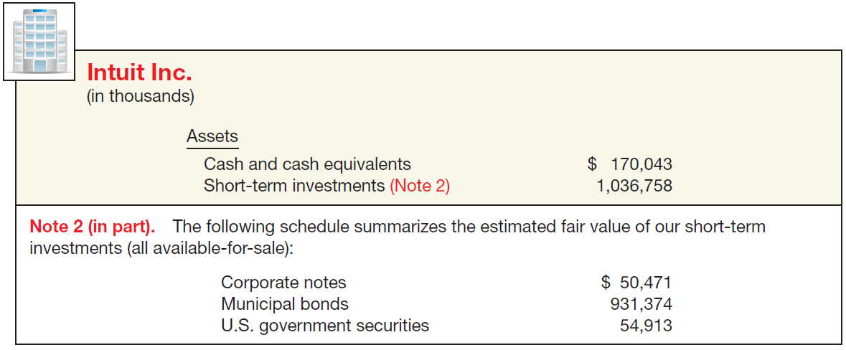

BALANCE SHEET – “Current Assets”
Short-Term Investments
ILLUSTRATION 5-5
Balance Sheet Presentation of Investments in Securities
LO 2

Slide 18
BALANCE SHEET – “Current Assets”
Receivables
Major categories of receivables should be shown in the balance sheet or the related notes.
A company should clearly identify
  Anticipated loss due to uncollectibles.
  Amount and nature of any nontrade receivables.
  Receivables used as collateral.
LO 2

Slide 19
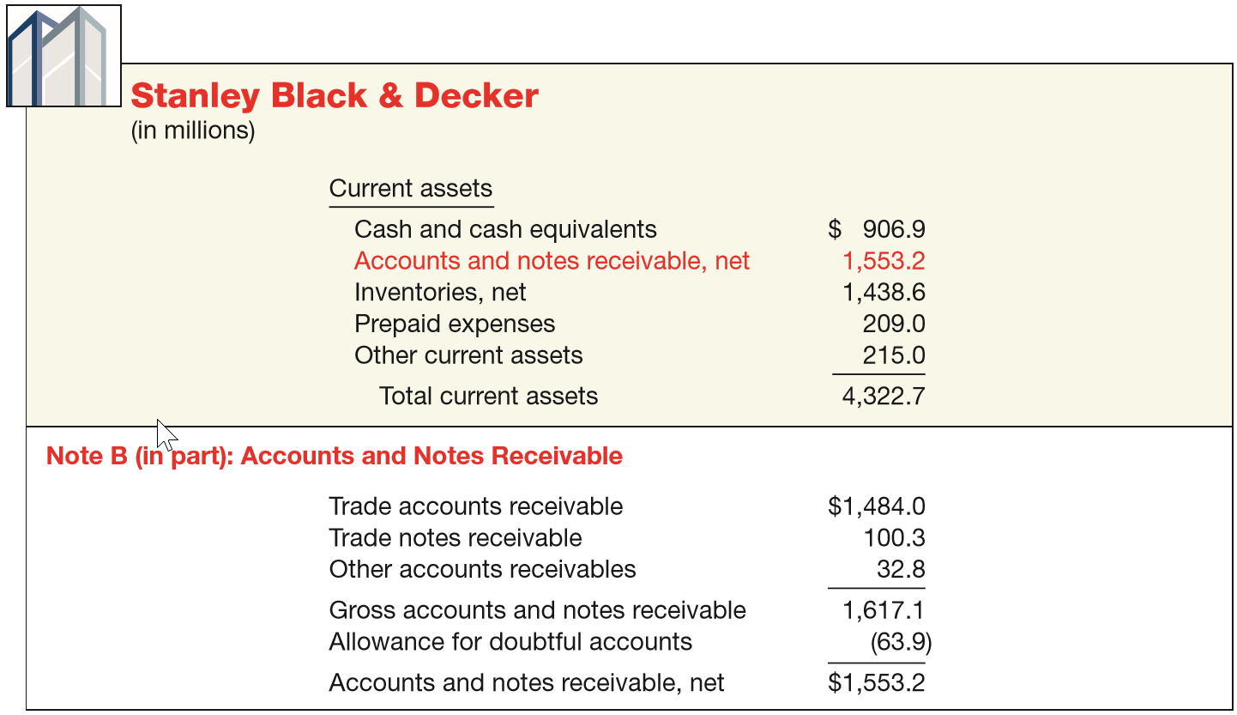
BALANCE SHEET – “Current Assets”
Receivables
ILLUSTRATION 5-6
Balance Sheet Presentation of Receivables
LO 2

Slide 20
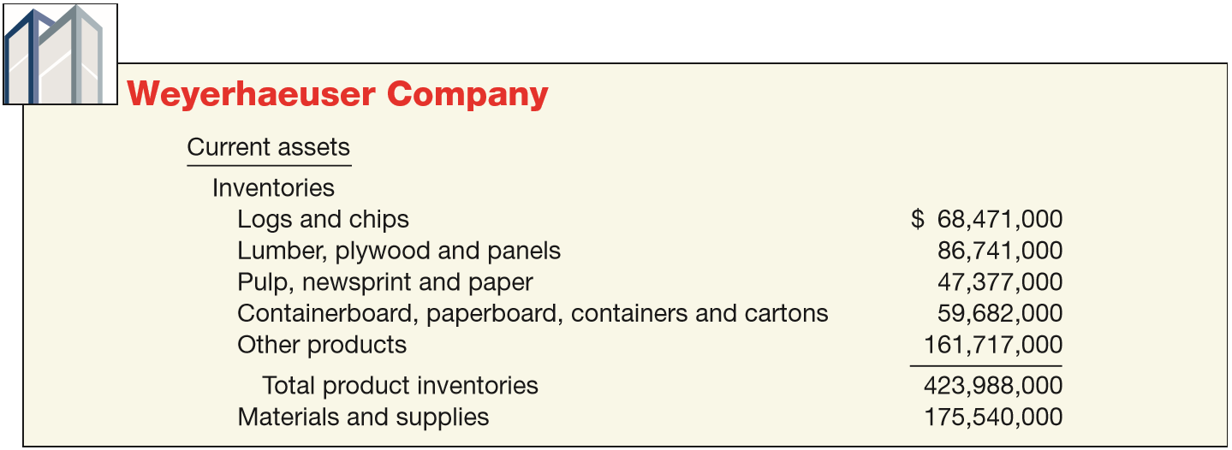
BALANCE SHEET – “Current Assets”
Inventories
Disclose:
  Basis of valuation (e.g., lower-of-cost-or-market).
  Cost flow assumption (e.g., FIFO or LIFO).
ILLUSTRATION 5-8
Balance Sheet Presentation of Inventories, Showing Product Lines

Slide 21
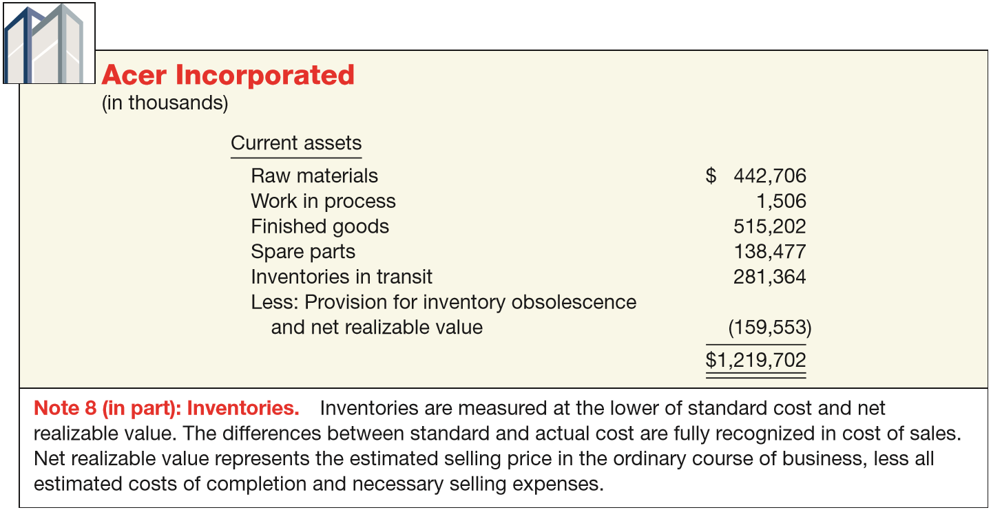
BALANCE SHEET – “Current Assets”
Inventories
ILLUSTRATION 5-7
Balance Sheet Presentation of Inventories, Showing Stage of Completion
LO 2

Slide 22
BALANCE SHEET – “Current Assets”
Prepaid Expenses
Payment of cash, that is recorded as an asset because service or benefit will be received in the future.
Cash Payment
BEFORE
Expense Recorded
Prepayments often occur in regard to:
  insurance
  supplies
  advertising
  rent
  taxes
LO 2

Slide 23
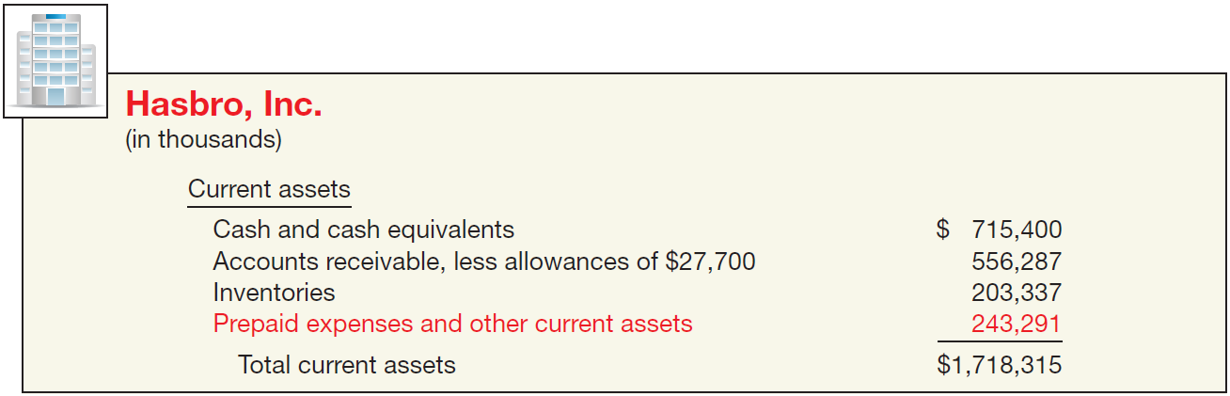
BALANCE SHEET – “Current Assets”
Prepaid Expenses
ILLUSTRATION 5-9
Balance Sheet Presentation
of Prepaid Expenses
LO 2

Slide 24
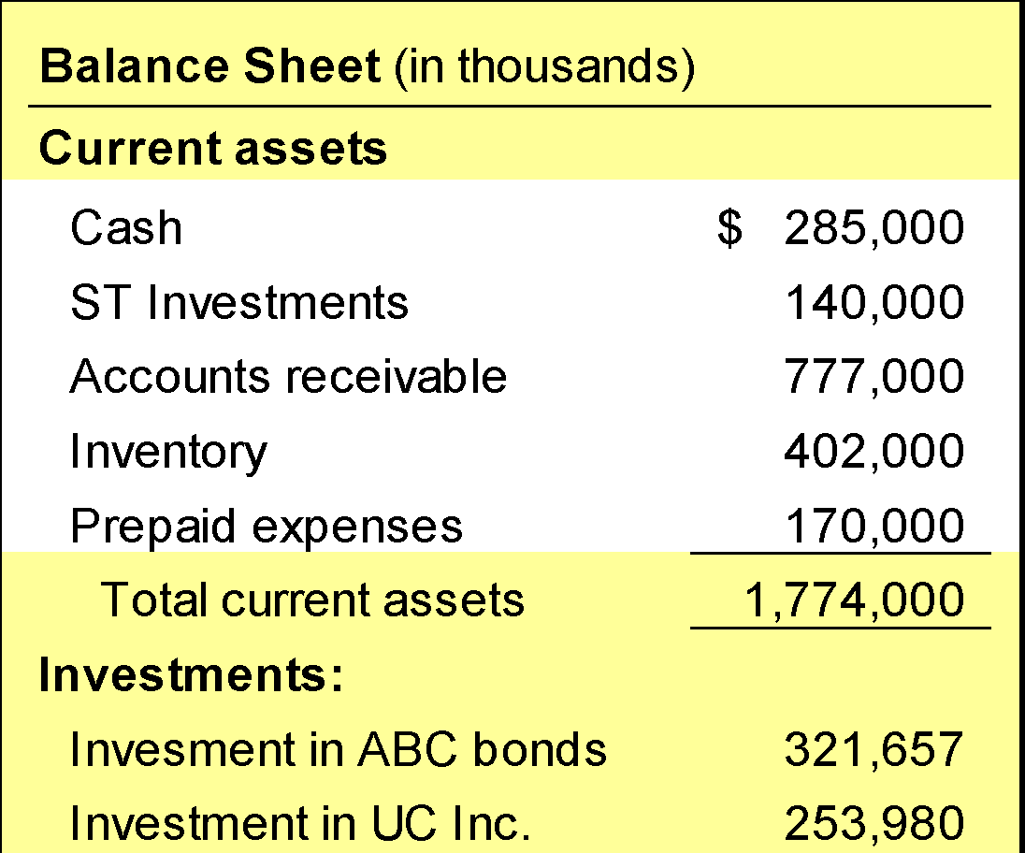
BALANCE SHEET – “Current Assets”
Summary
Cash and other assets a company expects to
  convert into cash,
  sell, or
  consume
either in one year or in the operating cycle, whichever is longer.
LO 2

Slide 25
Classification in the Balance Sheet
Noncurrent Assets
  Long-Term Investments
  Securities (bonds, common stock, or long-term notes).
  Tangible fixed assets not currently used in operations (land held for speculation).
  Special funds (sinking fund, pension fund, plant expansion fund, or cash surrender value of life insurance).
  Nonconsolidated subsidiaries or affiliated companies.
LO 2

Slide 26
BALANCE SHEET – “Noncurrent Assets”
Long-Term Investments
Portfolios
Type
Valuation
Classification
Held-to-Maturity
Debt
Amortized
Cost
Current or Noncurrent
Trading
Debt or
Equity
Fair Value
Current
Available-
for-Sale
Debt or
Equity
Fair Value
Current or Noncurrent
LO 2

Slide 27
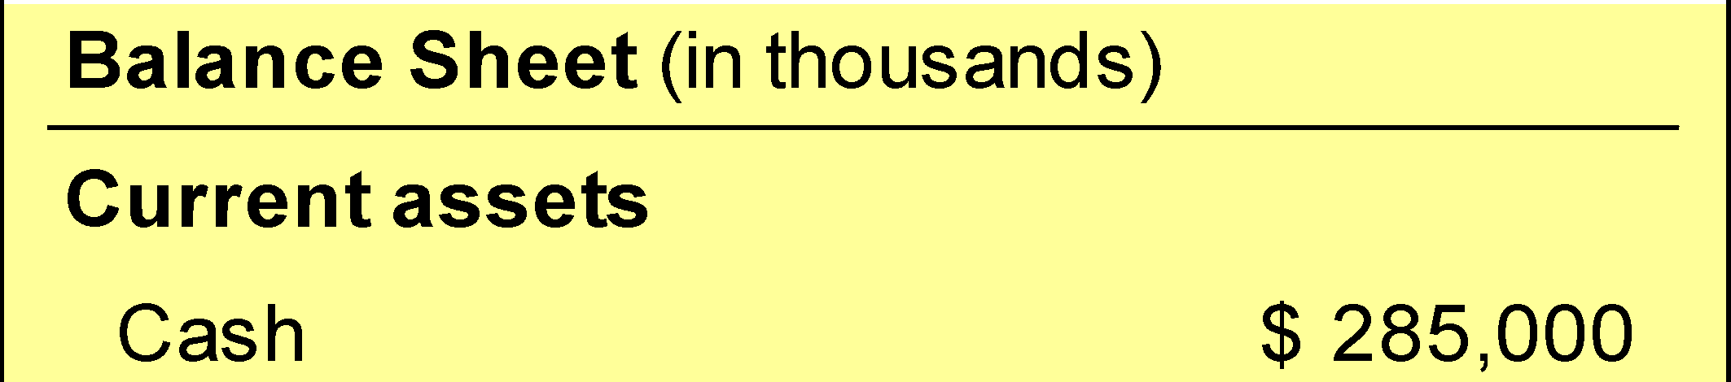
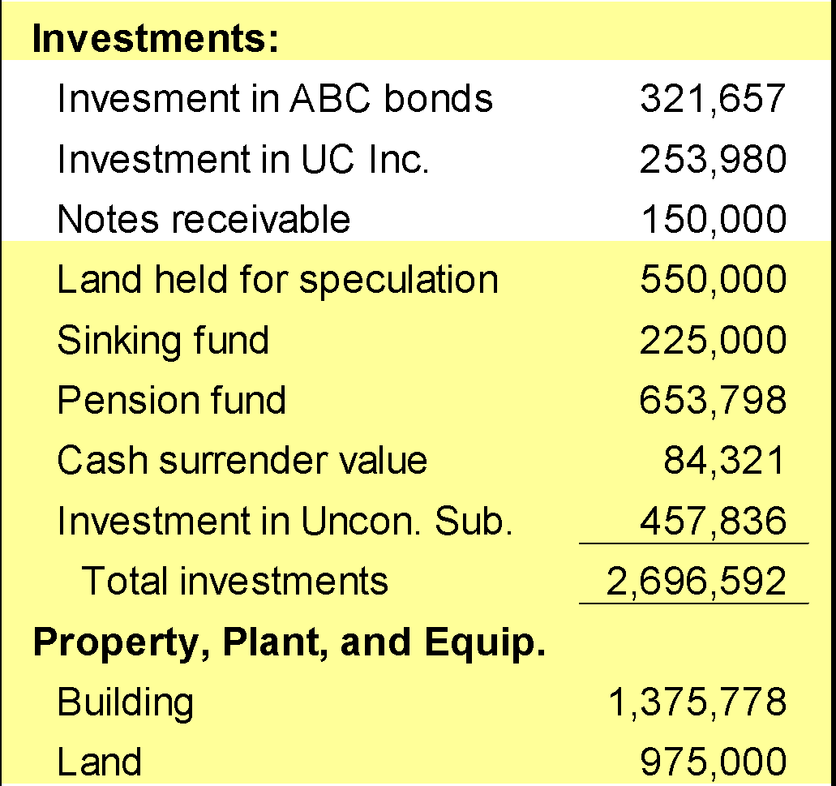
BALANCE SHEET – “Noncurrent Assets”
Long-Term Investments
Securities
Bonds,
Stock, and
Long-term notes
For marketable securities, management’s intent determines current or noncurrent classification.

Slide 28
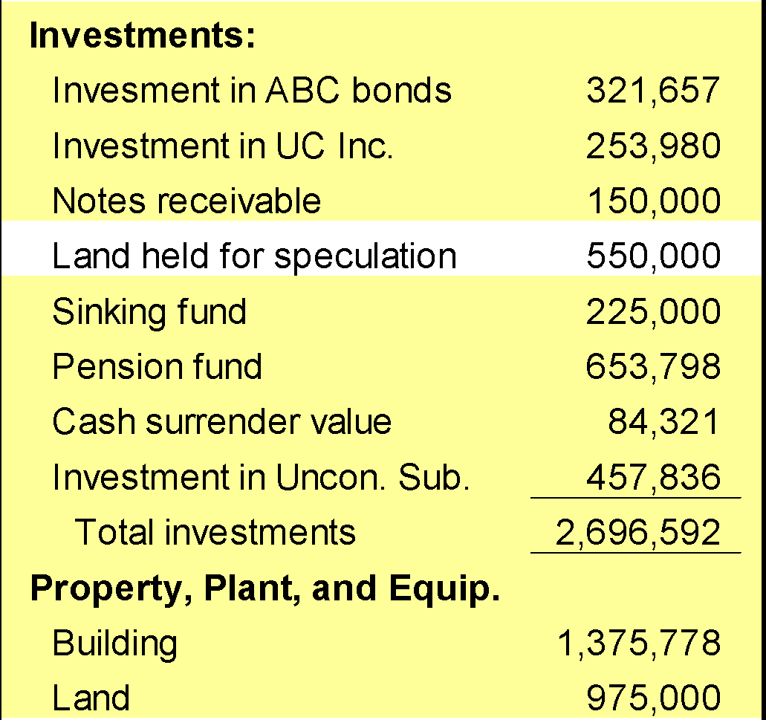
BALANCE SHEET – “Noncurrent Assets”
Long-Term Investments
Fixed Assets
Land held for speculation

Slide 29
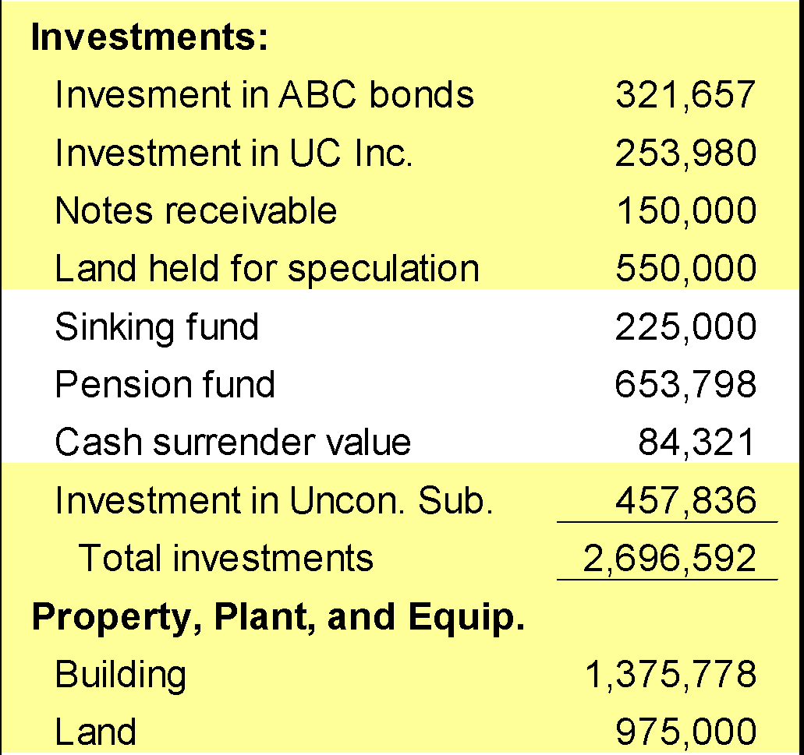
BALANCE SHEET – “Noncurrent Assets”
Long-Term Investments
Special Funds
Sinking fund
Pensions fund
Cash surrender value of life insurance

Slide 30
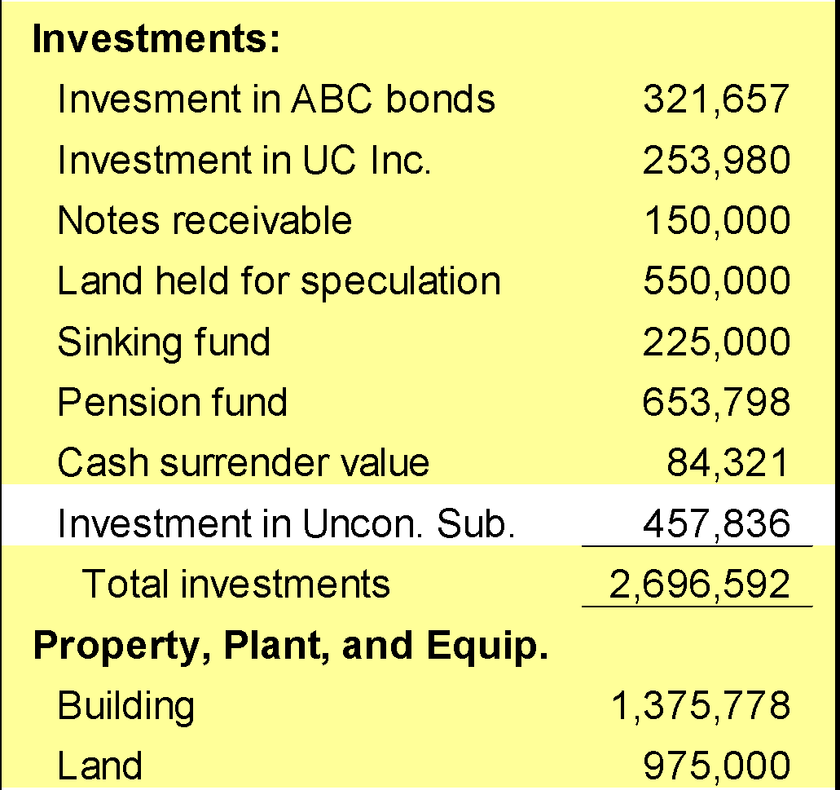
BALANCE SHEET – “Noncurrent Assets”
Long-Term Investments
Nonconsolidated Subsidiaries or Affiliated Companies

Slide 31
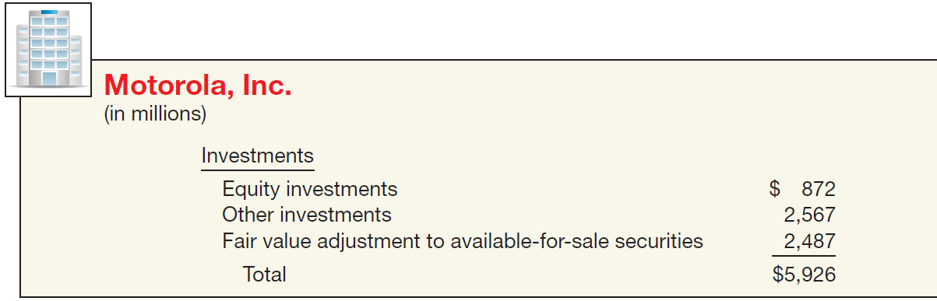
BALANCE SHEET – “Noncurrent Assets”
Long-Term Investments
ILLUSTRATION 5-10
Balance Sheet Presentation of
Long-Term Investments
LO 2

Slide 32
BALANCE SHEET – “Noncurrent Assets”
Property, Plant, and Equipment
Tangible long-lived assets used in the regular operations of the business.
  Physical property such as land, buildings, machinery, furniture, tools, and wasting resources (minerals).
  With the exception of land, a company either depreciates (e.g., buildings) or depletes (e.g., oil reserves) these assets.
LO 2

Slide 33
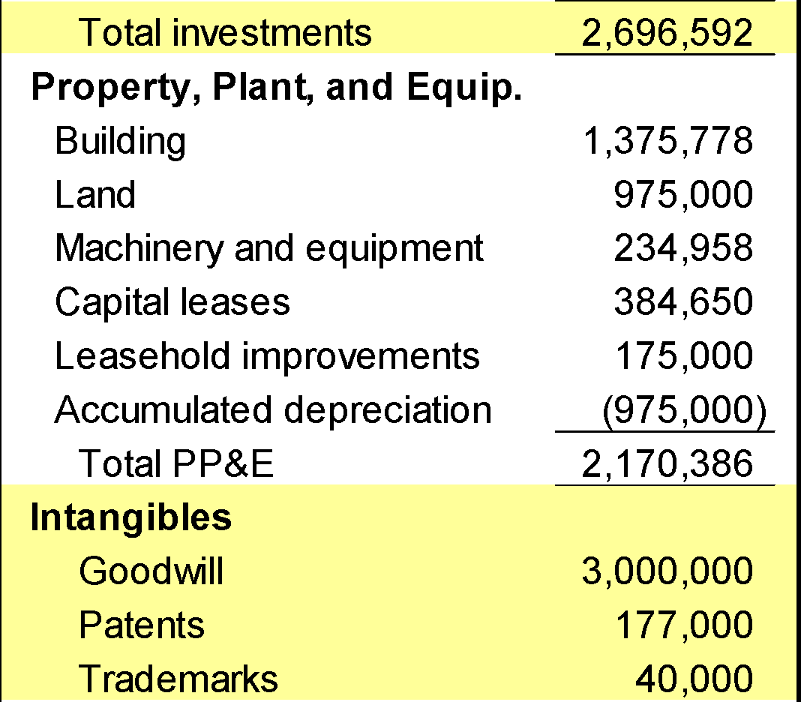
BALANCE SHEET – “Noncurrent Assets”
Property, Plant, and Equipment
A company discloses the basis it uses to value property, plant, and equipment.
LO 2

Slide 34
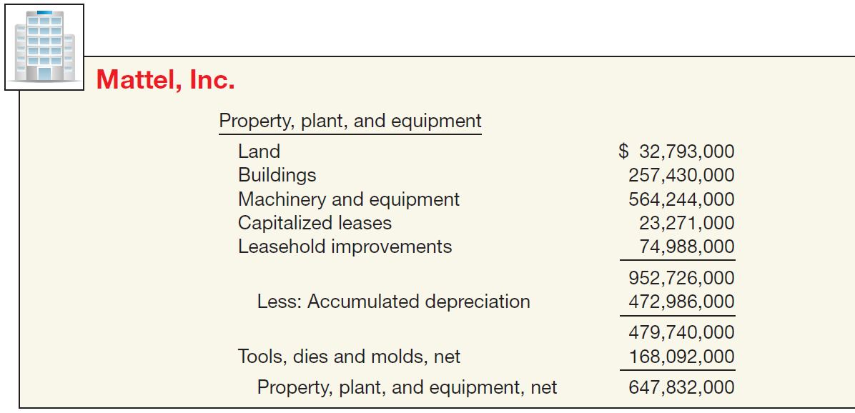
BALANCE SHEET – “Noncurrent Assets”
Property, Plant, and Equipment
ILLUSTRATION 5-11
Balance Sheet Presentation of Property, Plant, and Equipment
LO 2

Slide 35
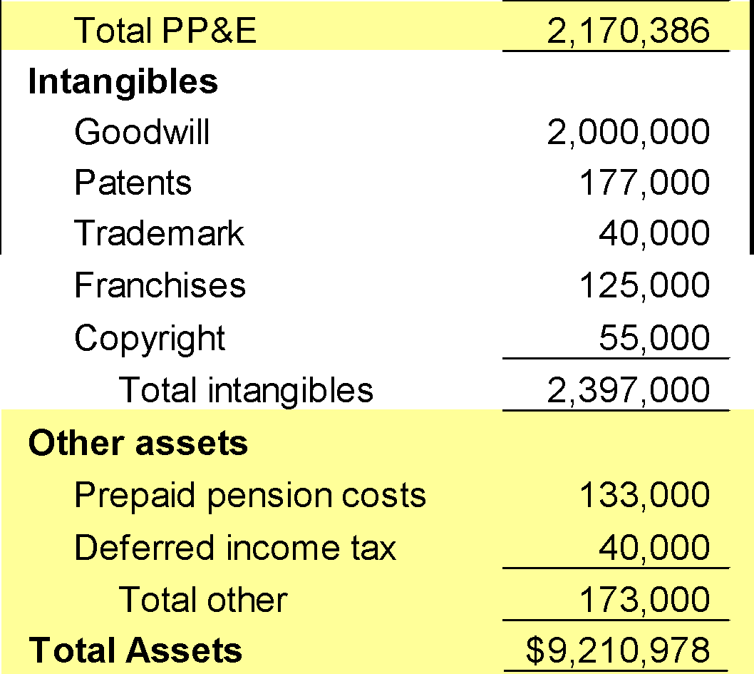
BALANCE SHEET – “Noncurrent Assets”
Intangible Assets
Lack physical substance and are not financial instruments.
  Limited life intangibles amortized.
  Indefinite-life intangibles tested for impairment.
LO 2

Slide 36
BALANCE SHEET – “Noncurrent Assets”
Illustration: Patrick Corporation adjusted trial balance contained the following asset accounts at December 31, 2017: Prepaid Rent $12,000; Goodwill $50,000; Franchise Fees Receivable $2,000; Franchises $47,000; Patents $33,000; Trademarks $10,000. Prepare the intangible assets section of the balance sheet.
Intangible Assets
Goodwill $ 50,000
Franchises 47,000
Patents 33,000
Trademarks 10,000
Total $140,000
LO 2

Slide 37
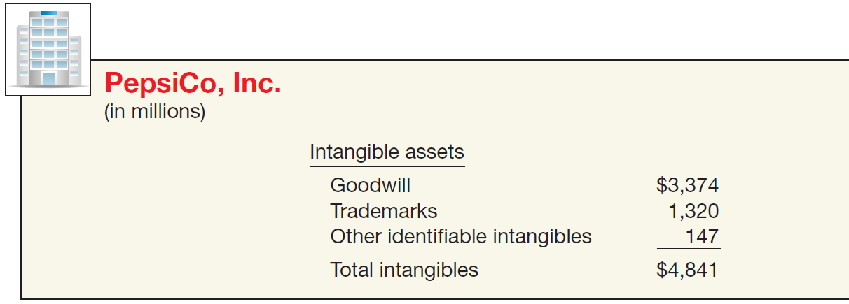
BALANCE SHEET – “Noncurrent Assets”
Intangible Assets
ILLUSTRATION 5-12
Balance Sheet Presentation of Intangible Assets
LO 2

Slide 38
BALANCE SHEET – “Noncurrent Assets”
Other Assets
  Items vary in practice. Can include
  Long-term prepaid expenses
  Non-current receivables
  Assets in special funds
  Deferred income taxes
  Property held for sale
  Restricted cash or securities
LO 2

Slide 39
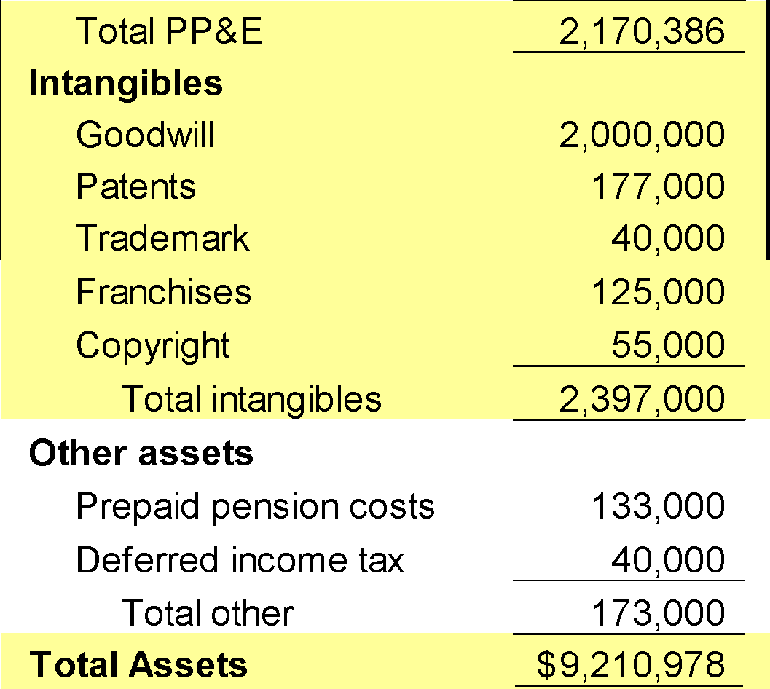
BALANCE SHEET – “Noncurrent Assets”
Other Assets
This section should include only unusual items sufficiently different from assets in the other categories.
LO 2

Slide 40
WHAT DO THE NUMBERS MEAN? “SHOW ME THE ASSETS!”
WHAT’S YOUR PRINCIPLE
Before the dot-com bubble burst, concerns about liquidity and solvency led creditors of many dot-com companies to demand more assurances that these companies could pay their bills when due. A key indicator for creditors is the amount of working capital. For example, when a report predicted that Amazon. com’s working capital would turn negative, the company’s vendors began to explore steps that would ensure that Amazon would pay them.
Some vendors demanded that their dot-com customers sign notes stating that the goods shipped to them would serve as collateral for the transaction. Other vendors began shipping goods on consignment—an arrangement whereby the vendor retains ownership of the goods until a third party buys and pays for them. Another recent bubble in the real estate market created a working capital and liquidity crisis for no less a revered ﬁnancial institution than Bear Stearns. What happened? Bear
continued
LO 2

Slide 41
WHAT DO THE NUMBERS MEAN? “SHOW ME THE ASSETS!”
WHAT’S YOUR PRINCIPLE
Stearns was one of the biggest investors in mortgage-backed securities. But when the housing market cooled off and the value of the collateral backing Bear Stearns’ mortgage securities dropped dramatically, the market began to question Bear Stearns’ ability to meet its obligations. The result: The Federal Reserve stepped in to avert a collapse of the company, backing a bailout plan that guaranteed $30 billion of Bear Stearns’ investments. This paved the way for a buy-out by JPMorgan Chase at $2 per share (later amended to $10 a share)—quite a bargain since Bear Stearns had been trading above $80 a share just a month earlier.
Source: Robin Sidel, Greg Ip, Michael M. Phillips, and Kate Kelly, “The Week That Shook Wall Street: Inside the Demise of Bear Stearns,” Wall Street Journal (March 18, 2008), p. A1.
LO 2

Slide 42
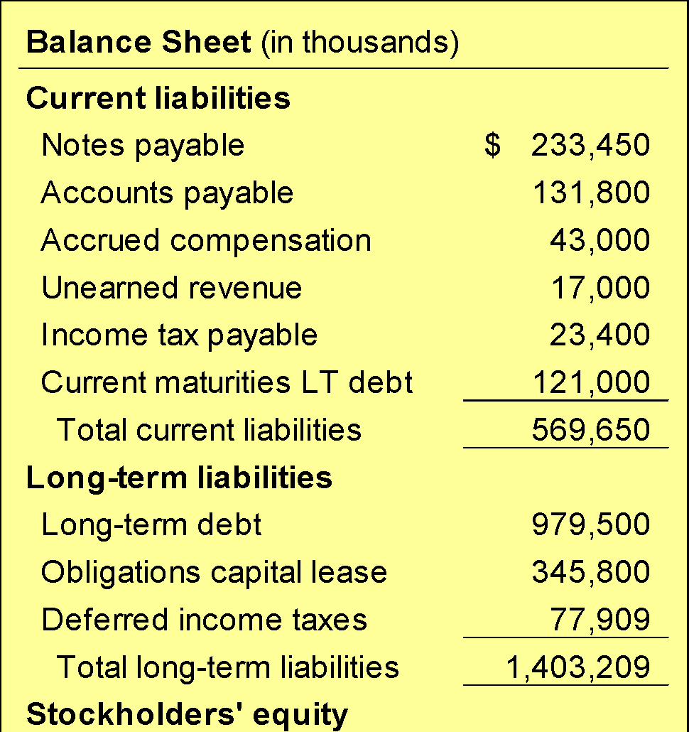
Classification in the Balance Sheet
Liabilities
Companies classify liabilities as current or long-term.
LO 2

Slide 43
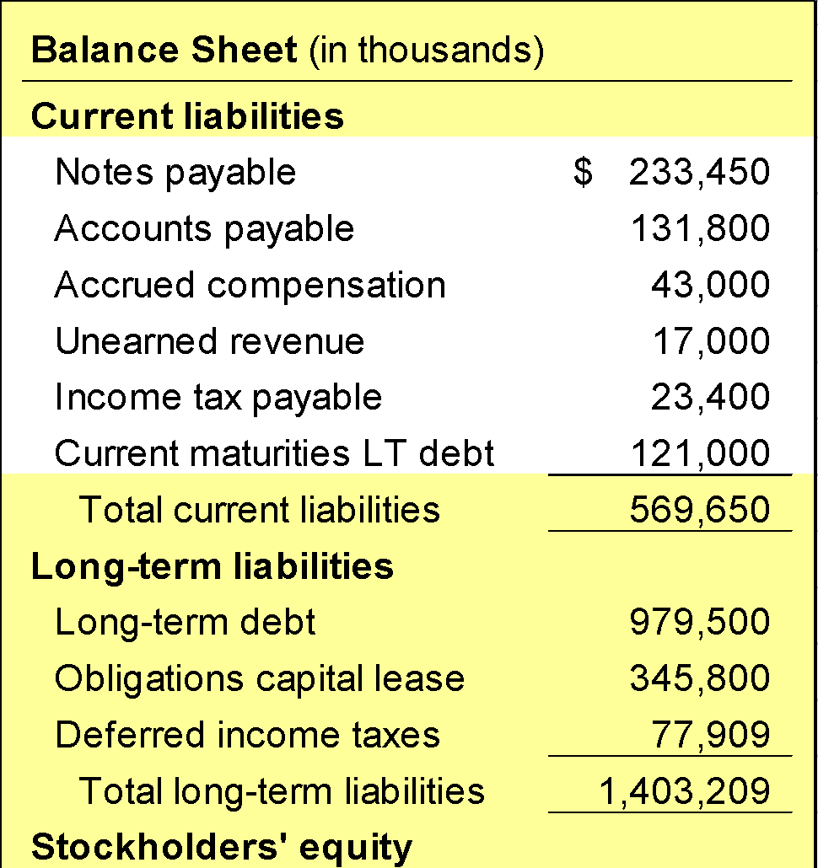
BALANCE SHEET – “Liabilities”
Current Liabilities
Obligations that a company reasonably expects to liquidate either through the use of current assets or the creation of other current liabilities.
LO 2

Slide 44
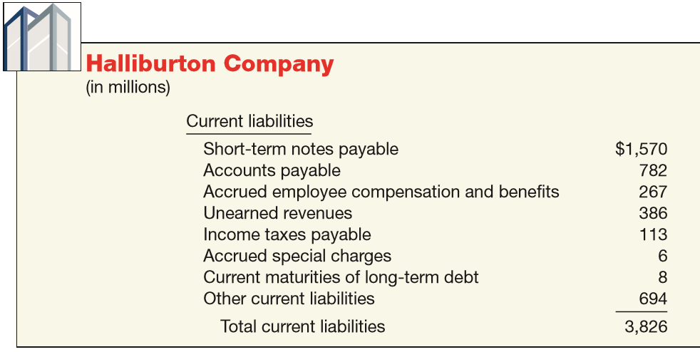
BALANCE SHEET – “Liabilities”
Current Liabilities
ILLUSTRATION 5-13
Balance Sheet Presentation of Current Liabilities
LO 2

Slide 45
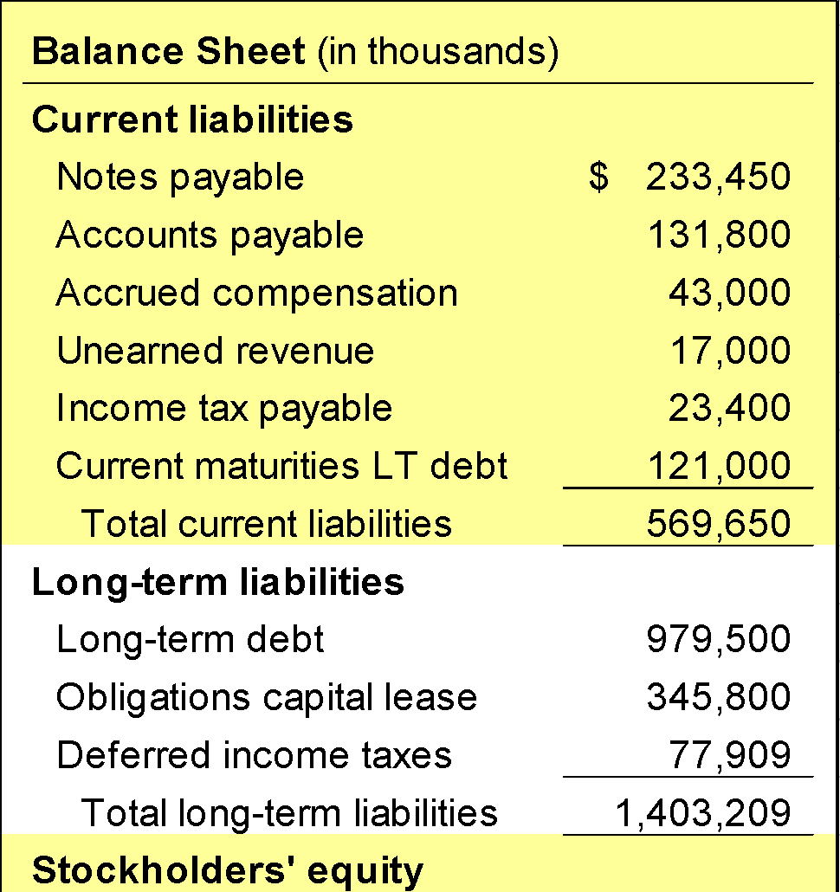
BALANCE SHEET – “Liabilities”
Long-Term Liabilities
Obligations that a company does not reasonably expect to liquidate within the normal operating cycle.
All covenants and restrictions must be disclosed.
LO 2

Slide 46
BALANCE SHEET – “Liabilities”
Illustration: Included in Adams Company’s December 31, 2017, trial balance are the following accounts: Accounts Payable $220,000; Pension Asset/Liability $375,000; Discount on Bonds Payable $29,000; Unearned Revenue $41,000; Bonds Payable $400,000; Salaries and Wages Payable $27,000; Interest Payable $12,000; Income Taxes Payable $29,000. Prepare the long-term liabilities section of the balance sheet.
Long-term liabilities
Pension Asset/liability $375,000
Bonds payable 400,000
Discount on bonds payable (29,000)
Total $746,000
LO 2

Slide 47
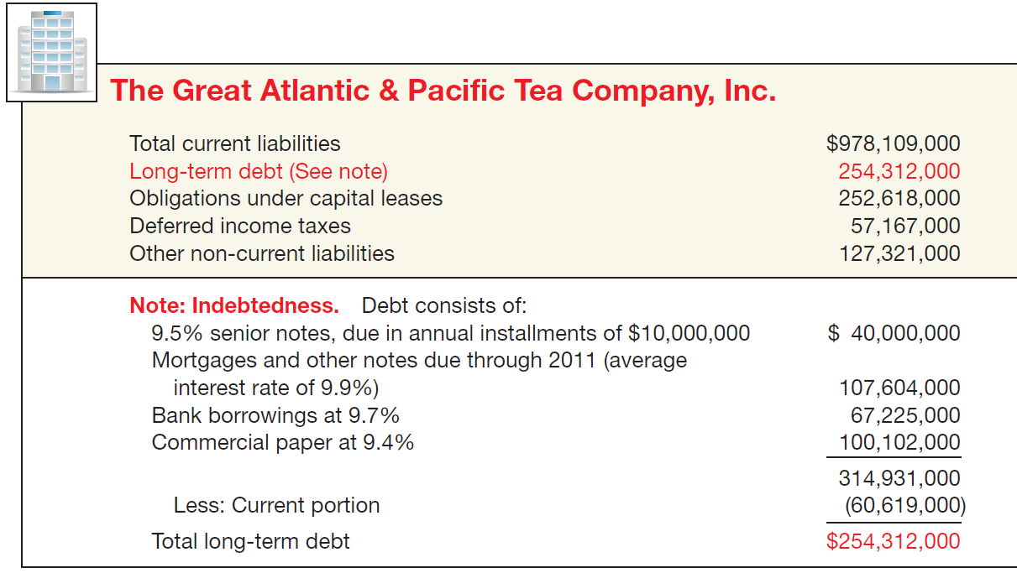
BALANCE SHEET – “Liabilities”
Long-Term Liabilities
ILLUSTRATION 5-14
Balance Sheet Presentation of Long-Term Liabilities
LO 2

Slide 48
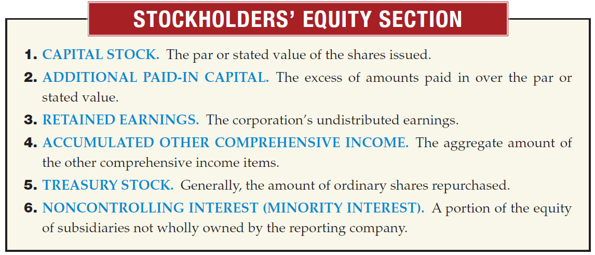
Classification in the Balance Sheet
Owners’ Equity
LO 2

Slide 49
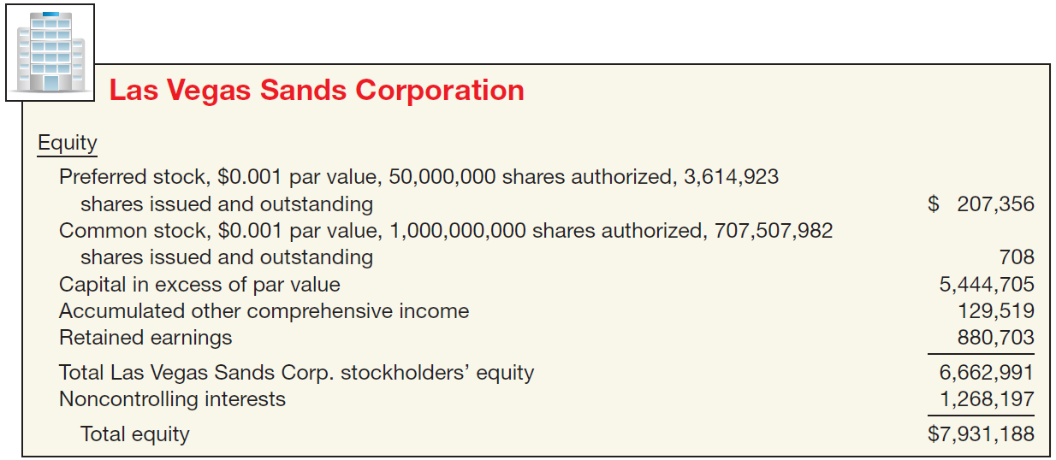
Classification in the Balance Sheet
Owners’ Equity
ILLUSTRATION 5-15
Balance Sheet Presentation of Stockholders’ Equity
LO 2

Slide 50
Classification in the Balance Sheet
Account
Classification
(a) Investment in preferred stock
(a) Current asset/Investment
(b) Treasury stock
(b) Stockholders’ Equity
(c) Common stock
(c) Stockholders’ Equity
(d) Cash dividends payable
(d) Current liability
(e) Accumulated depreciation
(e) Contra-asset
(f) Interest payable
(f) Current liability
(g) Deficit
(g) Stockholders’ Equity
(h) Trading securities
(h) Current asset
(i) Unearned revenue
(i) Current liability
LO 2

Slide 51
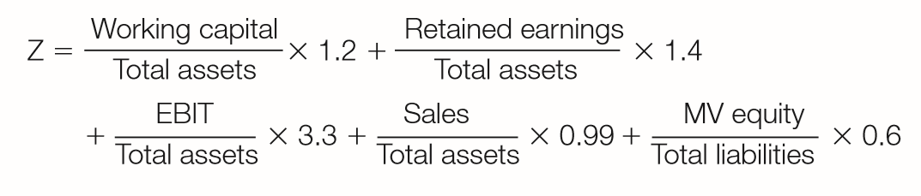
WHAT DO THE NUMBERS MEAN? WARNING SIGNALS
WHAT’S YOUR PRINCIPLE
Analysts use balance sheet information in models designed to predict ﬁnancial distress. Researcher E. I. Altman pioneered a bankruptcy-prediction model that derives a “Z-score” by combining balance sheet and income measures in the following equation. Following extensive testing,
Altman found that companies with Z-scores above 3.0 are unlikely to fail. Those with Z-scores below 1.81 are very likely to fail. Altman developed the original model for publicly held manufacturing companies. He and others have modiﬁed the model to apply to companies in various industries, emerging companies, and companies not traded in public markets.
continued
LO 2

Slide 52
WHAT DO THE NUMBERS MEAN? WARNING SIGNALS
WHAT’S YOUR PRINCIPLE
At one time, the use of Z-scores was virtually unheard of among practicing accountants. Today, auditors, management consultants, and courts of law use this measure to help evaluate the overall ﬁnancial position and trends of a ﬁrm. In addition, banks use Z-scores for loan evaluation. While a low score does not guarantee bankruptcy, the model has been proven accurate in many situations.
Source: Adapted from E. I. Altman and E. Hotchkiss, Corporate Financial Distress and Bankruptcy, Third Edition (New York: John Wiley and Sons, 2006).
LO 2

Slide 53
LEARNING OBJECTIVES
5
Balance Sheet and Statement of Cash Flows
After studying this chapter, you should be able to:
Explain the uses and limitations of a balance sheet.
Identify the major classifications of the balance sheet.
Prepare a classified balance sheet using the report and account formats.
Identify the purpose and content of the statement of cash flows.
Prepare a basic statement of cash flows.
Understand the usefulness of the statement of cash flows.
Determine which balance sheet information requires supplemental disclosure.
Describe the major disclosure techniques for the balance sheet.
LO 3

Slide 54
Balance Sheet Format
Classified Balance Sheet
  Account form
  Report form
Accounting Trends and Techniques (New York: AICPA) indicates that all of the 500 companies surveyed use either the “report form” (484) or the “account form” (16), sometimes collectively referred to as the “customary form.”
LO 3

Slide 55
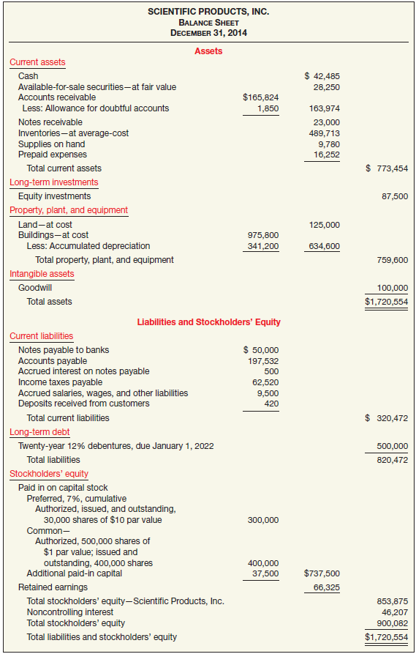

Balance Sheet Format
SCIENTIFIC PRODUCTS, INC
Balance Sheet
December 31, 2017
Report Form
UNDERLYING CONCEPTS
The presentation of balance sheet information meets the objective of ﬁnancial reporting—to provide information about entity resources, claims to resources, and changes in them.
ILLUSTRATION 5-16
Classified Report Form Balance Sheet
LO 3

Slide 56
LEARNING OBJECTIVES
5
Balance Sheet and Statement of Cash Flows
After studying this chapter, you should be able to:
Explain the uses and limitations of a balance sheet.
Identify the major classifications of the balance sheet.
Prepare a classified balance sheet using the report and account formats.
Identify the purpose and content of the statement of cash flows.
Prepare a basic statement of cash flows.
Understand the usefulness of the statement of cash flows.
Determine which balance sheet information requires supplemental disclosure.
Describe the major disclosure techniques for the balance sheet.
LO 4

Slide 57
STATEMENT OF CASH FLOWS
The income statement, the statement of stockholders’ equity, and the balance sheet—each present SOME information about the cash flows of an enterprise during a period.
UNDERLYING CONCEPTS
The statement of cash ﬂows meets the objective of ﬁnancial reporting—to help assess the amounts, timing, and uncertainty of future cash ﬂows.
The statement of cash flows presents a DETAILED SUMMARY of all the cash inflows and outflows, or the sources and uses of cash during the period.
LO 4

Slide 58
STATEMENT OF CASH FLOWS
Purpose of the Statement of Cash Flows
To provide relevant information about the cash receipts and cash payments of an enterprise during a period.
The statement provides answers to the following questions:
  Where did the cash come from?
  What was the cash used for?
  What was the change in the cash balance?
LO 4

Slide 59
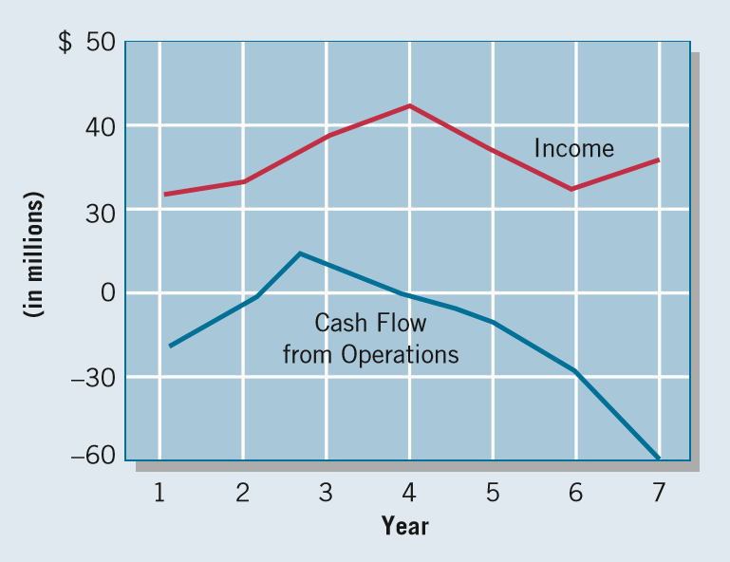
WHAT DO THE NUMBERS MEAN? WATCH THAT CASH FLOW
WHAT’S YOUR PRINCIPLE
Investors usually focus on net income measured on an accrual basis. However, information on cash ﬂows can be important for assessing a company’s liquidity, ﬁnancial ﬂexibility, and overall ﬁnancial performance. The graph below shows W. T. Grant’s ﬁnancial performance over 7 years. Although W. T. Grant showed consistent proﬁts and even some periods of
earnings growth, its cash ﬂow began to “go south” starting in about year 3. The company ﬁled for bankruptcy shortly after year 7. Financial statement readers who studied the company’s cash ﬂows would have found early warnings of its problems. The Grant experience is a classic case, illustrating the importance of cash flows as an early-warning
continued

Slide 60
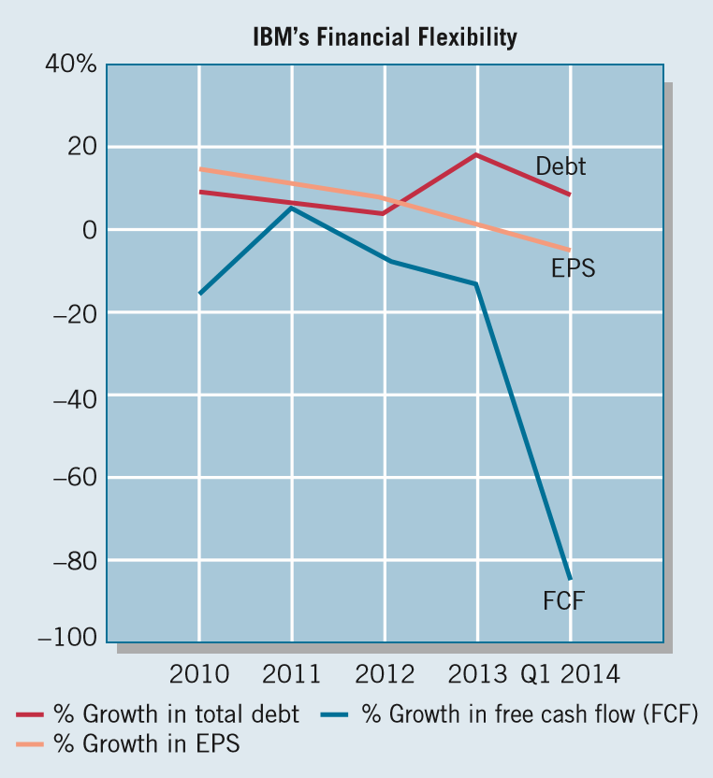
WHAT DO THE NUMBERS MEAN? WATCH THAT CASH FLOW
WHAT’S YOUR PRINCIPLE
signal of financial problems. The recent picture at IBM is similar and raises some red ﬂags as to the company’s ﬁnancial ﬂexibility. As shown in the following chart, IBM’s earnings per share (EPS) growth has held steady, but growth in free cash ﬂow is on the decline. A look under the hood
indicates that while debt levels are increasing, IBM has been using free cash ﬂow for increased dividends and share buybacks. Recall that buybacks increase EPS by reducing shares outstanding. However, some analysts
believe that many of the funds should be allocated to R&D. That is, free cash ﬂow going toward dividends and share repurchases indicates IBM’s “low quality of earnings.”
Source: A. Shields, “Why IBM Has Generated Higher Earnings
Despite Falling Revenue,” Market Realist,
http://marketrealist.com/2014/07/why-ibmhas-generated-higher-earnings-despite-falling-revenues/ (July 11, 2014).
LO 4

Slide 61
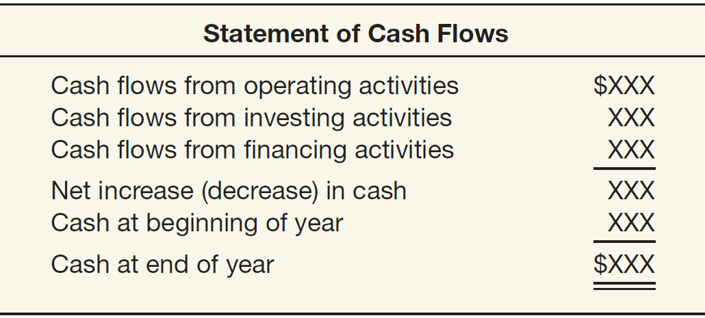
STATEMENT OF CASH FLOWS
Content and Format
Three different activities:
  Operating,
  Investing,
  Financing
ILLUSTRATION 5-17
Basic Format of Cash
Flow Statement
LO 4

Slide 62
STATEMENT OF CASH FLOWS
Content and Format
Operating
Investing
Financing
Cash effects of transactions that enter into the determination of net income.
Making and collecting loans and acquiring and disposing of investments and property, plant, and equipment.
Obtaining resources from owners and providing them with a return on their investment, and borrowing money from creditors and repaying the amounts borrowed.
LO 4

Slide 63
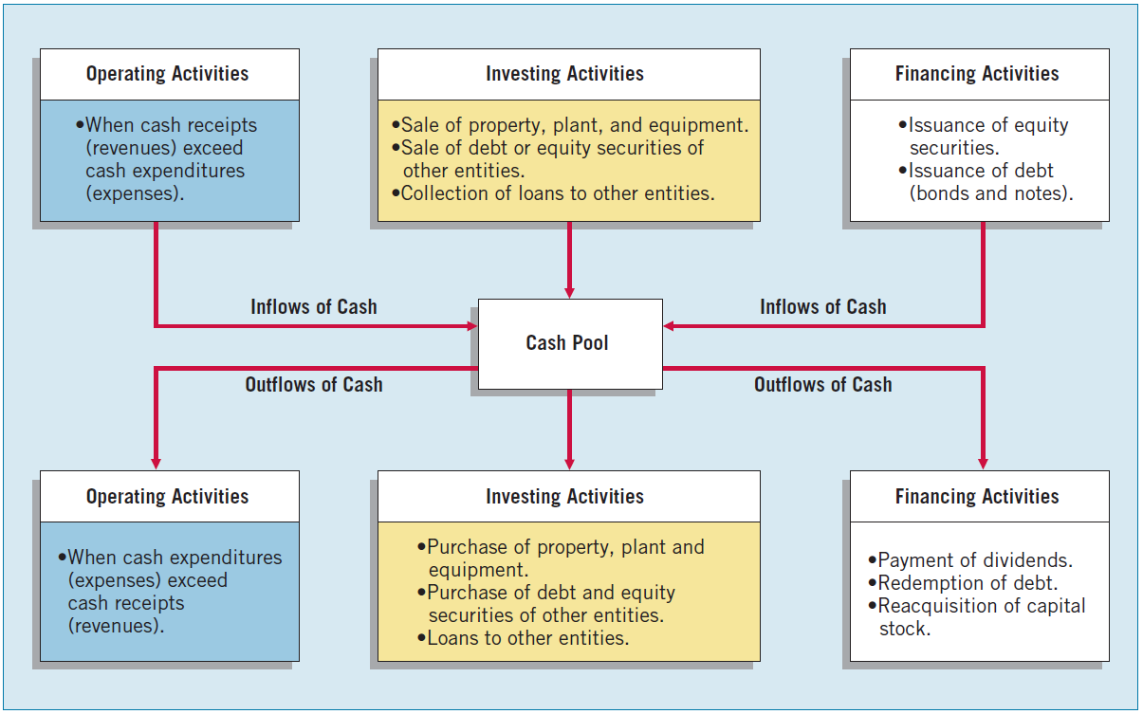
STATEMENT OF CASH FLOWS
ILLUSTRATION 5-18
Cash Inﬂows and Outﬂows
LO 4

Slide 64
LEARNING OBJECTIVES
5
Balance Sheet and Statement of Cash Flows
After studying this chapter, you should be able to:
Explain the uses and limitations of a balance sheet.
Identify the major classifications of the balance sheet.
Prepare a classified balance sheet using the report and account formats.
Identify the purpose and content of the statement of cash flows.
Prepare a basic statement of cash flows.
Understand the usefulness of the statement of cash flows.
Determine which balance sheet information requires supplemental disclosure.
Describe the major disclosure techniques for the balance sheet.
LO 5

Slide 65
STATEMENT OF CASH FLOWS
Overview of the Preparation of the Statement
Information obtained from several sources:
comparative balance sheets,
the current income statement, and
selected transaction data.
LO 5

Slide 66
STATEMENT OF CASH FLOWS
Illustration: On January 1, 2017, in its first year of operations, Telemarketing Inc. issued 50,000 shares of $1 par value common stock for $50,000 cash. The company rented its office space, furniture, and telecommunications equipment and performed marketing services throughout the first year. In June 2017 the company purchased land for $15,000. ILLUSTRATION 5-19 shows the company’s comparative balance sheets at the beginning and end of 2017.
LO 5

Slide 67
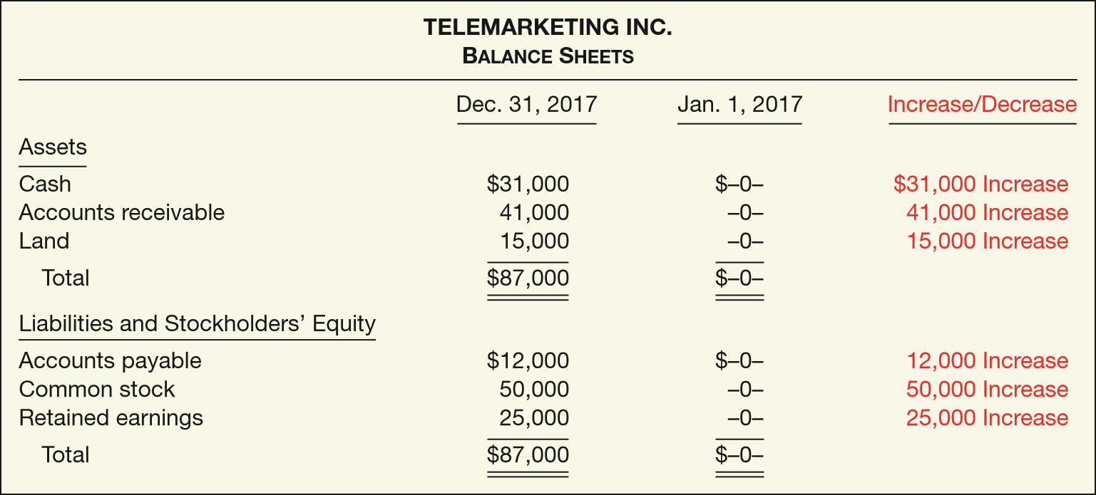
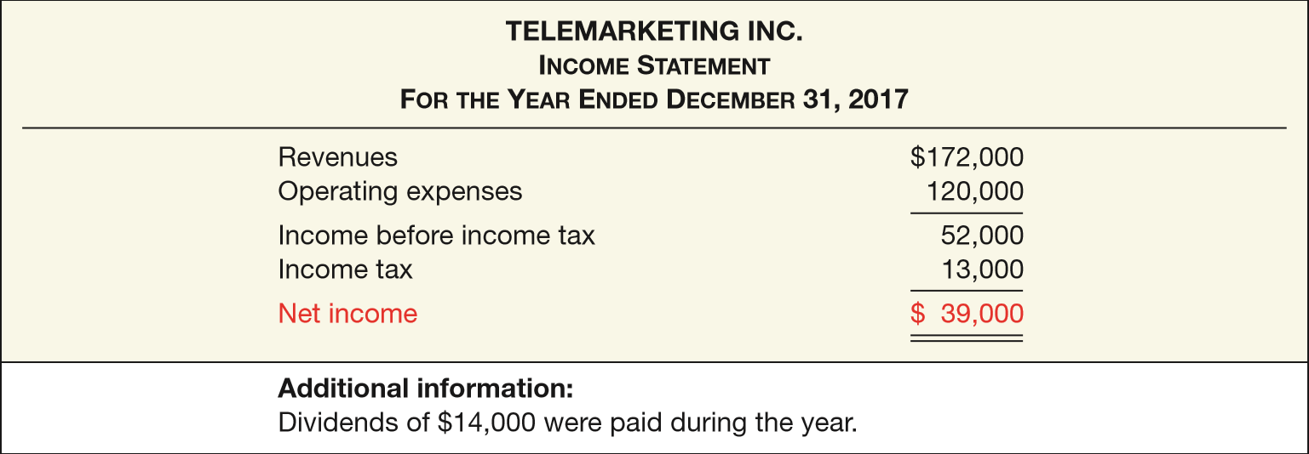
ILLUSTRATION 5-19
ILLUSTRATION 5-20

Slide 68
STATEMENT OF CASH FLOWS
Preparing the Statement of Cash Flows
Four steps:
  Determine the net cash provided by (or used in) operating activities.
  Determine the net cash provided by (or used in) investing and financing activities.
  Determine the change (increase or decrease) in cash during the period.
  Reconcile the change in cash with the beginning and the ending cash balances.
LO 5

Slide 69
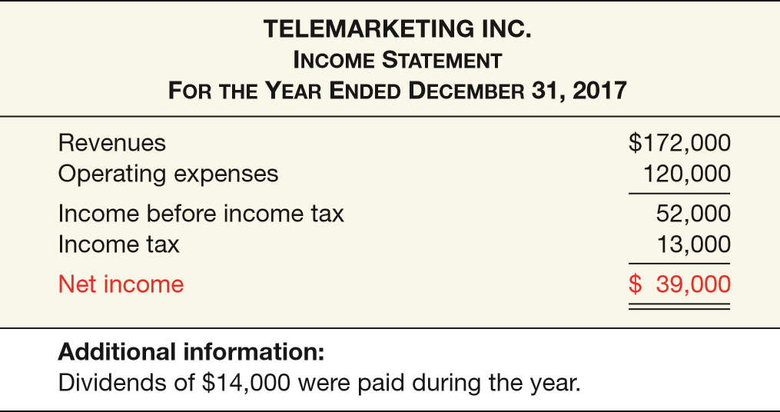
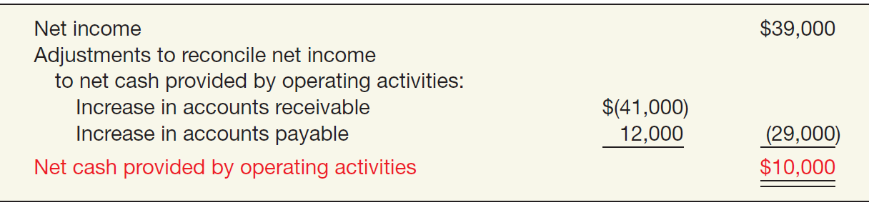

STATEMENT OF CASH FLOWS
ILLUSTRATION 5-19
ILLUSTRATION 5-20
Cash provided by operating activities
ILLUSTRATION 5-21
LO 5

Slide 70
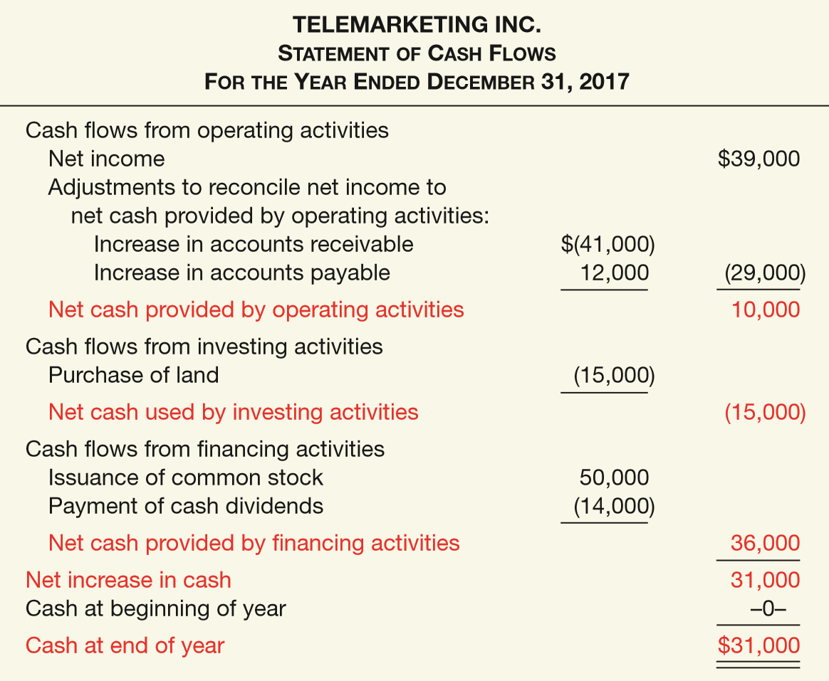
STATEMENT OF CASH FLOWS
ILLUSTRATION 5-19
ILLUSTRATION 5-20
Next, the company determines its investing and financing activities.
ILLUSTRATION 5-22

Slide 71
STATEMENT OF CASH FLOWS
Illustration: Keyser Beverage Company reported the following items in the most recent year.
Activity
Net income $40,000
Dividends paid 5,000
Increase in accounts receivable 10,000
Increase in accounts payable 5,000
Purchase of equipment 8,000
Depreciation expense 40,000
Issue of notes payable 20,000
Operating
Financing
Operating
Operating
Investing
Operating
Financing
Required: Compute net cash provided by operating activities.
LO 5

Slide 72
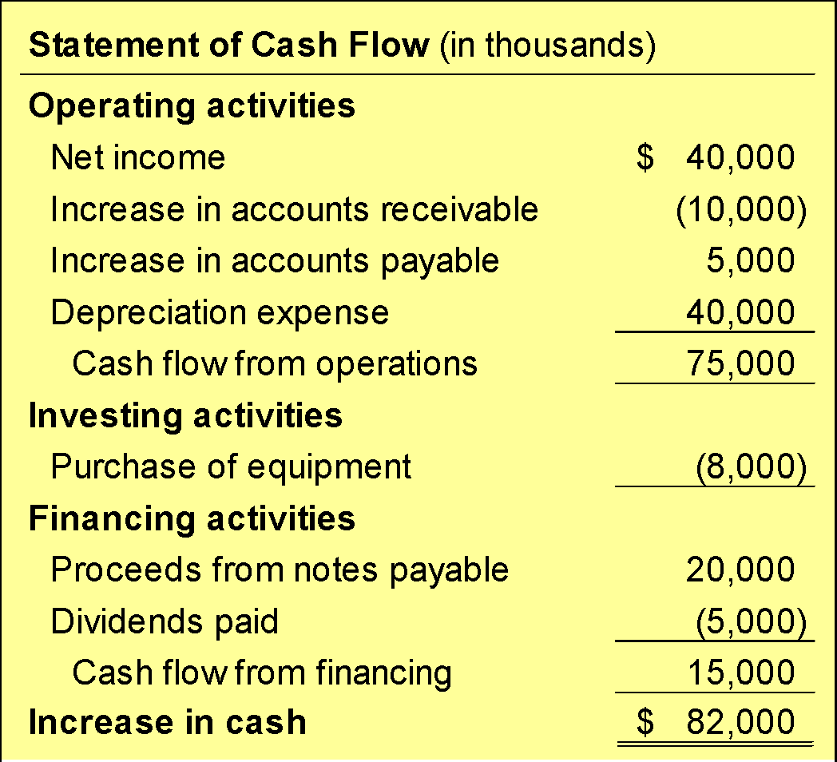
STATEMENT OF CASH FLOWS
Noncash credit to revenues.
Noncash charge to expenses.
LO 5

Slide 73
STATEMENT OF CASH FLOWS
Question
In preparing a statement of cash flows, which of the following transactions would be considered an investing activity?
a. Sale of equipment at book value
b. Sale of merchandise on credit
c. Declaration of a cash dividend
d. Issuance of bonds payable at a discount.
LO 5

Slide 74
STATEMENT OF CASH FLOWS
Significant Noncash Activities
Significant financing and investing activities that do not affect cash are reported in either a separate schedule at the bottom of the statement of cash flows or in the notes.
Examples include:
  Issuance of common stock to purchase assets.
  Conversion of bonds into common stock.
  Issuance of debt to purchase assets.
  Exchanges on long-lived assets.
LO 5

Slide 75
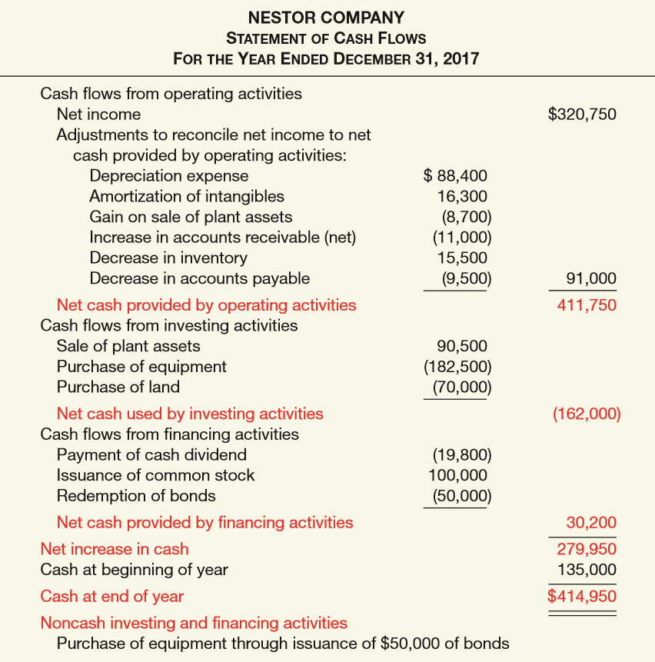
ILLUSTRATION 5-23
Comprehensive Statement of Cash Flows
LO 5

Slide 76
LEARNING OBJECTIVES
5
Balance Sheet and Statement of Cash Flows
After studying this chapter, you should be able to:
Explain the uses and limitations of a balance sheet.
Identify the major classifications of the balance sheet.
Prepare a classified balance sheet using the report and account formats.
Identify the purpose and content of the statement of cash flows.
Prepare a basic statement of cash flows.
Understand the usefulness of the statement of cash flows.
Determine which balance sheet information requires supplemental disclosure.
Describe the major disclosure techniques for the balance sheet.
LO 6

Slide 77
STATEMENT OF CASH FLOWS
Usefulness of the Statement of Cash Flows
Without cash, a company will not survive.
Cash flow from Operations:
  High amount – company is able to generate sufficient cash to pay its bills.
  Low amount - company may have to borrow or issue equity securities to pay bills.
LO 6

Slide 78
Usefulness of the Statement of Cash Flows
Financial Liquidity
ILLUSTRATION 5-25 Formula for Current Cash Debt Coverage
Net Cash Provided by
Operating Activities
Current Cash Debt Coverage Ratio
=
Average Current Liabilities
Ratio indicates whether the company can pay off its current liabilities from internally generated cash flows. A ratio near 1:1 is good.
LO 6

Slide 79
Usefulness of the Statement of Cash Flws
Financial Flexibility
ILLUSTRATION 5-26
Formula for Cash Debt Coverage
Net Cash Provided by
Operating Activities
Cash Debt Coverage Ratio
=
Average Total Liabilities
This ratio indicates a company’s ability to repay its liabilities from net cash provided by operating activities, without having to liquidate the assets employed in its operations.
LO 6

Slide 80
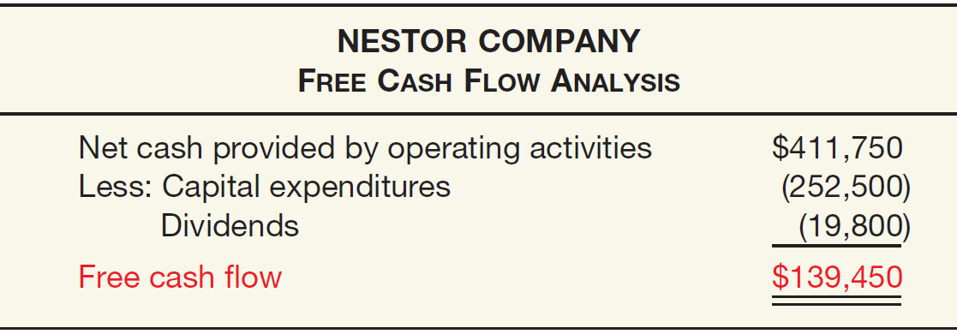
Usefulness of the Statement of Cash Flows
Free Cash Flow
ILLUSTRATION 5-28
Free Cash Flow Computation
The amount of discretionary cash flow a company has that may be used for purchasing additional investments, retiring its debt, purchasing treasury stock, or simply adding to its liquidity.
LO 6

Slide 81
Usefulness of the Statement of Cash Flows
Question
The current cash debt coverage ratio is often used to assess
a. financial flexibility.
b. liquidity.
c. profitability.
d. solvency.
LO 6

Slide 82
WHAT DO THE NUMBERS MEAN? “THERE OUGHT TO BE A LAW”
WHAT’S YOUR PRINCIPLE
As one manager noted, “There ought to be a law that before you can buy a stock, you must be able to read a balance sheet.” We agree, and the same can be said for a statement of cash ﬂows. Krispy Kreme Doughnuts provides an example of how stunning earnings growth can hide real problems. Not long ago, the doughnut maker was a glamour stock with a 60 percent earnings per share growth rate and a price-earnings ratio around 70. Seven months later, its stock price had dropped 72 percent. What happened? Stockholders alleged that Krispy Kreme may have been inﬂating its revenues and not taking enough bad debt expense (which inﬂated both assets and income). In addition, Krispy Kreme’s operating cash ﬂow was negative. Most ﬁnancially sound companies generate positive cash ﬂow. The following are additional examples of how one rating agency rated the earnings quality of some companies, using some key balance sheet and statement of cash ﬂow measurements. Another rating organization uses a metric to adjust for shortcomings in amounts reported in the balance sheet.
continued

Slide 83
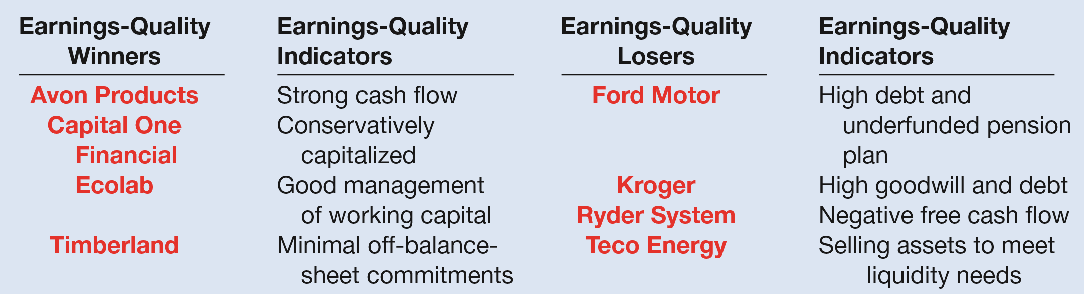
WHAT DO THE NUMBERS MEAN? “THERE OUGHT TO BE A LAW”
WHAT’S YOUR PRINCIPLE
Just as improving balance sheet and cash ﬂow information is a leading indicator of improved earnings, a deteriorating balance sheet and statement of cash ﬂows warn of earnings declines (and falling stock prices). This was the case at Avon; its strong cash ﬂow rating subsequently declined, such that its free cash ﬂow was just 76 percent of net income. This raised red ﬂags about the results on foreign investments by Avon.
Sources: Adapted from Gretchen Morgenson, “How Did They Value Stocks? Count the Absurd Ways,” New York Times on the Web (March 18, 2001); K. Badanhausen, J. Gage, C. Hall, and M. Ozanian, “Beyond Balance Sheet: Earnings Quality,” Forbes.com (January 28, 2005); and H. Karp, “Avon’s Investments Fall Short,” Wall Street Journal (December 8, 2011).
LO 6

Slide 84
LEARNING OBJECTIVES
5
Balance Sheet and Statement of Cash Flows
After studying this chapter, you should be able to:
Explain the uses and limitations of a balance sheet.
Identify the major classifications of the balance sheet.
Prepare a classified balance sheet using the report and account formats.
Identify the purpose and content of the statement of cash flows.
Prepare a basic statement of cash flows.
Understand the usefulness of the statement of cash flows.
Determine which balance sheet information requires supplemental disclosure.
Describe the major disclosure techniques for the balance sheet.
LO 7

Slide 85
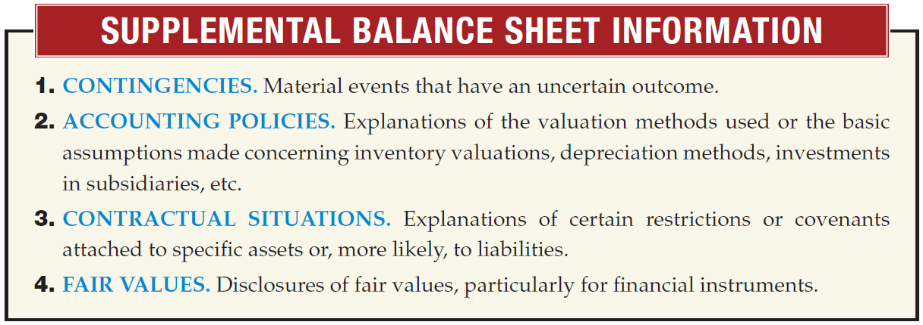
ADDITIONAL INFORMATION
Supplemental Disclosures
Four types of information that are supplemental to account titles and amounts presented in the balance sheet:
LO 7

Slide 86
LEARNING OBJECTIVES
5
Balance Sheet and Statement of Cash Flows
After studying this chapter, you should be able to:
Explain the uses and limitations of a balance sheet.
Identify the major classifications of the balance sheet.
Prepare a classified balance sheet using the report and account formats.
Identify the purpose and content of the statement of cash flows.
Prepare a basic statement of cash flows.
Understand the usefulness of the statement of cash flows.
Determine which balance sheet information requires supplemental disclosure.
Describe the major disclosure techniques for the balance sheet.
LO 8

Slide 87
ADDITIONAL INFORMATION
Techniques of Disclosure
  Parenthetical Explanations
  Notes
  Cross-Reference and Contra Items
  Supporting Schedules
  Terminology
LO 8

Slide 88

Techniques of Disclosure
Parenthetical Explanations
ILLUSTRATION 5-31
Parenthetical Disclosure of Shares Issued—Ford Motor Company
LO 8

Slide 89
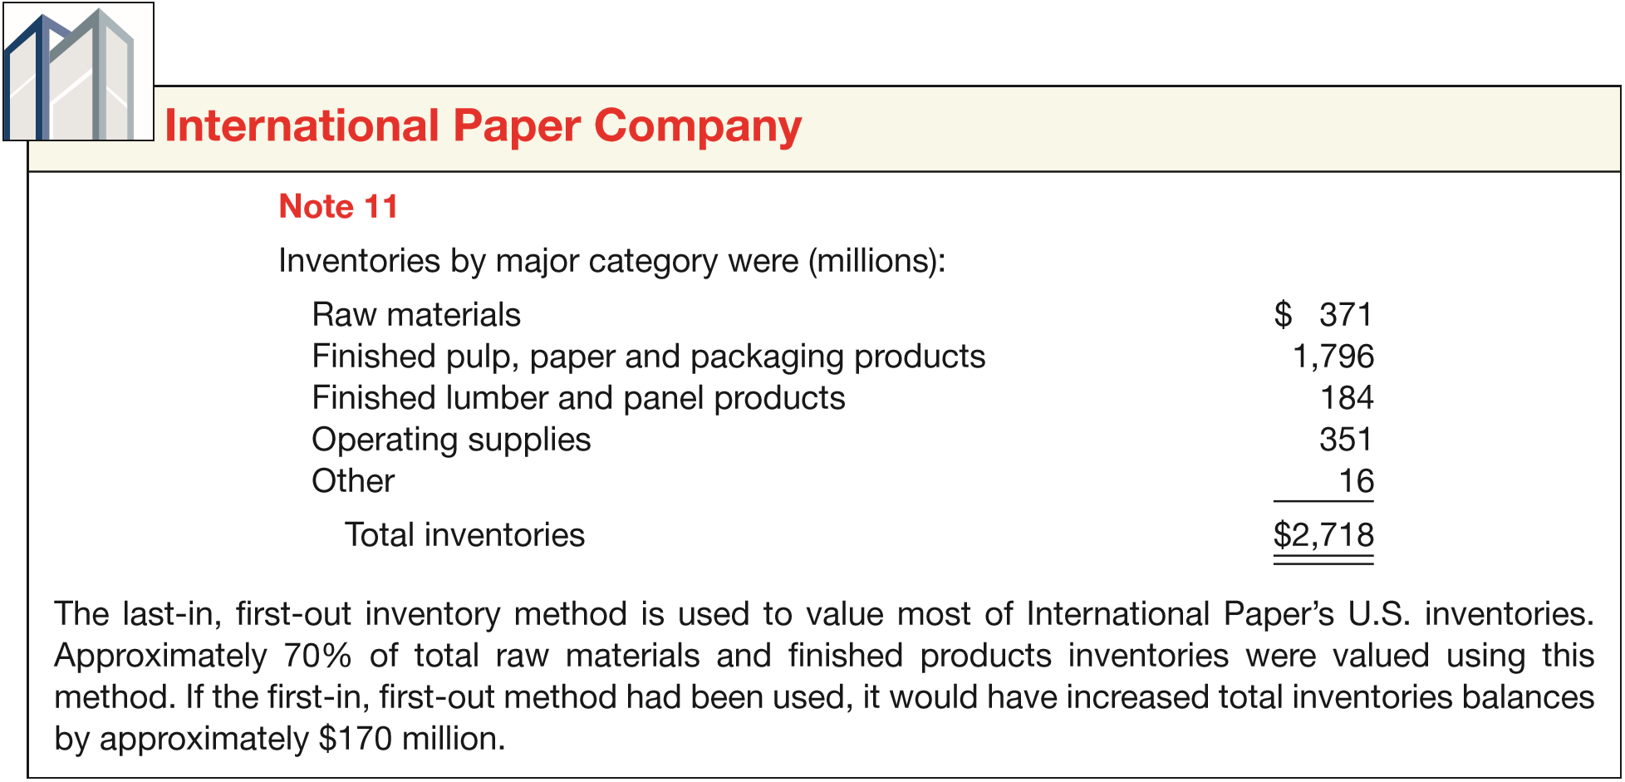
Techniques of Disclosure
Notes
ILLUSTRATION 5-32
Note Disclosure
LO 8

Slide 90

Techniques of Disclosure
Cross-Reference
ILLUSTRATION 5-34
Cross-Referencing
LO 8

Slide 91
Techniques of Disclosure
Contra Items
  A contra account on a balance sheet reduces either an asset, liability, or owners’ equity account. Examples include
  Accumulated Depreciation—Equipment and Discount on Bonds Payable.
  An adjunct account increases either an asset, liability, or owners’ equity account. An example is
  Premium on Bonds Payable.
LO 8

Slide 92

Supporting Schedules
ILLUSTRATION 5-35
Disclosure through Use of Supporting Schedules

Slide 93
EVOLVING ISSUE BALANCE SHEET REPORTING: GROSS OR NET?
WHAT’S YOUR PRINCIPLE
In addition to the issue of ﬁnancial statement presentation discussed in the opening story, a second area of controversy for balance sheet reporting is the issue of offsetting (or netting) of assets and liabilities. It is generally accepted that offsetting of recognized assets and recognized liabilities detracts from the ability of users both to understand the transactions and conditions that have occurred and to assess the company’s future cash ﬂows. In other words, providing information on assets, liabilities, and stockholders’ equity helps users to compute rates of return and evaluate capital structure. However, netting assets and liabilities can limit a user’s ability to assess the future economic beneﬁts and obligations. That is, offsetting hides the existence of assets and liabilities, making it difﬁcult to evaluate liquidity, solvency, and ﬁnancial ﬂexibility. As a result, GAAP does not permit the reporting of summary accounts alone (e.g., total assets, net assets, and total liabilities). Recently, the IASB and FASB have worked to develop common criteria for offsetting on the balance sheet. Current offsetting rules under IFRS are more restrictive than GAAP. The rules proposed would allow offsetting only in rare circumstances (e.g., when right of offset is legally enforceable). Implementation of these new
continued

Slide 94
EVOLVING ISSUE BALANCE SHEET REPORTING: GROSS OR NET?
WHAT’S YOUR PRINCIPLE
rules in the United States would result in a dramatic “grossing up” of balance sheets (particularly for ﬁnancial institutions). For example, one study estimated that the new rules would gross up U.S. banks’ balance sheets by $900 billion (or an average of 68%, ranging from a 31.4% increase for Citigroup to 104.7% for Morgan Stanley).* Not surprisingly, the FASB received signiﬁcant push-back from some of its constituents (particularly ﬁnancial institutions) to the proposed rules. As a result, to date the Boards have not been able to agree on a converged standard, thereby stalling this project. However, the Boards have issued converged disclosure requirements. The disclosure rules require companies to disclose both gross information and net information about instruments and transactions that are eligible for offset in the balance sheet. While the Boards have not been able to develop a converged set of criteria for offsetting, the information provided under the new converged disclosure rules should enable users of a company’s ﬁnancial statements to evaluate the effects of netting arrangements on its ﬁnancial position. In doing so, the new rules support the full disclosure principle.
*See Y. N’Diaye, “S&P: Accounting Rule Could Boost Bank Balance Sheets by Average 68%,” https://mninews.deutsche-boerse.com (September 22, 2011).
LO 8

Slide 95

APPENDIX 5A
RATIO ANALYSIS—A REFERENCE
USING RATIOS TO ANALYZE PERFORMANCE
  Analysts and other interested parties can gather qualitative information from financial statements by examining relationships between items on the statements and identifying trends.
LO 9 Identify the major types of financial ratios and what they measure.

Slide 96

APPENDIX 5A
RATIO ANALYSIS—A REFERENCE
RATIO ANALYSIS
ILLUSTRATION 5A-1
A Summary of Financial Ratios
LO 9

Slide 97

APPENDIX 5A
RATIO ANALYSIS—A REFERENCE
RATIO ANALYSIS
ILLUSTRATION 5A-1
A Summary of Financial Ratios
LO 9

Slide 98

APPENDIX 5A
RATIO ANALYSIS—A REFERENCE
RATIO ANALYSIS
ILLUSTRATION 5A-1
A Summary of Financial Ratios
LO 9

Slide 99
RELEVANT FACTS - Similarities
  Both IFRS and GAAP allow the use of title “balance sheet” or “statement of financial position.” IFRS recommends but does not require the use of the title “statement of financial position” rather than balance sheet.
  Both IFRS and GAAP require disclosures about (1) accounting policies followed, (2) judgments that management has made in the process of applying the entity’s accounting policies, and (3) the key assumptions and estimation uncertainty that could result in a material adjustment to the carrying amounts of assets and liabilities within the next financial year. Comparative prior period information must be presented and financial statements must be prepared annually.
  IFRS and GAAP require presentation of non-controlling interests in the equity section of the balance sheet.
LO 10 Compare the accounting procedure related to the balance sheet under GAAP and IFRS.

Slide 100
RELEVANT FACTS - Differences
  IFRS requires a classified statement of financial position except in very limited situations. IFRS follows the same guidelines as this textbook for distinguishing between current and noncurrent assets and liabilities. However under GAAP, public companies must follow SEC regulations, which require specific line items.
  Under IFRS, current assets are usually listed in the reverse order of liquidity. For example, under GAAP cash is listed first, but under IFRS it is listed last.
  IFRS has many differences in terminology. For example in the equity section common stock is called share capital—ordinary.
  Use of the term “reserve” is discouraged in GAAP, but there is no such prohibition in IFRS.
LO 10

Slide 101
ON THE HORIZON
The FASB and the IASB are working on a project to converge their standards related to financial statement presentation. A key feature of the proposed framework is that each of the statements will be organized, in the same format, to separate an entity’s financing activities from its operating and investing activities and, further, to separate financing activities into transactions with owners and creditors. Thus, the same classifications used in the statement of financial position would also be used in the statement of comprehensive
income and the statement of cash flows. The project has three phases. You
can follow the joint financial presentation project at the following link: http://www.fasb.org/project/financial_statement_ presentation.shtml.
LO 10

Slide 102
IFRS SELF-TEST QUESTION
Current assets under IFRS are listed generally:
  by importance.
  in the reverse order of their expected conversion to cash.
  by longevity.
  alphabetically.
LO 10

Slide 103
IFRS SELF-TEST QUESTION
Companies that use IFRS:
  may report all their assets on the statement of financial position at fair value.
  are not allowed to net assets (assets - liabilities) on their statement of financial positions.
  may report non-current assets before current assets on the statement of financial position.
  do not have any guidelines as to what should be reported on the statement of financial position.
LO 10

Slide 104
IFRS SELF-TEST QUESTION
A company has purchased a tract of land and expects to build a production plant on the land in approximately 5 years. During the 5 years before construction, the land will be idle. Under IFRS, the land should be reported as:
  land expense.
  property, plant, and equipment.
  an intangible asset.
  a long-term investment.
LO 10

Slide 105
COPYRIGHT
“Copyright © 2016 John Wiley & Sons, Inc. All rights reserved. Reproduction or translation of this work beyond that permitted in Section 117 of the 1976 United States Copyright Act without the express written permission of the copyright owner is unlawful. Request for further information should be addressed to the Permissions Department, John Wiley & Sons, Inc. The purchaser may make back-up copies for his/her own use only and not for distribution or resale. The Publisher assumes no responsibility for errors, omissions, or damages, caused by the use of these programs or from the use of the information contained herein.”

