Slide 1
Carbohydrates pt. 2
Chapter 3

Slide 2
ABSORPTIONAND TRANSPORT
Dietary monosaccharides to be absorbed into the bloodstream, they must twice cross the plasma membrane of enterocytes
First enter the cell on the brush border (apical) side
Exit on the basolateral side that faces a network of capillaries connected to the hepatic portal vein
The newly absorbed sugars are delivered directly to the liver where they will be metabolized according to the body’s needs,

Slide 3
The movement of molecules across cell membranes, including those of enterocytes is a highly regulated process
Monosaccharides movement mediated by specialized transport proteins integrated in the cell membrane
The energy-dependent sodium- glucose cotransporters (SGLTs)
The facilitated diffusion glucose transporters (GLUTs)
Each tissue has a different distribution of SGLTs and GLUTs

Slide 4
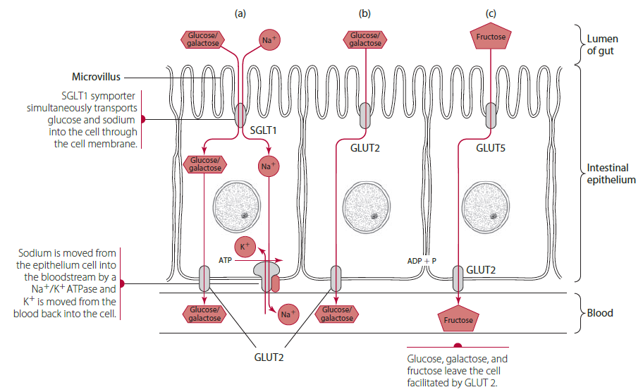
SGLTs The energy-dependent sodium- glucose cotransporters
Symporters
  simultaneously transports two substances (Na+ and glucose or galactose) in the same direction and is thus a symporter.
SGLTs are enzyme proteins that take up glucose into cells against an electrochemical gradient, and take up sodium ions down their concentration gradient.
SGLT1 and SGLT2 play prominent roles in monosaccharide transport
The function of SGLTs is coupled with sodium cotransport and ATP hydrolysis
Dependent on cellular energy and exemplify active transport

Slide 5
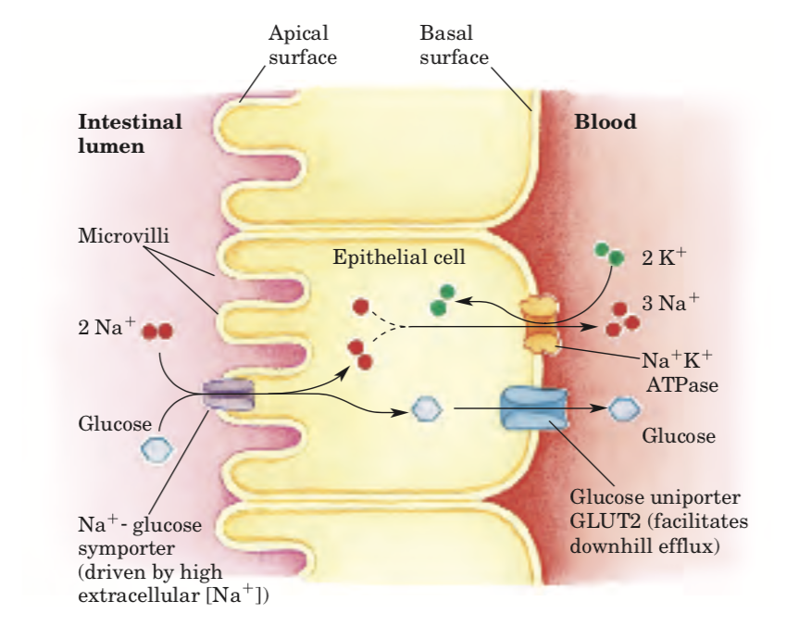
SGLTs
SGLT’s- secondary transport
Rely on the sodium concentration gradient generated by the sodium–potassium ATPase as a source of chemical potential to generate energy for taking up glucose against concentration gradient
The Na􏰄K􏰄 ATPase continues to pump Na􏰄 outward to maintain the Na􏰄 gradient that drives glucose uptake.

Slide 6
The transport protein of SGLT1 has two binding sites. The glucose binding site is not available unless the transport protein has already bound a Na+.
Firstly, an Na+/K+ ATPase pump on the basolateral membrane of the proximal tubule cell uses ATP molecules to move 3 sodium ions outward into the blood, while bringing in 2 potassium ions
The SGLT proteins use the energy from this downhill sodium ion gradient created by the ATPase pump to transport glucose across the apical membrane, against an uphill glucose gradient

Slide 7
SGLT1
Expressed mainly in the brush border membrane of enterocytes where its primary role is the absorption of dietary glucose and galactose
Mutations in the SGLT1 gene causing the genetic abnormality called glucose-galactose malabsorption.
Patients with the mutation experience severe diarrhea unless food sources of glucose and galactose are removed from the diet

Slide 8
SGLT2
SGLT2 is highly expressed in the proximal tubule of the kidney where it is responsible for reabsorbing glucose from the glomerular filtrate.
Important for glucose retention
In type 2 diabetes mellitus, SGLT2 may be upregulated, which can exacerbate hyperglycemia.
Anti- hyperglycemic drugs called SGLT2 inhibitors are being used to promote the urinary excretion of glucose by blocking the glucose reabsorption in the kidney proximal tubule

Slide 9
GLUTs
Facilitated diffusion
Transport glucose across the plasma membrane. They are enzyme proteins that can also transport galactose and fructose
GLUTs are expressed in a wide variety of cells, from red blood cells to liver to the brain
Each GLUT is an integral protein, penetrating and spanning the lipid bilayer of the plasma membrane

Slide 10
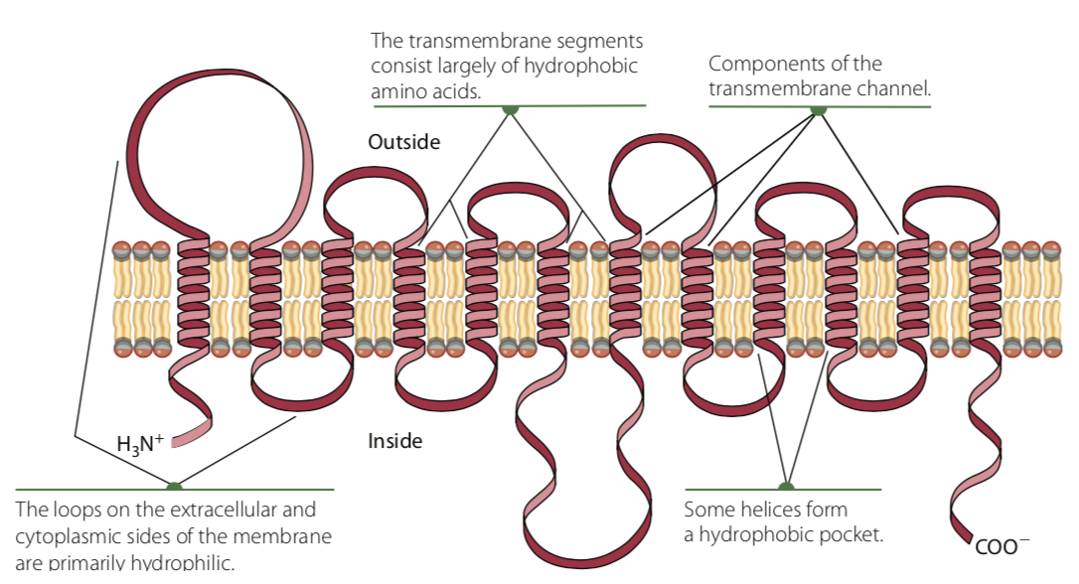
GLUTs
When glucose or other substrate attaches to the protein’s binding site, it causes a conformational change in the protein, allowing the substrate to translocate to the other side of the membrane
After the substrate is released, the conformational change is reversed and the GLUT protein can repeat the process.

Slide 11
GLUTs
The GLUT family divided into three classes
GLUT1 :
High Affinity for Glucose
Insulin independent
Allows glucose to cross the blood–brain barrier and supplies glucose to CNS
Supply of glucose to erythrocytes, endothelial cells of the brain, and most fetal tissue.
Patients with GLUT1 deficiency syndrome follow a ketogenic diet

Slide 12
GLUTs
GLUT2
Insulin dependent
Lowest-affinity glucose transporter
Predominant expression in the b-cells of the pancreas, liver, small intestine, and kidney ( only uptake when glucose concentration is high)
Starts working when Glut 1 & 3 saturated
Transport of most monosaccharides from enterocytes into the portal blood
High insulin levels cause GLUT2 to leave the plasma membrane of the enterocyte and return to storage vesicles.

Slide 13
GLUTs
GLUT3
High-affinity glucose transporter ( Saturated with glucose
Dominant expression in brain and neurons that are highly dependent on glucose as a fuel
Insulin Independent

Slide 14
GLUTs
Glut 4
Adipose tissue, muscle, heart
Insulin dependent: insulin always uptake of glucose/ translocation of GLUT4 from intracellular storage vesicles to the plasma membrane
Moderate affinity
Glut 5
Uptake of fructose/ does not recognize glucose
expressed primarily in the small intestine and to a lesser degree in kidney, brain, skeletal muscle, and adipose tissue. Its main function is to transport dietary fructose across the brush border membrane of enterocytes.

Slide 15
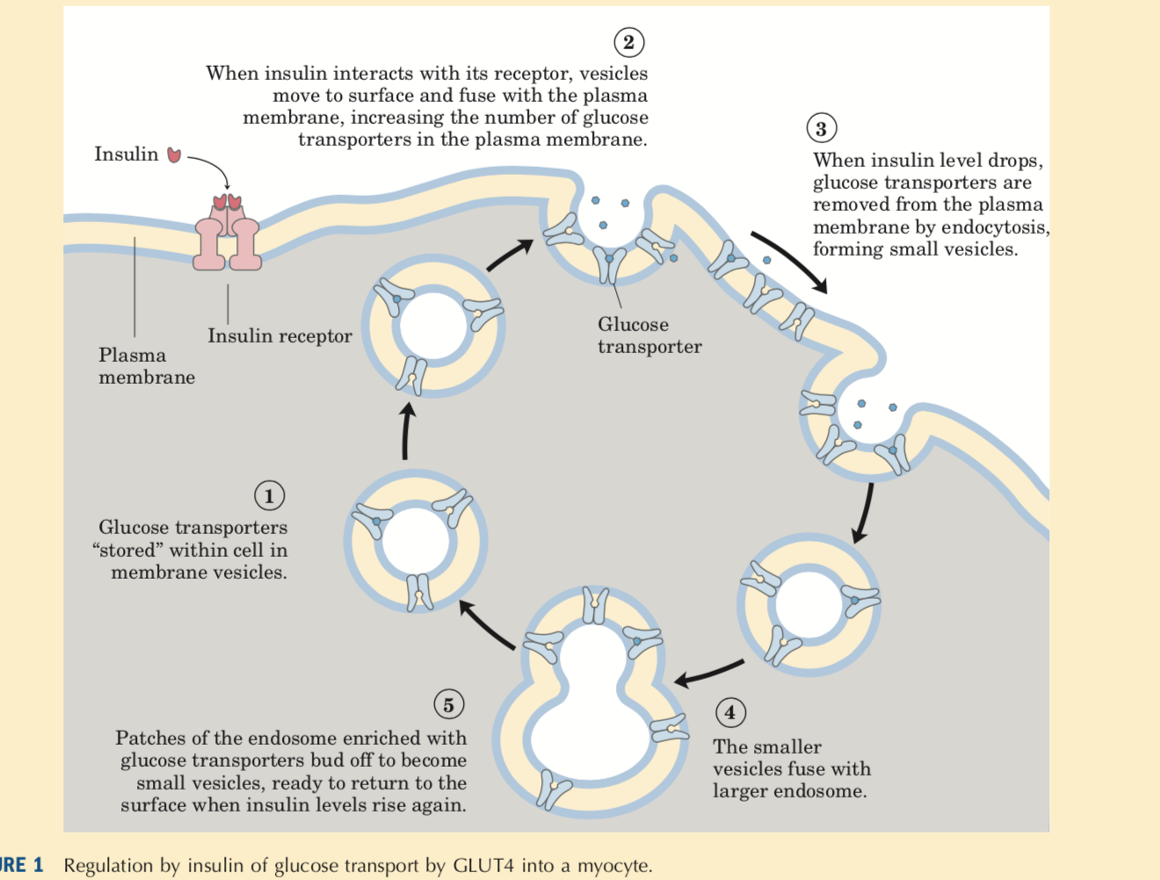

Slide 16
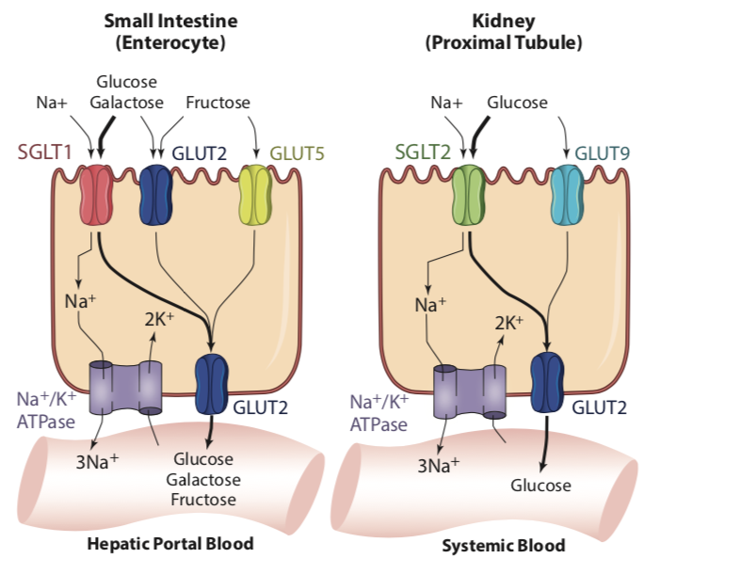
Transporters in the enterocyte encounter the greatest variety of monosaccharides derived from dietary sources.
In contrast, the kidney filters and reabsorbs primarily glucose because glucose is practically the only monosaccharide in the systemic circulation
Low Na+

Slide 17
Intestinal Absorption of Glucose and Galactose
After carbohydrate digestion, glucose and galactose are transported into the enterocyte involving both active transport (SGLTs) and facilitated diffusion (GLUTs).
Active transport: The attachment of Na+ to the carrier increases the transport protein’s affinity for glucose
After Na+ and glucose are transported into the enterocyte, they are released from SGLT1.
When intracellular glucose concentration increases, glucose binds to GLUT2 in the basolateral membrane
GLUT2 will facilitate exit of glucose and other monosaccharides from the enterocyte into the underlying capillaries for delivery into the hepatic portal vein
Notes:
Na+ that has entered the cell is “pumped” back out by the energy-requiring Na1/K1-ATPase (also called the sodium-potassium pump) located in the basolateral mem- brane. Na1/K1-ATPase works by first combining with ATP in the presence of Na1 on the inner surface of the cell membrane
the activity of Na1/K1-ATPase occurs in a different membrane location opposite of SGLT1, and that SGLT1 itself is not phosphorylated by ATP. Yet the over- all process of glucose (and galactose) transport involving SGLT1 is referred to as active transport.

Slide 18
Facilitated Transport
When glucose concentration in the intestinal lumen is high→ after a large carbohydrate meal, glucose is transported into the enterocyte by GLUT2 (low affinity) in the brush border membrane
After high-carbohydrate meals, more glucose is transported into the enterocyte by facilitated transport than by active transport via SGLT1.
Notes:
When blood glucose is high, insulin triggers translocation of GLUT2 from membrane → intracellular vesicles… thus decreasing absorption of glucose into enterocytes, decreasing absorption of glucose by enterocyte cells,
In insulin resistance, glut 2 remain in brush border membrane

Slide 19
Intestinal Absorption of Fructose
GLUT5
Facilitated diffusion
GLUT5 has a high affinity for fructose and is not influenced by the presence of glucose
Mainly in small intestine
Absorption does not require energy
When the intracellular concentration increases, fructose is transported out of the enterocyte into the hepatic portal vein by GLUT2 in the basolateral membrane
The facilitated transport process can proceed only down a concentration gradient → slower absorption rate compared to glucose and galactose

Slide 20
Hepatic Metabolism of Dietary Monosaccharides
After intestinal absorption of glucose, galactose, and fructose, they enter the hepatic portal vein→ liver.
All of the galactose and fructose is taken up by the liver through specific GLUTs and metabolized.
Only 30–40% of glucose is taken up by the liver, with the majority passing through into the systemic circulation ( only glucose is found in blood)
Galactose → glucose derivatives → and stored as liver glycogen
Fructose→ supplies liver with energy… excess is stored as triacylglycerol

Slide 21
BLOOD GLUCOSE CONCENTRATION
Maintaining normal blood glucose concentration
Insulin inhibits hepatic gluconeogenesis and promotes glucose utilization
Glucagon increases the breakdown of liver glycogen by glycogenolysis.
Secretion of glucocorticoid hormones (stress hormones) primarily cause increased activity of hepatic gluconeogenesis and antagonize insulin response by skeletal muscle and white adipose tissue
“In both mouse and human muscle cells, GC reduce insulin-stimulated glucose uptake attenuating insulin-induced GLUT4 translocation to the cell membrane.
Kuo T, McQueen A, Chen TC, Wang JC. Regulation of Glucose Homeostasis by Glucocorticoids. Adv Exp Med Biol. 2015;872:99-126.

Slide 22
