Slide 1
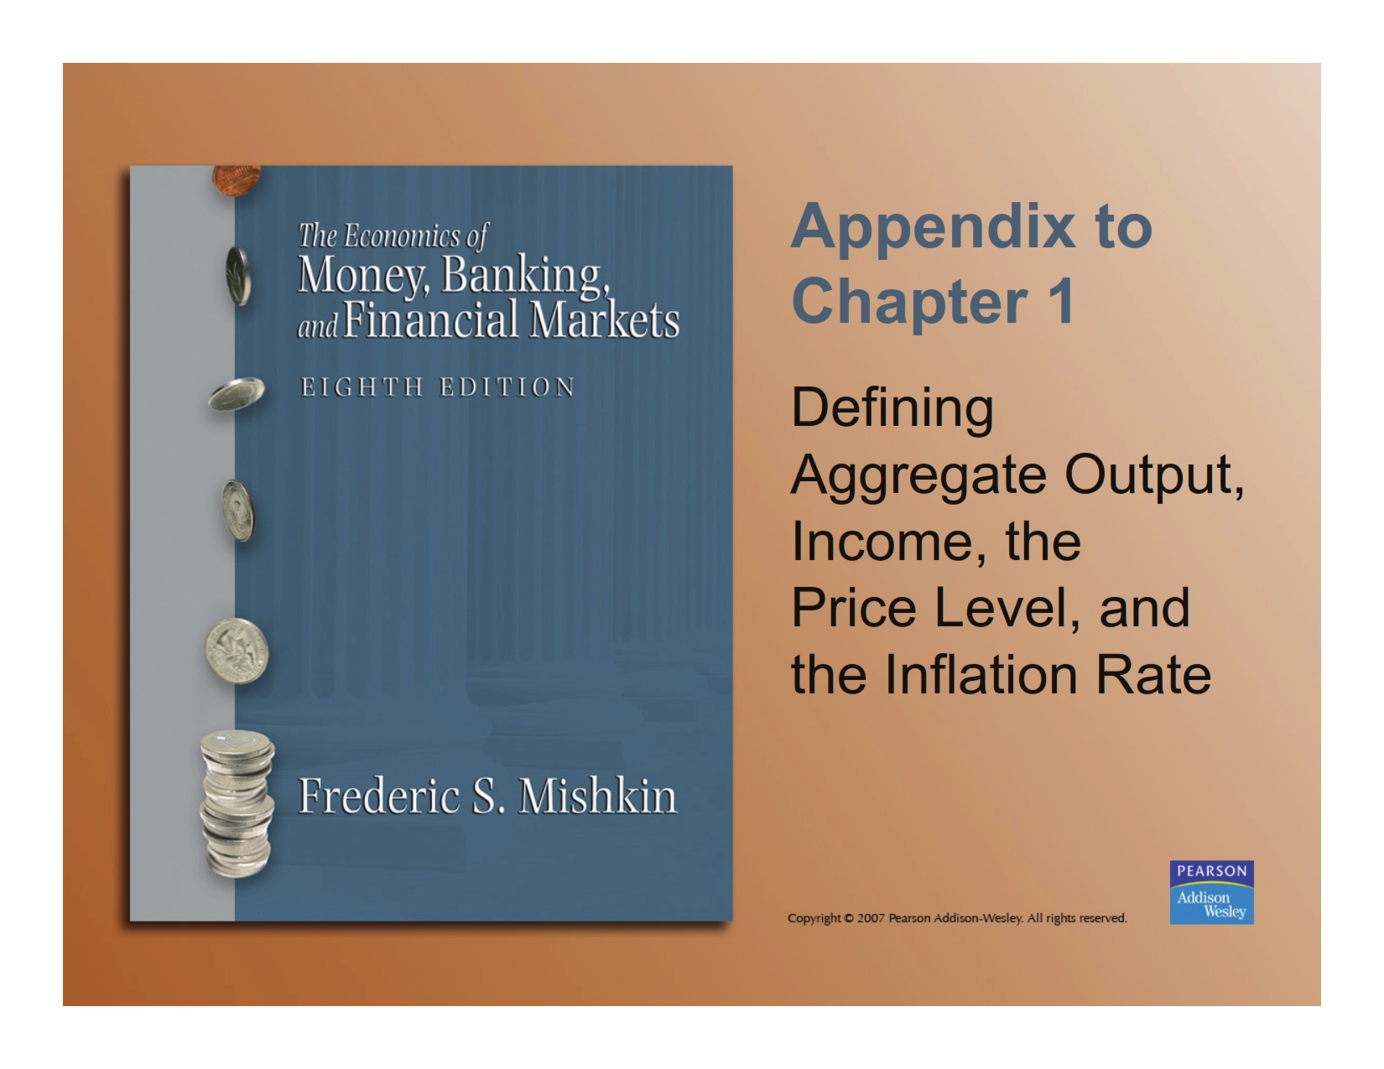

Slide 2
Aggregate Output & Aggregate Income
Aggregate Output
Gross Domestic Product (GDP) is the market value of all final goods and services produced in the domestic economy during a particular year
Aggregate Income It is total income received by all factors of production (land, capital, labor, entrepreneurship) that are used in the production process during a particular year
Distinction Between Nominal and Real Nominal = values of Q’s measured using current prices Real = values of Q’s measured using constant prices

Slide 3
Aggregate Price Level
Aggregate price level is a measure of average prices in the economy.
One measure of the price level is the GDP Deflator
GDP Deflator = nominal GDP ÷ real GDP
Another measure of the aggregate price level is the Consumer Price Index (CPI)
The CPI is a measure of the average change over time in the prices paid by urban consumer for a market basket of goods and services.

Slide 4
Growth Rates
A growth rate is a percentage change in a variable
GDP growth is the percentage change in GDP relative to the previous year
Inflation rate is the percentage change in the CPI relative to the previous year
Investment growth is the percentage change in investment relative to the previous year

Slide 5
Calculation of GDP Growth and the Inflation Rate

