Slide 1
Assessment of speech sound disorders
Chapter 6

Slide 2
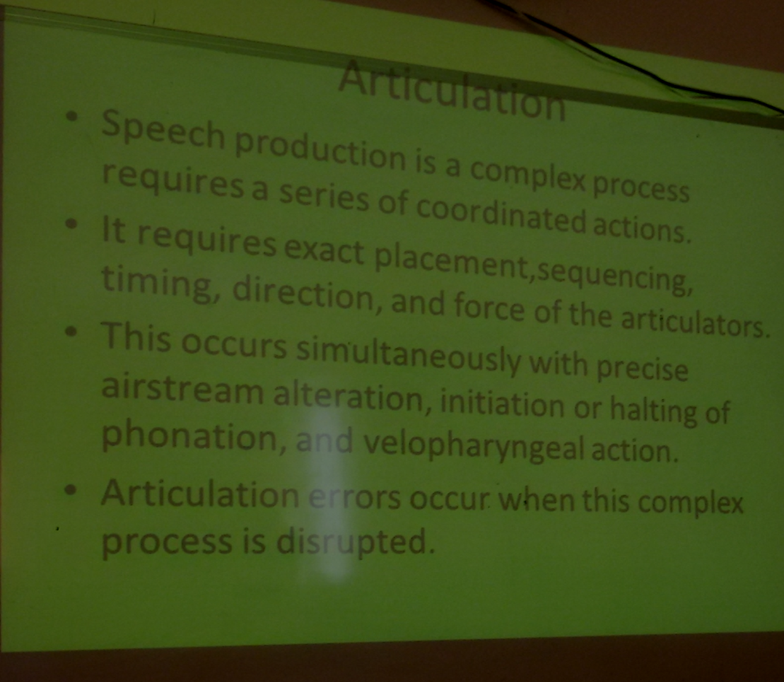

Slide 3
The causes of articulation disorder:
1. organic causes (a known physical cause) such as hearing loss, cleft lip or palate, cerebral palsy, ankyloglossia (tongue-tie), apraxia, or dysarthria
2. Functional causes (no known physical cause issues).
Clinicians attempt to identify physical cause particularly during the oral-facial examination. However, in many cases, the precise cause of a speech sound disorder
is unknown.

Slide 4
purposes of an assessment of articulation and phonological processes include:
Describing the articulatory or phonological development and status of the client
Determining whether the individual’s speech sufficiently deviates from normal expectations to warrant concern or intervention
Identifying factors that relate to the presence or maintenance of the speech disorder
Determining the direction of treatment
Making prognostic judgments about change with and without intervention
Monitoring changes in articulatory or phonological abilities

Slide 5
Components of articulation evaluation:
History of the Client
Contributing Factors : hearing Impairment, medical or Neurological Factors dental Problems ,maturation and motor development
Assessment of Speech Sound Disorders :
-Screening:
Formal and Informal Tests
Speech Sampling
Stimulability of Errors
-Analysis:
Number of Errors
Error Types (substitutions, omissions, distortions, additions)
Form of Errors (distinctive features, phonological processes)

Slide 6
Consistency of Errors
Intelligibility
Rate of Speech
Prosody
Orofacial Examination
Hearing Assessment
Language Assessment
Determining the Diagnosis
Providing Information (written report, interview, etc.)

Slide 7
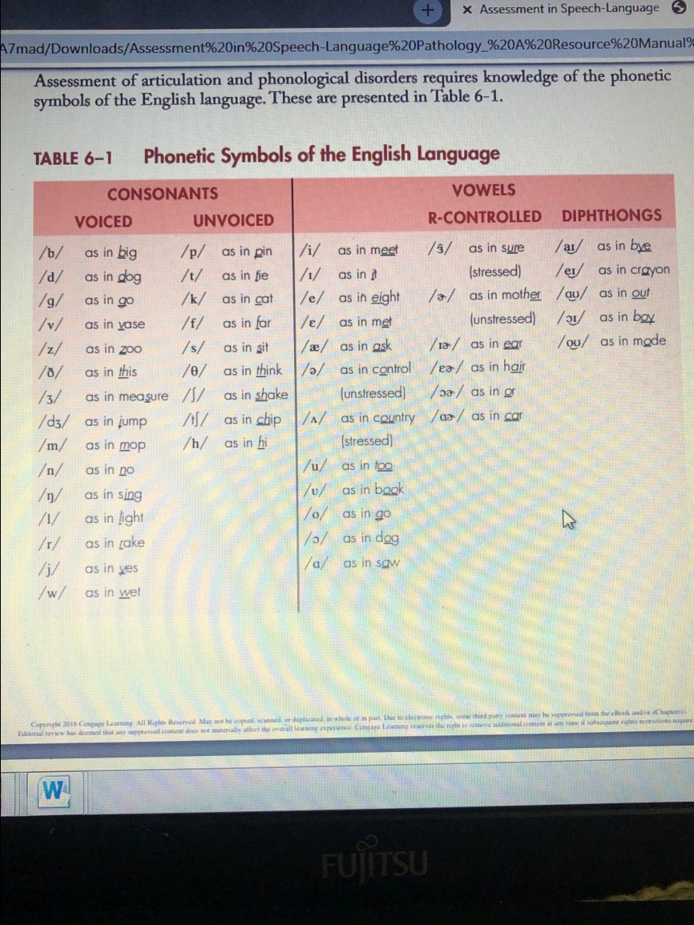

Slide 8
Screening
quickly identify those people who communicate within normal limits and those who may have a communicative disorder.
People with communicative disorder referred for a complete evaluation.
A screening is not an in-depth assessment and should not take more than a few minutes.
Screenings most commonly occur in the schools.
An articulation or phonological processes screening test does not have to be formal.

Slide 9
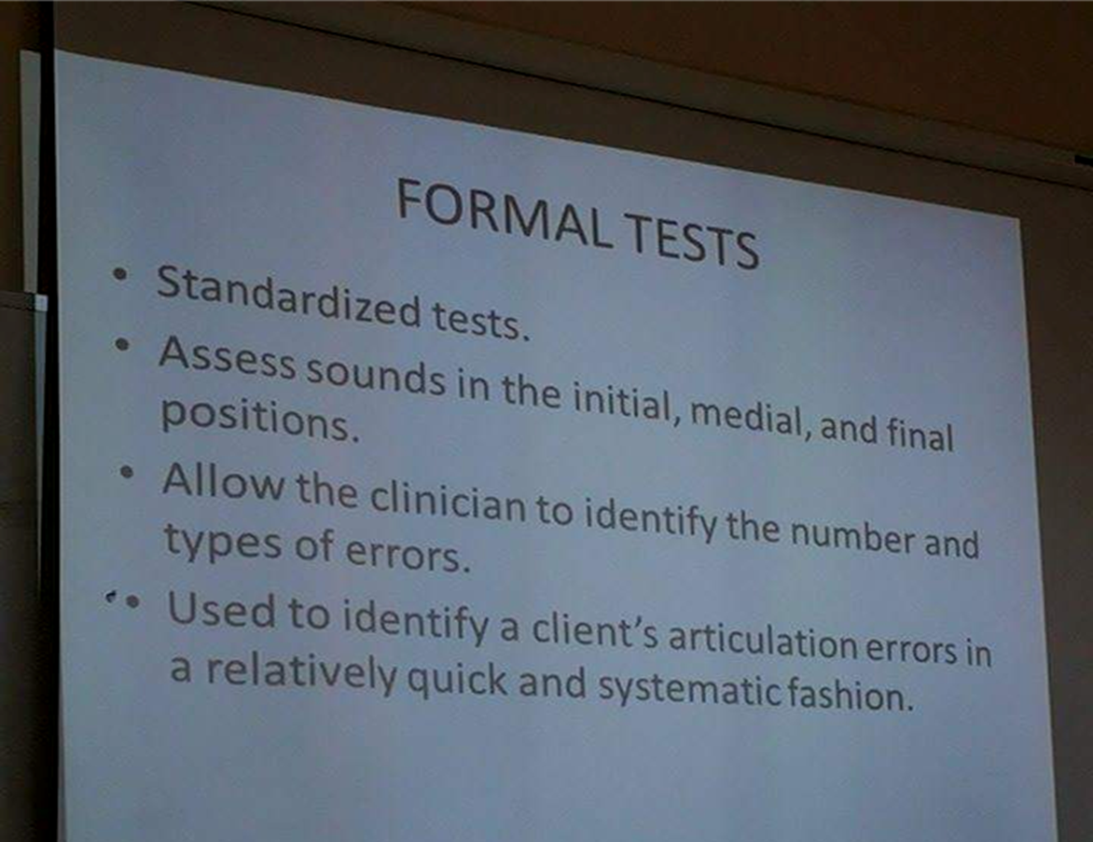
Formal test:

Slide 10
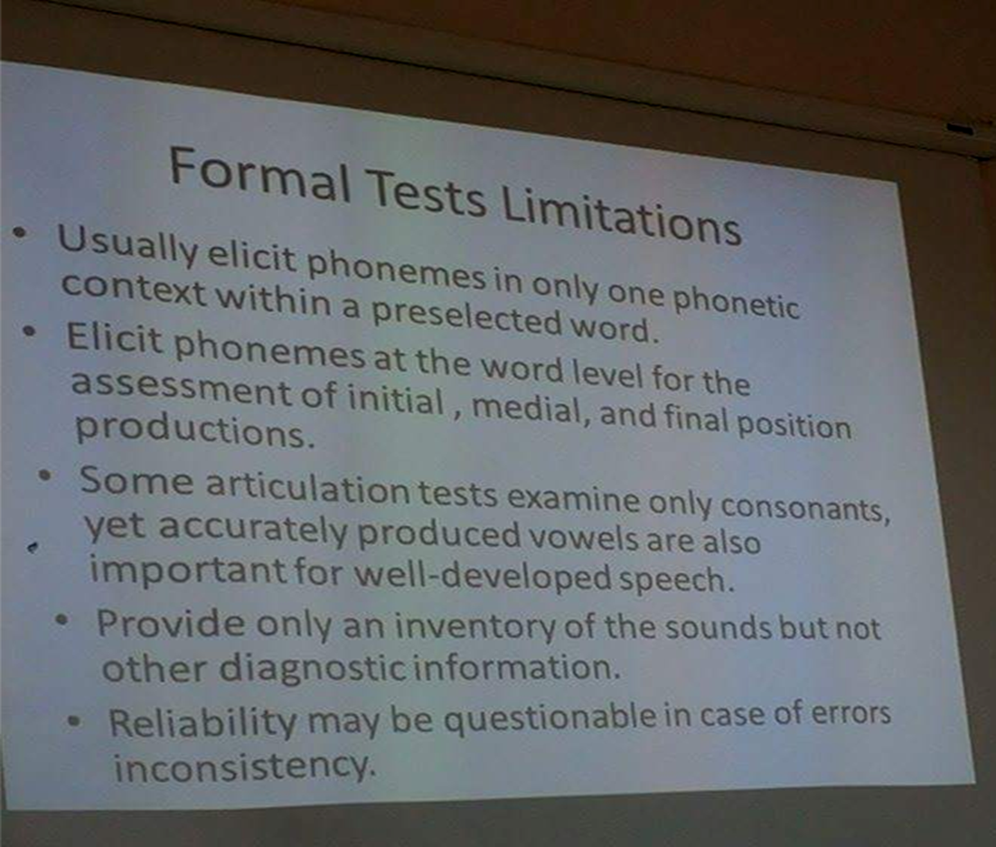

Slide 11
cont
When evaluating clients with moderate to severe articulation disorders, tests of phonological processes may prove more diagnostically valuable than traditional articulation tests.

Slide 12
Stimulability
client’s ability to produce a correct (or improved) production of an erred sound. The client attempts to imitate the clinician’s correct production, often after receiving specific instructions regarding the articulatory placement or manner of sound production.

Slide 13
The assessment of stimulability provides important prognostic information.
Those behaviors that are most easily stimulated provide excellent starting points in therapy because they often lead to treatment success quicker than other, less stimulable behaviors

Slide 14
cont
The ability to stimulate erred sounds is based on :
1. good working knowledge of phonetics. The clinician must know what needs to be changed in order to improve the production.
Note: in some cases, there is more than one way to correctly articulate a sound. For example, a “textbook description” of /t/ is a lingua-alveolar sound produced by tapping the tongue on the hard palate. However, some people produce a good /t/ by tapping the tongue on the front teeth.

Slide 15
cont
2. Visually observing the client’s erred productions.
seeing an error can help identify what needs to change in order to produce a better sound.

Slide 16
DEVELOPMENTAL NORMS FOR PHONEMES AND BLENDS
Clinicians often use normative data to determine whether or not a child is developing within normal expectations.
DEVELOPMENTAL NORMS FOR PHONEMES AND BLENDS:
• A norm is only an average age at which a behavior occurs. It refers, therefore, to a hypothetical child who does not, and never did, exist.
• True norms are collected from and apply to a normal, randomly selected sample. These exact representative samples rarely exist in the real world.
• Different norms are rarely in agreement with each other.

Slide 17
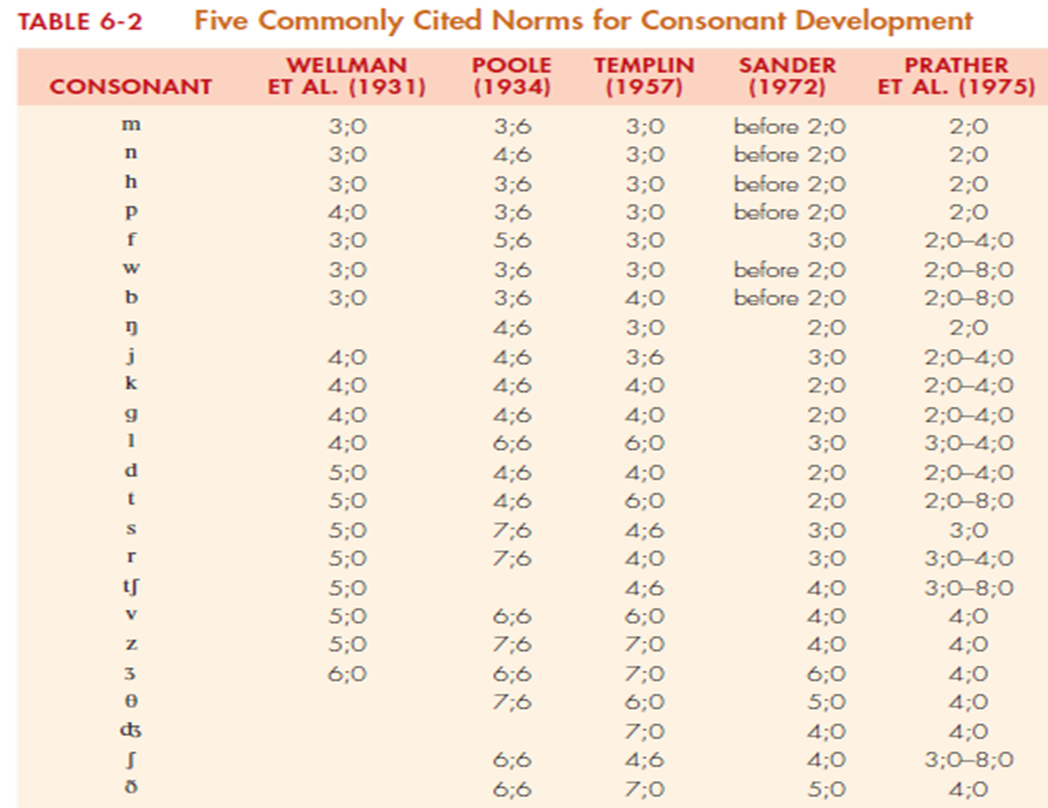

Slide 18
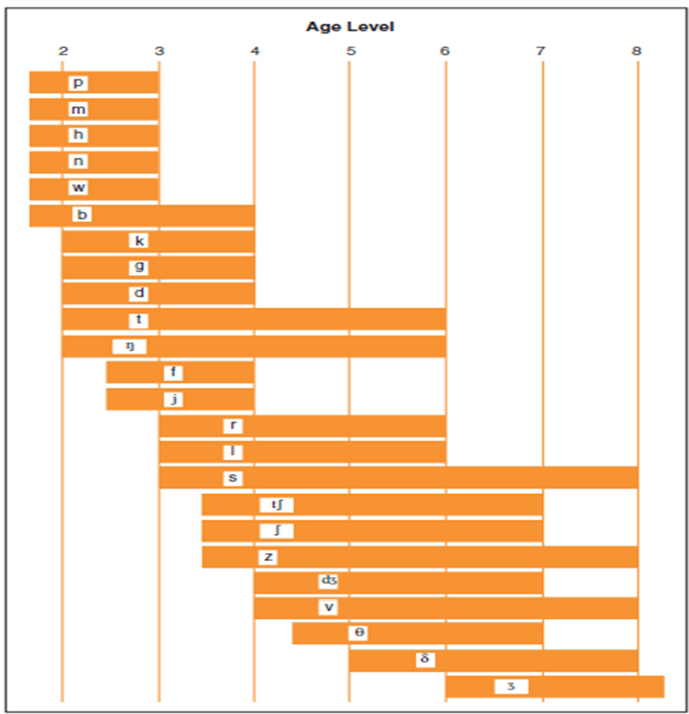

Slide 19
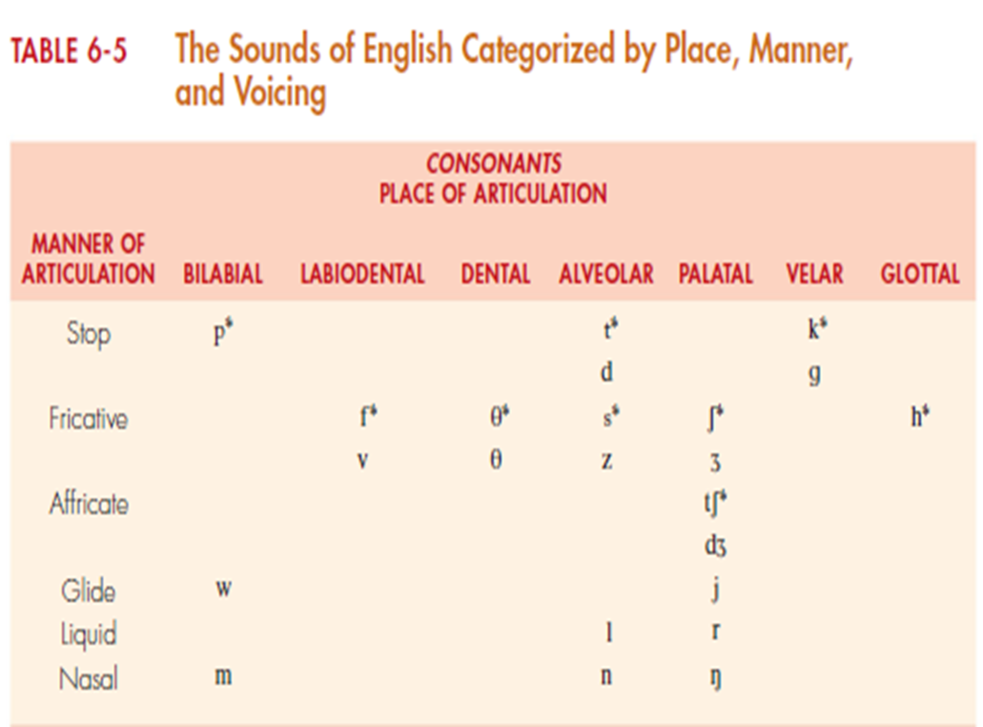

Slide 20
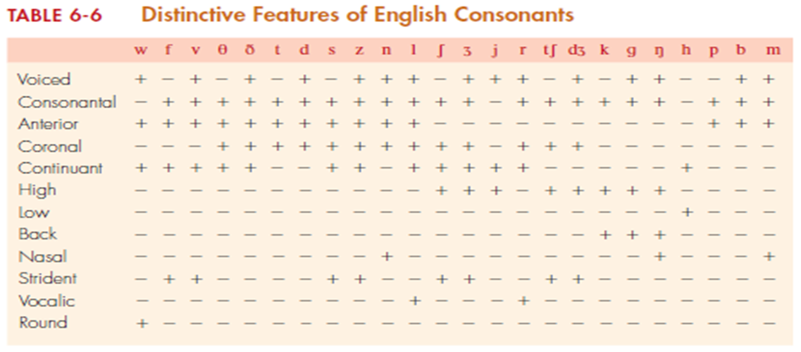

Slide 21
DISTINCTIVE FEATURES OF CONSONANTS
Individual sounds consist of unique and distinct features that, make each sound different from all other sounds.
The following examples show several distinctive feature patterns:
/t/ for /k/ (tup for cup)
/d/ for /g/ (dumb for gum)
The erred feature in this example is an anterior placement. (place of articulation)
/d/ for /n/ (dice for nice)
/b/ for /m/ (bake for make)
The erred pattern involves nasality. Nonnasal sounds are substituted for nasal sounds.

Slide 22
PHONOLOGICAL PROCESSES
Phonological processes describe what children do in the normal developmental process of speech to simplify standard adult productions. When a child uses many different processes or uses processes that are not commonly present during speech acquisition, intelligibility may be impaired.

Slide 23
cont
The advantage of using a phonological processes approach when analyzing articulation is that the clinician can identify error patterns and then target those patterns to remediate more than one sound at a time. For example, if a child exhibits a final consonant deletion pattern, the clinician may choose to target final consonants in general rather than focus on only a few sounds in the final position

Slide 24
Alveolarization:
Substitution of an alveolar phoneme for a labial or linguadental phoneme:
/tœn/ for pan
Assimilation (Harmony):
Alteration of a consonant phoneme that is influenced by, and becomes more like, a surrounding phoneme:
/bɛb/ for bed ɛ] ʤ
Backing:
Substitution of a more posteriorly produced phoneme for an anteriorly produced phoneme:
/kap/ for top

Slide 25
Cluster Reduction:
Reduction of a cluster to a singleton:
/pen/ for plane
Coalescence:
Substitution of a single phoneme that is different from two adjacent target phonemes yet takes on features of the target:
/fok/ for smoke
Deaffrication:
Substitution of a fricative for an affricate phoneme:
/ʃip/ for chip
Denasalization:
Substitution of a homorganic stop (similar place of articulation) for a nasal phoneme:
/do/ for no

Slide 26
Depalatalization:
Substitution of an alveolar fricative or affricate for a palatal fricative or affricate:
/wats/ for wash
/fIs/ for fish
Diminutization:
Addition of /i/ or consonant + /i/:
/legi/ for leg
/hœti/ for hat
Doubling:
Repetition of a word:
/gogo/ for go

Slide 27
Epenthesis:
Insertion of a new phoneme:
/bəlu/ for blue
Final Consonant Deletion:
Deletion of the final consonant:
/pu/ for pool
Fronting:
Substitution of a more anteriorly produced phoneme:
/su/ for shoe
Gliding:
Substitution of a glide for a liquid:
/pwey/ for play

Slide 28
Initial Consonant Deletion:
Deletion of the initial singleton consonant:
/œn/ for man
/ul/ for pool
Labialization:
Substitution of a labial phoneme for a phoneme produced with the tip of the tongue:
/hœf/ for hat
Metathesis (Spoonerism):
Transposition of two phonemes:
/likstip/ for lipstick

Slide 29
Reduplication:
Repetition of a complete or incomplete syllable:
/wawa/ for water
/dada/ for dog
Stopping:
Substitution of a stop for a fricative or affricate:
/top/ for soap
/kœt/ for catch
Stridency Deletion:
Omission of a strident or the substitution of a nonstrident consonant:
/op/ for soap
/kiθ/ for kiss

Slide 30
Unstressed Syllable Deletion:
Deletion of an unstressed syllable:
/nœnə / for banana
Voicing or Devoicing:
Alteration in voicing influenced by a surrounding phoneme:
/beg/ for bake
Vocalization (Vowelization)
Substitution of a vowel for a liquid phoneme in the final position:
/pipo/ for people

Slide 31
The most common processes that occur in normal speech are unstressed syllable deletion,
final consonant deletion,
gliding,
cluster reduction.
Note that some children never produce certain processes

Slide 32
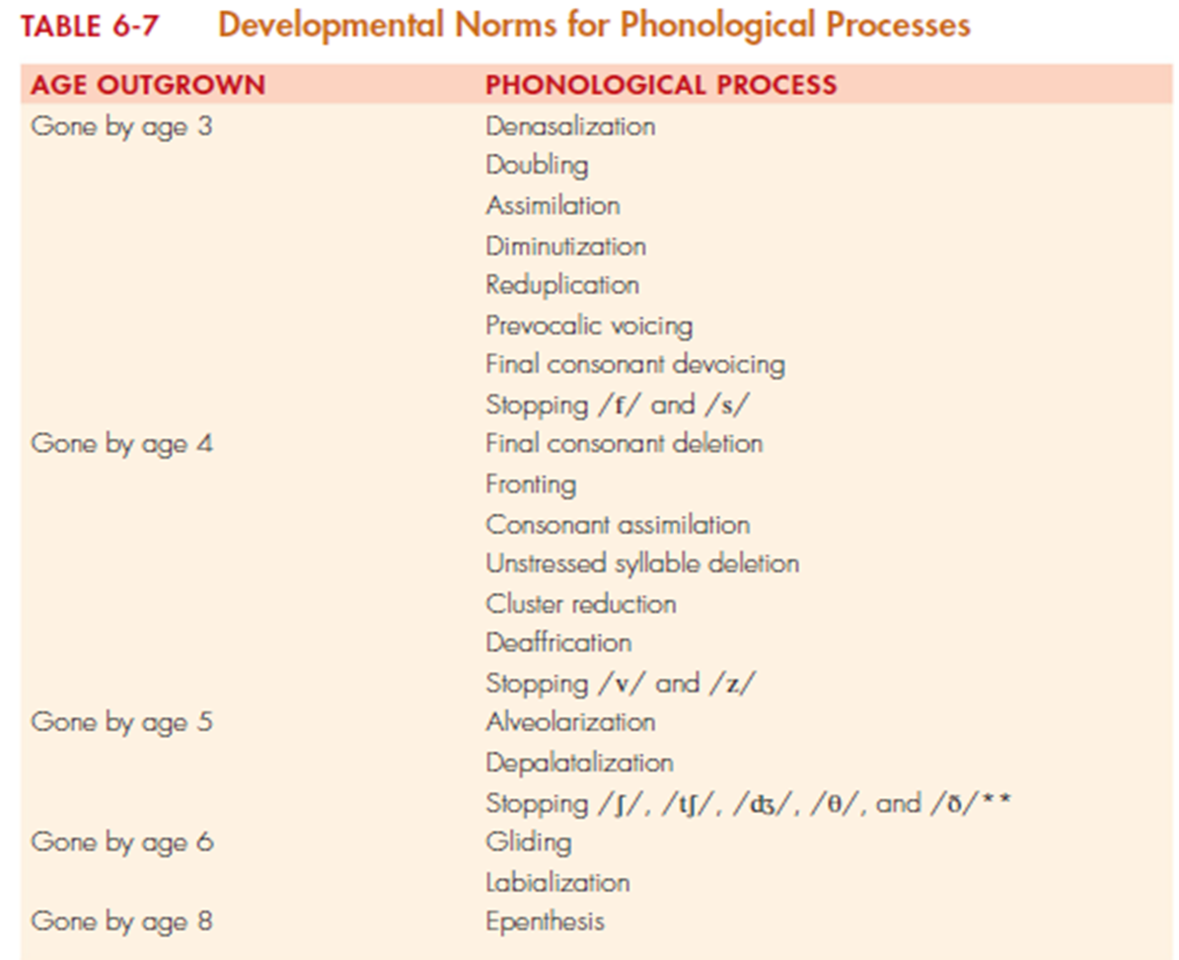

Slide 33
Childhood apraxia of speech
Childhood apraxia of speech (CAS) is a motor speech disorder. A child with CAS has difficulty sequencing sounds, syllables, and words for speech even though there is no muscle weakness, paralysis, or other physical limitation.
Its etiology is usually unknown, although in some cases it is secondary to a genetic disorder or acquired from a stroke or brain injury.
Differential diagnosis is challenging because behaviors associated with CAS are also associated with other communicative disorders. These may include
dysarthria
speech delay,
fluency disorder
expressive and receptive language impairment,
literacy disorder, and phonological impairment.

Slide 34
cont
This is complicated by the fact that CAS often co-occurs with one or more of these other communicative disorders. Behaviors associated with CAS vary from one child to another, and also vary within the same child as the child matures
three segmental and suprasegmental features of CAS:
1. Inconsistent errors on consonants and vowels in repeated productions of syllables or words
2. Lengthened and disrupted coarticulatory transitions between sounds and syllables
3. Inappropriate prosody, especially in the realization of lexical or phrasal stress

Slide 35
cont
clinicians should focus on differentiating CAS from other similar disorders during an assessment. Evaluate all aspects of speech that may be affected, with particular emphasis on:
Automatic versus volitional actions
Single postures versus sequences of postures
Simple contexts versus more complex or novel contexts
Repetitions of the same stimuli versus repetitions of varying stimuli

Slide 36
cont
Tasks for which responses can be judged after auditory versus visual cues, auditory
versus tactile cues, visual versus tactile cues, or which combinations (e.g., auditory
and visual) seem to produce the best results.
• Fluidity, rate, and accuracy of speech in relationship to one another
• Performance of tasks in multiple contexts (e.g., spontaneous speech, imitation,
elicited speech, discourse, utterances of varying lengths, etc.) (ASHA, 2007a)
• Impaired auditory comprehension

Slide 37
cont
Impaired verbal expression
Presence of paraphasias
Perseveration
Agrammatism, or grammatical errors
Nonfluent speech or nonmeaningful fluent speech
Impaired prosodic features of speech
Difficulty repeating words, phrases, and sentences

Slide 38
في جدول صفحة 229ما بعرف اذا مهم شوفو

