Slide 1
Chapter 13
The Properties of Solutions
Copyright ©The McGraw-Hill Companies, Inc. Permission required for reproduction or display.
Notes:
‹#›

Slide 2
The Properties of Solutions
13.1 Types of Solutions: Intermolecular Forces and Solubility
13.2 Why Substances Dissolve: Understanding the Solution Process
13.3 Solubility as an Equilibrium Process
13.4 Quantitative Ways of Expressing Concentration
13.5 Colligative Properties of Solutions
Notes:
‹#›

Slide 3
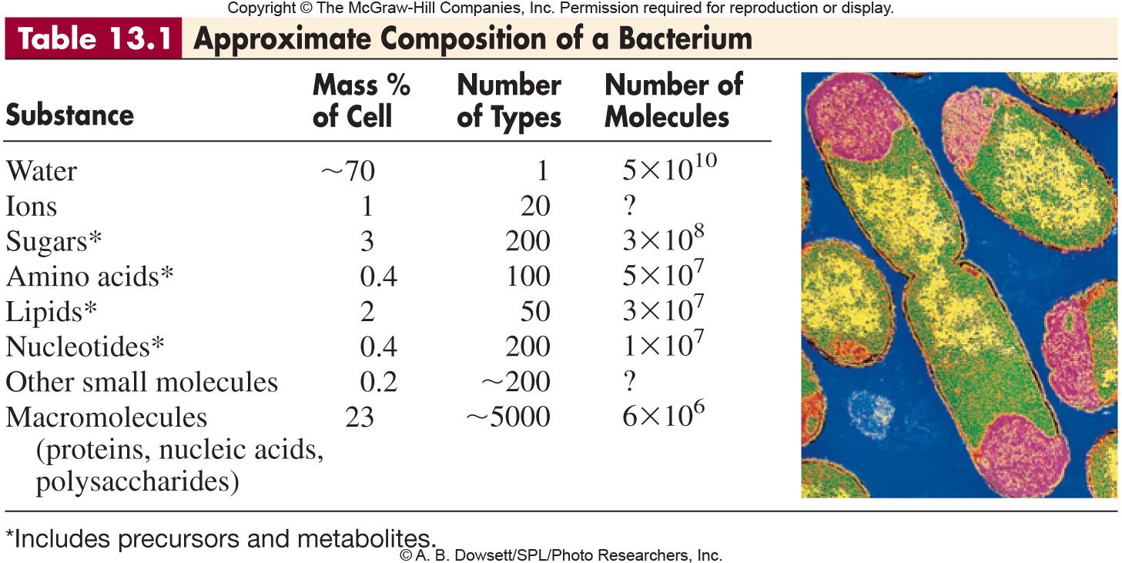
Notes:
‹#›

Slide 4
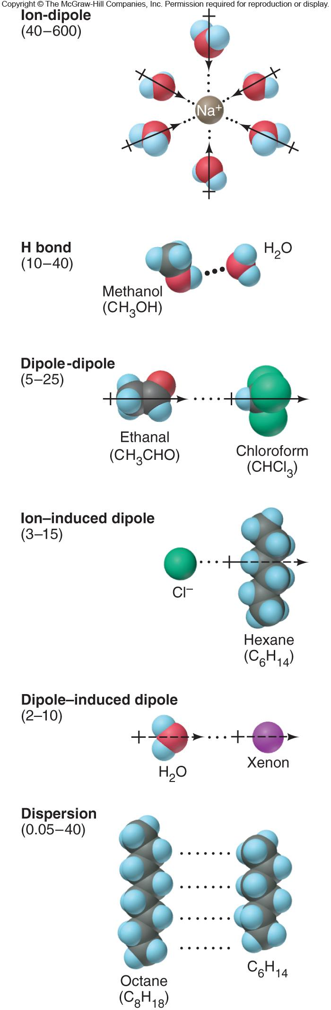
Figure 13.1
The major types of intermolecular forces in solutions.
Notes:
‹#›

Slide 5
LIKE DISSOLVES LIKE
Substances with similar types of intermolecular forces dissolve in each other.
When a solute dissolves in a solvent, solute-solute interactions and solvent-solvent interactions are being replaced with solute-solvent interactions. The forces must be comparable in strength in order for a solution to form.
Notes:
‹#›

Slide 6
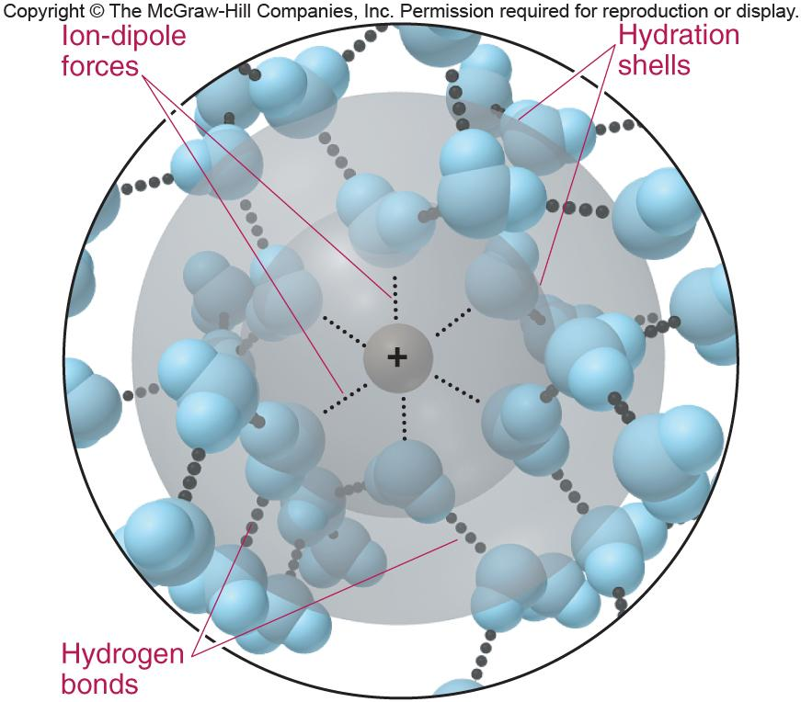
Figure 13.2
Hydration shells around an aqueous ion.
Notes:
‹#›

Slide 7
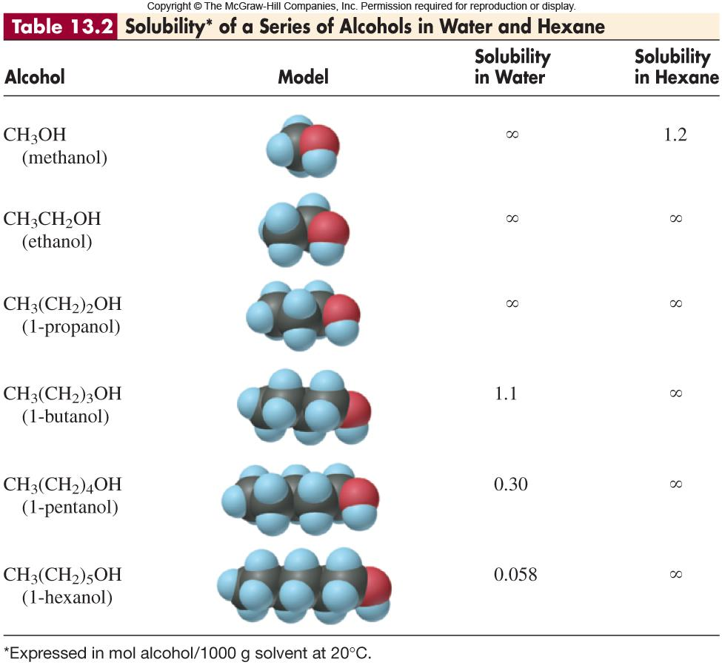
Notes:
‹#›

Slide 8
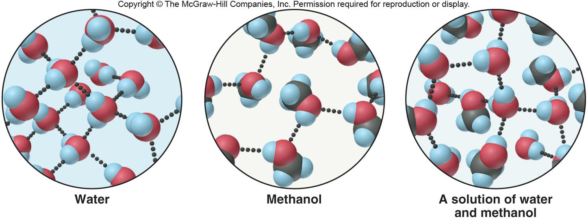
Figure 13.3
Like dissolves like: solubility of methanol in water.
Notes:
‹#›

Slide 9
SAMPLE PROBLEM 13.1
Predicting Relative Solubilities of Substances
PROBLEM:
Predict which solvent will dissolve more of the given solute:
(a) Sodium chloride in methanol (CH₃OH) or in 1-propanol (CH₃CH₂CH₂OH)
(b) Ethylene glycol (HOCH₂CH₂OH) in hexane (CH₃CH₂CH₂CH₂CH₂CH₃)
or in water.
(c) Diethyl ether (CH₃CH₂OCH₂CH₃) in water or in ethanol (CH₃CH₂OH)
PLAN:
Consider the intermolecular forces that exist between solute molecules and between solvent molecules. Consider whether the solute-solvent interactions are as strong.
SOLUTION:
(a) Methanol. NaCl is ionic and will form ion-dipoles with the -OH groups of both methanol and 1-propanol. However, 1-propanol is subject to the dispersion forces to a greater extent.
(b) Water. Hexane has no dipoles to interact with the -OH groups in ethylene glycol. Water can H bond to the ethylene glycol.
(c) Ethanol. Diethyl ether can interact through dipole-dipole and dispersion forces. Ethanol can provide both while water would like to H bond.
Notes:
‹#›

Slide 10
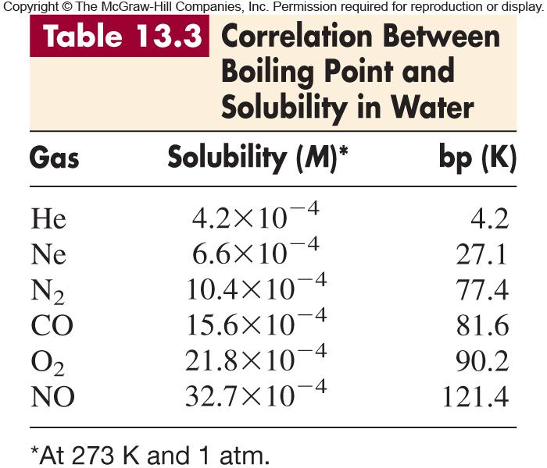
Notes:
‹#›

Slide 11
Heats of Solution and Solution Cycles
1. Solute particles separate from each other - endothermic
solute (aggregated) + heat solute (separated) ΔH_{solute} > 0
2. Solvent particles separate from each other - endothermic
solvent (aggregated) + heat solvent (separated) ΔH_{solvent} > 0
3. Solute and solvent particles mix - exothermic
solute (separated) + solvent (separated) solution + heat ΔH_{mix} < 0
ΔH_{soln} = ΔH_{solute} + ΔH_{solvent} + ΔH_{mix}
Notes:
‹#›

Slide 12
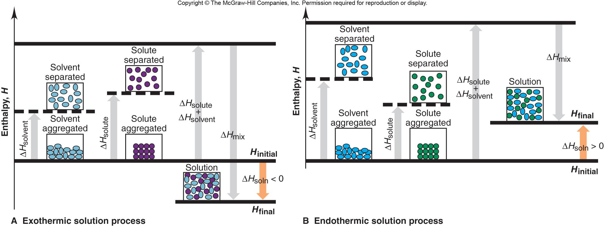
Figure 13.4
Solution cycles and the enthalpy components of the heat of solution.
Notes:
‹#›

Slide 13
Heats of Hydration
Solvation of ions by water - always exothermic
H₂O
M⁺(g) [or X⁻(g)] M⁺(aq) [or X⁻(aq)] ΔH_{hydr of the ion} < 0
ΔH_{hydr} is related to the charge density of the ion, that is, coulombic charge and size matter.
Lattice energy is the negative of the ΔH involved in the formation of an ionic solid from its gaseous ions (∆H < 0 for the reaction below).
M⁺(g) + X⁻(g) MX(s) ΔH_{lattice} is always > 0
Notes:
‹#›

Slide 14
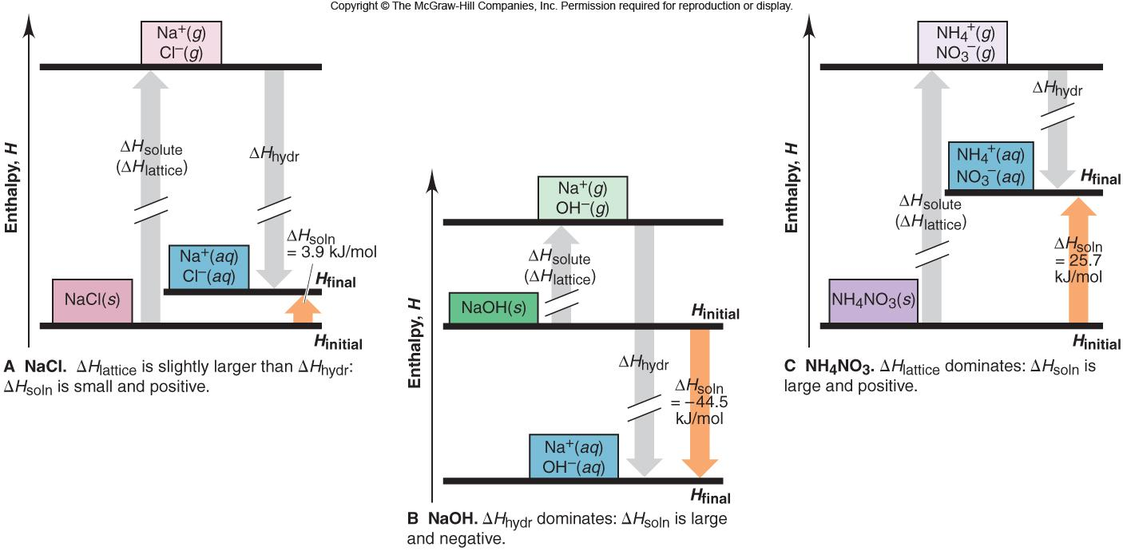
Figure 13.5
Dissolving ionic compounds in water.
Notes:
‹#›

Slide 15
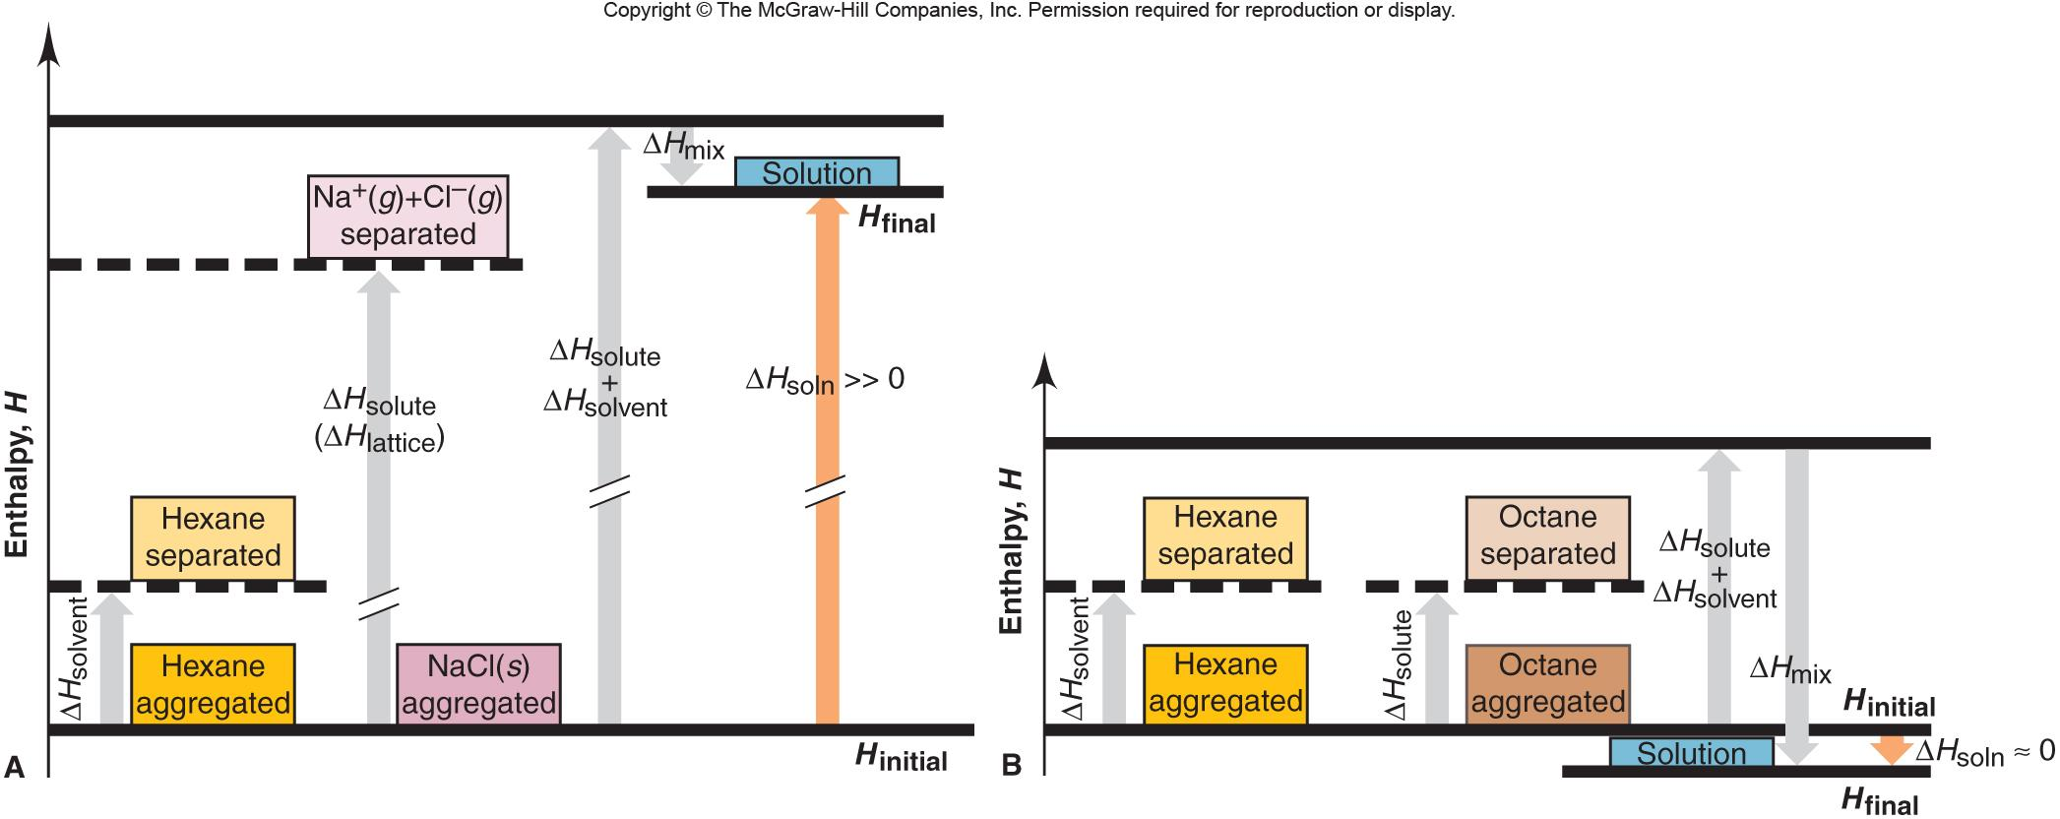
Figure 13.6
Enthalpy diagrams for dissolving NaCl and octane in hexane.
Notes:
‹#›

Slide 16
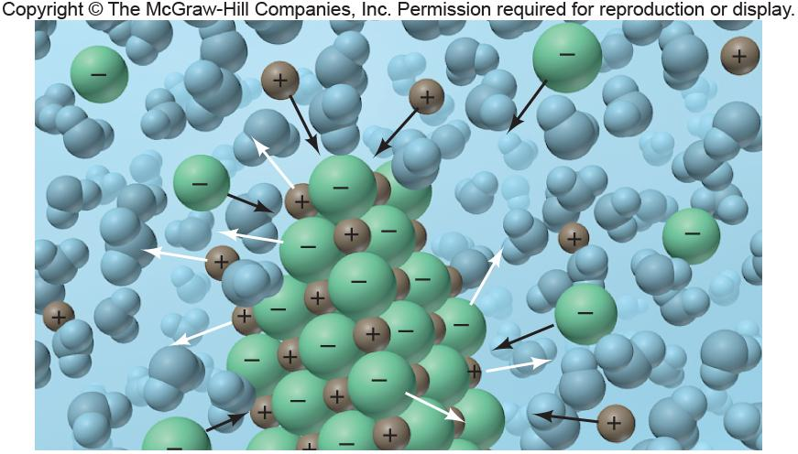
Figure 13.7
Equilibrium in a saturated solution.
solute (undissolved) solute (dissolved)
Notes:
‹#›

Slide 17
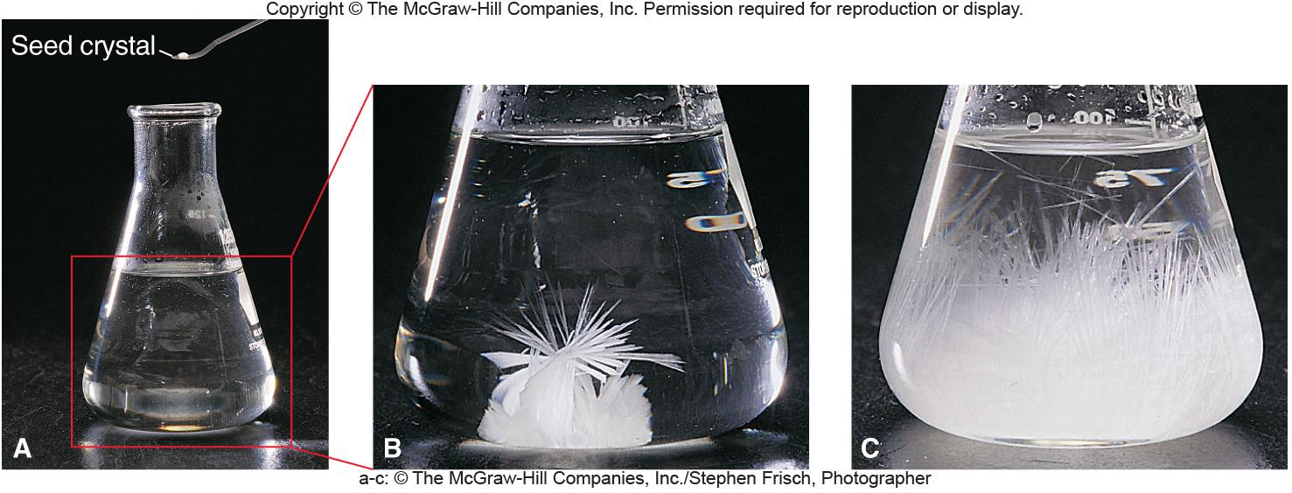
Figure 13.8
Sodium acetate crystallizing from a supersaturated solution.
Notes:
‹#›

Slide 18
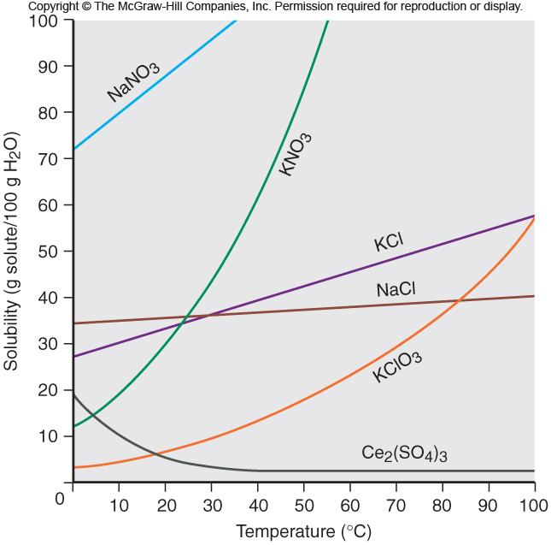
The relation between solubility and temperature for several ionic compounds.
Figure 13.9
Notes:
‹#›

Slide 19
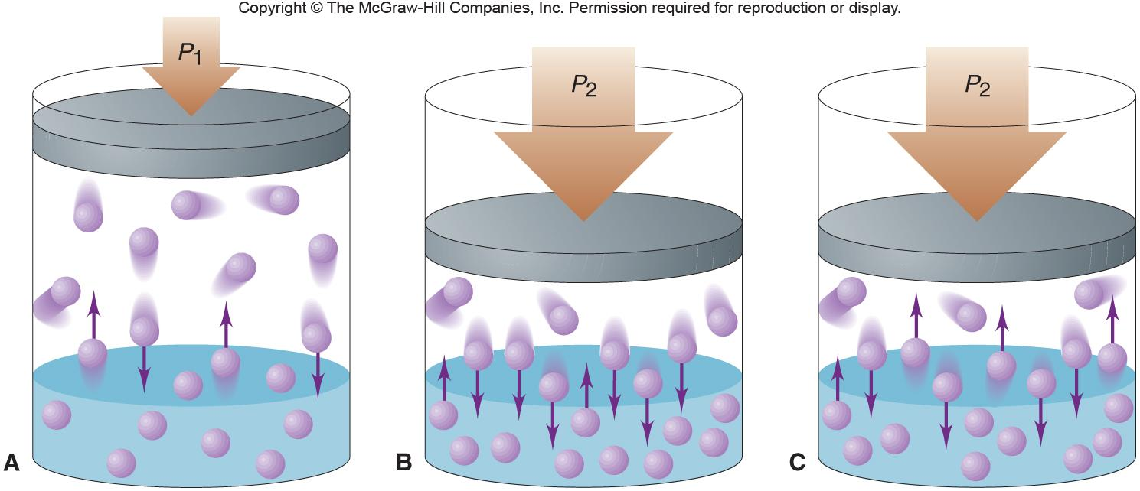
Figure 13.10
The effect of pressure on gas solubility.
Notes:
‹#›

Slide 20
Henry’s law
S_{gas} = k_{H} x P_{gas}
The solubility of a gas (S_{gas}) is directly proportional to the partial pressure of the gas (P_{gas}) above the solution.
Notes:
‹#›

Slide 21
SAMPLE PROBLEM 13.2
Using Henry’s Law to Calculate Gas Solubility
PROBLEM:
The partial pressure of carbon dioxide gas inside a bottle of cola is 4 atm at 25ºC. What is the solubility of CO₂? The Henry’s law constant for CO₂ dissolved in water is 3.3 x 10⁻² mol/L•atm at 25ºC.
PLAN:
Knowing k_{H} and P_{gas}, we can substitute them into Henry’s law equation.
SOLUTION:
S = (3.3 x 10⁻² mol/L•atm)(4 atm) =
0.1 mol/L
CO₂
Notes:
‹#›

Slide 22
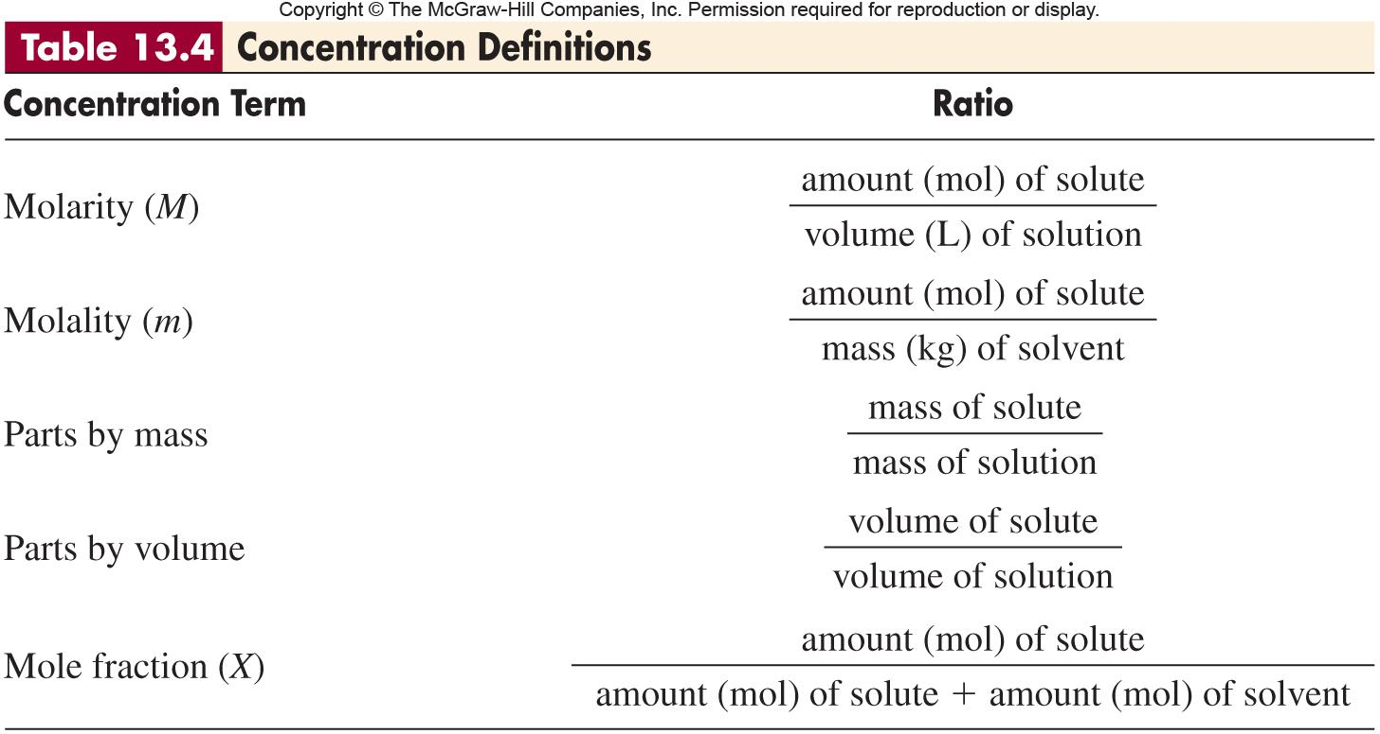
Notes:
‹#›

Slide 23
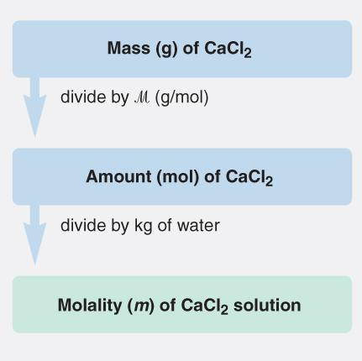
SAMPLE PROBLEM 13.3
Calculating Molality
PROBLEM:
What is the molality of a solution prepared by dissolving 32.0 g of CaCl₂ in 271 g of water?
PLAN:
We have to convert the grams of CaCl₂ to moles and the grams of water to kg. Then substitute into the equation for molality.
SOLUTION:
mol CaCl₂
32.0 g CaCl₂
x
= 0.288 mol CaCl₂
110.98 g CaCl₂
0.288 mol CaCl₂
molality =
= 1.06 m CaCl₂
kg
271 g H₂O
x
10³ g
Notes:
‹#›

Slide 24
SAMPLE PROBLEM 13.4
Expressing Concentration in Parts by Mass, Parts by Volume, and Mole Fraction
PROBLEM:
(a) Find the concentration of calcium (in ppm) in a 3.50-g pill that contains 40.5 mg of Ca.
(b) The label on a 0.750-L bottle of Italian chianti indicates “11.5% alcohol by volume.” How many liters of alcohol does the wine contain?
(c) A sample of rubbing alcohol contains 142 g of isopropyl alcohol (C₃H₇OH) and 58.0 g of water. What are the mole fractions of alcohol and water?
PLAN:
(a) Convert mg to g of Ca, find the ratio of grams Ca to grams of pill and multiply by 10⁶.
(b) Knowing the % alcohol and total volume, we can find volume of alcohol.
(c) Convert grams of solute and grams of solvent to moles; find the ratios of parts to the total.
Notes:
‹#›

Slide 25
SAMPLE PROBLEM 13.4
Expressing Concentrations in Parts by Mass, Parts by Volume, and Mole Fraction
continued
g
SOLUTION:
(a)
40.5 mg Ca
x
10³ mg
x
10⁶
= 1.16 x 10⁴ ppm Ca
3.50 g
11.5 L alcohol
(b)
0.750 L chianti
x
= 0.0862 L alcohol
100. L chianti
mol
(c)
mol isopropyl alcohol =
142 g x
= 2.36 mol C₃H₇OH
60.09 g
mol
mol water =
58.0 g x
= 3.22 mol H₂O
18.02 g
2.36 mol C₃H₇OH
3.22 mol H₂O
2.36 mol C₃H₇OH + 3.22 mol H₂O
2.36 mol C₃H₇OH + 3.22 mol H₂O
= 0.423
χ C₃H₇OH
= 0.577
χ H₂O
Notes:
‹#›

Slide 26
Interconverting Concentration Terms
To convert a term based on amount (mol) to one based on mass, you need the molar mass. These conversions are similar to mass-mole conversions.
To convert a term based on mass to one based on volume, you need the solution density. Working with the mass of a solution and the density (mass/volume), you can obtain volume from mass and mass from volume.
Molality involves quantity of solvent, whereas the other concentration terms involve quantity of solution.
Notes:
‹#›

Slide 27
SAMPLE PROBLEM 13.5
Converting Concentration Terms
PROBLEM:
Hydrogen peroxide is a powerful oxidizing agent used in concentrated solution in rocket fuels and in dilute solution as a hair bleach. An aqueous solution of H₂O₂ is 30.0% by mass and has a density of 1.11 g/mL. Calculate its
(a) Molality
(b) Mole fraction of H₂O₂
(c) Molarity
PLAN:
(a) To find the mass of solvent we assume the % is per 100 g of solution. Take the difference in the mass of the solute and solution for the mass of peroxide.
(b) Convert g of solute and solvent to moles before finding χ.
(c) Use the density to find the volume of the solution.
SOLUTION:
(a)
g of H₂O = 100.0 g solution - 30.0 g H₂O₂ =
70.0 g H₂O
mol H₂O₂
30.0 g H₂O₂ x
34.02 g H₂O₂
molality =
= 12.6 m H₂O₂
kg H₂O
70.0 g H₂O x
10³ g
Notes:
‹#›

Slide 28
SAMPLE PROBLEM 13.5
Converting Concentration Terms
continued
(b)
mol H₂O
70.0 g H₂O x
= 3.88 mol H₂O
18.02 g H₂O
0.882 mol H₂O₂
= 0.185 χ of H₂O₂
0.882 mol H₂O₂ + 3.88 mol H₂O
mL
(c)
100.0 g solution x
= 90.1 mL solution
1.11 g
0.882 mol H₂O₂
= 9.79 M H₂O₂
L
90.1 mL solution x
10³ mL
Notes:
‹#›

Slide 29
Colligative Properties
Raoult’s law (vapor pressure of a solvent above a solution, P_{solvent})
P_{solvent} = X_{solvent} x Pº_{solvent}
where Pº_{solvent} is the vapor pressure of the pure solvent
Pº_{solvent} - P_{solvent} = ΔP = X_{solute} x Pº_{solvent}
Boiling Point Elevation and Freezing Point Depression
ΔT_{b} = K_{b}m
ΔT_{f} = K_{f}m
Osmotic Pressure
Π = M R T where M is the molarity, R is the ideal gas law constant and T is the Kelvin temperature
Notes:
‹#›

Slide 30
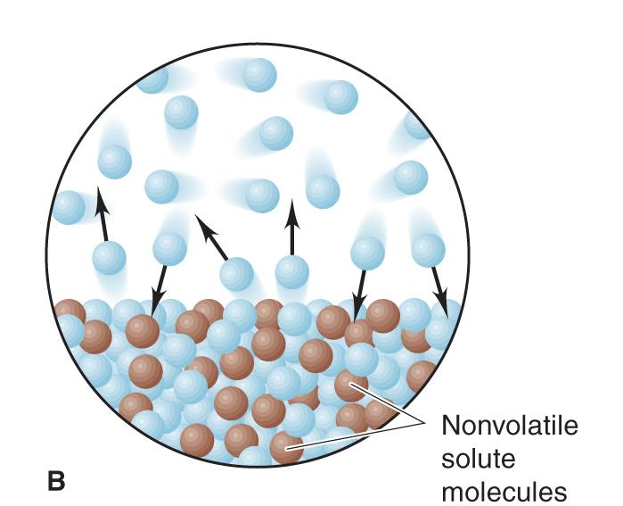
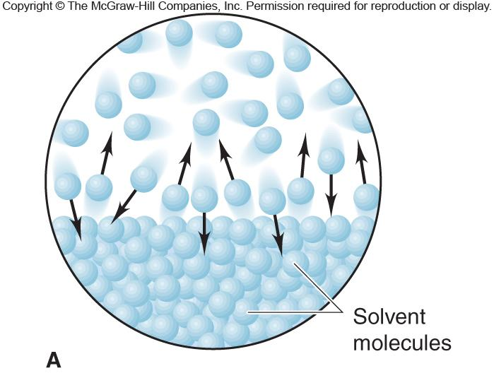
Figure 13.11
The effect of a solute on the vapor pressure of a solution.
Notes:
‹#›

Slide 31
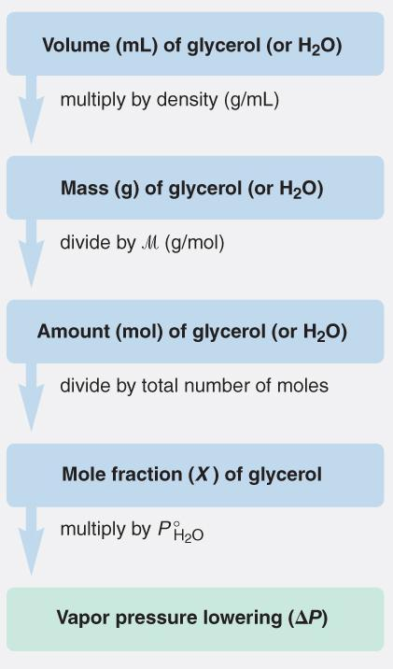
SAMPLE PROBLEM 13.6
Using Raoult’s Law to Find the Vapor Pressure Lowering
PROBLEM:
Calculate the vapor pressure lowering, ΔP, when 10.0 mL of glycerol (C₃H₈O₃) is added to 500. mL of water at 50.ºC. At this temperature, the vapor pressure of pure water is 92.5 torr and its density is 0.988 g/mL. The density of glycerol is 1.26 g/mL.
PLAN:
Find the mol fraction, χ, of glycerol in solution and multiply by the vapor pressure of water.
Notes:
‹#›

Slide 32
SAMPLE PROBLEM 13.6 continued
Using Raoult’s Law to Find the Vapor Pressure Lowering
SOLUTION:
1.26 g C₃H₈O₃
mol C₃H₈O₃
10.0 mL C₃H₈O₃ x
x
= 0.137 mol C₃H₈O₃
mL C₃H₈O₃
92.09 g C₃H₈O₃
0.988 g H₂O
mol H₂O
500. mL H₂O x
x
= 27.4 mol H₂O
mL H₂O
18.02 g H₂O
ΔP =
0.137 mol C₃H₈O₃
x
92.5 torr
= 0.461 torr
0.137 mol C₃H₈O₃ + 27.4 mol H₂O
Notes:
‹#›

Slide 33
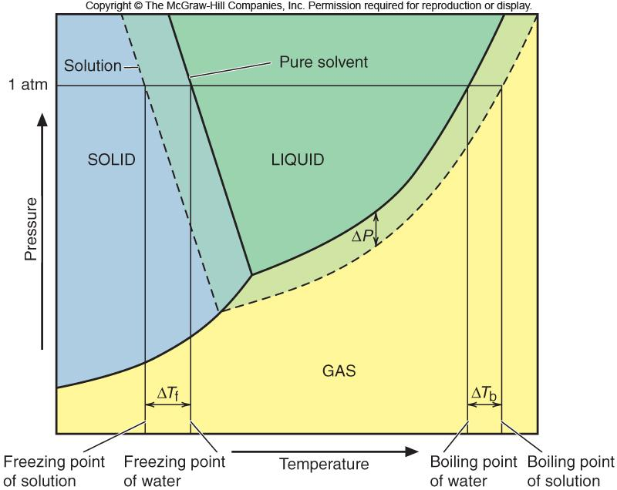
Figure 13.12
Phase diagrams of solvent and solution.
Notes:
‹#›

Slide 34
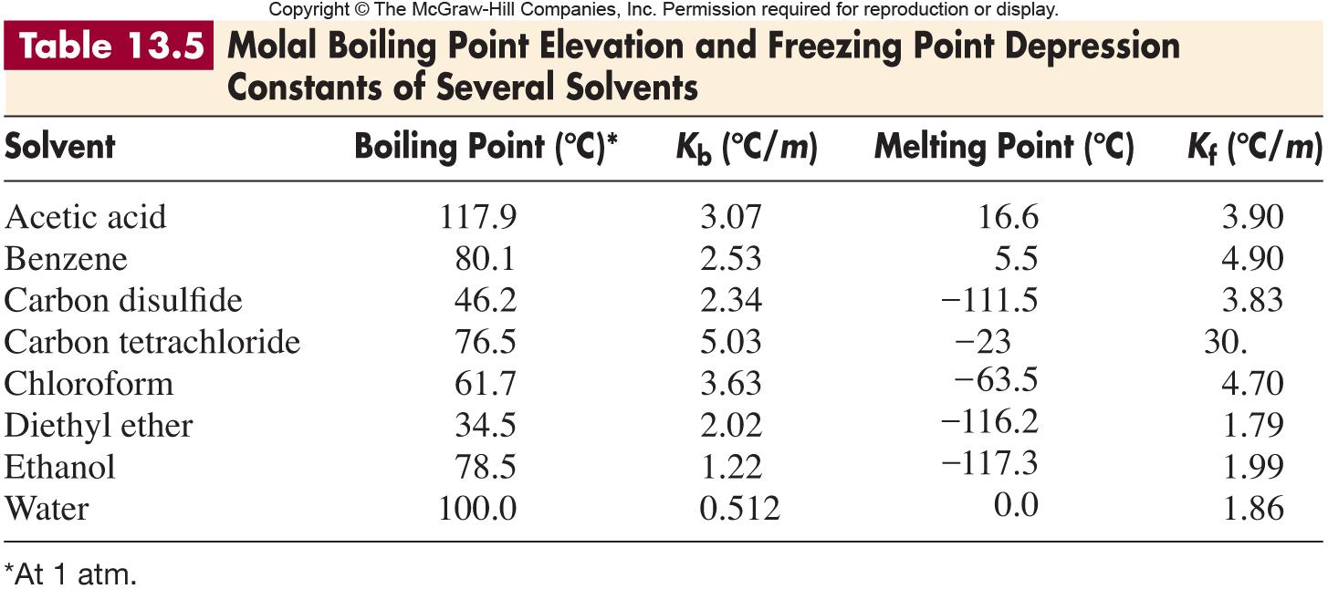
Notes:
‹#›

Slide 35
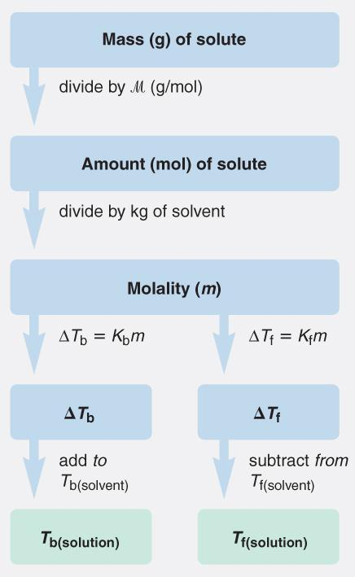
SAMPLE PROBLEM 13.7
Determining the Boiling Point Elevation and Freezing Point Depression of a Solution
PROBLEM:
You add 1.00 kg of ethylene glycol (C₂H₆O₂) antifreeze to your car radiator, which contains 4450 g of water. What are the boiling and freezing points of the solution?
PLAN:
Find the number of mols of ethylene glycol; m of the solution; multiply by the boiling or freezing point constant; add or subtract, respectively, the changes from the boiling point and freezing point of water.
Notes:
‹#›

Slide 36
SAMPLE PROBLEM 13.7
continued
Determining the Boiling Point Elevation and Freezing Point Depression of a Solution
SOLUTION:
mol C₂H₆O₂
1.00 x 10³ g C₂H₆O₂ x
= 16.1 mol C₂H₆O₂
62.07 g C₂H₆O₂
16.1 mol C₂H₆O₂
= 3.62 m C₂H₆O₂
4.450 kg H₂O
ΔT_{bp} =
0.512ºC/m
x
3.62 m
= 1.85ºC
ΔT_{fp} =
1.86ºC/m
x
3.62 m = 6.73ºC
bp = 100.00ºC + 1.85ºC = 101.85ºC
fp = 0.00ºC - 6.73ºC = -6.73ºC
Notes:
‹#›

Slide 37
Osmotic Pressure
The symbol for osmotic pressure is Π.
n_{solute}
Π α
or Π α M
V_{solution}
n_{solute}
Π =
RT
= MRT
V_{solution}
Notes:
‹#›

Slide 38
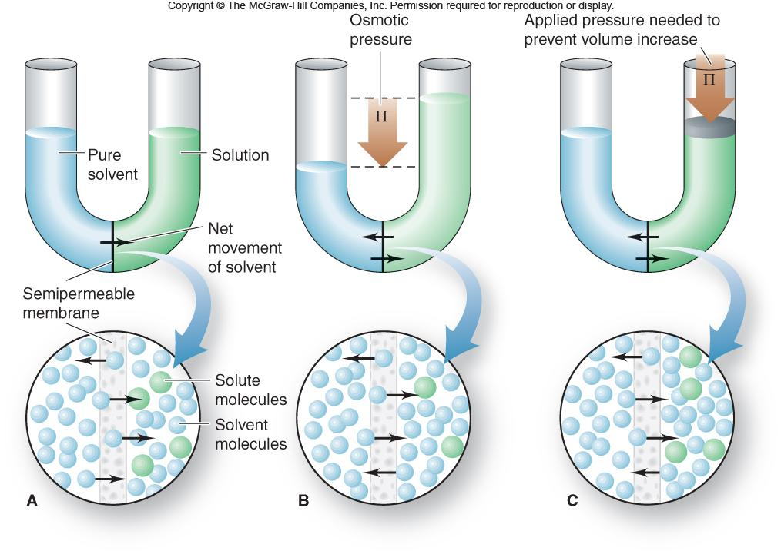
Figure 13.13
The development of osmotic pressure.
Notes:
‹#›

Slide 39
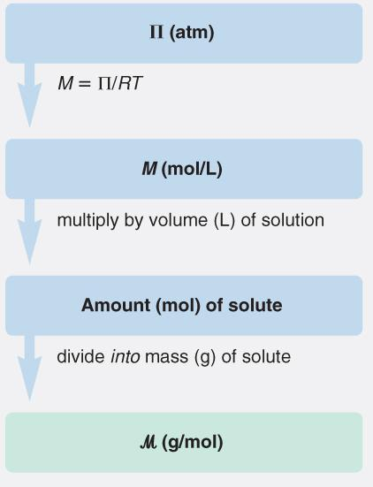
SAMPLE PROBLEM 13.8
Determining Molar Mass from Osmotic Pressure
PROBLEM:
Biochemists have discovered more than 400 mutant varieties of hemoglobin, the blood protein that carries oxygen throughout the body. A physician studying a variety associated with a fatal disease first finds its molar mass (M). She dissolves 21.5 mg of the protein in water at 5.0ºC to make 1.50 mL of solution and measures an osmotic pressure of 3.61 torr. What is the molar mass of this variety of hemoglobin?
PLAN:
We know Π as well as R and T. Convert Π to atm and T to K. Use the Π equation to find M and then the amount and volume of the sample to get to M.
Notes:
‹#›

Slide 40
SAMPLE PROBLEM 13.8
continued
Determining Molar Mass from Osmotic Pressure
SOLUTION:
Π
3.61 torr x
atm
M =
=
760 torr
RT
= 2.08 x 10⁻⁴ M
(0.0821 L•atm/mol•K)(273.15 K + 5.0)
2.08 x 10⁻⁴ mol
L
x 1.50 mL x
= 3.12 x 10⁻⁷ mol
L
10³ mL
g
x
1
21.5 mg x
= 6.89 x 10⁴ g/mol
10³ mg
3.12 x 10⁻⁷ mol
Notes:
‹#›

Slide 41
Colligative Properties of Electrolyte Solutions
For electrolyte solutions, the compound formula
tells us how many particles are in the solution.
The van’t Hoff factor, i, tells us what the “effective” number of ions are in the solution.
van’t Hoff factor (i)
measured value for electrolyte solution
i =
expected value for nonelectrolyte solution
For vapor pressure lowering: ΔP = i(χ _{solute}x Pº_{solvent})
For boiling point elevation: ΔT_{b} = i(Κ_{b}m)
For freezing point depression: ΔT_{f} = i(Κ_{f}m)
For osmotic pressure: Π = i(MRT)
Notes:
‹#›

Slide 42
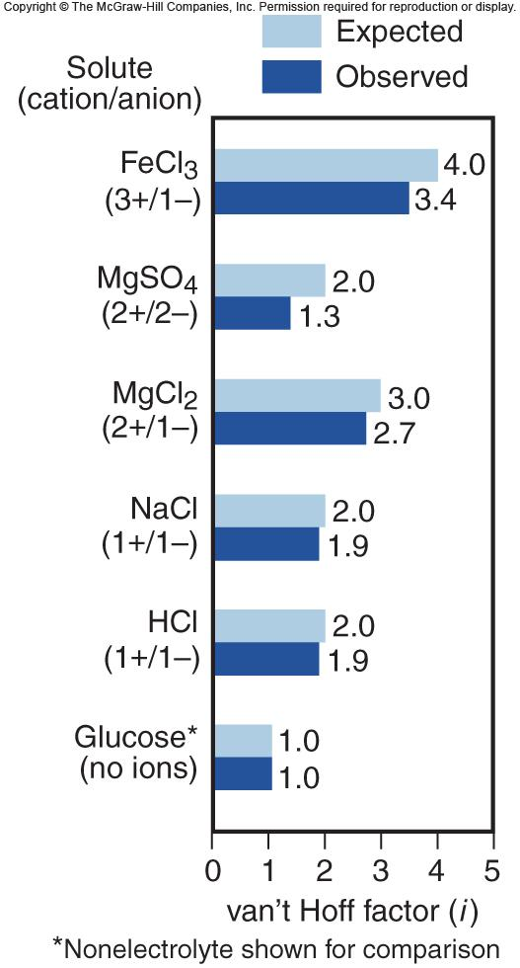
Figure 13.14
Nonideal behavior of strong electrolyte solutions.
Notes:
‹#›

Slide 43
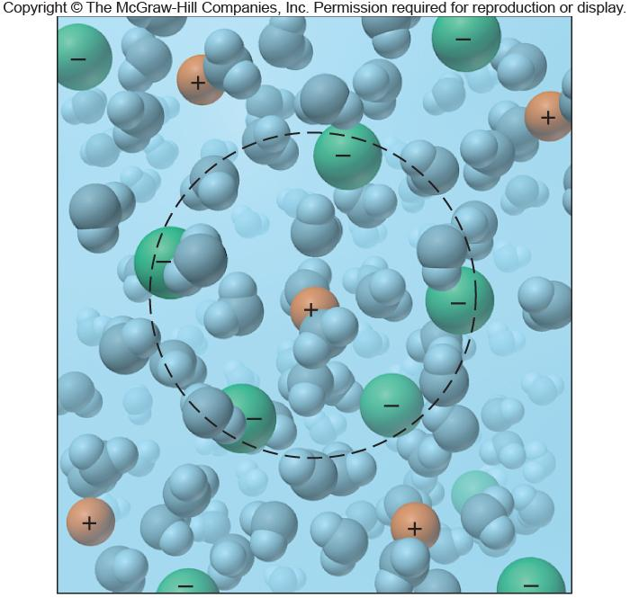
Figure 13.15
An ionic atmosphere model for nonideal behavior of electrolyte solutions.
Notes:
‹#›

Slide 44
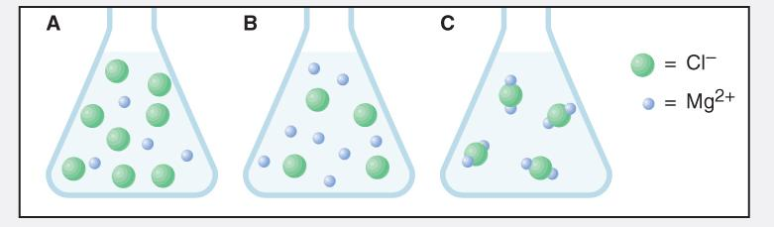
SAMPLE PROBLEM 13.9
Depicting a Solution to Find Its Colligative Properties
PROBLEM:
A 0.952-g sample of magnesium chloride is dissolved in 100. g of water.
(a) Which scene depicts the solution best?
(b) What is the amount (mol) represented
by each green sphere?
(c) Assuming the solution is ideal, what is its freezing point (at 1 atm)?
PLAN:
(a) Consider the formula for magnesium chloride, an ionic compound.
(b) Use the answer to part (a), the mass given, and the molar mass to determine the number of moles/sphere.
(c) The total number of moles of cations and anions, mass of solvent, and equation for freezing point depression can be used to find the freezing point of the solution.
Notes:
‹#›

Slide 45
SAMPLE PROBLEM 13.9
Depicting a Solution to Find Its Colligative Properties
continued
SOLUTION:
(a) The formula for magnesium chloride is MgCl₂; therefore the correct depiction must be A with a ratio of 2 Cl⁻/ 1 Mg²⁺.
0.952 g MgCl₂
(b)
mol MgCl₂ =
95.21 g MgCl₂
= 0.0100 mol MgCl₂
mol MgCl₂
2 mol Cl⁻
mol Cl⁻ =
0.0100 mol MgCl₂
x
= 0.0200 mol Cl⁻
1 mol MgCl₂
0.0200 mol Cl⁻
mol/sphere =
= 2.50 x 10⁻³ mol/sphere
8 spheres
Notes:
‹#›

Slide 46
SAMPLE PROBLEM 13.9
Depicting a Solution to Find Its Colligative Properties
continued
SOLUTION:
0.0100 mol MgCl₂
(c)
molality (m) =
= 0.100 m MgCl₂
1 kg
100. g x
10³ g
Assuming this is an IDEAL solution, the van’t Hoff factor, i, should be 3.
ΔT_{f} = i (K_{f} m)
= 3(1.86ºC/m x 0.100 m)
= 0.558ºC
T_{f} = 0.000ºC - 0.558ºC = - 0.558ºC
Notes:
‹#›

