Slide 1


Slide 2
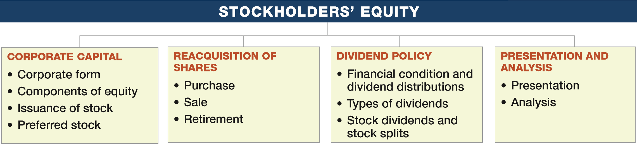
PREVIEW OF CHAPTER 15
Intermediate Accounting
16th Edition
Kieso ● Weygandt ● Warfield

Slide 3
LEARNING OBJECTIVES
15
Stockholders’ Equity
After studying this chapter, you should be able to:
Describe the corporate form and the issuance of shares of stock.
Describe the accounting and reporting for reacquisition of shares.
Understand the accounting and reporting issues related to dividends.
Indicate how to present and analyze stockholders’ equity.
LO 1

Slide 4
CORPORATE CAPITAL
Three primary forms of business organization
Proprietorship
Partnership
Corporation
Special characteristics of the corporate form:
  Influence of state corporate law.
  Use of capital stock or share system.
  Development of a variety of ownership interests.
LO 1

Slide 5
CORPORATE CAPITAL
State Corporate Law
Corporation must submit articles of incorporation to the state in which incorporation is desired.
State issues a corporation charter.
Advantage to incorporate in a state whose laws favor the corporate form of business organization.
  Delaware
Accounting for stockholder’s equity follows the provisions of each state’s business incorporation act.
LO 1

Slide 6
WHAT DO THE NUMBERS MEAN? 1209 NORTH ORANGE STREET
WHAT’S YOUR PRINCIPLE
Nothing about 1209 North Orange Street hints at the secrets inside. It’s a humdrum ofﬁce building, a low-slung affair with a faded awning and a view of a parking garage. Hardly worth a second glance, if even a ﬁrst one. But behind its doors is one of the most remarkable corporate collections in the world: 1209 North Orange, you see, is the legal address of no fewer than 285,000 separate businesses.
Its occupants, on paper, include giants like American Airlines, Apple, Bank of America, Berkshire Hathaway, Cargill, Coca-Cola, Ford, General Electric, Google, JPMorgan Chase, and Wal-Mart. These companies do business across the nation and around the world. Here at 1209 North Orange, they simply have a dropbox. What brings these marquee names to 1209 North Orange, and to other Delaware addresses, also attracts less-upstanding corporate citizens. For instance, 1209 North Orange was, until recently, a business address of Timothy S. Durham, known as “the Midwest Madoff.” Recently, Durham was found guilty of bilking 5,000 mostly middle-class and elderly investors out of $207 million. It was also an address of Stanko Subotic, a Serbian businessman and convicted smuggler—just one of many Eastern Europeans drawn to the state. Big corporations, small-time businesses, rogues, scoundrels, and worse—all have turned up at Delaware addresses in hopes of minimizing taxes, skirting regulations, plying friendly courts, or, when
(continued)
LO 1

Slide 7
WHAT DO THE NUMBERS MEAN? 1209 NORTH ORANGE STREET
WHAT’S YOUR PRINCIPLE
needed, covering their tracks. Federal authorities worry that, in addition to the legitimate businesses ﬂocking here, drug-trafﬁckers, embezzlers, and money-launderers are increasingly heading to Delaware, too. It’s easy to set up shell companies here, no questions asked.
Today, Delaware regularly tops lists of domestic and foreign tax havens because it allows companies to lower their taxes in another state—for instance, the state in which they actually do business or have their headquarters—by shifting royalties and similar revenues to holding companies in Delaware, where they are not taxed. In tax circles, the arrangement is known as “the Delaware loophole.” Over the last decade, the Delaware loophole has enabled corporations to reduce the taxes paid to other states by an estimated $9.5 billion. However, recently some companies are concerned that the environment in Delaware has become more hostile. Among their gripes: a growing tide of shareholder litigation, for which some feel that the state has not done enough to curb. Only time will tell if these developments have soured companies on Delaware as an incorporation target. Yet in the past two years, approximately 85 percent of the companies that went public incorporated in Delaware.
Sources: L. Wayne, “How Delaware Thrives as a Corporate Tax Haven,” The New York Times (June 30, 2012); and L. Hoffman, “Dole and Other Companies Sour on Delaware as a Corporate Haven,” Wall Street Journal (August 8, 2015).
LO 1

Slide 8
CORPORATE CAPITAL
Capital Stock or Share System
In the absence of restrictive provisions, each share carries the following rights:
  To share proportionately in profits and losses.
  To share proportionately in management (the right to vote for directors).
  To share proportionately in assets upon liquidation.
  To share proportionately in any new issues of stock of the same class—called the preemptive right.
LO 1

Slide 9
CORPORATE CAPITAL
Variety of Ownership Interests
Common stock is the residual corporate interest.
  Bears ultimate risks of loss.
  Receives the benefits of success.
  Not guaranteed dividends nor assets upon dissolution.
Preferred stock is a special class of stock created by contract, when stockholders’ sacrifice certain rights in return for other rights or privileges, usually dividend preference.
LO 1

Slide 10
CORPORATE CAPITAL
Common Stock
Account
Contributed Capital
Additional Paid-in Capital
Account
Preferred Stock
Account
Two Primary Sources of Equity
Retained Earnings
Account
Assets – Liabilities = Equity
Less:
Treasury Stock
Account
LO 1

Slide 11
CORPORATE CAPITAL
Issuance of Stock
  Shares authorized - Shares offered for sale - Shares issued
Accounting problems:
  Par value stock.
  No-par stock.
  Stock issued in combination with other securities.
  Stock issued in noncash transactions.
  Costs of issuing stock.
LO 1

Slide 12
CORPORATE CAPITAL
Par Value Stock
Low par values help companies avoid a contingent liability.
Corporations maintain accounts for:
  Preferred Stock or Common Stock.
  Paid-in Capital in Excess of Par (also called Additional Paid-in Capital)
LO 1

Slide 13
CORPORATE CAPITAL
Illustration: Blue Diamond Corporation issued 300 shares of $10 par value common stock for $4,500. Prepare the journal entry to record the issuance of the shares.
Cash 4,500
Common Stock (300 x $10) 3,000
Paid-in Capital in Excess of Par Value 1,500
LO 1

Slide 14
CORPORATE CAPITAL
No-Par Stock
Reasons for issuance:
  Avoids contingent liability.
  Avoids confusion over recording par value versus fair market value.
A major disadvantage of no-par stock is that some states levy a high tax on these issues. In addition, in some states the total issue price for no-par stock may be considered legal capital, which could reduce the flexibility in paying dividends.
LO 1

Slide 15
CORPORATE CAPITAL
Illustration: Video Electronics Corporation is organized with authorized common stock of 10,000 shares without par value. If Video Electronics issues 500 shares for cash at $10 per share, it makes the following entry.
Cash 5,000
Common Stock 5,000
LO 1

Slide 16
CORPORATE CAPITAL
Illustration: Some states require that no-par stock have a stated value. If a company issued 1,000 of the shares with a $5 stated value at $15 per share for cash, it makes the following entry.
Cash 15,000
Common Stock 5,000
Paid-in Capital in Excess of Stated Value 10,000
LO 1

Slide 17
CORPORATE CAPITAL
Stock Issued with Other Securities (Lump-Sum)
Two methods of allocating proceeds:
  Proportional method.
  Incremental method.
LO 1

Slide 18
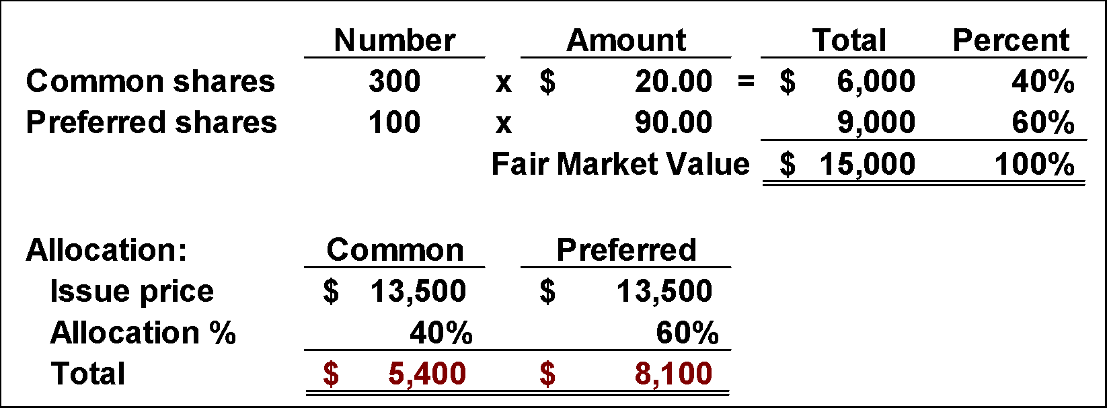
CORPORATE CAPITAL
Illustration: Beveridge Corporation issued 300 shares of $10 par value common stock and 100 shares of $50 par value preferred stock for a lump sum of $13,500. Common stock has a market value of $20 per share, and preferred stock has a market value of $90 per share.
Proportional Method
LO 1

Slide 19
CORPORATE CAPITAL
Prepare the journal entry to record issuance of shares.
Proportional Method
Cash 13,500
Preferred Stock (100 x $50) 5,000
Paid-in Capital in Excess of Par – Preferred 3,100
Common Stock (300 x $10) 3,000
Paid-in Capital in Excess of Par – Common 2,400
LO 1

Slide 20
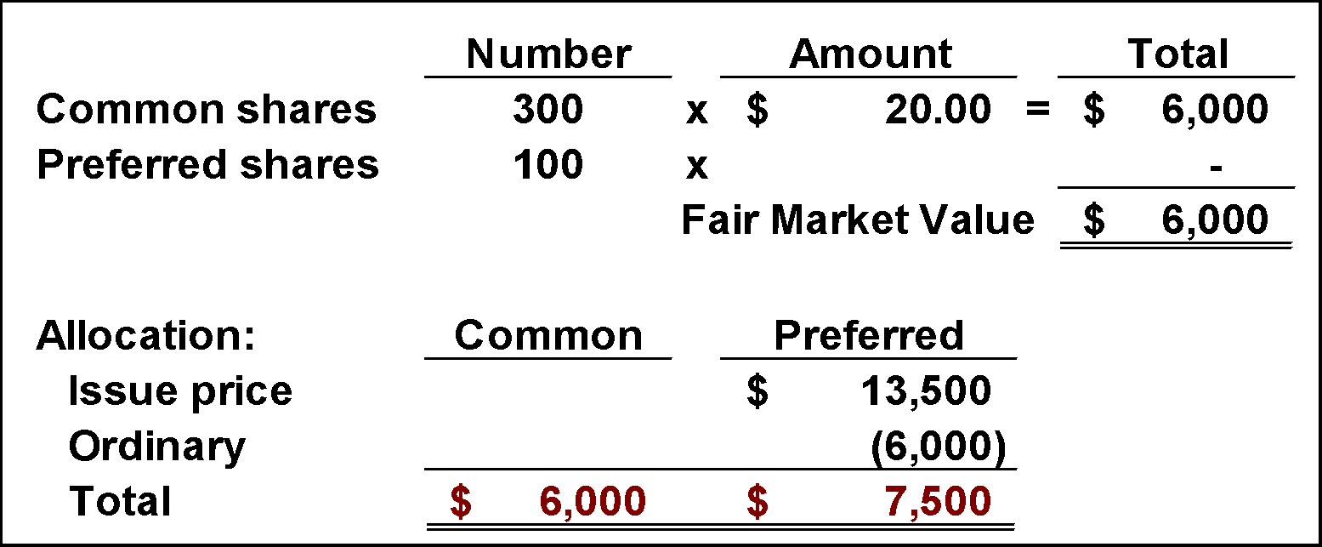
CORPORATE CAPITAL
Illustration: Beveridge Corporation issued 300 shares of $10 par value common stock and 100 shares of $50 par value preferred stock for a lump sum of $13,500. The common stock has a market value of $20 per share, and the value of preferred stock is unknown.
Incremental Method
LO 1

Slide 21
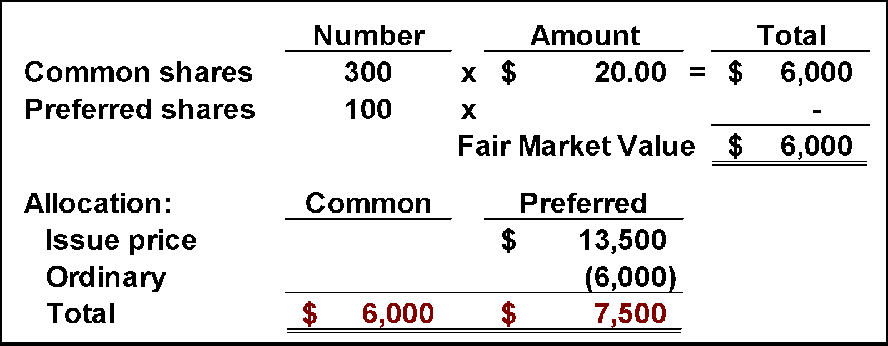
CORPORATE CAPITAL
Prepare the journal entry to record issuance of shares.
Incremental Method
Cash 13,500
Preferred Stock (100 x $50) 5,000
Paid-in Capital in Excess of Par – Preferred 2,500
Common Stock (300 x $10) 3,000
Paid-in Capital in Excess of Par – Common 3,000
LO 1

Slide 22
CORPORATE CAPITAL
Stock Issued in Noncash Transactions
The general rule: Companies should record stock issued for services or property other than cash at the
  fair value of the stock issued or
  fair value of the noncash consideration received,
  whichever is more clearly determinable.
LO 1

Slide 23
CORPORATE CAPITAL
Illustration: The following series of transactions illustrates the procedure for recording the issuance of 10,000 shares of $10 par value common stock for a patent for Arganda Company, in various circumstances.
1. Arganda cannot readily determine the fair value of the patent, but it knows the fair value of the stock is $140,000.
Patents 140,000
Common Stock 100,000
Paid-in Capital in Excess of Par - Common 40,000
LO 1

Slide 24
CORPORATE CAPITAL
2. Arganda cannot readily determine the fair value of the stock, but it determines the fair value of the patent is $150,000.
Patents 150,000
Common Stock 100,000
Paid-in Capital in Excess of Par - Common 50,000
LO 1

Slide 25
CORPORATE CAPITAL
3. Arganda cannot readily determine the fair value of the stock nor the fair value of the patent. An independent consultant values the patent at $125,000 based on discounted expected cash flows.
Patents 125,000
Common Stock 100,000
Paid-in Capital in Excess of Par - Common 25,000
LO 1

Slide 26
CORPORATE CAPITAL
Costs of Issuing Stock
Direct costs incurred to sell stock, such as
  underwriting costs,
  accounting and legal fees,
  printing costs, and
  taxes,
should be reported as a reduction of the amounts paid in (Paid-in Capital in Excess of Par).
LO 1

Slide 27
WHAT DO THE NUMBERS MEAN? THE DISAPPEARING RECEIVABLE
WHAT’S YOUR PRINCIPLE
Sometimes companies issue stock but may not receive cash in return. As a result, a company records a receivable.
Controversy existed regarding the presentation of this receivable on the balance sheet. Some argued that the company should report the receivable as an asset similar to other receivables. Others argued that the company should report the receivable as a deduction from stockholders’ equity (similar to the treatment of treasury stock). The SEC settled this issue: It requires companies to use the contra equity approach because the risk of collection in this type of transaction is often very high.
This accounting issue surfaced in Enron’s accounting. Starting in early 2000, Enron issued shares of its common stock to four “special-purpose entities” in exchange for which it received a note receivable. Enron then increased its assets (by recording a receivable) and stockholders’ equity, a move the company now calls an accounting error. As a result of this accounting treatment, Enron overstated assets and stockholders’ equity by $172 million in its 2000 audited ﬁnancial statements and by $828 million in
(continued)
LO 1

Slide 28
WHAT DO THE NUMBERS MEAN? THE DISAPPEARING RECEIVABLE
WHAT’S YOUR PRINCIPLE
its unaudited 2001 statements. This $1 billion overstatement was 8.5 percent of Enron’s reported stockholders’ equity at that time.
As Lynn Turner, a former chief accountant of the SEC, noted, “It is a basic accounting principle that you don’t record equity until you get cash, and a note doesn’t count as cash.” Situations like this led investors, creditors, and suppliers to lose faith in the credibility of Enron, which eventually caused its bankruptcy.
Source: Adapted from Jonathan Weil, “Basic Accounting Tripped Up Enron—Financial Statements Didn’t Add Up—Auditors Overlook a Simple Rule,” Wall Street Journal (November 11, 2001), p. C1.
LO 1

Slide 29
Preferred Stock
Features often associated with preferred stock.
  Preference as to dividends.
  Preference as to assets in the event of liquidation.
  Convertible into common stock.
  Callable at the option of the corporation.
  Nonvoting.
LO 1

Slide 30
Preferred Stock
Features of Preferred Stock
  Cumulative
  Participating
  Convertible
  Callable
  Redeemable
A corporation may attach whatever preferences or restrictions, as long as it does not violate its
state incorporation law.
LO 1

Slide 31
Preferred Stock
Illustration: Bishop Co. issues 10,000 shares of $10 par value preferred stock for $12 cash per share. Bishop records the issuance as follows:
Cash 120,000
Preferred stock 100,000
Paid-in Capital in Excess of Par - Preferred 20,000
LO 1

Slide 32
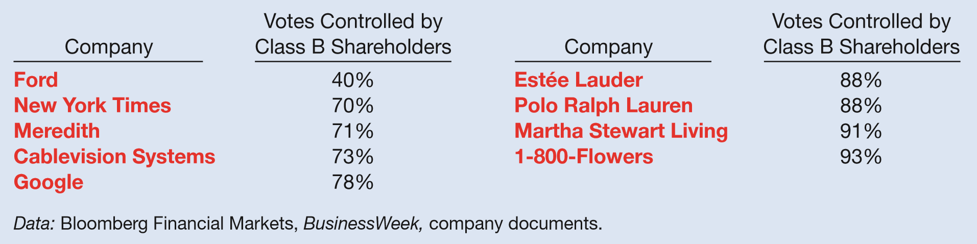
WHAT DO THE NUMBERS MEAN? A CLASS (B) ACT
WHAT’S YOUR PRINCIPLE
Some companies grant preferences to different shareholders by issuing different classes of common stock. For example, ownership of Dow Jones & Co. was controlled by family members who owned Class B shares, which carry super voting powers. The same is true for the Ford family’s control of Ford Motor Co. Class B shares are often criticized for protecting owners’ interest at the expense of shareholder return. These shares often can determine if a takeover deal gets done, or not. Here are some notable companies with two-tiered shares.
For family-controlled companies, issuing newer classes of lower or nonvoting stock effectively creates currency for acquisitions, increases liquidity, or puts a public value on the company without diluting the family’s voting control. This was one of
(continued)
LO 1

Slide 33
WHAT DO THE NUMBERS MEAN? A CLASS (B) ACT
WHAT’S YOUR PRINCIPLE
the main reasons Facebook gave when it created a dual-class share structure. In that IPO, Facebook founder Mark Zuckerberg owns only a quarter of the stock but still holds 57 percent of Facebook’s voting rights.
Google has gone even further and created a Class C stock that gives its owners zero votes. That sounds bad. In practice, however, the nonvoting shares won’t be so different from holders of Google’s Class A shares, which get one vote apiece. Both groups are dominated by holders of the only shares that matter: Class B shares with 10 votes each. Most of those are owned by Google’s founders, Larry Page and Sergey Brin.
Yet Page and Brin aren’t satisﬁed with the 55.7 percent majority of votes that they control. As Google issues less-potent Class A shares—to compensate employees or to ﬁnance acquisitions—the company’s founders have seen their voting power diluted. But now that the company is issuing the neutered Class C shares, Page and Brin are free to create as many shares as they like without giving up an iota of their grip on Google’s direction.
Sources: Adapted from Andy Serwer, “Dual-Listed Companies Aren’t Fair or Balanced,” Fortune (September 20, 2004), p. 83; Alex Halperin, “A Class (B) Act,” Businessweek (May 28, 2007), p. 12; The Big Number, “20 Companies That Went Public in 2011 with Two or More Classes of Stock,” Wall Street Journal (February 8, 2012), p. B5; MoneyWatch, “Facebook’s IPO by the Important Numbers,” www.cbsnews.com (May 17, 2012); and N. Summers, “Why Google Is Issuing a New Kind of Toothless Stock,” Businessweek (April 3, 2014).
LO 1

Slide 34
LEARNING OBJECTIVES
15
Stockholders’ Equity
After studying this chapter, you should be able to:
Describe the corporate form and the issuance of shares of stock.
Describe the accounting and reporting for reacquisition of shares.
Understand the accounting and reporting issues related to dividends.
Indicate how to present and analyze stockholders’ equity.
LO 2

Slide 35
REACQUISITION OF SHARES
Corporations purchase their outstanding stock to:
  Provide tax-efficient distributions of excess cash to stockholders.
  Increase earnings per share and return on equity.
  Provide stock for employee stock compensation contracts or to meet potential merger needs.
  Thwart takeover attempts or to reduce the number of stockholders.
  Make a market in the stock.
LO 2

Slide 36
REACQUISITION OF SHARES
Purchase of Treasury Stock
Two acceptable methods:
  Cost method (more widely used).
  Par (Stated) value method.
Treasury stock reduces stockholders’ equity.
LO 2

Slide 37
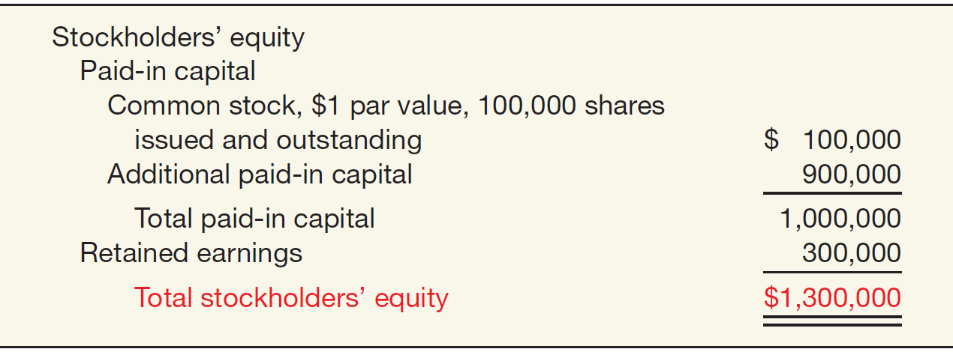
REACQUISITION OF SHARES
Illustration: Cripe Company issued 100,000 shares of $1 par value common stock at a price of $10 per share. In addition, it has retained earnings of $300,000.
ILLUSTRATION 15-5
Stockholders’ Equity with No Treasury Stock
LO 2

Slide 38
REACQUISITION OF SHARES
Illustration: Cripe Company issued 100,000 shares of $1 par value common stock at a price of $10 per share. In addition, it has retained earnings of $300,000.
On January 20, Cripe acquires 10,000 of its shares at $11 per share. Cripe records the reacquisition as follows.
Treasury Stock 110,000
Cash 110,000
LO 2

Slide 39
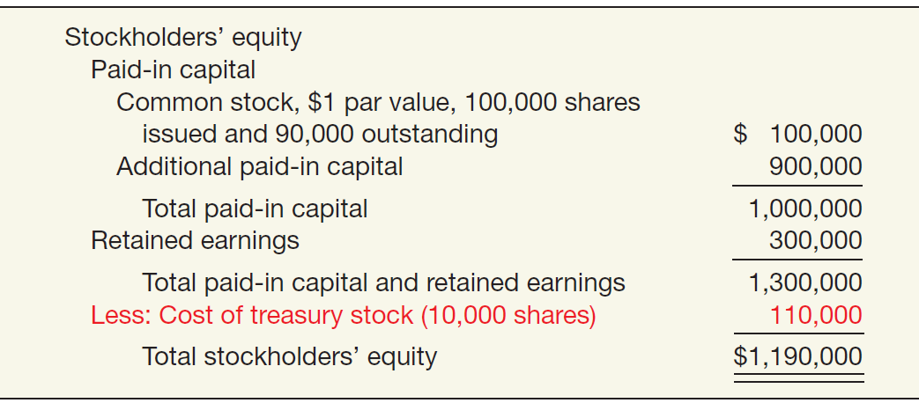
REACQUISITION OF SHARES
Illustration: The stockholders’ equity section for Cripe after purchase of the treasury stock.
ILLUSTRATION 15-6
Stockholders’ Equity with No Treasury Stock
LO 2

Slide 40
REACQUISITION OF SHARES
Sale of Treasury Stock
  Above Cost
  Below Cost
Both increase total assets and stockholders’ equity.
LO 2

Slide 41
REACQUISITION OF SHARES
Sale of Treasury Stock above Cost. Cripe acquired 10,000 treasury share at $11 per share. It now sells 1,000 shares at $15 per share on March 10. Cripe records the entry as follows.
Cash 15,000
Treasury Stock 11,000
Paid-in Capital from Treasury Stock 4,000
LO 2

Slide 42
REACQUISITION OF SHARES
Sale of Treasury Stock below Cost. Cripe sells an additional 1,000 treasury shares on March 21 at $8 per share, it records the sale as follows.
Cash 8,000
Paid-in Capital from Treasury Stock 3,000
Treasury Stock 11,000
LO 2

Slide 43
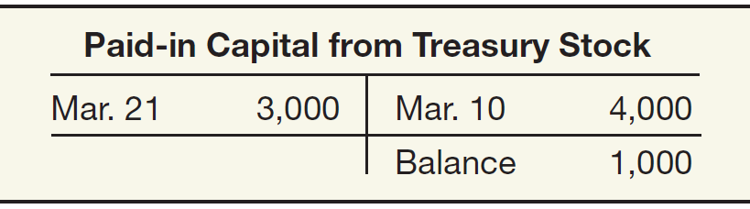
REACQUISITION OF SHARES
ILLUSTRATION 15-7
Treasury Stock Transactions in Paid-in Capital Account
Illustration: Assume that Cripe sells an additional 1,000 shares at $8 per share on April 10.
Cash 8,000
Paid-in Capital from Treasury Stock 1,000
Retained Earnings 2,000
Treasury Stock 11,000
LO 2

Slide 44
REACQUISITION OF SHARES
Retiring Treasury Stock
  Decision results in
    cancellation of the treasury stock and
    a reduction in the number of shares of issued stock.
LO 2

Slide 45
LEARNING OBJECTIVES
15
Stockholders’ Equity
After studying this chapter, you should be able to:
Describe the corporate form and the issuance of shares of stock.
Describe the accounting and reporting for reacquisition of shares.
Understand the accounting and reporting issues related to dividends.
Indicate how to present and analyze stockholders’ equity.
LO 3

Slide 46
DIVIDEND POLICY
Few companies pay dividends in amounts equal to their legally available retained earnings. Why?
  Maintain agreements with creditors.
  Meet state incorporation requirements.
  To finance growth or expansion.
  To smooth out dividend payments.
  To build up a cushion against possible losses.
LO 3

Slide 47
DIVIDEND POLICY
Financial Condition and Dividend Distributions
A company should not pay a dividend unless both the present and future financial position warrant the distribution.
The SEC encourages companies to disclose their dividend policy in their annual report, especially those that
have earnings but fail to pay dividends, or
do not expect to pay dividends in the foreseeable future.
The SEC encourages companies that consistently pay dividends to indicate whether they intend to continue this practice in the future.
LO 3

Slide 48
DIVIDEND POLICY
Types of Dividends
Cash dividends.
Property dividends (dividends in kind).
Liquidating dividends.
All dividends, except for stock dividends, reduce the total stockholders’ equity in the corporation.
LO 3

Slide 49
Types of Dividends
Cash Dividends
  Board of directors vote on the declaration of cash dividends.
  A declared cash dividend is a liability.
Companies do not declare or pay cash dividends on treasury stock.
Three dates:
  Date of declaration
  Date of record
  Date of payment
LO 3

Slide 50
Cash Dividends
Illustration: David Freight Corp. on June 10 declared a cash dividend of 50 cents a share on 1.8 million shares payable July 16 to all stockholders of record June 24.
At date of declaration (June 10)
Retained Earnings 900,000
Dividends Payable 900,000
At date of record (June 24) No entry
At date of payment (July 16)
Dividends Payable 900,000
Cash 900,000
LO 3

Slide 51
Types of Dividends
Property Dividends
  Dividends payable in assets other than cash.
  Restate at fair value the property it will distribute, recognizing any gain or loss.
LO 3

Slide 52
Property Dividends
Illustration: Hopkins, Inc. transferred to stockholders some of its equity investments costing $1,250,000 by declaring a property dividend on December 28, 2016, to be distributed on January 30, 2017, to stockholders of record on January 15, 2017. At the date of declaration, the securities have a market value of $2,000,000. Hopkins makes the following entries.
At date of declaration (December 28, 2016)
Equity Investments 750,000
Unrealized Holding Gain or Loss—Income 750,000
Retained Earnings 2,000,000
Property Dividends Payable 2,000,000
LO 3

Slide 53
Property Dividends
Illustration: Hopkins, Inc. transferred to stockholders some of its equity investments costing $1,250,000 by declaring a property dividend on December 28, 2016, to be distributed on January 30, 2014, to stockholders of record on January 15, 2017. At the date of declaration, the securities have a market value of $2,000,000. Hopkins makes the following entries.
At date of distribution (January 30, 2017)
Property Dividends Payable 2,000,000
Equity Investments 2,000,000
LO 3

Slide 54
Types of Dividends
Liquidating Dividends
  Any dividend not based on earnings reduces corporate paid-in capital.
  The portion of these dividends in excess of accumulated income represents a return of part of the stockholder’s investment.
LO 3

Slide 55
Liquidating Dividends
Illustration: Horaney Mines Inc. issued a “dividend” to its common stockholders of $1,200,000. The cash dividend announcement noted stockholders should consider $900,000 as income and the remainder a return of capital. Horaney Mines records the dividend as follows.
Date of declaration
Retained Earnings 900,000
Paid-in Capital in Excess of Par-Common 300,000
Dividends Payable 1,200,000
Date of payment
Dividends Payable 1,200,000
Cash 1,200,000
LO 3

Slide 56
DIVIDEND POLICY
Stock Dividends and Stock Splits
Stock Dividends
  Issuance by a company of its own stock to stockholders on a pro rata basis, without receiving any consideration.
  Used when management wishes to “capitalize” part of earnings.
  If stock dividend is less than 20–25 percent of the common shares outstanding, company transfers fair market value from retained earnings (small stock dividend).
LO 3

Slide 57
Stock Dividends
Illustration: Koebele Corporation has outstanding 1,000 shares of $100 par value common stock and retained earnings of $50,000. If Koebele declares a 10 percent stock dividend, it issues 100 additional shares to current stockholders. If the fair value of the stock at the time of the stock dividend is $130 per share, the entry is:
Date of declaration
Retained Earnings 13,000
Common Stock Dividend Distributable 10,000
Paid-in Capital in Excess of Par-Common 3,000
Date of distribution
Common Stock Dividend Distributable 10,000
Common Stock 10,000
LO 3

Slide 58
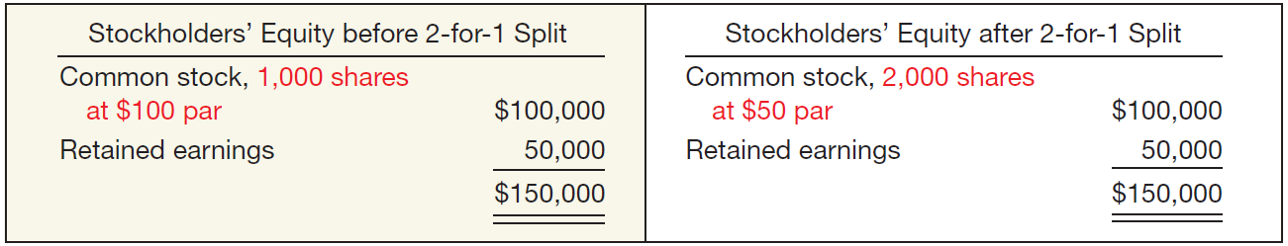
DIVIDEND POLICY
  Stock Splits
  To reduce the market value of shares.
  No entry recorded for a stock split.
  Decrease par value and increase number of shares.
ILLUSTRATION 15-14
Effects of a Stock Split
LO 3

Slide 59
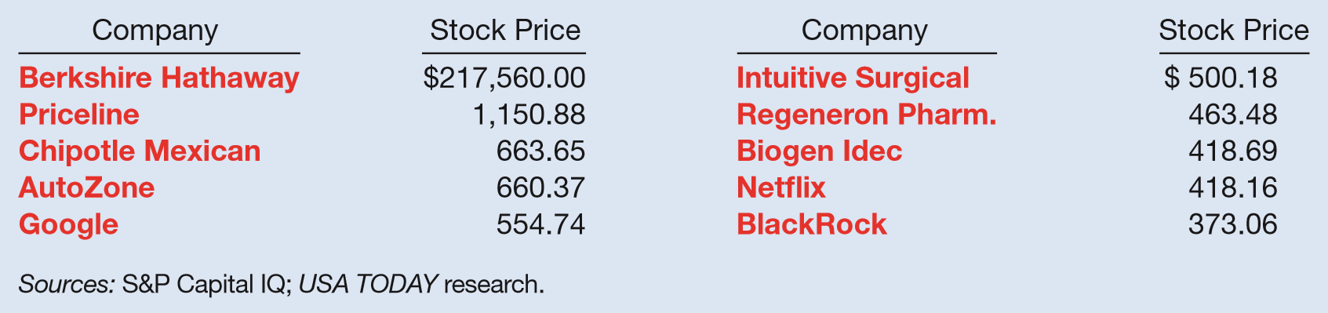
WHAT DO THE NUMBERS MEAN? SPLITSVILLE
WHAT’S YOUR PRINCIPLE
Is it time for a stock split? Starbucks and Kroger recently announced 2-for-1 splits, and Netflix announced a 7-for-1 split. The nine splits announced in the first part of 2015 indicate that the year will surpass 2014’s stock split total of 11 and may even beat the highest level achieved in 2007— 28 splits. Guessing which companies might be next to split their shares is a hobby of investors. When companies’ per share prices get high, some look to lower their per share prices to make them more attractive to individual investors. It’s a bit of an old-fashioned development, but one that investors are still conditioned to monitor. There’s no question that stocks with the highest per share prices would be the logical place to consider for possible splits. The table below lists the S&P 500 stocks with the highest per share prices.
(continued)
LO 3

Slide 60
WHAT DO THE NUMBERS MEAN? SPLITSVILLE
WHAT’S YOUR PRINCIPLE
Some companies are considering reverse stock splits in which, say, ﬁve shares are consolidated into one. Thus, a stock previously trading at $5 per share would be part of an unsplit share trading at $25. Unsplitting might thus avoid some of the negative consequences of a low trading price. The downside to this strategy is that analysts might view reverse splits as additional bad news about the direction of the stock price. For example, Webvan, a failed Internet grocer, did a 1-for-25 reverse split just before it entered bankruptcy. And struggling Tenet Healthcare executed a 1-for-4 reverse split in combination with a debt restructuring, in order to get its stock price into a more favorable trading range.
Sources: M. Murphy, “Tenet CFO Says Reverse Split Could Help Land New Business,” Wall Street Journal (October 2, 2012); and M. Krantz, “Starbucks Splits Stock. Who’s Next?” USA TODAY (March 18, 2015).
LO 3

Slide 61
DIVIDEND POLICY
  Stock Split and Stock Dividend Differentiated
  Large Stock Dividend - 20–25 percent of the number of shares previously outstanding.
    Same effect on market price as a stock split.
    Par value transferred from retained earnings to capital stock.
LO 3

Slide 62
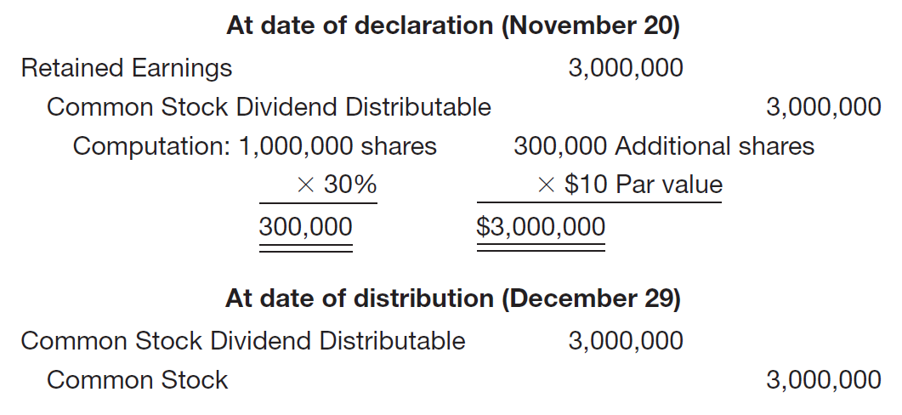
Dividend Policy
Illustration: Luna Steel, Inc. declared a 30 percent share dividend on November 20, payable December 29 to stockholders of record December 12. At the date of declaration, 1,000,000 shares, par value $10, are outstanding and with a fair value of $200 per share. The entries are:
ILLUSTRATION 15-15
Stock Dividend Entries
LO 3

Slide 63
WHAT DO THE NUMBERS MEAN? DIVIDENDS UP, DIVIDENDS DOWN
WHAT’S YOUR PRINCIPLE
As the economy recovered from the ﬁnancial crisis, a number of U.S. companies increased their dividend payout in a sign of growing conﬁdence and rising cash balances. In such a slow growth environment, with interest rates persistently low and the tax treatment of dividends still favorable, an investment strategy focusing on stocks with the potential of increasing dividends may be particularly timely. Said one market watcher, “Investors too often overlook the importance of dividends, particularly the contribution to total return from reinvested dividends. . . . Dividends also can provide a good hedge against inﬂation in the form of a growing stream of income.” A recent study indicates the importance of dividends. Companies that raised their dividends are classiﬁed as dividend growers and initiators, as opposed to other companies that are classiﬁed as dividend cutters and eliminators. The study also identiﬁed companies with no change in dividend policy.
(continued)
LO 3

Slide 64
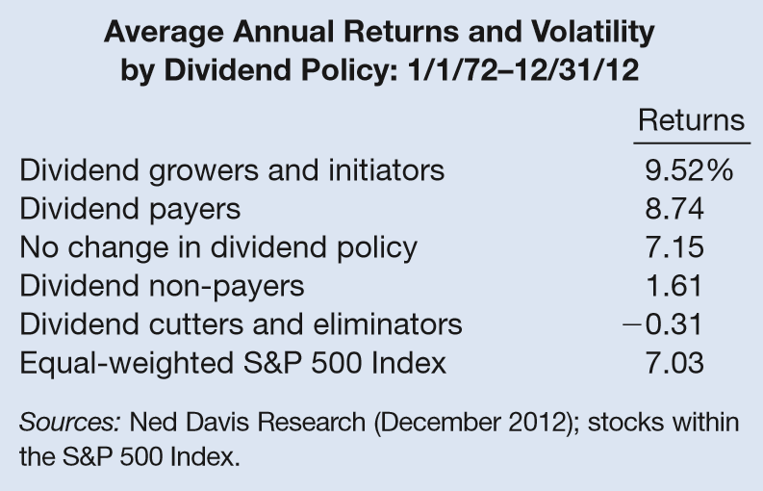
WHAT DO THE NUMBERS MEAN? DIVIDENDS UP, DIVIDENDS DOWN
WHAT’S YOUR PRINCIPLE
The table in the next column supports the advice to keep an eye on dividend growth. What the table tells us is that companies that grew or initiated a dividend have experienced the highest returns relative to other stocks since 1972. Over that time span, an investment of $100 would have grown to $4,169, while dividend non-payers only increased to $193. In addition, the higher performers offered lower volatility of returns in all market environments. Thus, companies that grow dividends are signaling
conﬁdence about future earnings
and are most likely to perform
well throughout market cycles—
this makes them good candidates
for long-term growth.
Sources: “Dividend Growth Stocks May Be Timely as the Economy Sputters,” T. Rowe Price Report (Fall 2011); and Hartford Funds, “The Power of Dividends: Past, Present, and Future,” Second Quarter 2014 White Paper (2014).
LO 3

Slide 65
LEARNING OBJECTIVES
15
Stockholders’ Equity
After studying this chapter, you should be able to:
Describe the corporate form and the issuance of shares of stock.
Describe the accounting and reporting for reacquisition of shares.
Understand the accounting and reporting issues related to dividends.
Indicate how to present and analyze stockholders’ equity.
LO 4

Slide 66
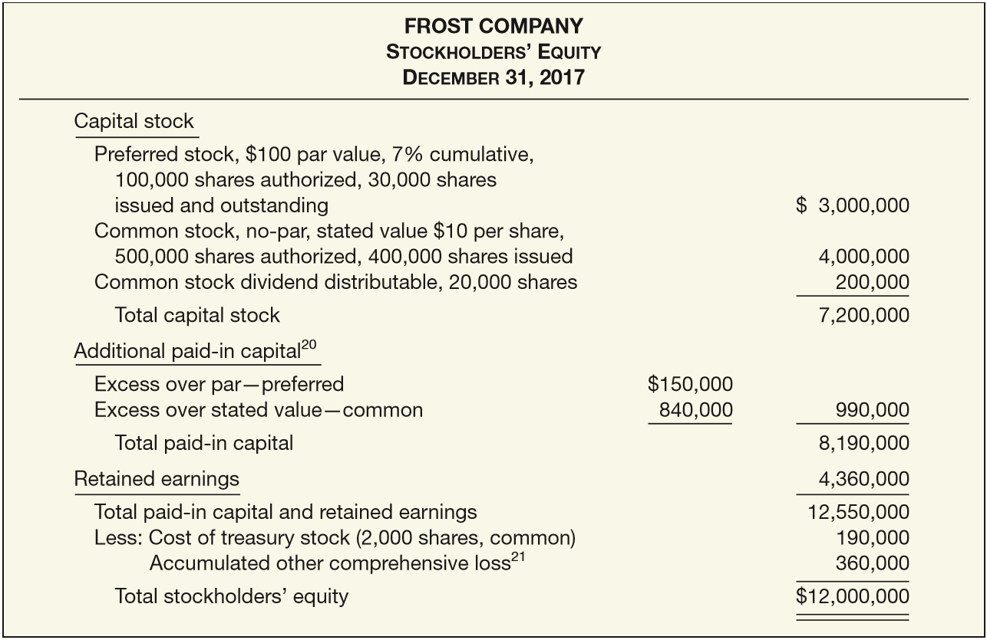
PRESENTATION OF EQUITY
ILLUSTRATION 15-17
Comprehensive Stockholders’ Equity Presentation
LO 4

Slide 67
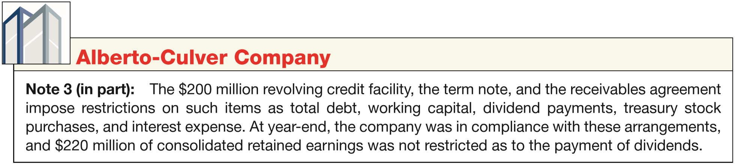
PRESENTATION OF EQUITY
Disclosure of Restrictions on Retained Earnings
  Restrictions are best disclosed by note.
  Restrictions may be based on the retention of a certain retained earnings balance, the ability to maintain certain working capital requirements, additional borrowing, and other considerations.
ILLUSTRATION 15-18
Disclosure of Restrictions on
Retained Earnings and Dividends
LO 4

Slide 68
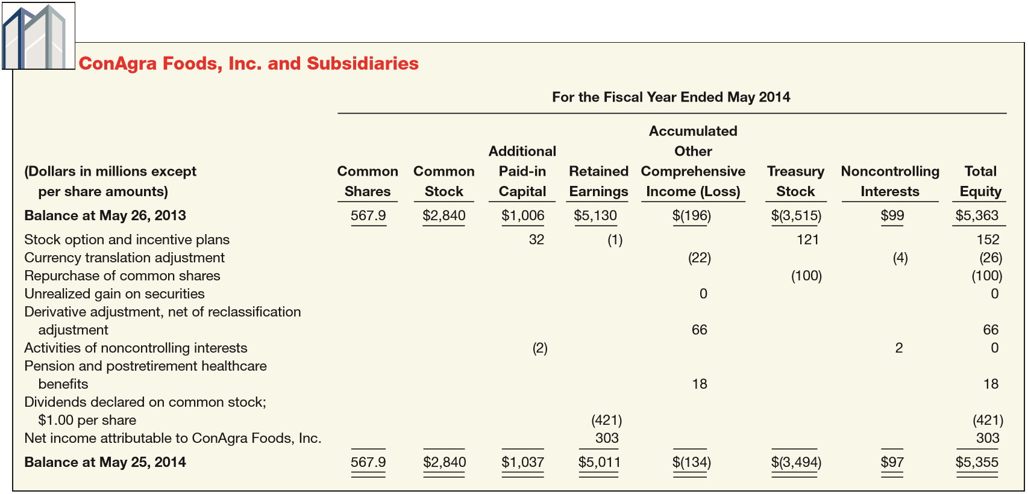
PRESENTATION OF EQUITY
Statement of Stockholders’ Equity
ILLUSTRATION 15-19
Columnar Format for Statement of Common Stockholders’ Equity
LO 4

Slide 69
ANALYSIS OF EQUITY
Analysts use stockholders’ equity ratios to evaluate a company’s profitability and long-term solvency.
Three ratios:
Rate of return on common stock equity.
Payout ratio.
Book value per share.
LO 4

Slide 70
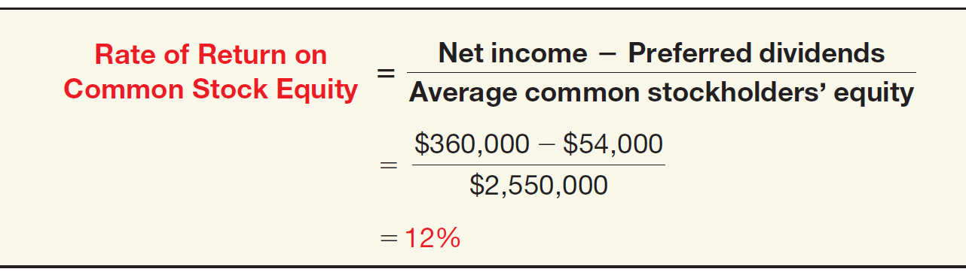
Analysis
Rate of Return on Common Stockholders’ Equity
Illustration: Marshall's Inc. had net income of $360,000, declared and paid preferred dividends of $54,000, and average common stockholders’ equity of $2,550,000.
ILLUSTRATION 15-20
Computation of Return on Common Stockholders’ Equity
Ratio shows how many dollars of net income the company earned for each dollar invested by the owners.
LO 4

Slide 71
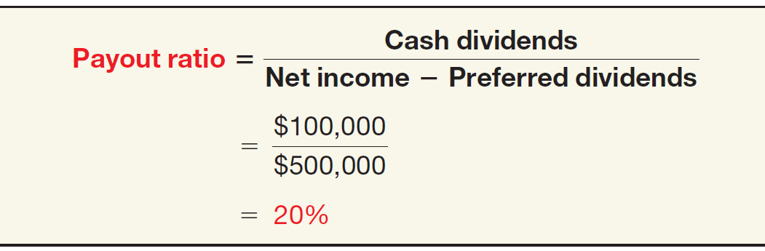
Analysis
Payout Ratio
Illustration: Midgley Co. has cash dividends of $100,000 and net income of $500,000, and no preferred stock outstanding.
ILLUSTRATION 15-21
Computation of Payout Ratio
In the fourth quarter of 2014, 36 percent of the earnings of the S&P 500 was distributed via dividends.
LO 4

Slide 72
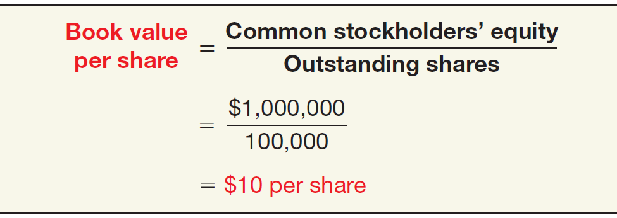
Analysis
Book Value per Share
Illustration: Uretz Corporation’s common stockholders’ equity is $1,000,000 and it has 100,000 shares of common stock outstanding
ILLUSTRATION 15-22
Computation of Book Value per Share
Amount each share would receive if the company were liquidated on the basis of amounts reported on the balance sheet.
LO 4

Slide 73
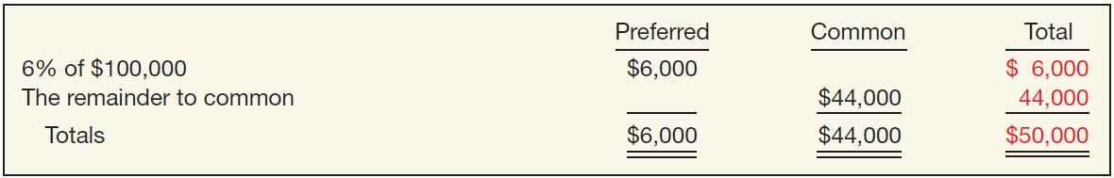
APPENDIX 15A
DIVIDEND PREFERENCES AND BOOK VALUE PER SHARE
Dividend Preferences
Illustration: In 2017, Mason Company is to distribute $50,000 as cash dividends, its outstanding common stock have a par value of $400,000, and its 6 percent preferred stock have a par value of $100,000.
1. If the preferred stock are noncumulative and nonparticipating:
ILLUSTRATION 15A-1
LO 5 Explain the different types of preferred stock dividends and their effect on book value per share.

Slide 74
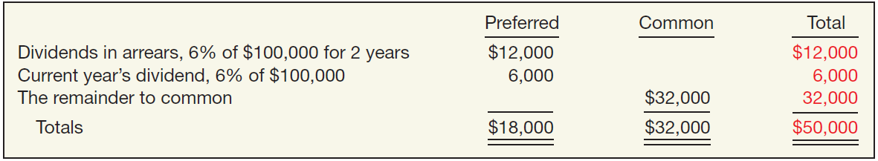
APPENDIX 15A
DIVIDEND PREFERENCES AND BOOK VALUE PER SHARE
Illustration: In 2017, Mason Company is to distribute $50,000 as cash dividends, its outstanding common stock has a par value of $400,000, and its 6 percent preferred stock has a par value of $100,000.
If the preferred stock is cumulative and non-participating, and Mason Company did not pay dividends on the preferred stock in the preceding two years:
ILLUSTRATION 15A-2
LO 5

Slide 75
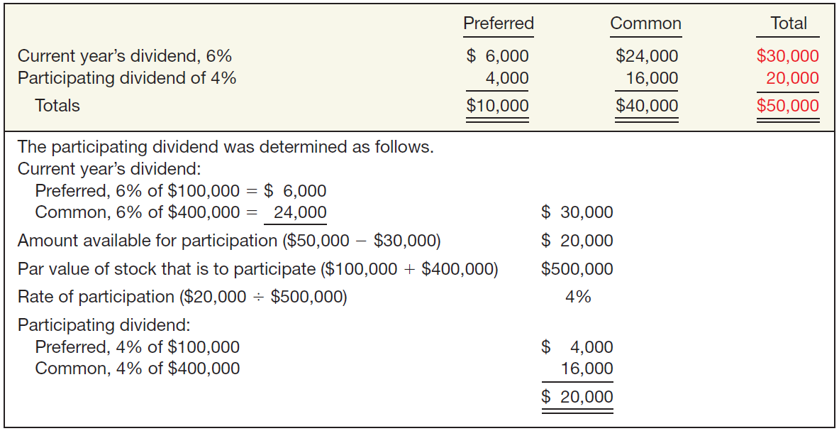
APPENDIX 15A
DIVIDEND PREFERENCES AND BOOK VALUE PER SHARE
If the preferred stock is noncumulative and is fully participating:
ILLUSTRATION 15A-3
LO 5

Slide 76
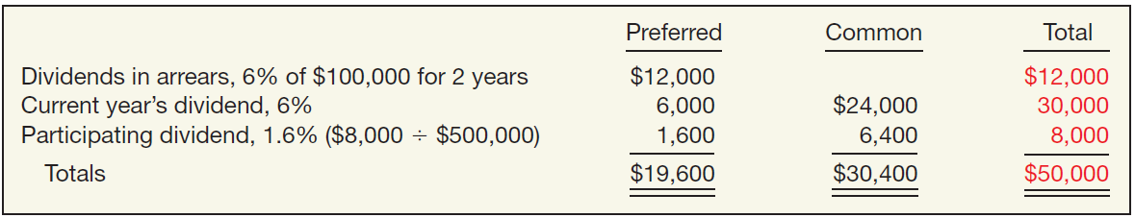
APPENDIX 15A
DIVIDEND PREFERENCES AND BOOK VALUE PER SHARE
Illustration: In 2017, Mason Company is to distribute $50,000 as cash dividends, its outstanding common stock has a par value of $400,000, and its 6 percent preferred stock has a par value of $100,000.
4. If the preferred stock is cumulative and fully participating, and Mason Company did not pay dividends on the preferred stock in the preceding two years:
ILLUSTRATION 15A-4
LO 5

Slide 77
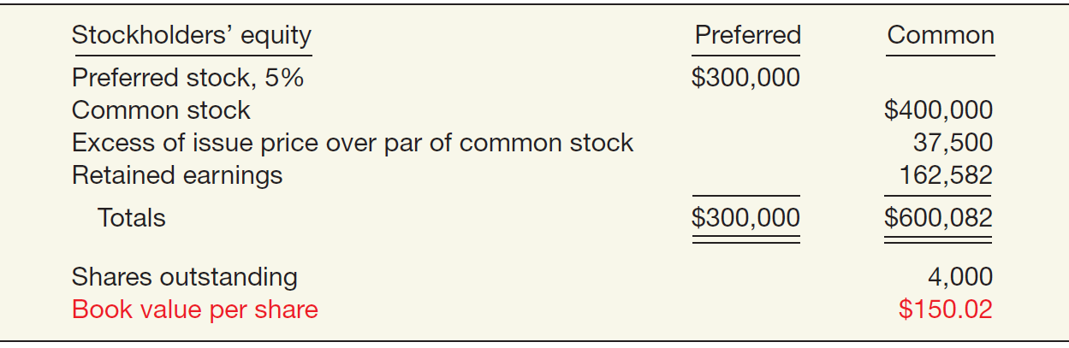
APPENDIX 15A
DIVIDEND PREFERENCES AND BOOK VALUE PER SHARE
Book Value Per Share
Book value per share is computed as net assets divided by outstanding stock at the end of the year. The computation becomes more complicated if a company has preferred stock.
ILLUSTRATION 15A-5
LO 5

Slide 78
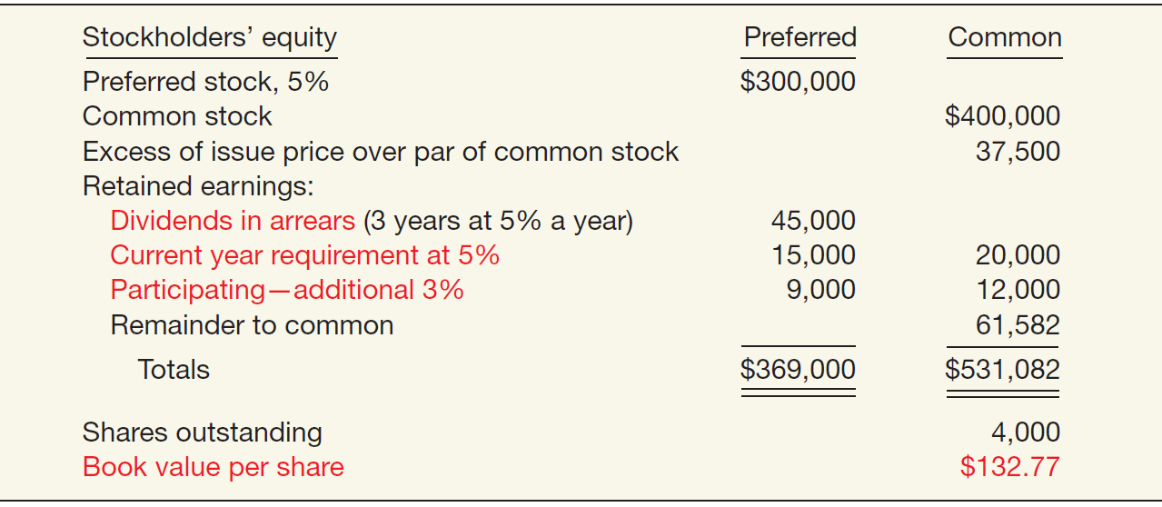
APPENDIX 15A
DIVIDEND PREFERENCES AND BOOK VALUE PER SHARE
Assume that the same facts exist except that the 5 percent preferred stock is cumulative, participating up to 8 percent, and that dividends for three years before the current year are in arrears.
ILLUSTRATION 15A-6
LO 5

Slide 79

RELEVANT FACTS - Similarities
  The accounting for the issuance of shares and purchase of treasury stock are similar under both IFRS and GAAP.
  The accounting for declaration and payment of dividends and the accounting for stock splits are similar under both IFRS and GAAP.
LO 6 Compare the procedures for accounting for stockholders’ equity under GAAP and IFRS.

Slide 80
RELEVANT FACTS - Differences
  Major differences relate to terminology used, introduction of concepts such as revaluation surplus, and presentation of stockholders’ equity information.
  Many countries have different investor groups than the United States. For example, in Germany, financial institutions like banks are not only the major creditors but often are the largest shareholders as well.
  The accounting for treasury share retirements differs between IFRS and GAAP. Under GAAP, a company has three options: (1) charge the excess of the cost of treasury shares over par value to retained earnings, (2) allocate the difference between paid-in capital and retained earnings, or (3) charge the entire amount to paid-in capital. Under IFRS, the excess may have to be charged to paid-in capital, depending on the original transaction related to the issuance of the shares.
LO 6

Slide 81
RELEVANT FACTS - Differences
  The statement of changes in equity is usually referred to as the statement of stockholders’ equity (or shareholders’ equity) under GAAP.
  Both IFRS and GAAP use the term retained earnings. However, IFRS relies on the term “reserve” as a dumping ground for other types of equity transactions, such as other comprehensive income items as well as various types of unusual transactions related to convertible debt and share option contracts. GAAP relies on the account Accumulated Other Comprehensive Income (Loss).
  Under IFRS, it is common to report “revaluation surplus” related to increases or decreases in items such as property, plant, and equipment; mineral resources; and intangible assets. The term surplus is generally not used in GAAP. In addition, unrealized gains on the above items are not reported in the financial statements under GAAP.
LO 6

Slide 82
ON THE HORIZON
The IASB and the FASB are currently working on a project related to financial statement presentation. An important part of this study is to determine whether certain line items, subtotals, and totals should be clearly defined and required to be displayed in the financial statements. For example, it is likely that the statement of changes in equity and its presentation will be examined closely. In addition, the options of how to present other comprehensive income under GAAP will change in any converged standard.
LO 6

Slide 83
IFRS SELF-TEST QUESTION
Under IFRS, the amount of capital received in excess of par value would be credited to:
  Retained Earnings.
  Contributed Capital.
  Share Premium.
  Par value is not used under IFRS.
LO 6

Slide 84
IFRS SELF-TEST QUESTION
The term reserves is used under IFRS with reference to all of the following except:
  gains and losses on revaluation of property, plant, and equipment.
  capital received in excess of the par value of issued shares.
  retained earnings.
  fair value differences.
LO 6

Slide 85
IFRS SELF-TEST QUESTION
Under IFRS, a purchase by a company of its own shares results in:
  an increase in treasury shares.
  a decrease in assets.
  a decrease in equity.
  All of the above.
LO 6

Slide 86
COPYRIGHT
“Copyright © 2016 John Wiley & Sons, Inc. All rights reserved. Reproduction or translation of this work beyond that permitted in Section 117 of the 1976 United States Copyright Act without the express written permission of the copyright owner is unlawful. Request for further information should be addressed to the Permissions Department, John Wiley & Sons, Inc. The purchaser may make back-up copies for his/her own use only and not for distribution or resale. The Publisher assumes no responsibility for errors, omissions, or damages, caused by the use of these programs or from the use of the information contained herein.”

