Slide 1
Thermal Fluid Engineering ENMC4411 Chapter 3 Fluid Control volume equations
Afif Akel Hasan
Mechanical & Mechatronics Engineering Department
Birzeit University

Slide 2
Outline
System basic equations
Shear stress & viscosity
Volume flow rate
Mass conservation ( continuity)
Linear momentum equation
Energy conservation

Slide 3
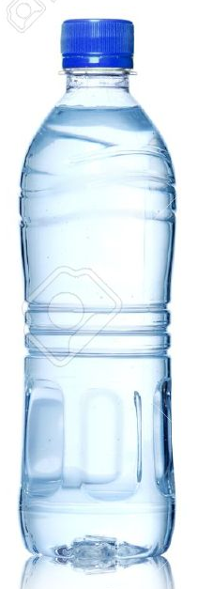
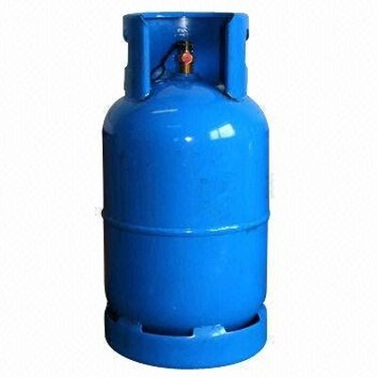
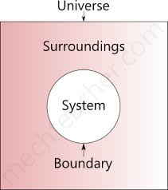

System
A system is defined as an arbitrary quantity of mass of fixed identity ( definite mass of material )
System may change position and thermal condition , but must always entail the same matter .
System is distinguished from other matter which called surroundings ,by its boundaries ,the boundary of system form a closed surface .
m_{system} = constant or (dm /at ) = 0

Slide 4
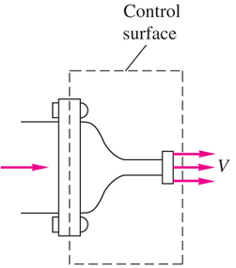

Control Volume
Control volume : a definite volume is designated in a space.
Boundary of this volume is known as control surface.
A mount and identity of matter in the control volume may change with time but the shape of the C.V is fixed.
Energy and mass may flow across the control volume
e.g : flow through section of a nozzle

Slide 5
Basic equation for a system
Mass conservation (dm /dt ) = 0
Newton’s 2ad law : linear –momentum equation
F = ma = m ( dV/dt ) = d ( mV ) /dt =dP/dt
ie. Net force on system accelerates the system
A vector law : F_{x} = ma_{x} , F_{y} = ma_{y} , F_{z} = ma_{z}
Angular momentum : if surrounding exerts a net moment a bout the center of mass M results in rotation effect .
M = (dH/dt ) when H = (rxV ) dm
H is a vector quantity M_{x} = (dH_{x}/dt )
For rigid body about x –axis M_{x} = I_{x} [d(ω_{x})/dt ];
ω angular velocity a bout x- axis
I_{x} = mass moment of inertia about x-axis

Slide 6
Basic equation for a system
Energy conservation ( 1st law of thermodynamics )
dQ-dW = dE Q : heat transfer
E : total energy of system
E = U + mV² /2 + mgz
W : work
Equation of state
Relates properties at given state P= F (V,T )
e.g Ideal gas P = mRT/V, ρ = P/ (TR)

Slide 7
Outline
System basic equations
Shear stress & viscosity
Volume flow rate
Mass conservation ( continuity)
Linear momentum equation
Energy conservation

Slide 8
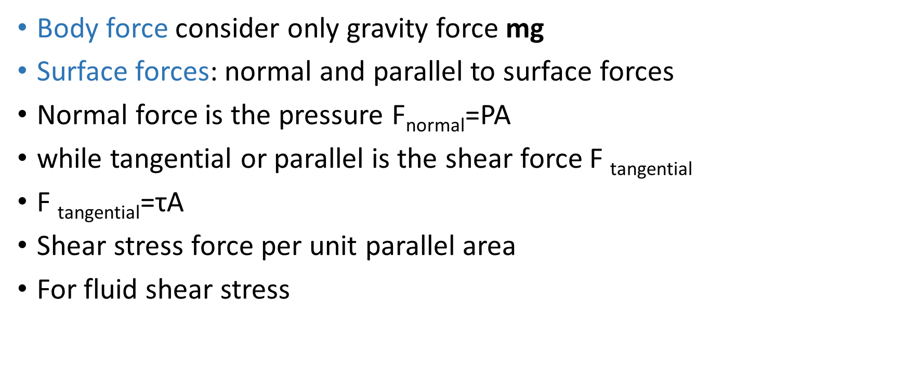
Fluid forces
Body force consider only gravity force mg
Surface forces: normal and parallel to surface forces
Normal force is the pressure F_{normal}=PA
while tangential or parallel is the shear force F _{tangential}
$\text{F} \text{tangential}$=τA
Shear stress force per unit parallel area
For fluid shear stress

Slide 9
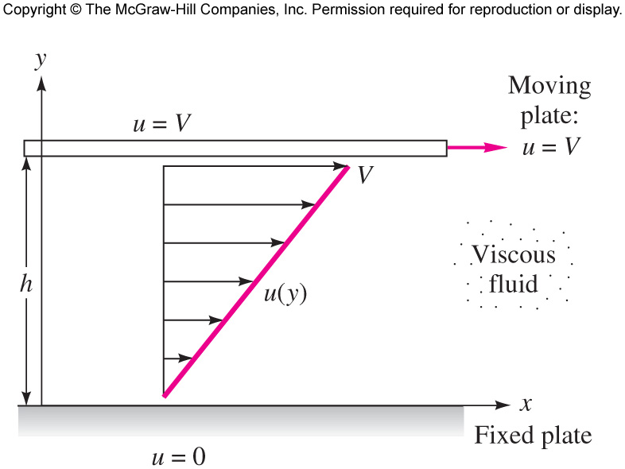
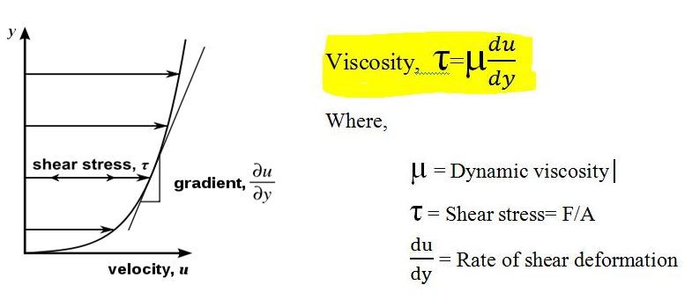

Viscosity
linear profile (V /h) = (∆u /∆y ) = (du /dy )

Slide 10
Unit of viscosity
μ = τ / (du /dy )
μ = (F/A)/(V /L ) = ( F/L²) / {(L/T)/L} but F = m a = ML/T²
[μ ] = { ML / T²L² }/(L/T)/L = (M / T L)
or [μ ] = FT / L²
[μ ] = M / TL
SI units [μ ] =kg/m.s or N.s/m²
US or BG [μ ] =slugs/ft.s
Other units poise = dynes \cm² 1N = 10⁵ dyne
1 N.s/m² = kg/m.s = 10 poise
centipoise = 10⁻² poise
see table 1.4 p.26 for typical values of μ more data in appendix A p.771
Kinematic viscosity ν = μ /ρ ➔ [υ] = L² /t ( fig .A.2 p.770) .
SI m²/s BG ft² /s

Slide 11
EXAMPLE 1.8
Suppose that the fluid being sheared in Fig. 1.6 is SAE 30 oil at 20°C. Compute the shear stress in the oil if V = 3 m/s and h = 2 cm.

Slide 12
Outline
System basic equations
Shear stress & viscosity
Volume flow rate
Mass conservation ( continuity)
Linear momentum equation
Energy conservation

Slide 13
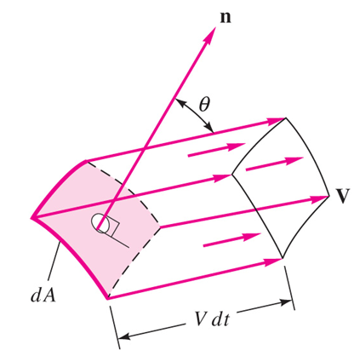
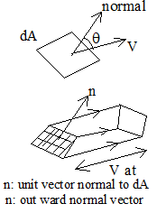
Volume & mass flow
Consider the fluid passing through surface S. what is the volume flow rate Q and the mass flow rate m through this surface ?
Let fluid at V pass through dA at angle θ off the normal , then amount of fluid swept during dt
dѴ = v dt dA cos θ
d Ѵ = v cos θ dt dA
d Ѵ = (v.n) dt dA
(d Ѵ /dt ) = (v.n) dA
V_{n} = velocity component normal to dA
Mass flow rate = ρQ

Slide 14

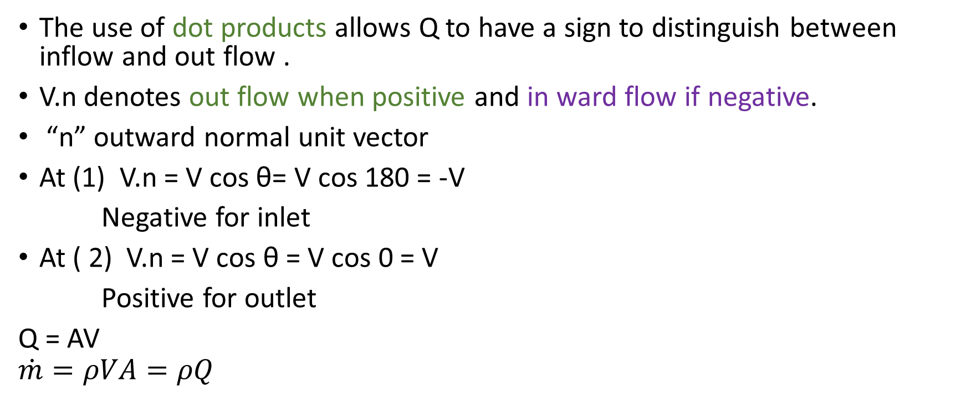
Volume & mass flow
The use of dot products allows Q to have a sign to distinguish between inflow and out flow .
V.n denotes out flow when positive and in ward flow if negative.
“n” outward normal unit vector
At (1) V.n = V cos θ= V cos 180 = -V
Negative for inlet
At ( 2) V.n = V cos θ = V cos 0 = V
Positive for outlet
Q = AV
$$\dot{m}=ρVA=ρQ$$

Slide 15

Example 3.1 P.139
$\dot{m}=ρVA=ρQ$
Q=VA
ρ= 800Kg/m³
V = 5 m/s
A = 0.1 m²
m. = ρ VA = 800*5*0.1= 400.0Kg/s

Slide 16
Outline
System basic equations
Shear stress & viscosity
Volume flow rate
Mass conservation ( continuity)
Linear momentum equation
Energy conservation

Slide 17
Mass conservation
Flow in – flow out = change of mass within CV
For steady flow no change of properties with time

Slide 18
EXAMPLE 3.6
The tank in Fig. E3.6 is being filled with water by two one-dimensional inlets. Air is trapped at the top of the tank. The water height is h. (a) Find an expression for the change in water height dh/dt. (b) Compute dh/dt if D1 = 1 in, D2 = 3 in, V1 = 3 ft/s, V2 = 2 ft/s, and At = 2 ft2, assuming water at 20°C.
The flow within is unsteady, and Eq. (3.22) applies with no outlets and two inlets:
Now if A_{t} is the tank cross-sectional area, the unsteady term can be evaluated as follows

Slide 19
EXAMPLE 3.6
The ρ_{a} term vanishes because it is the rate of change of air mass and is zero because the air is trapped at the top

Slide 20
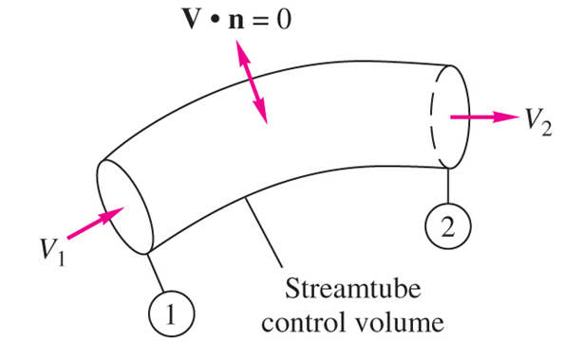
EXAMPLE 3.3
Write the conservation-of-mass relation for steady flow through a streamtube (flow everywhere parallel to the walls) with a single one-dimensional exit 1 and inlet 2 (Fig. E3.3).
For steady flow Eq. (3.24) applies with the single inlet and exit
in a streamtube in steady flow, the mass flow is constant across every section of the tube. If the density is constant,

Slide 21
Outline
System basic equations
Shear stress & viscosity
Volume flow rate
Mass conservation ( continuity)
Linear momentum equation
Energy conservation

Slide 22
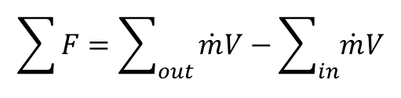
The Linear Momentum Equation
Newton’s second law of motion for a solid particle
For a control volume
At steady flow no change in linear momentum in CV
∑F = d ( mV ) /dt =dP/dt
$$\sum{F=\sum_{out}{\dot{m}V−\sum_{in}{\dot{m}V}}}$$

Slide 23
Forces on CV
force of two types
Body force on gravity ( weight )
Surface force including
a) surface tension ( neglect)
b) shear stress forces τ _{w} .
c) pressure force normal to the control volume .
Pressure force : normal inward to surface , let n normal outward unit area vector .
Pressure of control volume P as absolute pressure, outside pressure as Pa
the pressure force taken in consideration outside pressure ( P – Pa) then

Slide 24
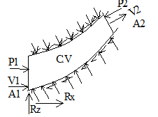

Forces on CV
Resultant of all shear forces τ_{w} and pressure forces on the wall are replaced with R_{x} and R_{y} .
For steady flow
$\sum{F=\sum_{out}{\dot{m}V−\sum_{in}{\dot{m}V}}}$

Slide 25
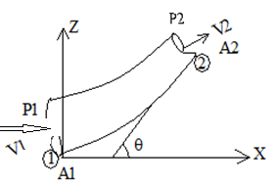
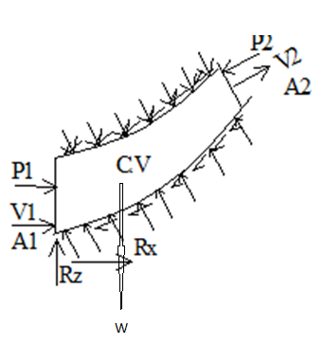

Example elbow
Evaluate forces coming on to the reducing elbow shown for steady flow .
∑F_{x} = V_{x1} ( -V₁ A₁ )ρ + V_{x2} ( V₂ A₂ )ρ
V_{x1} =V₁ , V_{x2} = V₂ cos θ
∑F_{x} = V₁ (- V₁ A₁ )ρ + V₂ cos θ ( V₂ A₂ )ρ $\sum{Fx=\sum_{out}{\dot{m}Vx−\sum_{in}{\dot{m}Vx}}}$
∑F_{x} = - $m$ V₁ + $m$V₂ cos θ
P₁ A₁ – p₂ A₂ cos θ +R_{x} = ρQ(V₂ cos θ − V₁ )
→ R_{x} = ρQ(V₂ cos θ − V₁ ) - P₁ A₁ – P₂ A₂ cos θ

Slide 26
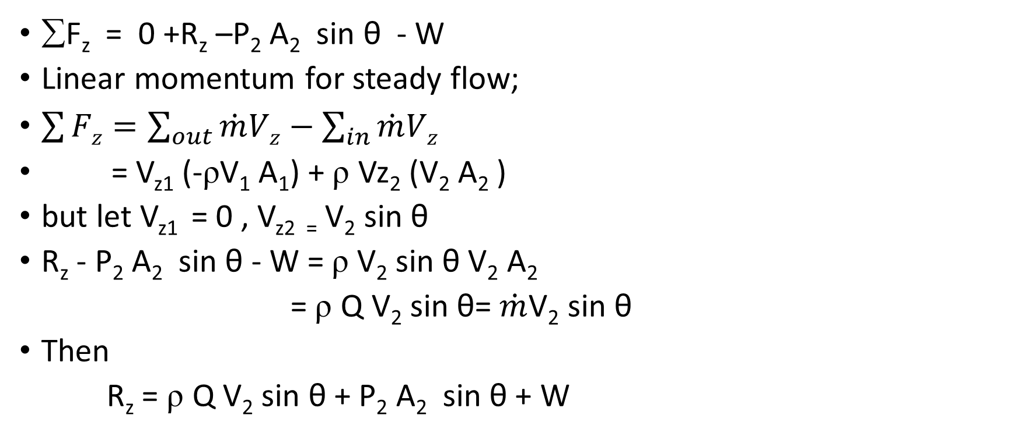
Example elbow
∑F_{z} = 0 +R_{z} –P₂ A₂ sin θ - W
Linear momentum for steady flow;
$\sum{Fz=\sum_{out}{\dot{m}Vz−\sum_{in}{\dot{m}Vz}}}$
= V_{z1} (-ρV₁ A₁) + ρ Vz₂ (V₂ A₂ )
but let V_{z1} = 0 , V_{z2 =} V₂ sin θ
R_{z} - P₂ A₂ sin θ - W = ρ V₂ sin θ V₂ A₂
= ρ Q V₂ sin θ= $\dot{m}$V₂ sin θ
Then
R_{z} = ρ Q V₂ sin θ + P₂ A₂ sin θ + W

Slide 27
Example 12.2 Force Generated by Flow in a Pipe Bend
Water flows through a horizontal, 180 pipe bend as illustrated in Fig. E12.2a. The flow cross-sectional area is constant at a value of 0.1 ft2 through the bend. The flow velocity at the entrance and exit of the bend is axial and 50 ft/s. The gage pressures at the entrance and exit of the bend are 30 psi and 24 psi, respectively. Calculate the horizontal (x and y) components of the anchoring force required to hold the bend in place.

Slide 28
EXAMPLE 3.9
As shown in Fig. 3.9a, a fixed vane turns a water jet of area A through an angle without changing its velocity magnitude. The flow is steady, pressure is P_{a} everywhere, and friction on the vane is negligible.
(a) Find the components F_{x} and F_{y} of the applied vane force.
(b) Find expressions for the force magnitude F and the angle between F and the horizontal; plot them versus θ.

Slide 29
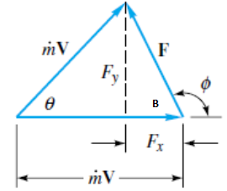
EXAMPLE 3.9
The pressure force is zero in the uniform atmosphere.
But the magnitudes V1=V2= V, and conservation of mass for the streamtube requires m˙ ₁ = m˙₂ = m˙ = ρAV.
Maximum force occurs at θ= 180°, that is, when the jet is turned around and thrown back in the opposite direction with its momentum completely reversed.
This force is 2m˙V and acts to the left; that is, φ=180°.

Slide 30
Outline
System basic equations
Shear stress & viscosity
Volume flow rate
Mass conservation ( continuity)
Linear momentum equation
Energy conservation

Slide 31

Mechanical Energy Equation
For steady flow
where hL, the head loss, accounts for the irreversible conversion of mechanical energy into internal energy due to friction.
The term which represents power due to devices that
transfer mechanical energy across the control volume boundary
hp is the pump head and ht is the turbine head
$$\dot{W}pump=\dot{m}ghp=ρgQhp=γQhp$$

Slide 32
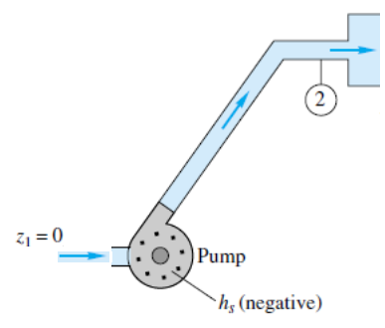
EXAMPLE 3.17
Gasoline at 20°C is pumped through a smooth 12-cm-diameter pipe 10 km long, at a flow rate of 75 m³/h (330 gal/min). The inlet is fed by a pump at an absolute pressure of 24 atm. The exit is at standard atmospheric pressure and is 150 m higher. Estimate the frictional head loss hf, and compare it to the velocity head of the flow V2/(2g).
For gasoline at 20°C, ρ=680 kg/m3, or ϒ =(680)(9.81)= 6670 N/m³. There is no shaft work.

Slide 33
Example 12.6 Hydroelectric Turbine
Assumptions:
1. The flow is steady and incompressible and g= 9.81 m/s2.
2. At (1) the velocity is essentially zero because the surface area is large; also the pressure is atmospheric.
3. At (2) the water exits at a specified velocity and as a free jet at atmospheric pressure
4. Neglect friction losses.

Slide 34
Hydroelectric Turbine
If hL =0 then ht = 98.2m

Slide 35
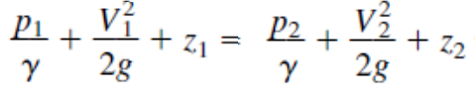
Frictionless Flow: The Bernoulli Equation
Bernoulli equation for steady frictionless incompressible flow along a
streamline
p, is the actual thermodynamic pressure of the fluid as it flows. To measure
its value, one could move along with the fluid, thus being “static” relative to the moving fluid.
Hence, p is normally termed the static pressure.
second termed the dynamic pressure
Third term is the hydrostatic pressure

Slide 36
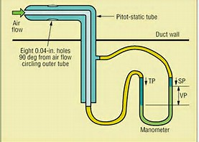
Pressure terms
Static Pressure
It is static relative to the moving fluid and can be measured through a flat opening in parallel to the flow.
Dynamic Pressure
The term 1/2 ρ v² is called the dynamic pressure.
Hydrostatic Pressure
The term γ h is called the hydrostatic pressure. It represent the pressure due to change in elevation.
Stagnation Pressure
the stagnation point where the velocity in the flow is zero

Slide 37
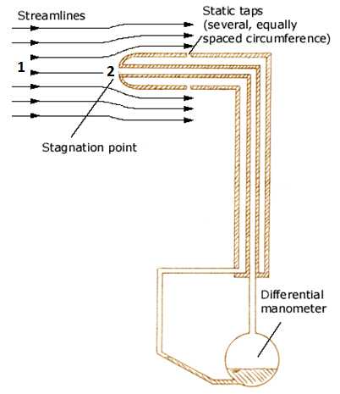





Pitot –tube theory
If z₁ = z₂ and point 2 is a stagnation point, i.e., v₂ = 0, the above equation reduces to

Slide 38
Bernoulli Equation
If we compare the Bernoulli equation with the energy equation we see that the Bernoulli equation contains many restrictions.
The complete list of assumptions for B. eq is as follows;
1. Steady flow—a common assumption applicable to many flows.
2. Incompressible flow—acceptable if the flow Mach number is less than 0.3.
3. Frictionless flow—very restrictive, solid walls introduce friction effects.
4. Flow along a single streamline—different streamlines may have different
“Bernoulli constants” w0= p/ρ+ V²/2 +gz, depending upon flow conditions.
5. No shaft work between 1 and 2—no pumps or turbines on the streamline.
6. No heat transfer between 1 and 2—either added or removed.

Slide 39
Hydraulic and Energy Grade Lines
The hydraulic grade line (HGL) shows the height corresponding to elevation and pressure head z + p/ϒ=HGL,
The energy grade line (EGL) shows the height of the total Bernoulli constant h0 =z+ p/ϒ+ V²/(2g)=EGL.
EGL = HGL + V²/(2g)

Slide 40
EXAMPLE 3.21
Find a relation between nozzle discharge velocity V2and tank free-surface height h as in Fig. E3.21. Assume steady frictionless flow
But since sections 1 and 2 are both exposed to atmospheric pressure p1= p2 = pa, the pressure terms cancel,

Slide 41
Siphon
Once it has been started by sufficient suction, the siphon will run continuously as long as reservoir fluid is available. Using Bernoulli’s equation with no losses, show:
(a) that the exit velocity V2 depends only upon gravity and the distance H and (b) that the lowest (vacuum) pressure occurs at point 3 and depends on the distance L , H.

Slide 42
EXAMPLE 3.24
A 10-cm fire hose with a 3-cm nozzle discharges 1.5 m³/min to the atmosphere. Assuming frictionless flow, find the force F_{B} exerted by the flange bolts to hold the nozzle on the hose.
B. Eq
given p2= pa= 0 gage pressure

Slide 43
EXAMPLE 3.24
control-volume force balance
The steady-flow momentum relation

