Slide 1
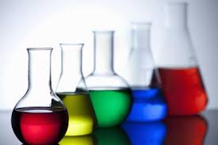
Chapter SEVEN: Calculation of doses - General Consideration

Slide 2
Objectives
Upon successful completion of this chapter, the student will be able to:
Differentiate between the various kinds of doses.
Describe the primary routes of drug/dose, administration and, for each, the dosage forms utilized.
Perform calculations of doses involving household measures.
Perform calculations pertaining to the quantity of a dose, the dosage regimen, and the supply of medication required for the prescribed period.

Slide 3
Dose Definations
The dose of a drug is the quantitative amount administered or taken by a patient for the intended medicinal effect.
The dose may be expressed as:
Single dose
Daily dose
Total dose
The schedule of dosing (e.g., four times per day for 10 days) is referred to as the dosage regimen.

Slide 4
The dose of a drug is based on its:
Biochemical and pharmacologic activity
Physical and chemical properties
The dosage form used
The route of administration
Various patient factors.
The dose of a drug for a particular patient may be determined in part on the basis of the patient’s:
Age
Weight
Body surface area
General physical health
Liver and kidney function (for drug metabolism and elimination)
The severity of the illness being treated

Slide 5
The usual adult dose of a drug is the amount that ordinarily produces the medicinal effect intended in the adult patient.
The usual pediatric dose is similarly defined for the infant or child patient.
The usual dosage range for a drug indicates the quantitative range or amounts of the drug that may be prescribed within the guidelines of usual medical practice

Slide 6
The dose response of individuals varies and may require dosage adjustment in a given patient.
Many anticancer drugs are administered cyclically, usually for 21 to 28 days, with a rest period between dosing cycles to allow recovery from the toxic effects of the drugs.

Slide 7
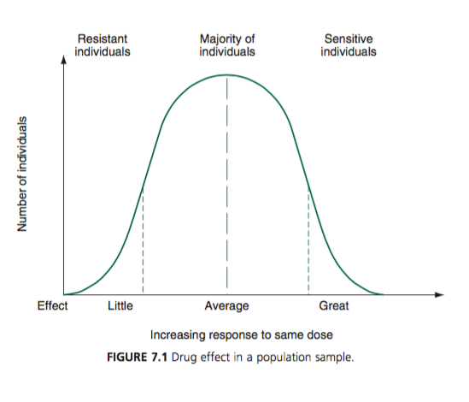

Slide 8
The median effective dose of a drug is the amount that produces the desired intensity of effect in 50% of the individuals tested.
The median toxic dose of a drug is the amount that produces toxic effects in 50% of the individuals tested.

Slide 9
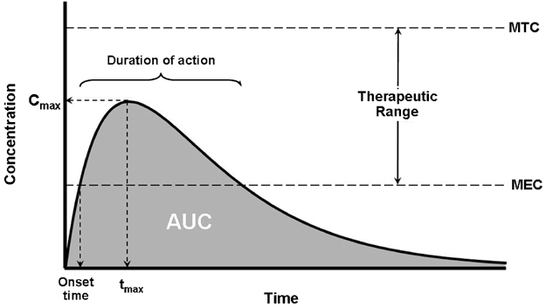

Slide 10
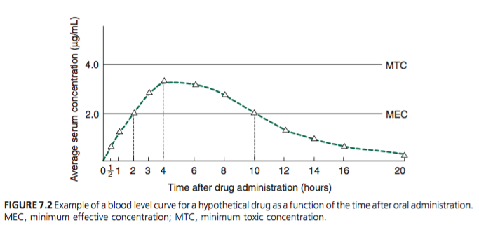

Slide 11
Some Terms …
Low-dose therapy
High-dose therapy
Monotherapy
Adjunctive therapy
Prophylactic doses
Therapeutic doses
Compounding
Combination products.

Slide 12
Routes of Drug/Dose administration and dosage forms
Doses of drugs are administered by a variety of dosage forms and routes of administration
In addition to the drug itself, dosage forms contain pharmaceutical ingredients, which provide:
The physical features
Stability requirements
Aesthetic characteristics desired for optimal therapeutic effects.
Included in the array of pharmaceutical ingredients are:
solvents
vehicles
preservatives
stabilizers
solubilizers
binders
fillers
disintegrants
flavorants
colorants
others

Slide 13
Note …
With added pharmaceutical ingredients, the quantity of an active ingredient in a dosage form represents only a portion (often a small portion) of the total weight or volume of a product.
For example, a tablet with 10 mg of drug actually could weigh many times that amount because of the added pharmaceutical ingredients.

Slide 14
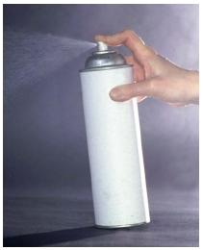
Aerosols
Pharmaceutical aerosols are products packaged under pressure that contain therapeutically active ingredients that are released on actuation of the valve assembly as:
A fine mist
Spray
Foam

Slide 15
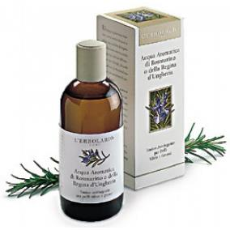
Aromatic Waters
Aromatic waters are clear, saturated solutions of volatile oils or other aromatic substances in water.
They are used orally, topically, or pharmaceutically for the characteristics of the aromatic material they contain.

Slide 16
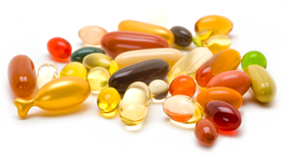
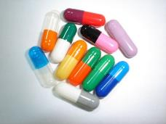
Capsules
Capsules are solid dosage forms in which one or more medicinal and/or inert substances are enclosed within small shells of gelatin.
Hard shell capsules
Soft-shell gelatin capsules

Slide 17
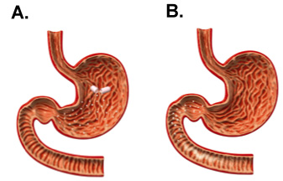
Delayed-release capsules are prepared in such a manner as to resist the release of the contents until the capsules have passed through the stomach and into the intestines.
Extended-release capsules are prepared in such a manner as to release the medication from the capsules over an extended period following ingestion.

Slide 18
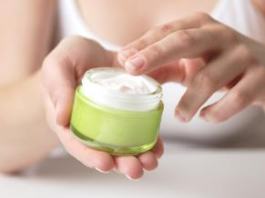
Creams
Creams are semisolid preparations containing one or more drug substances dissolved or dispersed in a suitable base.
Creams are divided into two types:
oil-in-water (O/W) creams
water-in-oil (W/O) creams
Compared to ointments, creams are easier to spread and remove.
Creams are used for administering drugs to the skin, although some are prepared for vaginal use.

Slide 19
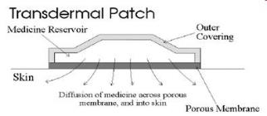
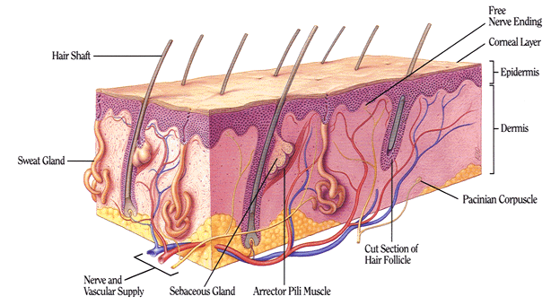
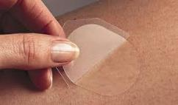
Drug Delivery Systems
Drug delivery systems are: physical carriers used to deliver medications to site-specific areas.
Transdermal drug delivery systems: support the passage of drug substances from the surface of the skin, through its various layers, and into the systemic circulation.
These systems are sophisticated skin patches containing a drug formulation within a reservoir for the controlled delivery of drug.

Slide 20
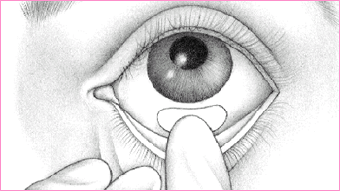
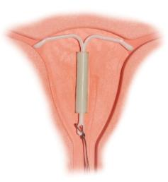
Ocular drug delivery systems: consist of drug-impregnated membranes that, when placed in the lower conjunctival sac, release medication at a constant rate over an extended period.
Intrauterine drug delivery systems: consist of a drug-containing intrauterine device that releases medication over an extended period after insertion into the uterus.

Slide 21
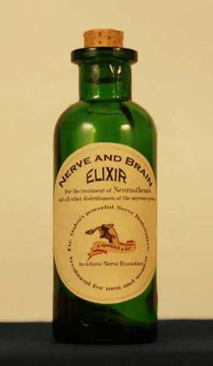
Elixirs
Elixirs are sweetened, flavored, hydroalcoholic solutions intended for oral administration.
They may be medicated or non-medicated.
Compared to syrups, elixirs are usually less sweet and less viscous because they contain a lesser amount of sugar.

Slide 22
Emulsion
An emulsion is a type of disperse system in which one liquid is dispersed throughout another liquid in the form of fine droplets.
The disperse phase is referred to as the internal phase
The dispersing phase is termed the external phase
A third agent, an emulsifier or emulsifying agent (EA), is added to facilitate the emulsification process and to provide stability to the system.

Slide 23
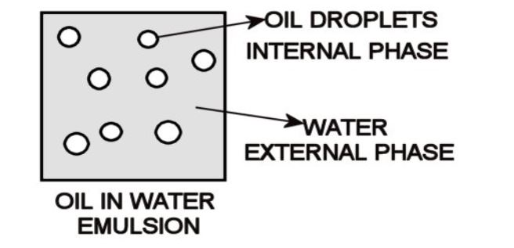

Slide 24
Emulsion
The type of emulsion produced is largely determined by the hydrophilicity or lipophilicity of the emulsifying agent (EA).
EA may have both hydrophilic and lipophilic characteristics:
EA that are more hydrophilic generally produce O/W emulsions
EA that are more lipophilic generally produce W/O emulsions.
The term hydrophile­lipophile balance (HLB number) quantifies this characteristics and is used in formulating and preparing emulsions of the desired type.
Materials that are highly polar or hydrophilic have been assigned higher numbers than materials that are less polar and more lipophilic.

Slide 25
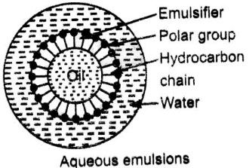

Slide 26
Emulsion
The taste and oleaginous feel of the oil is masked when administered in the form of an oil-in-water emulsion which a flavored aqueous external phase.
In addition to oral emulsion, some emulsions are prepared for topical administration (such as some lotions, foams and creams)
Intravenous Emulsions are prepared for the nutritional benefit of the oil (usually soybean oil).

Slide 27
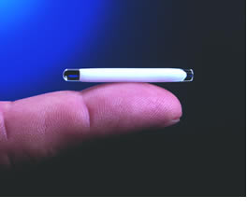
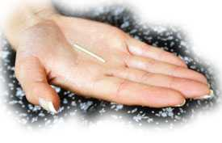
Implants and Pellets
implantable contraceptive
It is a contraceptive device that slides under the skin, and lasts up to three years.

Slide 28
Inhalations
Inhalations are finely powdered drug substances, solutions, or suspensions of drug substances administered by the nasal or oral respiratory route for local or systemic effects.
Special devices are used to facilitate administration
Metered-dose inhalers (MDIs)
Nebulizers
Dry powder Inhalers (DPI)

Slide 29
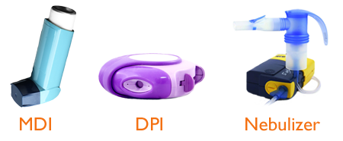
Different kinds of inhalers

Slide 30
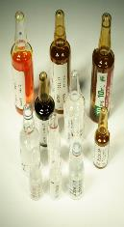
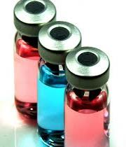
Injections
Injections are sterile preparations intended for parenteral administration by needle or pressure syringe.
Drugs may be injected into most any vessel or tissue of the body.
The most common routes are:
intravenous (IV)
intramuscular (IM)
subcutaneous (SC)
Injections may be solutions or suspensions of a drug substance in an aqueous or non-aqueous vehicle.
They may be small volume 'injections, packaged in ampoules for single-dose administration or Vials for multiple dose injections.

Slide 31

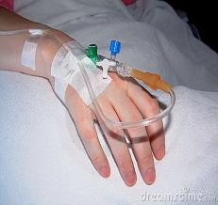
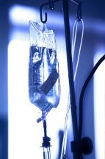
Large volume parenterals, (l00 mL to 1000 mL of fluid), are intended for the slow intravenous administration (or infusion) of medications and/or nutrients in the institutional or home-care setting.

Slide 32
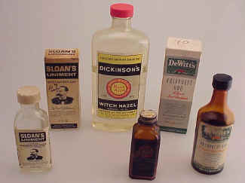
Liniments
Liniments are alcoholic or oleaginous solutions, suspensions, or emulsions of medicinal agents intended for external application to the skin, generally by rubbing.
Liniments are typically sold to relieve pain and stiffness, such as from sore muscles

Slide 33
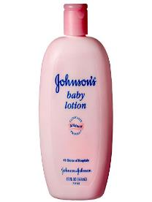
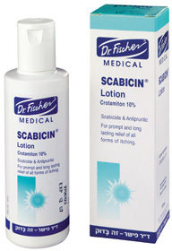
Lotions
Lotions are liquid preparations intended for external application to the skin.
Generally lotions are suspensions or emulsions of dispersed solid or liquid materials in an aqueous vehicle.
Their fluidity allows rapid and uniform application over a wide skin surface.
Lotions are intended to soften the skin and leave a thin coat of their components on the skin's surface as they dry.

Slide 34
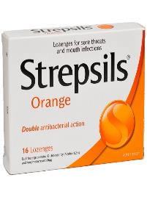
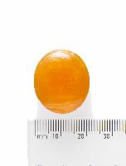
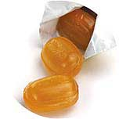
Lozenges
Similar terms: pastille, tablet, troche
Lozenges are solid preparations containing: one or more medicinal agents in a flovored, sweetened base.
Lozenges are intended to dissolve or disintegrate slowly in the mouth releasing medication generally for localized effects.
Lozenges are prepared by molding or compression.

Slide 35
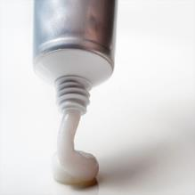
Ointments
Ointments are semisolid preparations intended for topical application.
Most ointments are applied to the skin, although-they may also be administered ophthalmically, nasally, or vaginally.

Slide 36
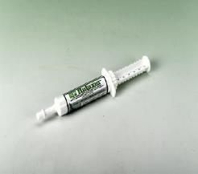
Pastes
Pastes are semisolid dosage forms that contain one or more drug substances intended for topical application.
Generally, pastes contain a higher proportion of solid materials than ointments thus :
They are more stiff
Less greasy
More absorptive of serous secretions when used on the skin.

Slide 37
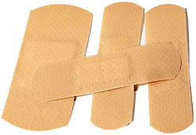
Plasters
Plasters are solid or semisolid adhesive masses spread across a suitable backing material.
Intended for external application to a part of the body for protection or for the medicinal benefit of added agents.

Slide 38
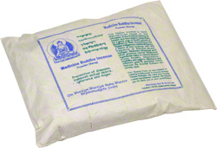
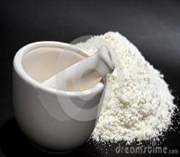
Powders
Powders are dry mixtures of finely divided medicinal and non-medicinal agents intended for internal or external use.
Powders may be dispensed to a patient and used in:
bulk form (such as powders measured by the spoonful to make a douche solution)
or they may be divided into single dosage units and packaged in folded papers or unit of use envelopes.

Slide 39
Solutions
Solutions are liquid preparations that contain one or more chemical substances (solute/s) dissolved in a solvent or mixture of solvents.
The solutes may be active or inactive ingredients
The solutes may be solids, liquids, or gases in their natural undissolved state.
The most common solvent used in pharmaceuticals is water.
However alcohol, glycerin, and propylene glycol are used as solvents or co-solvents depending on the product requirements for stability and use.

Slide 40
Suspensions
Suspensions are preparations containing finely divided, undissolved drug particles dispersed throughout a liquid vehicle.
Because the drug particles are not dissolved, suspensions assume a degree of opacity depending on the concentration and size of the suspended particles.
Suspensions are one type of disperse systems, common among pharmaceutical preparations.
The suspended particles are referred to as the disperse or dispersed phase.
The vehicle is termed the dispersion or dispersing phase.

Slide 41
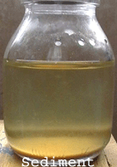
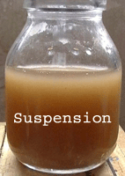

Slide 42
Suppositories
Suppositories are solid dosage forms intended for insertion into body orifices where they melt, soften, or dissolve and exert localized or systemic effects.
They are commonly used rectally and vaginally, and occasionally urethrally.
Suppositories are prepared in various weights, sizes, and shapes depending on their intended use.

Slide 43
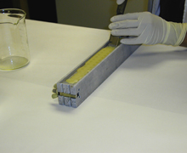
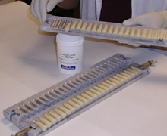
Ingredients are melted and placed in the suppository mold
Suppository mold is separated after it was cool down.
Suppositories are removed form the mold

Slide 44
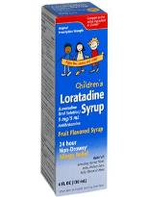
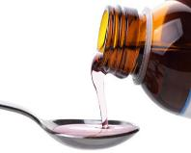
Syrups
Syrups are concentrated, aqueous solutions of a sugar or sugar substitute
Non-medicated syrups are sweet, pleasant-tasting vehicles for medicinal substances.
Among the non-medicated ingredients in syrups other than the sugar or sugar substitute are flavoring agents, colorants, co-solvents and antimicrobial preservatives to prevent microbial growth.
Syrups are administered orally for the therapeutic value of the medicinal agent(s).

Slide 45
Tablets
Tablets are solid dosage forms containing one or more medicinal substances with or without added pharmaceutical ingredients.
Among the pharmaceutical agents used are: diluents, disintegrants, colorants, binders, and coatings.
Tablets may be coated for
Appearance
Stability
Mask the bitter taste
Provide controlled release.
Most tablets are manufactured on the industrial scale by compression, using highly sophisticated machinery.

Slide 46
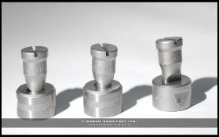
Punches and dies of various shapes and sizes enable the preparation of a wide variety of tablets of distinctive shapes, sizes, and surface markings.
Tablets intended to be swallowed whole
Chewable tablets (produce a pleasant taste and feel with mastication)
Buccal tablets are intended to be dissolved in the mouth or in the buccal cavity
Sublingual tablets are intended to be dissolved in the mouth or under the tongue;
Effervescent tablets are intended to be dissolved in water before taking.

Slide 47
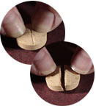
Tablets
Tablets are formulated to contain a specific quantity of drug substance.
To enable flexibility in dosing, manufacturers commonly make available various tablet or capsule strengths of a given medication.
As required, a tablet may also be broken in half (many tablets are "scored" or grooved for this purpose),
More than a single tablet may be taken as a prescribed dose
^{MEC}
^{MEC}

Slide 48
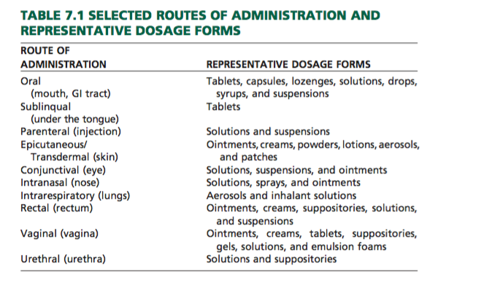

Slide 49
Dose Measurement
In the institutional setting, doses are measured and administered by professional and paraprofessional personnel.
A variety of measuring devices may be used, including:
calibrated cups for oral liquids
syringes and intravenous sets for parenteral medication.

Slide 50
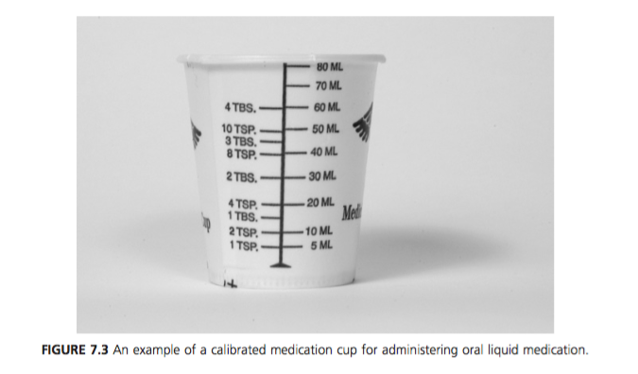

Slide 51
Liquid dosage is usually measured in ‘‘household’’ terms, most commonly by the teaspoonful and tablespoonful.

Slide 52
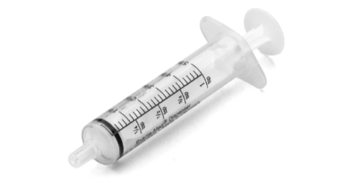
Teaspoon & Tablespoon
In calculating doses, pharmacists and physicians accept a capacity of:
5 mL for the teaspoonful
15 mL for the tablespoonful
It should be noted that the capacities of household:
Teaspoons may vary from 3 to 7 mL
Tablespoons may vary from 15 to 22 mL

Slide 53
According to the United States Pharmacopeia, ‘‘For household purposes, an American Standard Teaspoon has been established by the American National Standards Institute as containing 4.93 ±􏲍 0.24 mL

Slide 54
Any dropper, syringe, medicine cup, special spoon, or other device used to administer liquids should deliver 5 mL wherever a teaspoon calibration is indicated.

Slide 55
The drop as a unit of measure
Occasionally, the drop (abbreviated gtt) is used as a measure for small volumes of liquid medications.
A drop does not represent a definite quantity, because drops of different liquids vary greatly.
The United States Pharmacopeia defines the official medicine dropper as being constricted at the delivery end to a round opening with an external diameter of about 3 mm.

Slide 56
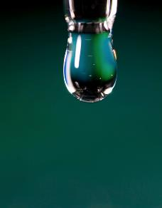
The dropper, when held vertically, delivers water in drops, each of which weighs between 45 and 55 mg.
Accordingly, the official dropper is calibrated to deliver approximately 20 drops of water per milliliter

Slide 57
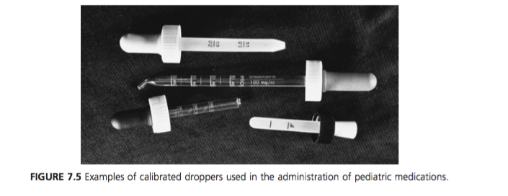
Guess !!
If a pharmacist counted 40 drops of a medication in filling a graduate cylinder to the 2.5-mL mark, how many drops per milliliter did the dropper deliver?

Slide 58
Case ‘1’
A physician asks a pharmacist to calculate the dose of a cough syrup so that it may be safely administered dropwise to a child. The cough syrup contains the active ingredient dextromethorphan HBr, 30 mg/15 mL, in a 120-mL bottle.
Based on the child’s weight and literature references, the pharmacist determines the dose of dextromethorphan HBr to be 1.5 mg for the child.
The medicine dropper to be dispensed with the medication is calibrated by the pharmacist and shown to deliver 20 drops of the cough syrup per 1 mL.
Calculate the dose, in drops, for the child.

Slide 59

General dose calculation
A pharmacist often needs to calculate:
The size of a dose
The number of doses
or the total quantity of medication to dispense.

Slide 60
Try these …
If the dose of a drug is 200 mg, how many doses are contained in 10 g?
If 1 tablespoon is prescribed as the dose, approximately how many doses will be contained in 1 pint of the medicine?
If the dose of a drug is 50 micro􏱐gram, how many doses are contained in 0.020 g?

Slide 61

Example Calculations of the Size of a Dose
How many teaspoonfuls would be prescribed in each dose of an elixir if 180 mL contained 18 doses?
How many drops would be prescribed in each dose of a liquid medicine if 15 mL contained 60 doses? The dispensing dropper calibrates 32 drops/mL.

Slide 62
Example Calculations of the Total Quantity of Product
How many milliliters of a liquid medicine would provide a patient with 2 tablespoonfuls twice a day for 8 days?
How many milliliters of a mixture would provide a patient with a teaspoonful dose to be taken three times a day for 16 days?
How many grams of a drug will be needed to prepare 72 dosage forms if each is to contain 30 mg?
It takes approximately 4 g of ointment to cover an adult patient’s leg. If a physician prescribes an ointment for a patient with total leg eczema to be applied twice a day for 1 week, which of the following product sizes should be dispensed: 15 g, 30 g, or 60 g?

Slide 63
Additional Examples of Calculations of Dose
If 0.050 g of a substance is used in preparing 125 tablets, how many micrograms are represented in each tablet?
If a preparation contains 5 g of a drug in 500 mL, how many grams are contained in each tablespoon- ful dose?
How many milligrams each of hydrocodone bitartrate and guaifenesin will be contained in each dose of the following prescription?
Hydrocodone Bitartrate 0.12g
Guaifenesin 2.4 g
Cherry Syrup ad 120 mL
Sig. Teaspoonful for cough.

Slide 64
How many grams of a drug substance are required to make 120 mL of a solution each teaspoonful of which contains 3 mg of the drug substance?
A physician ordered 500-mg capsules of tetracycline to be taken twice a day for 10 days. How many total grams of tetracycline would be prescribed?

Slide 65
Dosing Options
Low-Dose and High- Dose Therapies
The administration of doses that are much smaller or much larger than the usual dose of a drug
ِِExample (1): The use of aspirin in 81-mg amounts (rather than the usual dose of 325 mg) to lower the risk of heart attack and clot-related stroke.
Example (2): The use of low-dose postmenopausal hormone therapy, in which doses often 50% smaller than standard doses are administered.
Example (3): High-dose therapy is commonly associated with the chemotherapeutic treatment of cancer, in which there is an attempt, through increased dose intensity, to kill tumor cells.

Slide 66
Example
If a patient is changed from a daily standard-dose postmenopausal product containing 0.625 mg of conjugated estrogens (CE) to a low-dose formulation containing 0.35 mg CE, how many milligrams less of CE would the patient take per week?

Slide 67
Fixed-Dose Combination Products
A variety of prescription and nonprescription products are available containing two or more therapeutic agents in fixed-dose combinations.
An advantage of combination products is that two or more needed drugs may be taken in a single dose, which may be:
more convenient
enhance compliance
less expensive
A disadvantage is the relative inflexibility in dosing compared with individual drug dosing.

Slide 68
For example:
→ capsules containing amlodipine and benazepril HCl (LOTREL), two drugs used in the treatment of hypertension, are available in strengths of 2.5 mg/10 mg, 5 mg/ 10 mg, 5 mg/20 mg, and 10 mg/20 mg.

Slide 69
Example
Valsartan and hydrochlorothiazide tablets are available separately or in combination in strengths of:
80 mg/12.5 mg
160 mg/12.5 mg
160 mg/25 mg.
If a patient was receiving the lowest-dose combination product and the physician wished to double the dose of hydrochlorothiazide, what is the option?
An additional prescription for 12.5 mg of hydrochlorothiazide or individual prescriptions for 80 mg of valsartan and 25 mg of hydrochlorothiazide may be written

Slide 70
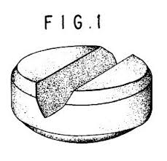



Splitting Tablets

Slide 71
Example
A patient attempted to split in half 20-mg unscored tablets of a drug, resulting in ‘‘half-tablets’’ differing by 1.5 mg in drug content.
Assuming a whole tablet was uniform in drug content, calculate the amount of drug in each ‘‘half tablet.’’

Slide 72
Special Dosing Regimens
Certain drugs have unique dosing regimens. Among them are chemotherapeutic agents and oral contraceptives.
Re - contraceptives: The prescribed regimen is based on a 28-day dosing cycle of 21 consecutive days of tablets containing a combination of estrogenic and progestational drugs followed by 7 consecutive days of tablets containing nondrug material.

Slide 73


Slide 74
Example
The ORTHO TRI-CYCLEN LO 28-day regimen consists of:
norgestimate (N)
ethinyl estradiol (EE)
nonmedicated tablets as follows:
7 white tablets containing 0.18 mg (N) 􏲱 0.025 mg (EE)
7 light blue tablets containing 0.215 mg (N) 􏲱 0.025 mg (EE)
7 dark blue tablets containing 0.25 mg (N) 􏲱 0.025 mg (EE)
7 green tablets containing 0 mg (N) 􏲱 0 mg (EE)
How many milligrams each of norgestimate and ethinyl estradiol are taken during each 28-day cycle?

Slide 75
Practice question (1)
The following regimen for oral prednisone is prescribed for a patient:
50 mg/day 10 days
25 mg/day 10 days
12.5 mg/day 10 days
5 mg/day 10 weeks
How many scored 25-mg tablets and how many 5-mg tablets should be dispensed to meet the dosing requirements?

Slide 76
Practice question (2)
Prior to a colonoscopy, a patient is instructed to take OSMOPREP tablets each of which contains 1.102 g sodium phosphate monobasic monohydrate and 0.398 g sodium phosphate dibasic anhydrous.
The dose is:
The evening before the procedure: 4 tablets with 8 ounces of clear liquids every 15 minutes for 5 cycles
Starting 3 to 5 hours before the procedure: 4 tablets with 8 ounces of clear liquids every 15 minutes for 3 cycles.
How many tablets, how much liquid, and how much total sodium phosphates are taken?
8 tablets,16 ounces liquid, 2g sodium phosphates
16 tablets, 1000 mL liquid, 32 g sodium phosphates
32 tablets, 1 quart liquid, 40 g sodium phosphates
32 tablets, 0.5 gallon liquid, 48 g sodium phosphates

Slide 77
Practice question (3)
The formula for AURALGAN, an otic solution, is:
Antipyrine 54 mg
Benzocaine 14 mg
Glycerin, dehydrated ad 1 mL
If a dropper delivers 20 drops/mL, how many milligrams of benzocaine would be delivered by a 3-drop dose of the solution?

Slide 78
Practice question (4)
Ipecac oral solution has the following formula:
Powdered Ipecac 70 g
Glycerin 100 mL
Syrup ad 1000 mL
Powdered ipecac contains 2 grams of the combined alkaloids emetine and cephaeline in each 100 grams of powder.
Calculate the quantity of these alkaloids, in milligrams, in each 5-mL dose of ipecac oral solution.

Slide 79
Practice question (5)
How many milliliters of an injection containing 250 mg of aminophylline in each 10 mL should be used in filling a medication order calling for 15 mg of aminophylline?

Slide 80
Practice question (6)
SYMBICORT 80/4.5 is an oral inhalation product containing 80 mcg of budesonide and 4.5 mcg of formoterol fumarate per inhalation.
The dose is stated as ‘‘two inhalations twice daily.’’
How much of each drug would be administered daily?
  160 mcg budesonide and 9 mcg formoterol fumarate
  0.32 mg budesonide and 0.18 mg formoterol fumarate
  320 mcg budesonide and 0.18 mg formoterol fumarate
  0.32 mg budesonide and 0.0l8 mg formoterol fumarate

Slide 81
Try These …
13th edition
3
4
5
8
10
15
18
21
25
30
32
14th edition
3
4
5
8
10
15
18
21
25
30
32

