Slide 1
Amino Acids and Peptides

Slide 2
The word protein that I propose to you . . . I would wish to derive from proteios, because it appears to be the primitive or principal substance of animal nutrition that plants prepare for the herbivores, and which the latter then furnish to the carnivores.
—J. J. Berzelius, letter to G. J. Mulder, 1838

Slide 3
Proteins are the most abundant biological macromolecules, occurring in all cells and all parts of cells. Proteins also occur in great variety; thousands of different kinds may be found in a single cell. Proteins are the molecular instruments through which genetic information is expressed. All proteins, whether from the most ancient lines of bacteria or from the most complex forms of life, are constructed from the same ubiquitous set of 20 amino acids, covalently linked in characteristic linear sequences.

Slide 4
Proteins are found in a wide range of sizes, from relatively small peptides with just a few amino acid residues to huge polymers with molecular weights in the millions. cells can produce proteins with strikingly different properties and activities by joining the same 20 amino acids in many different combinations and sequences.
From these building blocks different organisms can make such widely diverse products as enzymes, hormones, antibodies, transporters, muscle
fibers, the lens protein of the eye, feathers, spider webs, rhinoceros horn, milk proteins, antibiotics, mushroom poisons, and myriad other substances having distinct biological activities

Slide 5
Proteins are polymers of amino acids, with each amino acid residue joined to its neighbor by a specific type of covalent bond. Twenty different amino acids are
commonly found in proteins. The first to be discovered was asparagine, in 1806. The last of the 20 to be found, threonine, was not identified until 1938. All the amino acids have trivial or common names, in some cases derived from the source from which they were first isolated. Asparagine was first found in asparagus, and
glutamate in wheat gluten; tyrosine was first isolated from cheese (its name is derived from the Greek tyros, “cheese”); and glycine (Greek glykos, “sweet”) was so named because of its sweet taste.

Slide 6
All 20 of the common amino acids are α-amino acids. They
have a carboxyl group and an amino group bonded to the
same carbon atom (the carbon) (Fig. 3–2). They differ from each other in their side chains, or R groups, which vary in structure, size, and electric charge, and which influence the solubility of the amino acids in water. In addition to these 20 amino acids there are many less common ones. Some are residues modified after a protein has been synthesized; others are amino acids present in living organisms but not as constituents of proteins. The common amino acids of proteins have been assigned three letter abbreviations and one-letter symbols (Table 3–1), which are used as shorthand to indicate the composition and sequence of amino acids polymerized in proteins.

Slide 7
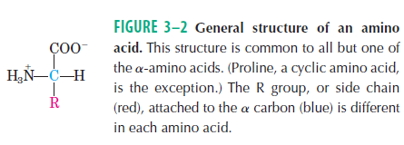

Slide 8
A carbon atom with four different substituents is said to be asymmetric, and asymmetric carbons are called chiral centers (Greek chiros, “hand”; some stereoisomers are related structurally as the right hand is to the left).
A molecule with only one chiral carbon can have two stereoisomers; when two or more (n) chiral carbons are present, there can be 2ᴧn stereoisomers. Stereoisomers that are mirror images of each other are called enantiomers (Fig. 1–19). Pairs of stereoisomers that are not mirror images of each other are called diastereomers (Fig. 1–20).

Slide 9
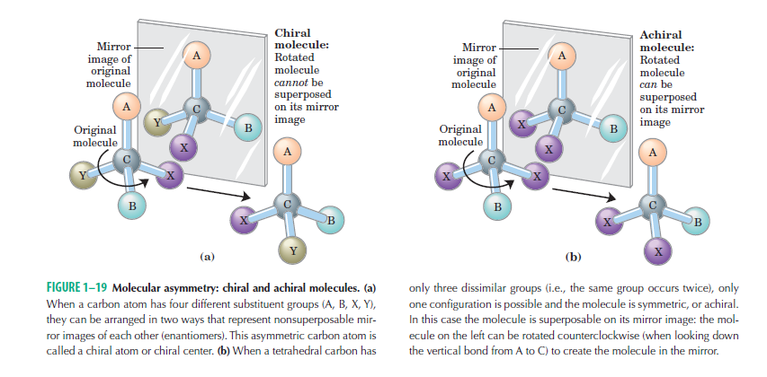

Slide 10
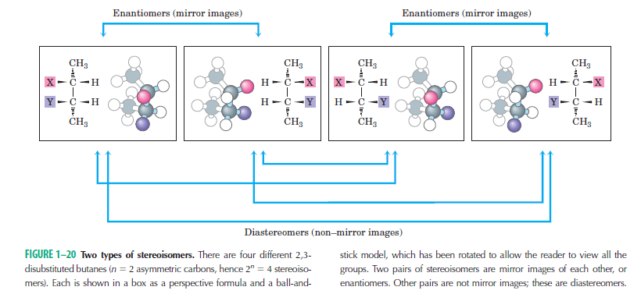

Slide 11
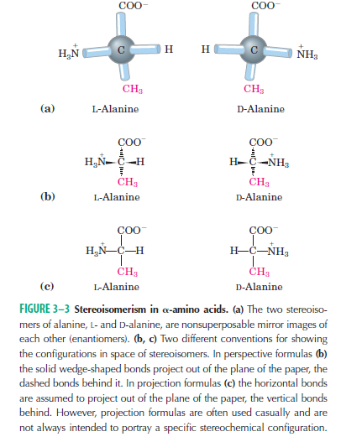

Slide 12

Two conventions are used to identify the carbons in an amino acid—a practice that can be confusing. The additional carbons in an R group are commonly designated β , γ, δ , ε , and so forth, proceeding out from the carbon. For most other organic molecules, carbon atoms are simply numbered from one end, giving highest priority (C-1) to the carbon with the substituent containing the atom of highest atomic number.

Slide 13
Nearly all biological compounds with a chiral center occur
naturally in only one stereoisomeric form, either D or L. The amino acid residues in protein molecules are exclusively L stereoisomers. D-Amino acid residues have been found in only a few, generally small peptides, including some peptides of bacterial cell walls and certain peptide antibiotics. It is remarkable that virtually all amino acid residues in proteins are L stereoisomers.
When chiral compounds are formed by ordinary chemical reactions,
the result is a racemic mixture of D and L isomers, which are difficult for a chemist to distinguish and separate. But to a living system, D and L isomers are as different as the right hand and the left. The formation of stable, repeating substructures in proteins generally requires that their constituent amino acids be of one stereochemical series. Cells are able to specifically synthesize the L isomers of amino acids because the active sites of enzymes are asymmetric, causing the reactions they catalyze to be stereospecific

Slide 14
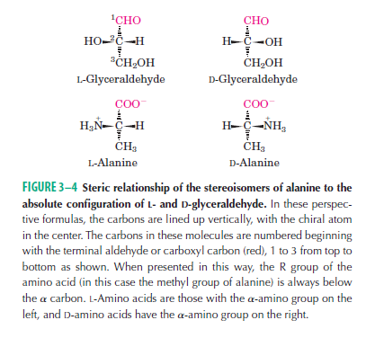

Slide 15

Amino Acids Can Be Classified by R Group
Knowledge of the chemical properties of the common amino acids is central to an understanding of biochemistry. The topic can be simplified by grouping the amino
acids into five main classes based on the properties of their R groups (Table 3–1), in particular, their polarity, or tendency to interact with water at biological pH (near
pH 7.0). The polarity of the R groups varies widely, from nonpolar and hydrophobic (water-insoluble) to highly polar and hydrophilic (water-soluble).
The structures of the 20 common amino acids are shown in Figure 3–5, and some of their properties are listed in Table 3–1.

Slide 16
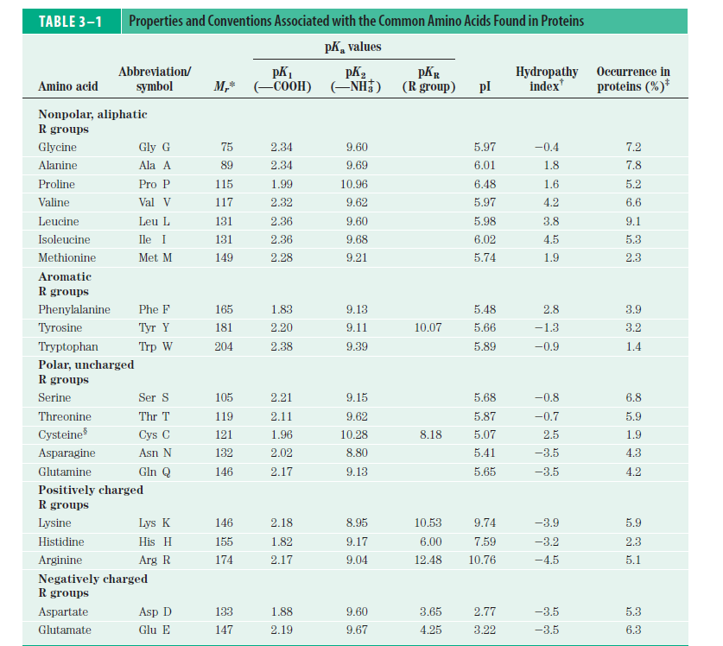

Slide 17
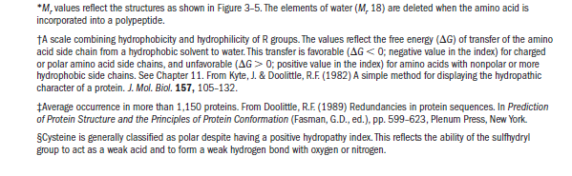

Slide 18
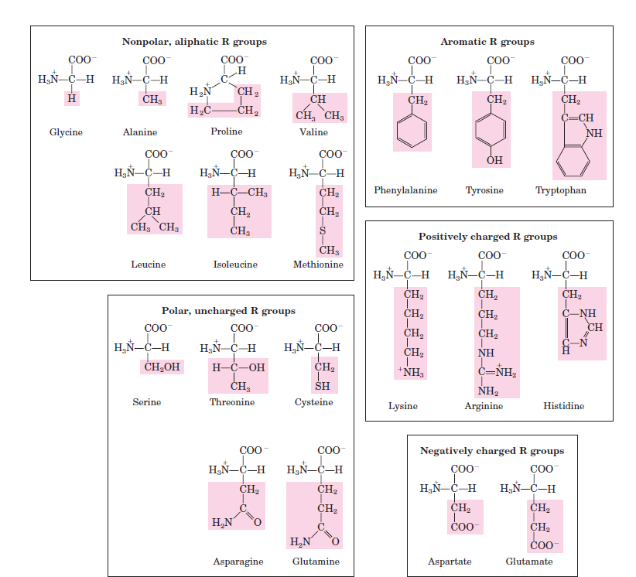

Slide 19
Nonpolar, Aliphatic R Groups The R groups in this class of amino acids are nonpolar and hydrophobic. The side chains of alanine, valine, leucine, and isoleucine tend to cluster together within proteins, stabilizing protein structure by means of hydrophobic interactions. Glycine has the simplest structure. Although it is most easily grouped with the nonpolar amino acids, its very small side chain makes no real contribution to hydrophobic interactions. Methionine, one of the two sulfur-containing amino acids, has a nonpolar thioether group in its side chain. Proline has an aliphatic side chain with a distinctive cyclic structure. The secondary amino (imino) group of proline residues is held in a rigid conformation that reduces the structural flexibility of polypeptide regions containing proline

Slide 20
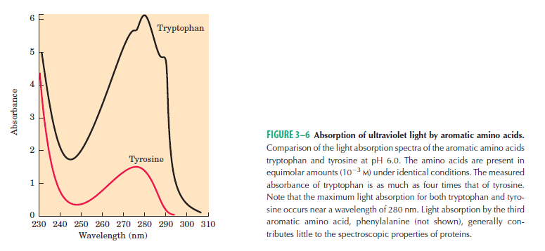
Aromatic R Groups Phenylalanine, tyrosine, and tryptophan, with their aromatic side chains, are relatively nonpolar (hydrophobic). All can participate in hydrophobic interactions. The hydroxyl group of tyrosine
can form hydrogen bonds, and it is an important functional group in some enzymes. Tyrosine and tryptophan are significantly more polar than phenylalanine, because Tryptophan and tyrosine, and to a much lesser extent
phenylalanine, absorb ultraviolet light (Fig. 3–6;. This accounts for the characteristic strong absorbance of light by most proteins at a wavelength
of 280 nm, a property exploited by researchers in the characterization of proteins.

Slide 21
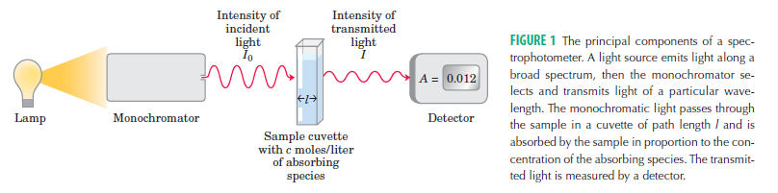

Slide 22
Polar, Uncharged R Groups The R groups of these
amino acids are more soluble in water, or more hydrophilic, than those of the nonpolar amino acids, because they contain functional groups that form
hydrogen bonds with water. This class of amino acids includes serine, threonine, cysteine, asparagine, and glutamine. The polarity of serine and threonine
is contributed by their hydroxyl groups; that of cysteine by its sulfhydryl group, which is a weak acid and can make weak hydrogen bonds with oxygen or nitrogen;
and that of asparagine and glutamine by their amide groups.
Asparagine and glutamine are the amides of two other amino acids also found in proteins, aspartate and glutamate, respectively, to which asparagine and
glutamine are easily hydrolyzed by acid or base. Cysteine is readily oxidized to form a covalently linked dimeric amino acid called cystine, in which two cysteine
molecules or residues are joined by a disulfide bond (Fig. 3–7). The disulfide-linked residues are strongly hydrophobic (nonpolar). Disulfide bonds play a special role in the structures of many proteins by forming covalent links between parts of a polypeptide molecule or between two different polypeptide chains.

Slide 23
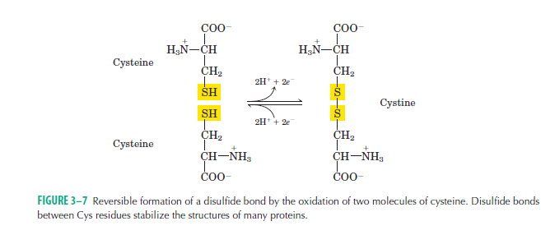

Slide 24
Positively Charged (Basic) R Groups The most hydrophilic R groups are those that are either positively or negatively charged. The amino acids in which the R
groups have significant positive charge at pH 7.0 are lysine, which has a second primary amino group at the position on its aliphatic chain; arginine, which has a positively charged guanidinium group; and histidine, which has an aromatic imidazole group. As the only common amino acid having an ionizable side chain with pKa near neutrality, histidine may be positively charged (protonated form) or uncharged at pH 7.0. His residues facilitate many enzyme-catalyzed reactions by serving as proton donors/acceptors.
Negatively Charged (Acidic) R Groups The two
amino acids having R groups with a net negative charge at pH 7.0 are aspartate and glutamate, each of which has a second carboxyl group.
Uncommon

Slide 25
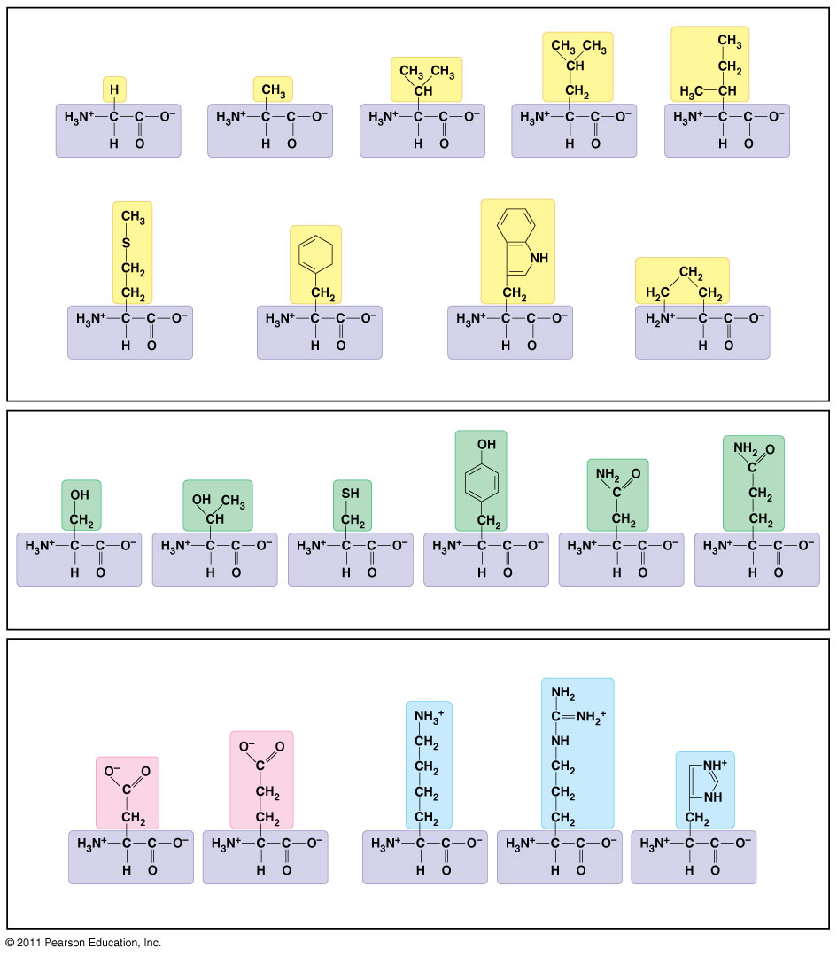
Nonpolar side chains; hydrophobic
Side chain (R group)
Glycine (Gly or G)
Alanine (Ala or A)
Valine (Val or V)
Leucine (Leu or L)
Isoleucine (Ile or I)
Methionine (Met or M)
Phenylalanine (Phe or F)
Tryptophan (Trp or W)
Proline (Pro or P)
Polar side chains; hydrophilic
Serine (Ser or S)
Threonine (Thr or T)
Cysteine (Cys or C)
Tyrosine (Tyr or Y)
Asparagine (Asn or N)
Glutamine (Gln or Q)
Electrically charged side chains; hydrophilic
Basic (positively charged)
Acidic (negatively charged)
Aspartic acid (Asp or D)
Glutamic acid (Glu or E)
Lysine (Lys or K)
Arginine (Arg or R)
Histidine (His or H)
Notes:
Figure 5.16 The 20 amino acids of proteins.

Slide 26
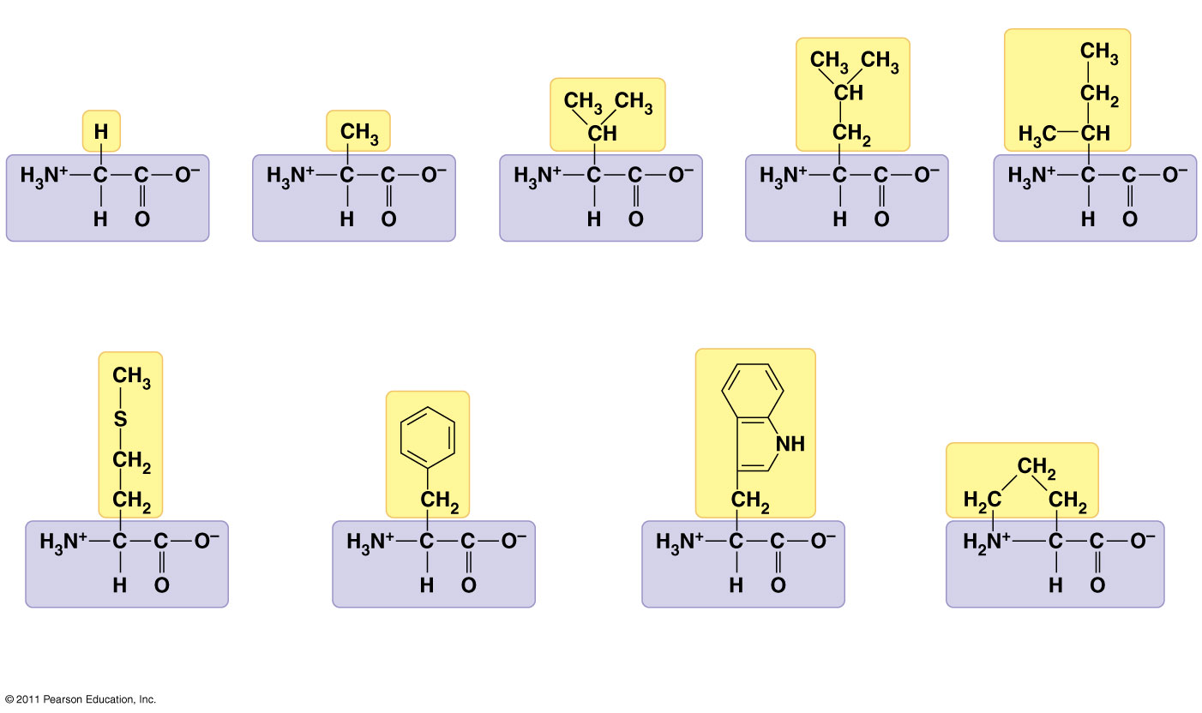
Nonpolar side chains; hydrophobic
Side chain
Glycine (Gly or G)
Alanine (Ala or A)
Valine (Val or V)
Leucine (Leu or L)
Isoleucine (Ile or I)
Methionine (Met or M)
Phenylalanine (Phe or F)
Tryptophan (Trp or W)
Proline (Pro or P)
Notes:
Figure 5.16 The 20 amino acids of proteins.

Slide 27
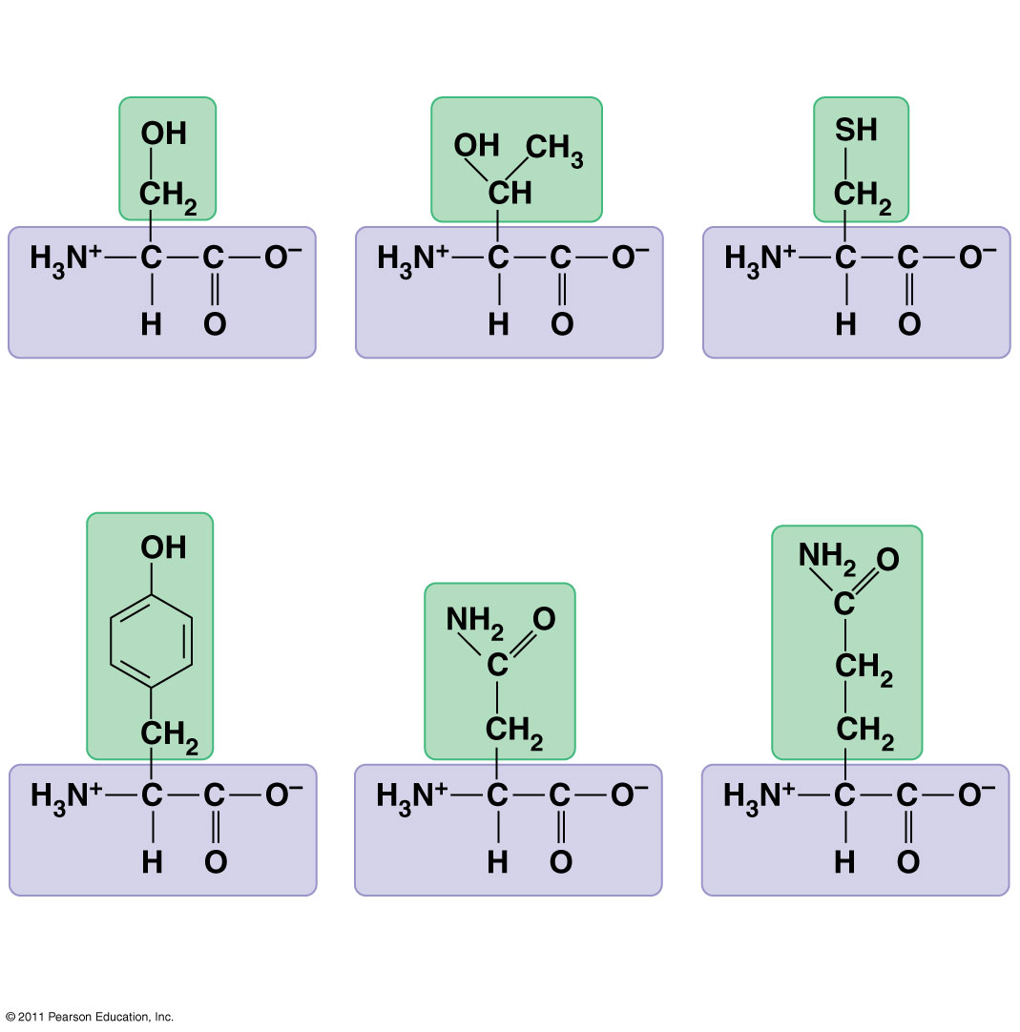
Polar side chains; hydrophilic
Serine (Ser or S)
Threonine (Thr or T)
Cysteine (Cys or C)
Tyrosine (Tyr or Y)
Asparagine (Asn or N)
Glutamine (Gln or Q)
Notes:
Figure 5.16 The 20 amino acids of proteins.

Slide 28
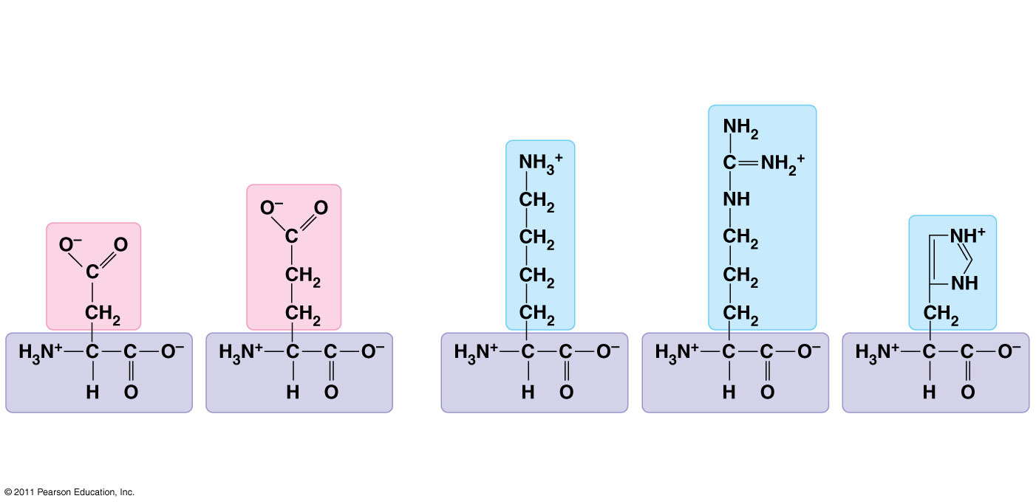
Electrically charged side chains; hydrophilic
Basic (positively charged)
Acidic (negatively charged)
Aspartic acid (Asp or D)
Glutamic acid (Glu or E)
Lysine (Lys or K)
Arginine (Arg or R)
Histidine (His or H)
Notes:
Figure 5.16 The 20 amino acids of proteins.

Slide 29
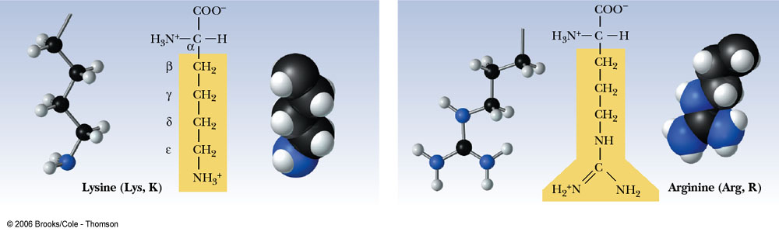
(Basic R-group amino acids)
Amino-aliphatic R-group Guanidino R-group

Slide 30
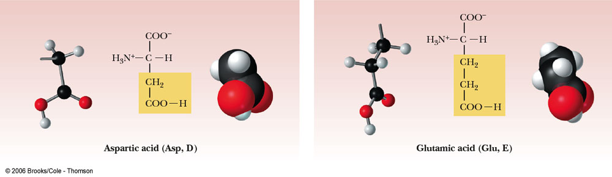
(Acidic R-group amino acids)
Carboxyl R-group (-ve charged)

Slide 31
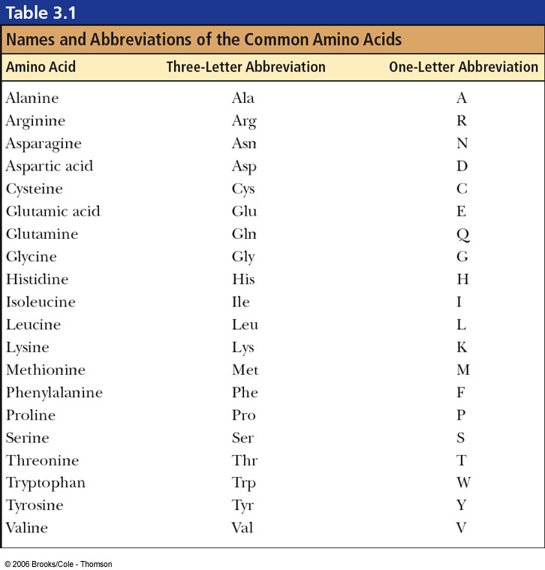
Table 3-1, p.62

Slide 32
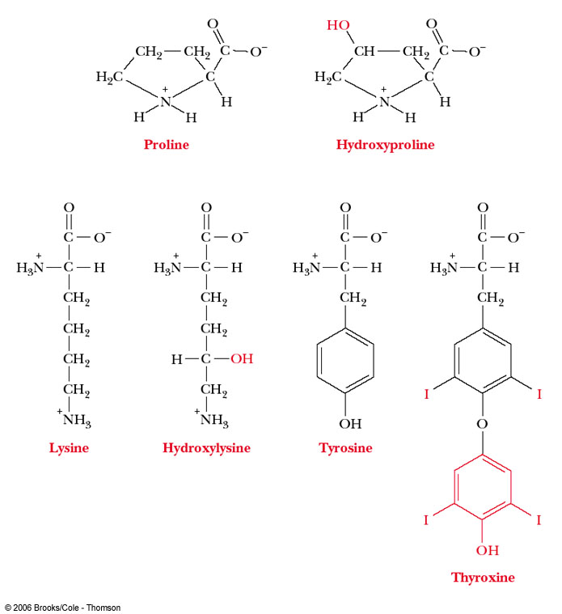
Uncommon amino acids results from posttranslational modification,
Found only in few connective tissue proteins such as collagen.
Thyroxine hormone: is a modification of tyrosine that produced
in thyroid gland.

Slide 33
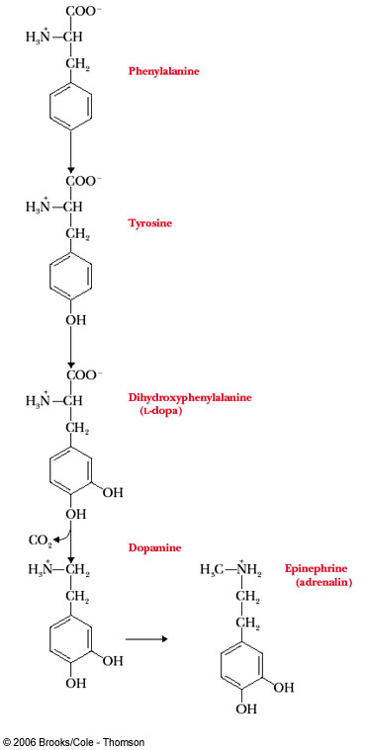
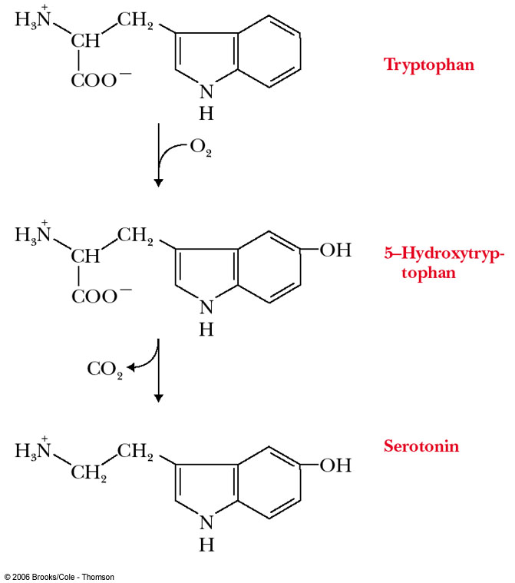
Tryptophan and phenyl alanine are the precursor amino acids for neurotansmitters synthesis

Slide 34
Amino acids to calm down and Pep up Some people insist that supplements of Tyrosine give them a morning lift and that tryptophan helps them sleep at night .Milk proteins have high levels of tryptophan ; a glass of warm milk before bed is widely believed to be an aid in inducing sleep. Cheese and red wines contain high amounts of tyramine , which mimics epinephrine ; for many people a cheese omelet in the morning is a favorite way to a start the day.

Slide 35
Tyramine is a naturally-occurring compound often present in many plants and animals. It can also form from tyrosine — an amino acid found in a variety of foods — when those foods are fermented, or start to decay. It is known as an amine because of its molecular structure, which contains nitrogen, and is derived from ammonia.
In humans, this compound acts to release catecholamines — or the ‘fight or flight’ hormones — made by the adrenal glands into the bloodstream. Some of the substances that can be released include dopamine, norepinephrine — also known as noradrenaline — and epinephrine. When these hormones are in the bloodstream, systolic blood pressure and heart rate can rise.
This rise in blood pressure can often be dangerous for people who take monoamine oxidase inhibitors (MAOIs). Since the enzyme monoamine oxidase is the mechanism the human body typically uses to rid itself of excessive amounts of tyramine, if MAOIs are taken, tyramine levels may build up, leading to increased risk of a stroke. This is why many people taking MAOIs are advised to avoid foods containing tyramine.

