Slide 1
Chapter Ten
Pricing:
Understanding and Capturing Customer Value

Slide 2
Pricing:
Understanding and
Capturing Customer Value
Topic Outline
What Is a Price?
Major Pricing Strategies
Other Internal and External Considerations Affecting Price Decisions

Slide 3
What Is a Price?
Price is the amount of money charged for a product or service. It is the sum of all the values that consumers give up in order to gain the benefits of having or using a product or service.
Notes:
Note to Instructor
Discussion Question
How does a company like Starbuck’s price their products?
This will lead to a good overview of the chapter as students will most likely focus on customers, costs and competitors.

Slide 4
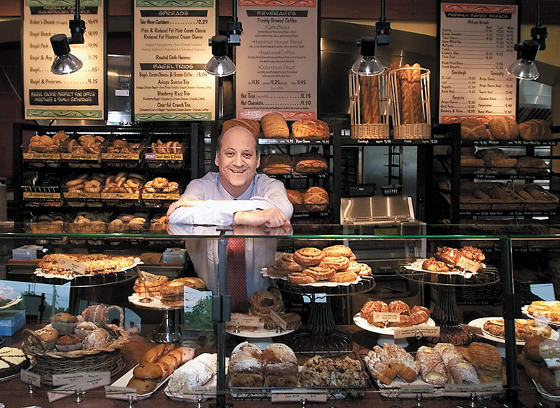
What Is a Price?
Price is the only element in the marketing mix that produces revenue; all other elements represent costs

Slide 5
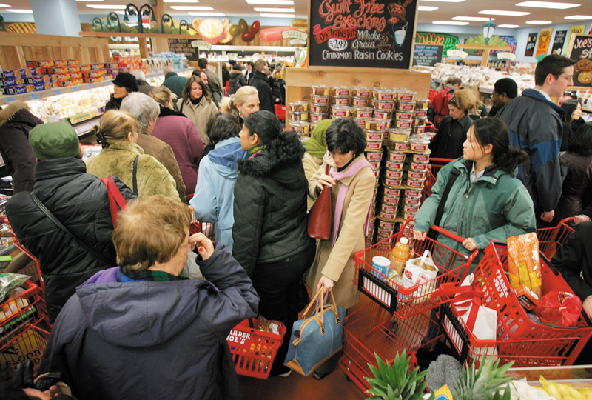
Major Pricing Strategies
Customer Value-Based Pricing
Understanding how much value consumers place on the benefits they receive from the product and setting a price that captures that value

Slide 6
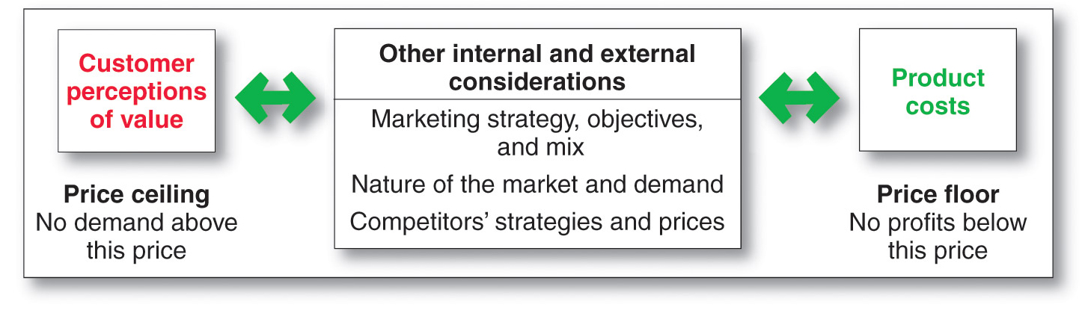
Major Pricing Strategies
Customer Value-Based Pricing

Slide 7
Major Pricing Strategies
Customer Value-Based Pricing
Value-based pricing uses the buyers’ perceptions of value, not the sellers cost, as the key to pricing. Price is considered before the marketing program is set.
Value-based pricing is customer driven
Cost-based pricing is product driven
Notes:
Note to Instructor
Students often confuse value with low price. You might want to bring up a product that some of them will value even at a high price. You can bring up the latest iPhone product or a luxury car. Some students will feel that the price for these products is too high, however, others will see the value these products offer to the consumer.

Slide 8
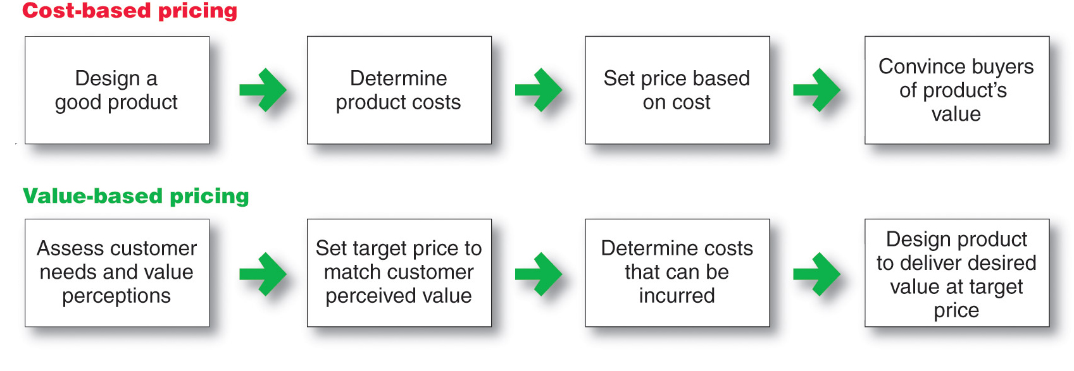
Major Pricing Strategies
Customer Value-Based Pricing

Slide 9
Major Pricing Strategies
Customer Value-Based Pricing
Good-value pricing
offers the right combination of quality and good service at a fair price
Notes:
Note to Instructor
Existing brands are being redesigned to offer more quality for a given price or the same quality for less price.
In many cases good-value pricing includes less expensive items.

Slide 10

Major Pricing Strategies
Customer Value-Based Pricing
Everyday low pricing (EDLP) charging a constant everyday low price with few or no temporary price discounts
Notes:
Note to Instructor
This link is for Wal-Mart’s homepage. It is interesting to compare this to kohls.com, which does NOT practice EDLP but focuses on special promotions and deals.

Slide 11
Major Pricing Strategies
Customer Value-Based Pricing
High-low pricing charging higher prices on an everyday basis but running frequent promotions to lower prices temporarily on selected items
Notes:
Note to Instructor

Slide 12
Major Pricing Strategies
Customer Value-Based Pricing
Value-added pricing attaches value-added features and services to differentiate offers, support higher prices, and build pricing power

Slide 13
Major Pricing Strategies
Cost-Based Pricing
Cost-based pricing setting prices based on the costs for producing, distributing, and selling the product plus a fair rate of return for effort and risk

Slide 14
Major Pricing Strategies
Cost-Based Pricing
Cost-based pricing adds a standard markup to the cost of the product

Slide 15
Major Pricing Strategies
Cost-Based Pricing
Types of costs

Slide 16
Major Pricing Strategies
Cost-Based Pricing
Fixed costs are the costs that do not vary with production or sales level
  Rent
  Heat
  Interest
  Executive salaries

Slide 17
Major Pricing Strategies
Cost-Based Pricing
Variable costs are the costs that vary with the level of production
  Packaging
  Raw materials
Notes:
Note to Instructor
This link is to steelonthenet.com that shows current prices for the raw materials used to make steel including coal, iron oar, natural gas, steel scrap, and electricity. This site tracks the prices over time so students can see how these change.

Slide 18
Major Pricing Strategies
Cost-Based Pricing
Total costs are the sum of the fixed and variable costs for any given level of production

Slide 19
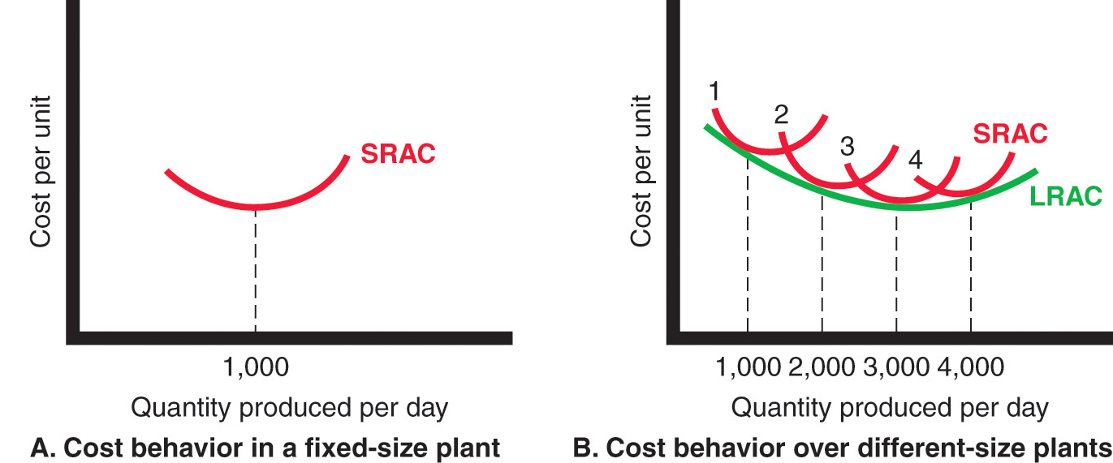
Major Pricing Strategies
Costs as a Function of Production Experience
Notes:
Note to Instructor
It is best to use an example like the Texas Instruments (TI) example given in the book:
TI has built a plant to produce 1,000 calculators per day. Figure 10.3A shows the typical short‑run average cost curve (SRAC). It shows that the cost per calculator is high if TI’s factory produces only a few per day. But as production moves up to 1,000 calculators per day, average cost falls. This is because fixed costs are spread over more units, with each one bearing a smaller share of the fixed cost. TI can try to produce more than 1,000 calculators per day, but average costs will increase because the plant becomes inefficient. Workers have to wait for machines, the machines break down more often, and workers get in each other’s way.
If TI believed it could sell 2,000 calculators a day, it should consider building a larger plant. The plant would use more efficient machinery and work arrangements. Also, the unit cost of producing 2,000 calculators per day would be lower than the unit cost of producing 1,000 units per day, as shown in the long‑run average cost (LRAC) curve (Figure 10.3B). In fact, a 3,000‑capacity plant would even be more efficient, according to Figure 10.3B. But a 4,000-daily production plant would be less efficient because of increasing diseconomies of scale—too many workers to manage, paperwork slowing things down, and so on. Figure 10.3B shows that a 3,000-daily production plant is the best size to build if demand is strong enough to support this level of production.

Slide 20
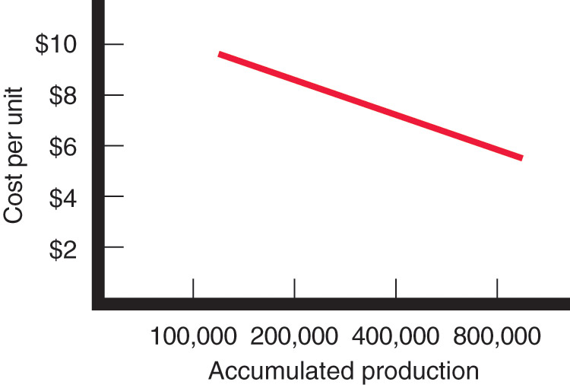
Major Pricing Strategies
Costs as a Function of Production Experience
Experience or learning curve is when average cost falls as production increases because fixed costs are spread over more units
Notes:
Note to Instructor
The TI example continues as follows:
Suppose TI runs a plant that produces 3,000 calculators per day. As TI gains experience in producing calculators, it learns how to do it better. Workers learn shortcuts and become more familiar with their equipment. With practice, the work becomes better organized, and TI finds better equipment and production processes. With higher volume, TI becomes more efficient and gains economies of scale. As a result, average cost tends to fall with accumulated production experience. This is shown in Figure 10.4. Thus, the average cost of producing the first 100,000 calculators is $10 per calculator. When the company has produced the first 200,000 calculators, the average cost has fallen to $9. After its accumulated production experience doubles again to 400,000, the average cost is $7. Here accumulated production is drawn on a semilog scale so that equal distances represent the same percentage increase in output.

Slide 21
Major Pricing Strategies
Cost-Plus Pricing
Cost-plus pricing adds a standard markup to the cost of the product
Benefits
  Sellers are certain about costs
  Prices are similar in industry and price competition is minimized
  Buyers feel it is fair
Disadvantages
  Ignores demand and competitor prices

Slide 22
Major Pricing Strategies
Break-Even Analysis and Target Profit Pricing
Break-even pricing is the price at which total costs are equal to total revenue and there is no profit
Target profit pricing is the price at which the firm will break even or make the profit it’s seeking

Slide 23
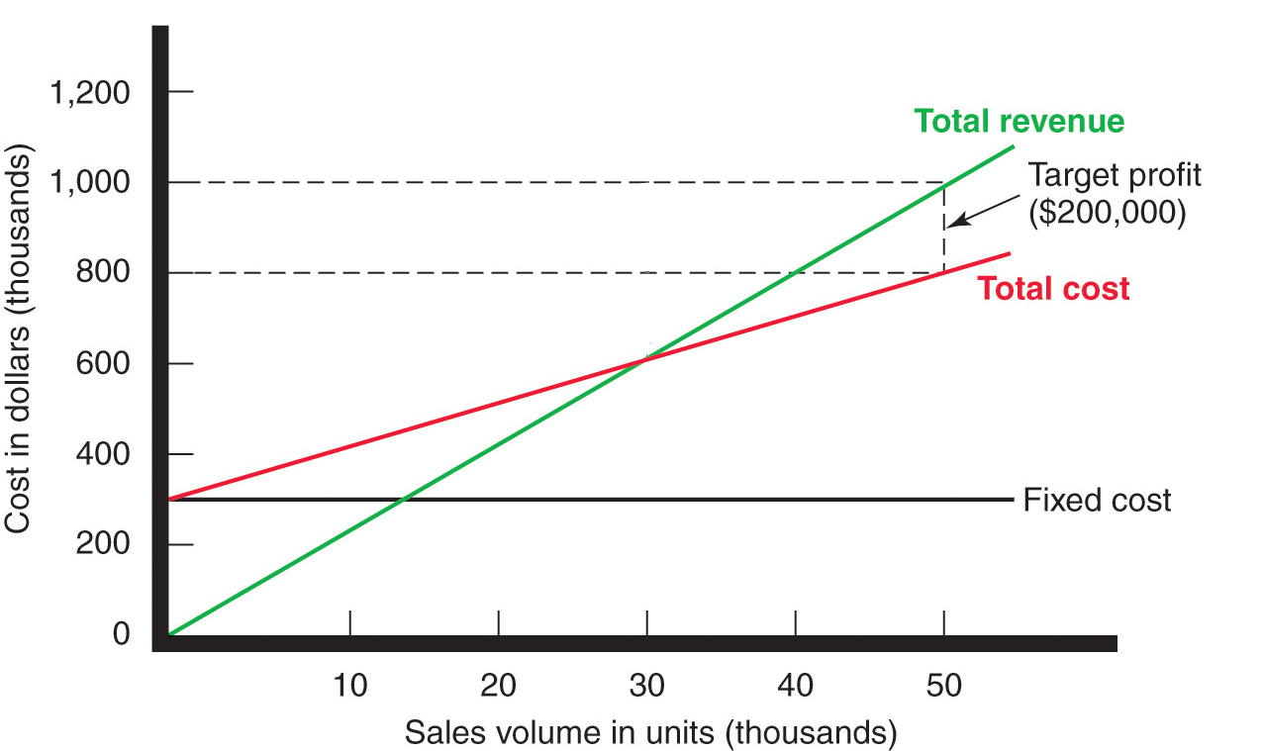
Major Pricing Strategies
Break-Even Analysis and Target Profit Pricing

Slide 24
Major Pricing Strategies
Competition-based pricing
Setting prices based on competitors’ strategies, costs, prices, and market offerings.
Consumers will base their judgments of a product’s value on the prices that competitors charge for similar products.

Slide 25
Considerations in Setting Price

Slide 26
Other Internal and External Considerations Affecting Price Decisions
Target costing starts with an ideal selling price based on consumer value considerations and then targets costs that will ensure that the price is met

Slide 27
Other Internal and External Considerations Affecting Price Decisions
Organizational considerations include:
Who should set the price
Who can influence the prices

Slide 28

Other Internal and External Considerations Affecting Price Decisions
The Market and Demand
Before setting prices, the marketer must understand the relationship between price and demand for its products

Slide 29

Other Internal and External Consideration Affecting Price Decisions
Competition
Notes:
Note to Instructor
Discussion Question
How has the Internet has changed pricing competition?
This link is to Bestprices.com, one of many Web sites that offers low prices. Ask them if they know of other sites where they can obtain low prices.
Under pure competition, the market consists of many buyers and sellers trading in a uniform
commodity, such as wheat, copper, or financial securities. No single buyer or seller has
much effect on the going market price. In a purely competitive market, marketing research,
product development, pricing, advertising, and sales promotion play little or no role. Thus,
sellers in these markets do not spend much time on marketing strategy.
Under monopolistic competition, the market consists of many buyers and sellers who
trade over a range of prices rather than a single market price. A range of prices occurs because
sellers can differentiate their offers to buyers.
Positioning on
Under oligopolistic competition, the market consists of a few sellers who are highly sensitive
to each other’s pricing and marketing strategies. Because there are few sellers, each
seller is alert and responsive to competitors’ pricing strategies and moves.
In a pure monopoly, the market consists of one seller. The seller may be a government
monopoly (the U.S. Postal Service), a private regulated monopoly (a power company), or a
private nonregulated monopoly (DuPont when it introduced nylon). Pricing is handled differently
in each case.

Slide 30
Other Internal and External Considerations Affecting Price Decisions
The demand curve shows the number of units the market will buy in a given period at different prices
Normally, demand and price are inversely related
Higher price = lower demand
For prestige (luxury) goods, higher price can equal higher demand when consumers perceive higher prices as higher quality

Slide 31
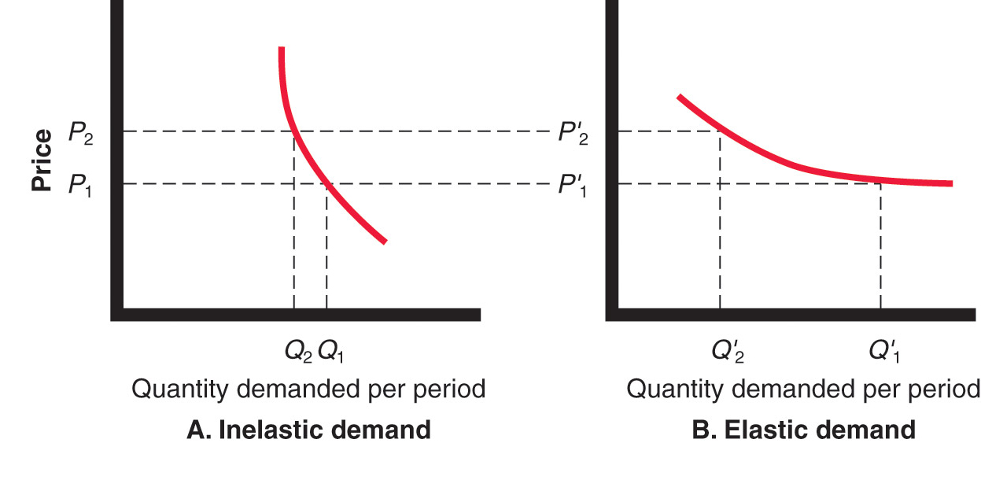
Other Internal and External Considerations Affecting Price Decisions

Slide 32
Other Internal and External Considerations Affecting Price Decisions
Price elasticity of demand illustrates the response of demand to a change in price
Inelastic demand occurs when demand hardly changes when there is a small change in price
Elastic demand occurs when demand changes greatly for a small change in price
Notes:
Note to Instructor
Factors that affect price elasticity of demand include:
Unique product
Quality
Prestige
Substitute products
Cost relative to income

Slide 33
Other Internal and External Considerations Affecting Price Decisions
Price elasticity of demand =
% change in quantity demand
% change in price
Notes:
Note to Instructor
Factors that affect price elasticity of demand include:
Unique product
Quality
Prestige
Substitute products
Cost relative to income

Slide 34
Other Internal and External Consideration Affecting Price Decisions

Slide 35

All rights reserved. No part of this publication may be reproduced, stored in a retrieval system, or transmitted, in any form or by any means, electronic, mechanical, photocopying, recording, or otherwise, without the prior written permission of the publisher. Printed in the United States of America.
Copyright © 2012 Pearson Education, Inc.
Publishing as Prentice Hall

