Slide 1
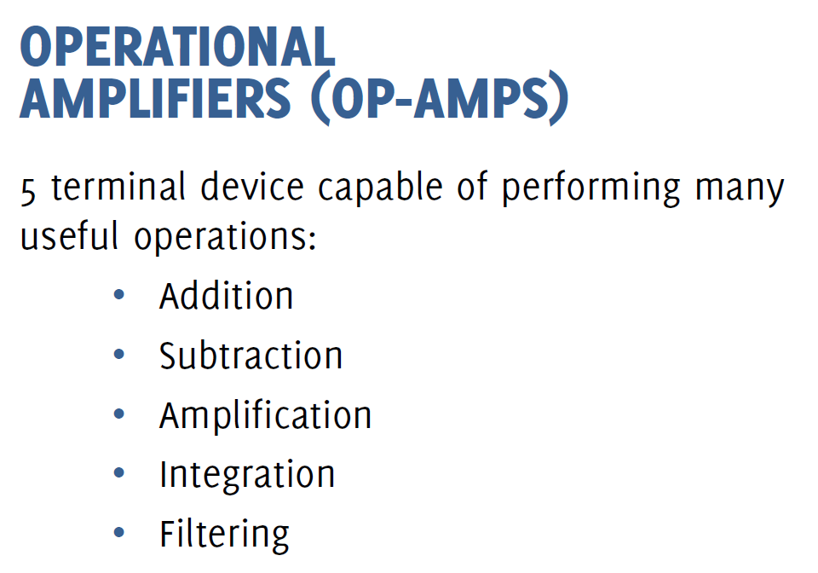

Slide 3
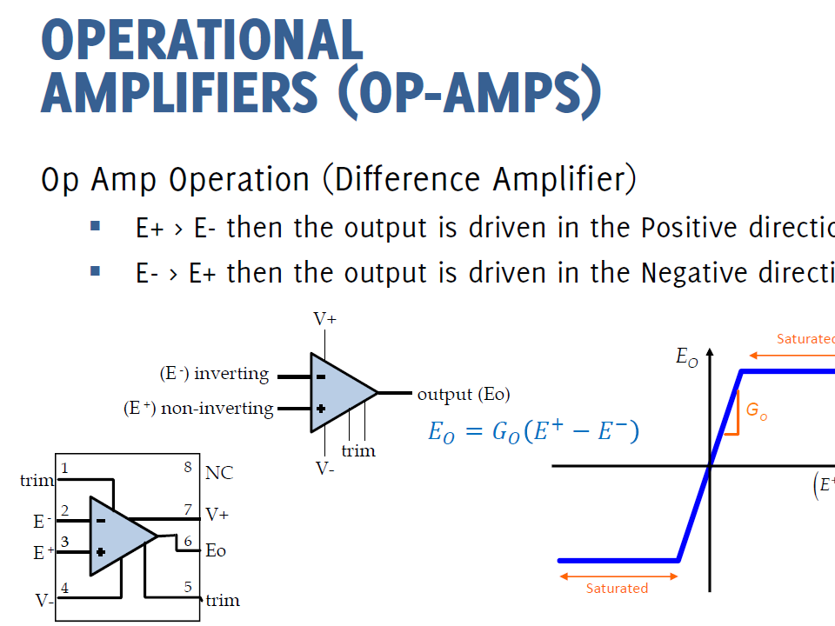

Slide 4
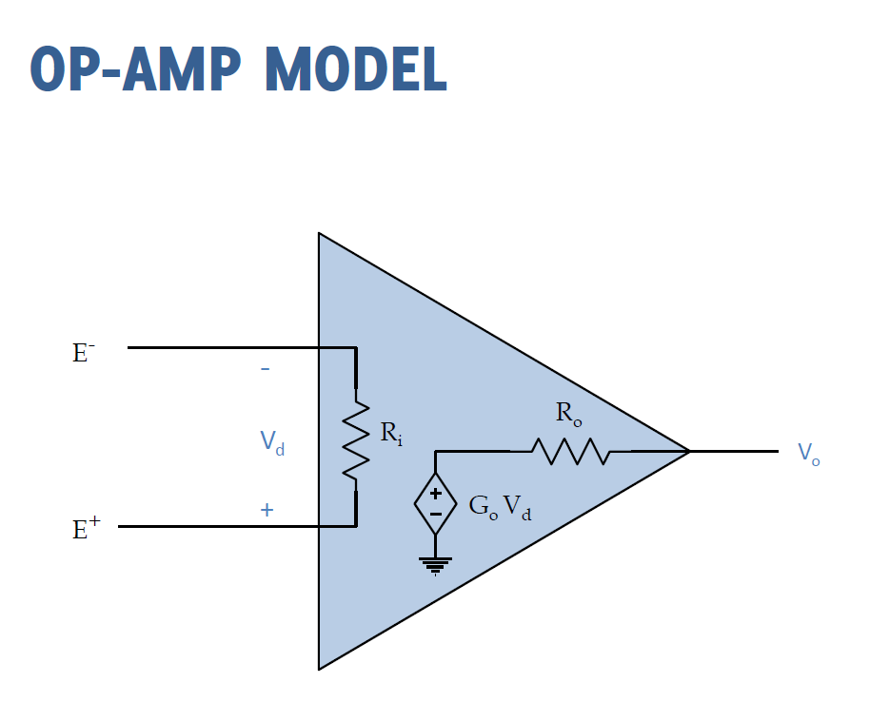

Slide 5
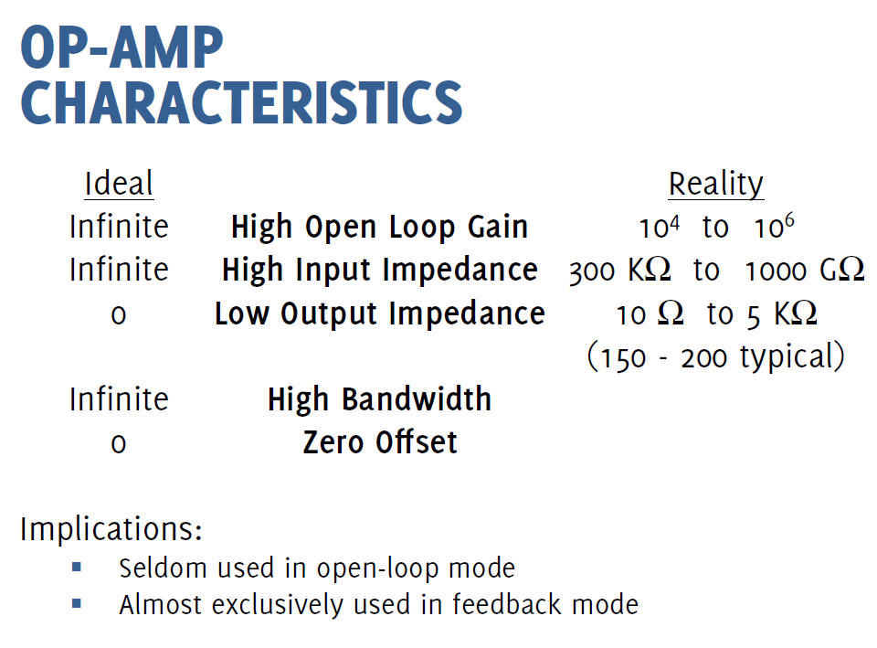

Slide 6
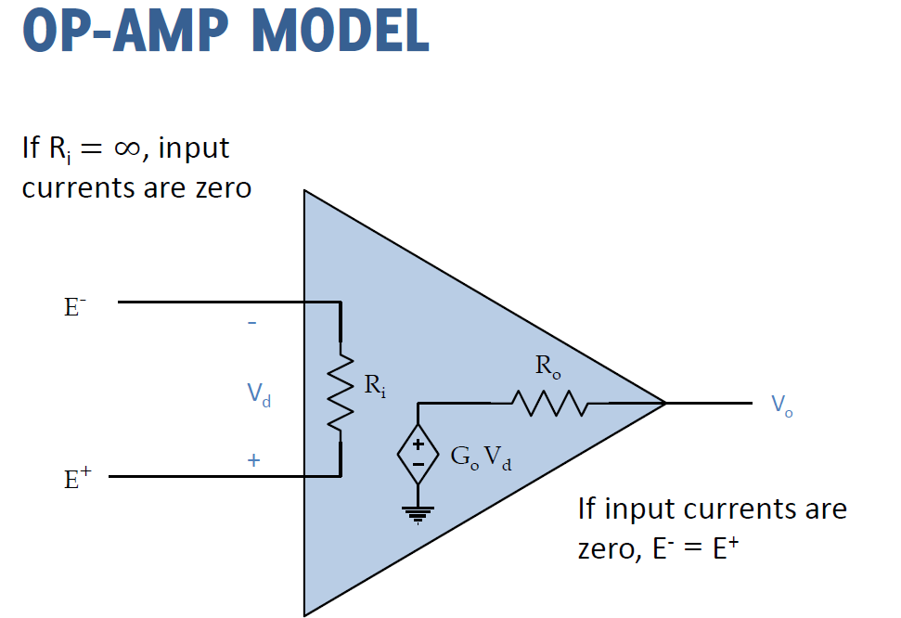

Slide 7
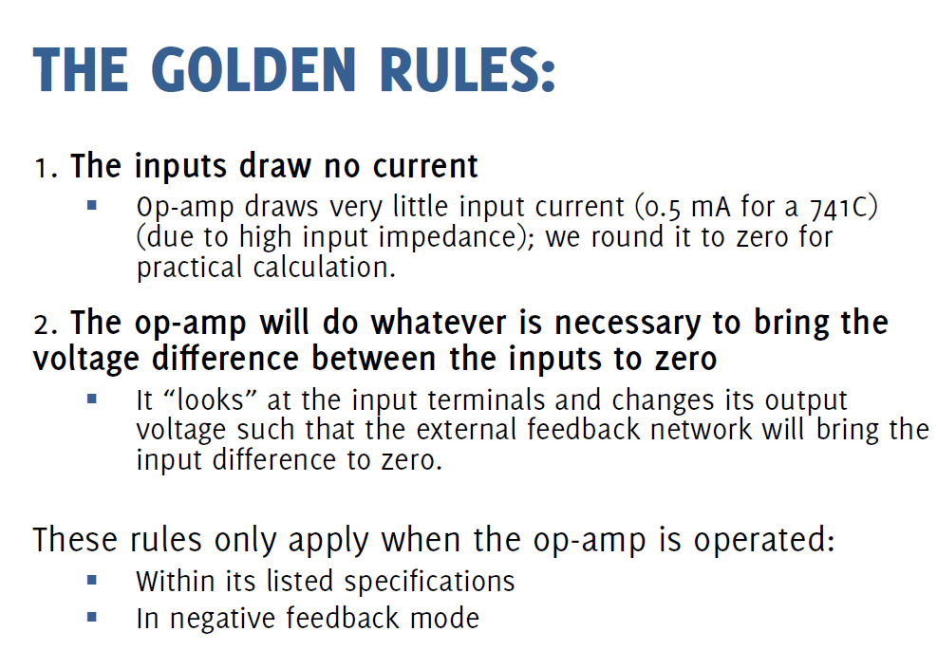

Slide 8
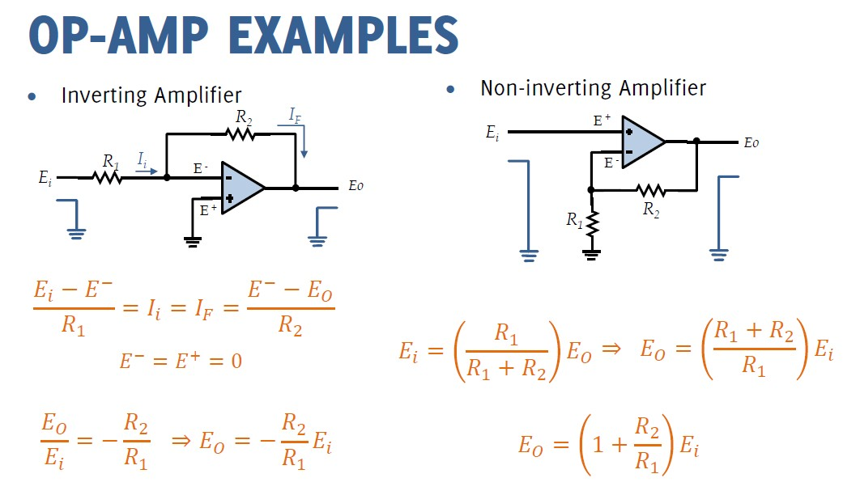

Slide 10
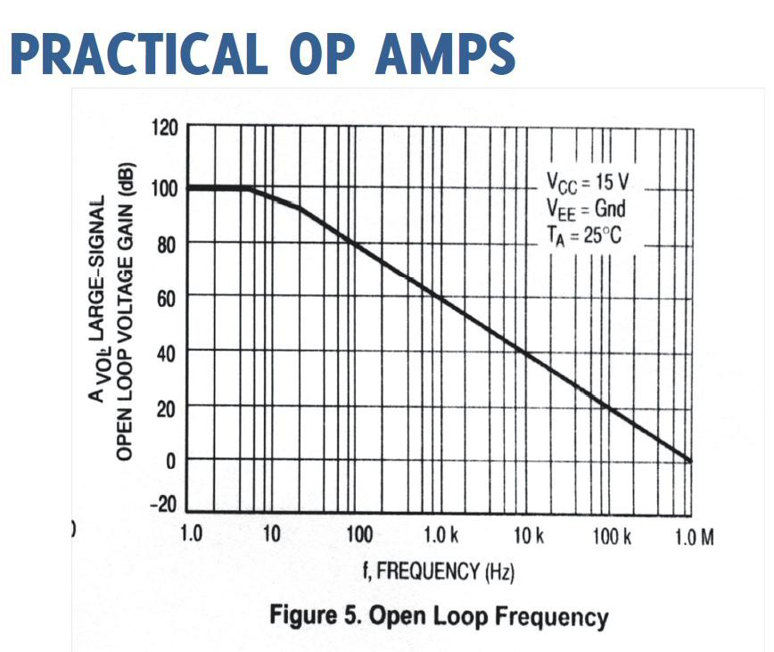

Slide 11
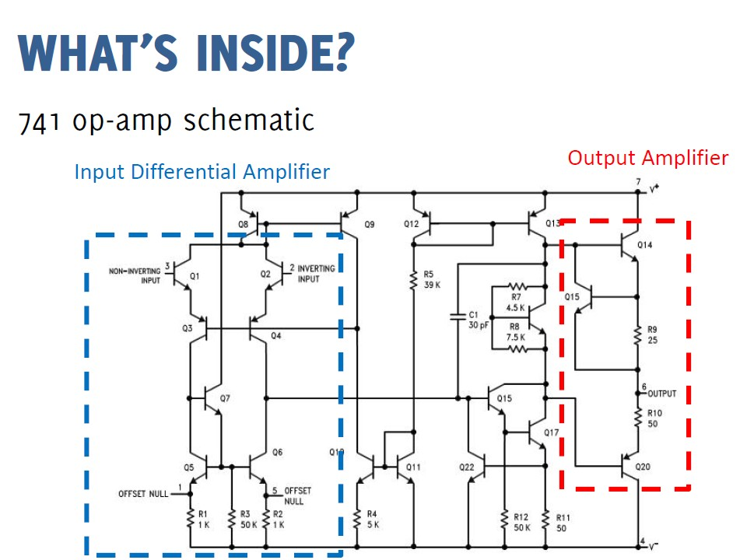

Slide 12
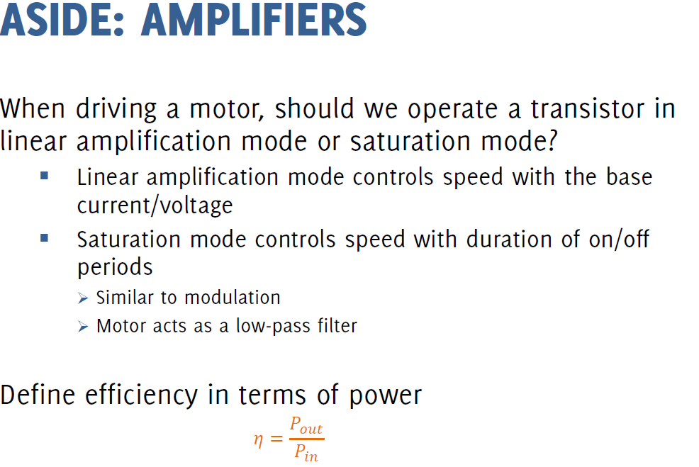

Slide 13
🞂 The ideal operational amplifier
Terminals
Basic ideal op-amp properties
🞂 Op-amp families
🞂 Operational amplifier circuits
Comparator and buffer
Inverting and non-inverting amplifier
Summing and differential amplifier
Integrating and differentiating amplifier
Current-voltage conversion

Slide 14

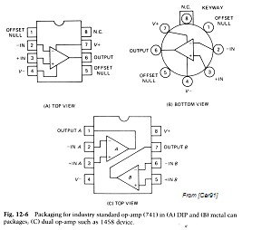
🞂 Primary op-amp terminals
Inverting input
Non-inverting input
Output
Power supply

Slide 15

🞂 The ideal op-amp is characterized by seven properties
Knowledge of these properties is sufficient to design and analyze a large number of useful circuits
🞂 Basic op-amp properties
Infinite open-loop voltage gain
Infinite input impedance
Zero output impedance
Zero noise contribution
Zero DC output offset
Infinite bandwidth
Differential inputs that stick together

Slide 16


🞂 Property No.1: Infinite Open-Loop Gain
Open-Loop Gain Avol is the gain of the op-amp without
positive or negative feedback
In the ideal op-amp Avol is infinite
Typical values range from 20,000 to 200,000 in real devices
🞂 Property No.2: Infinite Input Impedance
Input impedance is the ratio of input voltage to input current
When Zin is infinite, the input current Iin=0
High-grade op-amps can have input impedance in the TΩ range
Some low-grade op-amps, on the other hand, can have mA input currents

Slide 17
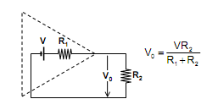
🞂 Property No. 3: Zero Output Impedance
The ideal op-amp acts as a perfect internal voltage
source with no internal resistance
This internal resistance is in series with the load, reducing the output voltage available to the load
Real op-amps have output-impedance in the 100-20Ω
range
Example

Slide 18

🞂 Property No.4: Zero Noise Contribution
In the ideal op-amp, zero noise voltage is produced internally
This is, any noise at the output must have been at the input as well
Practical op-amp are affected by several noise sources, such as resistive and semiconductor noise
These effects can have considerable effects in low signal-level
applications
🞂 Property No. 5: Zero output Offset
The output offset is the output voltage of an amplifier when both inputs are grounded
The ideal op-amp has zero output offset, but real op-amps have some amount of output offset voltage

Slide 19
🞂 Property No. 6: Infinite Bandwidth
The ideal op-amp will amplify all signals from DC to the highest AC frequencies
In real opamps, the bandwidth is rather limited
This limitation is specified by the Gain-Bandwidth product (GB), which is equal to the frequency where the amplifier gain becomes unity
Some op-amps, such as the 741 family, have very limited bandwidth of up to a few KHz
🞂 Property No. 7: Differential Inputs Stick Together
In the ideal op-amp, a voltage applied to one input
also appears at the other input

Slide 20

🞂 General-Purpose Op-Amps
These devices are designed for a very wide range of applications
These op-amps have limited bandwidth but in return have very good stability (they are called frequency compensated)
Non-compensated op-amps have wider frequency response but have a tendency to oscillate
🞂 Voltage Comparators
These are devices that have no negative feedback networks and therefore saturate with very low (µV) input signal voltages
Used to compare signal levels of the inputs
🞂 Low Input Current Op-Amps
Op-amps with very low (pico-amp) input currents, as opposed to µA or mA input currents found in other devices
🞂 Low Noise Op-Amps
Optimized to reduce internal noise
Typically employed in the first stages of amplification circuits
🞂 Low Power Op-Amps
Optimized for low power consumption
These devices can operate at low power-supply voltages (I.e., ±1.5VDC)
🞂 Low Drift Op-Amps
Internally compensated to minimize drift caused by temperature
Typically employed in instrumentation circuits with low-level input signals

Slide 21
🞂 Wide Bandwidth Op-Amps
These devices have a very high GB product (i.e., 100MHz)
compared to 741-type op-amps (0.3-1.2MHz)
These devices are sometimes called video op-amps
🞂 Single DC Supply Op-Amps
Devices that operate from a monopolar DC power supply
voltage
🞂 High-Voltage Op-Amps
Devices that operate at high DC power supply voltages (i.e.
±44VDC) compared to most other op-amps (±6V to ±22V)
🞂 Multiple Devices
Those that have more than one op-amp in the same package (i.e., dual or quad op-amps)
🞂 Instrumentation Op-Amps
These are DC differential amplifiers made with 2-3 internal
op-amps
Voltage gain is commonly set with external resistors

Slide 22
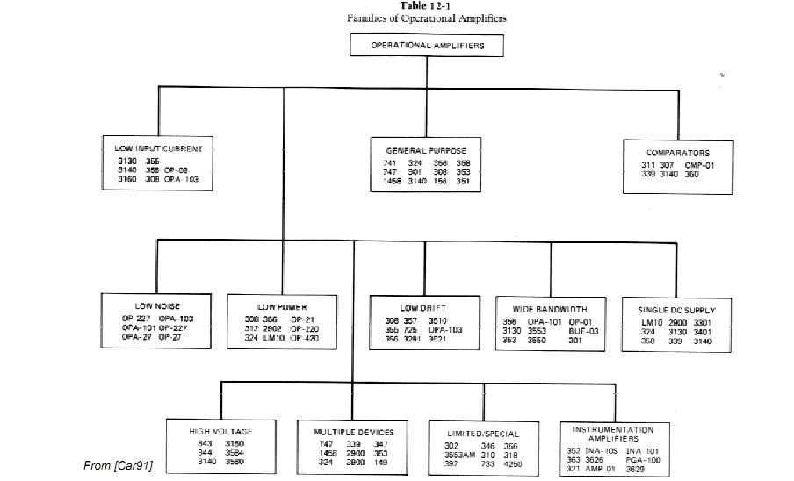

Slide 23

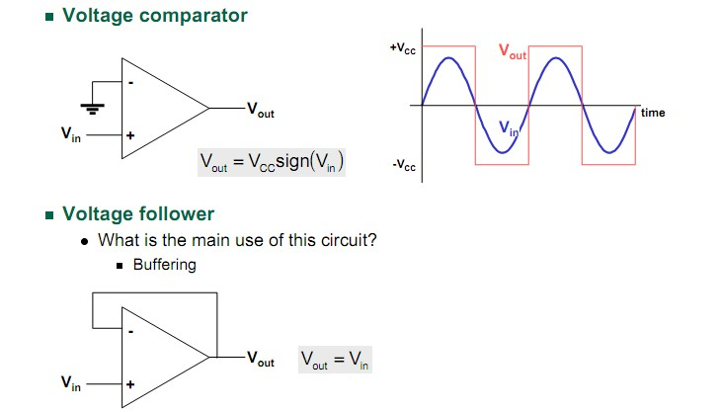

Slide 24

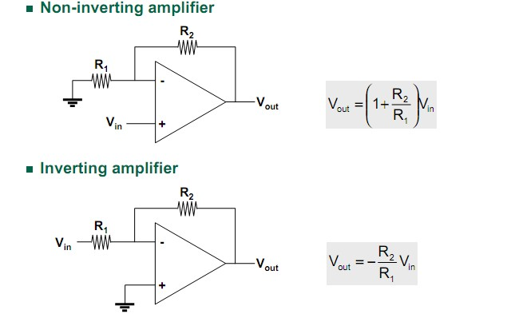

Slide 25
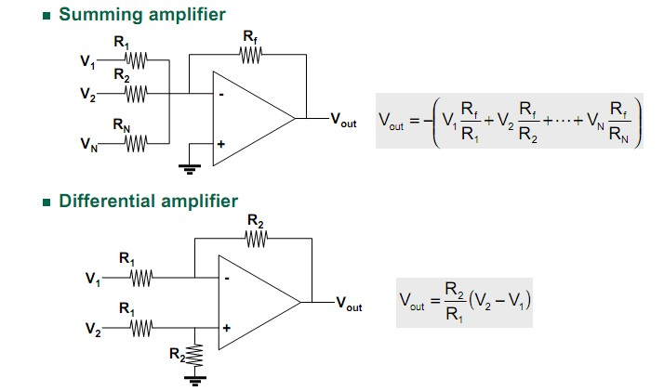

Slide 26

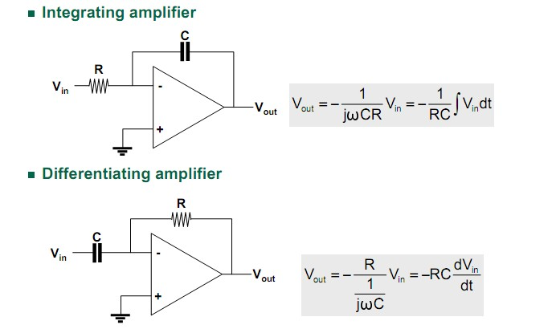

Slide 27

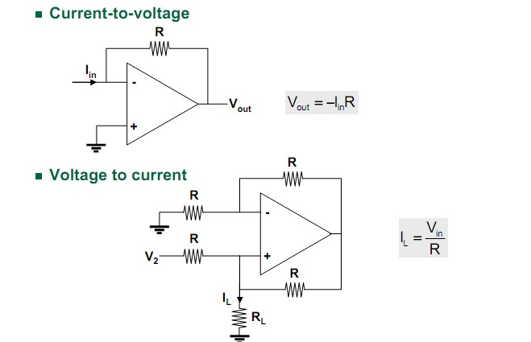

Slide 28
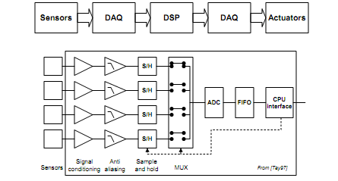
Architecture of data acquisition systems

Slide 29
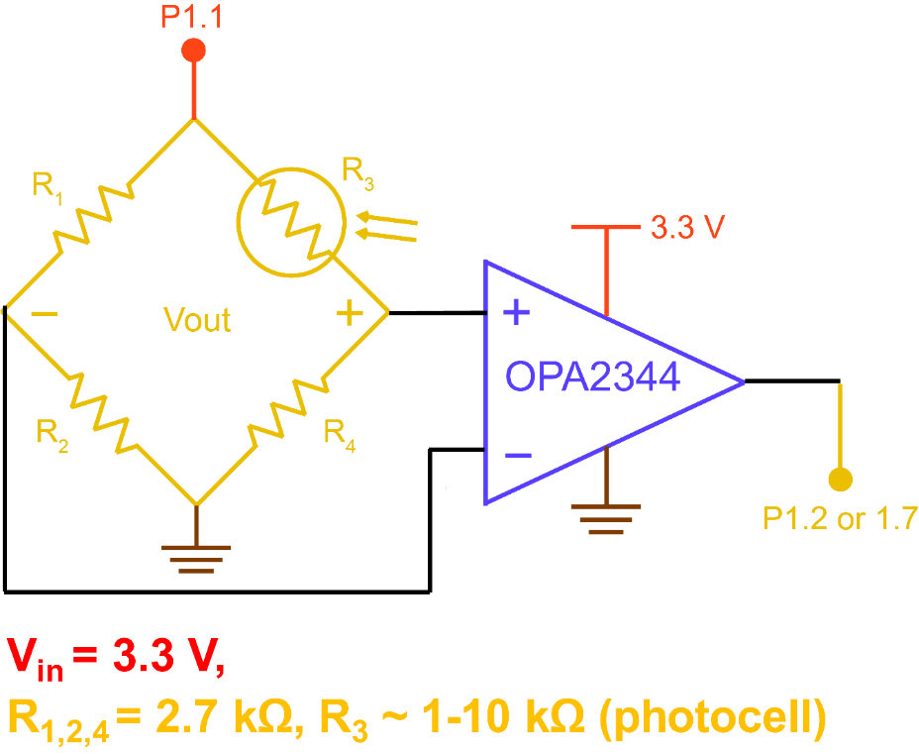
Power Blocked Comparator

Slide 30
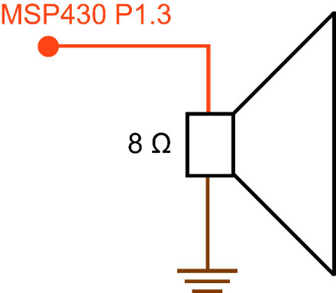
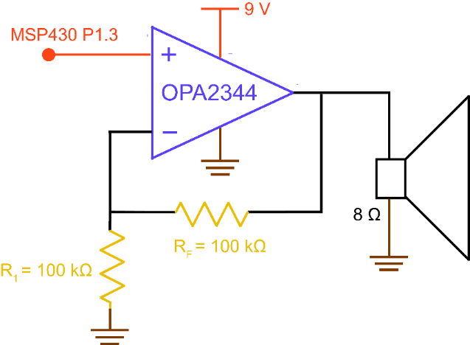
Driving Speaker

Slide 31
Instrumentation amplifiers

Slide 32
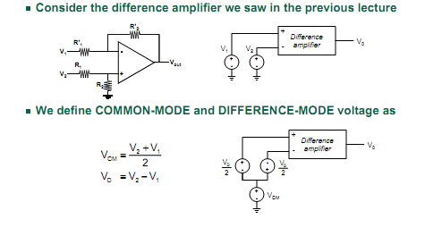
Instrumentation amplifiers

Slide 33
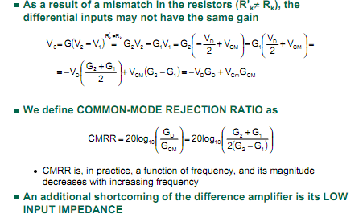
Instrumentation amplifiers

Slide 34
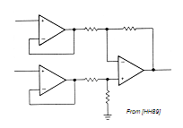
Instrumentation amplifiers
The term INSTRUMENTATION AMPLIFIER is used to denote a difference amplifier with
High gain (INA2126)
Single-ended output
High input impedance
High CMRR
High input impedance may be achieved by buffering the differential inputs
This solution, however, requires high CMRR both in the followers and in the final op-amp
Otherwise, since the input buffers have unity gain, all the CM rejection must come in the output op-amp, requiring precise resistor matching

Slide 35
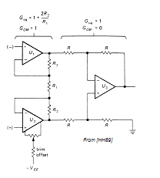
Common mode rejection ratio
A better solutions is the “standard” instrumentation amplifier shown below
Input stage provides high GD and unity GCM
Close resistor (R2) matching is NOT critical
As a result, the output op-amp (U3) does not require exceptional CMRR and resistor matching in U3is not critical
Offset trimming can be done at one of the input op-amps

Slide 36
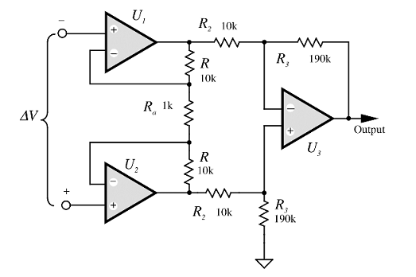

INA….

Slide 37
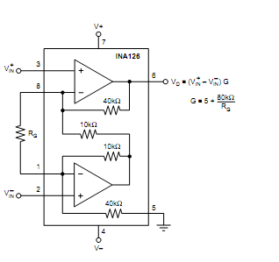

Slide 38
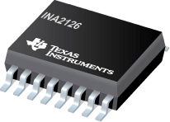
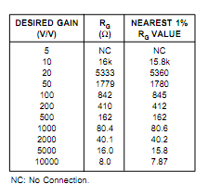
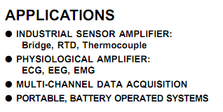
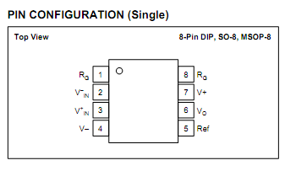
INA126…..

Slide 39
Problems

Slide 40
Problem

Slide 41
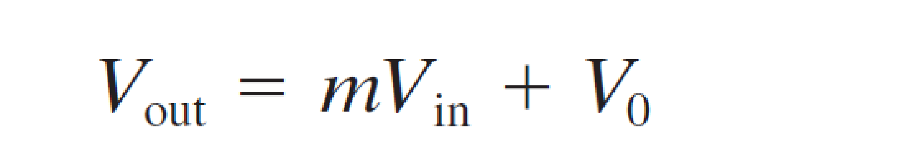
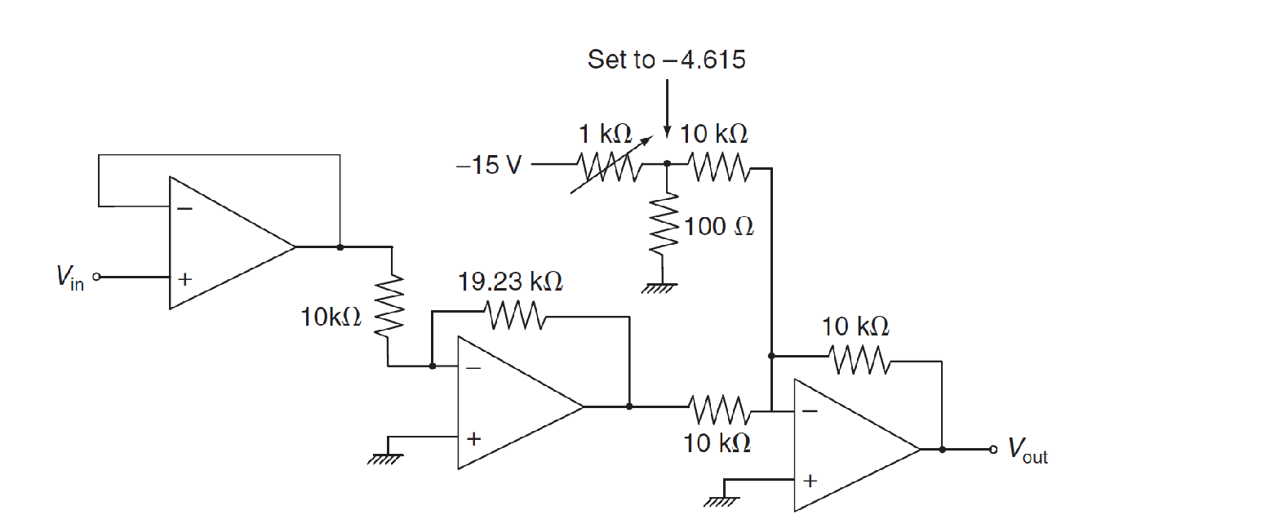
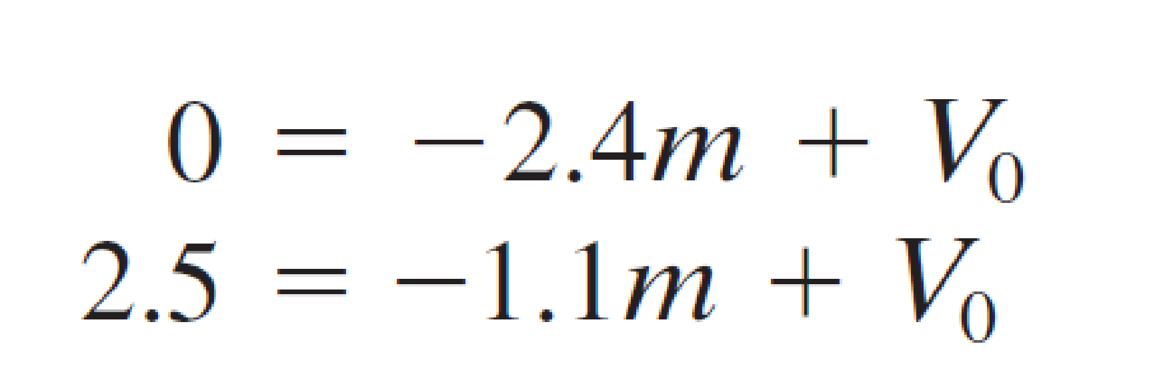
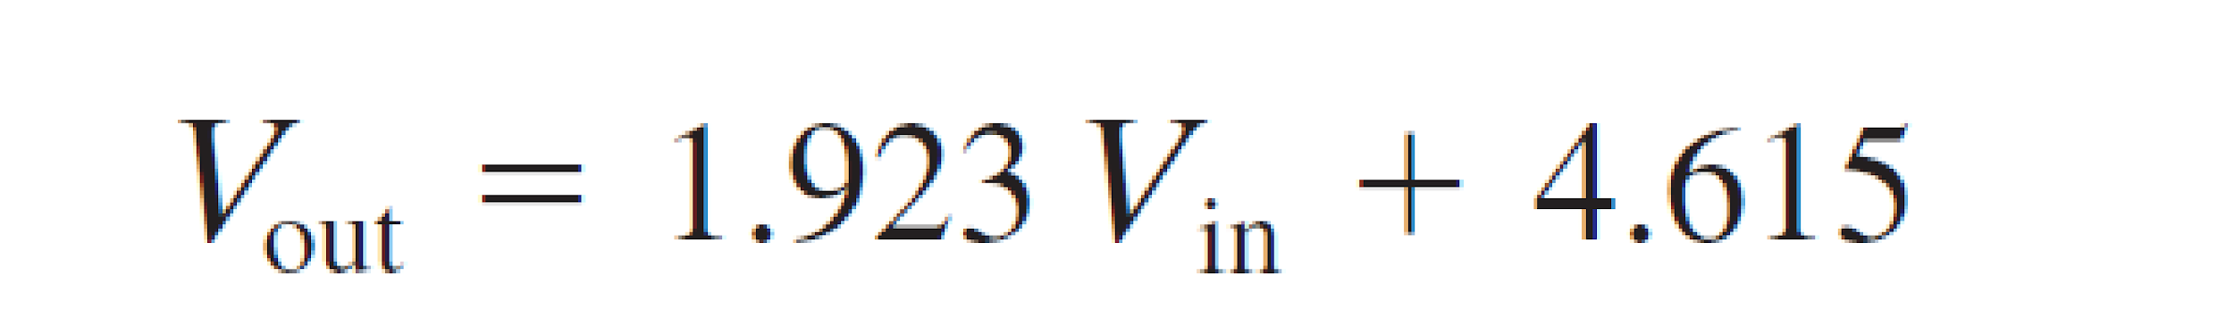
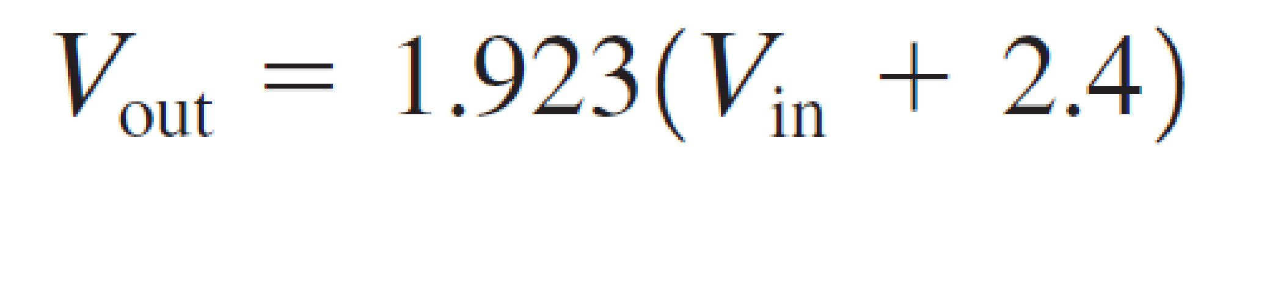

Slide 42
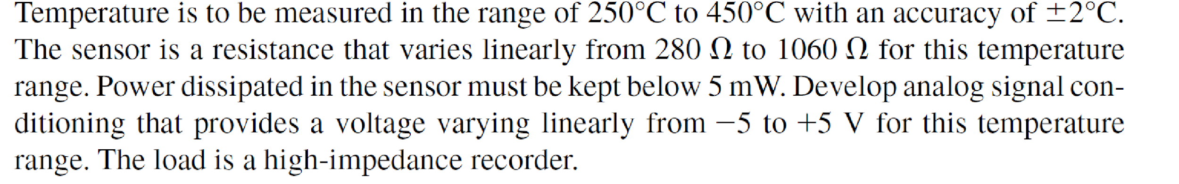

Slide 43
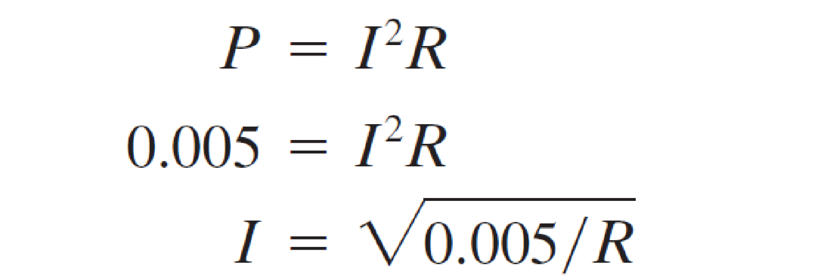
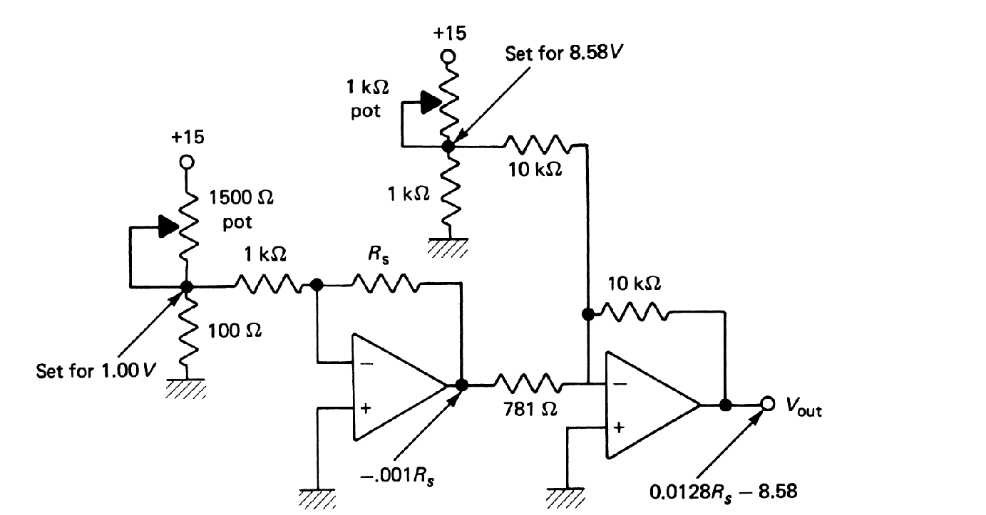
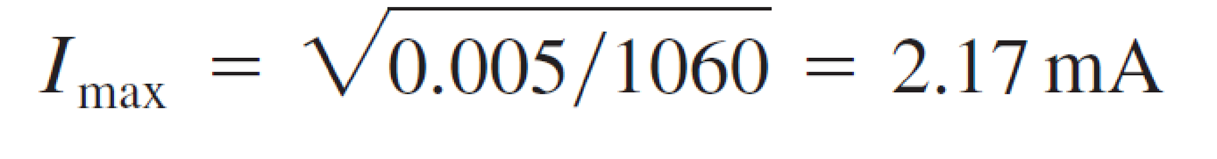
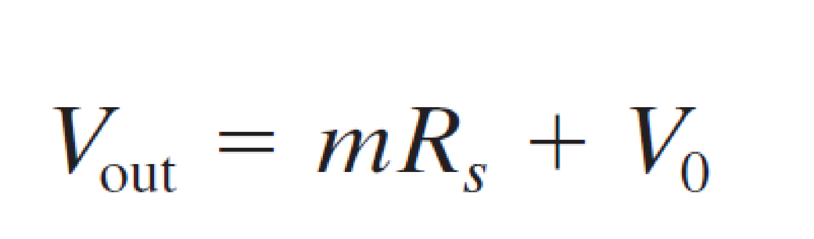
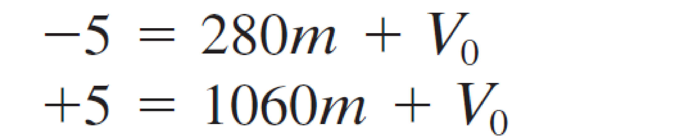
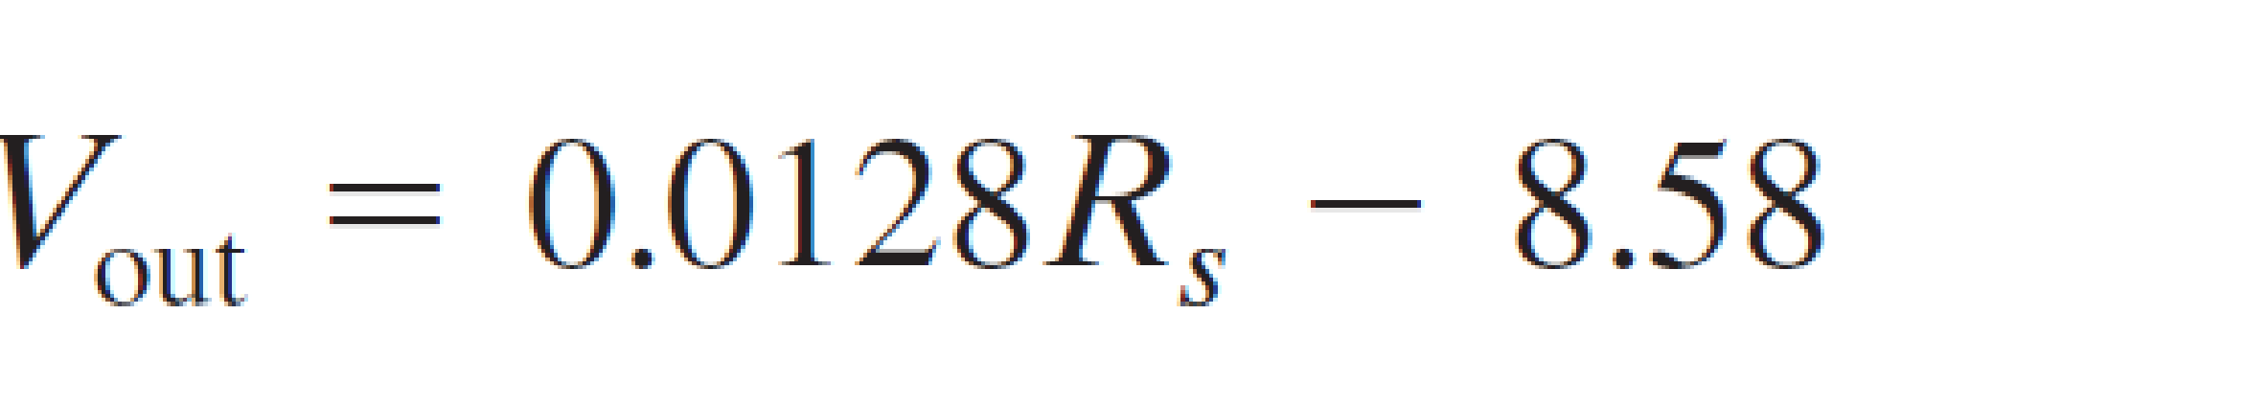

Slide 44
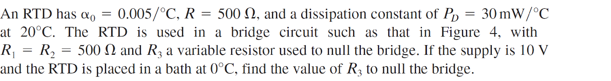
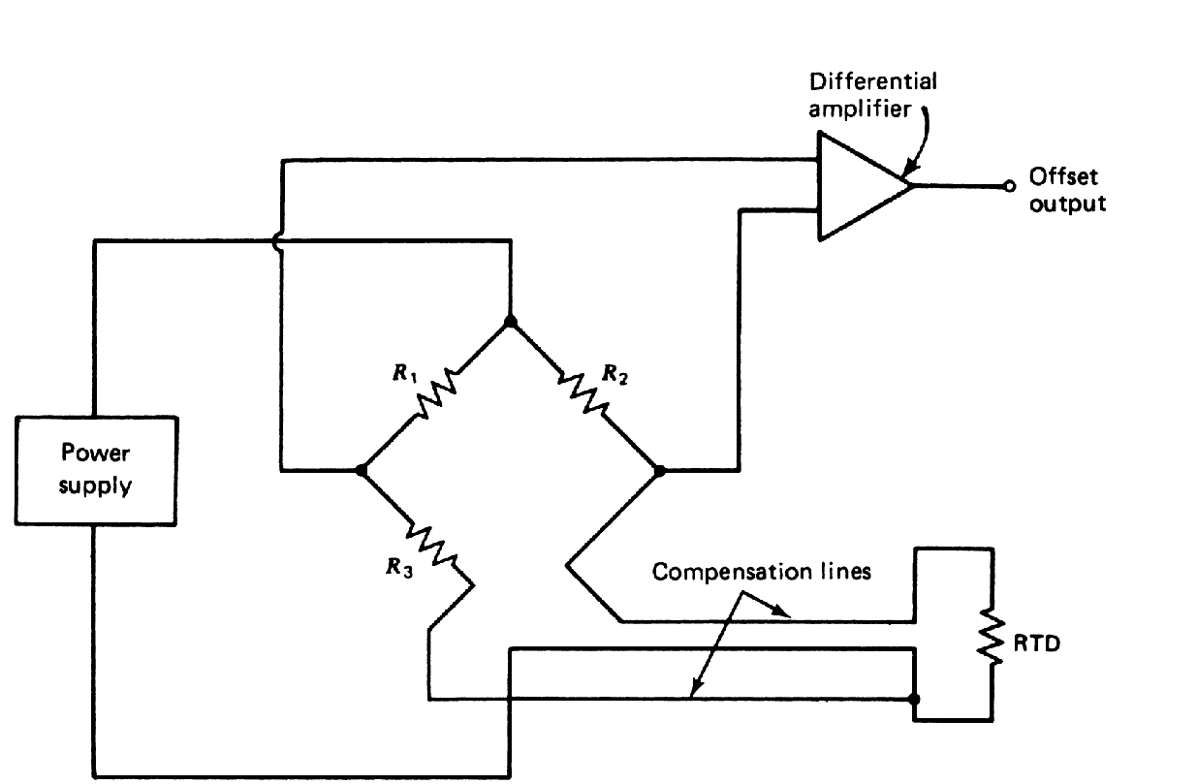

Slide 45
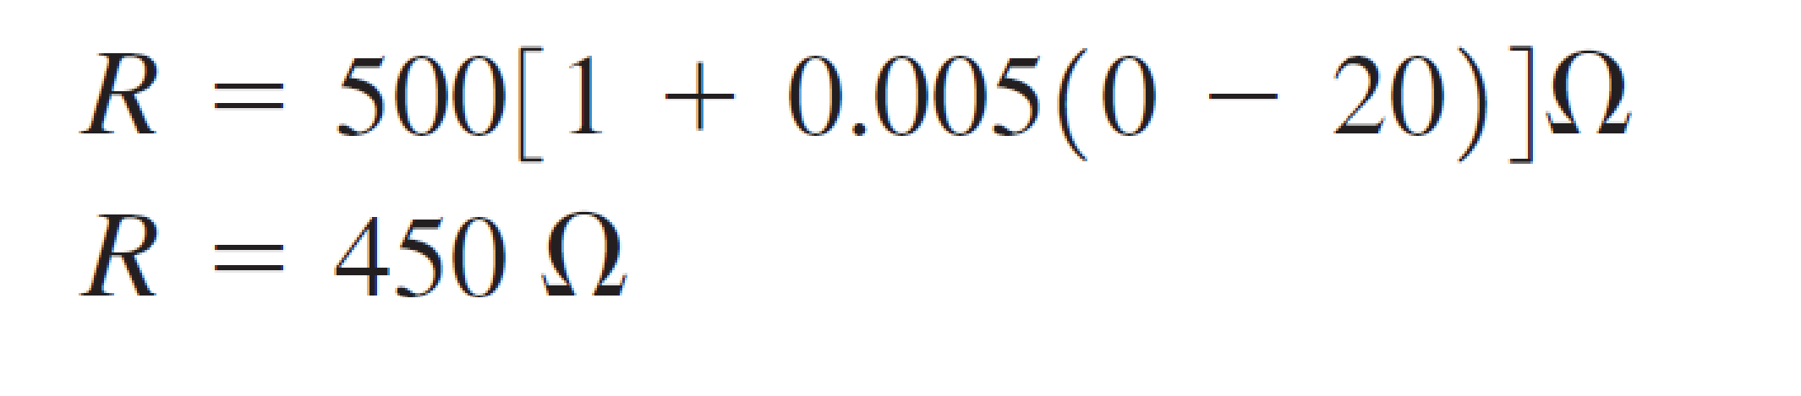
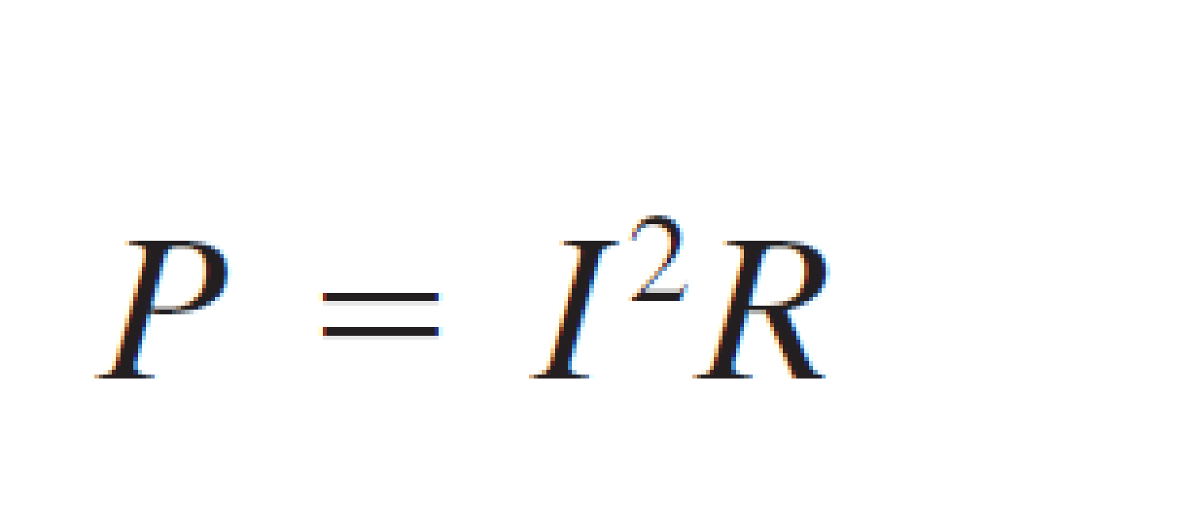
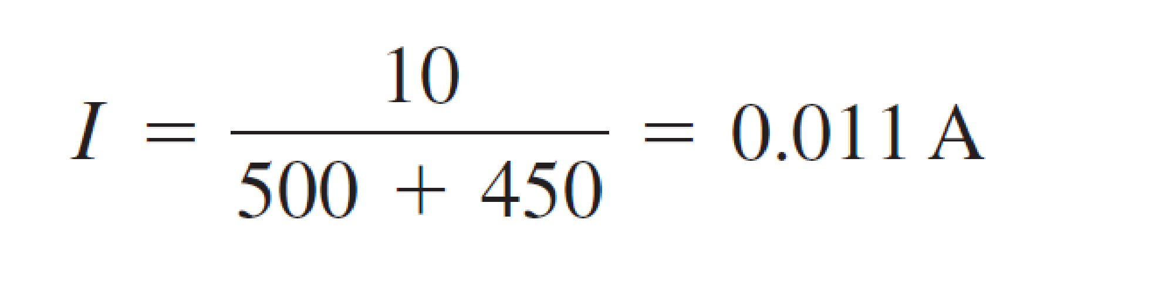
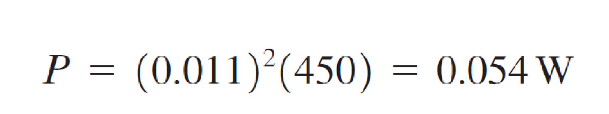



Slide 46

Vapor flows through a chamber containing a liquid at 100C. A control system will regulate the vapor temperature, so a measurement must be provided to convert 50C to 80C into 0 to 2V. The error should not exceed ±1C. If the liquid level rises to the tip of the transducer, its temperature will rise suddenly to 100C. This event should cause alarm comparator output.
Use RTD.
R@ 65C=150ohm
α @ 65C=.004/C
PD=30mW/C

Slide 47







Slide 48
Temperature for plating operation must be measured for control within a range 500-600F. Develop measuring system that scales this temperature into range 0 to 5 V for input to an 8-bit ADC measurement must be within ±1 F.
Use Thermistor type J
260C Vj25=12.84mV
315.6 Vj25=15.90mV

Slide 49






Slide 50


Slide 51







Slide 52


Slide 53


Slide 54



Slide 55

Design problem
Develop a system that turns an alarm LED when the temperature in the chamber reaches 10±0.5C. When the temperature drops below about 8C, the LED should be turned OFF. Use thermistor to measure the temperature.
The dissipation constant of the sensor
is 5mW/C.

Slide 56



Schmitt Trigger

Slide 57







Slide 58
Interfacing Circuits
Measurement of resistance
Voltage dividers
Wheatstone Bridge
Temperature compensation for strain gauges
AC bridges
Measurement of capacitance
Measurement of impedance
Amplifier Transistor
Diodes
Regulators
BJT
MOSFET

Slide 59


Slide 60


Slide 61


Slide 62


Slide 63


Slide 64


Slide 65


Slide 66


Slide 67


Slide 68


Slide 69


Slide 70


Slide 71


Slide 72



Slide 73


Slide 74


Slide 75


Slide 76



Slide 77


Slide 78


Slide 79


Slide 80


https://howtomechatronics.com/tutorials/arduino/arduino-dc-motor-control-tutorial-l298n-pwm-h-bridge/

Slide 81

L298N IC H-bridge
Input1 | Input2 | Spinning Direction
Low(0) | Low(0) | Motor OFF
High(1) | Low(0) | Forward
Low(0) | High(1) | Backward
High(1) | High(1) | Motor OFF
https://lastminuteengineers.com/l298n-dc-stepper-driver-arduino-tutorial/

Slide 82


After defining the pins, in the loop section, we start with reading the joystick X and Y axis values. The joystick is actually made of two potentiometers which are connected to the analog inputs of the Arduino and they have values from 0 to 1023. When the joystick stays in its center position the value of both potentiometers, or axes is around 512.
int xAxis = analogRead(A0); // Read Joysticks X-axis
int yAxis = analogRead(A1); // Read Joysticks Y-axis

Slide 83
Speed Control of Robot backward
// Y-axis used for forward and backward control
if (yAxis < 470) {
// Set Motor A backward
digitalWrite(in1, HIGH);
digitalWrite(in2, LOW);
// Set Motor B backward
digitalWrite(in3, HIGH);
digitalWrite(in4, LOW);
// Convert the declining Y-axis readings for going backward from 470 to 0 into 0 to 255 value for the PWM signal for increasing the motor speed
motorSpeedA = map(yAxis, 470, 0, 0, 255);
motorSpeedB = map(yAxis, 470, 0, 0, 255);
}
We will add a little tolerance and consider the values from 470 to 550 as center. So if we move the Y axis of joystick backward and the value goes below 470 we will set the two motors rotation direction to backward using the four input pins. Then, we will convert the declining values from 470 to 0 into increasing PWM values from 0 to 255 which is actually the speed of the motor.
Similar, if we move the Y axis of the joystick forward and the value goes above 550 we will set the motors to move forward and convert the readings from 550 to 1023 into PWM values from 0 to 255. If the joystick stays in its center the motors speed will be zero.

Slide 84

Speed Control right/left
// X-axis used for left and right control
if (xAxis < 470) {
// Convert the declining X-axis readings from 470 to 0 into increasing 0 to 255 value
int xMapped = map(xAxis, 470, 0, 0, 255);
// Move to left - decrease left motor speed, increase right motor speed
motorSpeedA = motorSpeedA - xMapped;
motorSpeedB = motorSpeedB + xMapped;
// Confine the range from 0 to 255
if (motorSpeedA < 0) {
motorSpeedA = 0;
}
if (motorSpeedB > 255) {
motorSpeedB = 255;
}
}
if (xAxis > 550) {
// Convert the increasing X-axis readings from 550 to 1023 into 0 to 255 value
int xMapped = map(xAxis, 550, 1023, 0, 255);
// Move right - decrease right motor speed, increase left motor speed
motorSpeedA = motorSpeedA + xMapped;
motorSpeedB = motorSpeedB - xMapped;
// Confine the range from 0 to 255
if (motorSpeedA > 255) {
motorSpeedA = 255;
}
if (motorSpeedB < 0) {
motorSpeedB = 0;
}
}
So again, first we need to convert the X axis readings into speed values from 0 to 255. For moving left, we use this value to decrease the left motor speed and increase the right motor speed. Here, because of the arithmetic functions we use two additional “if” statements to confine the range of the motor speed from 0 to 255.

