Slide 1
How the Web Works
Dr. Yousef Hassouneh
Chapter 1

Slide 2
Objectives
1
2
Definitions and History
Internet Protocols
3
4
Client-Server Model
Domain Name System
5
6
Uniform Resource Locators (URL)
Hypertext Transfer Protocol (HTTP)
7
Web Servers

Slide 3
Definitions and history
Section 1 of 8

Slide 4
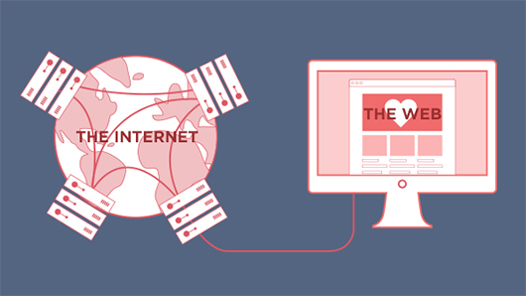
Internet = Web?
The answer is no
The World-Wide Web (WWW or simply the Web) is certainly what most people think of when they see the word “internet.”
Notes:
But the WWW is only a subset of the Internet.

Slide 5

Internet
is a vast, international network of computers.
Consists of computers around the world and the communication links that connect them.
  the physical connections between computers vary, but the overall effect is that computers around the world can communicate and share resources
Notes:
The interconnected network of computer networks that spans the globe.

Slide 6
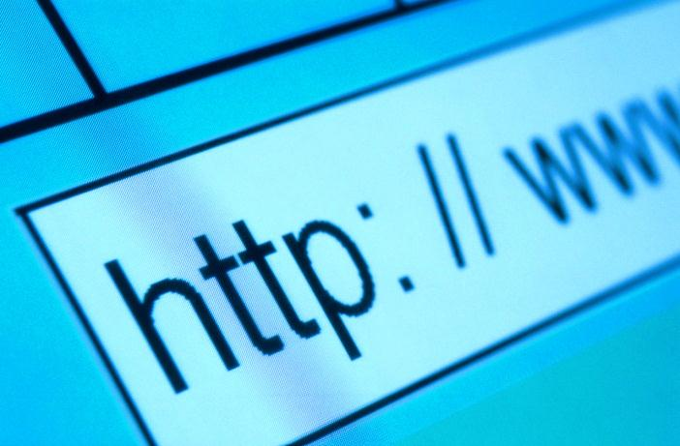
The World Wide Web
World Wide Web (WWW)
Software consists of web pages, images, sound files,..etc and the software that stores and retrieves these files
Notes:
The graphical user interface to information stored on computers running web servers
connected to the Internet.

Slide 7
Checkpoint
Could the web exist without the internet?
Could the internet exist without the web?
Internet could exist without the Web
Web couldn't exist without the Internet
Internet is the hardware that stores and executes the Web software
Notes:
The graphical user interface to information stored on computers running web servers
connected to the Internet.

Slide 8
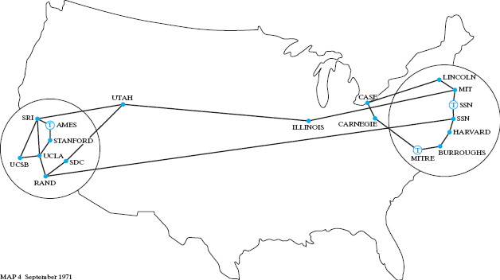
Short History of the Internet
Perhaps not short enough
The early ARPANET network was funded and controlled by the United States government, and was used exclusively for academic and scientific purposes.
The early network started small with just a handful of connected campuses in 1969 and grew to a few hundred by the early 1980s.

Slide 9
TCP/IP
Rides to the rescue
To promote the growth and unification of the disparate networks a suite of protocols was invented to unify the networks together.
By 1981, new networks built in the US began to adopt the TCP/IP (Transmission Control Protocol / Internet Protocol) communication model (discussed in the next section), while older networks were transitioned over to it.

Slide 10
Core Features of the Web
main features of the web:
A URL to uniquely identify a resource on the WWW.
The HTTP protocol to describe how requests and responses operate.
A software program (later called web server software (Apache, Microsoft Internet Information Server (IIS))) that can respond to HTTP requests.
HTML to publish documents.
A program (later called a browser) to make HTTP requests from URLs and that can display the HTML it receives.
Notes:
Shortly after that initial proposal Berners-Lee developed the main features of the web:

Slide 11
W3C
The World Wide Web Consortium (W3C) is an international organization committed to improving the web
W3C sets standards for the World Wide Web (WWW)
Standards developed by the Consortium include:
CSS
DOM
HTML
HTTP
XHTML
XML
…
Notes:
Also in late 1994, Berners-Lee helped found the World Wide Web Consortium (W3C), which would soon become the international standards organization that would oversee the growth of the web.
This growth was very much facilitated by the decision of CERN to not patent the work and ideas done by its employee and instead left the web protocols and code-base royalty free.

Slide 12
Web Apps Compared to Desktop Apps
First the advantages of web apps
Some of the advantages of web applications include:
  Accessible from any internet-enabled computer.
  Usable with different operating systems and browser platforms.
  Easier to roll out program updates since only need to update software on server and not on every desktop in organization.
  Centralized storage on the server means fewer concerns about local storage (which is important for sensitive information such as health care data).

Slide 13
Web Apps Compared to Desktop Apps
Now the disadvantages of web apps
Some of the disadvantages of web applications include:
  Requirement to have an active internet connection (the internet is not always available everywhere at all times).
  Security concerns about sensitive private data being transmitted over the internet.
  Concerns over the storage, licensing and use of uploaded data.
  Problems with certain websites on certain browsers not looking quite right.
  Prevent access to some softwares (like Adobe Flash on iOS).

Slide 14
What is an “Intranet”?
One of the more common terms you might encounter in web development is the term “intranet” which refers to an internet network that is local to an organization or business.
Intranet resources are often private, meaning that only employees (or authorized external parties such as customers or suppliers) have access to those resources.
Thus Internet is a broader term that encompasses both private (intranet) and public networked resources.

Slide 15
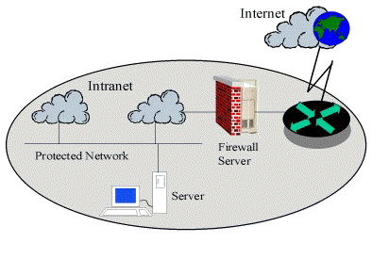
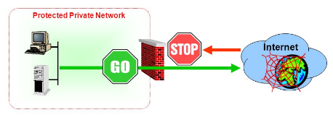
What is an “Intranet”?
Intranets are typically protected from unauthorized external access via security features such as firewalls.

Slide 16
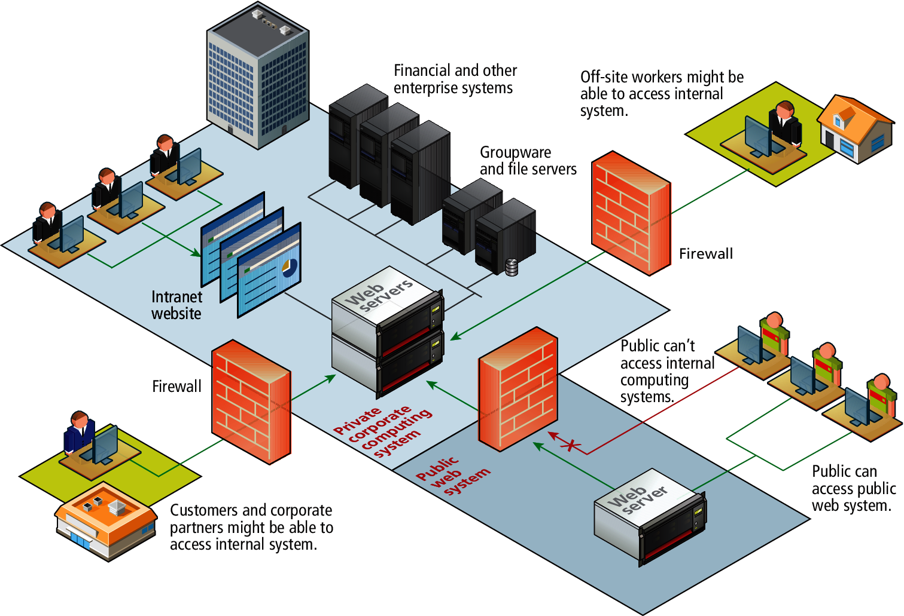
Intranet versus Internet

Slide 17
Static Web Sites VS Dynamic Web Sites
  Static web site
  Consists only HTML pages that look identical for all users at all times
  Dynamic web site
  Capable of producing different content for different visitors from the same source code file. The website can display different content based on what operating system or browser the visitor is using, whether she/he is using a PC or a mobile device.
A dynamic Website page is not necessarily better than a static Website page. The two simply serve different purposes.
Notes:
Partying Like It’s 1995
https://about.gitlab.com/2016/06/03/ssg-overview-gitlab-pages-part-1-dynamic-x-static/
In the earliest days of the web, a webmaster (the term popular in the 1990s for the person who was responsible for creating and supporting a web site) would publish web pages, and periodically update them.
In those early days, the skills needed to create a web site were pretty basic: one needed knowledge of the HTML markup language and perhaps familiarity with editing and creating images.
This type of web site is commonly referred to as a

Slide 18
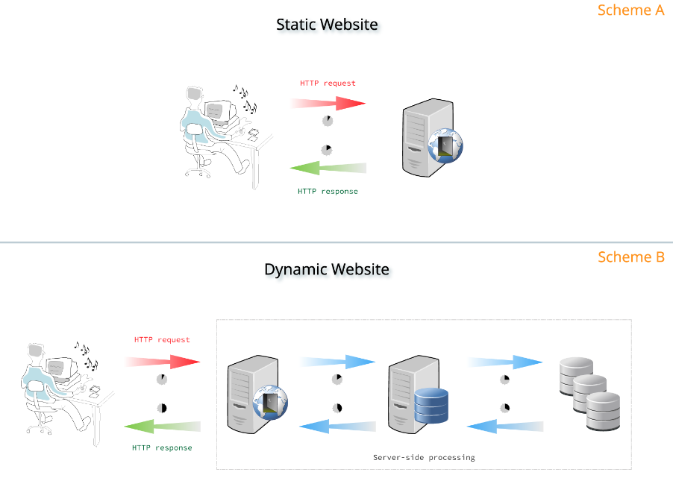
Static Web Sites VS Dynamic Web Sites
Notes:
Partying Like It’s 1995
Static and Dynamic Websites
Static websites are a combination of HTML markup (the text we see written on web pages), CSS (Cascading Style Sheets), which are the styles and layouts applied to that pages, and JavaScript, a programming language that defines their behavior (e.g., fade in and fade out, hover effects, etc.). These pages are stored as simple files, usually in a VPS, which are then served by a web server. When we type in our web browsers the URL for a web page like that, our browser (called client) is making an HTTP request to that server, which identifies which files are being requested, and send them back to our browsers via an HTTP response.
Dynamic websites are more complicated than that. Besides the markup, the styles and the behavior, they do more things that our web browsers can identify. For example, if you are buying something online, it's easy to understand that the prices and the availability of that item are dynamically recovered from some data, generally stored in databases. This process of recovering data and processing it before responding to our browsers as web pages containing that information, is called server-side processing.
…..
Scheme A: the client (web browser) sends an HTTP request to the web server with a URL. The HTML (HyperText Markup Language) file requested, stored in the web server, is immediately returned to the client with an HTTP response, and its content is interpreted by the browser and then displayed to the user. This is known as client-side processing.
Scheme B: the client sends an HTTP request to the web server, which dispatches the request to the application server. The application server may request data from a database first, and then constructs the HTTP response based on the data recovered from the database. This response is passed back to the web server, which returns the HTML file, constructed by the application server, to the client, via HTTP response. This is called server-side processing.
https://about.gitlab.com/2016/06/03/ssg-overview-gitlab-pages-part-1-dynamic-x-static/
In the earliest days of the web, a webmaster (the term popular in the 1990s for the person who was responsible for creating and supporting a web site) would publish web pages, and periodically update them.
In those early days, the skills needed to create a web site were pretty basic: one needed knowledge of the HTML markup language and perhaps familiarity with editing and creating images.
This type of web site is commonly referred to as a

Slide 19
Dynamic Web Sites
Within a few years of the invention of the web, sites began to get more complicated as more and more sites began to use programs running on web servers to generate content dynamically.

Slide 20
Dynamic Web Sites
What are they?
These server-based programs would read content from databases, interface with existing enterprise computer systems, communicate with financial institutions, and then output HTML that would be sent back to the users’ browsers.
This type of web site is called here in this book a dynamic web site because the page content is being created at run-time by a program created by a programmer; this page content can vary for user to user.

Slide 21
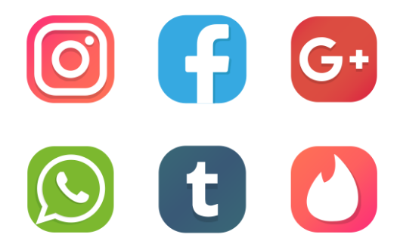
Web 2.0
Its meaning for users
For the users, Web 2.0 referred to an interactive experience where users could contribute and consume web content, thus creating a more user-driven web experience.

Slide 22
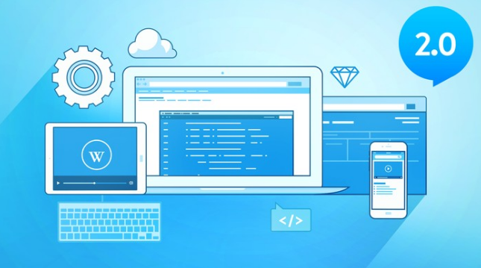
Web 2.0
Its meaning for developers
For software developers, Web 2.0 also referred to a change in the paradigm of how dynamic web sites are created.
Programming logic, which previously existed only on the server, began to migrate to the browser.
This required learning Javascript, a rather tricky programming language that runs in the browser, as well as mastering the rather difficult programming techniques involved in asynchronous communication.

Slide 23
Checkpoint
Describe the difference between the Internet and the Web.

Slide 24
Internet protocols
Section 2 of 8

Slide 25
What’s a Protocol?
Protocol
A set of rules that control the way two entities (applications, devices, ...) communicate with each other.
Notes:
The internet exists today because of a suite of interrelated communications protocols.
is a set of rules that partners in communication use when they communicate.

Slide 26
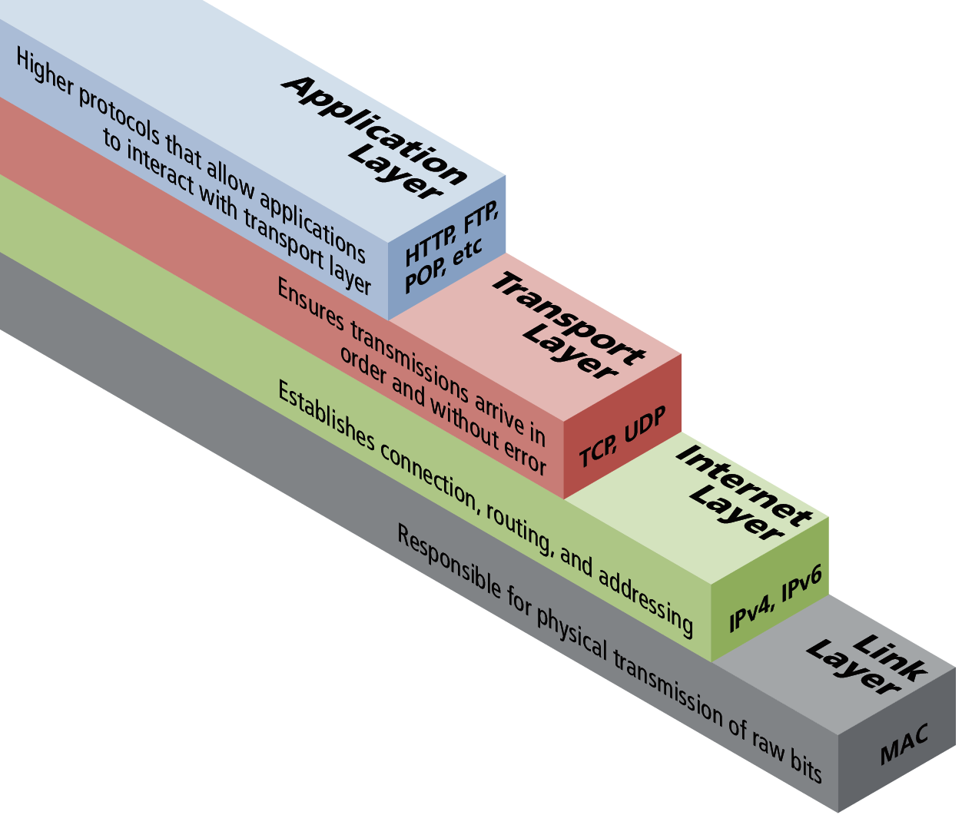
Four Layer Network Model
Computer A
Computer B

Slide 27
Internet Protocol (IP)
The Internet uses the Internet Protocol (IP) addresses to identify destinations on the Internet.
Every device connected to the Internet has an IP address, which is a numeric code that is meant to uniquely identify it.

Slide 28
IP Addresses

Slide 29
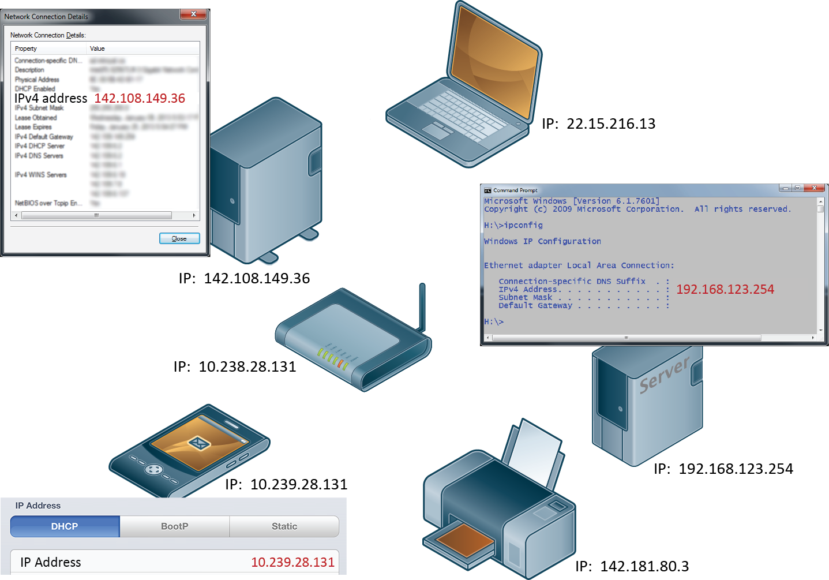
IP addresses and the Internet

Slide 30
IP Addresses
Inside of networks is different
Your IP address will generally be assigned to you by your Internet Service Provider (ISP).

Slide 31
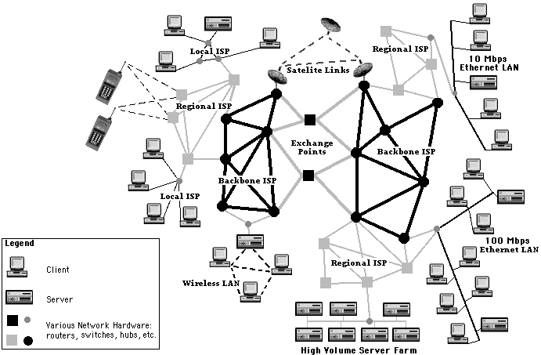
The Inter-network is a big network of networks.

Slide 32
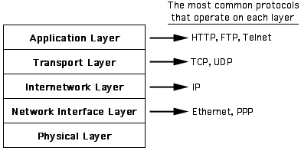
The five-layer networking model for the internet.

Slide 33
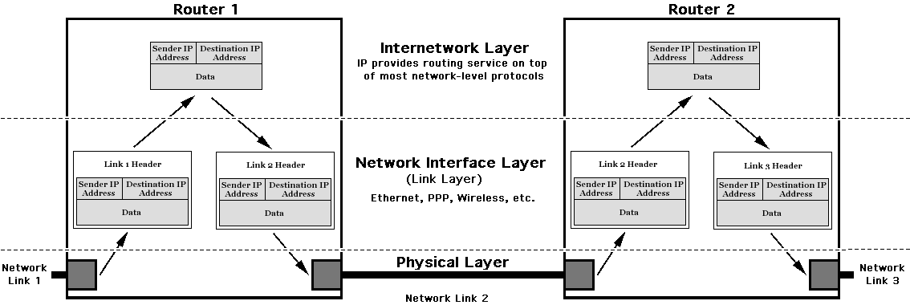
Routers direct packets among different networks based upon IP addresses.
Some IP features: Flow Control, Time To Live (TTL).
No delivery guarantee at this layer.

Slide 34
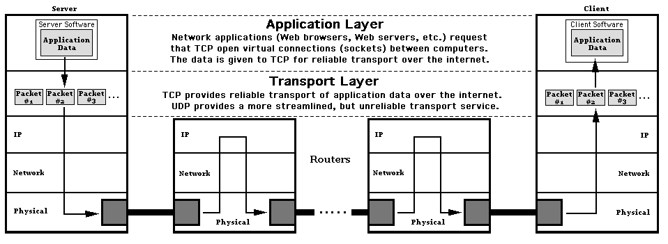
Transport Layer -- End-to-End Service
Transmission Control Protocol (TCP) -- Divides data into packets, verifies arrival on the other end, puts packets back together. TCP connections between two computers called sockets.
User Datagram Protocol (UDP) -- No guarantee of delivery, often single packet transmission, used for Domain Name Service.

Slide 35
Client-Server MODEL
Section 3 of 8

Slide 36
Client-Server Model
What is it?
The web is sometimes referred to as a client-server model of communications.
In the client-server model, there are two types of actors: clients and servers.
The server is a computer agent that is normally active 24 hours a day, 7 days a week (or simply 24/7), listening for queries from any client who make a request.
A client is a computer agent that makes requests and receives responses from the server, in the form of response codes, images, text files, and other data.

Slide 37
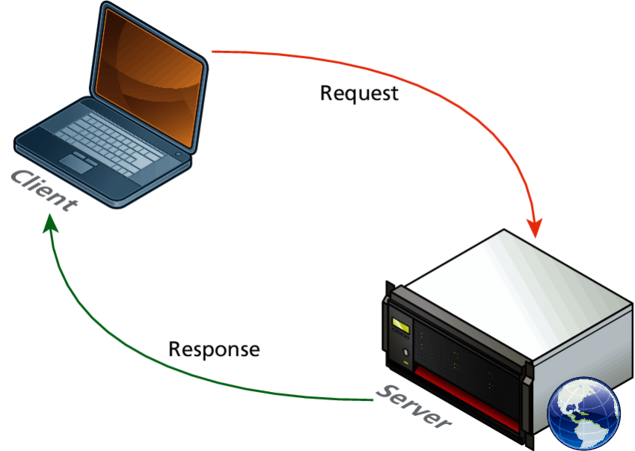
Request-Response Loop
Within the client-server model, the request-response loop is the most basic mechanism on the server for receiving requests and transmitting data in response.
The client initiates a request to a server and gets a response that could include some resource like an HTML file, an image or some other data.

Slide 38
Clients and Web Servers
Clients (browsers) send HTTP requests and web servers send HTTP responses
  Provide HTML pages to the client
Client Browser
Server
1. HTTP request
HTML
Page
HTML
Page
HTML
Page
2. Process request and return page or HTTP response code
HTML
Page
HTML
Page
3. HTTP response

Slide 39
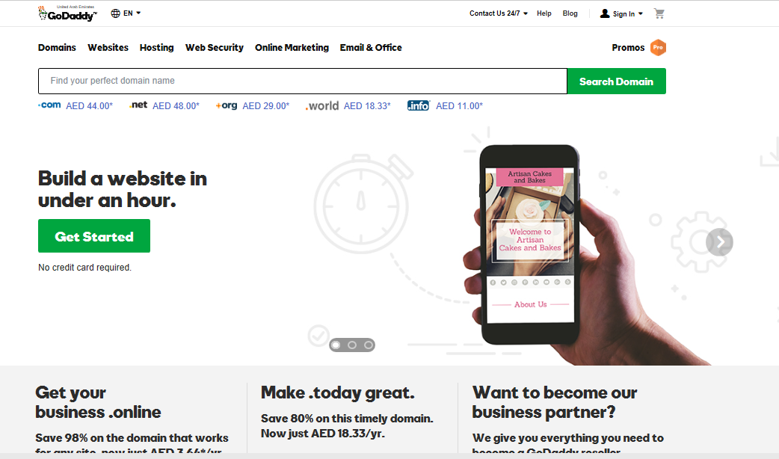


Commercial Web Hosting
Large commercial web hosting companies such as GoDaddy, Blue Host, Dreamhost, and others will typically host hundreds or even thousands of sites on a single machine (or mirrored on several servers).
Notes:
It is also common for the reverse to be true – that is, a single server machine may host multiple sites.

Slide 40
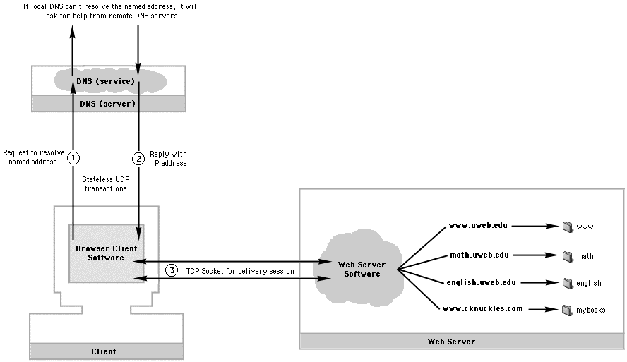
Two useful application layer services on the Web.
Domain Name Service (DNS) -- Uses UDP for transport.
Virtual Hosting -- Maps Domain Names onto folders on the Web server.

Slide 41

The structure of a Uniform Resource Locator (URL)
How: The application layer protocol. Example: Browsers and Web servers use http (hypertext transfer protocol)
Where: The named address of the resource -- Translated to IP address for internet travel, then used to locate the virtual space (folder) on the Web server.
What: Path to specific resource in that folder.

Slide 42
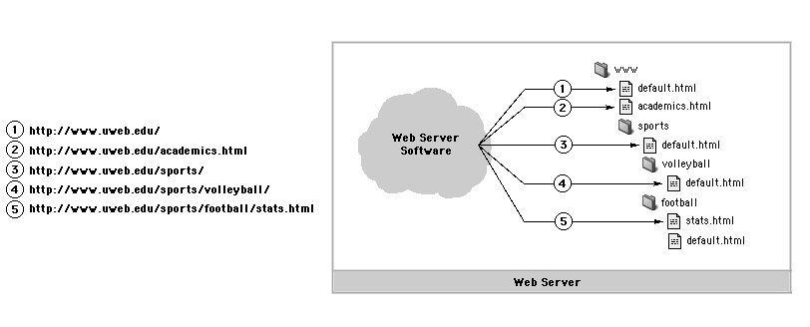
The what part of a URL identifies a particular resource within the folder assigned to the domain name (where part of URL).
The request for a directory loads a default file in that directory. If there is no default file, then the directory contents may be listed.
The request for a file loads that file.

Slide 43
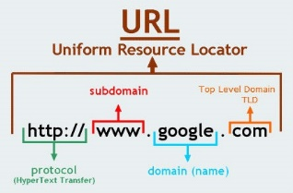
URL Components
In order to allow clients to request particular resources from the server, a naming mechanism is required so that the client knows how to ask the server for the file.
For the web that naming mechanism is the Uniform Resource Locator (URL).

Slide 44
DOMAIN NAME SYSTEM (DNS)
Section 5 of 8

Slide 45
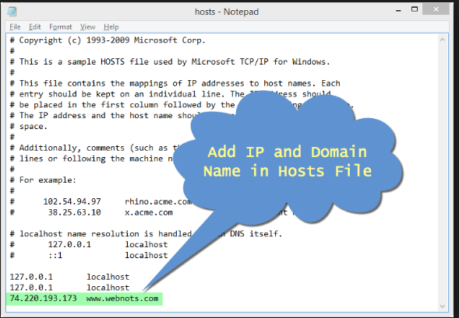

Domain Name System
Why do we need it?
As elegant as IP addresses may be, human beings do not enjoy having to recall long strings of numbers. Instead of IP addresses, we use the Domain Name System (DNS)
  Associates unique computer IP Addresses with the text-based domain names you type into a web browser
  Browser: http://google.com
  IP Address:172.217.16.68
{a set of servers that map written names to IP addresses}

Slide 46
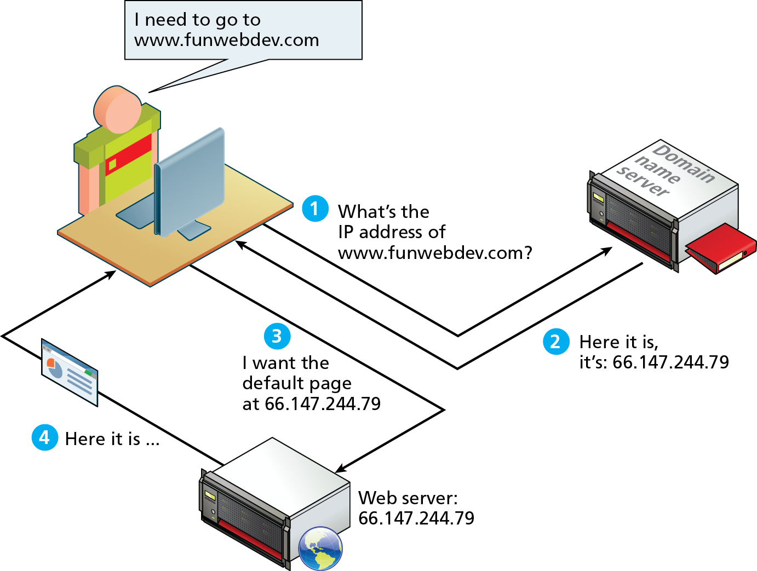
DNS Overview

Slide 47
Domain Levels
Notes:
A domain name can be broken down into several parts. They represent a hierarchy, with the rightmost parts being closest to the root at the “top” of the Internet naming hierarchy. All domain names have at least a top-level domain (TLD) name and a second-level domain (SLD) name. Most websites also maintain a third-level WWW subdomain and perhaps others. Figure 1.26 illustrates a domain with four levels. The rightmost portion of the domain name (to the right of the rightmost period) is called the top-level domain. For the top level of a domain, we are limited to two broad categories, plus a third reserved for other use. They are:

Slide 48
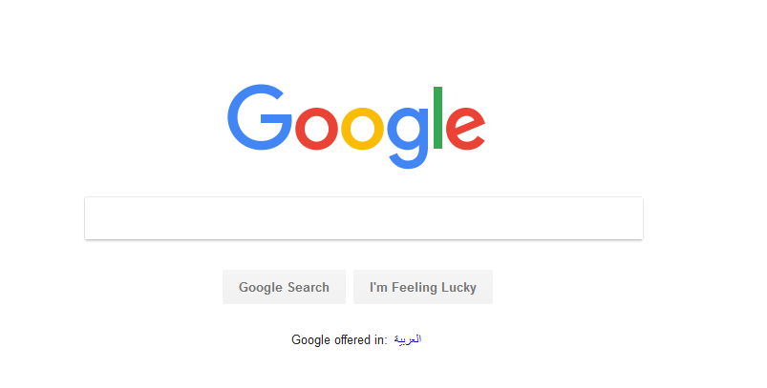
Domain Levels
172.217.16.68
www.google.com
Three levels
192.116.22.102
google.com
Two levels
Notes:
A domain name can be broken down into several parts. They represent a hierarchy, with the rightmost parts being closest to the root at the “top” of the Internet naming hierarchy. All domain names have at least a top-level domain (TLD) name and a second-level domain (SLD) name. Most websites also maintain a third-level WWW subdomain and perhaps others. Figure 1.26 illustrates a domain with four levels. The rightmost portion of the domain name (to the right of the rightmost period) is called the top-level domain. For the top level of a domain, we are limited to two broad categories, plus a third reserved for other use. They are:

Slide 49
Types of TLDs
Generic top-level domains (gTLD)
Country code top-level domain (ccTLD)

Slide 50
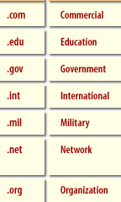
TLD
Top-Level Domain Name
A top-level domain (TLD) identifies the right-most part of the domain name.
Examples of generic TLDs:
.com, .org, .net, .mil, .gov, .edu, .int, .aero, .asia, .cat, .jobs, .name, .biz, .mobi, .museum, .info, .coop, .post, .pro, .tel, .travel

Slide 51
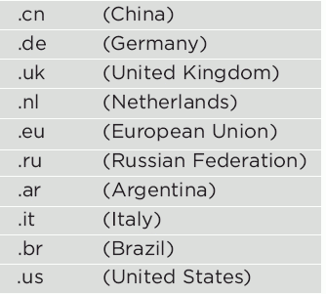
County Code TLDs
Two character codes originally intended to indicate the geographical location (country) of the web site.
Examples:
  .ps,.jp, .uk
Notes:
See http://www.iana.org/cctld/cctld-whois.htm
In practice, it is fairly easy to obtain a domain name
with a country code TLD that is not local to the registrant.

Slide 52
Name Registration
How are domain names assigned?
Special organizations or companies called domain name registrars manage the registration of domain names.
These domain name registrars are given permission to do so by the appropriate generic top-level domain (gTLD) registry and/or a country code top-level domain (ccTLD) registry.

Slide 53
Uniform Resource Locators (URL)
Section 6 of 8

Slide 54
URL Components
In order to allow clients to request particular resources from the server, a naming mechanism is required so that the client knows how to ask the server for the file.
For the web that naming mechanism is the Uniform Resource Locator (URL).

Slide 55
Hypertext transfer protocol (http)
Section 7 of 8

Slide 56
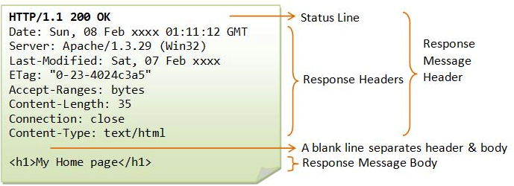
HTTP
The HTTP protocol establishes a TCP connection on port 80 (by default).
The server waits for the request, and then responds with a response code, headers and an optional message (which can include files).
Notes:
http:80
Smtp:25
ftp:20
adds reliability to network layer
an identifier for the location of a document on a web site
a basic URL: http://www.aw-bc.com/info/regesstepp/index.html ~~~~ ~~~~~~~~~~~~~ ~~~~~~~~~~~~~~~~~~~~~~~~~~ protocol host path
upon entering this URL into the browser, it would:
ask the DNS server for the IP address of www.aw-bc.com
connect to that IP address at port 80
ask the server to GET /info/regesstepp/index.html
display the resulting page on the screen

Slide 57
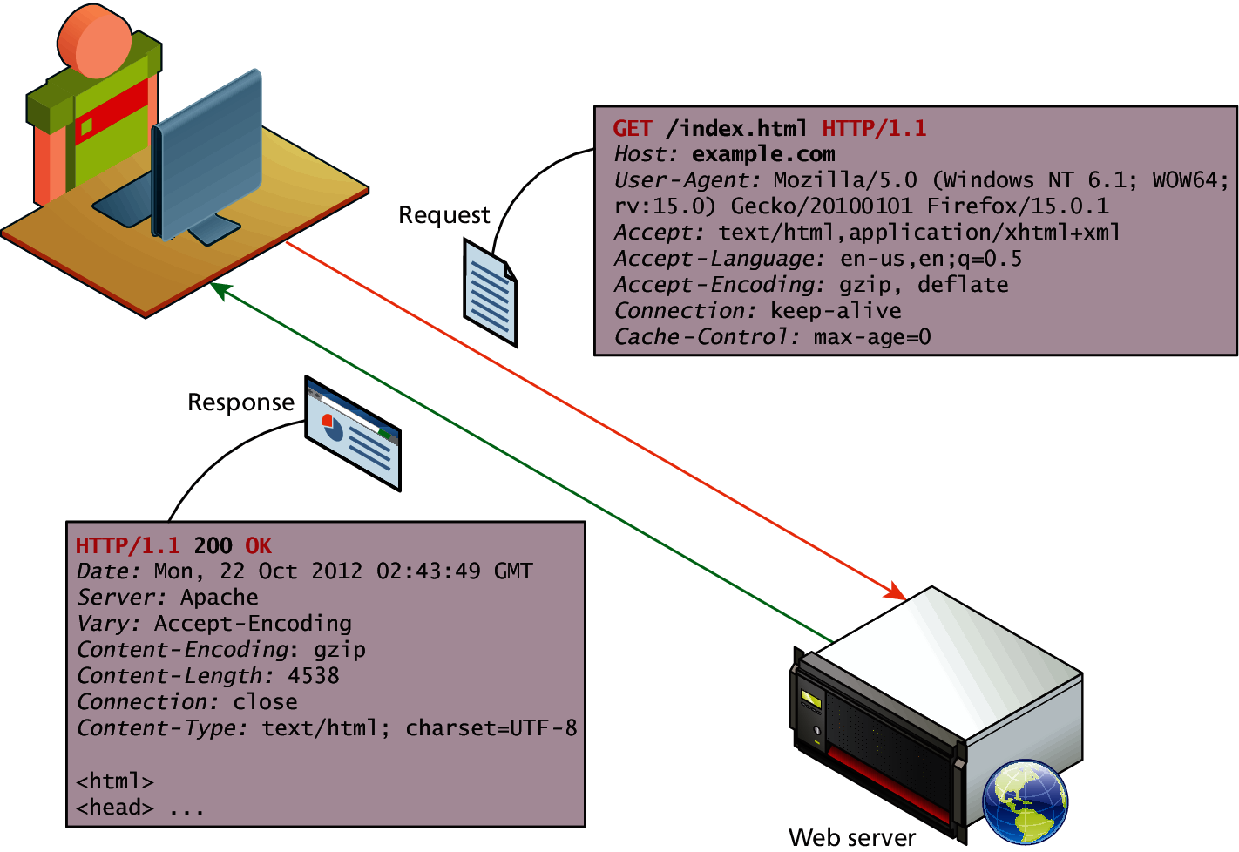
HTTP
Notes:
https://www.ntu.edu.sg/home/ehchua/programming/webprogramming/HTTP_Basics.html

Slide 58
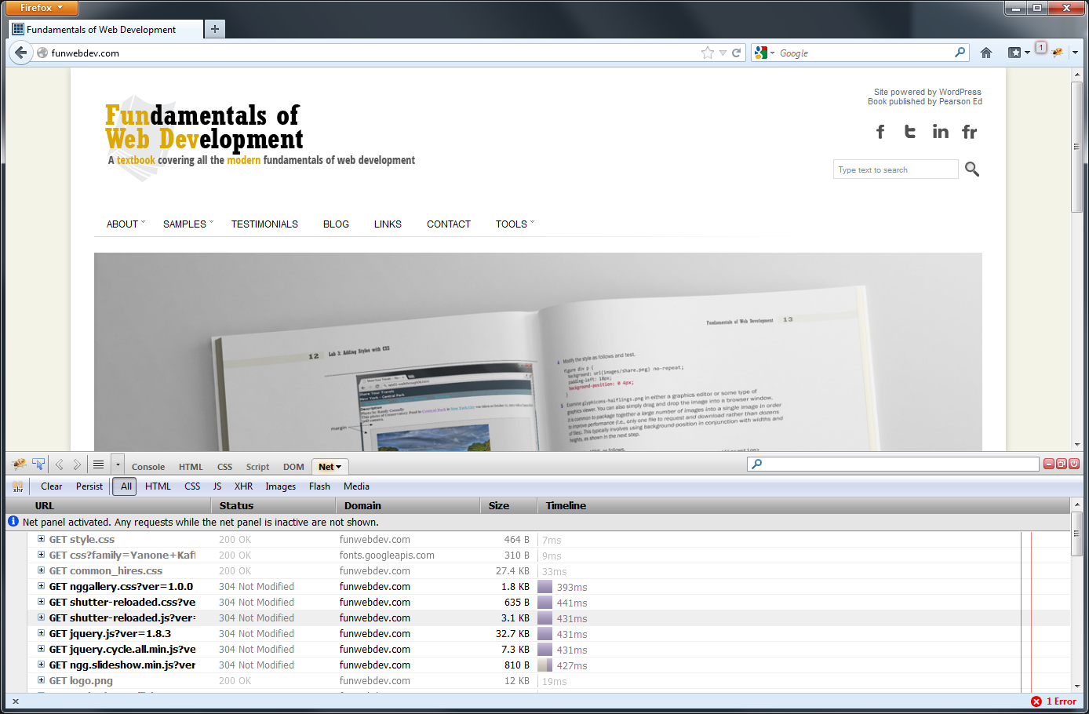
Browser Tools for HTTP
Modern browsers provide the developer with tools that can help us understand the HTTP traffic for a given page.

Slide 59
HTTP Request Methods
The HTTP protocol defines several different types of requests, each with a different intent and characteristics.
The most common requests are the GET and POST request, along with the HEAD request.
Other requests, such as PUT, DELETE, CONNECT, TRACE and OPTIONS are seldom used, and are not covered here.

Slide 60
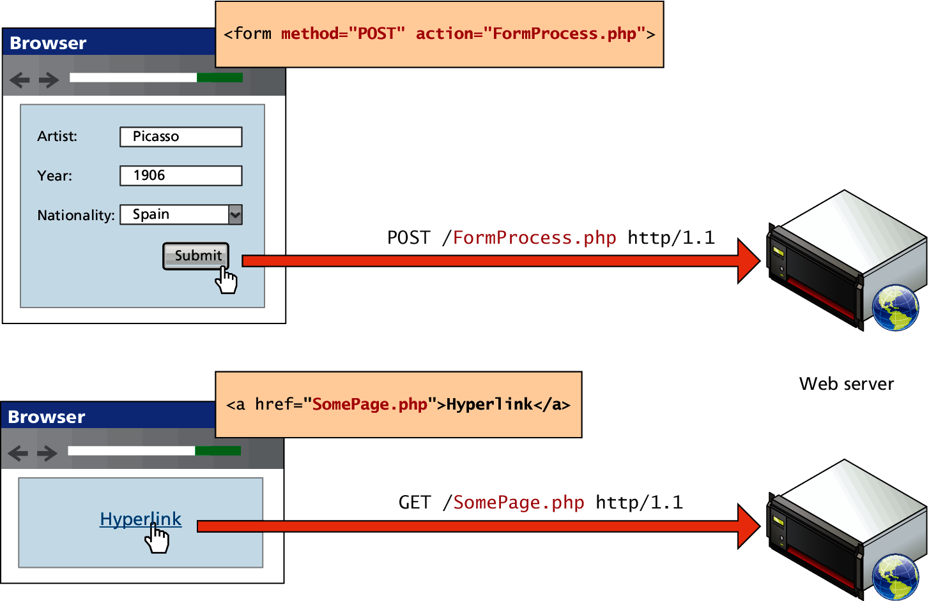
GET versus POST requests

Slide 61
Web Servers
Section 8 of 8

Slide 62
Web Servers
A web server is, at a fundamental level, nothing more than a computer that responds to HTTP requests.

Slide 63
What You’ve Learned
1
2
Definitions and History
Internet Protocols
3
4
Client-Server Model
Domain Name System
5
6
Uniform Resource Locators (URL)
Hypertext Transfer Protocol (HTTP)
7
Web Servers

