Slide 1
Chapter 4 language intervention for infants and preschool children
Hiba + Aseel Mushasha

Slide 2
Grammatical classification of the first 50 words produced
Nominals : 50%, eg : milk, dog, car.
Action words : 11–14% , eg: give, do, up, bye-bye.
Modifiers: 14–19 % . Eg: mine, no dirty.
Personal/social : 10%. Eg : no, please.
Functional : 4 %. Eg: this, for.
Expressive vocabulary growth :
Age : Number of Words
15 months : 4–6
18 months : 20–50
24 months : 200–300
3 years : 900–1,000
4 years: 1,500–1,600
5 years : 2,100–2,200

Slide 3
children’s early vocabularies express a basic set of semantic functions or intentions
There main consideration in the selection of target vocabulary in the strategies used to facilitate the acquisition of early lexical items:
1) words that can be used in many different contexts during the child’s daily activities.
(2) words that are important to the child, such as names of significant others or types of favorite foods or toys.
(3) words that represent dynamic rather than static states, especially referents that can be acted on or manipulated directly by the child such as a ball or a spoon, rather than a tree or a wall.

Slide 4
contexts/activities that can be used to stimulate different types of semantic intentions at the single-word level:
Existence/naming: Introduce a container filled with interesting objects and reveal them to the child one at a time.
Nonexistence: Expose an attractive object to the child and then hide it from view.
Recurrence: Initiate a desirable activity and then stop.
Action: Engage the child in an activity such as making pudding that will elicit a number of different actions (e.g., open, pour, stir, mix).
Possession: Place a combination of the child’s and clinician’s belongings in a box, pull them out one at a time, and sort into separate piles.
Locative: Engage the child in play with trucks or cars using props such as a Fisher-Price Garage or Little Peoples Wheelies Race Track that encourage changes in location.
Rejection: Offer objects or activities that are known to be unappealing to the child.
Denial: In a playful manner, intentionally misname objects or body parts that the child already knows.

Slide 5
One evidence-based strategy to promote simultaneous development of receptive and expressive vocabulary is reading books together, either the clinician and his young clients or the clients and their parents.
Referrer to the book 175 -174 for a case study.
As children approach the third birthday, a transition plan is developed.
The transition plan is typically prepared at the last IFSP meeting before the transition occurs.
It includes 1) the steps needed to prepare the child and family for the new setting.
2) It also outlines the steps for preparing the professionals who will be providing the special education services at the new setting

Slide 6
Helpful hints:
1. Clinicians may want to incorporate some of the main characteristics of mothers child-directed speech, in their speech to young children. These include exaggerated intonation, short utterance length, simple vocabulary and syntactic structures, frequent repetition of utterances, and talking about topics in the “here and now.”
2. Clinician (CL) responses to child (CH) utterances should be framed in a way that encourages the exchange to continue and keeps the child in the interaction(sometimes referred to as turnabouts). For example:
CH: dat?
CL: Kitty cat. What does it say?
vs.
CH: dat?
CL: It’s a kitty.

Slide 7
3.Clinicians can maximize the effectiveness of intervention activities by selecting toys and materials that are developmentally supportive for a particular child.
4. Clinicians need to be aware that many infants with communication impairments may exhibit concomitant impairments in other areas. Intervention programs must accommodate the infant’s overall developmental profile. For example, tactile stimulation often elicits abnormal primitive reflexes in children with cerebral palsy and can significantly interfere with therapeutic programming.
5. Clinicians should be prepared to address skepticism of other professionals and families/caregivers regarding the merits of language intervention with infants and very young children.
6. The clinician can provide families with the treatment steps that are followed,
and address their concerns and questions.

Slide 8
Intervention for children for 3-5 years :
During this developmental period, children acquire the major portion of the linguistic system.
Characteristic of this period:
rapid growth in vocabulary. After the age of 18 months, children add approximately 9 to 10 new words to their lexicons each day, or 3,000 words per year.
Average utterance length continues to increase, and the acquisition of syntax has its onset as children begin to impose word order on their two-word combinations.
Morphological forms emerge and become solidified, although complete mastery is not attained until the early elementary school years.
This developmental period also is marked by children’s ability to understand and produce a variety of simple and complex sentence forms.
children in this age range demonstrate substantial development in the area of emergent literacy through exposure and interaction with print.

Slide 9
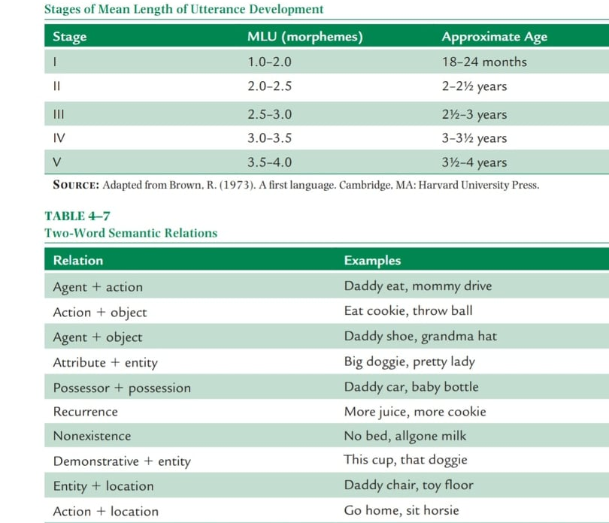

Slide 10
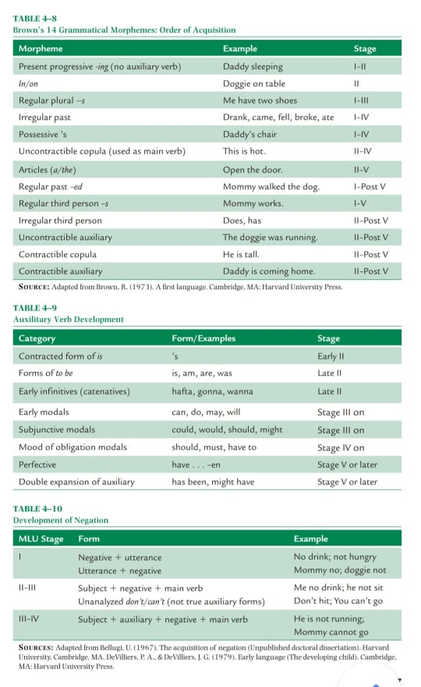

Slide 11
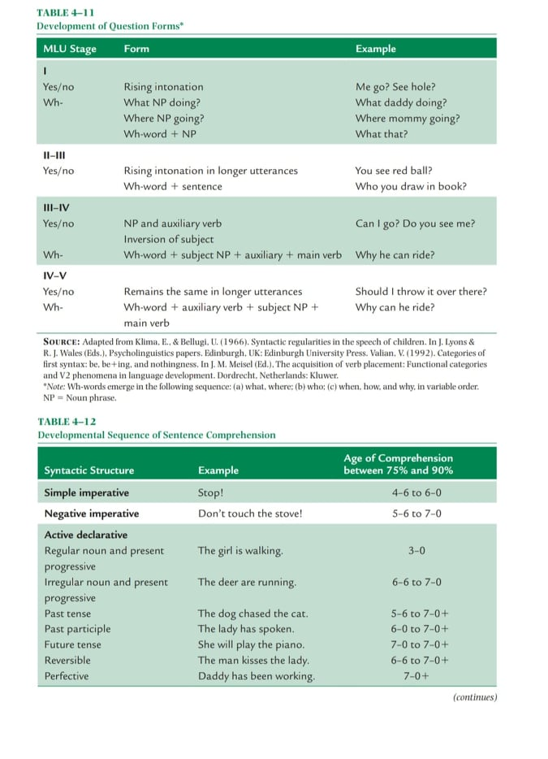

Slide 12
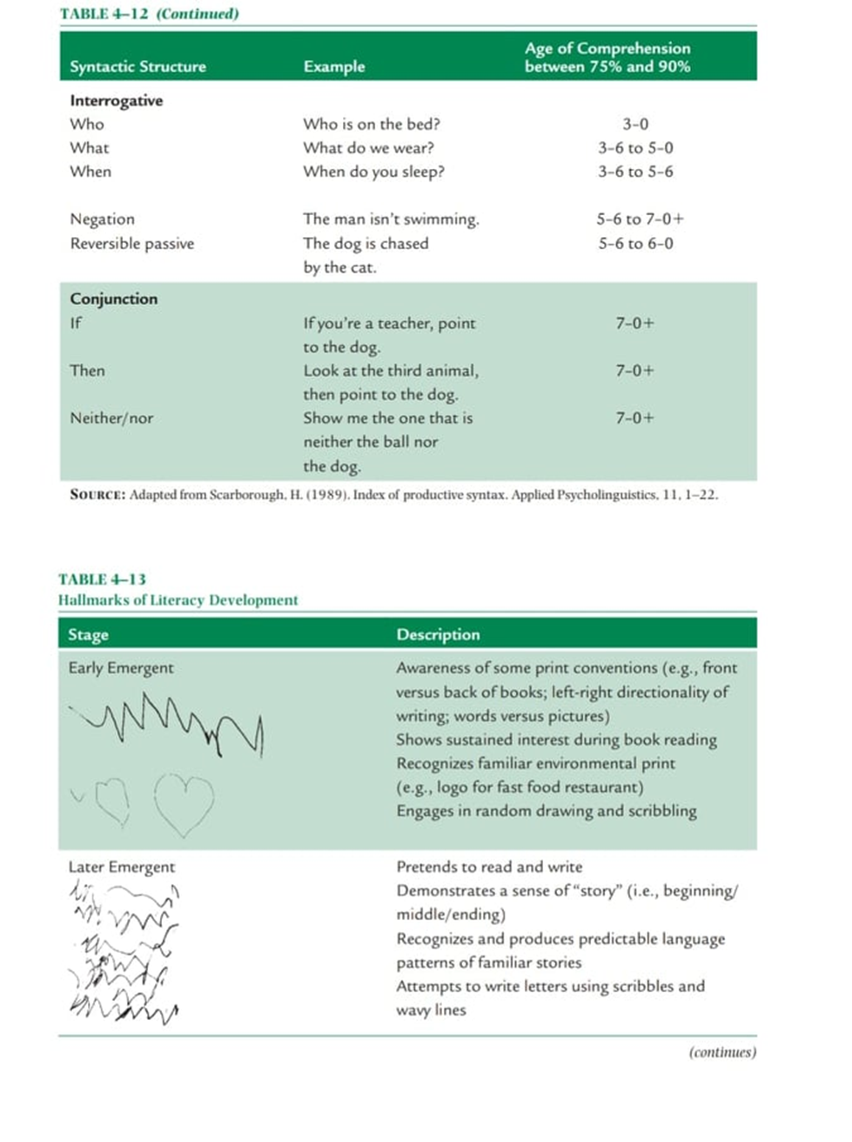

Slide 13
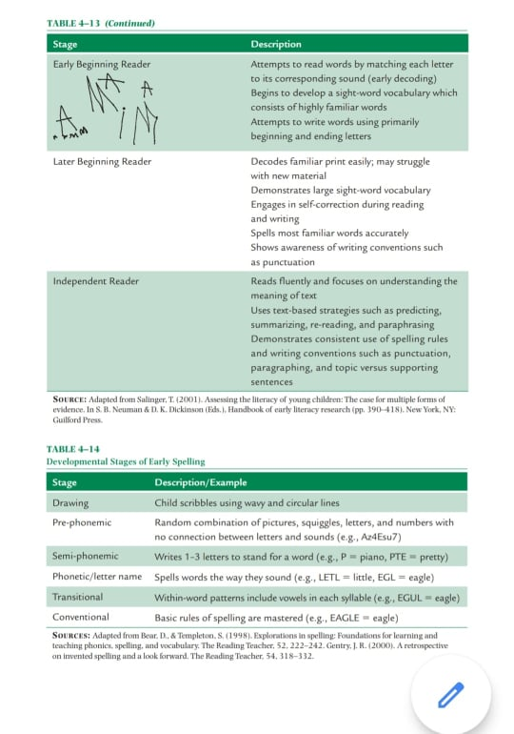

Slide 14
TREATMENT APPROACHES FOR INFANTS, TODDLERS, AND PRESCHOOLERS
These approaches emphasize the provision of intervention in naturalistic contexts. This means that children/students are engaged in authentic, meaningful activities that are functionally linked to their daily activities.
Several basic remediation approaches are described in the following sections.
They can be used in combination and are appropriate for a variety of service models, including Response to Intervention (RTI), other collaborative approaches, and small-group/individual therapy.

Slide 15
Focused Stimulation
In this approach, the clinician provides concentrated exposure to a target form in a variety of contexts (e.g., individual words, embedded in sentences or short stories). The clinician preselects a linguistic target and produces it in high concentration throughout natural and meaningful adult–child interactions. Because the focus is on comprehension, the child is not required to produce the linguistic form. This approach can encompass a wide variety of targets, including vocabulary, grammatical morphemes, and syntax.

Slide 16
Incidental Teaching
This is a naturalistic approach that encourages a child to initiate communication by arranging the environment to increase the likelihood that the child will produce a verbal or nonverbal intervention target. The child’s successful communicative attempts are rewarded through natural consequences such as a requested object or event. The clinician also responds to the child’s communicative attempts with requests for expansion or elaboration. Variations of incidental teaching include milieu and time-delay approaches .

Slide 17
Floortime/Developmental, Individual Difference, Relationship-Based
This approach to intervention focuses on building the foundations of social, emotional, and intellectual capacities in young children rather than targeting isolated behaviors or skills. It encourages socially appropriate child-initiated interactions with emphasis on developmental milestones, individual differences, and the relationship between the child and others in the environment. A critical component of this model is family engagement.

Slide 18
Family-Centered
This approach trains parents and other caregivers to foster the development of language and communication in naturalistic contexts such as the home setting. The SLP functions in an indirect or educational capacity with family members, helping them become the “change agents” for their child. These programs may focus on improving the child’s communication skills and/or improving the adult family members’ ability to engage in mutually reinforcing communicative interactions with their child.

Slide 19
EMERGENT LITERACY INTERVENTION (BIRTH THROUGH PRESCHOOL YEARS)
The overall goal of emergent literacy intervention is to promote oral and print-knowledge skills that are associated with the ability to successfully learn reading and writing skills.
This goal addresses the significant reciprocal relationship between early intervention and academic achievement.
Indirect roles encompass collaborative consultation with others, professional staff development, parent/community education, and curricular policy recommendations regarding the critical nature of emergent literacy skill acquisition for all children.
There are several other components of emergent literacy, each of which can be used as an avenue to increase a child’s print knowledge. Following are five main areas, accompanied by instructional guidelines .

Slide 20
Shared Book-Reading and Sense of Story
Phonological Awareness
Alphabetic Letter Name and Sound Knowledge
Adult Modeling of Literacy Activities
Experience with Writing Materials
Note: read from book the instructional guidelines and the examples.

