Slide 1
Vocal Folds
Material 4
Length of the entire vocal fold
Length of the entire vocal fold in newborns is about 2.5-3.0 mm, with no gender difference up to the age of 10.
In adults, vocal fold length is about 17-21 mm in males and 11-15 mm in females.

Slide 2
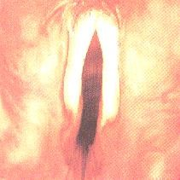
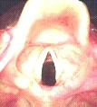
Vocal Folds
Adult vocal folds-normal Pediatric vocal folds-normal

Slide 3
Anatomical – Clinical Indications
Because of the pliable tissue lining the pediatric larynx, normal respiratory pressure may be enough to deform the laryngeal structure (e.g. Laryngomalacia and Tracheomalacia).
The curved shape of the pediatric airway should be considered while conducting laryngoscopy, stroboscope and intubation

Slide 4
The narrowness of the cricothyroid membrane depression in the pediatric larynx should be taken into consideration while considering a cricothyroctomy or a cricothyroid puncture
It is also important if a botox injection is considered.
The large size of arytenoid cartilages obscures much of the vocal folds

Slide 5

Vocal Abuse/Misuse
LARYNGEAL HYPERTENSION
  Nodules
  Polyps
  Contact Ulcers
  Cysts
Reduces phonatory mechanism’s ability to work efficiently.
Disrupts coordination of supporting parts.

Slide 6
Misuse (cont.)
INAPPROPRIATE PITCH LEVEL:
  puberphonia
  persistent glottal fry
  lack of pitch variability
EXCESSIVE TALKING
  how much
  how fast
  how loud

Slide 7
Misuse
ventricular phonation
aphonia, dysphonia of a psychological origin
INCREASED TENSION AND STRAIN
  hard glottal attack
  high laryngeal position
  anteroposterior laryngeal squeezing

Slide 8
Benign Lesion
Hoarseness
Epithelial Lesion
Abnormal Tissue Growth
Leukoplakia, Hyperkeratosis
Leukoplakia - plaque like
Papillary keratosis - warty like

Slide 9
Trauma
Attempted strangulation, blunt or penetrating neck wound
Laryngeal fracture/crush
Surgical reconstruction
SLP needs to understand altered laryngeal anatomy (Cases 51-53)

Slide 10
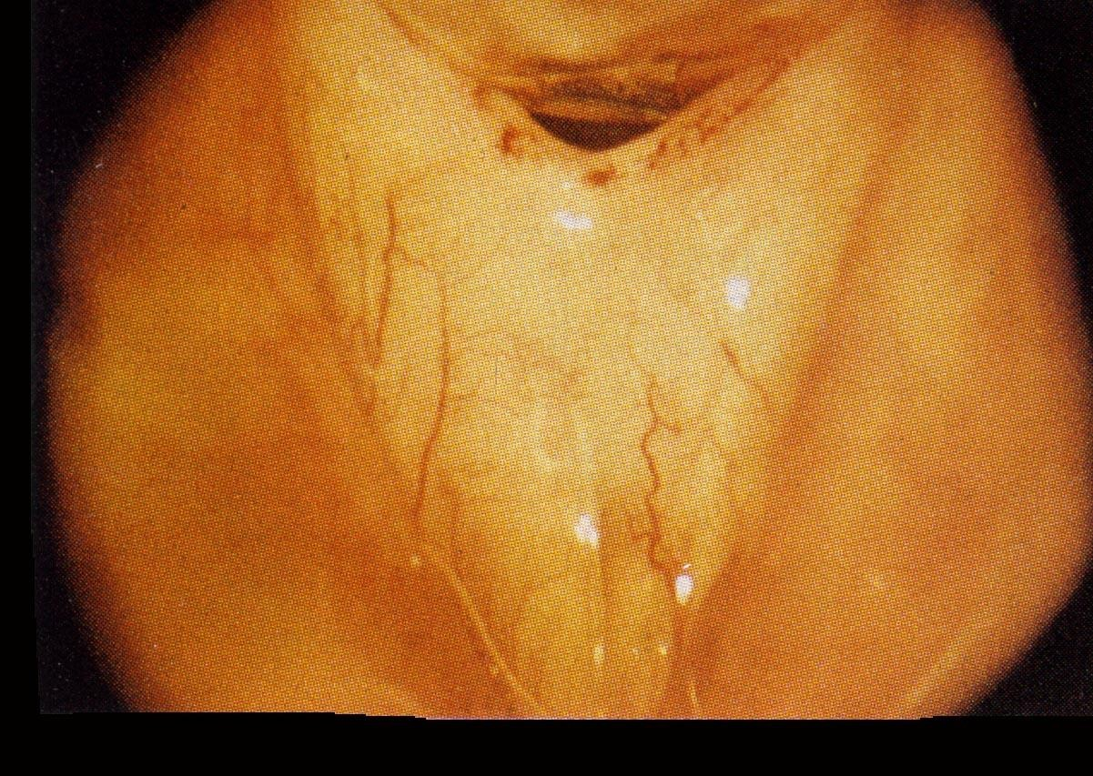

Slide 11
Ventricular Phonation
DX usually make during laryngoscopic examination
Determine compression versus vibration (Case 10)

Slide 12
Stroboscopic Signs
Abnormal symmetry and periodicity
Reduced amplitude of excursion
Reduced mucosal wave

Slide 13
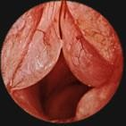
Edema
Fluid buildup and retention
Typically superficial layer
Related to abuse and smoking ( Cases 26-27)

Slide 14
Laryngoscopic and Stroboscopic Signs
Fluid filled
Usually bilateral
Greater mucosal wave
Increased mass
Decreased stiffness

Slide 15

Acoustics & Aerodynamics
Lower FO
Increased FO and amplitude variability
Increased spectral noise
Limited experimental data

Slide 16
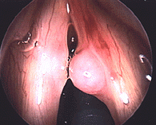
Intracordal Cysts
Hoarsness
Margin of folds
Superficial layer of lamina propria
  retention cyst
  epidermoid cyst
Affects young women and professional voice users (Cases 22, 24,25)

Slide 17
Stroboscopic Signs
Absence of mucosal wave over the cyst
Reduced glottal closure
Asymmetry
Mass and stiffness affected

Slide 18
Acoustics & Aerodynamics
Data not available
Similarities to nodules and polyps expected
Data limited - higher airflows expected

Slide 19
Sulcus Vocalis
Hoarseness
Furrow/groove along upper medial edge of the epithelium
Superficial layer of lamina propria
Varies in length and depth

Slide 20
etiology uncertain
  abuse
  congenital
  trauma

Slide 21
Laryngoscopic and Stroboscopic Signs
Depression along edge of fold
Diminished vibrational amplitudes
Little mucosal wave along edge of fold

Slide 22
Acoustics & Aerodynamics
No acoustic data present
  Your hypotheses would be??
Little data on airflows/pressures
  Your hypotheses would be??

Slide 23
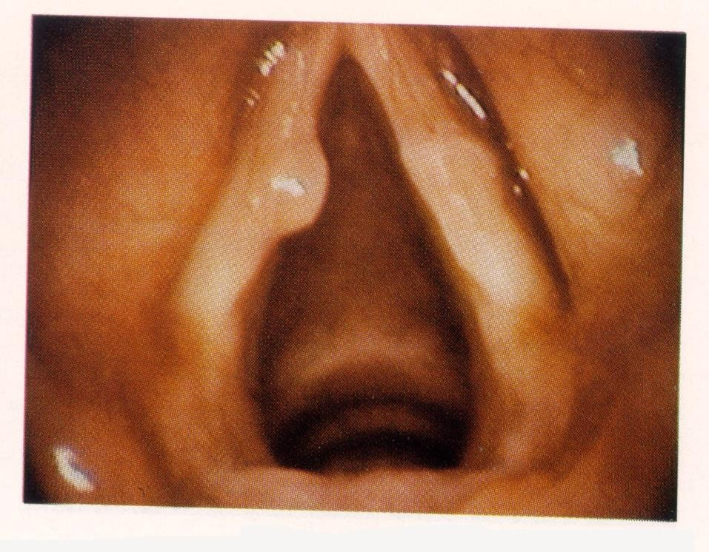
Polyps
Hoarseness
Very similar to nodule in etiology
Different in terms of pathophysiology
  larger
  more vascular
  Inflammatory (Cases 18-21)

Slide 24
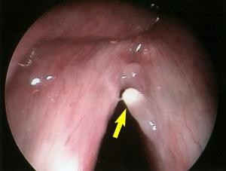
http://www.med.jhu.edu/voice/polyps.html

Slide 25
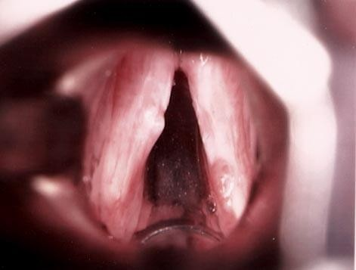

Slide 26
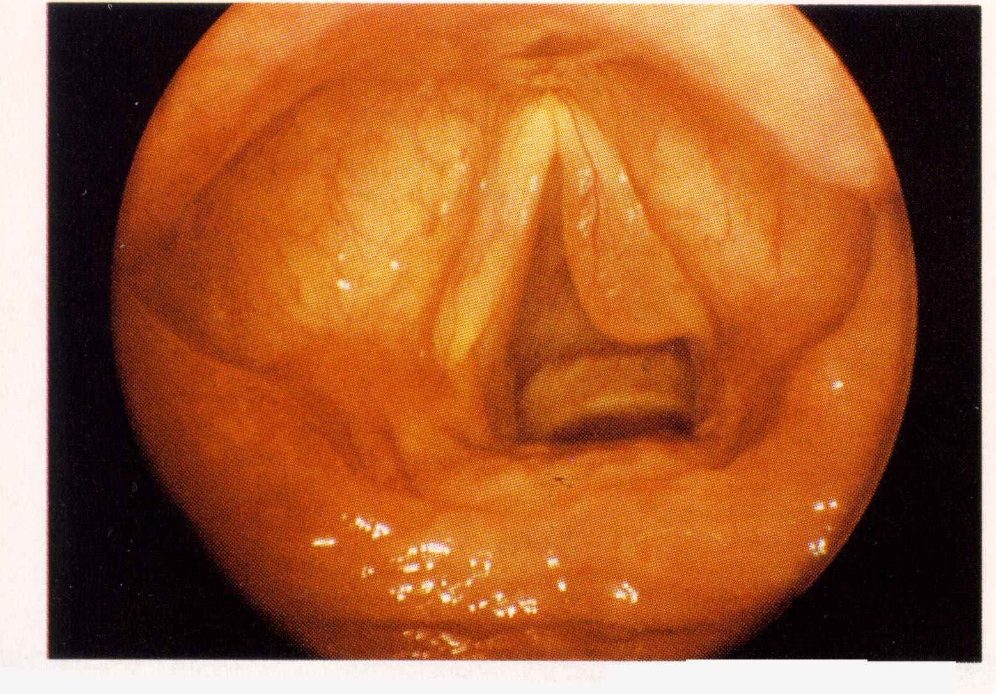

Slide 27
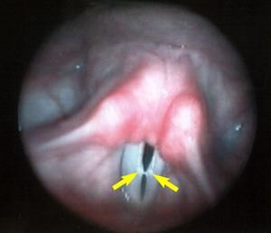
Vocal Nodules
Hoarseness
Benign growths
Reaction to compression forces on folds (Cases 13-17)
http://www.med.jhu.edu/voice/nodcys.html

Slide 28
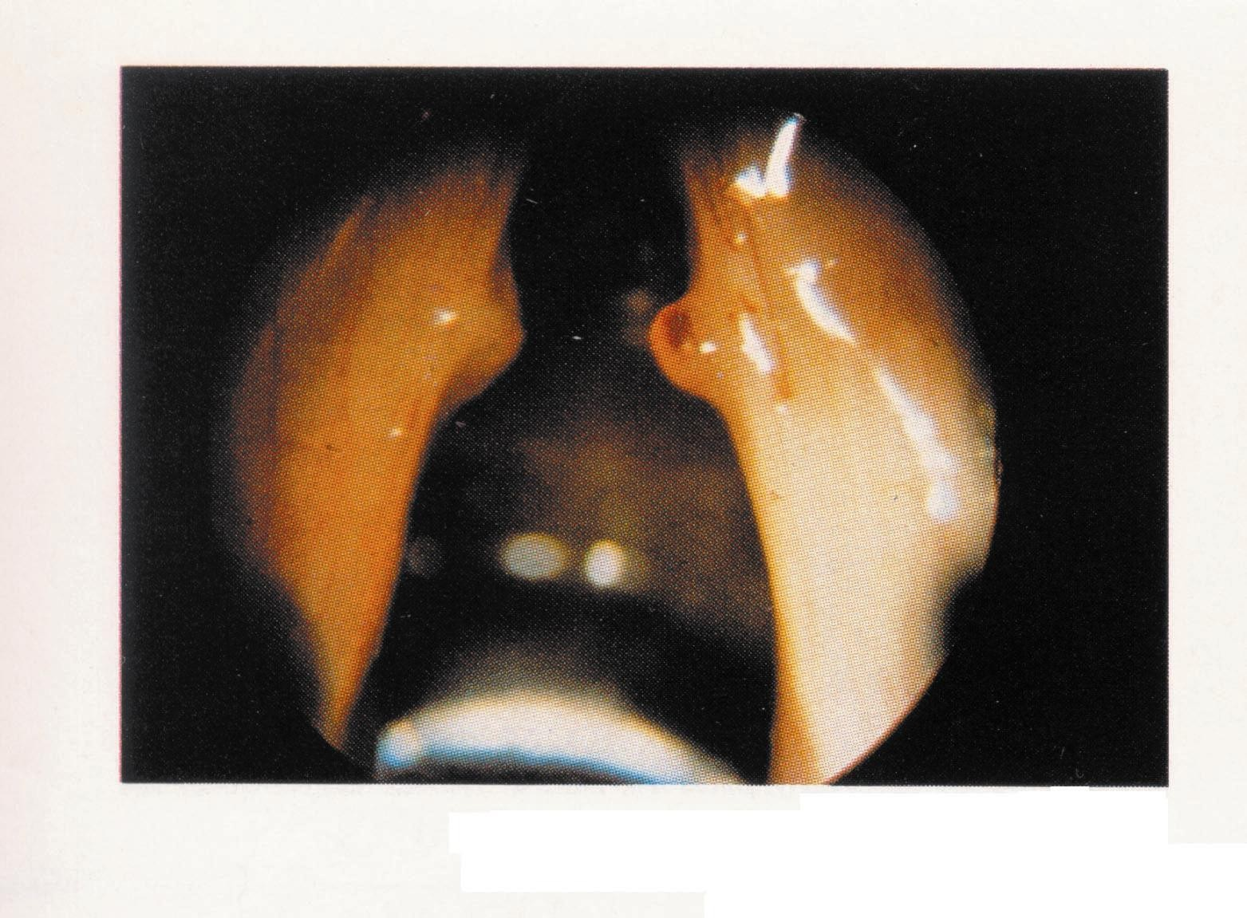

Slide 29
Acute vs. chronic condition
– vascular/edema vs. hyalinization/fibrosis

Slide 30



Vocal Nodules
Who and Why?
  Children and women
  Alcohol and smoking
  Personality
Where?
  Reinke’s space

Slide 31
Laryngoscopic Signs
Midpoint or anterior 1/3 posterior 2/3 junction
Incomplete glottal closure
Varying degrees of size

Slide 32
Puberphonia
Adolescent falsetto, Pubescent falsetto, Incomplete mutation, Mutational falsetto
Persistence of a high pitched voice beyond the age at which the male voice change is expected to have occurred. (Cases 80-81)

Slide 33
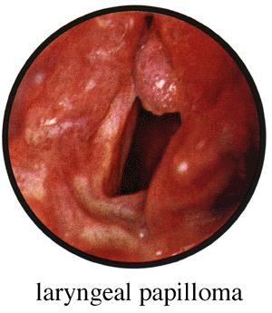
Papilloma
Lesions may exist in the subglottal, glottal or supraglottal areas.
Tracheotomy may be necessary.

Slide 34

Papilloma (cont.)
No acoustic & aerodynamic data
Laryngoscopy shows whitish cluster of tissue (raspberry.) Only comes in one flavor
Reduced or absent mucosal wave
Altered biomechanics
Increased VF mass (Cases 63-64)

Slide 35
Papilloma
Hoarseness
Epithelial lesion
Fairly common
Possible viral etiology
Affects both children and adults
Resistant to Tx
Obstruction of airway - proliferation

Slide 36
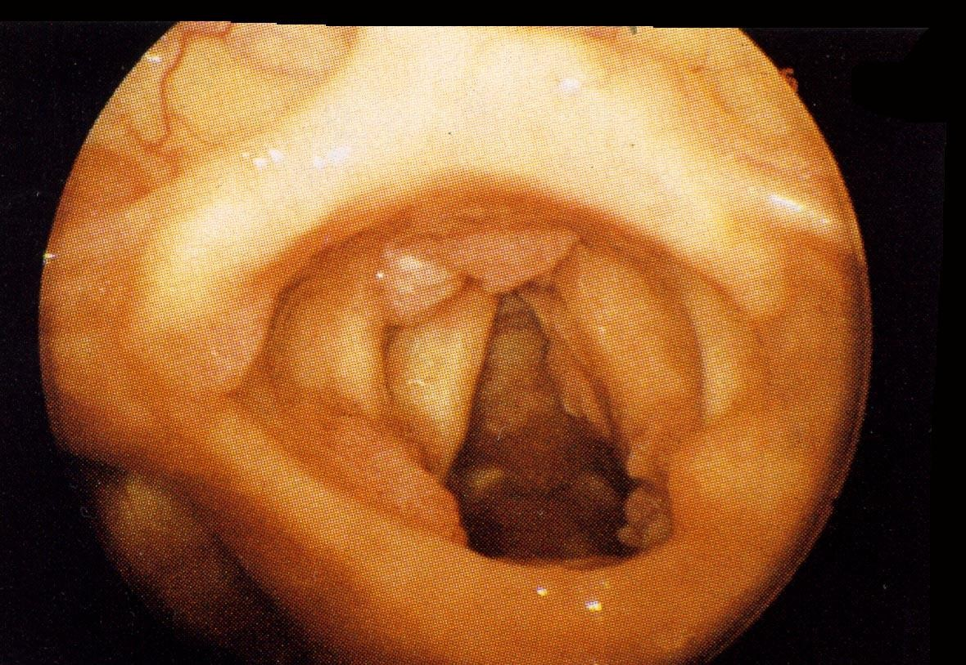

Slide 37
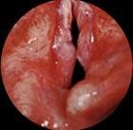
Keratosis
Pre-malignant tissue growth on the VF
Originates on the epithelium but may enter the superficial layer of the lamina propria. (Cases 66-67)

Slide 38
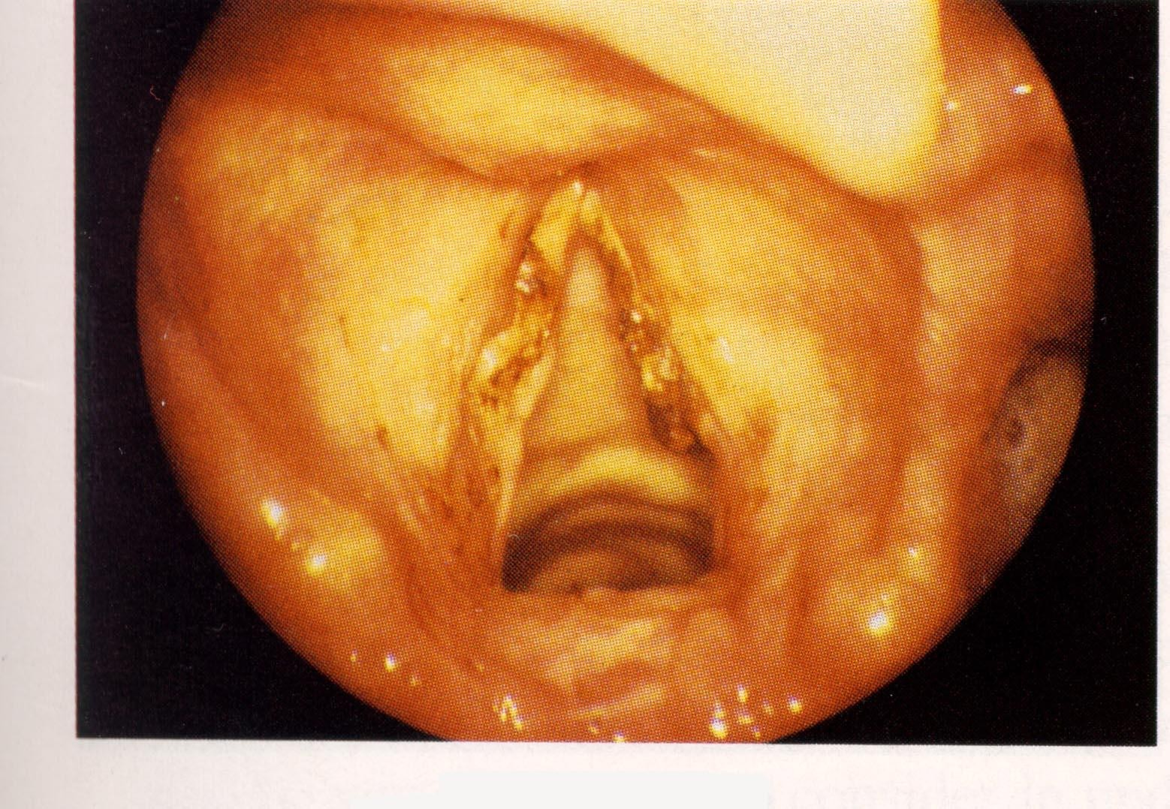

Slide 39
Keratosis (cont.)
Other terms: leukoplakia, hyperkeratosis
2 kinds of lesions:
  flat, white plaque-like lesions (leukoplakia)
  warty lesions (papillary keratosis)

Slide 40

Keratosis (cont.)
Cause:
– smoking, environmental pollutants, GERD
Lesions may be unilateral or bilateral and asymmetric in appearance
Keratosis (cont.)
Rough glottal edge
Perceptual signs: hoarseness or roughness

Slide 41
Acoustic Signs of Keratosis
Little data available
Due to growths on the vocal folds, greater than normal frequency and amplitude perturbation as well as greater than normal spectral noise would be expected.

Slide 42
Vascular Disorders
HEMORRHAGE (Case 51)
  hoarseness, aphonia and loss of pitch range
  usually unilateral
  reddish color - dark on visual exam, prominent vessel possibly

Slide 43
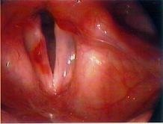

Slide 44
HEMORRHAGE (Cont.)
stem from trauma, steroid use, anti- coagulant
pain
vocal fatigue

Slide 45
Varix & Ectasia
VARIX - Prominent blood vessel distended
superior surface or edge
associated many times with polyp
abuse/trauma
ECTASIA - Dilation of small blood vessel.

Slide 46

Aerodynamics & Acoustics
Hypotheses?

Slide 47
Ankylosis of the CA Joint
(Cases 52-53)
Hoarseness/ breathiness
Fixation of CA joint - arthritis, trauma
Similar to VF paralysis
– pain=differentiating symptom
No acoustic & aerodynamic data

Slide 48
Laryngoscopy & Stroboscopy
Lack of movement of impaired aryteniod
Incomplete glottal closure
Bilateral versus unilateral signs
Edema, irritation of the joint

Slide 49
Thermal Trauma
Chemical tracheobronchitis
Edema
Airway obstruction
Tracheotomy required
Intubation - double dose of irritation
Stridor

Slide 50

Etiology
Smokers Vs. non-smokers
Secondary smoke
Environmental pollutants
Premalignant Sign?

Slide 51
Granulomas
(Cases 30-32)
Frequency of occurrence is small
Dependent mostly on intubator’s skill and duration of intubation
Foam and Cuff developed by Weymuller (1988)

Slide 52
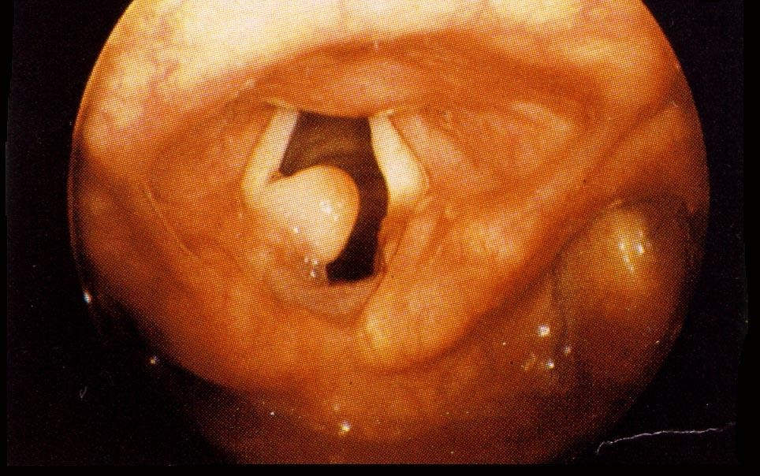

Slide 53
Granulomas cont.
Hoarseness
Due to intubation/extubation
Life threatening airway limitation
Anesthesia application
Mucoperichondrium becomes irritated
Ulcer results
Granulation tissue covers

Slide 54
Contact Ulcer/Granuloma
Stomach secretions or secretions from nose
– PND (posterior nasal drip)
Fatigue
Throat clearing
Slight hoarseness possible
Throat pain - hyoid

Slide 55

Contact Ulcer/Granuloma cont.
Medial surface of vocal process
Ulceration/bacteria
Irritation on both processes
Etiology - abuse, closure pattern, gastric reflux
Adult males

Slide 56
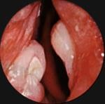
Contact Ulcer

