Slide 1
Cancer

Slide 2
Cancer
Cancer is the 2nd leading COD to Heart Disease.
Men: Prostate, lung, colorectal.
Women: Breast, lung, colorectal.
> 500,000 deaths in the U.S. annually.
50% of Patients are curable.
At least 10 types of curable cancer.
33% cured with radiation or surgery.

Slide 3
What is Cancer?
Common term for cancers.
Malignancy, Tumor, Neoplasm.
If regulatory system goes wrong (for a variety reasons) cells may:
  Die.
  Sometimes they will be stimulated to carry on dividing in such a manner that a lump or tumor is formed.
Tumors can be benign or malignant.

Slide 4
Tumors
Cancers are malignant tumors which if left untreated will invade other tissues, spread other parts of the body, and sooner or later will be fatal to the host.
“Cancer is a logical coordinated process in which a normal cell undergoes changes and acquires special capabilities.”

Slide 5
Cancer
Cancer is not one single disease- just a name given to a collection of diseases that have similar characteristics.
Cancer cells are often shaped differently from healthy cells, they do not function properly.

Slide 6
Characteristics of Cancer Cells
Benign tumor | Malignant tumor
Encapsulated | Abnormal chromosomes
No spread | Invade & metastasize
Look normal | Look abnormal
Slow growth | Higher growth rate
Recurrence rare after surgical removal | Recurrence common after surgery

Slide 7
What do the terms "locally invasive" and "metastatic" mean?
Locally invasive: the tumor can invade the tissues surrounding it.
Metastatic: the tumor can send cells into other tissues in the body, which may be distant from the original tumor.

Slide 8
How cancer spread (metastasis)
Definition: spread of cancer cells from a primary site to a distant secondary site.
Occurs by:
Lymphatic or vascular system.
Direct spread to adjacent tissues by invasion.
Combination of both routes.

Slide 9
To Differentiate or Not to Differentiate
Cells are defined by tissue of origin.
The more differentiated a cancer cell is, the more it resembles a normal cell.
The less differentiated a cancer cell is, the less it resembles a normal cell.

Slide 10
What are the different types of cancer?
Cancers are classified either according to the kind of fluid or tissue from which they originate, or according to the location in the body.

Slide 11
Types of Cancer
The following five broad categories indicate the tissue and blood classifications of cancer:
Carcinoma: Found in body tissue known as epithelial tissue that covers or lines surfaces of organs, glands, or body structures. For example, a cancer of the lining of the stomach is called a carcinoma. Carcinomas account for 80 percent to 90 percent of all cancer cases.
Sarcoma: Growing from connective tissues, such as cartilage, fat, muscle, tendons, and bones. Examples of sarcoma include osteosarcoma (bone) and chondrosarcoma (cartilage).

Slide 12
Types of Cancer
Lymphoma: Originates in the nodes or glands of the lymphatic system, or in organs such as the brain and breast.
Leukemia: Cancer of the bone marrow.
Myeloma: Grows in the plasma cells. In some cases, the myeloma cells collect in one bone and form a single tumor, called a plasmacytoma. However, in other cases, the myeloma cells collect in many bones, forming many bone tumors. This is called multiple myeloma.

Slide 13
Causes of Cancer
Diagnosis, treatment, and prognosis for childhood cancers are different than for adult cancers.
The survival rate for childhood cancer is about 79 percent, while in adult cancers the survival rate is 64 percent.

Slide 14
Causes of Cancer
This difference is thought to be because childhood cancer is more responsive to therapy, and a child can tolerate more aggressive therapy.
Mutation is usually what causes childhood cancer.
Cancer in adults usually occurs from environmental exposures.

Slide 15
Etiology
Hormonal:
Endogenous, exogenous.
Breast, endometrium, prostate.
Chemical:
Alters DNA structure.
Asbestos, Tobacco, Benzene, Tar.
Primarily Lung, others- skin, leukemias, urinary.

Slide 16
Etiology
3. Drugs: Chemotherapy Agents such as Alkalayting Agent [VP-16].
Example: Treatment for Osteosarcoma, Cured, later develop Leukemia secondary to VP-16.

Slide 17
Etiology
4. VIRAL: CMV: Kaposi’s Sarcoma.

Slide 18
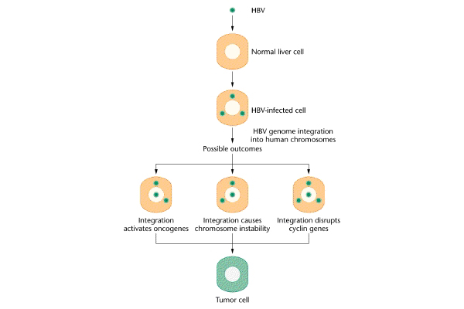
Example of virus in humans causing cancer: If infected with HBV, risk of liver cancer is increased 100x.

Slide 19
Etiology
5. Radiation:
    CML.
    AML.
    Skin.
    Osteosarcoma.
    Thyroid.

Slide 20
Etiology
Heredity:
Gene mutation passed on from one or both parents.
May or may not develop into a cancer.
Example: Inherited Genes on chromosomes.
BRCA 1 BRCA 2 - Breast Cancer/Ovarian.

Slide 21
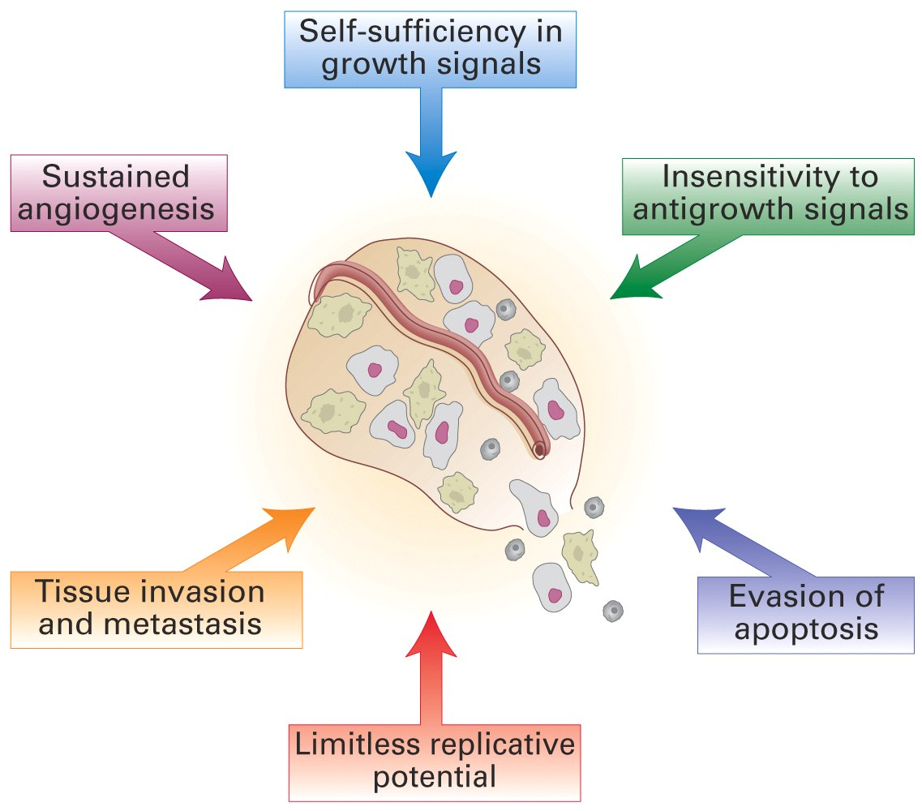
Overview of the (genetic) changes in cells that cause cancer
How identify cause of these changes?

Slide 22
Risk of Cancer
Absolute risk: Absolute risk of a disease is your risk of developing the disease over a time period.
Relative Risk: is used to compare the risk in two different groups of people. For example, the groups could be smokers and non-smokers.
Attributable Risk: the amount of disease incidence that can be attributed to a specific exposure.

Slide 23
Etiology / Risk Factors
Behavior:
  Lifestyle, Alcohol Consumption, Nutrition, Smoking.
  Motivation for Preventative Behavior.
Exposure:
  Occupational Hazards, Environmental Risks, Biological Risks.

Slide 24
Risk Factors
Genetic Make-up:
Ethnicity.
Sex.
Others:
Iatrogenic Risks.
Socioeconomic Risks.
Age.
Medications.
Infections.

Slide 25
The Role of Risk Assessments
Assists in:
  Diagnosis.
  Establishing patterns of inheritance.
  Identification of persons at risk.
  Contributing to the biological understanding of cancer.
  Altering or change risk factors to result in a decrease in new cases of cancer.

Slide 26
Early Warning Signs of Cancer
Change in bowel or bladder habits.
A sore that doesn’t heal.
Unusual bleeding or discharge.
Thickening or lump in breast or elsewhere.
Indigestion.
Obvious wart or mole.
Nagging cough or hoarseness.
Unexplained anemia.
Sudden unexplained weight loss.

Slide 27
Diagnostic Imaging

Slide 28
How is cancer diagnosed?
There is no single test that can accurately diagnose cancer.
The complete evaluation of a patient usually requires a thorough history and physical examination along with diagnostic testing.

Slide 29
What are the different types of diagnostic imaging?
There are three types of imaging used for diagnosing cancer:
Transmission imaging.
Reflection imaging.
Emission imaging.

Slide 30
Transmission Imaging
X-rays, computed tomography scans (CT scans), and fluoroscopy.
The beam passes very quickly through less dense types of tissue such as watery secretions, blood, and fat, leaving a darkened area on the x-ray film.
Muscle and connective tissues (ligaments, tendons, and cartilage) appear gray. Bones will appear white.

Slide 31
Reflection Imaging
Produced by sending high-frequency sounds to the body part or organ being studied such as Ultrasound.

Slide 32
Emission Imaging
Occurs when tiny nuclear particles or magnetic energy are detected by a scanner and analyzed by computer.

Slide 33
Emission Imaging
  Magnetic resonance imaging (MRI).
  Positron emission tomography (PET).
    PET is a type of nuclear medicine procedure. This means that a tiny amount of a radioactive substance, called a radionuclide (radiopharmaceutical or radioactive tracer).
    PET studies evaluate the metabolism of a particular organ or tissue, so that information about the physiology (functionality) and anatomy (structure) of the organ or tissue is evaluated, as well as its biochemical properties.

Slide 34
Laboratory Tests

Slide 35
Laboratory Tests
The following are some of the more common laboratory tests:
Blood tests.
Urinalysis.
Tumor markers: Substances either released by cancer cells into the blood or urine or substances created by the body in response to cancer cells.
Must be used with other tests for the following reasons:
People with benign conditions may also have elevated levels of these substances in their blood.
Not every person with a tumor has tumor markers.
Some tumor markers are not specific to any one type of tumor.

Slide 36
Tumor Markers
Prostate-specific antigen (PSA):
Prostate-specific antigen is always present in low concentrations in the blood of adult males.
An elevated PSA level in the blood may indicate prostate cancer, but other conditions such as benign prostatic hyperplasia (BPH) and prostatitis can also raise PSA levels.
Prostatic acid phosphatase (PAP):
In addition to prostate cancer, elevated levels of PAP may indicate testicular cancer, leukemia, and non-Hodgkin’s lymphoma.

Slide 37
Tumor Biopsy

Slide 38
Tumor Biopsy
Endoscopic biopsy: This type of biopsy is performed through a fiberoptic endoscope.
Bone marrow biopsy.
Excisional or incisional biopsy:
When the entire tumor is removed, it is called excisional biopsy technique.
If only a portion of the tumor is removed, it is called incisional biopsy technique.

Slide 39
Uses of Genetic Testing

Slide 40
Uses of Genetic Testing
Diagnostic testing:
Identify or confirm the diagnosis of a disease or condition.
Gives a "yes" or "no" answer in most cases.
Predictive genetic testing:
Determines the chances that a healthy individual with or without a family history of a certain disease might develop that disease.

Slide 41
Treatment

Slide 42
Treatment Options
Chemotherapy
Radiotherapy
Surgery
Stem Cell Transplants

Slide 43
Treatment Options
Other Approaches:
Hormonal Therapy.
Biological Response Modifiers.
Gene Therapy.
Supportive Therapy (Other drugs).

