Slide 1
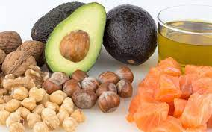
LIPIDS

Slide 2
Lipids and Health
A group of compounds that dissolve in organic solvents such as petrol or chloroform, but are usually insoluble in water
Lipids, a BAD food?
Development of obesity and coronary heart disease

Slide 3
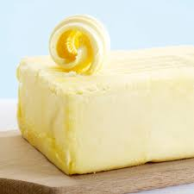
lipids
Enhances the flavor, texture and palatability of food
Important for adequate nutrition
Essential fatty acids can’t be synthesized by the body
Required for a range of metabolic and physiological processes and structure of cell membranes
Storage of energy
Insulation/help control body temperature

Slide 4
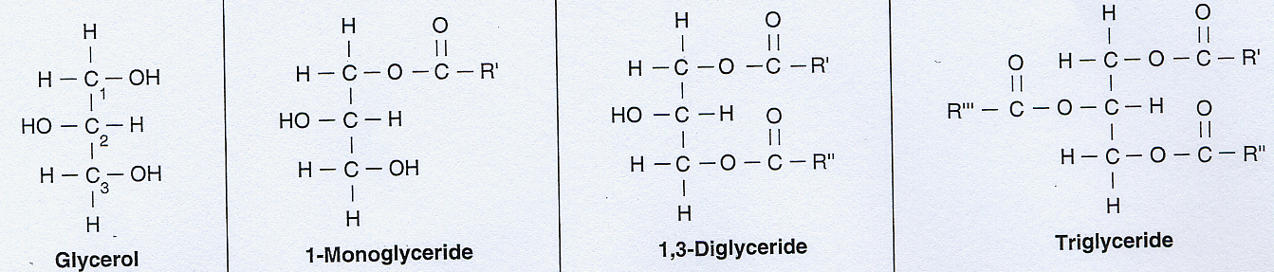
Chemical structure of Fats
Triacylglycerols make up about 95% of dietary lipids
A triacylglycerol molecule is formed from a glycerol molecule (a three-carbon alcohol)
And three fatty acids attached

Slide 5
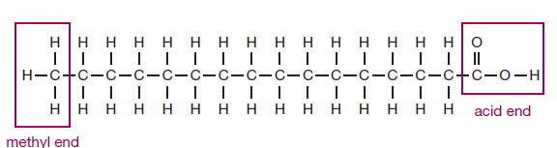
Fatty Acids
Consist of a chain of carbon atoms with hydrogens attached, a methyl group at one end and a carboxylic acid group at the other end
Vary in :
Length of the carbon chain
Degree of saturation

Slide 6
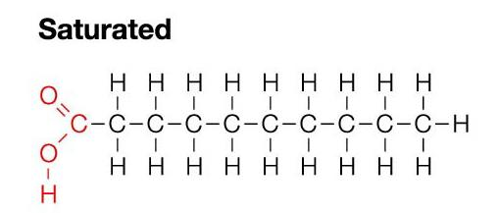
Fatty Acids
CHAIN LENGTH:
Short-chain fatty acids ( ≤ 6 carbons)
Medium-chain fatty acids ( 8-12 carbons)
Long-chain fatty acids (≥14 carbons)
NUMBER OF DOUBLE BONDS
Saturated fatty acids (none)
Monounsaturated fatty acids (1)
Polyunsaturated fatty acids (2 or more)

Slide 7
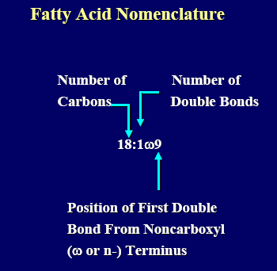
Fatty Acids
Long-chain fatty acids:
Found in meats, fish, and vegetables oils
Medium chain fatty acids:
Dairy products

Slide 8
Functions of Fatty acids
Make up Cell membrane
Unsaturated fatty acids play an important role in maintaining fluidity of cell membrane
Precursors of eicosanoids (a group of hormone-like substances that help regulate blood pressure, blood clotting, and other body functions )

Slide 9
Fatty Acids
“unsaturated” and “saturated” are NOT absolute terms used to describe the only types of fatty acids present.
They are relative descriptions that indicate which kinds of fatty acids are present in the largest proportion

Slide 10
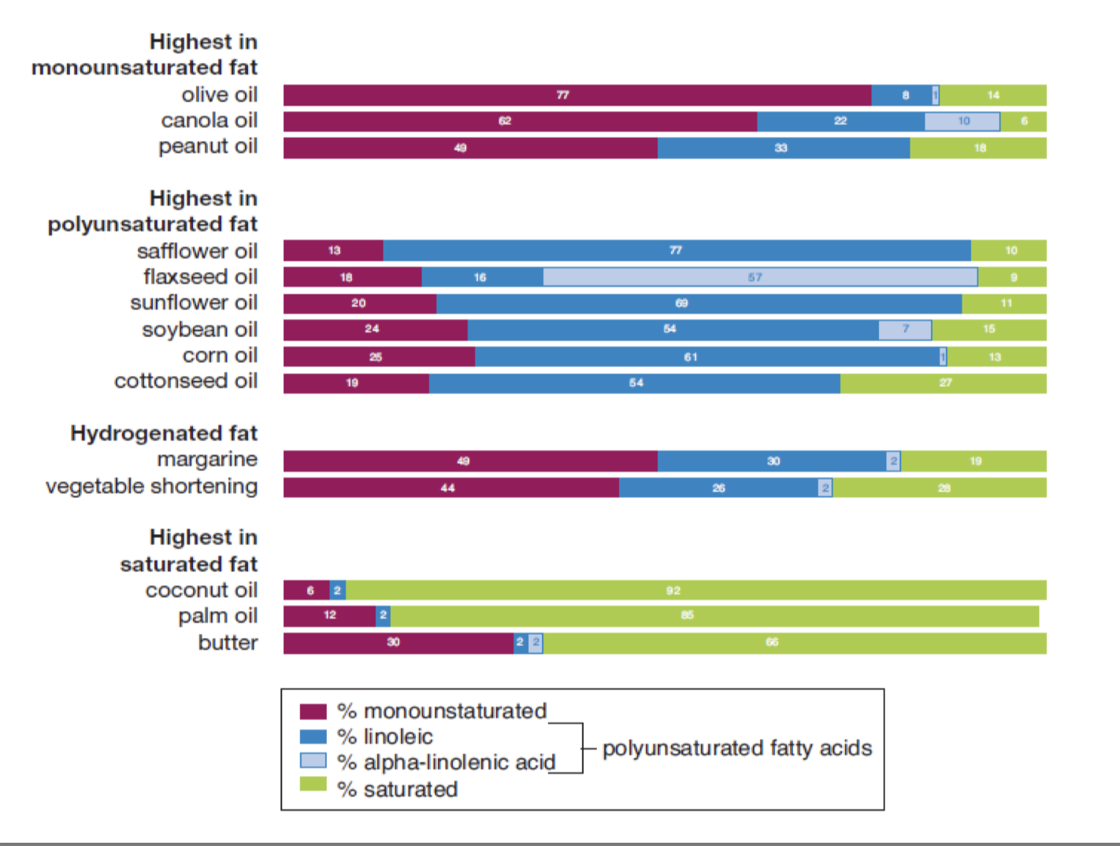

Slide 11
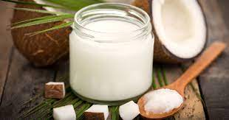
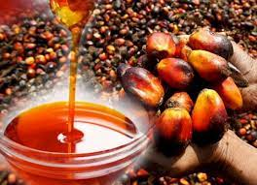
Unsaturated and saturated fats
Saturated fatty acids- straight chains and pack tightly
Example: Butter mostly saturated fatty acids ---solid at room temperature
Inserting a double bond in a saturated fatty acid reduces its melting point.
Oils (e.g. soybean oil) containing a predominance of polyunsaturated fatty acids are liquid at room temperature.
Saturated : Animal fats—the fat in meat, whole-milk dairy products, and egg yolks
Plants with saturated fatty acids: palm oil, palm kernel oil, and coconut oil

Slide 12
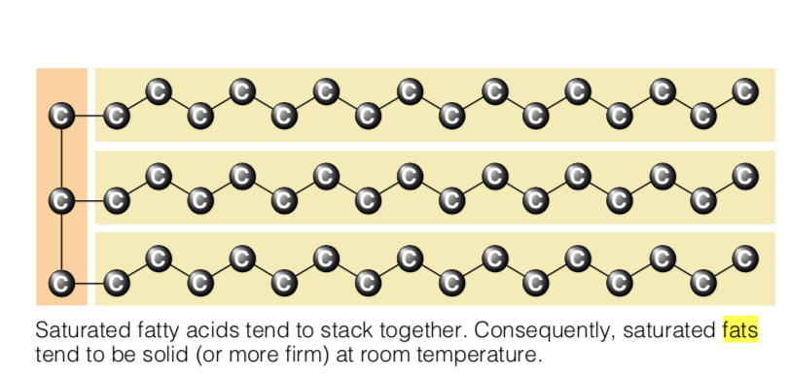
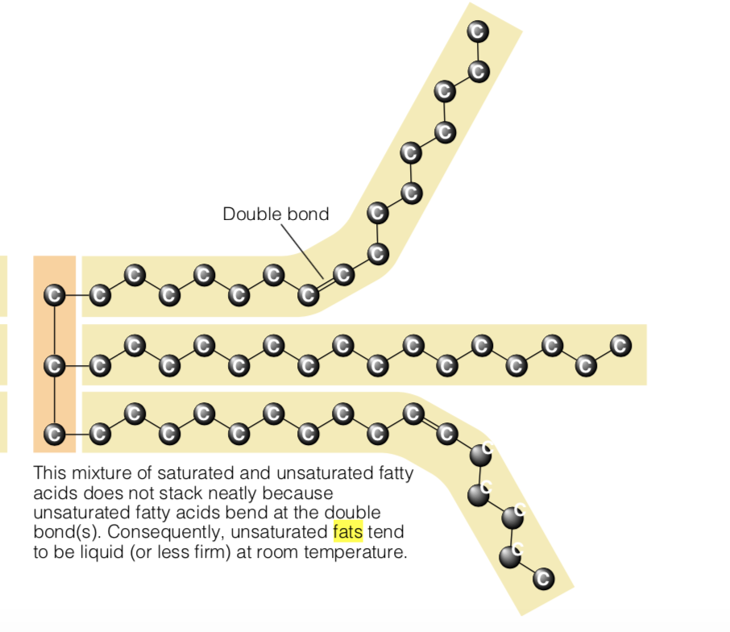
Saturated Fatty acids= pack tightly
Unsaturated Fatty acids= bend due to double bond, will have a lower melting point

Slide 13
Saturated Fatty Acids
Commonly known as a “bad” fat because it raises blood cholesterol levels
May also make the inner lining of arteries more prone to inflammation and the buildup of fatty plaques
Saturated fats raise LDL (bad) cholesterol. High LDL cholesterol increases risk for cardiovascular disease
Reducing saturated fat intake is one of the most important changes needed in the modern diet

Slide 14
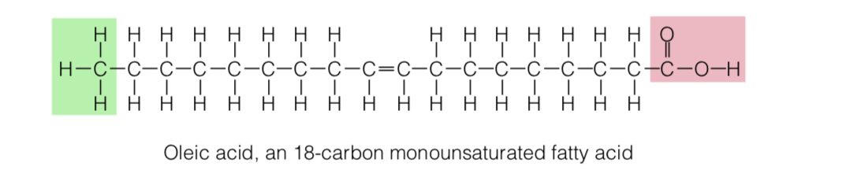
Unsaturated Fatty acids
physically kinked and unable to pack together
Lower melting point
Monounsaturated fats: one single double bond
Olives, olive oil, canola oil, peanut oil, avocado,
cashews, almonds, and most other nuts. – Meat fat (moderate amount)

Slide 15
Polyunsaturated fatty acids
Contain Multiple double bond and are classified according to the position
Position of the double bond effects nutrition and health characteristic of the fatty acid
Three families in polyunsaturated FA
If the first double bond is three carbon atoms from the methyl end of the carbon chain n-3 or ω-3
If first double bond is next to the sixth carbon atom from the methyl end ----- n-6 or ω-6 fatty
If the first double bond is next to the ninth carbon atom from the methyl end----- n-9 or ω-9 group

Slide 16
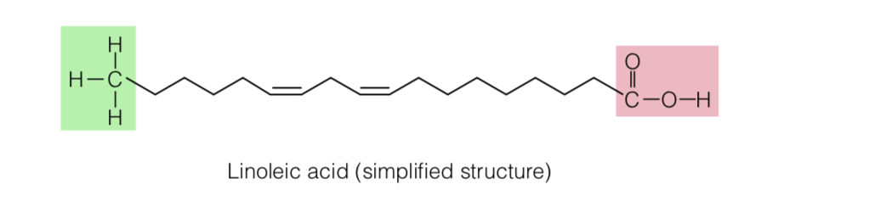
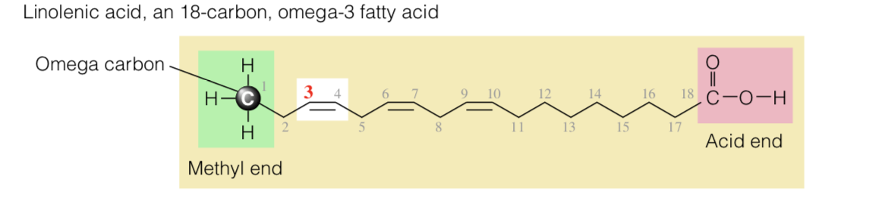
18:2 ω6
Both are essential fatty acids
18:3ω3

Slide 17
Polyunsaturated fats found in corn, soybean, safflower, and cottonseeds oils, and also in fish.
Unsaturated fatty acids are commonly known as “good fats” because when they are eaten in place of saturated fats they lower LDL cholesterol and raise HDL cholesterol.
When monounsaturated fats replace carbohydrates in the diet, improvements in triglyceride and HDL levels occur.

Slide 18
Properties of unsaturated fatty acids
The degree of unsaturation also influences stability. All fats become spoiled when exposed to oxygen. The oxidation of fats produces a variety of compounds that smell and taste rancid
Double bonds can react with oxygen and form harmful compounds when exposed to high heat
Saturated fats are most resistant to oxidation and thus least likely to become rancid.

Slide 19
Hydrogenation
Initially used by manufacturers to protect fat-containing products against rancidity
During hydrogenation, some or all of the points of unsaturation are saturated by adding hydrogen molecule
Protects against oxidation
Prolonging shelf life
Alters the texture of foods (making liquid vegetable oils more solid)

Slide 20
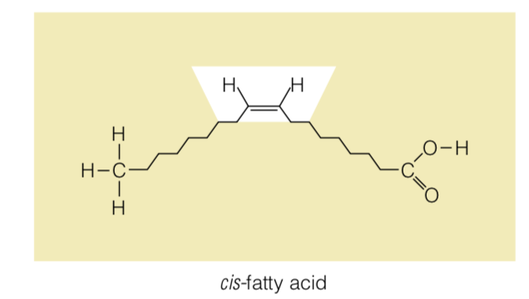
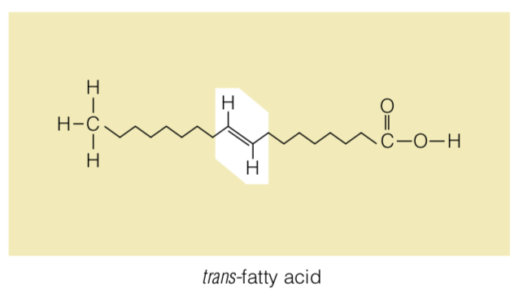
Trans Fats
In nature, most double bonds are cis
Few naturally occurring FA are trans

Slide 21
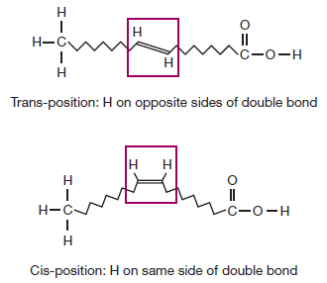
Hydrogenation and Trans Fats
The process of hydrogenation changes the placement of the hydrogen atoms around the remaining double bonds from the natural cis position to the rare trans position

Slide 22
Trans Fat
Raise LDL cholesterol.
Lower HDL cholesterol
Increase serum triglyceride levels
Increase insulin resistance
Raise biomarkers of inflammation (e.g., C- reactive protein, tumor necrosis factor receptors)

Slide 23
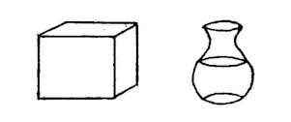
Hydrogenation
  Produces fats for kitchen use
  Margarine and other butter substitutes can be produced by partial hydrogenation of polyunsaturated oils derived from corn, cottonseed, peanut, and soybean oils

Slide 24
Trans fat intake
Trans fat intake should be less than 1% total calories
2 g trans fat in a 2000-calorie diet
French fries, stick margarine, shortening, potato chips, baked goods, and crackers.

Slide 25
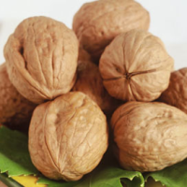
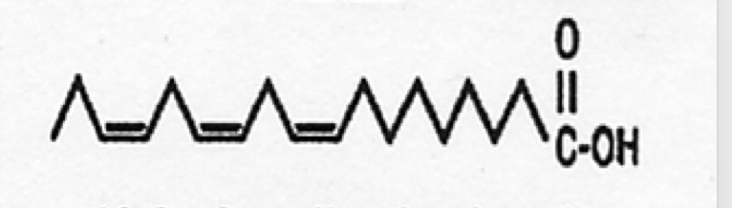
Essential fatty acids
Two essential Fatty Acids (The body can’t make them, must take them from food)
One omega 3/ Alpha-Linolenic Acid
Found in flaxseed, canola, soybean, and walnut oils, walnuts
One omega 6/ Linoleic Acid
found in plant oils such as safflower, sunflower, corn, and soybean oils, poultry, Nuts, seeds
Alpha-Linolenic Acid

Slide 26
Types of Lipids
Classes of Lipids
Triglycerides ( fats and oils)
Phospholipids (e.g. lecithin)
Sterols ( e.g. cholesterol)

Slide 27
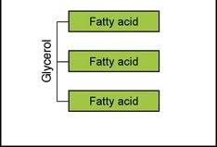
Triglycerides
Composed of three fatty acids attached to a glycerol ( fat we get from food)
Energy storage/ energy fuel
Regulate body temperature
Fat deposits insulate and cushion internal organs to protect them from mechanical injury
Help absorb fat soluble vitamins when taken at the same meal

Slide 28
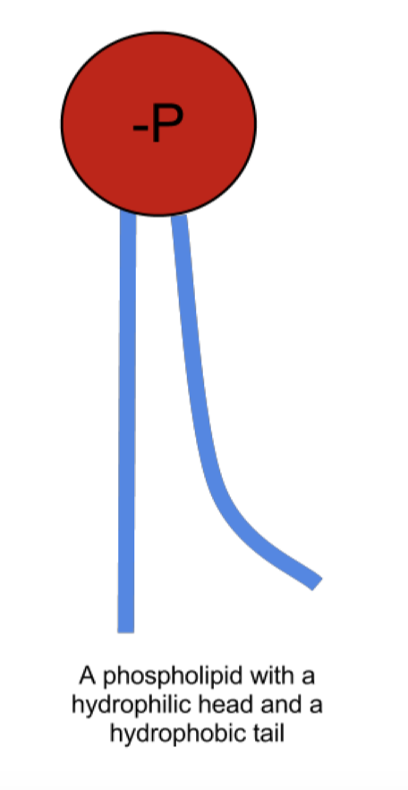
Phospholipids
Glycerol attached to 2 fatty acids and a phosphate group
Polar head – amphipathic molecule
hydrophobic fatty acids make phospholipids soluble in fat
hydrophilic phosphate group allows them to di solve in water.
Used by the food industry as an emulsifier to mix fats with water in products mayonnaise and salad dressings

Slide 29
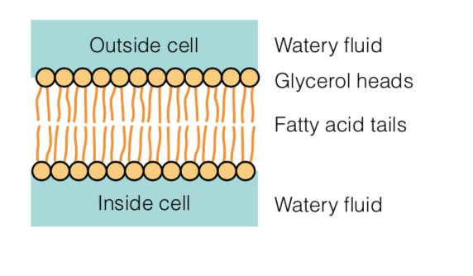
Phospholipids
constituents of cell membranes
Phospholipids are soluble in both water and fat
Help fat-soluble substances, including vitamins and hormones, to pass easily in and out of cells

Slide 30
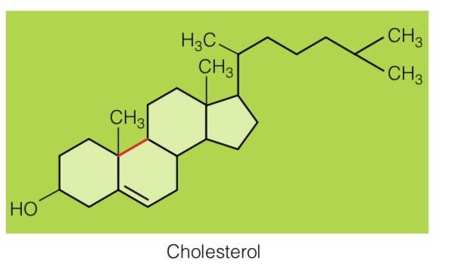
Sterols
Have ring structures
The most well-known sterol is cholesterol
Cholesterol is a precursor for
  Bile acids
  Steroid hormones
  Vitamin D

Slide 31
Cholesterol
Cholesterol is found exclusively in animals, with liver and egg yolks the richest sources.
Cholesterol occurs in the tissues of all animals- the liver can synthesize cholesterol
cholesterol that is made in the body is referred to as endogenous, whereas cholesterol from outside the body (from foods) is referred to as exogenous
not an essential nutrient
When dietary cholesterol decreases, endogenous cholesterol production increases to maintain an adequate supply
Cholesterol’s harmful effects in the body occur when it accumulates in the artery walls and contributes to the formation of plaque

