Slide 1
Calcium & Iron
NUTD 334

Slide 2
Calcium
Present in many foods
We hear a lot about dairy products
  Its true because it’s the most bioavailable
  Most foods that we eat including sweets consist of milk
Calcium present in many other foods but
  Bioavailability is not as good as dairy products
  Its bioavailability affected by phytates (in whole grains) & phytates (in green leafy vegetables)
Notes:
Bioavailable means the body can absorb the most of the mineral from that food group

Slide 3
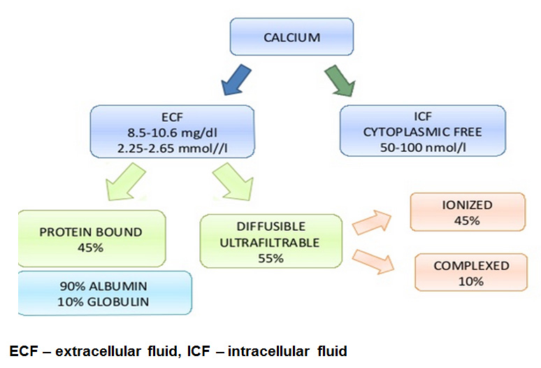
Calcium Distribution
Most abundant mineral in the body
Structural role in bone mineral/ teeth
99% of body’s Ca is found in bone and teeth
Mineral component of bone is mainly Ca and P (hydroxyapatite)
1% is found in the blood and soft tissue (see image)

Slide 4
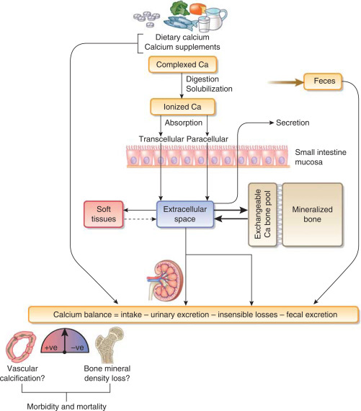
Digestion
Absorbed in all parts of the intestine
Acidic pH increases absorption
Calcium bone deposition is limited by age

Slide 5
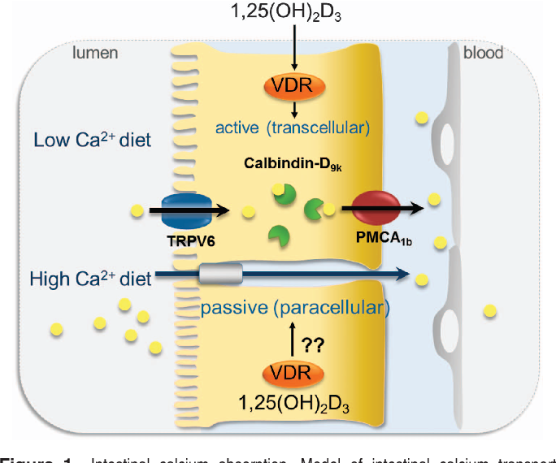
Intestinal absorption mechanism
Active transport
Para cellular

Slide 6
Transport in Blood
Transport of Ca in Blood
Serum Ca: 8.8 -10.8 mg/dL
Transported in blood in following 3 forms:
  Free (ionized): 50%
  Bound to proteins: 40%
    Mainly: albumin and pre-albumin
  Complexed with sulfate, phosphate and citrate:10%

Slide 7
Excretion
50% of ingested Ca is excreted in urine/d
Equivalent amount is secreted into the intestine/ joins unabsorbed Ca in feces
Skin- in sweat/ skin exfoliation: 15mg/d

Slide 8
Calcium needs
Calcium is required in
  1000 mg/day for adults
  1200 mg/day for the elederly
Not meeting those needs overtime (not instant) may lead to osteoporosis
Osteoporosis may lead to brittle bones and increased risk of fractures

Slide 9
Calcium and bone
Osteoblasts
  Synthesize bone tissue
Osteoclasts
  Eats out bones and release calcium

Slide 10
Calcium function
Calcium as signaling molecule
  Entry of calcium into beta cell releases insulin
  Entry of calcium into muscle cells causes its contraction
  Calcium release can result in neurotransmitter release by nerve cells

Slide 11
Calcium homeostasis
Calcium serum conceternation
  9 to 10 mg/dl
  Regulated by parathyroid and calcintonin hormones
  Parathyroids hormone release when Ca serum concentration drops
  Calcitonin hormone releases when Ca serum conctenration rises
Calcium enters the cells through ligand gated channels, and voltage gated channel
Calcium exit cells through sodium calcium exchanger, ATP dependent calcium channels
Notes:
Parathyroid horomone release by parathyroid gland
Calcitonis hormone released by thyroid galnd

Slide 12
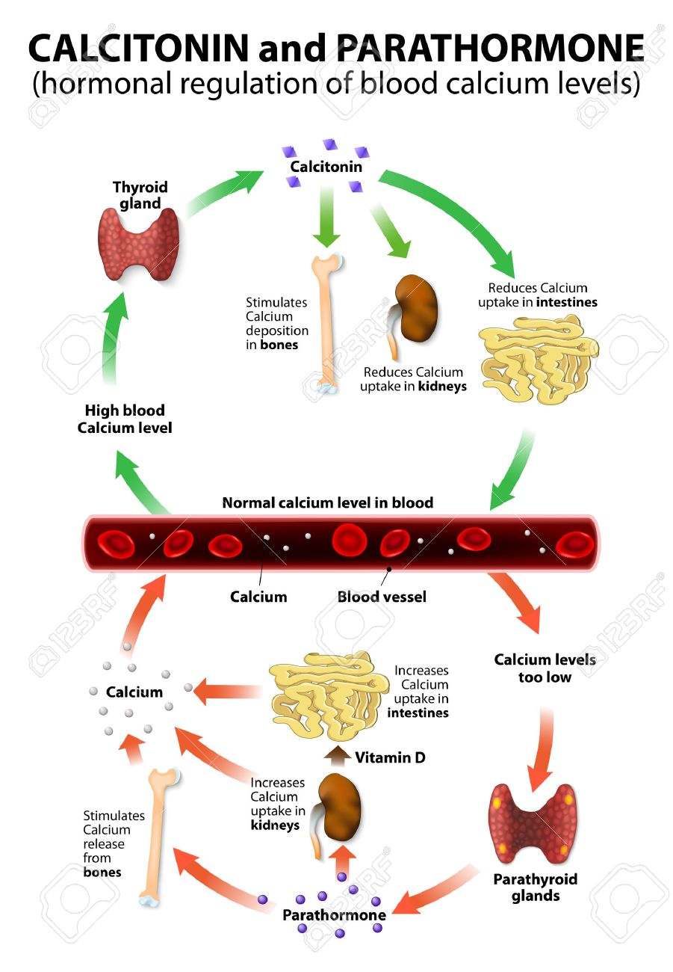

Slide 13
Other factors that affect calcium regulation
Glucocorticoids
    Reduces Ca absorption
Estrogen
  Required in narrow limits
  Menopause decrease Estrogen level resulting in BMD loss
  Hormone Replacement therapy reduces BMD loss
T3 & T4
  Stimulate bone loss, hyperthyroidism?
Growth Hormone
  Improves cartilage formation on bones (IFG)
  Can increase vitamin D synthesis in the kidneys so increases Ca absorption

Slide 14
Nutrient interaction
Dietary Fiber
  Bacterial growth and binding of Calcium
  Decrease intestinal transit time
Phytates and Oxalates
  Bind calcium
Caffeine
  Reduces absorption and reabsorption
  Increases excretion by 10 mg
Zn (reduces), P (reduces), Iron (reduces), Mg (improves), Lactose (improves), fat (reduces), protein (increases calcium excretion), sulfate amino acids, alcohol (reduces and increase loss), smoking (reduces) , and frequent meals (increases)

Slide 15
Factors that affect Calcium Absorption
Decrease | Increase
Menopause | Lactation
Aging | Low serum Calcium
Achlorhydria | Pregnancy
Vitamin D deficiency or insufficiency | Hyper and normal vitamin D status
Rapid intestinal transit time

Slide 16
High and low
Hypercalcemia
  Osteoclasts overgrowth
  Excess vitamin D
  Dieuretics
  Hyperparathyrodism
Hypocalcemia
  Low vitamin D
  Hypoparathyrodism

Slide 17
Iron

Slide 18
Iron in food
Heme iron
  Red meat, organ meat
  Ferrous form
  Better bioavailability
Non heme iron
  Plant based
  Ferric form that needs to be converted to Ferrous form for absorption (can you know which vitamin help this process?)
  Less bioavailability

Slide 19
Iron cycle
Stored in liver in Ferritin protein
  Ferritin can be measured in blood
Iron trasported in the blood via transferrin protein
Once absorbed it is devliered to the liver for storage or release
When released it is devliered to the bone marrow for heamoglobulic syntheis

Slide 20
Iron recylce
Each 3 to 4 months red blood cells are broken down in the spleen
Iron released is then transported to the liver for storage or release again.

Slide 21
Iron absorption regulation
When liver iron stroes are high hepcidin is released by the liver to the intestine
  Iron abosrbed in intestinal cells is not integrated into transferrin
  Once intestinal cells die iron is excreted with faeces
When liver iron stores are low hepcidin release is low
  Iron absorbed in intestinal cells is bound to transferrin and ready for absorption

Slide 22
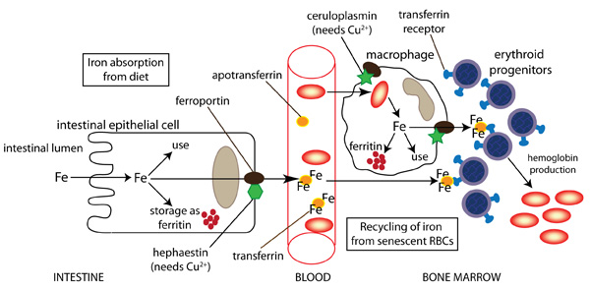
Iron and RB cells synthesis

Slide 23
Iron function
Oxygen transport via haemoglobulin
Myoglobulin protein in the muscle that stores oxygen
Cytochrome enzyme required in metabolic activities for the release of energy
Required in Chromatin which is found nucleus

Slide 24
High and low
Iron defeciency anemia
  Microcytic and hyprchromic cell
  Iron poor diets, bleeding, and infections could be causes
  Symptoms range from
Haemochromatosis
  When hepcidin production is low due ot liver damage
  Iron absorption is very high leading to excess iron in blood
  Treatment is with blood donation

