Slide 1
INTRODUCTION TO INDUSTRIAL PHARMACY
Lab Instructors
Assist. Lecturers Pharmacist
Anas Tarik Nafei
Zainab Hassan Mahdi

Slide 2
Definition of Industrial Pharmacy
The conversion of raw materials into certain dosage forms.
Or it is manufacturing, development, marketing and distribution of drug products including quality assurance of these activities.
E.g.: Tablets, capsules, suspensions and ampoules.

Slide 3
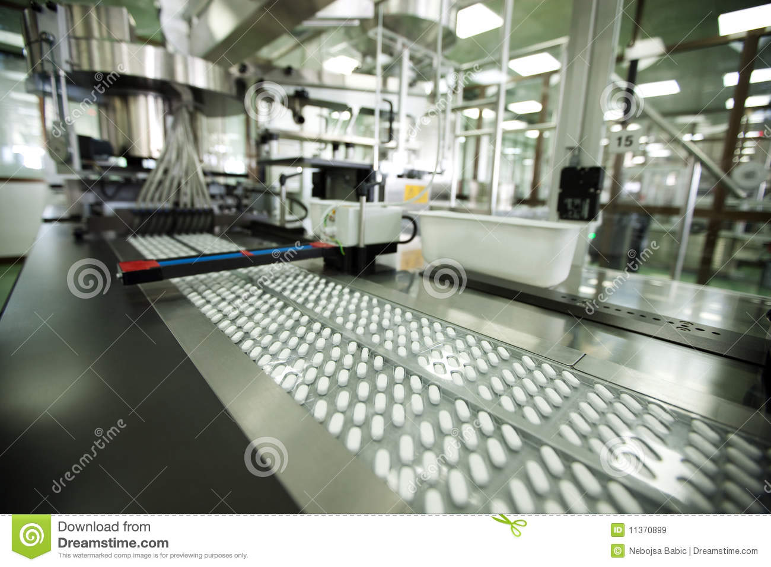
Properties of Dosage Form
Bioavialable
Safe
Stable
Effective

Slide 4
Requirements to Formulate Dosage Form
Physicochemical properties of active ingredient and additives
Physical properties
Appearance, Texture,
Color, Odor, Taste, Melting point, Boiling point, Density, Solubility.
Chemical properties
Oxidation, Decomposition, Crystal structure, Toxicity, Thermodynamic properties

Slide 5
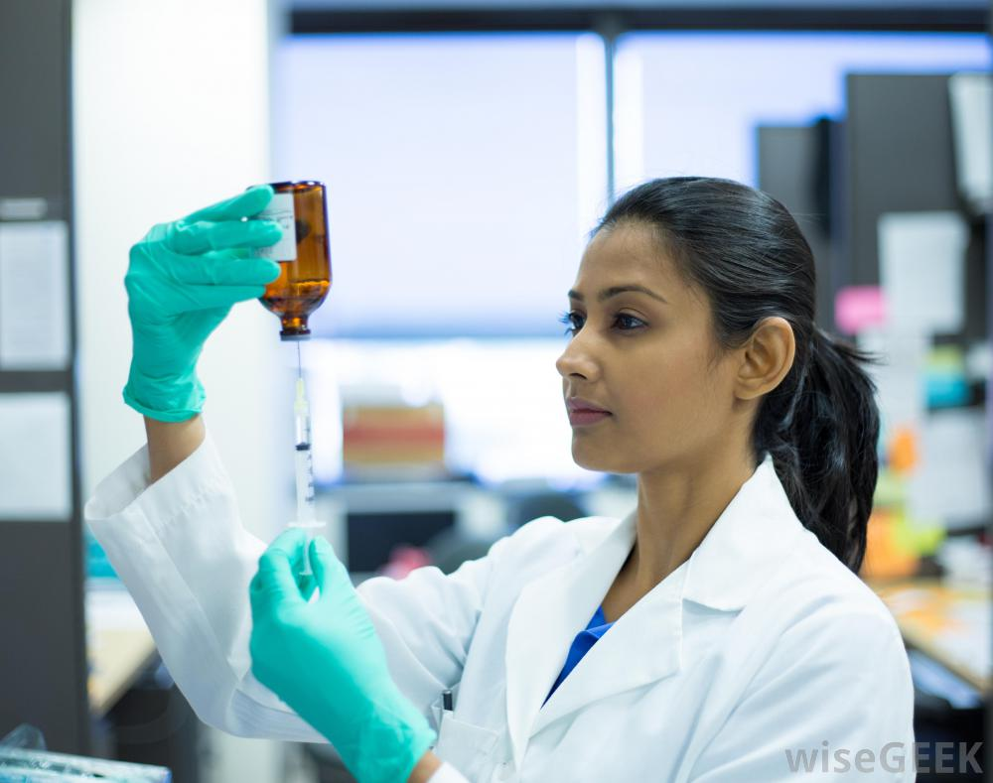
Department of Drug Industry
      Research and development department
A- Small Scale department (pilot plant)
B- Responsible for formulation of a new dosage forms.
C- Need Wikipedia pharmacist
E.g.: Discover new drug like Evotaz (atazanavir and cobicistat) tablets for HIV and check its pharmacological properties then transfer to development department to develop the new drug

Slide 6
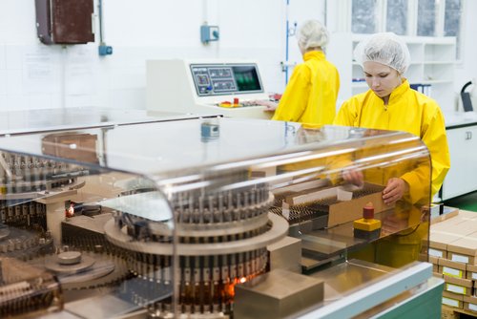
2- Production department
(A) Large scale department (full-scale plant).
(B) Responsible for production of dosage form in large scale department.
(C) Need skilled workers.
E.g. Area for production of tablets, capsules, ampoules and solutions.

Slide 7
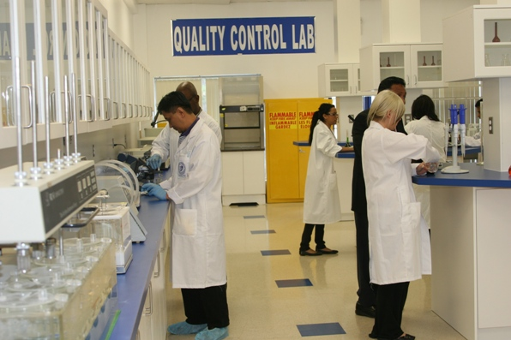
3- Quality control department:
  Evaluation department.
  Responsible for evaluation of dosage form before going to the market and following up the product from the market to ensure the stability.
  E.g.: Ensure no differences between batches for the same company within accepted evaluations.

Slide 8
4- Marketing department:
Responsible for marketing of drugs to pharmacies and hospitals.
5- Non-laboratory department:
Responsible for finding markets for dispense, management, accounting and personnel.

Slide 9
Drug Factories Requirements
1- Compatible with the GMP specifications like clean, sterilization, and all personnel should wear certain protective work outfits.
2- Departments separation
E.g.: Antibiotics department should be separated from other departments.

Slide 10
Equipments used in laboratory
1st: Tablet equipment
Cubic mixer
  Dense powder and granules
Ribbon mixer
  Wet granulation
Double cone mixer
  Dry and free flowing powders
(1) Mixers
Suppository mixer
V-Shaped mixer
  Non viscous granules or powder
Z-Shaped mixer
  Powder and granules

Slide 11
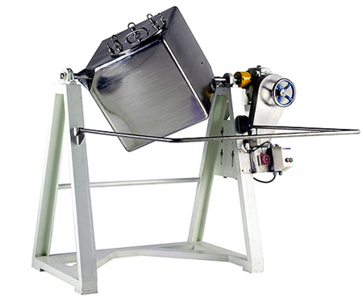
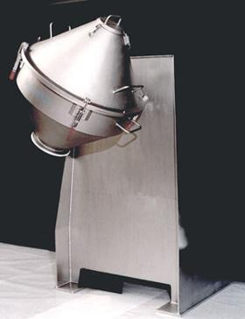
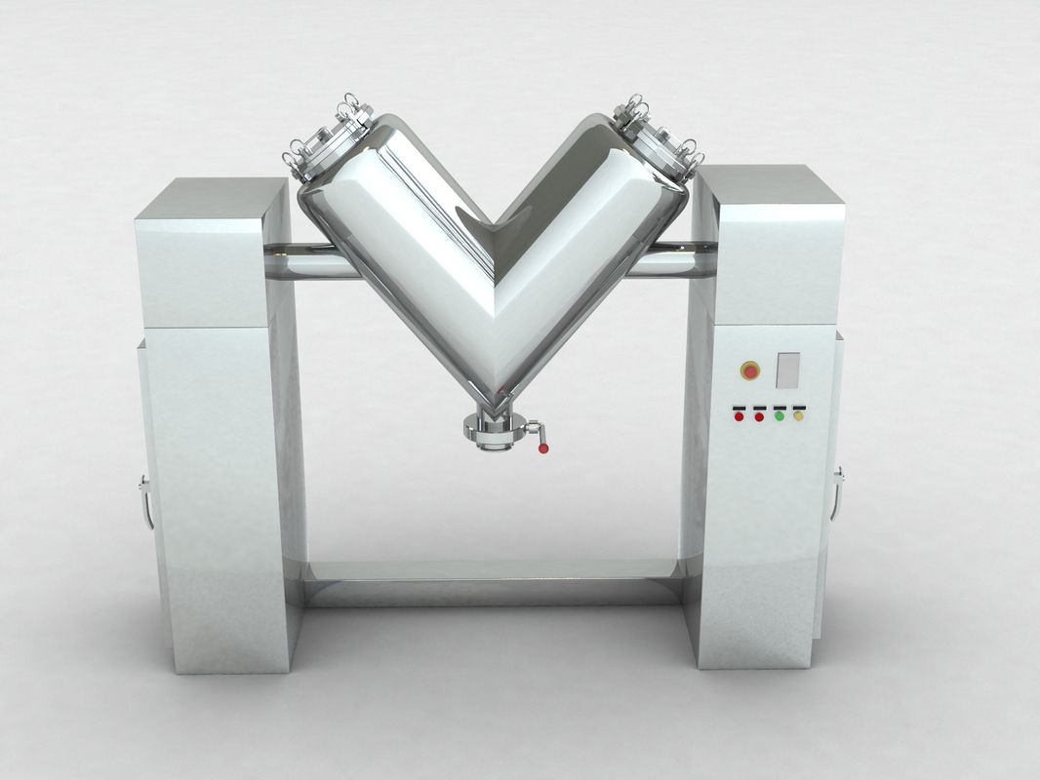
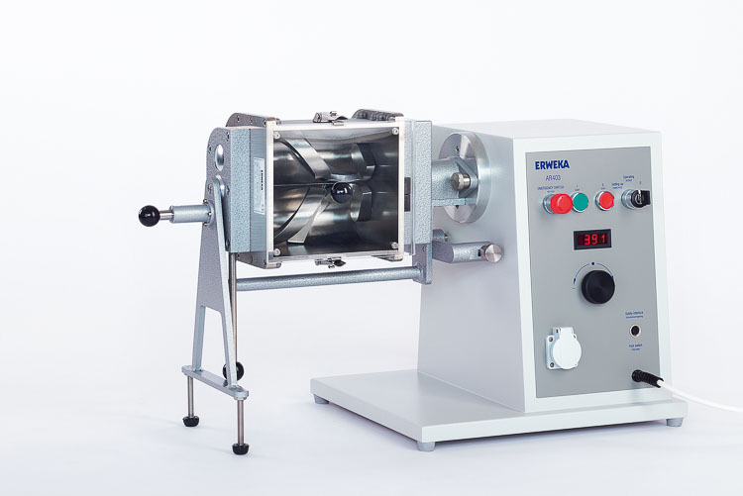
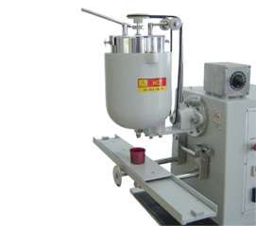
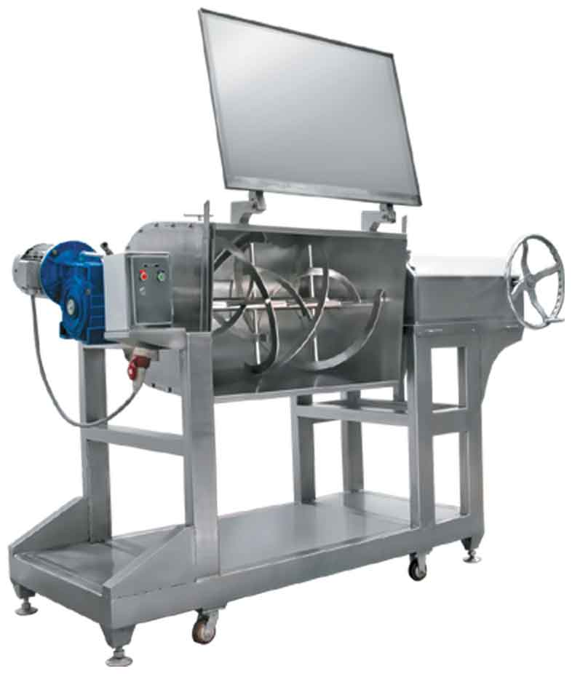

Slide 12
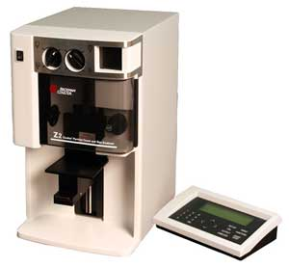
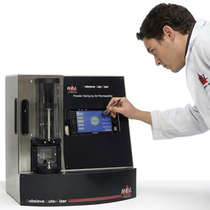
  (2) Sieves
  Get uniform particle size
  Sub-sieve sizer
  Separate particles according to their size (0.2 to 50µm range).
  Coulter counter
  Measure number of particles and size (< 1µm).

Slide 13
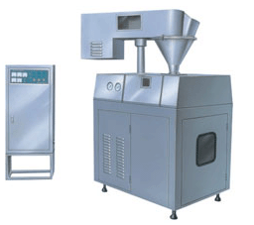
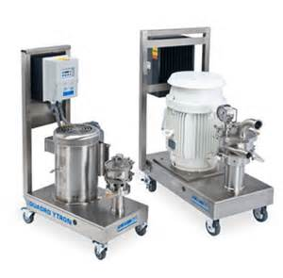
  (3) Homogenizer [Granulator]
  Dry granulator
  granulate slugs and pellets.
  Wet granulator granulate suspensions, emulsions and dispersions.

Slide 14
(4) Tablet machine
a- Hooper (for storing the materials).
b- Feeder.
d- Upper punch (determine the thickness of the tablet) and the lower punch (determine the weight of the tablet).
c- Die.

Slide 15
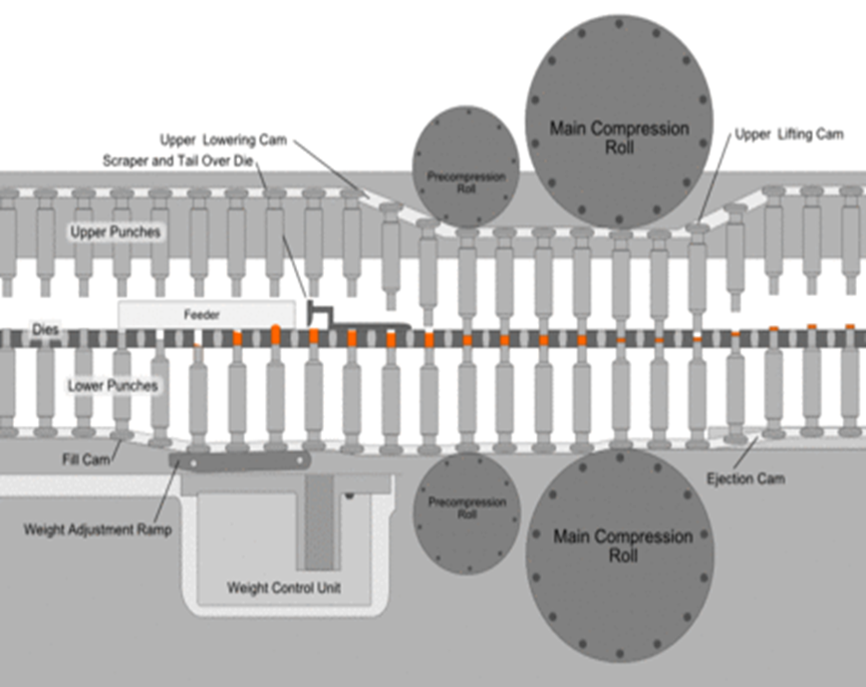
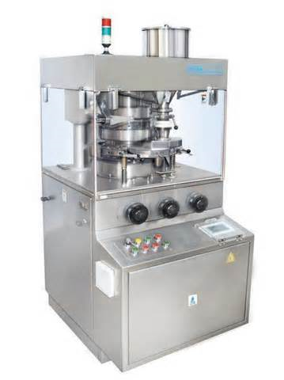

Slide 16
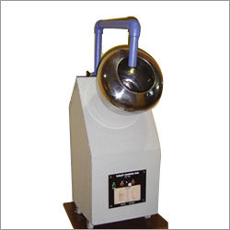
  (5) Coating pan:
  produce uniform coating on tablet by either sugar or thin film.
  (6) Polishing drum:
  add polishing materials during operating the drum.

Slide 17
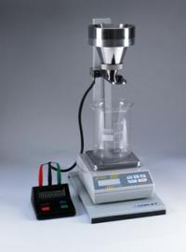
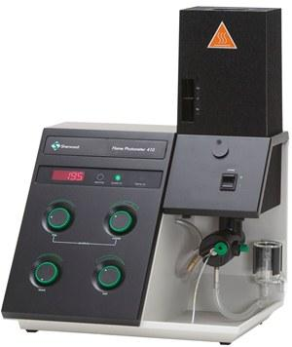
  (7) Evaluation equipment
  Quality control department to determine the manufactured tablet fall within required standards.
    (A) Flow meter: measure the flowability of the tablets.
    (B) Flame photometer: measure the concentration or amount of ions such as K and Na.
    (C) Hardness tester: measure the hardness of the tablet

Slide 18
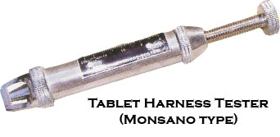
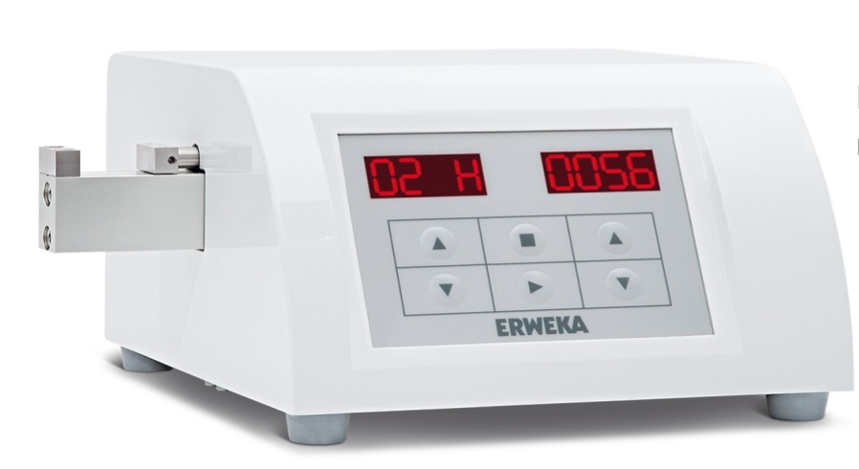
  Hardness tester:
  Electrical hardness tester
  such as Erweka hardness tester.
  Manual hardness tester
  such as Monsato hardness tester.

Slide 19
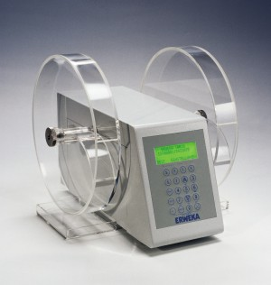
1- very friable tablet
crack rapidly.
(D)
Tablet friabilator:
measures the tablet friability that means
2- very solid tablet
will not crack easily.

Slide 20
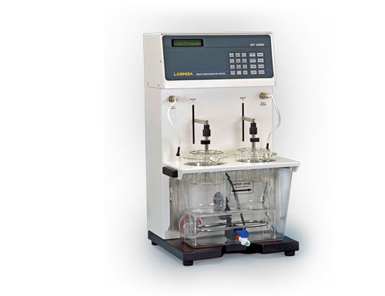
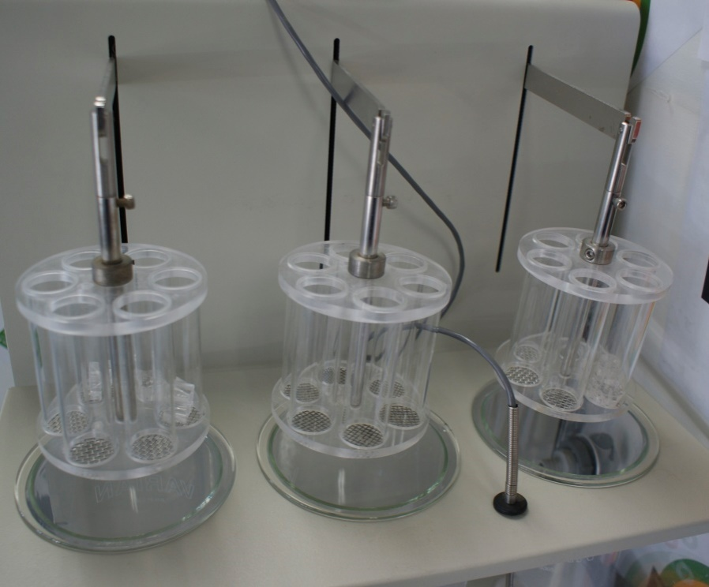
  (E)Disintegration apparatus:
  measure the time required for disintegration and evacuation from the stomach.
  consist of 2-4 baskets each has 6 cylinders, the dosage form placed in the cylinder, which will be immersed in buffer and placed in water bath operating at 37° C.
  The disintegration time is between 15-30 minutes.
  Exception: (Hard tablet) with higher quantity of binder will require > 30 min. to disintegrate.

Slide 21
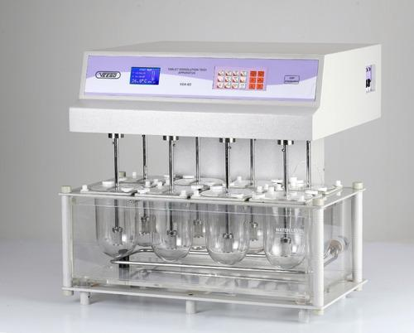
  (f) Dissolution rate apparatus
  In vitro method to measure the dissolution of drugs inside the body.
  Consist of 2-6 jars filled with buffer (0.1N HCl, phosphate) and the (Tablet, film or In-situ gel) is placed in the jar and a sample is taken every 10 min.

Slide 22
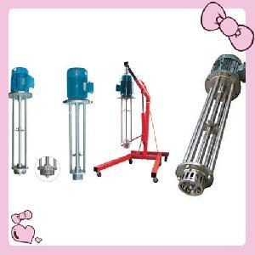
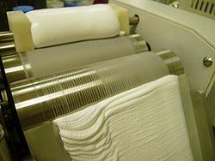
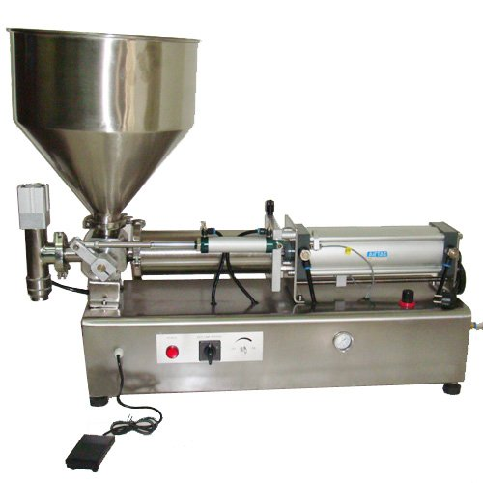
2nd: Semi solid dosage form equipment:
  Ointment agitator (Filler).
  Three roller mill.
  Collapsible closer (to close the tubes).

Slide 23
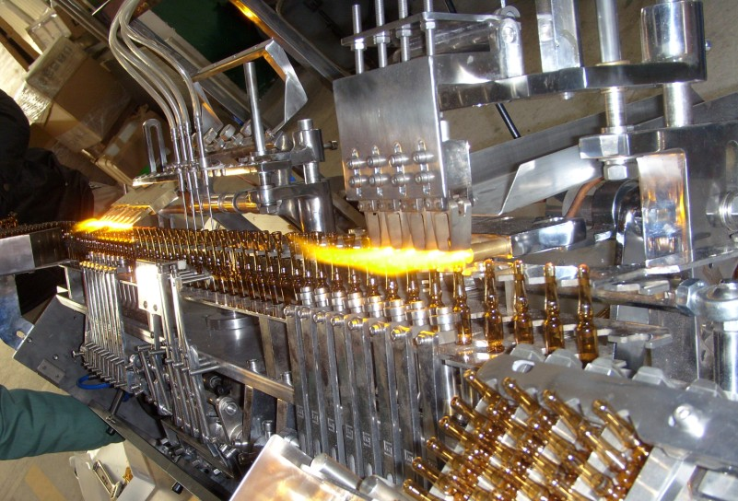
3rd: Ampoules equipment:
  (A) Ampoule filling machine (consist of manual tool fills the ampoule in every push is 1 ml).
  (B) Ampoule filling and sealing machine (connected with other device that control it’s operation).
  (C) Ampoule sealing machine
  (utilize high temperature heat to seal the tip of the ampoule).
  (D) Millipore filter
  (sterilization of liquid because of small pores (0.3 – 0.5 µ)).

Slide 24
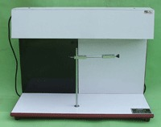
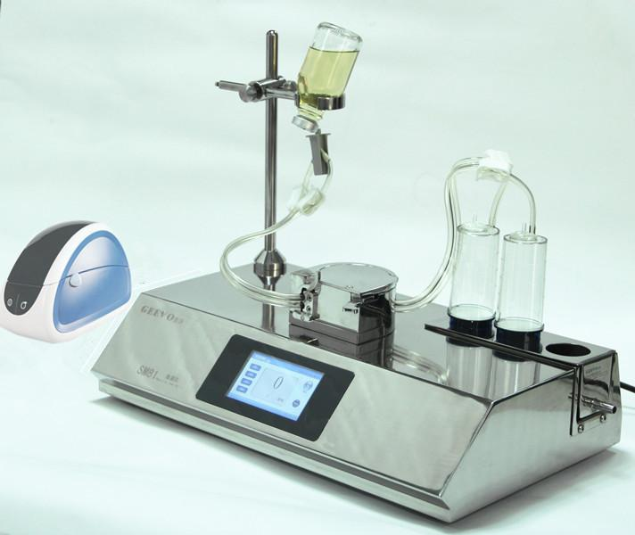
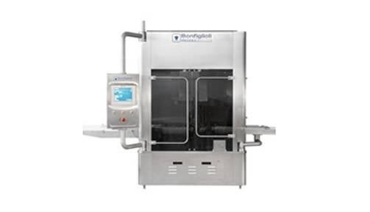
  Devices for evaluation of ampoules:
  (2) Leaker test apparatus.
  (1) Clarity test device.
  (3) Sterility test.

Slide 25
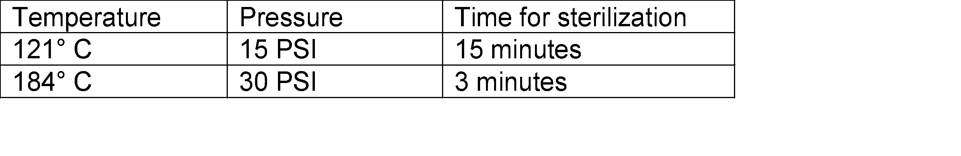
4th: Drying equipment:
Dry oven
for dry heat or heat sterilization that require long time.
Autoclave
for moist heat sterilization.
Tray dryer
which operates by passing hot streams of air.
Freeze dryer
for substances affected by heat or moisture especially hormones.

Slide 26
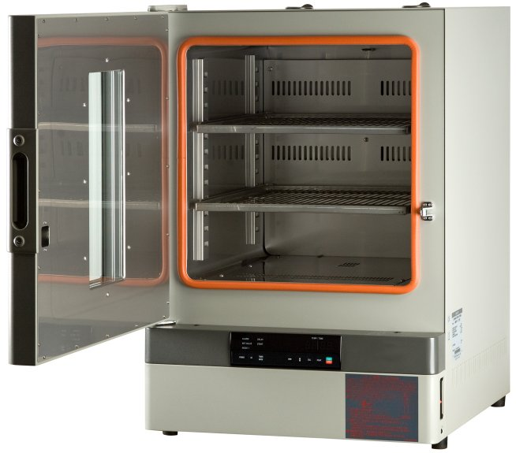
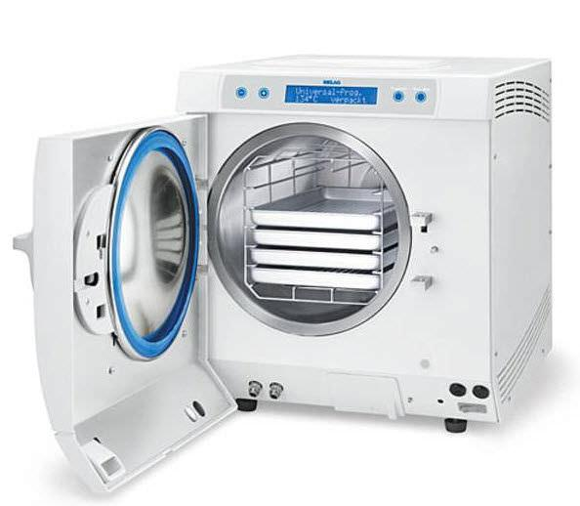
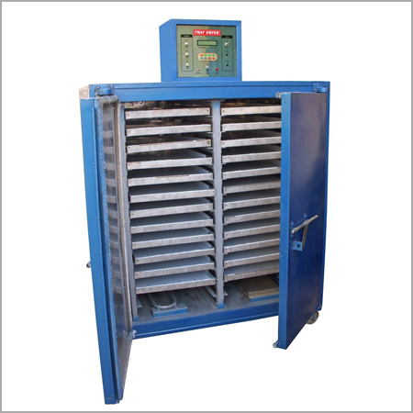
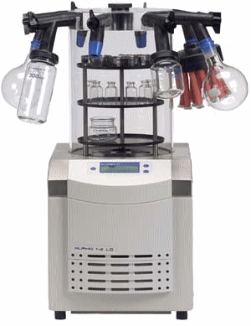

Slide 27


